Slide 1
Exploring Awareness Needs and
Information Display Preferences
Between Coworkers
Gina Venolia
A. J. Bernheim Brush
Brian R. Meyers
James Scott
Microsoft Research

Slide 2
Motivation
We were considering building
a situated awareness/communication UI
to increase ad-hoc communication
with a particular absent teammate

Slide 3
Three situated display locations
Nameplate | Just outside the person’s office
Screensaver | On the person’s desktop PC
Person Screen | Representing the person in a remote coworker’s office or site

Slide 4
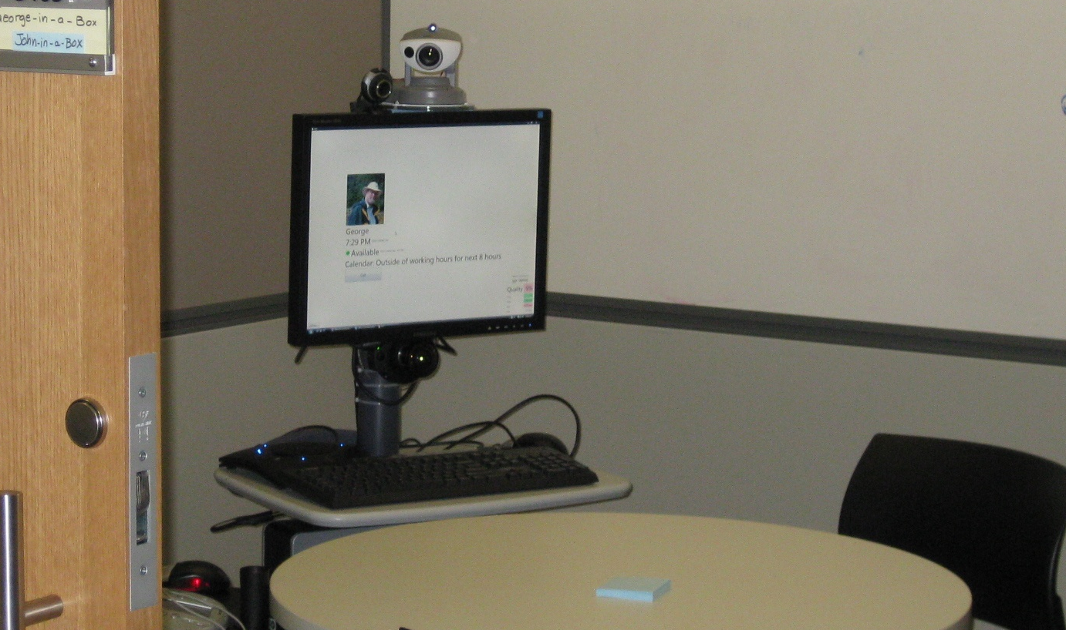
Person Screen at a remote site

Slide 5
Two groups of capabilities
Awareness
Communication
Is now a good time to talk? If not now, when?
What is he working on?
Who has he been talking with?
…
Video call
Text chat
Document sharing
Screen sharing
Whiteboard sketching
…

Slide 6
Research questions
RQ1: What awareness info would people be willing to display?
RQ2: Would putting the awareness display in a semiprivate space increase the amount of awareness information?
  Does place mediate access?
… so we decided to do a survey

Slide 7
Survey population
MS Usability Database
MS employees
Full time knowledge workers
Work onsite
Interact with a coworker at least once a week
50% USA; 50% elsewhere
Developers, testers and project managers
Worldwide but mostly USA
2000 valid email addresses
353 responses
241 valid responses (12%)
1500 email addresses
522 responses
308 valid responses (21%)
← These populations are largely the same →

Slide 8
Survey design – 174 questions
Office configuration
Staying aware of collocated coworkers
Staying aware of remote coworkers
Current sharing behavior
Proposed personal website
Proposed nameplate
Proposed screensaver
Proposed person screen
Rating each scenario

Slide 9
Survey design – 174 questions
Office configuration
Staying aware of collocated coworkers
Staying aware of remote coworkers
Current sharing behavior
Proposed personal website
Proposed nameplate
Proposed screensaver
Proposed person screen
Rating each scenario

Slide 10
Survey design – 174 questions
Office configuration
Staying aware of collocated coworkers
Staying aware of remote coworkers
Current sharing behavior Baseline
Proposed personal website Non-situated control
Proposed nameplate Situated semipublic
Proposed screensaver Situated semiprivate
Proposed person screen Situated remote
Rating each scenario

Slide 11
Survey design – 174 questions
All coworkers have access
Some coworkers have access
No coworkers have access
Office configuration
Staying aware of collocated coworkers
Staying aware of remote coworkers
Current sharing behavior for 15 info types
Proposed personal website for 15 info types
Proposed nameplate for 15 info types
Proposed screensaver for 15 info types
Proposed person screen for 15 info types
Rating each scenario
Note that participants couldn’t
copy between the conditions
Would display
Would sometimes or partially display
Would not display

Slide 12
Info types adapted from Olson, Grudin & Horvitz 2004
Identifying information
Current activity
Work phone number
Email address
Mobile phone number
Picture of yourself
Home phone number
Your geographic location (such as your city)
Your Instant Messenger status (e.g. in a meeting, on the phone)
Current meeting from your calendar
Computer activity (that is, whether you are logged in and active on any computer)
Titles of documents you have worked on recently
URLs of web pages you have recently visited
Video feed of you in your current location (for example, in a meeting)
Past and future activities
Details of your calendar events for today and tomorrow
Your availability during the last week based on Instant Messenger status
When you have logged on and off your computer during the last week

Slide 13
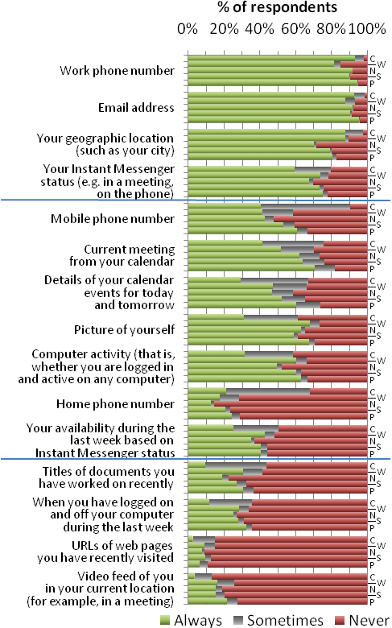
Current meeting
Details of your calendar
Current
Personal Website
Nameplate
Picture of yourself
Screensaver
Person Screen
Always share
Computer activity
Sometimes
Never share
Huge effect by info type (supporting RQ1)
Little effect by display (not supporting RQ2)

Slide 14
Surprise! Place did not appear to mediate access.
Expectation: More sharing on the Nameplate, Screensaver and Person Screen displays (RQ2)
Reality: Although the audience may be more predictable, situated displays may be viewed by unintended people
“I would want to have at least a pin code for my coworker to unlock this personal screen in case a stranger walks into my coworker’s office”

Slide 15
Surprise! People were comfortable sharing information on a website.
Expectation: Website would be the lowest-sharing condition
Reality: Website was same or higher
  Perhaps security through obscurity?
  Perhaps they were responding as if access were restricted?
  Perhaps comfort through familiarity (e.g. Facebook)?
Q: How often would you expect coworkers to look at your personal website?
A: 1-5 coworkers per week
“For personal websites, I would like to control groups of people and how much info they see about me.”
“Close Coworkers only. Not all corp.”

Slide 16
Surprise! Office owners are uncomfortable drawing visitors in when absent.
Expectation: Screensaver would provide greater sense of privacy than Nameplate
Reality: The Screensaver was viewed as attracting random people into the sanctity of the office
“I would not give anyone any incentive to enter my office such as these described”
“A screensaver encourages random traffic in to my office when I'm not there, which I'm not comfortable with”

Slide 17
Surprise! Person Screen was not just for distant coworkers.
Expectation: Person Screen would be considered useful only for distant coworkers
Reality: The Person Screen was perceived as useful for even nearby coworkers
Q: How far away are the primary work locations of the coworkers for whom you would want a Person Screen? (Check all that apply)
A: A few steps away from your primary work location

Slide 18
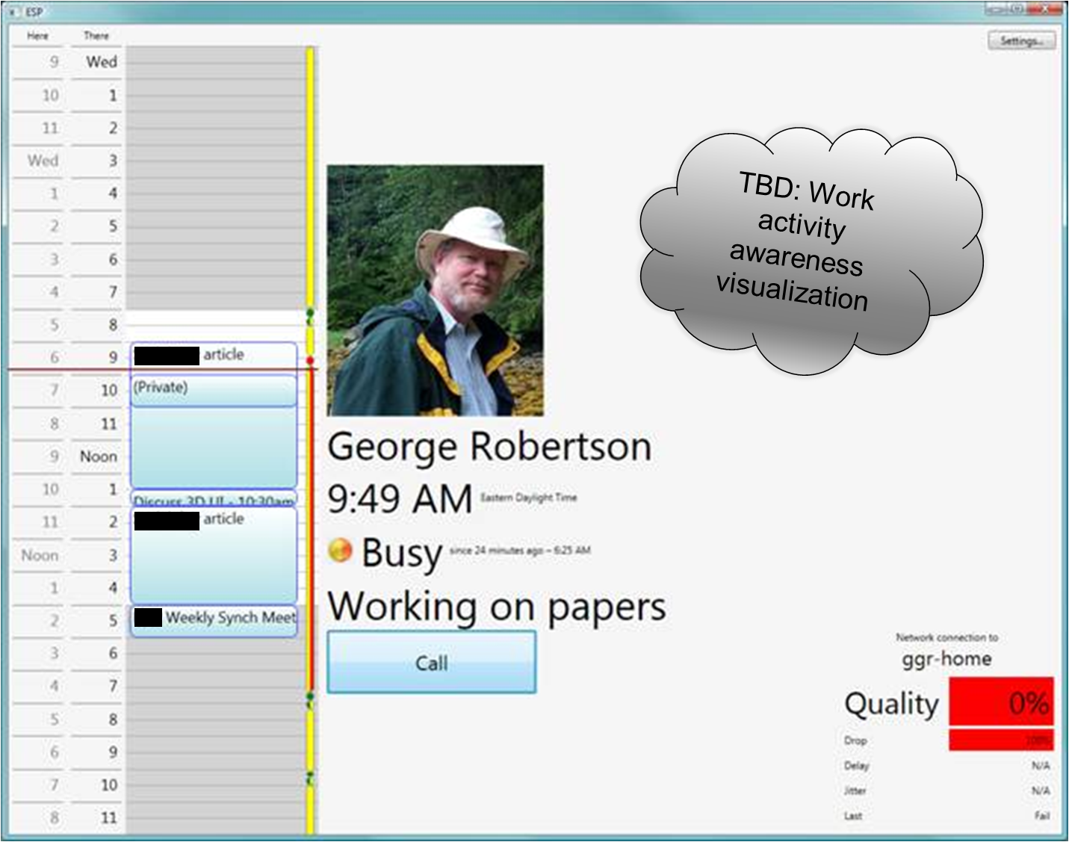

Slide 19
Thanks

