Slide 1
The Promise of Differential Privacy
Cynthia Dwork, Microsoft Research
TexPoint fonts used in EMF.
Read the TexPoint manual before you delete this box.: AAAAAAAA

Slide 2
NOT A History Lesson
Developments presented out of historical order; key results omitted

Slide 3
NOT Encyclopedic
Whole sub-areas omitted

Slide 4
Outline
Part 1: Basics
  Smoking causes cancer
  Definition
  Laplace mechanism
  Simple composition
  Histogram example
  Advanced composition
Part 2: Many Queries
  Sparse Vector
  Multiplicative Weights
  Boosting for queries
Part 3: Techniques
  Exponential mechanism and application
  Subsample-and-Aggregate
  Propose-Test-Release
  Application of S&A and PTR combined
Future Directions
Notes:
TCC 2009 has lots of useful slides

Slide 5
Basics
Model, definition, one mechanism, two examples, composition theorem

Slide 6
Model for This Tutorial
C
?
Database is a collection of rows
  One per person in the database
Adversary/User and curator computationally unbounded
All users are part of one giant adversary
  “Curator against the world”

Slide 7
Databases that Teach
Database teaches that smoking causes cancer.
  Smoker S’s insurance premiums rise.
  This is true even if S not in database!
Learning that smoking causes cancer is the whole point.
  Smoker S enrolls in a smoking cessation program.
Differential privacy: limit harms to the teachings, not participation
  The outcome of any analysis is essentially equally likely, independent of whether any individual joins, or refrains from joining, the dataset.
  Automatically immune to linkage attacks
Notes:
Why is this exactly the right guarantee?
Socially useful studies are powerful; the outcomes can harm people. The adjudication of liability is, after all, just a dream.
When the database teaches that smoking causes cancer the first thing that happens is that the smokers are further harmed: their insurance premiums rise.
>But learning that smoking causes cancer is the whole point: the smoker enrolls in a smoking cessation program.
>Differential privacy encourages participation in the database by limiting harms to those caused by the conclusions of the analyses.
It deconstructs “harm,” teasing apart those harms that are inherent in utility from those harms that come from, say, re-identification of supposedly anonymized data.

Slide 8
Differential Privacy [D., McSherry, Nissim, Smith 06]
M gives (ε, 0) - differential privacy if for all adjacent x and x’, and all C µ range(M): Pr[ M (x) 2 C] ≤ e^{ε} Pr[ M (x’) 2 C]
Neutralizes all linkage attacks.
Composes unconditionally and automatically: Σ_{i} ε _{i}
ratio bounded
Pr [response]
Bad Responses:
Z
Z
Z

Slide 9

(ε, δ) - Differential Privacy
M gives (ε, δ) - differential privacy if for all adjacent x and x’, and all C µ range(M ): Pr[ M (D) 2 C] ≤ e^{ε} Pr[ M (D’) 2 C] + δ
Neutralizes all linkage attacks.
Composes unconditionally and automatically: (Σ_{i} ε_{i} , Σ_{i} δ_{i} )
ratio bounded
Pr [response]
Bad Responses:
Z
Z
Z
This talk: $δ$ negligible

Slide 10
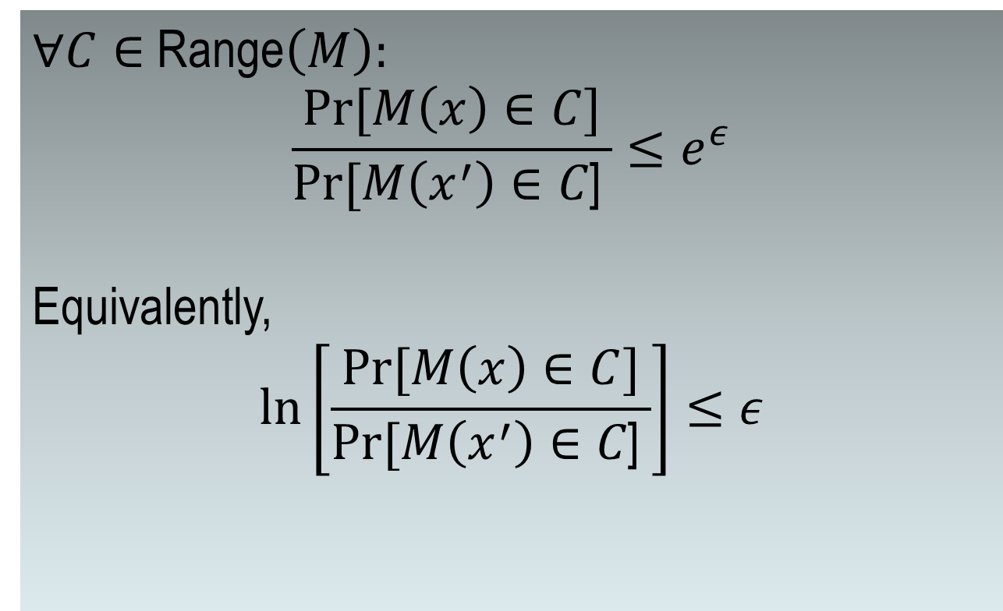
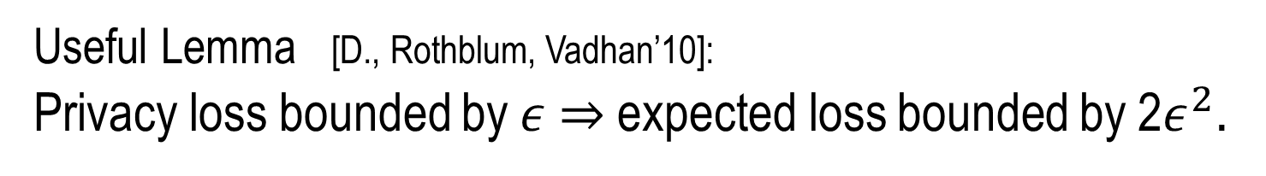
$∀C∈$ Range$\left(M\right):$
$$\frac{Pr⁡[M\left(x\right)∈C]}{Pr⁡[M\left(x^{′}\right)∈C\text{] }}≤e^{ε}$$
Equivalently,
$$ln\left[\frac{Pr⁡[M\left(x\right)∈C]}{Pr⁡[M\left(x^{′}\right)∈C\text{] }}\right]≤ε$$
“Privacy Loss”
Useful Lemma [D., Rothblum, Vadhan’10]:
Privacy loss bounded by $ε$ $⇒$ expected loss bounded by 2$ε^{2}.$

Slide 11
Bounding E_{q »D} ln ( P[q ] / P’[q] )
Assume D, D’ are A-dp wrt one another, for A < 1. Then 0 · E_{q » D} ln[ D(q)/D’(q) ] · 2A² (that is, B · 2A²).
KL(D||D’) = ∑_{q} ln[ D(q)/D’(q) ] D(q); always ¸ 0
So, KL(D||D’) · KL(D||D’) + KL(D’||D)
= ∑_{q} D(q) ( ln[ D(q)/D’(q) ] + ln[ D’(q)/D(q) ] ) + (D’(q)-D(q)) ln[ D’(q)/D(q) ]
· ∑ _{q} 0 + |D’(q)-D(q)| A
= A ∑ _{q} [ max (D(q),D’(q)) - min (D(q),D’(q)) ]
· A ∑ _{q} e^{A} min (D(q),D’(q)) - min (D(q),D’(q))
· A ∑ _{q} (e^{A} – 1) min (D(q),D’(q))
· 2A² when A < 1

Slide 12
Sensitivity of a Function
f = max_{adjacent x,x’} |f(x) – f(x’)|
Adjacent databases differ in at most one row.
Counting queries have sensitivity 1.
Sensitivity captures how much one person’s data can affect output
Notes:
Variance is 2R^2

Slide 13
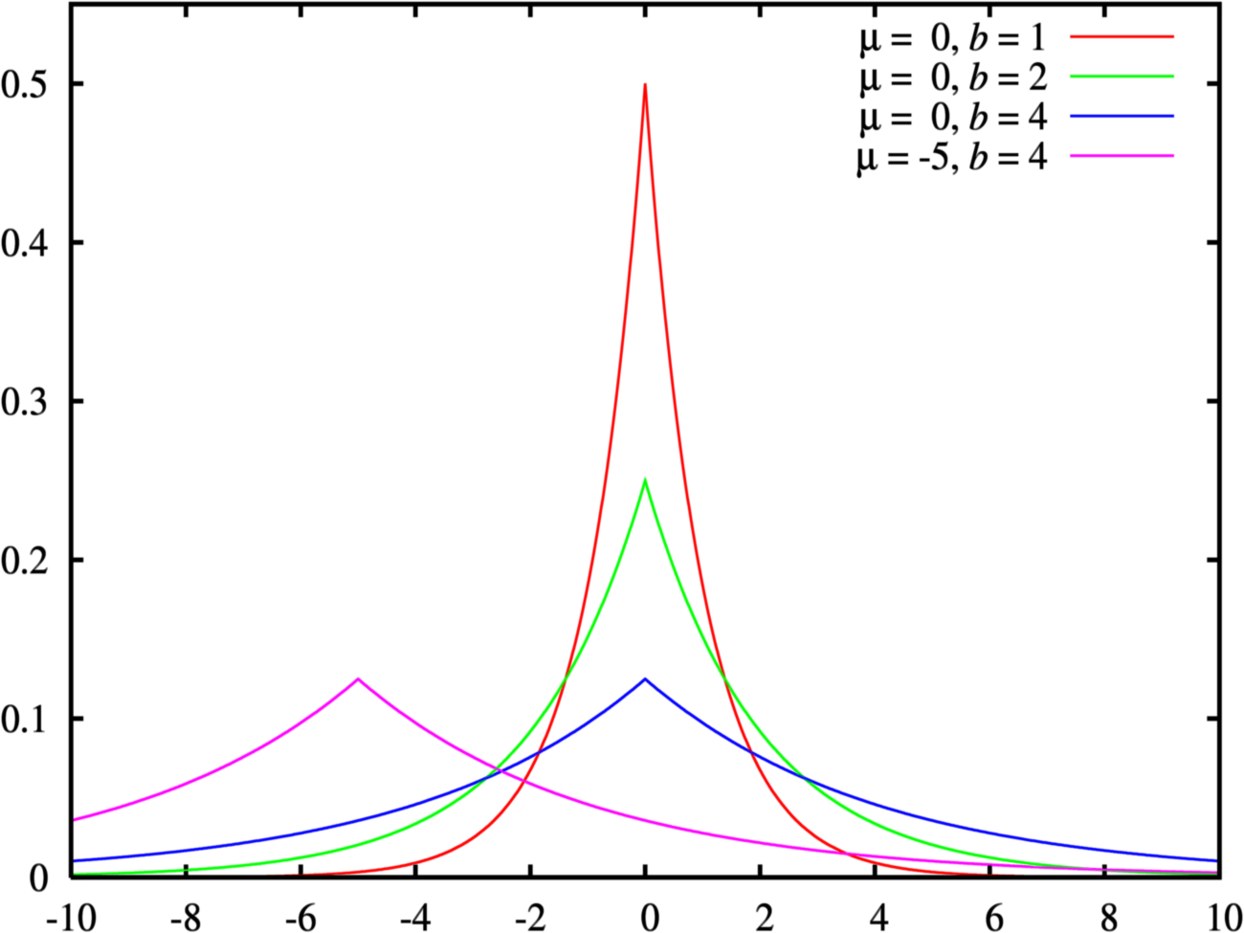
Laplace Distribution Lap(b)
p(z) = exp(-|z|/b)/2b
variance = 2b²
¾ = √2 b
Increasing b flattens curve

Slide 14
Calibrate Noise to Sensitivity
Δf = max_{adj x,x’} |f(x) – f(x’)|
Theorem [DMNS06]: On query f, to achieve ε-differential privacy, use
scaled symmetric noise [Lap(b)] with b = Δf/ε.
-4b
-3b
-2b
-b
0
b
2b
3b
4b
5b
Noise depends on f and ε, not on the database
Smaller sensitivity (Δf) means less distortion
Notes:
Variance is 2R^2

Slide 15

Example: Counting Queries
How many people in the database satisfy property $P$?
  Sensitivity = 1
  Sufficient to add noise $∼Lap(1/{ε)}$
What about multiple counting queries?
  It depends.

Slide 16
Vector-Valued Queries
Δf = max_{adj x, x’} ||f(x) – f(x’)||₁
Theorem [DMNS06]: On query f, to achieve ε-differential privacy, use
scaled symmetric noise [Lap(Δf/ε)]^{d} .
-4b
-3b
-2b
-b
0
b
2b
3b
4b
5b
Noise depends on f and ε, not on the database
Smaller sensitivity (Δf) means less distortion
Notes:
Variance is 2R^2

Slide 17
Example: Histograms
Δf = max_{adj x, x’} ||f(x) – f(x’)||₁
Theorem: To achieve ε-differential privacy, use
scaled symmetric noise [Lap(Δf/ε)]^{d} .

Slide 18
Why Does it Work ?
Δf = max_{x, Me} ||f(x+Me) – f(x-Me)||₁
Theorem: To achieve ε-differential privacy, add
scaled symmetric noise [Lap(Δf/ε)].
-4b
-3b
-2b
-b
0
b
2b
3b
4b
5b
Pr[ M (f, x – Me) = t]
= exp(-(||t- f⁻||-||t- f⁺||)/R) ≤ exp(Δf/R)
Pr[ M (f, x + Me) = t]
Notes:
Variance is R^2

Slide 19
“Simple” Composition
k-fold composition of (ε,±)-differentially private mechanisms is (kε, k±)-differentially private.

Slide 20
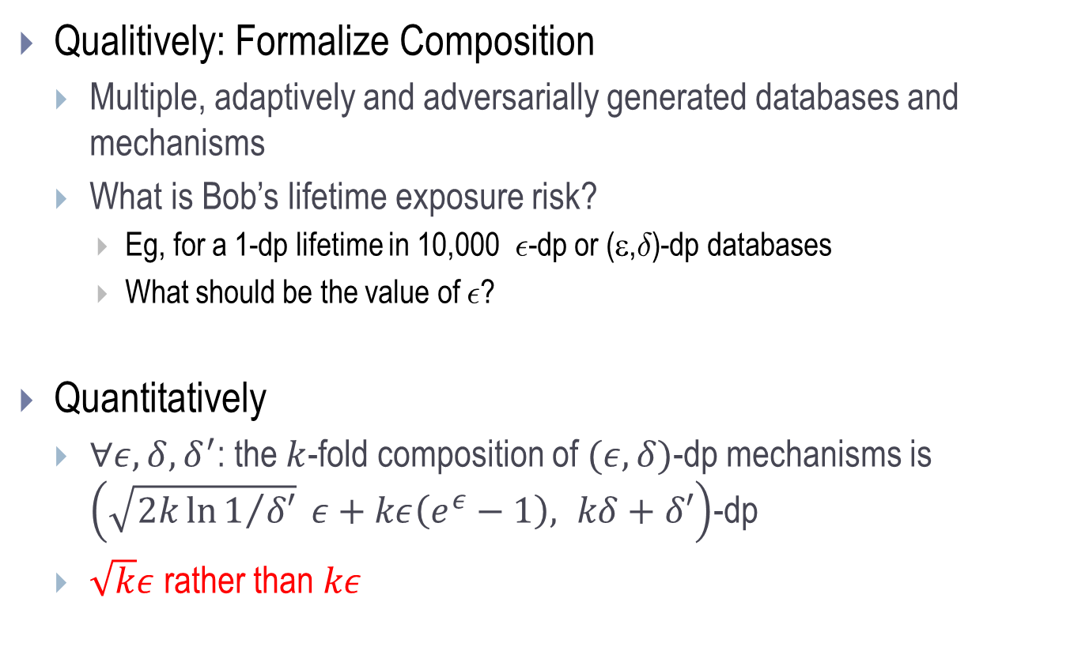
Composition [D., Rothblum,Vadhan’10]
Qualitively: Formalize Composition
  Multiple, adaptively and adversarially generated databases and mechanisms
  What is Bob’s lifetime exposure risk?
    Eg, for a 1-dp lifetime in 10,000 ²-dp or (ε,±)-dp databases
    What should be the value of ²?
Quantitatively
  $∀ε, δ, δ^{′}$: the $k$-fold composition of $(ε,δ)$-dp mechanisms is $\left(\sqrt{2k\ln{1/{δ′}}} ε+kε\left(e^{ε}−1\right), kδ+δ′\right)$-dp
  $\sqrt{k}ε$ rather than $kε$

Slide 21
Adversary’s Goal: Guess b
Adversary
Choose b ² {0,1}
(x_{1,0}, x_{1,1}), M₁
M₁(x_{1,b})
(x_{2,0}, x_{2,1}), M₂
M₂(x_{2,b})
b = 0 is real world
b=1 is world in which
Bob’s data replaced
with junk
…
(x_{k,0}, x_{k,1}), M_{k}
M_{k}(x_{k,b})
Notes:
Bellare, Desai, Pointcheval, and Rogaway

Slide 22
    Flavor of Privacy Proof
RVs Y and Z are ²-differentially private wrt each other if
  Max _{S µ Supp(Y)} ln(Pr[Y 2 S] / Pr[Z 2 S]) · ε and vice versa
  (Equivalently, Max _{y 2 Supp(Y)} ln(Pr[Y = y] / Pr[Z = y]) · ε)
  M is ε-dp iff the random variables M(x), M(x’), for adjacent x, x’, are ε-dp wrt each other
E _{y ← Y} [ ln(Pr[Y = y] / Pr[Z = y]) ] · 2ε².
Model cumulative privacy loss as a Martingale [Dinur,D.,Nissim’03]
  Bound on max loss (ε)
  Bound on expected loss (2ε²)
  Pr_{M1,…,Mk}[ | ∑_{i} loss from M_{i} | > z√(k) A + kB] < exp(-z²/2)
A
B
Notes:
SPLIT AND EMPHASIZE RVs and privacy loss

Slide 23
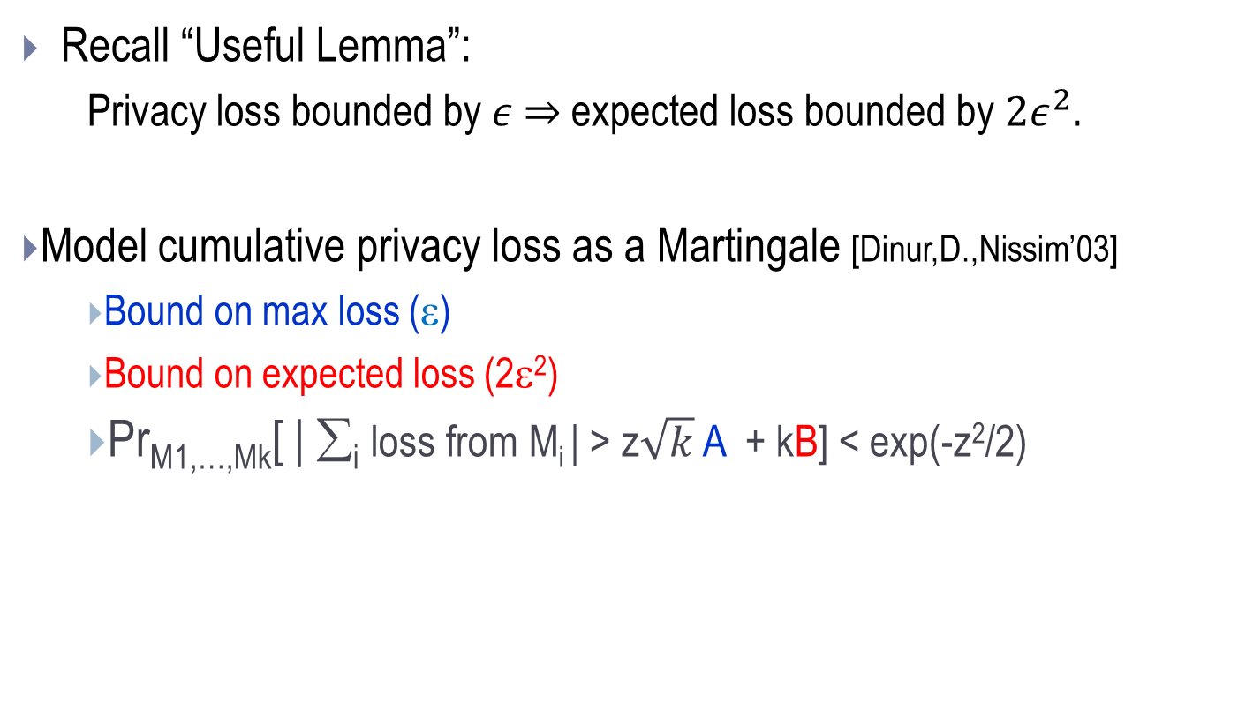
    Flavor of Privacy Proof
Recall “Useful Lemma”:
  Privacy loss bounded by $ε$ $⇒$ expected loss bounded by ${2ε}^{2}.$
Model cumulative privacy loss as a Martingale [Dinur,D.,Nissim’03]
  Bound on max loss (ε)
  Bound on expected loss (2ε²)
  Pr_{M1,…,Mk}[ | ∑_{i} loss from M_{i} | > z$\sqrt{k}$ A + kB] < exp(-z²/2)
A
B
Notes:
SPLIT AND EMPHASIZE RVs and privacy loss

Slide 24
Extension to (ε,δ)-dp mechanisms
Reduce to previous case via “dense model theorem” [MPRV09]
(ε, δ)-dp
Y
z
(ε, δ)-dp
δ - close
(ε,0)-dp
Y’

Slide 25
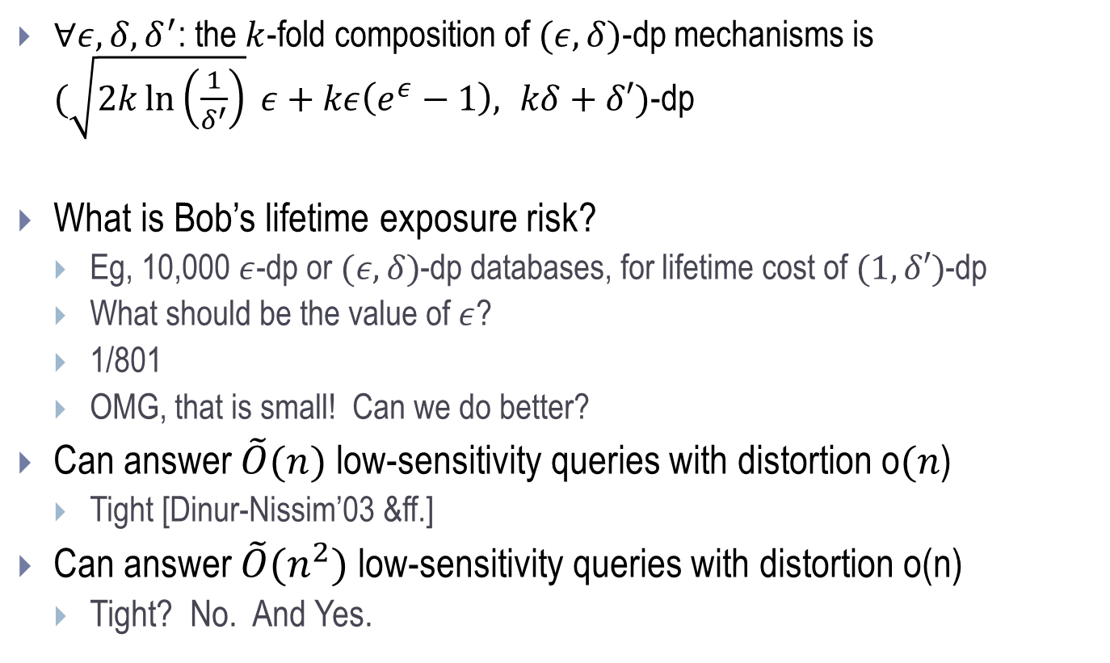
Composition Theorem
    $∀ε, δ, δ^{′}$: the $k$-fold composition of $(ε,δ)$-dp mechanisms is $(\sqrt{2k\ln\left(\frac{1}{δ^{′}}\right)} ε+kε\left(e^{ε}−1\right), kδ+δ′)$-dp
What is Bob’s lifetime exposure risk?
  Eg, 10,000 $ε$-dp or $(ε,δ)$-dp databases, for lifetime cost of $(1,δ′)$-dp
  What should be the value of $ε$?
  1/801
  OMG, that is small! Can we do better?
Can answer $\tilde{O}(n)$ low-sensitivity queries with distortion o$(n$)
  Tight [Dinur-Nissim’03 &ff.]
Can answer $\tilde{O}(n^{2})$ low-sensitivity queries with distortion o(n)
  Tight? No. And Yes.

Slide 26
Outline
Part 1: Basics
  Smoking causes cancer
  Definition
  Laplace mechanism
  Simple composition
  Histogram example
  Advanced composition
Part 2: Many Queries
  Sparse Vector
  Multiplicative Weights
  Boosting for queries
Part 3: Techniques
  Exponential mechanism and application
  Subsample-and-Aggregate
  Propose-Test-Release
  Application of S&A and PTR combined
Future Directions
Notes:
TCC 2009 has lots of useful slides

Slide 27
Many Queries
Sparse Vector; Private Multiplicative Weights, Boosting for Queries

Slide 28
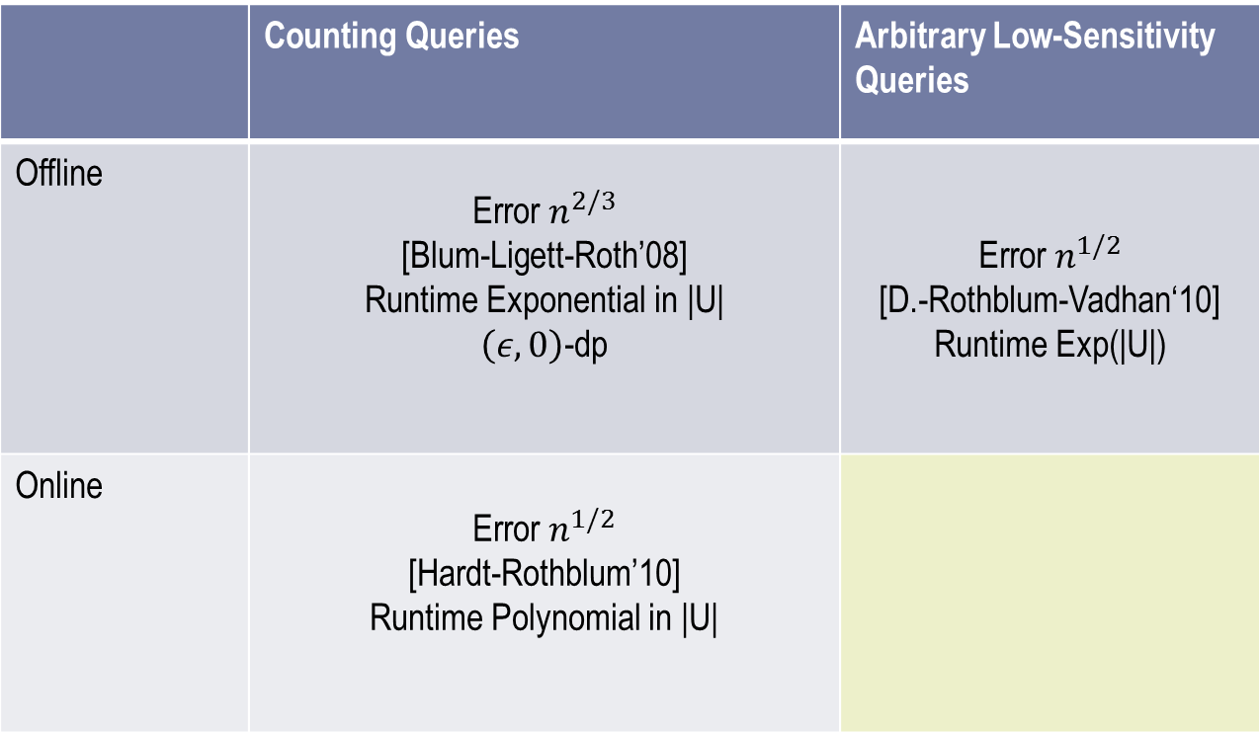

 | Counting Queries | Arbitrary Low-Sensitivity Queries
Offline | Error $n^{2/3}$ [Blum-Ligett-Roth’08] Runtime Exponential in |U| $\left(ε,0\right)$-dp | Error $n^{1/2}$ [D.-Rothblum-Vadhan‘10] Runtime Exp(|U|)
Online | Error $n^{1/2}$ [Hardt-Rothblum’10] Runtime Polynomial in |U|
Error $n^{1/2}$
[Hardt-Rothblum]
Runtime Exp(|U|)
Caveat: Omitting polylog(various things, some of them big) terms
Notes:
Add runtimes!

Slide 29
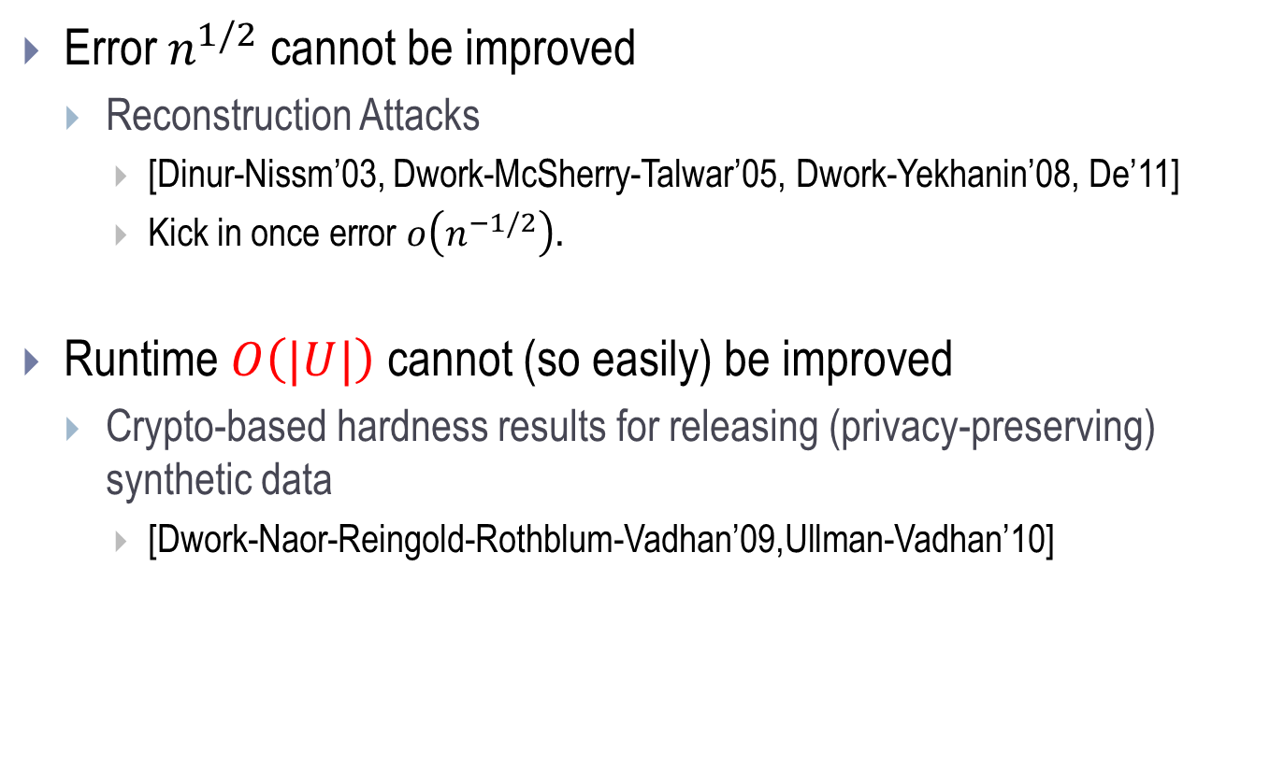
Known barriers
Error $n^{1/2}$ cannot be improved
  Reconstruction Attacks
    [Dinur-Nissm’03, Dwork-McSherry-Talwar’05, Dwork-Yekhanin’08, De’11]
    Kick in once error $o\left(n^{−1/2}\right).$
Runtime $O\left(|U|\right)$ cannot (so easily) be improved
  Crypto-based hardness results for releasing (privacy-preserving) synthetic data
    [Dwork-Naor-Reingold-Rothblum-Vadhan’09,Ullman-Vadhan’10]

Slide 30
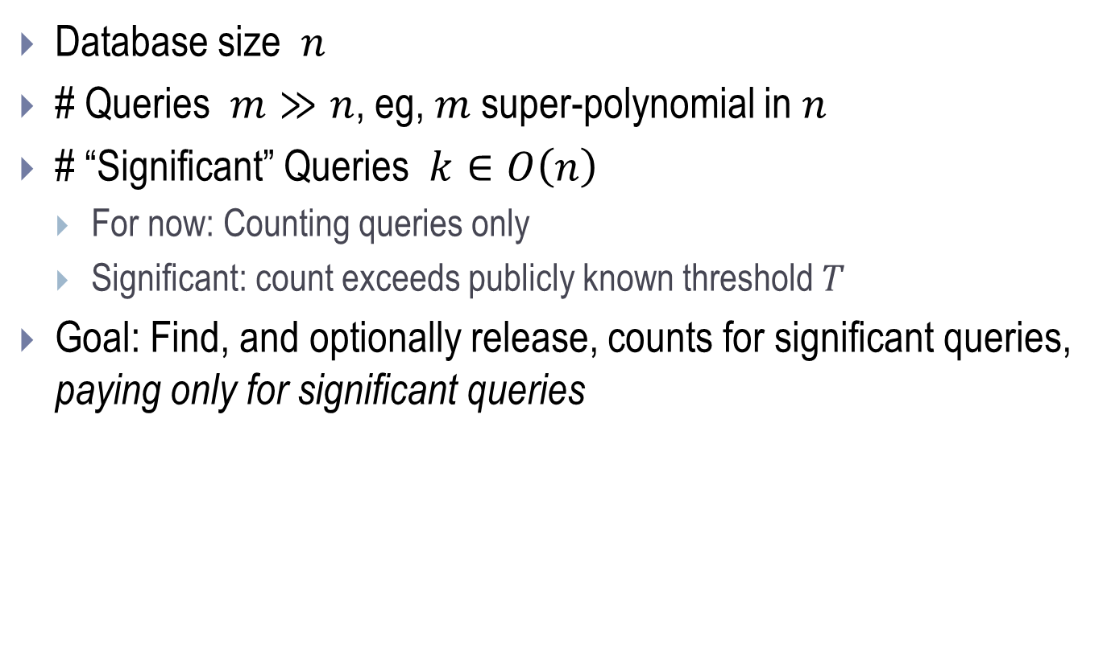
Sparse Vector
Database size $n$
# Queries $m≫n$, eg, $m$super-polynomial in $n$
# “Significant” Queries $k∈O\left(n\right)$
  For now: Counting queries only
  Significant: count exceeds publicly known threshold $T$
Goal: Find, and optionally release, counts for significant queries, paying only for significant queries
insignificant
insig
insignificant
insig
insig

Slide 31
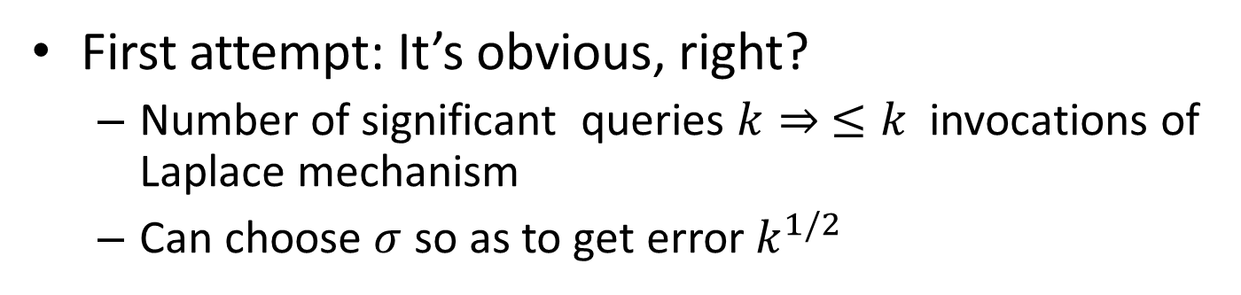
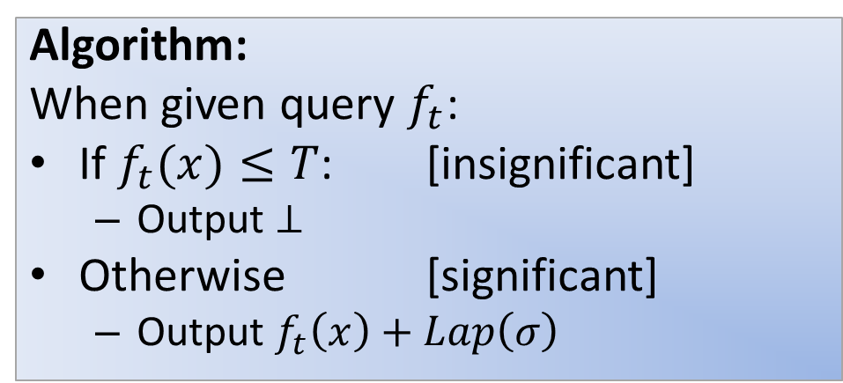
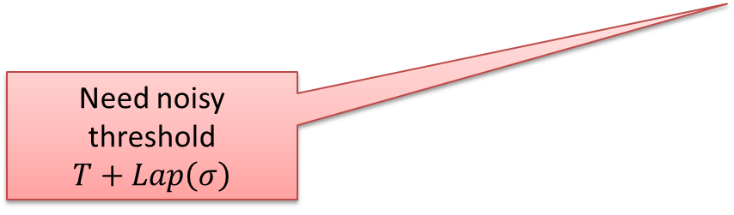
Algorithm and Privacy Analysis
[Hardt-Rothblum]
Algorithm:
When given query $f_{t}$:
If $f_{t}(x)≤T$: [insignificant]
  Output $⊥$
Otherwise [significant]
  Output $f_{t}\left(x\right)+Lap\left(σ\right)$
Caution: Conditional branch leaks private information!
Need noisy threshold $T+Lap\left(σ\right)$
First attempt: It’s obvious, right?
  Number of significant queries $k⇒ ≤k$ invocations of Laplace mechanism
  Can choose $σ$ so as to get error $k^{1/2}$

Slide 32

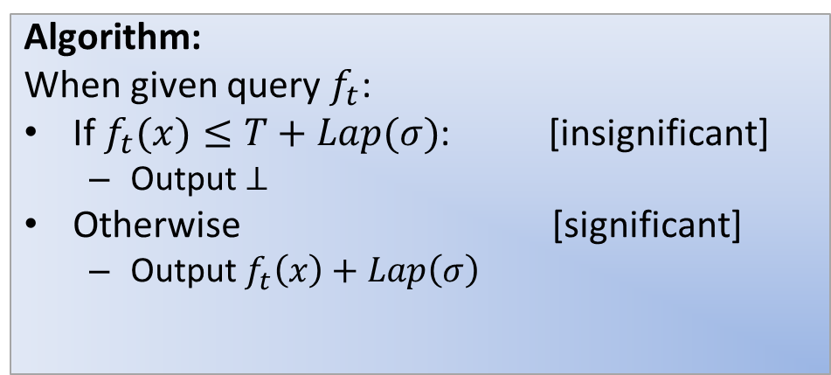

Algorithm and Privacy Analysis
Caution: Conditional branch leaks private information!
Algorithm:
When given query $f_{t}$:
If $f_{t}(x)≤T+Lap(σ)$: [insignificant]
  Output $⊥$
Otherwise [significant]
  Output $f_{t}\left(x\right)+Lap\left(σ\right)$
Intuition: counts far below T leak nothing
  Only charge for noisy counts in this range:
$$T$$
$$∞$$

Slide 33
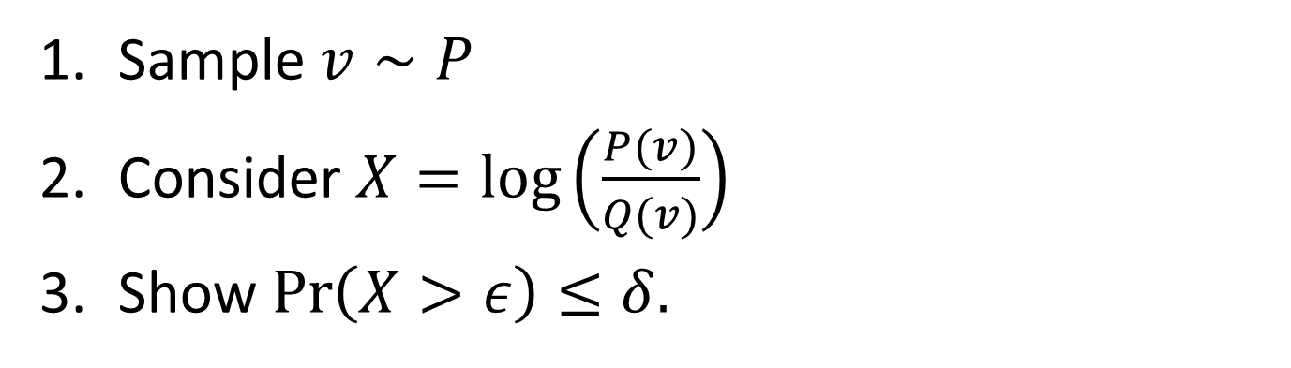
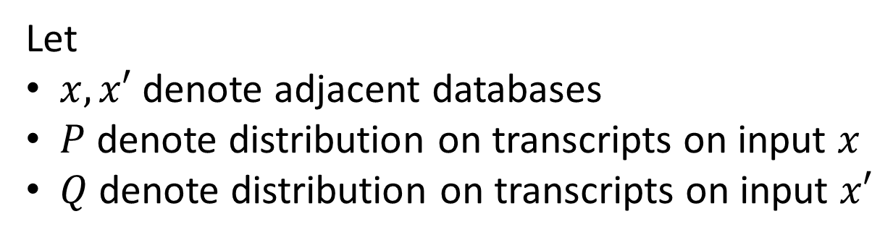

Let
$x,x′$ denote adjacent databases
$P$ denote distribution on transcripts on input $x$
$Q$ denote distribution on transcripts on input $x′$
Sample $v∼P$
Consider $X=\log\left(\frac{P(v)}{Q(v)}\right)$
Show $\operatorname{Pr}\left(X>ε\right)≤δ.$
Fact: (3) implies $\left(ε,δ\right)$-differential privacy

Slide 34
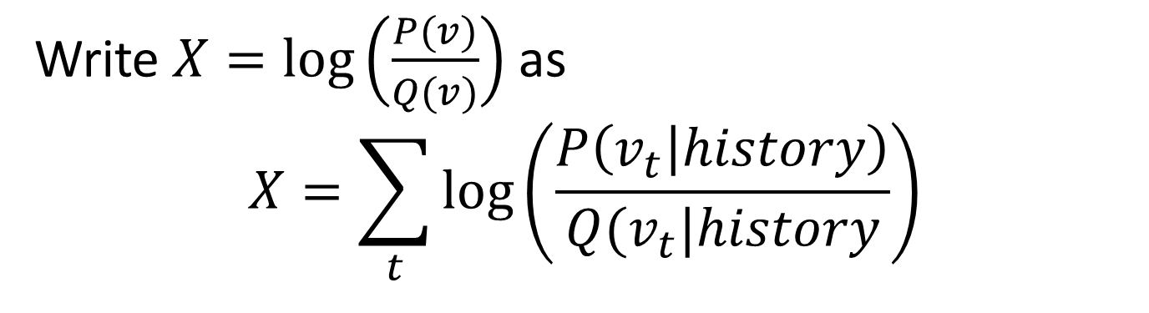
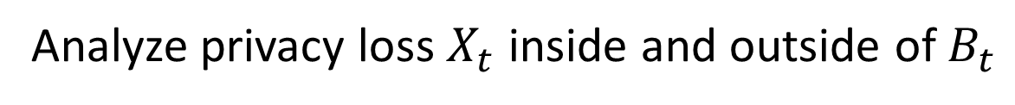
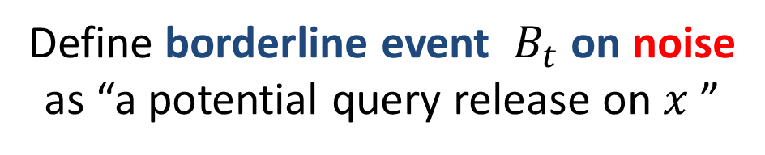
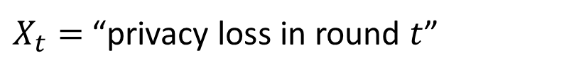
Write $X=\log\left(\frac{P(v)}{Q(v)}\right)$ as
$$X=\sum_{t}{\log\left(\frac{P\left(v_{t} | history\right)}{Q(v_{t}|history}\right)}$$
$X_{t}=$ “privacy loss in round $t$”
Define borderline event ${ B}_{t}$ on noise
as “a potential query release on $x$ ”
Analyze privacy loss $X_{t}$ inside and outside of $B_{t}$

Slide 35
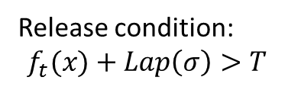
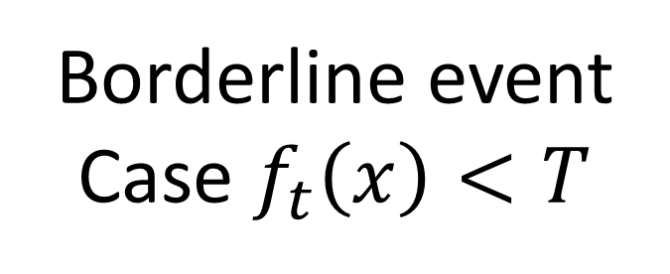
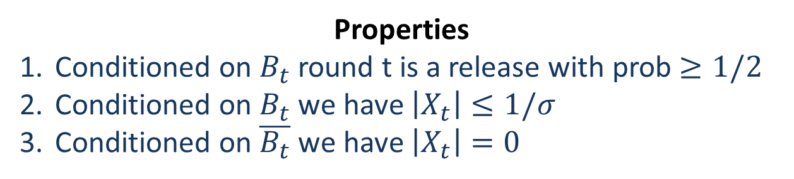





Borderline event
Case $f_{t}\left(x\right)<T$
Release condition:
$$f_{t}(x)+Lap\left(σ\right)>T$$
Borderline event
$$f_{t}(x)+Lap\left(σ\right)$$
$$T$$
$$Lap\left(σ\right)>a$$
$$f_{t}(x)$$
Definition of $a$
Mass to the left of $T$= Mass to the right of $T$
Properties
Conditioned on $B_{t}$ round t is a release with prob $≥1/2$
Conditioned on $B_{t}$ we have $\left|X_{t}\right|≤1/σ$
Conditioned on $\overline{B_{t}}$ we have $\left|X_{t}\right|=0$

Slide 36
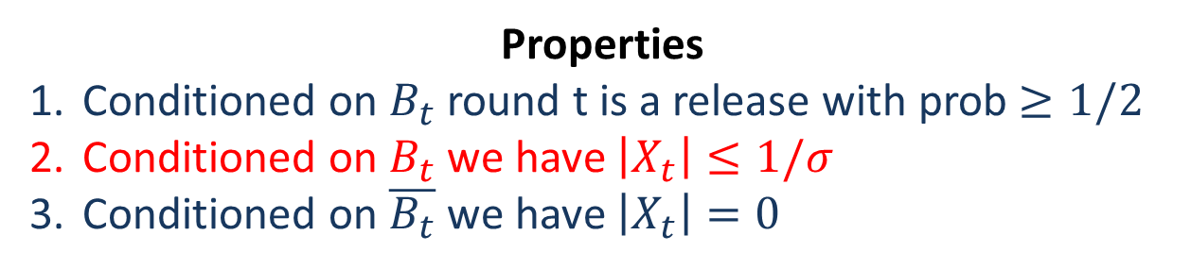
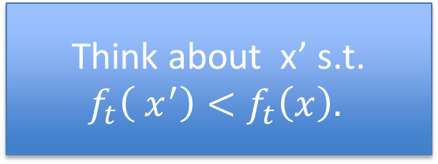

Borderline event
Case $f_{t}\left(x\right)<T$
Release condition:
$$f_{t}(x)+Lap\left(σ\right)>T$$
Borderline event
$$f_{t}(x)+Lap\left(σ\right)$$
$$T$$
$$Lap\left(σ\right)>a$$
$$f_{t}(x)$$
Definition of $a$
Mass to the left of $T$= Mass to the right of $T$
Properties
Conditioned on $B_{t}$ round t is a release with prob $≥1/2$
Conditioned on $B_{t}$ we have $\left|X_{t}\right|≤1/σ$
Conditioned on $\overline{B_{t}}$ we have $\left|X_{t}\right|=0$
Think about x’ s.t. $f_{t}\left( x^{′}\right)<f_{t}\left(x\right).$
Notes:
If borderline were just noise corresponding to an answer to the right of T, then conditioned on this x cannot have a \bot event. But with that amount of noise an x’ with a slightly smaller count *can* have a \bot event. Thus conditioned on the noise B_t we would not have differential privacy (there is an event that happens with prob 0 on x and non-zero prob on x’).

Slide 37

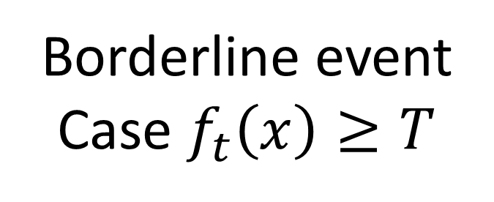
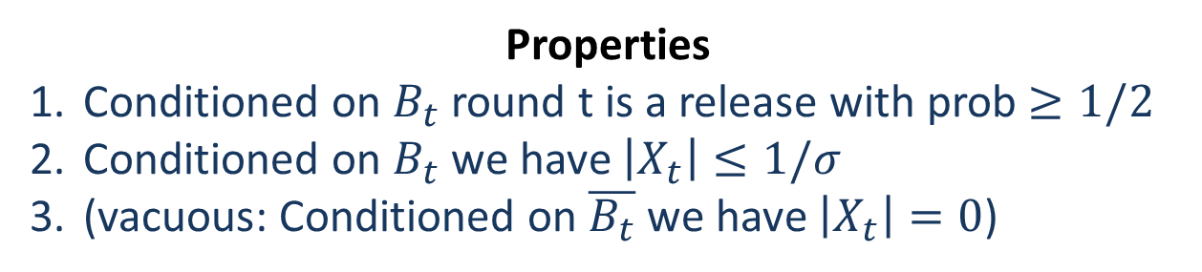
Borderline event
Case $f_{t}\left(x\right)≥T$
Release condition:
$$f_{t}(x)+Lap\left(σ\right)>T$$
Borderline event
$$f_{t}(x)+Lap\left(σ\right)$$
$$T$$
$$f_{t}(x)$$
Properties
Conditioned on $B_{t}$ round t is a release with prob $≥1/2$
Conditioned on $B_{t}$ we have $\left|X_{t}\right|≤1/σ$
(vacuous: Conditioned on $\overline{B_{t}}$ we have $\left|X_{t}\right|=0$)

Slide 38
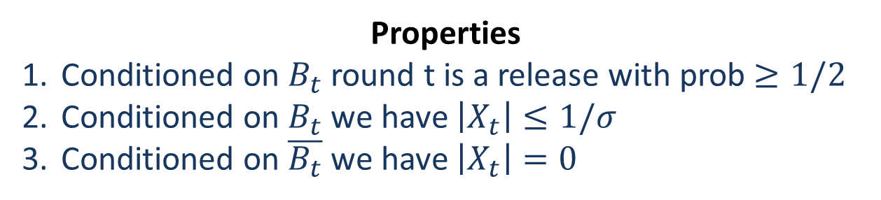
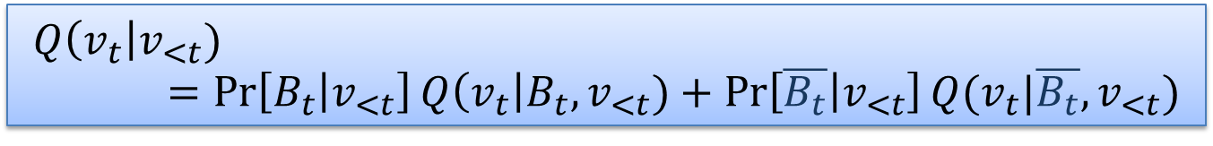
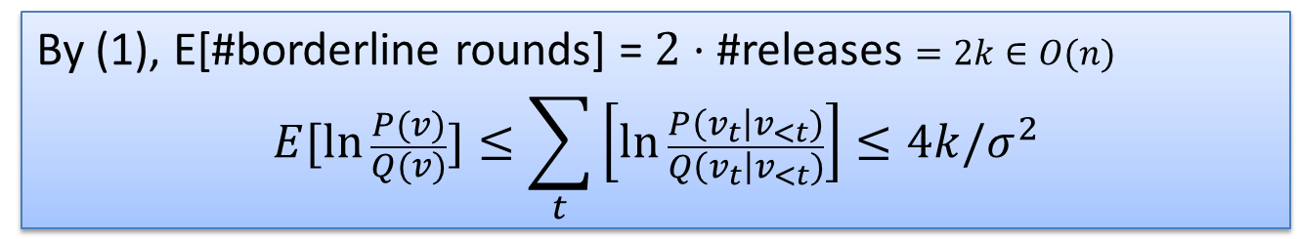
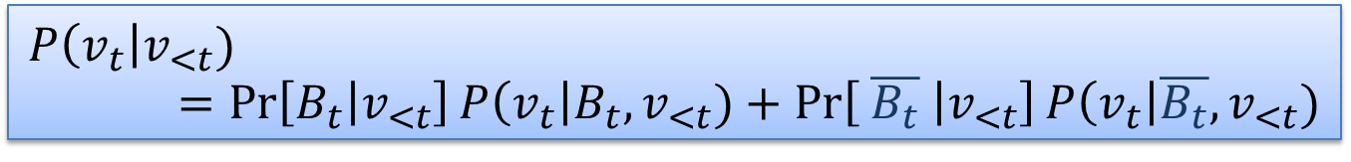
Properties
Conditioned on $B_{t}$ round t is a release with prob $≥1/2$
Conditioned on $B_{t}$ we have $\left|X_{t}\right|≤1/σ$
Conditioned on $\overline{B_{t}}$ we have $\left|X_{t}\right|=0$
$$P\left(v_{t}\right|v_{<t})=\operatorname{Pr}\left[B_{t} | v_{<t}\right]P\left(v_{t}\right|B_{t},v_{<t})+\operatorname{Pr}\left[ \overline{B_{t}} | v_{<t}\right]P\left(v_{t}\right|\overline{B_{t}},v_{<t})$$
$$Q\left(v_{t}\right|v_{<t})=\operatorname{Pr}\left[B_{t} | v_{<t}\right]Q\left(v_{t}\right|B_{t},v_{<t})+\operatorname{Pr}\left[\overline{B_{t}} | v_{<t}\right]Q(v_{t}|\overline{B_{t}},v_{<t})$$
By (2,3),UL,+Lemma, $E_{v_{t}}\left[\ln{\frac{P\left(v_{t}\right|v_{<t})}{Q\left(v_{t}\right|v_{<t})}}\right]≤Pr⁡[B_{t}|v_{<t}](2/σ^{2}$)
By (1), E[#borderline rounds] = $2⋅$#releases $=2k∈O(n)$
$$E[\ln{\frac{P(v)}{Q(v)}]≤\sum_{t}{\left[\ln{\frac{P\left(v_{t}\right|v_{<t})}{Q\left(v_{t}\right|v_{<t})}}\right]≤4k/σ^{2}}}$$

Slide 39
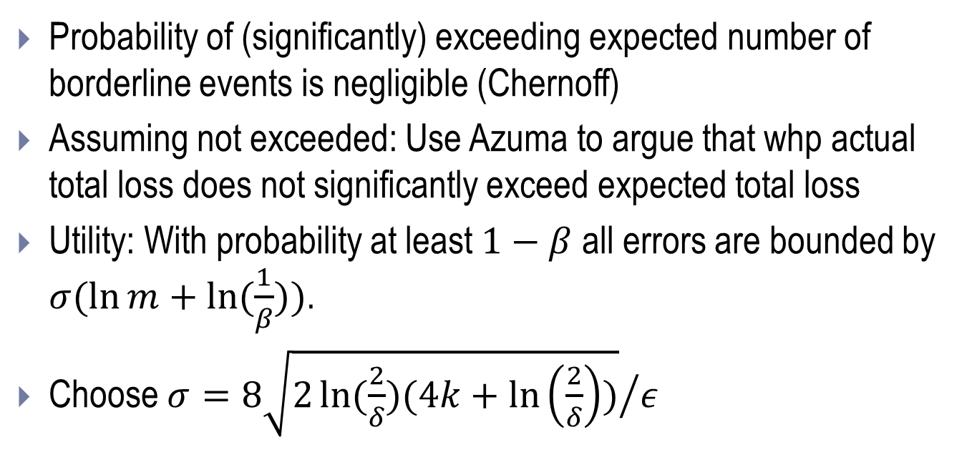
Wrapping Up: Sparse Vector Analysis
Expected total privacy loss $EX=O(\frac{k}{σ^{2}})$
Probability of (significantly) exceeding expected number of borderline events is negligible (Chernoff)
Assuming not exceeded: Use Azuma to argue that whp actual total loss does not significantly exceed expected total loss
Utility: With probability at least $1−β$ all errors are bounded by $σ(\ln{m+\ln{(\frac{1}{β}))}}$.
Choose $σ={8\sqrt{2\ln{(\frac{2}{δ})(4k+\ln\left(\frac{2}{δ}\right))}}}/ε$

Slide 40

Private Multiplicative Weights [Hardt-Rothblum’10]
Theorem (Main). There is an $(ε,δ)$-differentially private mechanism answering $k$ linear online queries over a universe U and database of size $n$ in
  time $O(|U|)$ per query
  error $O\left(n^{\frac{1}{2}}\log^{\frac{1}{2}}\left(k\right)\log^{\frac{1}{4}}\left(|U|\right)log⁡(\frac{1}{δ})\right)$.
Represent database as (normalized) histogram on U

Slide 41
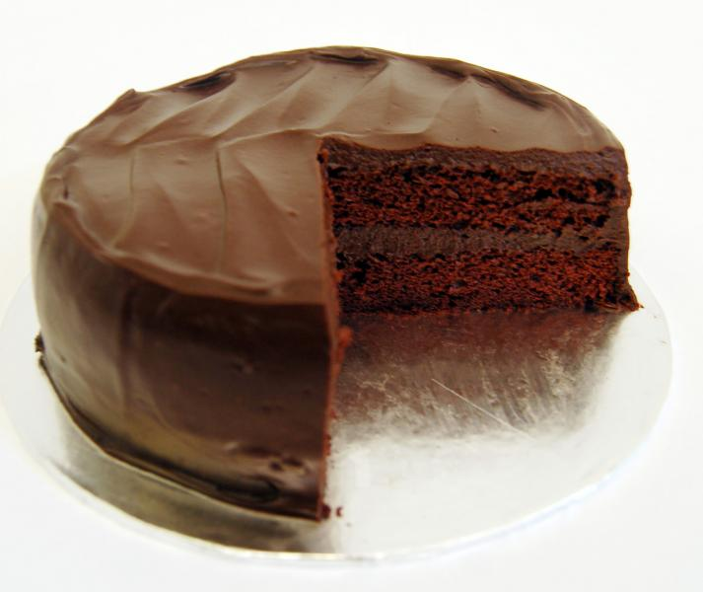
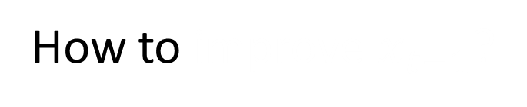

Multiplicative Weights
Recipe (Delicious privacy-preserving mechanism):
Maintain public histogram $x_{t}$ (with $x_{0}$ uniform)
For each $t=1,2,…,k:$
Receive query $f_{t}$
Output $f_{t}(x_{t−1})$ if it’s already accurate answer
Otherwise, output $f_{t}\left(x\right)+Lap\left(σ\right)$
  and “improve” histogram $x_{t−1}$
How to improve $x_{t−1}$?

Slide 42

Estimate $x_{t−1}$
Input $x$
Query $f_{t}$
1
. . .
0
1
2
3
4
5
N
Before update
Suppose $f_{t}\left(x_{t−1}\right)≪f_{t}\left(x\right)$

Slide 43
Estimate $x_{t−1}$
Input $x$
Query $f_{t}$
1
. . .
0
1
2
3
4
5
N
x 1.3
x 1.3
x 0.7
x 0.7
x 1.3
x 0.7
After update

Slide 44

Algorithm (slightly cheating):
Input histogram $x$ with $\sum{x_{i}}=1$
Maintain histogram $x_{t}$ with $x_{0}$ being uniform
Parameters $T,σ,η$
When given query $f_{t}$:
  If $\left|f_{t}\left(x_{t−1}\right)−f_{t}\left(x\right)\right|≤T$: [insignificant]
    Output $f_{t}(x_{t−1})$
  Otherwise [significant; update]
    Output $f_{t}\left(x\right)+Lap\left(σ\right)$
    $x_{t}\left[i\right]←x_{t−1}\left[i\right]⋅exp⁡(−η⋅r_{t}\left[i\right])$
      where $r_{t}\left[i\right]=f_{t}\left[i\right]⋅sign(f_{t}(x_{t−1})−f_{t}(x)$)
    Renormalize $x_{t}$

Slide 45

Algorithm:
Input histogram $x$ with $\sum{x_{i}}=1$
Maintain histogram $x_{t}$ with $x_{0}$ being uniform
Parameters $T,σ$
When given query $f_{t}$:
  If $\left|f_{t}\left(x_{t−1}\right)−f_{t}\left(x\right)\right|≤T+Lap(σ)$: [insignificant]
    Output $f_{t}(x_{t−1})$
  Otherwise [significant; update]
    Output $f_{t}\left(x\right)+Lap\left(σ\right)$
    $x_{t}\left[i\right]←x_{t−1}\left[i\right]⋅exp⁡(r_{t}\left[i\right])$
      where $r_{t}\left[i\right]=f_{t}\left[i\right]⋅sign(f_{t}(x)−f_{t}(x_{t−1})$)
    Renormalize $x_{t}$
Notes:
So if truth is larger than approximation then raise approximation on those elements in the query; if truth is smaller, than shrink approximation.

Slide 46

Algorithm:
Input histogram $x$ with $\sum{x_{i}}=1$
Maintain histogram $x_{t}$ with $x_{0}$ being uniform
Parameters $T,σ,η$
When given query $f_{t}$:
  If $\left|f_{t}\left(x_{t−1}\right)−f_{t}\left(x\right)\right|≤T+Lap(σ)$: [insignificant]
    Output $f_{t}(x_{t−1})$
  Otherwise [significant; update]
    Output $f_{t}\left(x\right)+Lap\left(σ\right)$
    $x_{t}\left[i\right]←x_{t−1}\left[i\right]⋅exp⁡(−η⋅r_{t}\left[i\right])$
      where $r_{t}\left[i\right]=f_{t}\left[i\right]⋅sign(f_{t}(x_{t−1})−f_{t}(x)$)
    Renormalize $x_{t}$
Conditional branch leaks private information

Slide 47
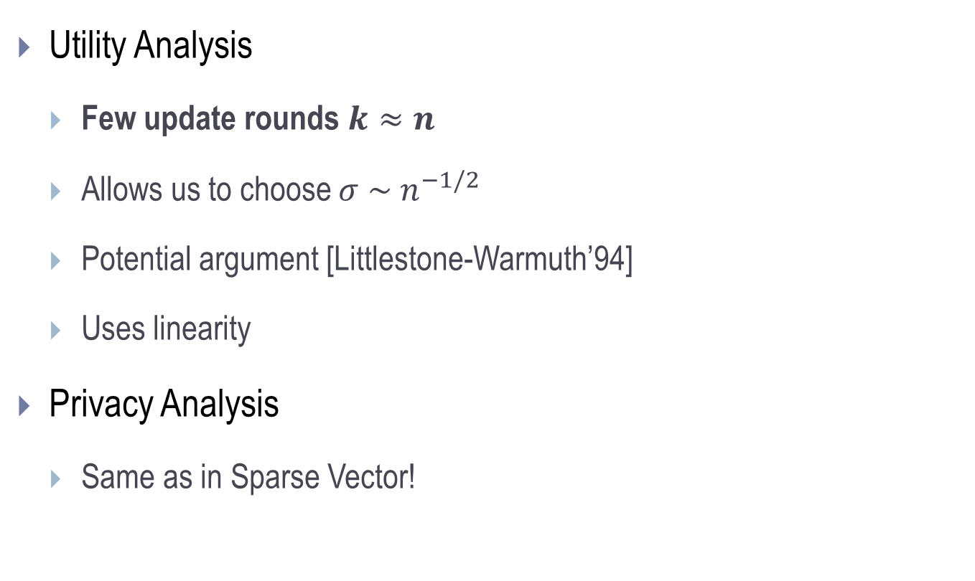
Analysis
Utility Analysis
  Few update rounds $k≈n$
  Allows us to choose $σ \sim n^{−1/2}$
  Potential argument [Littlestone-Warmuth’94]
  Uses linearity
Privacy Analysis
  Same as in Sparse Vector!

Slide 48
 | Counting Queries | Arbitrary Low-Sensitivity Queries
Offline | Error $n^{2/3}$ [Blum-Ligett-Roth’08] Runtime Exponential in |U| $\left(ε,0\right)$-dp | Error $n^{1/2}$ [D.-Rothblum-Vadhan‘10] Runtime Exp(|U|)
Online | Error $n^{1/2}$ [Hardt-Rothblum’10] Runtime Polynomial in |U|
Error $n^{1/2}$
[Hardt-Rothblum]
Runtime Exp(|U|)
Caveat: Omitting polylog(various things, some of them big) terms
Notes:
Add runtimes!

Slide 49
Boosting [Schapire, 1989]
General method for improving accuracy of any given learning algorithm
Example: Learning to recognize spam e-mail
  “Base learner” receives labeled examples, outputs heuristic
  Run many times; combine the resulting heuristics

Slide 50
S: Labeled examples from D
Base Learner
A
Does well on ½ + ´ of D
A₁, A₂, …
Combine A₁, A₂, …
Update D
Terminate?
Notes:
Combine to get something good for the original D.

Slide 51
S: Labeled examples from D
Base learner only sees samples, not all of D
Base Learner
A
Does well on ½ + ´ of D
A₁, A₂, …
Combine A₁, A₂, …
Update D
Terminate?
How?

Slide 52
Boosting for Queries?
Goal: Given database x and a set Q of low-sensitivity queries, produce an object O such that 8 q 2 Q : can extract from O an approximation of q(x).
Assume existence of (²₀, ±₀)-dp Base Learner producing an object O that does well on more than half of D
  Pr _{q » D} [ |q(O) – q(DB)| < ¸ ] > (1/2 + ´)

Slide 53
Initially:
D uniform on Q
S: Labeled examples from D
Base Learner
A
Does well on ½ + ´ of D
A₁, A₂, …
Combine A₁, A₂, …
Update D
Notes:
Combine to get something good for the original D.
We will run for a fixed number of iterations, so there is no termination test.

Slide 54



$${\text{D}}_{t}$$
$q_{i}\left(x\right)$ (truth)
$A_{t}(x)$
1
. . .
0
1
2
3
4
5
|Q |
Before update

Slide 55

$${\text{D}}_{t+1}$$
$q_{i}\left(x\right)$ (truth)
$A_{t}(x)$
1
. . .
0
1
2
3
4
5
|Q |
x 0.7
x 1.3
x 0.7
x 0.7
x 1.3
x 0.7
After update
${\text{D}}_{t+1}$increased where disparity is large, decreased elsewhere

Slide 56
Initially:
D uniform on Q
S: Labeled examples from D
Privacy?
Base Learner
A
Does well on ½ + ´ of D
A₁, A₂, …
Terminate?
median
Combine A₁, A₂, …
-1/+1
renormalize
Update D
Individual can affect
many queries at once!
Notes:
Combine to get something good for the original D.

Slide 57
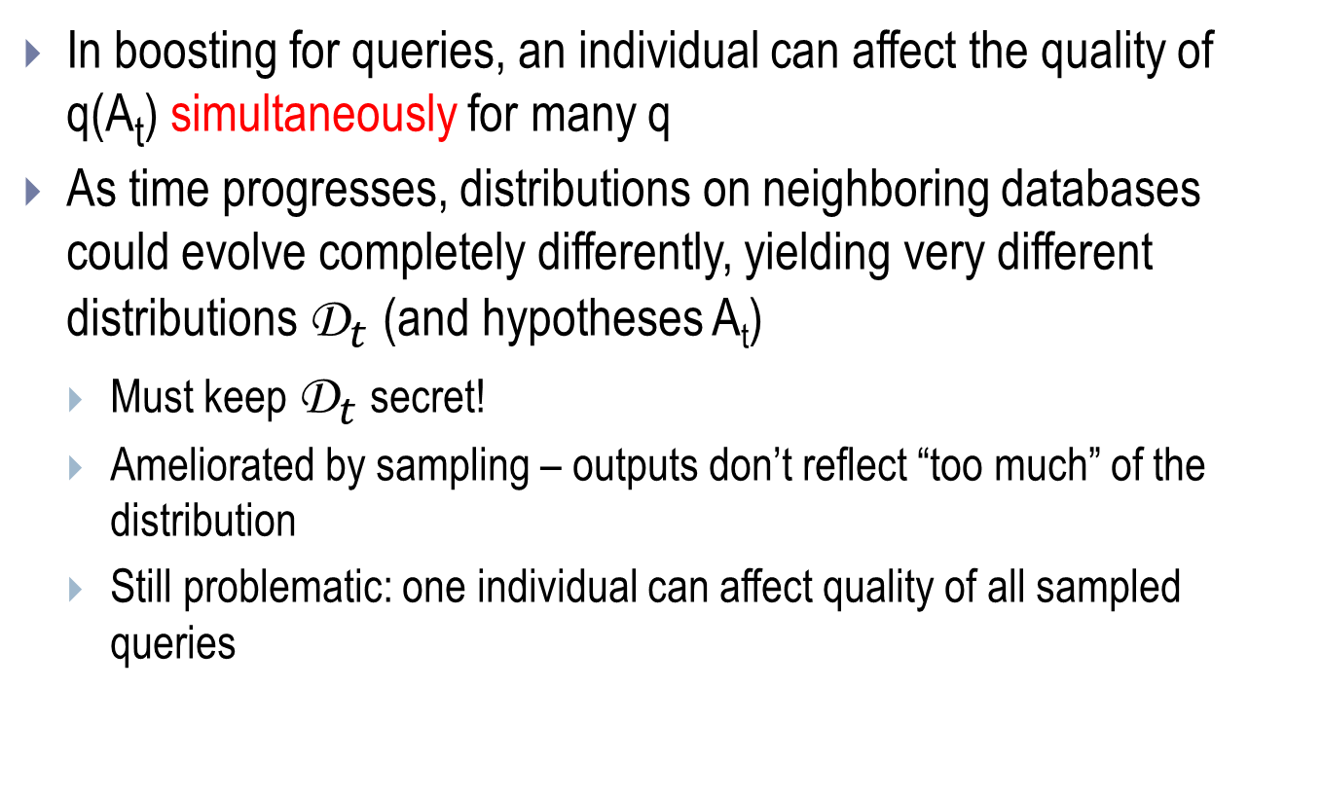
Privacy is Problematic
In boosting for queries, an individual can affect the quality of q(A_{t}) simultaneously for many q
As time progresses, distributions on neighboring databases could evolve completely differently, yielding very different distributions ${\text{D}}_{t}$(and hypotheses A_{t})
  Must keep ${\text{D}}_{t}$ secret!
  Ameliorated by sampling – outputs don’t reflect “too much” of the distribution
  Still problematic: one individual can affect quality of all sampled queries
Notes:
A_t’s diff because we are sampling to create input to base learner
(if only a few samples, maybe can avoid the q’s on the edge [good under $x$, not good under $x′$])
THIS NEVER WORKED OUT

Slide 58
Privacy?
Error of
S_{t} on q
λ
“Good enough”
Error x
Error x’
Queries q∈Q

Slide 59
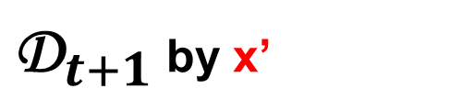
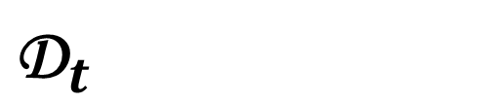
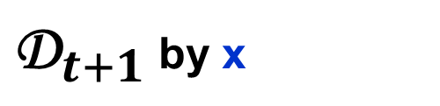
Privacy???
Weight
of q
λ
$${\text{D}}_{t}$$
${\text{D}}_{t+1}$ by x
${\text{D}}_{t+1}$ by x’
Queries q∈Q
Notes:
IMPROVE: deal with ratios

Slide 60
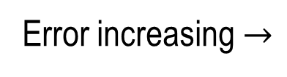
Private Boosting for Queries [Variant of AdaBoost]
Initial distribution D is uniform on queries in Q
S is always a set of k elements drawn from Q^{k}
Combiner is median [viz. Freund92]
Attenuated Re-Weighting
  If very well approximated by A_{t}, decrease weight by factor of e (“-1”)
  If very poorly approximated by A_{t}, increase weight by factor of e (“+1”)
  In between, scale with distance of midpoint (down or up):
  2 ( |q(DB) – q(A_{t})| - (¸ + ¹/2) ) / ¹ (sensitivity: 2½/¹)
λ
λ + μ
Error increasing $→$
(log |Q |^{3/2}½ √k) / ²´⁴
Notes:
Reweighting is similar under adjacent databases; would need lots of samples to detect difference. Never get hands on lots of samples.

Slide 61
Private Boosting for Queries [Variant of AdaBoost]
Initial distribution D is uniform on queries in Q
S is always a set of k elements drawn from Q^{k}
Combiner is median [viz. Freund92]
Attenuated Re-Weighting
  If very well approximated by A_{t}, decrease weight by factor of e (“-1”)
  If very poorly approximated by A_{t}, increase weight by factor of e (“+1”)
  In between, scale with distance of midpoint (down or up):
  2 ( |q(DB) – q(A_{t})| - (¸ + ¹/2) ) / ¹ (sensitivity: 2½/¹)
Reweighting similar under x and x’
Need lots of samples to detect difference
Adversary never gets hands on lots of samples
λ
λ + μ
Error increasing $→$
(log |Q |^{3/2}½ √k) / ²´⁴
Notes:
Reweighting is similar under adjacent databases; would need lots of samples to detect difference. Never get hands on lots of samples.

Slide 62
Privacy???
Pr of q
λ
$${\text{D}}_{t}$$
${\text{D}}_{t+1}$ by x
${\text{D}}_{t+1}$ by x’
Queries q ∈ Q

Slide 63
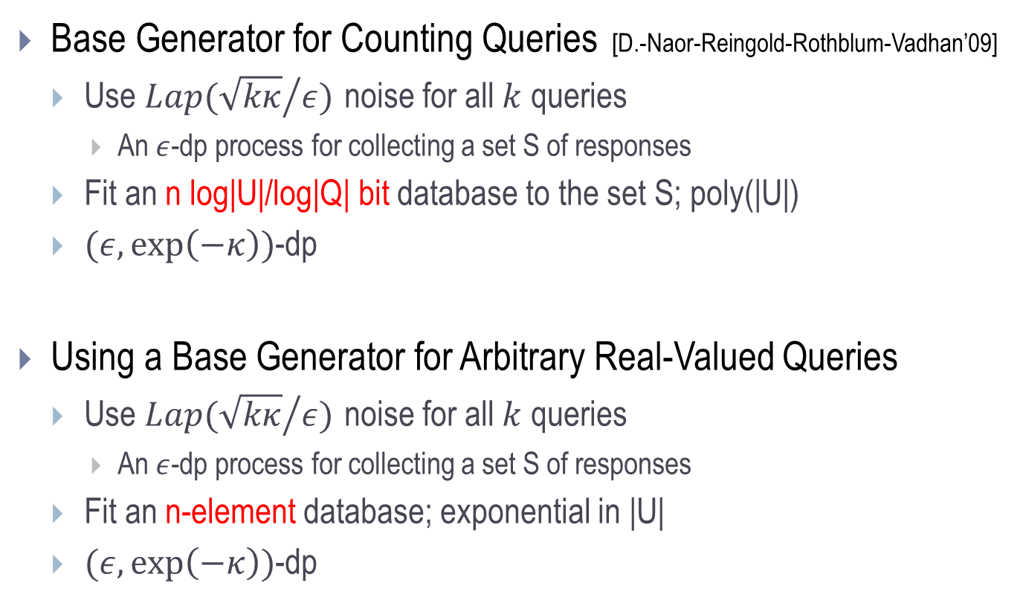
Agnostic as to Type Signature of Q
Base Generator for Counting Queries [D.-Naor-Reingold-Rothblum-Vadhan’09]
  Use $Lap({\sqrt{kκ}}/{ε)}$ noise for all $k$ queries
    An $ε$-dp process for collecting a set S of responses
  Fit an n log|U|/log|Q| bit database to the set S; poly(|U|)
  $(ε,\exp\left(−κ\right))$-dp
Using a Base Generator for Arbitrary Real-Valued Queries
  Use $Lap({\sqrt{kκ}}/{ε)}$ noise for all $k$ queries
    An $ε$-dp process for collecting a set S of responses
  Fit an n-element database; exponential in |U|
  $(ε,\exp\left(−κ\right))$-dp
Notes:
\lambda \in \tilde{O}((\log |X| + \log |Q|)\kappa^{3/2})/(\eps \sqrt{n}) for DNRRV construction
\lambda \in \tilde{O}((\sqrt{n \log |X|} \rho \kappa^{3/2} / \eps) for arbitrary

Slide 64
  Analyzing Privacy Loss
Know that “the epsilons and deltas add up”
  T invocations of Base Generator (ε_{base} , ±_{base})
  Tk samples from distributions (ε_{sample}, ±_{sample})
    k each from D₁, … , D_{T}
    Fair because samples in iteration t are mutually independent and distribution being sampled depends only on A₁, …, A _{t-1} (public)
Improve on (T ε_{base} + Tk ε_{sample} , T±_{base} +Tk ±_{sample})-dp via composition theorem
Notes:
Pr[… > z(A+B)\sqrt k + kA] < 2exp(-z^2/2)

Slide 65
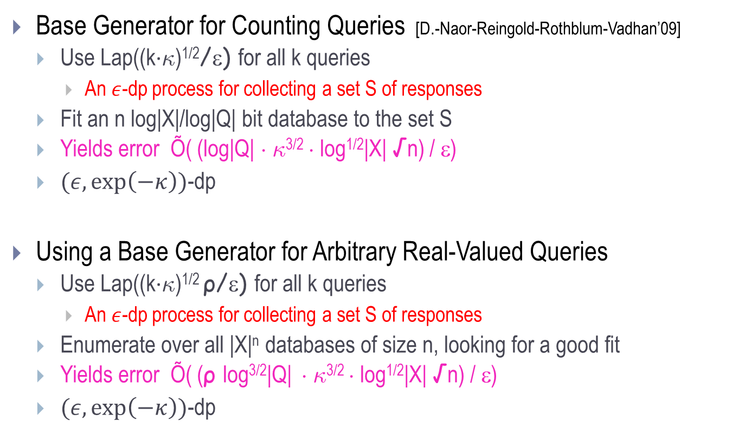
Agnostic as to Type Signature of Q
Base Generator for Counting Queries [D.-Naor-Reingold-Rothblum-Vadhan’09]
  Use Lap((k∙∙)^{1/2}/ε) for all k queries
    An $ε$-dp process for collecting a set S of responses
  Fit an n log|X|/log|Q| bit database to the set S
  Yields error Õ( (log|Q| ¢ ∙^{3/2} ¢ log^{1/2}|X| √n) / ε)
  $(ε,\exp\left(−κ\right))$-dp
Using a Base Generator for Arbitrary Real-Valued Queries
  Use Lap((k∙∙)^{1/2} ρ/ε) for all k queries
    An $ε$-dp process for collecting a set S of responses
  Enumerate over all |X|^{n} databases of size n, looking for a good fit
  Yields error Õ( (ρ log^{3/2}|Q| ¢ ∙^{3/2} ¢ log^{1/2}|X| √n) / ε)
  $(ε,\exp\left(−κ\right))$-dp
Notes:
\lambda \in \tilde{O}((\log |X| + \log |Q|)\kappa^{3/2})/(\eps \sqrt{n}) for DNRRV construction
\lambda \in \tilde{O}((\sqrt{n \log |X|} \rho \kappa^{3/2} / \eps) for arbitrary

Slide 66
 | Counting Queries | Arbitrary Low-Sensitivity Queries
Offline | Error $n^{2/3}$ [Blum-Ligett-Roth’08] Runtime Exponential in |U| $\left(ε,0\right)$-dp | Error $n^{1/2}$ [D.-Rothblum-Vadhan‘10] Runtime Exp(|U|)
Online | Error $n^{1/2}$ [Hardt-Rothblum’10] Runtime Polynomial in |U|
Error $n^{1/2}$
[Hardt-Rothblum]
Runtime Exp(|U|)
Caveat: Omitting polylog(various things, some of them big) terms
Notes:
Add runtimes!

Slide 67
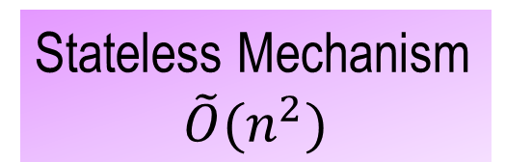
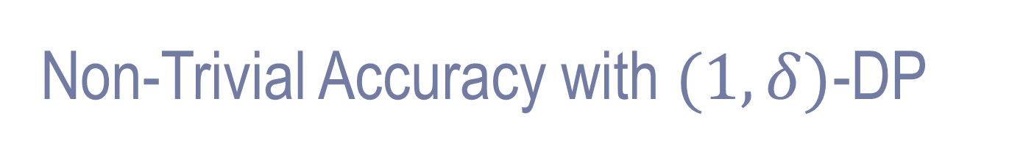


Non-Trivial Accuracy with $(1,δ)$-DP
Stateless Mechanism
$$\tilde{O}(n^{2})$$
Statefull Mechanism
$$exp⁡(n)$$
Barrier at $n^{2}\log{|U|}$
[D.,Naor,Vadhan]

Slide 68

Non-Trivial Accuracy with $(1,δ)$-DP
Independent Mechanisms
$$\tilde{O}(n^{2})$$
Statefull Mechanism
$$exp⁡(n)$$
Barrier at $n^{2}\log{|U|}$
[D.,Naor,Vadhan]

Slide 69
Non-Trivial Accuracy with $(1,δ)$-DP
Independent Mechanisms
$$\tilde{O}(n^{2})$$
Statefull Mechanism
$$exp⁡(n)$$
Moral: To handle many databases must relax adversary assumptions or introduce coordination

Slide 70
Outline
Part 1: Basics
  Smoking causes cancer
  Definition
  Laplace mechanism
  Simple composition
  Histogram example
  Advanced composition
Part 2: Many Queries
  Sparse Vector
  Multiplicative Weights
  Boosting for queries
Part 3: Techniques
  Exponential mechanism and application
  Subsample-and-Aggregate
  Propose-Test-Release
  Application of S&A and PTR combined
Future Directions
Notes:
TCC 2009 has lots of useful slides

Slide 71

Discrete-Valued Functions
$f\left(x\right)∈S=\{y_{1},y_{2},…,y_{k}\}$
  Strings, experts, small databases, …
  Each $y∈S$ has a utility for $x$, denoted $u(x,y)$
Exponential Mechanism [McSherry-Talwar’07]
  Output $y$ with probability $∝e^{u\left(x, y\right)ε/Δu}$
$${\left[\frac{\exp\left(u\left(x,y\right)\right)}{\exp\left(u\left(x^{′},y\right)\right)}\right]}^{ε/Δu}= {\left[e^{u\left(x,y\right)−u\left(x^{′},y\right)}\right]}^{ε/{Δu}} ≤{ e}^{ε}$$

Slide 72

Exponential Mechanism Applied
Many (fractional) counting queries [Blum, Ligett, Roth’08]:
Given $n$-row database $x$, set $Q$ of properties, produce a synthetic database $y$ giving good approx to “What fraction of rows of $x$ satisfy property $P$?” $∀P∈Q$.
  $S$ is set of all databases of size $m∈\tilde{O}({\log{|Q|}}/{α^{2})}≪n$
  $u\left(x,y\right)=−\max_{q∈Q}{|}q\left(x\right)−q(y)$|
-1/3
-62/4589
-7/286
-1/100000
-1/310

Slide 73
 | Counting Queries | Arbitrary Low-Sensitivity Queries
Offline | Error $n^{2/3}$ [Blum-Ligett-Roth’08] Runtime Exponential in |U| $\left(ε,0\right)$-dp | Error $n^{1/2}$ [D.-Rothblum-Vadhan‘10] Runtime Exp(|U|)
Online | Error $n^{1/2}$ [Hardt-Rothblum’10] Runtime Polynomial in |U|
Error $n^{1/2}$
[Hardt-Rothblum]
Runtime Exp(|U|)
What happened in 2009?
Notes:
Add runtimes!

Slide 74

High/Unknown Sensitivity Functions
Subsample-and-Aggregate [Nissim, Raskhodnikova, Smith’07]

Slide 75







Functions “Expected” to Behave Well
Propose-Test-Release [D.-Lei’09]
  Privacy-preserving test for “goodness” of data set
    Eg, low local sensitivity [Nissim-Raskhodnikova-Smith07]
Big gap
$−∞$…
……
…$∞$
$$x_{1},x_{2}, …, x_{n/2}$$
$$x_{1+n/2}, …, x_{n}$$
Robust statistics theory:
Lack of density at median is the only thing that can go wrong
PTR: Dp test for low sensitivity median (equivalently, for high density)
if good, then release median with low noise
else output $⊥$ (or use a sophisticated dp median algorithm)

Slide 76








Application: Feature Selection
$$x_{1}, x_{2}, …….$$
$$B_{1}$$
$$B_{2}$$
$$B_{3}$$
$$B_{T}$$
$$S_{1}$$
$$S_{2}$$
$$S_{3}$$
$$S_{T}$$
If “far” from collection with no large majority value, then output most common value.
Else quit.

Slide 77

Future Directions
Realistic Adversaries(?)
  Related: better understanding of the guarantee
    What does it mean to fail to have $ε$-dp?
    Large values of $ε$ can make sense!
Coordination among curators?
Efficiency
  Time complexity: Connection to Tracing Traitors
  Sample complexity / database size
Is there an alternative to dp?
  Axiomatic approach [Kifer-Lin’10]
Focus on a specific application
  Collaborative effort with domain experts

Slide 78
Thank You!
-4R
-3R
-2R
-R
0
R
2R
3R
4R
5R

