Slide 1
Automatically Generating Algebra Problems
26th Association for the Advancement of Artificial Intelligence (AAAI) Conference 2012
Rohit Singh¹ Sumit Gulwani² Sriram Rajamani³
¹ Massachusetts Institute of Technology, Cambridge, USA
² Microsoft Research, Redmond, USA
³ Microsoft Research, Bangalore, India
July 26th 2012

Slide 2
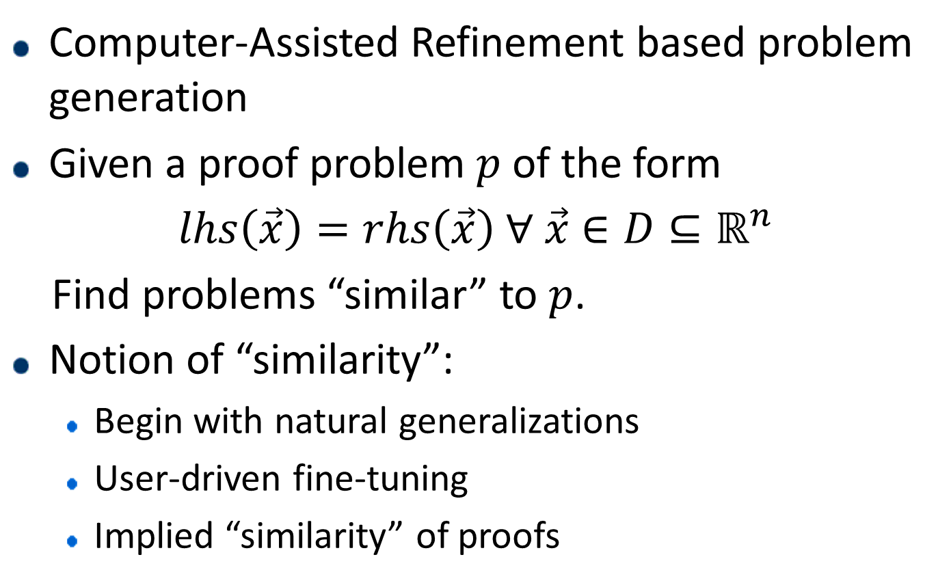
What is it?
Computer-Assisted Refinement based problem generation
Given a proof problem $p$ of the form
$lhs\left(\vec{x}\right)=rhs\left(\vec{x}\right) ∀ \vec{x}∈D⊆ℝ^{n}$
Find problems “similar” to $p$.
Notion of “similarity”:
  Begin with natural generalizations
  User-driven fine-tuning
  Implied “similarity” of proofs

Slide 3
Why is it useful?
High School Teacher
Practice Examples
Assignments
Examinations
Test the student with “similar” but not the same problems!

Slide 4
Why is it useful?
High School Student
Unsolved Exercises
Solved Book Examples
More Practice?
In-Class Examples
Assignments
Examinations
Try the learned concepts on “similar” but not the same problems before attempting Exams.

Slide 5
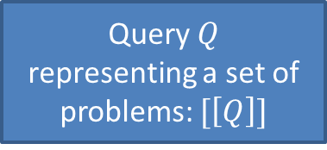




How does it work?
Problem $p$
Generalization
Query $Q$
representing a set of problems: $[\left[Q\right]]$
Query Tuning
Adding/Removing constraints
Changing the Choices
Query Execution
No
OK?
$$p_{1}$$
$$p_{2}$$
…
$$p_{m}$$
“Valid” Problems
Yes [Done!]

Slide 6



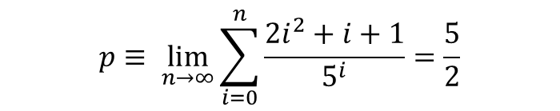
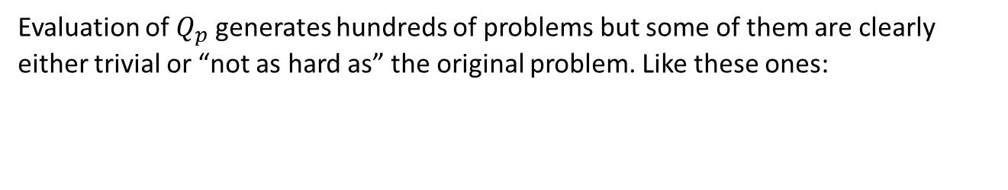
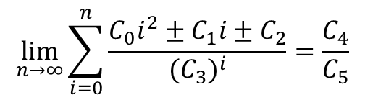

An Example
$$p≡ \lim_{n→∞}{\sum_{i=0}^{n}{\frac{2i^{2}+i+1}{5^{i}}}}=\frac{5}{2}$$
Consider
$$\lim_{n→∞}{\sum_{i=0}^{n}{\frac{C_{0}i^{2}±C_{1}i±C_{2}}{{(C_{3})}^{i}}}}=\frac{C_{4}}{C_{5}}$$
Generalization $Q_{p}≡$
With query constraints: $C_{3}≠0,C_{5}≠0,\gcd\left(C_{0},C_{1},C_{2}\right)=1,\gcd\left(C_{4},C_{5}\right)=1$ being generated automatically.
Evaluation of $Q_{p}$ generates hundreds of problems but some of them are clearly either trivial or “not as hard as” the original problem. Like these ones:
$$\lim_{n→∞}{\sum_{i=0}^{n}{\frac{4i+1}{5^{i}}}}=\frac{5}{2}$$
$$\lim_{n→∞}{\sum_{i=0}^{n}{\frac{4i−1}{5^{i}}}}=0$$
The teacher adds more constraints: $C_{0}≠0,C_{3}=C_{4}$ and evaluation after the refinement produces 21 problems (satisfactorily “similar” to the original one) e.g.
$$\lim_{n→∞}{\sum_{i=0}^{n}{\frac{3i^{2}+2i+1}{7^{i}}}}=\frac{7}{3} \lim_{n→∞}{\sum_{i=0}^{n}{\frac{5i^{2}+3i+3}{6^{i}}}}=6$$

Slide 7
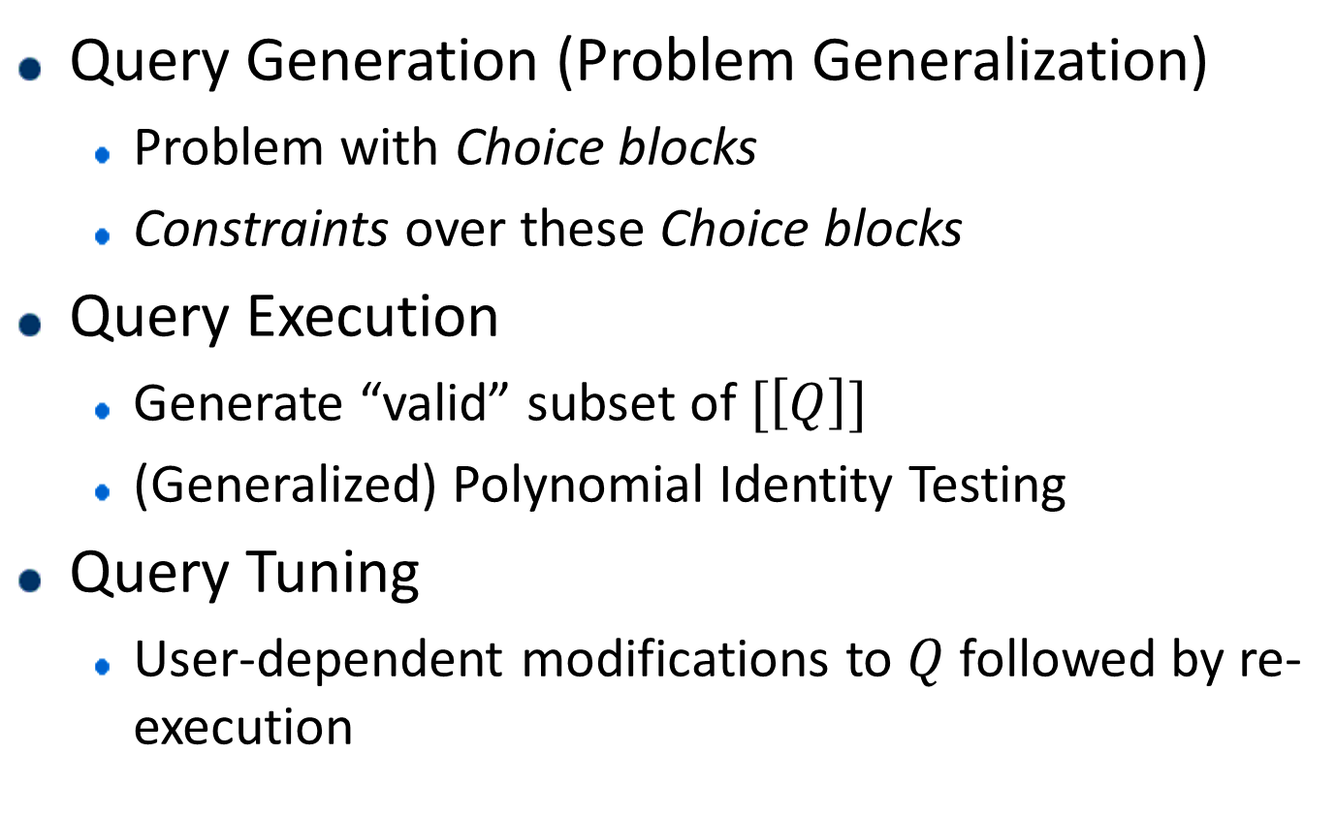
How does it work, again?
Query Generation (Problem Generalization)
  Problem with Choice blocks
  Constraints over these Choice blocks
Query Execution
  Generate “valid” subset of $[\left[Q\right]]$
  (Generalized) Polynomial Identity Testing
Query Tuning
  User-dependent modifications to $Q$ followed by re-execution

Slide 8
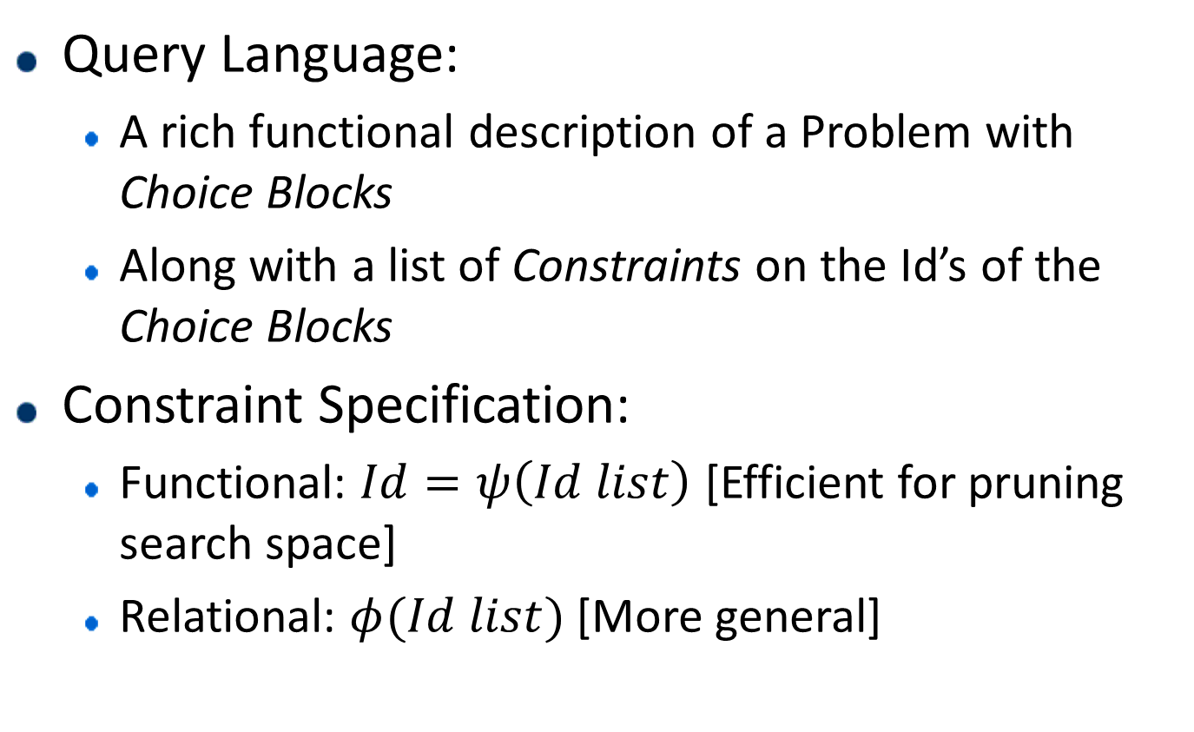
Query Generation
Query Language:
  A rich functional description of a Problem with Choice Blocks
  Along with a list of Constraints on the Id’s of the Choice Blocks
Constraint Specification:
  Functional: $Id=ψ\left(Id list\right)$ [Efficient for pruning search space]
  Relational: $φ(Id list)$ [More general]

Slide 9
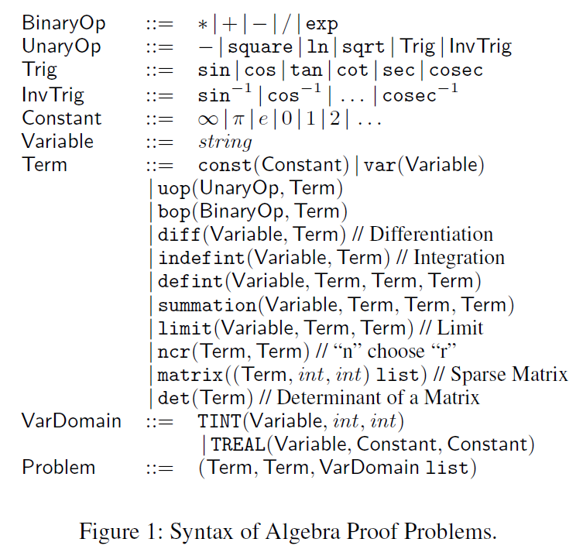
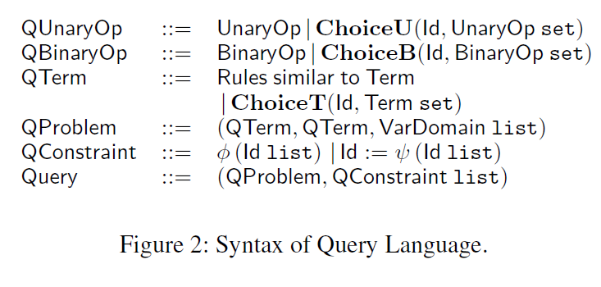

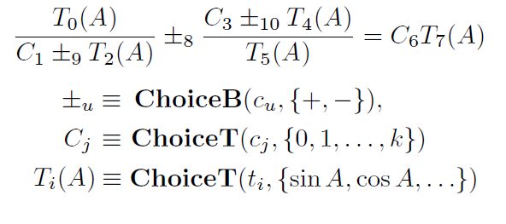
Query Language

Slide 10
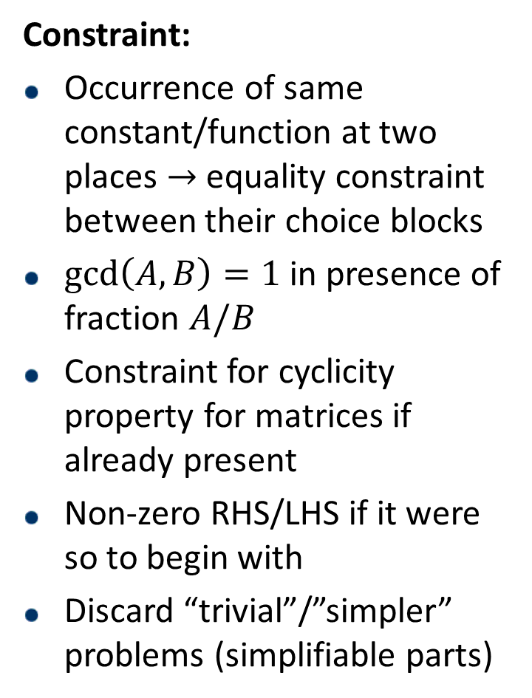
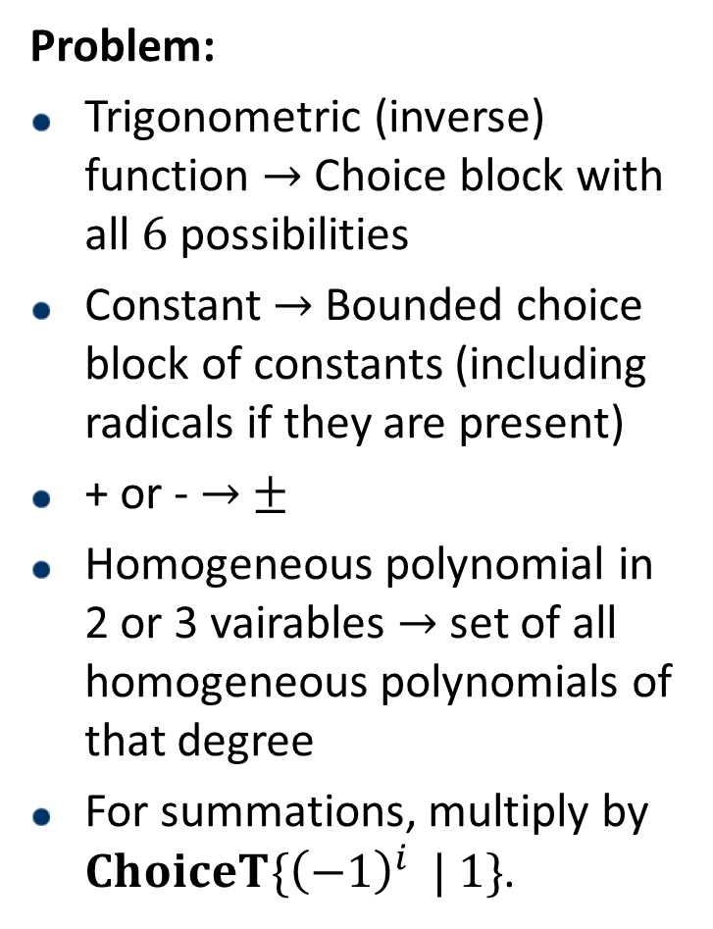
P/C Generation Heuristics
Problem:
Trigonometric (inverse) function $→$Choice block with all $6$ possibilities
Constant $→$ Bounded choice block of constants (including radicals if they are present)
+ or - $→$ $±$
Homogeneous polynomial in 2 or 3 vairables $→$ set of all homogeneous polynomials of that degree
For summations, multiply by $ChoiceT\{{\left(−1\right)}^{i} | 1\}$.
Constraint:
Occurrence of same constant/function at two places $→$ equality constraint between their choice blocks
$\gcd\left(A,B\right)=1$ in presence of fraction $A/B$
Constraint for cyclicity property for matrices if already present
Non-zero RHS/LHS if it were so to begin with
Discard “trivial”/”simpler” problems (simplifiable parts)

Slide 11
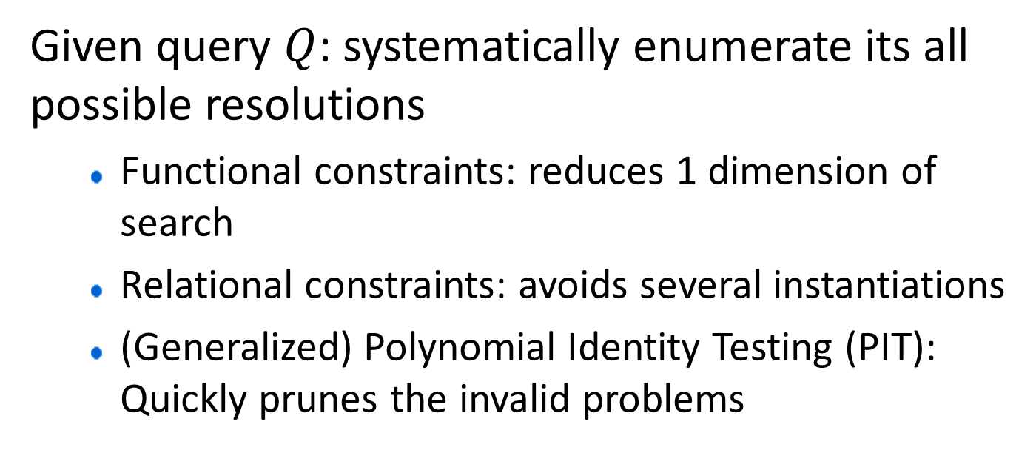
Query Execution
Given query $Q$: systematically enumerate its all possible resolutions
  Functional constraints: reduces 1 dimension of search
  Relational constraints: avoids several instantiations
  (Generalized) Polynomial Identity Testing (PIT): Quickly prunes the invalid problems

Slide 12
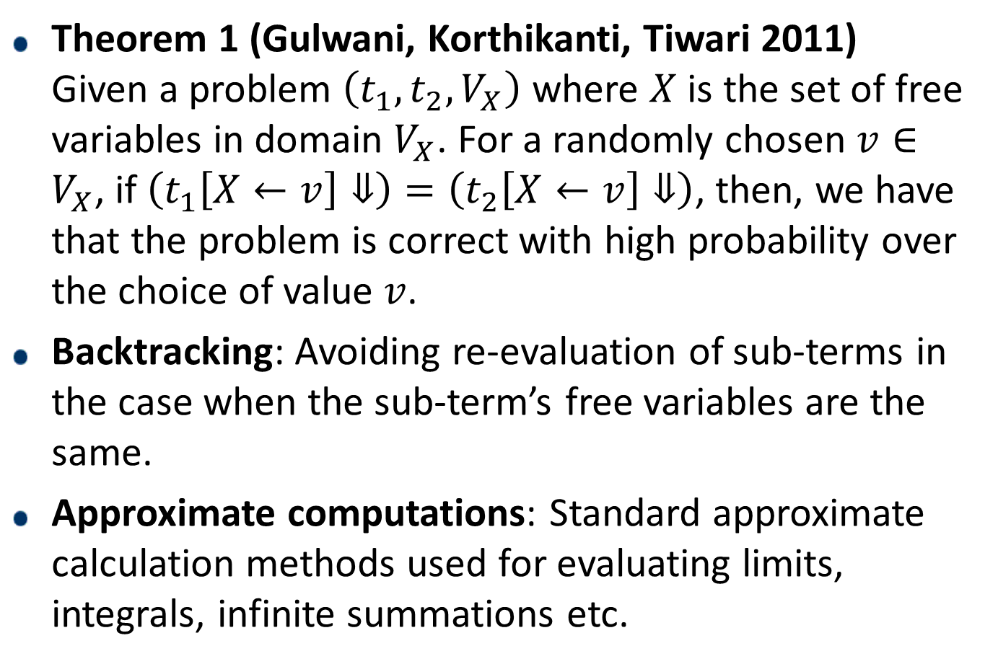
Query Execution
Theorem 1 (Gulwani, Korthikanti, Tiwari 2011)
Given a problem $\left(t_{1},t_{2},V_{X}\right)$ where $X$ is the set of free variables in domain $V_{X}$. For a randomly chosen $v∈V_{X}$, if $\left(t_{1}\left[X←v\right]⇓\right)=\left(t_{2}\left[X←v\right]⇓\right)$, then, we have that the problem is correct with high probability over the choice of value $v$.
Backtracking: Avoiding re-evaluation of sub-terms in the case when the sub-term’s free variables are the same.
Approximate computations: Standard approximate calculation methods used for evaluating limits, integrals, infinite summations etc.

Slide 13
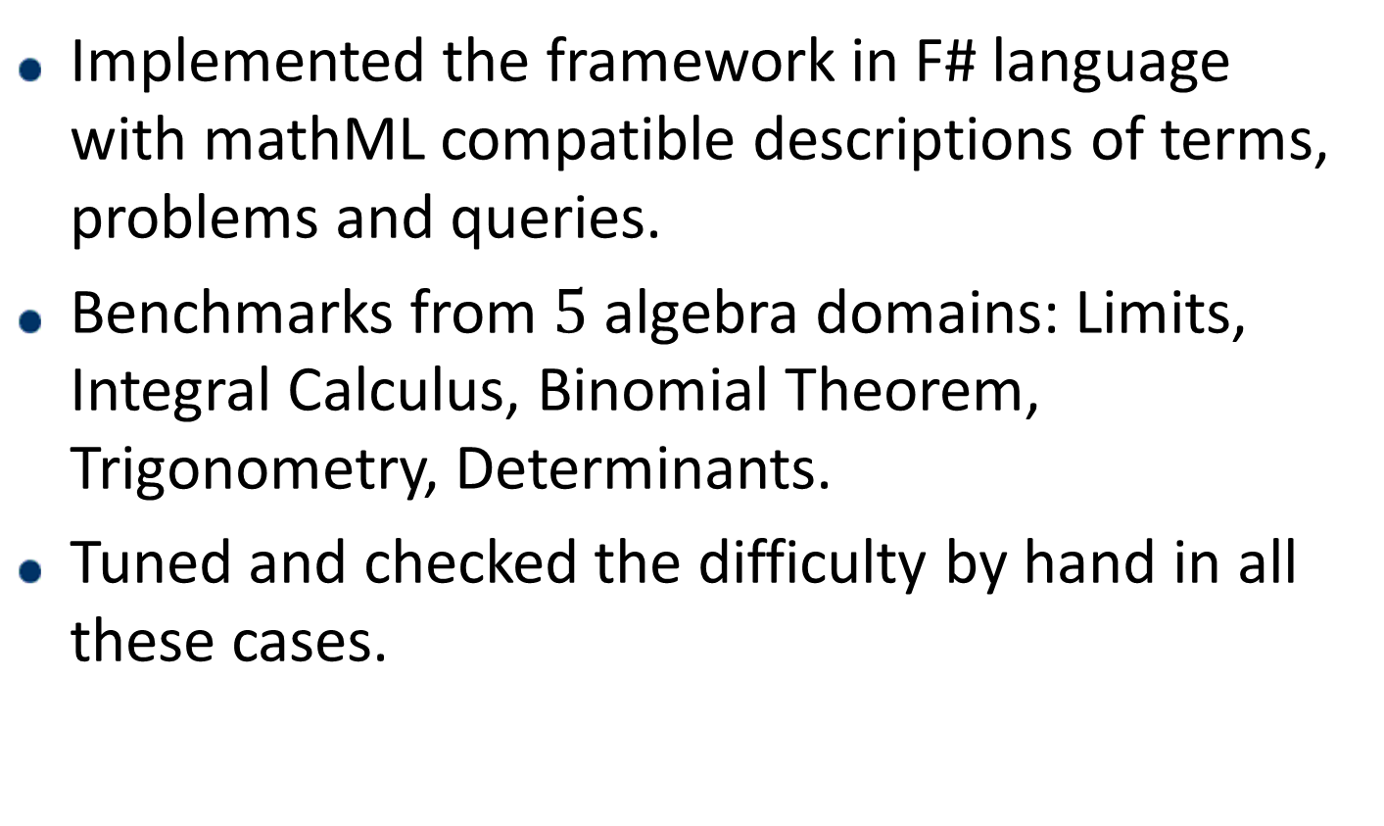
Empirical Results
Implemented the framework in F# language with mathML compatible descriptions of terms, problems and queries.
Benchmarks from $5$ algebra domains: Limits, Integral Calculus, Binomial Theorem, Trigonometry, Determinants.
Tuned and checked the difficulty by hand in all these cases.

Slide 14
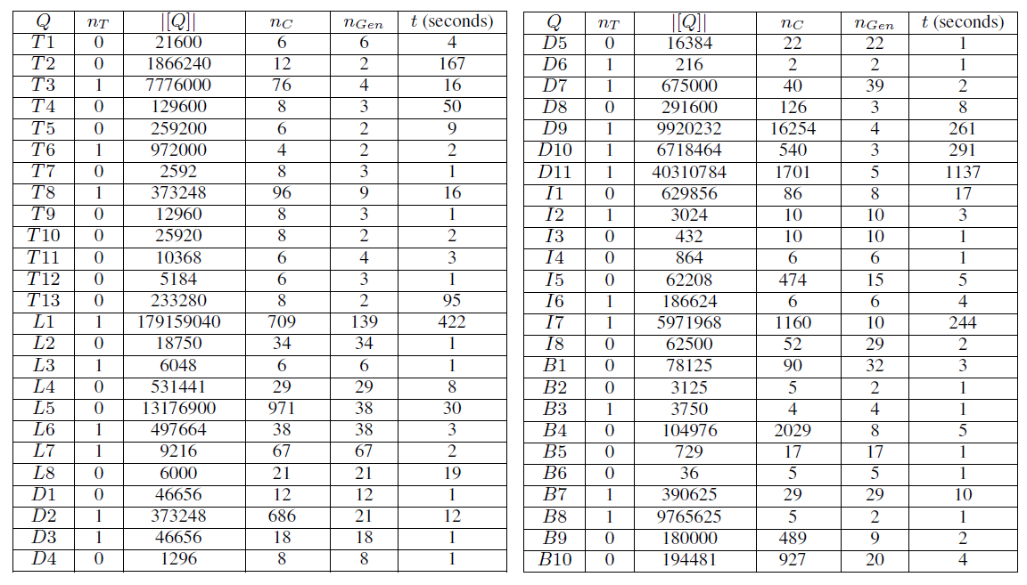
Empirical Results

Slide 15
Future and Ongoing Work
Web based GUI for Query Tuning
Statistical validation of “similarity”
Automated proof generation using the existing proof (A* like search)
Adding more domains (Physics, Numerical Chemistry, Geometry etc)

Slide 16
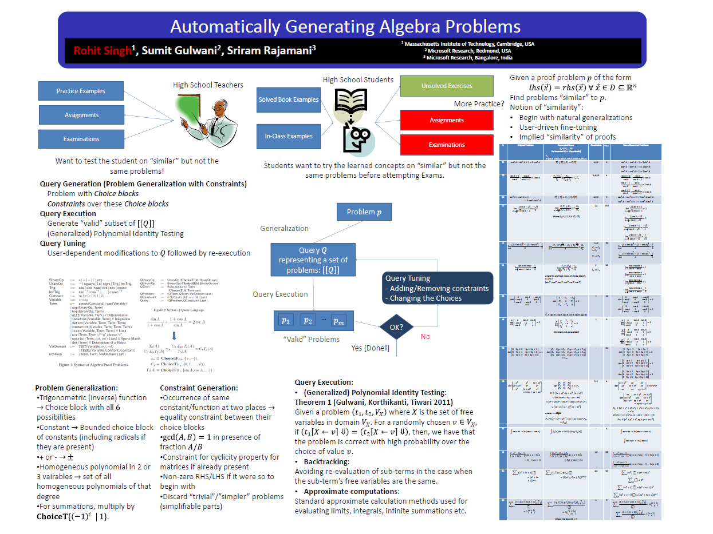
Thanks!

