Slide 1


Synthesizing Number Transformations from
Input-Output Examples
Rishabh Singh and Sumit Gulwani

Slide 2
Number
One of the most commonly used data type
Number Formatting
  Every language has its own format
  #.00? (C#, Excel), 05.2f (Python, C)
  End-users

Slide 3
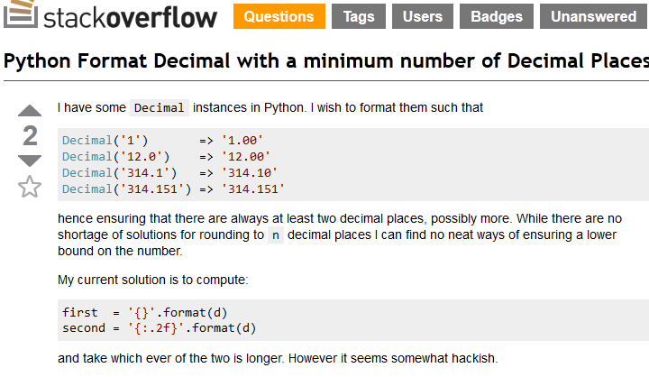
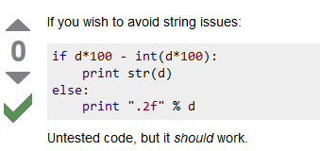
Help-forums

Slide 4
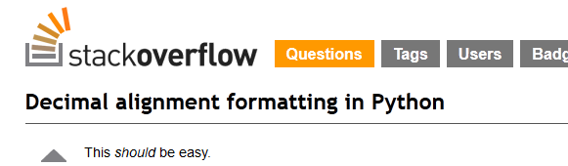
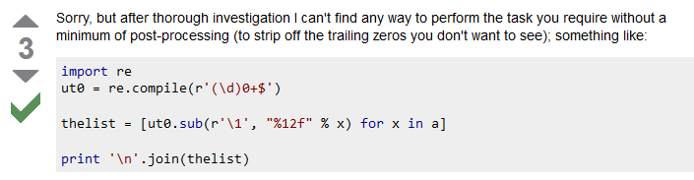
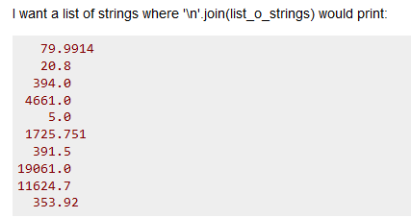
Help-forums

Slide 5
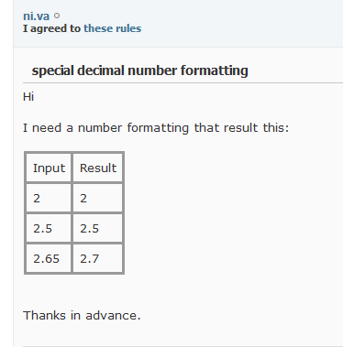
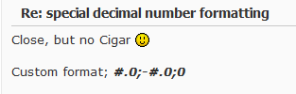

Excel Help-forums

Slide 6

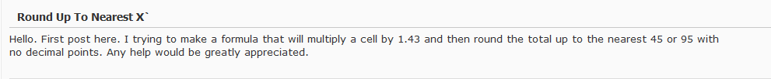

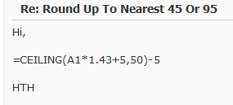
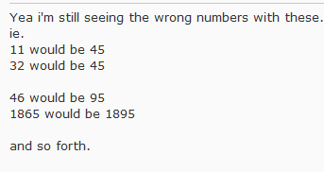
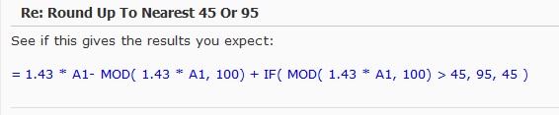
Excel Help-forums
upper 45 or 95

Slide 7
Observations from Help-forums
Input-Output Examples
  Specification mechanism
Additional inputs for removing ambiguity
Excel add-in with same interface

Slide 8
Talk Outline
Number Transformation Language
Synthesis Algorithm
String & Number Language Combination
Synthesis Algorithm for Combination
Experiments

Slide 9
Generic Framework
Expression Language L
  Expressive and succinct
Efficient Data structures for set of expressions
  Version-space algebra
GenerateStr
  All sets of expressions from I-O example
Intersect
  Intersect two sets of expressions

Slide 10
Number Transformations

Slide 11
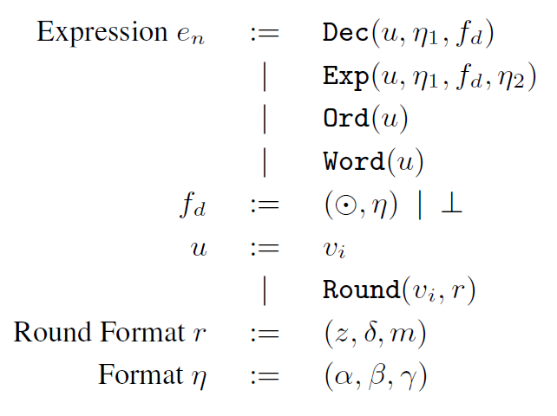
Number Transformation Language

Slide 12
Number Transformation Language

Slide 13
Number Transformation Language

Slide 14
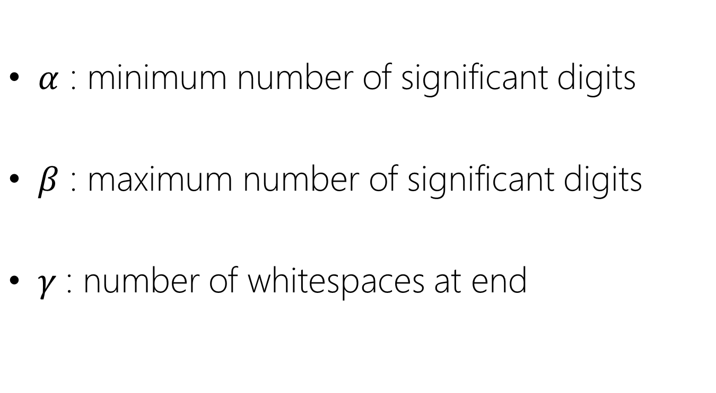
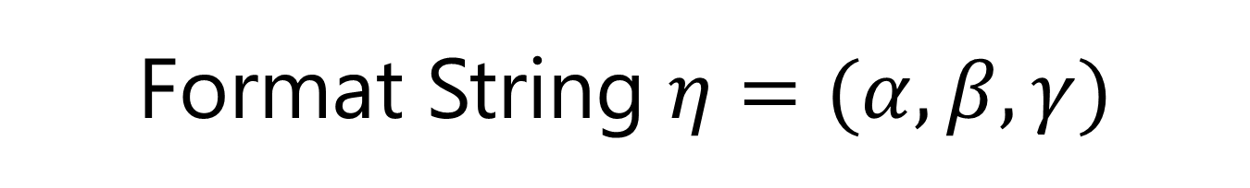
Format String $η=(α,β, γ)$
$α$ : minimum number of significant digits
$β$ : maximum number of significant digits
$γ$: number of whitespaces at end

Slide 15
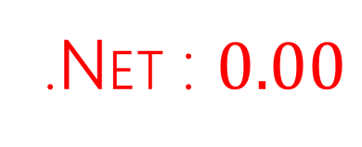
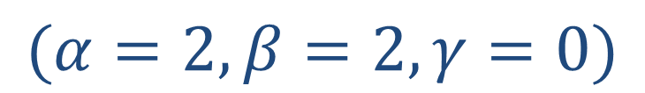
Number Format
Exactly 2 decimal places
123.4567 | 123.46
123.4 | 123.40
$$(α=2, β=2, γ=0)$$
.NET : $0.00$

Slide 16
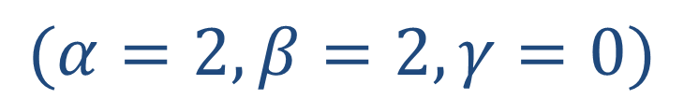
Semantics
Exactly 2 decimal places
$$(α=2, β=2, γ=0)$$
24.589 → 24.59
24.2 → 24.20

Slide 17

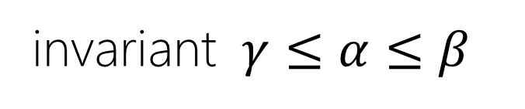
GenerateStr
Interval domains for $α, β, γ$
invariant $γ≤α≤β$
123.4567 | 123.46
$$(\tilde{α}=[0,2], \tilde{β}=[2,2], \tilde{γ}=[0,2])$$
123.4 | 123.40
$$(\tilde{α}=[2,2], \tilde{β}=[2,∞], \tilde{γ}=[0,0])$$

Slide 18
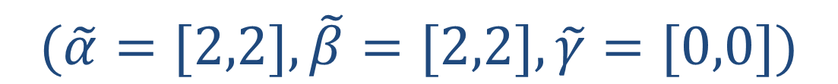

Intersect
$$(\tilde{α}=[0,2], \tilde{β}=[2,2], \tilde{γ}=[0,2])$$
$$∧$$
$$(\tilde{α}=[2,2], \tilde{β}=[2,∞], \tilde{γ}=[0,0])$$
$$(\tilde{α}=[2,2], \tilde{β}=[2,2], \tilde{γ}=[0,0])$$

Slide 19
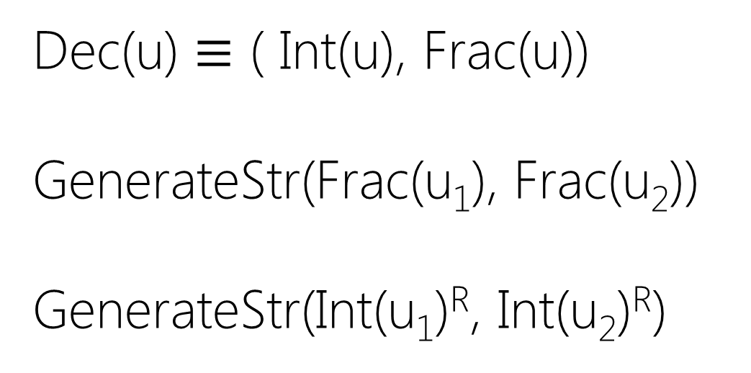
Extension to Integer parts
12.4567 | 012.46
123.4 | 123.40
Dec(u) $≡$ ( Int(u), Frac(u))
GenerateStr(Frac(u₁), Frac(u₂))
GenerateStr(Int(u₁)^{R}, Int(u₂)^{R})

Slide 20
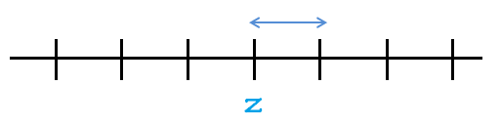

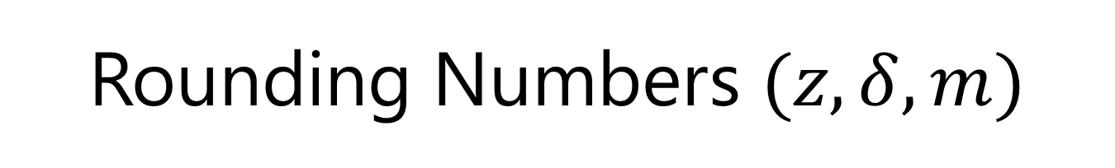


Rounding Numbers $(z, δ, m)$
$z :$ zero of interval
$δ :$ size of interval
$m :$ nearest, upper, lower
$$δ$$
$$x$$

Slide 21
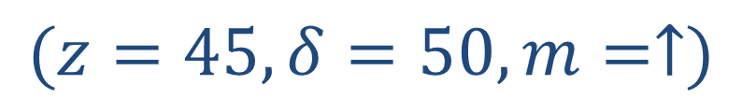
Round Format
Round off to upper 45
11 | 45
46 | 95
$$(z=45, δ=50, m=↑)$$
=Min(Roundup(A1/45, 0)*45,
Roundup(A1/95,0)*95)

Slide 22

GenerateStr
$$n_{1}→n_{2}$$
Not enough info. to learn precise $(z, δ,m)$

Slide 23

Intersect
Intersect((n₁,n’₁),(n₂,n’₂))
$z={n′}_{1}$
$δ∈Divisors\left({n′}_{2}−{n′}_{1}\right)$
  $δ>{|n}_{1}^{′}−n_{1}\left|,δ>{|n}_{2}^{′}−n_{2}\right|$

Slide 24

Intersect
Intersect((31,45),(86,95))
$z=45$
$δ∈Divisors(95−45)$

Slide 25

Intersect
Intersect((31,45),(86,95))
$z=45$
$δ∈Divisors\left(50\right)$

Slide 26

Intersect
Intersect((31,45),(86,95))
$z=45$
$δ∈\left\{1,2,5,10,25,50\right\}$

Slide 27

Intersect
Intersect((31,45),(86,95))
$z=45$
$δ∈\left\{1,2,5,10,25,50\right\}$
$δ>|45−31\left|,δ>|95−86\right|$

Slide 28

Intersect
Intersect((31,45),(86,95))
$z=45$
$δ∈\left\{1,2,5,10,25,50\right\}$
$δ>|14\left|,δ>|9\right|$

Slide 29

Intersect
Intersect((31,45),(86,95))
$z=45$
$δ∈\left\{25, 50\right\}$
$δ>|14\left|,δ>|9\right|$

Slide 30
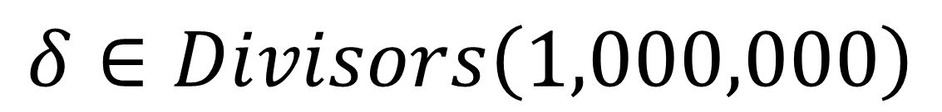

GenerateStr
$250,000→1,000,000$
$$1,450,000→2,000,000$$
$$δ∈Divisors\left(1,000,000\right)$$
Only need to maintain greatest value

Slide 31
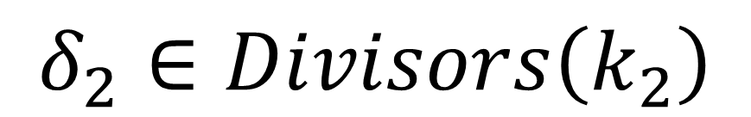
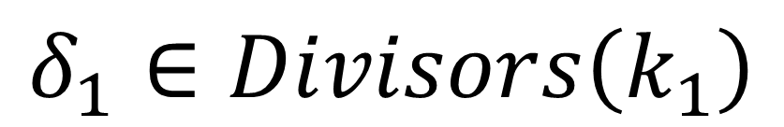
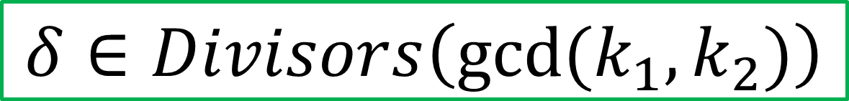

Intersect
$$δ_{1}∈Divisors\left(k_{1}\right)$$
$$∧$$
$$δ_{2}∈Divisors\left(k_{2}\right)$$
$$δ∈Divisors\left({gcd⁡(k_{1},k}_{2})\right)$$

Slide 32
Combining String and Number Transformations

Slide 33
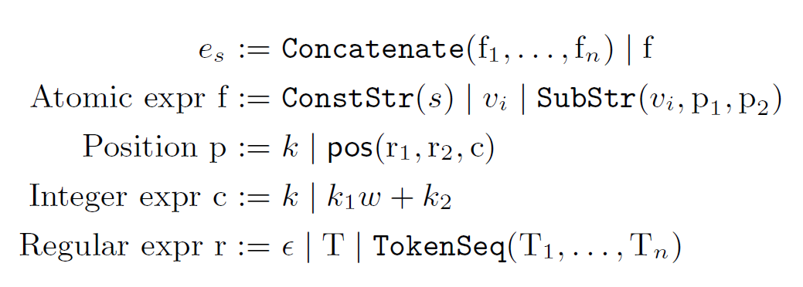
String Language [GulwaniPOPL11]

Slide 34
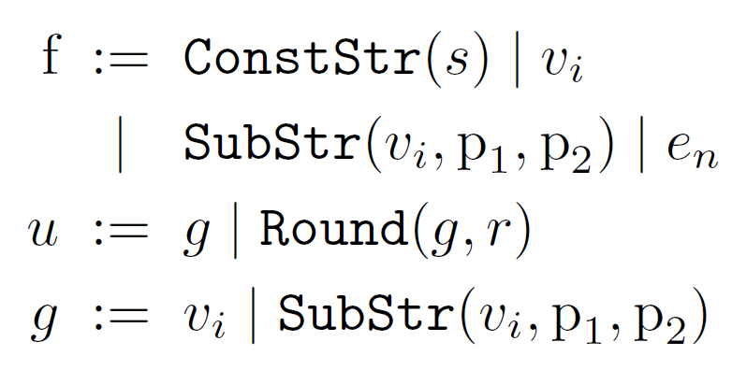
Combined Language

Slide 35
Combination Examples

Slide 36
Synthesis Algorithm
2004.07.08 →
7/8/2004
Program P₁ to extract 7 in input
(-5, -4)
(-5, dot -1)
(-5, dot 2)
(-5, 7)
(6, -4)
….
(P₁, 7 -> 7)

Slide 37
Synthesis Algorithm
2004.07.08 →
7/8/2004
Program P₂ to extract 07 in input
(dot 1, dot 2)
(dot 1, dot -1)
(-6, -4)
(-6, dot -1)
(-6, dot 2)
….
(P₁, 7 -> 7)
(P₂, 07 -> 7)

Slide 38
GenerateStr
2004.07.08 →
7/8/2004
(P₁, 7 -> 7)
(P₂, 07 -> 7)

Slide 39
GenerateStr
2004.07.08 →
7/8/2004
(P₃, 8 -> 8)
(P₄, 08 -> 8)

Slide 40
Constructing the DAG
₀7₁/₂8₃/₄2₅0₆0₇4₈
(P₁, 7 -> 7)
0
1
2
3
4
(P₂, 07 -> 7)
5
7
6
8

Slide 41
Intersection
DAG intersection
Edge-wise program intersection

Slide 42
Experiments

Slide 43
Benchmarks
50 benchmark problems
  Help forums
  Excel product team

Slide 44
Number of I/O examples

Slide 45
Performance

Slide 46
Related work
String Transformations [Gulwani POPL11]
Table Transformations [Singh,Gulwani VLDB12]
Spreadsheet Data Manipulation using Examples[Gulwani, Harris, Singh CACM 2012]

Slide 47
Conclusion
Number Transformation Language
  Synthesis algorithm
String + Number Transformations
  Combined Synthesis algorithm

Slide 48
Thanks!
CAV
Algorithm
Designers
Software Developers
End-Users
Large potential

Slide 49
Questions & Comments

Slide 50
Backup slides

Slide 51

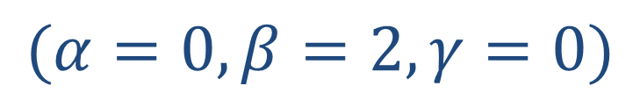
Number Format
123.4567 | 123.46
123.4 | 123.4
$$(α=0, β=2, γ=0)$$
.NET : $0.\#\#$

Slide 52

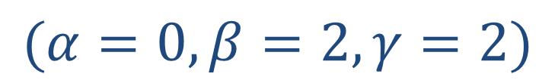
Number Format
123.4567 | 123.46
123.4 | 123.4_
$$(α=0, β=2, γ=2)$$
.NET : $0.??$

Slide 53
a | b
c | d
e | f
g | h
i | j
k | l

Slide 54
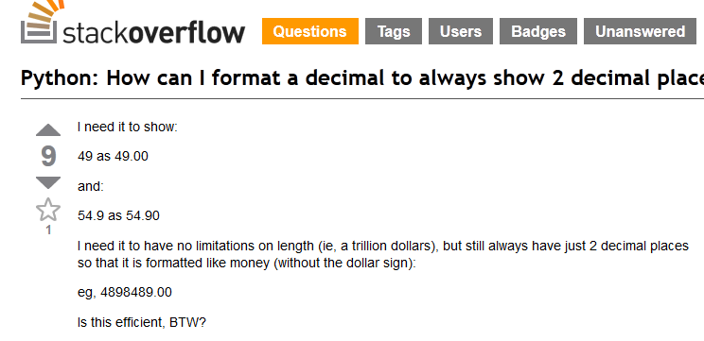
Help-forums

Slide 55
Number Format
At most 2 decimal places
123.4567 | 123.46
123.4 | 123.4
$$(α=0, β=2, γ=0)$$
.NET : $0.\#\#$

Slide 56
Number Format
Exactly 2 decimal places with space
123.4567 | 123.46
123.4 | 123.4_
$$(α=0, β=2, γ=2)$$
.NET : $0.??$

