Slide 1


Inferring Air Quality for Station Location
Recommendation Based on Urban Big Data
Shou-De Lin
Computer Science Department
National Taiwan University
Joint work with Dr. Hsun-Ping Hsieh from NTU, and Dr. Yu Zheng from MSRA

Slide 2
Outline
Goal, motivation and challenge
Related work and data analysis
Solutions
Experiment Results

Slide 3
Goals
1st goal: Given historical data of a small set of air-quality monitors, infer the air quality values (i.e. PM2.5 and PM10) of arbitrary locations without sensors deployed
2nd goal: Recommend deployment locations for new monitoring stations
Motivation: It is not cost-effective to deploy sensors everywhere
  still want to know the sensor values of locations without sensors
  need to optimize the utility in deploying new sensors

Slide 4
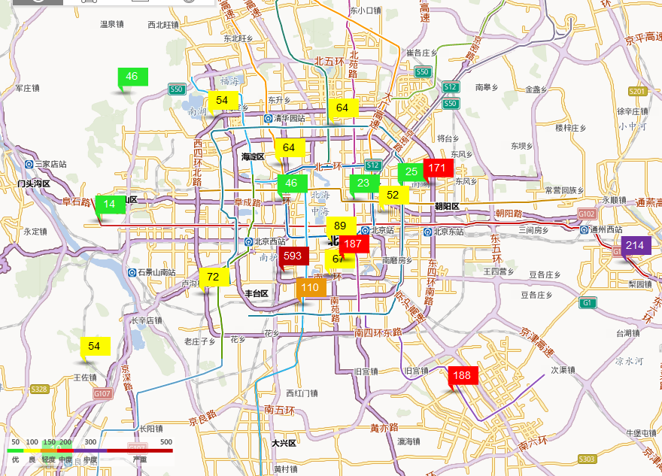


Slide 5
Outline
Goals, motivation and challenge
Related work and Data Analysis
Solutions
Experiment Results

Slide 6
Related work
Emission Models
  Interpolation[Donkelaar et al. 2006]
    Low accuracy
  Dispersion models[Hasenfratz et al. 2012]
    A simulation model for air pollutant dispersion.
Satellite Remote Sensing [Jiang et al. 2011]
  Hard to obtain real-time data
Crowdsourcing[Martin et al. 2008] [Vardoulakis et al. 2013]
  could cost time and money
Co-Training Based Prediction [Zheng. et al. 2013]
  Performance suffered when only sparse data are available

Slide 7
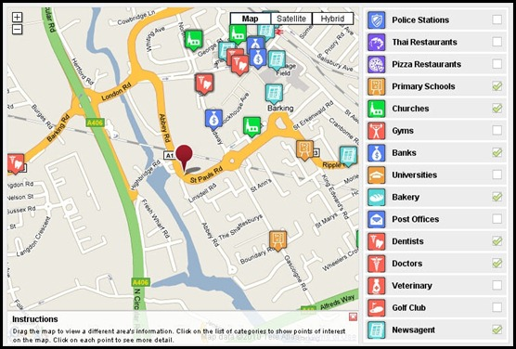
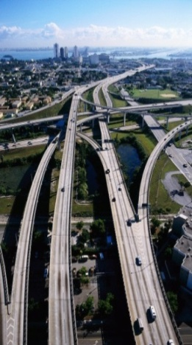


What kind of auxiliary Information to exploit?
Unhealthy
Point-of -Interest
Road-network
Weather
Historical & real-time air Quality data
(from monitoring stations)
Features

Slide 8
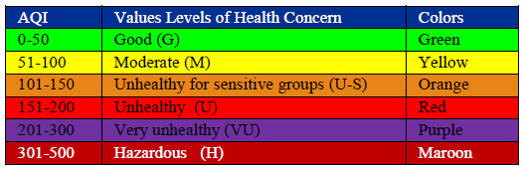
Preprocessing
Partition a city into disjoint grids
Extract features for each grid
  X-Y coordination
  Meteorological features
  POI features
  Road network features
Assume each grid has a single air-quality value
  can be treated as a regression or multi-class classification problem

Slide 9
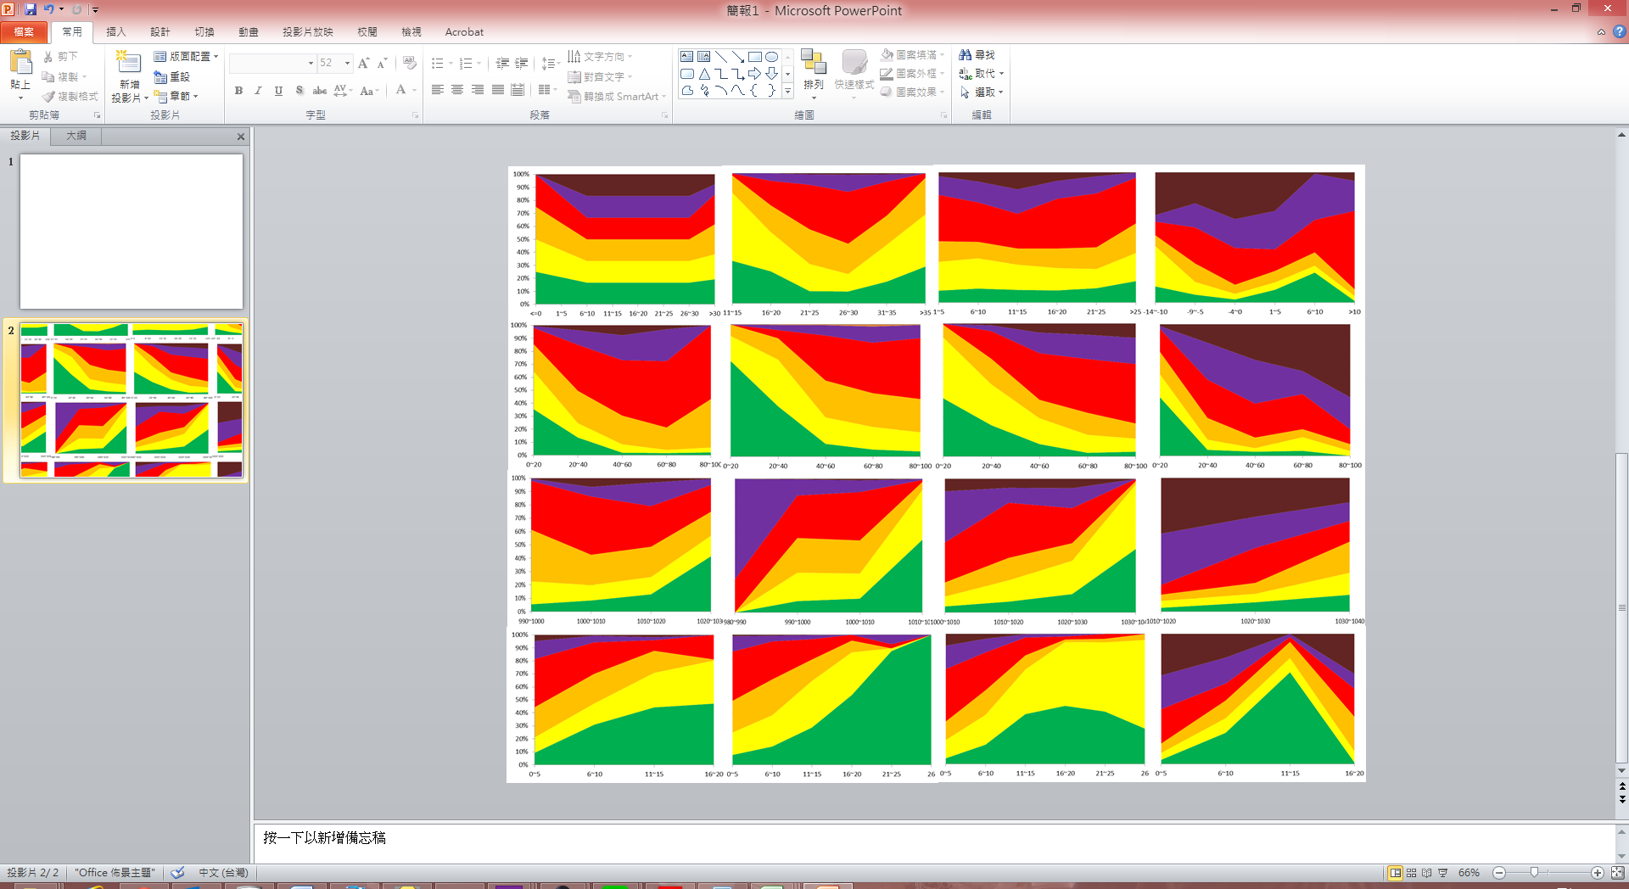
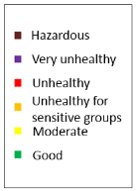
Meteorological features
Rainy, Sunny, Cloudy, Foggy
Wind speed
Temperature
Humidity
Barometer pressure
Spring
Summer
Fall
Winter
Temperature
Humidity
Pressure
Wind speed
AQI of PM_{2.5}
2012.8~2013.10 in Beijing

Slide 10
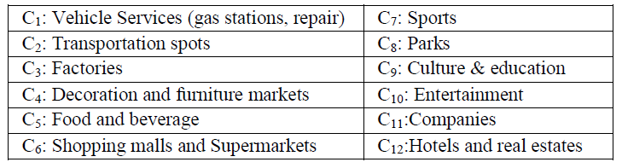
Land-Usage (POI) Features
They are used to indicate the land usage and the function of the region

Slide 11
Road Network Features
Features:
  Total length of highways in this grid
  Total length of other (low-level) road segments
  The number of intersections in the grid
Why road networks?
  Obtaining real-time traffic info is costly
  Road Network have a strong correlation with traffic flows

Slide 12
Outline
Goals, motivation and challenge
Related work and Data Analysis
Solutions
Experiment Results

Slide 13
Construct 3D Graph to Connect Grids
T=1
: labeled node
(locations with sensors)
……
……
: unlabeled node
(locations without sensors)
T=t-2
T=t-1
T=t

Slide 14
Learning and Inference in a Graphical Model
4
1
T=1
Probabilistic Graphical Model (PGM) assumes each node in the graph is a random variable, while the link weights capture the correlation between random variables
3
5
2
……
4
1
3
T=t-2
5
2
4
1
3
T=t-1
5
2
4
1
T=t
3
5
2

Slide 15
Connections in the Graph
4
1
Connect unlabeled nodes to geo-close neighbors
T=t-2
3
5
2
4
1
Connect unlabeled nodes to all labeled nodes
T=t-1
3
5
2
4
1
Connect unlabeled nodes to their corresponding historical nodes
T=t
3
5
2

Slide 16


Weights in the Graph
w^{t ,t-1}₁₁, w^{t ,t-2}₁₁, w^{t-1 ,t-2}₁₁
w^{t ,t-1}₃₃, w^{t ,t-2}₃₃, w^{t-1 ,t-2}₃₃
w^{t ,t}₁₂, w^{t ,t}₁₃, w^{t ,t}₁₄, w^{t ,t}₂₃, w^{t ,t}₂₅, w^{t ,t}₃₄, w^{t ,t}₃₅,w^{t ,t}₄₅
4
1
T=t-2
3
5
2
4
1
T=t-1
3
5
2
4
1
T=t
3
5
2
Location
Data
Road
Network
Weather

Slide 17

The Graph-based Inference Model
Assumption: Connected nodes should have similar label distribution, and the strength of correlation are determined by the weight between them
  Choose the global loss function to minimize:
where
  w_{ij} captures the correlation between nodes
  D(i): the corresponding AQI distribution for node i
  D(i)-D(j): difference of distribution
P
4
1
C₁C₂C₃C₄C₅C₆
Then how to determine weights?
3
5
2

Slide 18
Learning hyperparameters
MLE doesn’t work because the records for the unlabeled nodes is not available
Idea: whatever distribution inferred by the model, it has to be skewed (so in the decision phase we can easily make prediction)
Our solution: adjust the σ_{k} to minimize average label entropy for the unlabeled nodes
The average label entropy H(D_{U}) for the labeling function of the unlabeled nodes can be defined as
We can then perform gradient descent to update the parameter

Slide 19
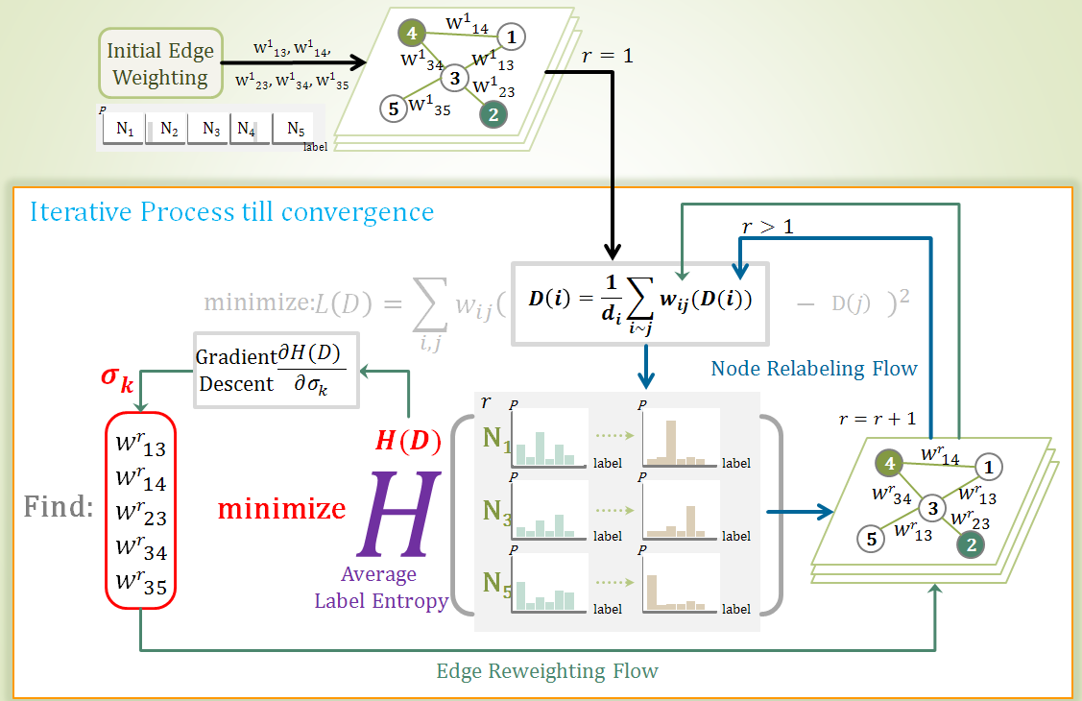
The Framework

Slide 20
Outline
Goals, motivation and challenge
Related work and Data Analysis
Solutions
Experiment Results

Slide 21
Experiments: Air Quality Dataset
PM2.5 and PM 10 in Beijing
Data sources |  | Statistics
POI | 2012 Q3 (Factory, Vehicle service, park, entertainment…etc) | 272,109
Road | #. Road Segments | 162,246
 | Highways length | 1,497km
 | Roads | 18,525km
 | #. Intersec. | 49,981
AQI & Meteorological data | #. Station | 22
 | Hours | 10449*22
 | Time spans | 8/24/2012-10/31/2013
Urban Size (grids) |  | 1km * 1km*2500
 | PM₁₀ | PM_{2.5}
Good | 445,167 | 211,519
Moderate | 846,297 | 289,464
Unhealthy for sensitive groups | 383,287 | 352,588
Unhealthy | 146,709 | 596,913
Very unhealthy | 54,261 | 234,955
Hazardous | 26,337 | 111,850

Slide 22
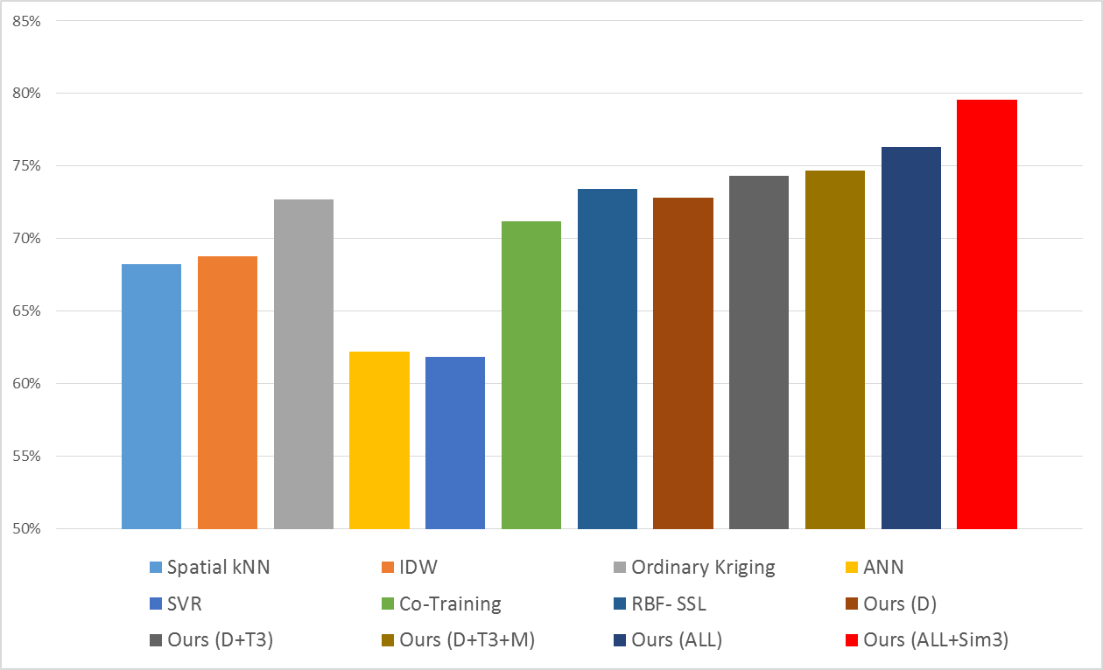
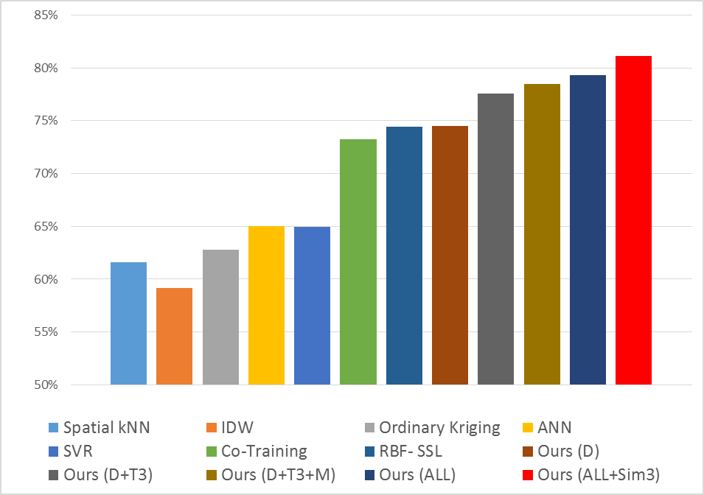
Results
Leave One Out Evaluation
  Take turns to hide all AQI labels of each station for prediction
Competitors
  Semi-supervised method
    Co-training framework: CRF+ANN (KDD 2013)
    Graph-based SSL using RBF function (ICML 2003)
  Regression method: SVR
  Interpolation method
    Spatial KNN
    Inverse distance weighted
    Ordinary Kriging
PM 2.5
Our method
F-score
PM 10
Our method
F-score

Slide 23
Goals
1st goal: Given historical data of a small set of air-quality monitors, infer the PM2.5 and PM10 values of arbitrary locations without sensors deployed
2nd goal: Recommend deployment locations for new monitoring stations
Motivation: It is not cost-effective to deploy sensors everywhere
  still want to know the sensor values of locations without sensors
  need to optimize the utility in deploying new sensors

Slide 24
Where to Deploy the Next Monitoring Stations?
Idea: deploying a new sensor to a location to significantly boost the accuracy of the inference model.
Challenge: cannot directly measure the improvement on inference accuracy
Surrogate: Minimize the uncertainty of a relatively accurate inference model
  The uncertainty can be modeled as the total entropy of the random variables
Naïve solution: simply pick k locations with the highest entropy.
  Drawback: they can be correlated
Notes:
since there is no observed values for the candidate deployment locations

Slide 25
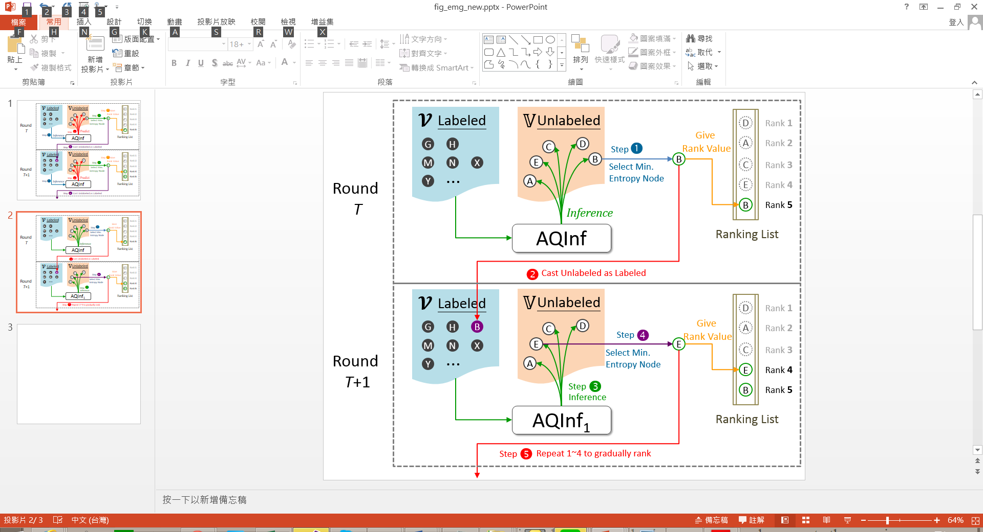
Greedy-based Entropy Minimization(GEM) Model
Steps:
Use the labeled set to learn an influence model
Infer the values of all nodes.
Obtain the most confident node, label it using the most likely value, and put it into the labeled set
Go back to step 1

Slide 26
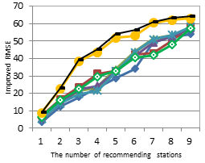
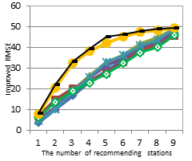
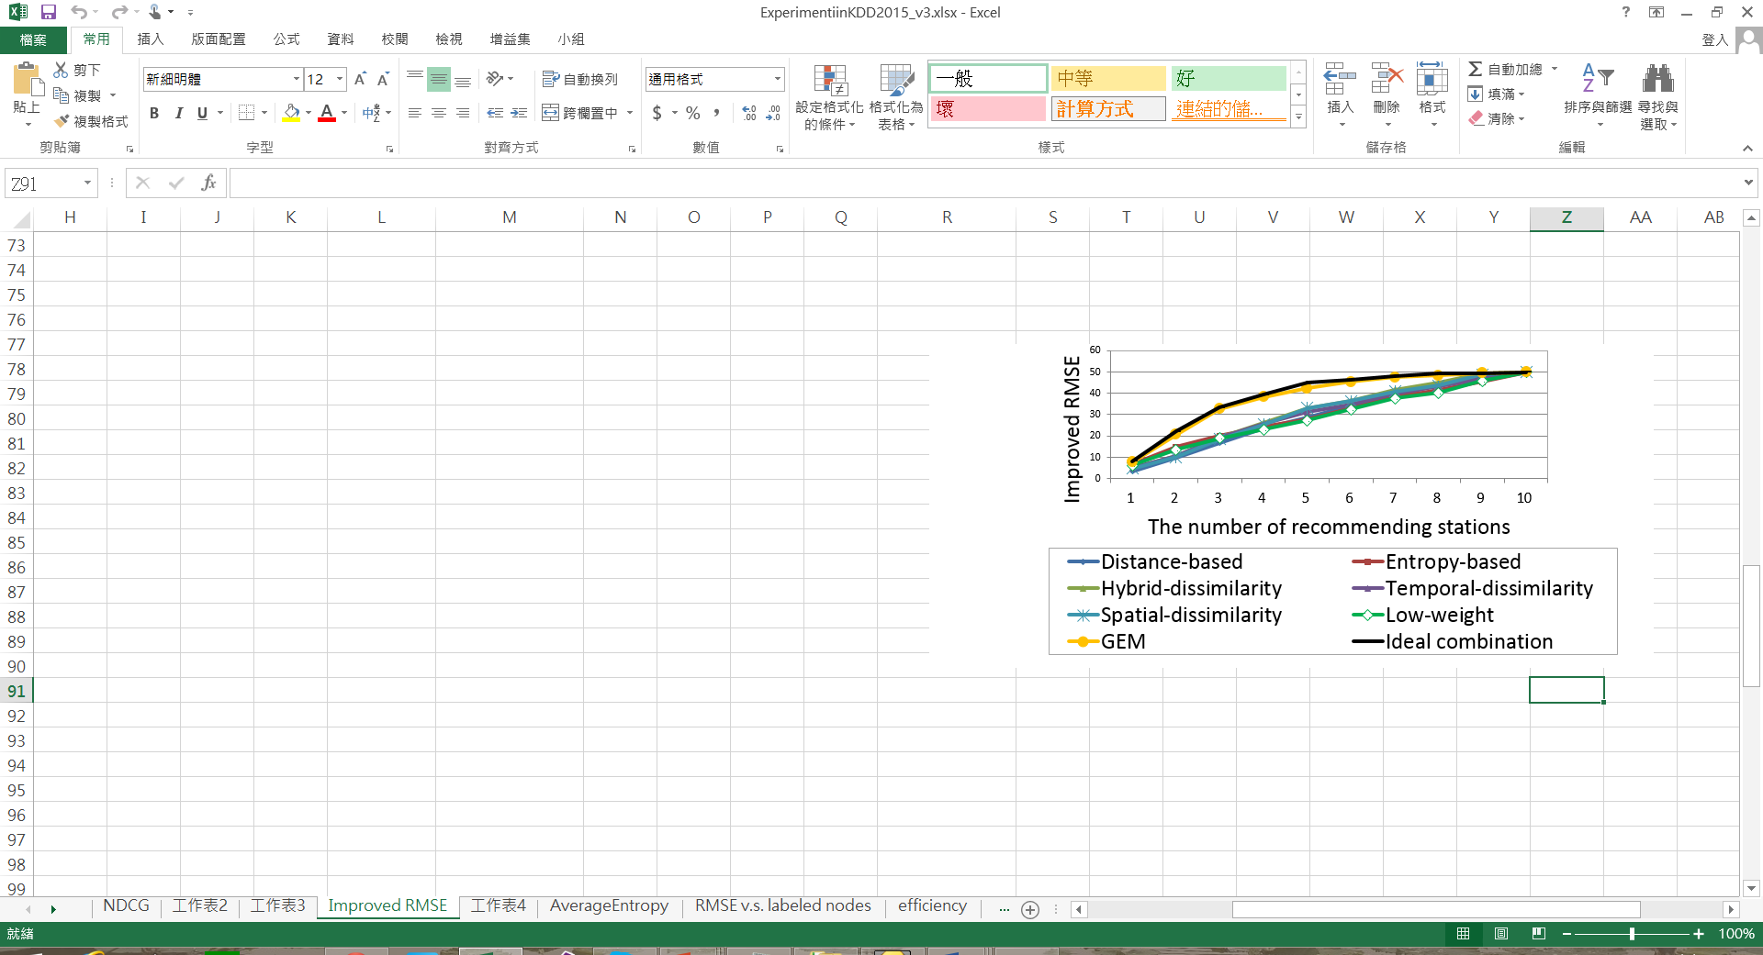
Experiments Results: the improvement of influence quality
PM 10
PM 2.5

Slide 27
Final Remark
The proposed model can be applied to other types of sensors
  It is a data-driven solution, no need to know the physical meaning of signal or the underlying diffusion models
  Additional information can be modeled as features to jointly determine the weight
  Thank You !!

