Slide 1




Efficient Discovery of Spatial Co-evolving Patterns in Massive Geo-sensory Data
Chao Zhang¹, Yu Zheng², Xiuli Ma³, Jiawei Han¹
¹UIUC, ²Microsoft, ³PKU
czhang82@illinois.edu

Slide 2
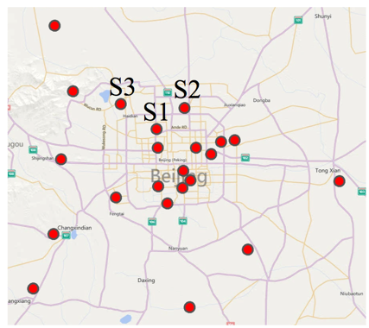
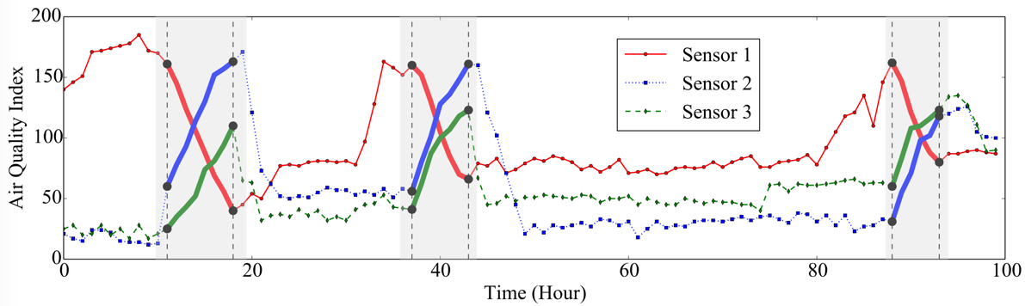
Big Geo-Sensory Data is Ubiquitous
Wireless sensor network (WSN): multiple sensors are deployed at different locations to monitor the target condition cooperatively.
The geo-sensory data is becoming big
  A modern WSN can contain hundreds of sensors, with each sensor collecting millions of records.

Slide 3
Spatial Co-evolving Pattern: An Example
Goal: mining a set of spatially correlated sensors that exhibit frequent co-evolution.
Frequent co-evolution for [s1, s2, s3]
  s1 decreases in AQI, s2 and s3 increase in AQI
  Caused by traffic flow in off-work hours

Slide 4
Spatial Co-evolving Pattern Mining
A spatial co-evolving pattern (SCP) contains
  a set of spatially connected sensors
  the frequent co-evolution in their readings
We aim to find all SCPs from the input geo-sensory data.

Slide 5
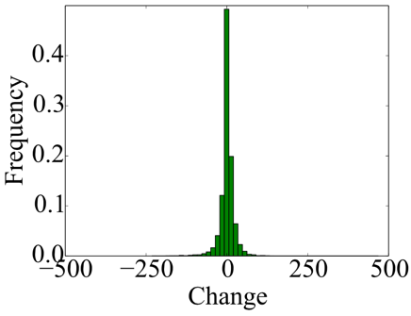
Why is it a Challenging Problem?
The truly interesting evolutions are often flooded by numerous trivial fluctuations.
  Existing motif discovery methods can only find trivial motifs from such data.
AQI Change Distribution

Slide 6
Why is it a Challenging Problem?
The combinatorial nature of SCP leads to an extremely large search space.
  An arbitrary number of sensors.
  The occurring time intervals of an SCP is uncertain.
Spatial combination
Temporal combination

Slide 7
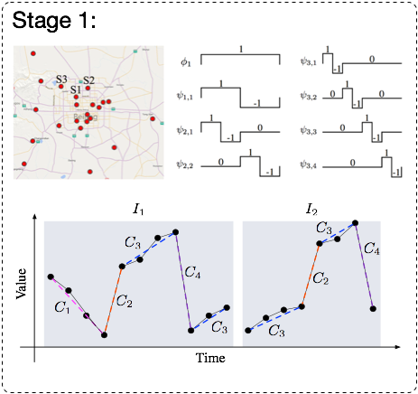
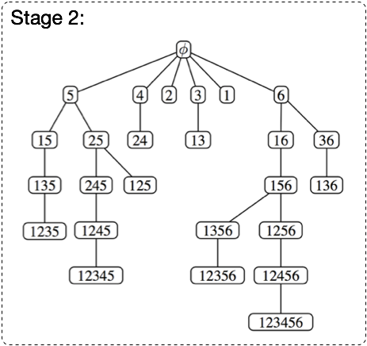
Assembler: A Two-stage Approach
Stage I: find frequent evolutions for individual sensors.
Stage II: assemble individual evolutions into SCPs based on the spatial constraint.

Slide 8
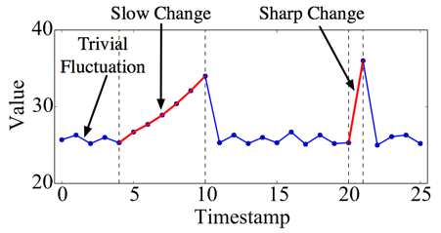
Stage I: Mining Frequent Evolutions for Individual Sensors
To find interesting evolutions, we must filter trivial fluctuations and identify evolving intervals.
In geo-sensory data, the changes occur with different rates and durations.

Slide 9
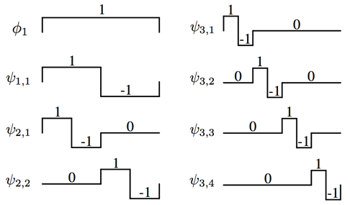
Extract Evolutions using Wavelet Transform
We capture multi-scale changes using wavelet transform.
  In the wavelet space, the coefficients of different bases measure the strengths of changes.
  We preserve large coefficients and discard small coefficients.

Slide 10
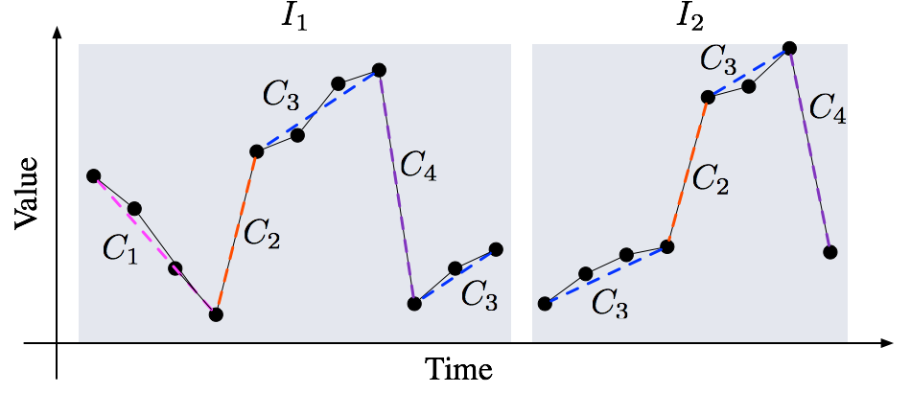
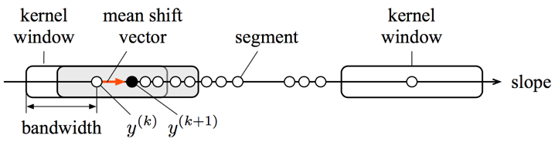
Detecting Frequent Evolutions
After extracting evolving intervals in the time series, we detect frequent evolutions via clustering.
A segment-and-group approach:
  Partition each interval into line segments.
  Use mean shift to cluster the line segments based on slope (change rate).
Segment
Mean shift clustering

Slide 11
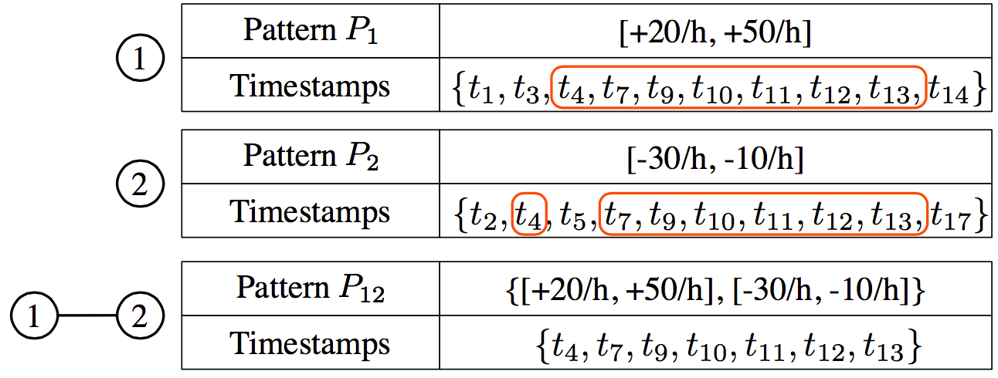
Stage II: SCP Generation
From individual sensors to groups of sensors
  Pattern assembling via timestamp intersection.

Slide 12
Stage II: SCP Generation
Anti-monotonicity: if one set of sensors have SCP, any of its subsets must also have SCP.
A baseline method based on Apriori: starting with patterns on individual sensors, obtain SCPs in a bottom-up manner.
The baseline method is not efficient enough
  It generates numerous candidates and keep them in memory.
  It performs pair-wise comparison to examine whether two candidates can be joined.

Slide 13
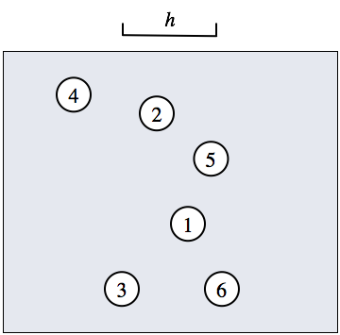
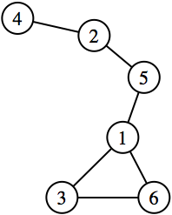
Stage II: SCP Generation
Can we leverage the spatial constraint to generate SCPs more efficiently?
The connectivity graph
  Each set of spatially connected sensors corresponds to a connected component in the connectivity graph.

Slide 14
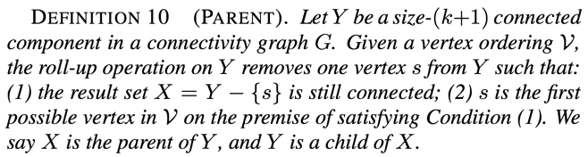
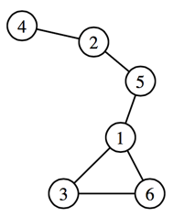
Parent Relation
We define the parent relation between two connected components.
Example:
Suppose V = 1 -> 2 -> 3 -> 4 -> 5 -> 6, then the parent relation generates:
{245} -> {25} -> {5} ->

Slide 15
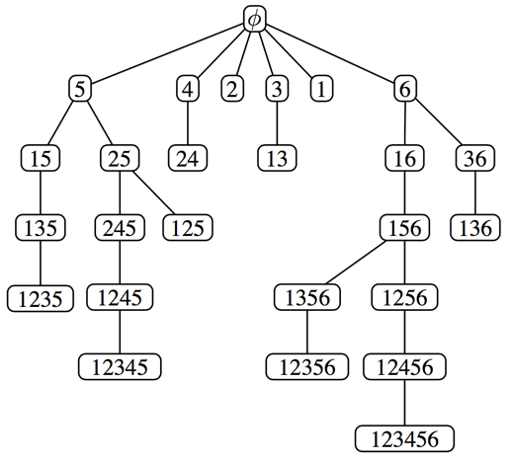
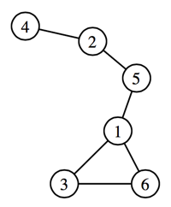
The SCP Search Tree
Starting from any connected component, by performing the roll-up operation, we can reach the same node .
A tree structure: each node is a connected component along with the SCPs occurring on it.

Slide 16
Reverse Search of SCPs
Starting from the root node, we perform depth-first construction of the SCP search tree
  SCPs are obtained on-the-fly
  Unqualified branches are pruned with anti-monotonicity.

Slide 17
Experimental Evaluation
Data sets
  Air: the AQI data collected by 180 sensors in northern China during 1.5 years.
  Bike: the bike rental data of 332 docks in New York during one year.

Slide 18
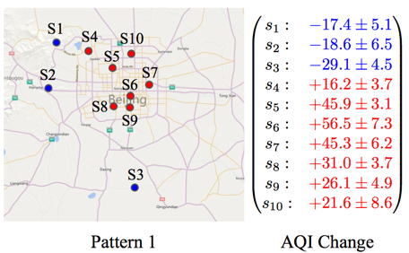
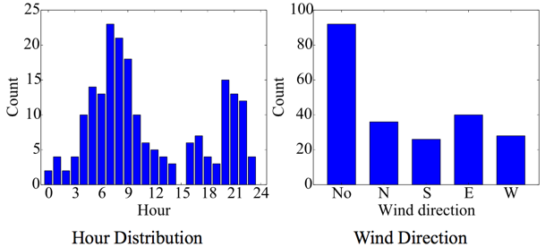
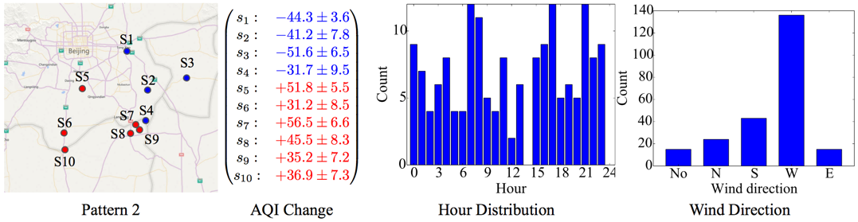
Example SCPs
On the Air data set:

Slide 19
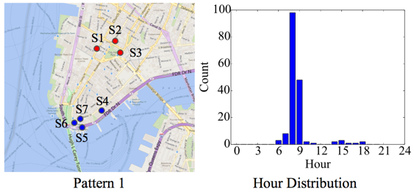
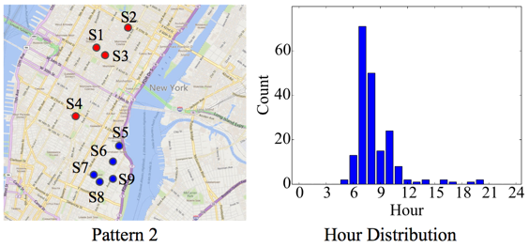
Example SCPs
On the Bike data set:

Slide 20
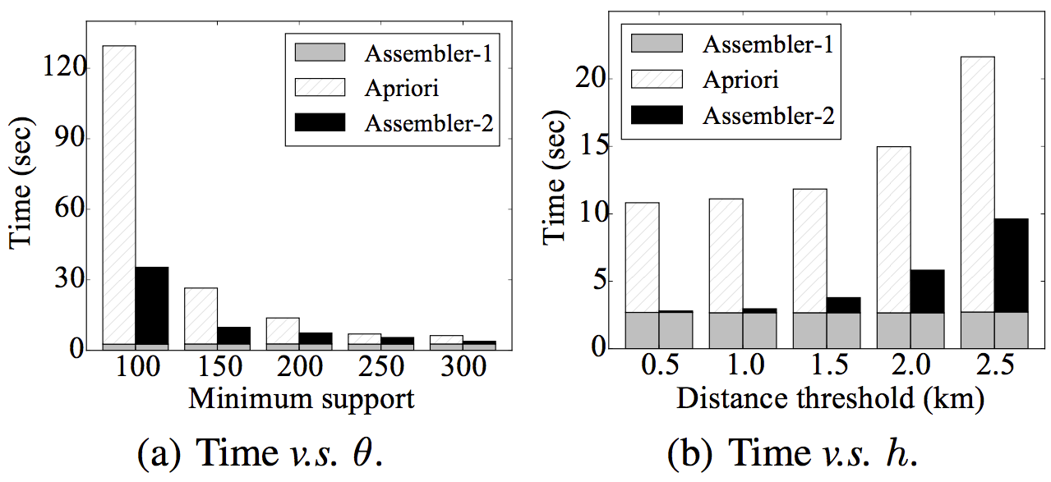
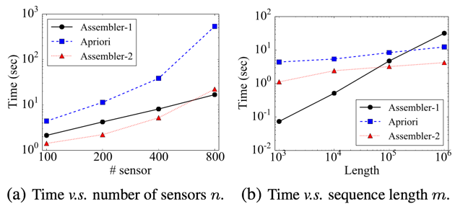
Running Time Comparison
Efficiency
Scalability

Slide 21
Summary
We study the problem of mining spatial co-evolving patterns from massive geo-sensory data.
We propose the two-stage method Assembler:
  Stage 1: it obtains frequent evolutions for individual sensors.
  Stage 2: it assembles single patterns into SCPs.
The experiment results show that Assembler is effective and efficient.

