Slide 1



Real-Time Human Pose Recognition in Parts from Single Depth Images
Jamie Shotton, Andrew Fitzgibbon, Mat Cook,
Toby Sharp, Mark Finocchio, Richard Moore,
Alex Kipman, Andrew Blake
CVPR 2011

Slide 2
The mission
Auto-initialize
a tracking algorithm
& recover from failures
All human poses, shapes & sizes
Limited compute budget
  super-real time on Xbox 360
  to allow games to run concurrently

Slide 3

The approach: body part recognition
right hand
left
shoulder
neck
right
elbow

Slide 4
Body part recognition
No temporal information
  frame-by-frame
Local pose estimate of parts
  each pixel & each body joint treated independently
  reduced training data and computation time
Very fast
  simple depth image features
  parallel decision forest classifier

Slide 5
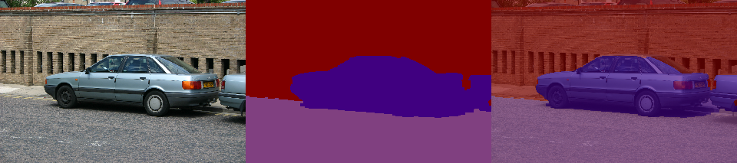
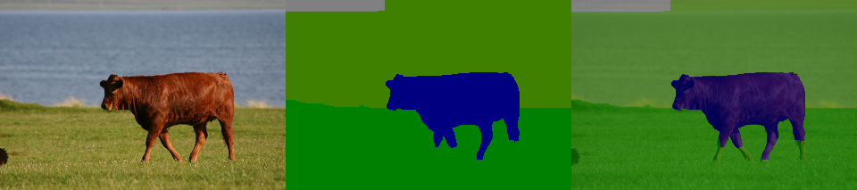
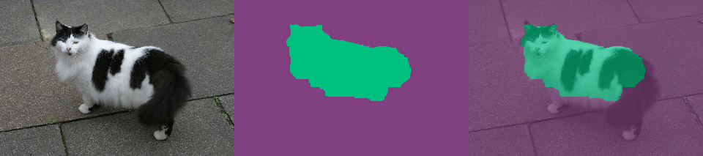
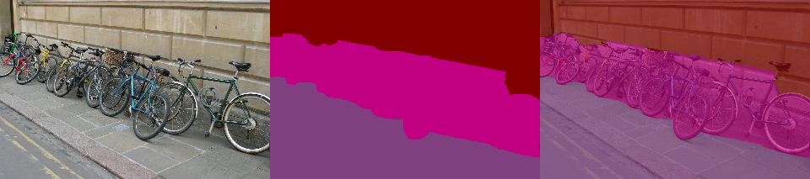
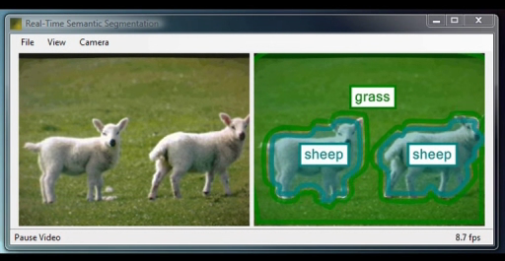
Object segmentation
[Shotton, Winn, Rother, Criminisi 06 + 08]
[Winn & Shotton 06]
building
water
building
car
cow
cat
bicycle
road
grass
road
road
[Shotton, Johnson, Cipolla 08]

Slide 6
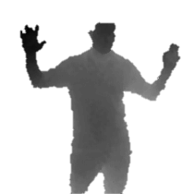

The Kinect pose estimation pipeline
capture
depth image &
remove bg
infer
body parts
per pixel
cluster pixels to
hypothesize
body joint
positions
fit model &
track skeleton

Slide 7
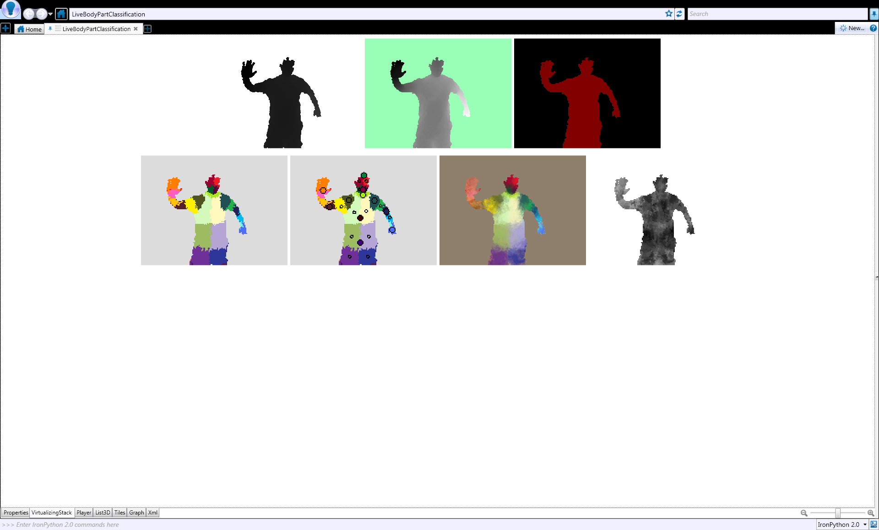
Classifying pixels
Compute P(c_{i}|w_{i})
  pixels i = (x, y)
  body part c_{i}
  image window w_{i}
Discriminative approach
  learn classifier P(c_{i}|w_{i}) from training data
image windows move
with classifier

Slide 8
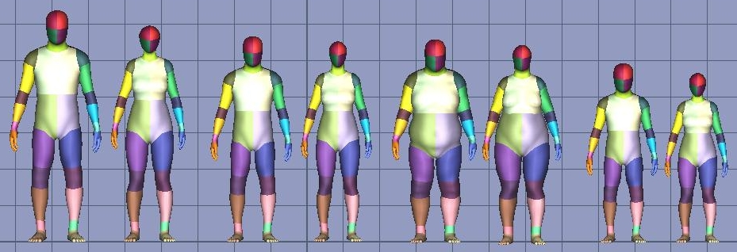
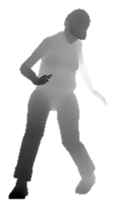
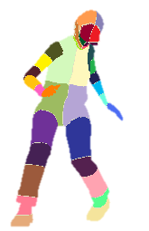



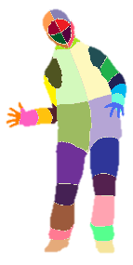

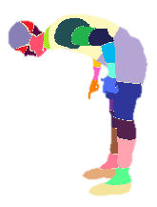

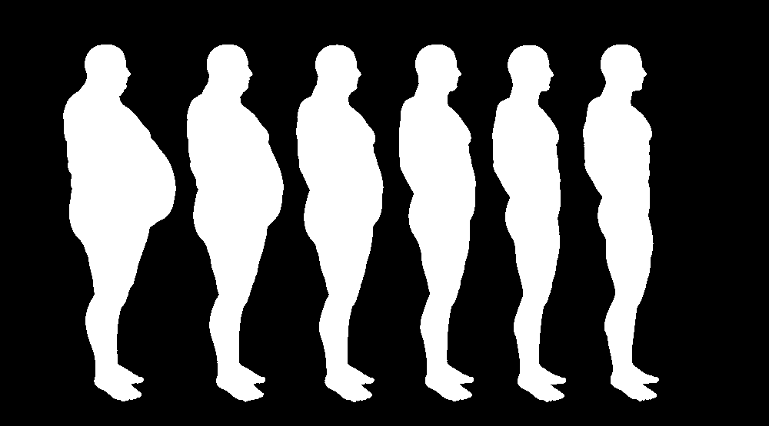

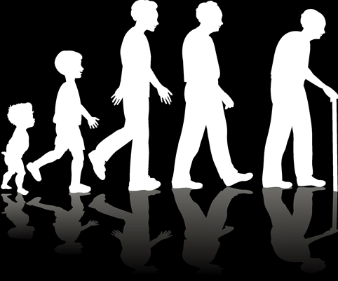
Synthetic training data
Record mocap
500k frames
distilled to 100k poses
Retarget to several models
Render (depth, body parts) pairs
Train invariance to:

Slide 9
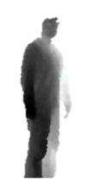
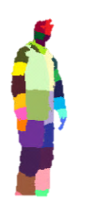
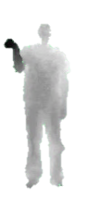
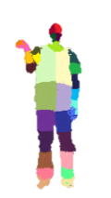
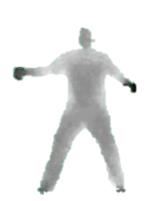
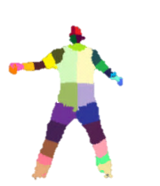

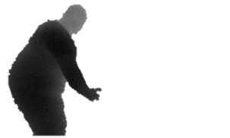

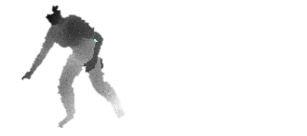
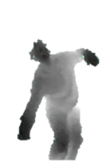
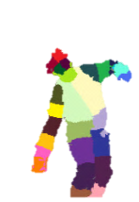



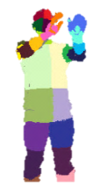
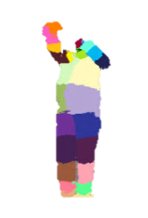



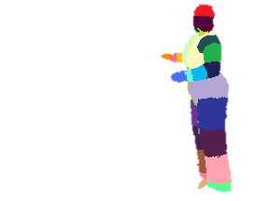
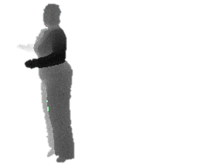
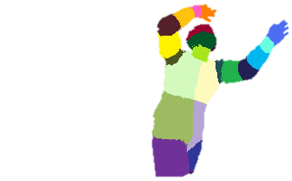
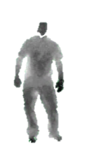
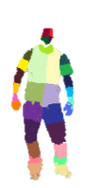
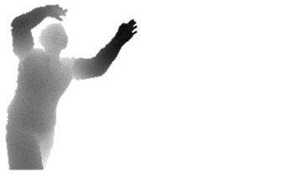
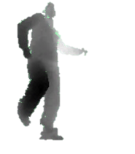
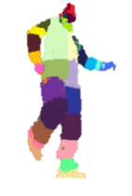
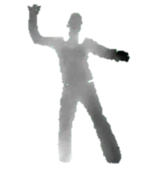
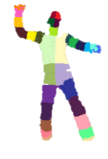
Synthetic vs real data
synthetic
(train & test)
real
(test)

Slide 10
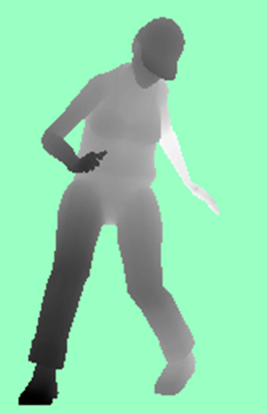


Fast depth image features
input
depth
image
Depth comparisons
  very fast to compute
Δ
Δ
x
Δ
Δ
x
x
x
image
depth
offset depth
Δ
Δ
feature
response
$$f\left(I, \text{x}\right)=d_{I}\left(\text{x}\right)−d_{I}(\text{x}+Δ)$$
x
x
image coordinate
$$Δ=\frac{v}{d_{I}\left(\text{x}\right)}$$
scales inversely with depth
Background pixels
d = large constant

Slide 11
Decision tree classification
image window
centred at x
Toy example:
distinguish
left (L) and right (R)
sides of the body
f(I, x; Δ₁) > θ₁
no
yes
f(I, x; Δ₂) > θ₂
no
yes
P(c)
L R
P(c)
P(c)
L R
L R

Slide 12

Training decision trees
[Breiman et al. 84]
for all pixels
P_{n}(c)
Q_{n} = (I, x)
body part c
f(I, x; Δ_{n}) > θ_{n}
n
no
yes
P_{l}(c)
reduce
entropy
P_{r}(c)
l
r
c
c
Take (Δ, θ) that maximises
information gain:
Goal: drive entropy
at leaf nodes
to zero
$$ΔE=−\frac{\left|Q_{l}\right|}{\left|Q_{n}\right|}E(Q_{l})−\frac{\left|Q_{r}\right|}{\left|Q_{n}\right|}E(Q_{r})$$

Slide 13
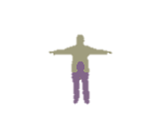
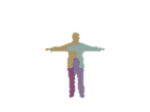
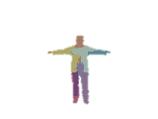
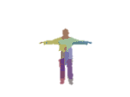
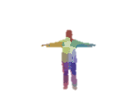

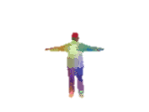
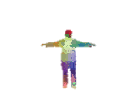
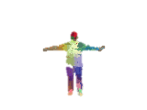
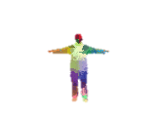
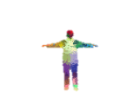

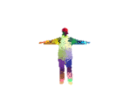

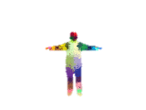

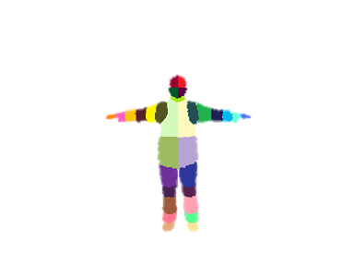




















Depth of trees
input depth
ground truth parts
inferred parts (soft)
depth 1
depth 2
depth 3
depth 4
depth 5
depth 6
depth 7
depth 8
depth 9
depth 10
depth 11
depth 12
depth 13
depth 14
depth 15
depth 16
depth 17
depth 18

Slide 14

Depth of trees
synthetic test data
real test data

Slide 15



Decision forest classifier
[Amit & Geman 97]
[Breiman 01]
[Geurts et al. 06]
$$(I, \text{x})$$
$$(I, \text{x})$$
tree 1
tree T
………
P_{T}(c)
P₁(c)
c
c
Trained on different random subset of images
  “bagging” helps avoid over-fitting
Average tree posteriors
$$P\left(c | I,\text{x}\right)=\frac{1}{T}\sum_{t=1}^{T}{P_{t}(c|I,\text{x})}$$

Slide 16




Number of trees
ground truth
inferred body parts (most likely)
1 tree
3 trees
6 trees

Slide 17






Feature window size
31
63
129
195
260
ground
truth

Slide 18
Number of training images
NB trees fixed
to maximum
depth 20

Slide 19


Body parts to joint hypotheses
Define 3D world space density:
Mean shift for mode detection
1
2
3D coord
of i ^{th} pixel
pixel
weight
3D coord
bandwidth
pixel index i
inferred
probability
depth at
i ^{th} pixel
3. hypothesize
body joints
…

Slide 20

input depth
inferred body parts
front view
side view
top view
inferred joint positions
no tracking or smoothing

Slide 21

input depth
inferred body parts
front view
side view
top view
inferred joint positions
no tracking or smoothing

Slide 22

Joint prediction accuracy

Slide 23
Joint prediction accuracy

Slide 24


From proposals to skeleton
1
Use…
  3D joint hypotheses
  kinematic constraints
  temporal coherence
… to give
  full skeleton
  higher accuracy
  invisible joints
  multi-player
2
3
4. track skeleton

Slide 25
Summary
  Frame-by-frame gives robustness
  Body parts representation for efficiency
  Fast, simple machine learning
  Significant engineering to scale to a massive, varied training data set

Slide 26




Slide 27

With thanks to:
                Andrew Fitzgibbon, Mat Cook, Andrew Blake, Toby Sharp,
                Ollie Williams, Sebastian Nowozin, Antonio Criminisi, Mihai Budiu, Ross Girshick, Duncan Robertson, John Winn, Shahram Izadi, Pushmeet Kohli
                The whole Kinect team, especially: Alex Kipman, Mark Finocchio, Ryan Geiss, Richard Moore, Robert Craig, Momin Al-Ghosien,
                Matt Bronder, Craig Peeper

