Slide 1
Compressive Data Gathering for Large-Scale Wireless Sensor Networks
Chong Luo, Feng Wu, Jun Sun and Chang Wen Chen
Mobicom’09, Beijing, China

Slide 2
Outline
Background
  Compressive sensing theory
  New research opportunities
Compressive Data Gathering
  The first complete design to apply CS theory for sensor data gathering
Conclusion

Slide 3
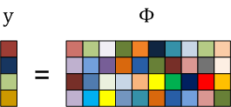
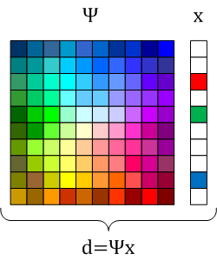


Compressive Sensing
If an N-dimensional signal is K-sparse in a known domain Ψ, it can be recovered from M random measurements by:

Slide 4
New Research Opportunities
Compressive Sensing Hallmarks
Data Communications Research
Universal
  Same random projection op. for any compressible signal
Democratic
  Potentially unlimited number of measurements
  Each measurement carries the same amount of information
Asymmetrical
  Simple encoding, most processing at decoder
Random linear network coding
  Achieves multicast capacity
Fountain code
  a.k.a. rateless erasure code
  Perfect reconstruction from N(1+ε) encoding symbols
Distributed source coding
  e.g. Slepian-Wolf coding
  Blind encoding, joint decoding
Notes:
It is not hard to find many similarities between CS and Data communication topics..

Slide 5
From Compressive Sensing to Compressive Data Gathering
The asymmetrical property makes CS a perfect match for wireless sensor networks
Compressive Sensing | Compressive Data Gathering
Sample-then-compress Sample-with-compression | Compress-then-transmit Compress-with-transmission
Notes:
The long-established paradigm for digital data acquisition is to uniformly sample data at its Nyquist rate, and then compress the data before storage or transmission. CS shifts this paradigm by directly acquiring compressed data, turning sample-then-compress process into sample-with-compression process.

Slide 6
Data Gathering in WSNs
Challenges
  Global communication cost reduction
  Energy consumption load balancing

Slide 7









Basic Idea
A simple chain topology
d_{N}
…
…
…
…
…
… …
d₂
d₂
d₁
d₁
… …
d₁
… …
… …
s_{N}
s₁
s₂
s₃
 | Global comm. cost | Bottleneck load
Baseline transmission | N(N+1)/2 | N
Proposed CDG | NM | M

Slide 8
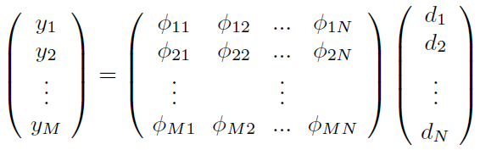

Is Reconstruction Possible?
Facts
  Sensor readings exhibit strong spatial correlations
According to CS theory
  Reconstruction can be achieved in a noisy setting by solving:
M<<N

Slide 9

Practical Problem 1
Abnormal readings compromise data sparsity
Solution:
Signal d₁
Representation of d₁ in DCT domain
Signal in time domain
Representation in DCT domain
Signal d₂
Representation of d₂ in time domain
7-sparse
Overcomplete basis

Slide 10

Practical Problem 2
If a signal is not sparse in any intuitively known domain
value
y
Φ
d
t
1
2
3
4
5
6
7
8
9
10
11
12
13
14
15
16
17
18
19
20

Slide 11
Universal Sparsity
CS-based data representation and recovery is optimal in exploiting data sparsity
  Encoder
    The same random projection operation
  Decoder
    Select and design representation basis Ψ
    Reorder signal d to make it sparse in a known domain
Neither transform-based compression nor distributed source coding is able to exploit these special types of data sparsity
Notes:
Data collection and transmission order can be totally different from the recovery order. This flexibility is especially important for wireless multi-hop networks, in which transmitting data back and forth consumes a lot of energy.

Slide 12
Network Capacity Gain
Theorem: In a wireless sensor network with N nodes, CDG can achieve a capacity gain of N/M over baseline transmission, given that sensor readings are K-sparse, and M = c₁K.
  Mathematical proof
  Simulation verification

Slide 13
Example 1
CTD data from NOAA
  N=1000, K≈40
M=100
Recon. Precision | 99.2%
Comm. Reduction | 5
Capacity Gain | 10
Notes:
Only 40 coefficients (4.0%) are larger than 0.2

Slide 14
Example 2
Temperature data from data center
  498 temperature sensors
  sensor readings exhibit little spatial correlations
Reorder sensors according to their readings at t₀

Slide 15
Utilizing Temporal Correlation
Sensor readings at t₀ + Δt are sparse as well
  Temperatures do not change violently with time
∆t=30min

Slide 16
Conclusion
Compressive Sensing is an emerging field which may bring fundamental changes to networking and data communications research
Our Contributions
  The first complete design to apply CS theory to sensor data gathering
  CDG exploits “universal sparsity”
  CDG improves network capacity
Future Work
  Bring innovations to LDPC, NC, DSC, and Fountain code through CS theory

Slide 17
Thanks!

