Slide 1


Explicating SDKs:
Uncovering Assumptions Underlying Secure Authentication and Authorization
Rui Wang¹*, Yuchen Zhou²*†,
(*Lead authors, †Speaker)
Shuo Chen¹, Shaz Qadeer¹, David Evans² and Yuri Gurevich¹
¹Microsoft Research and ²University of Virginia

Slide 2
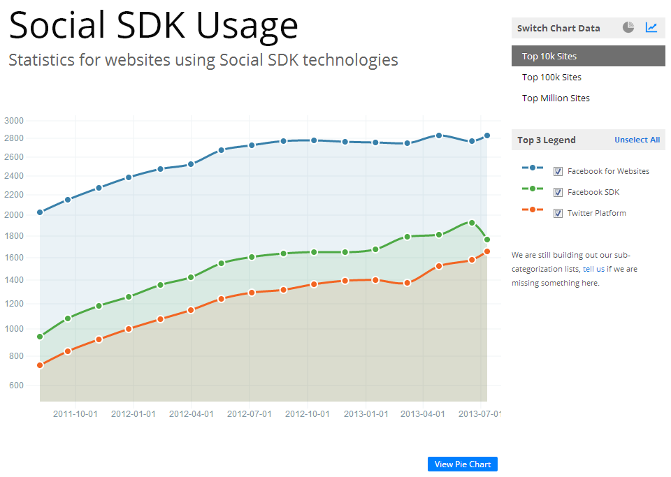
chart source: builtwith.com
Most modern apps are empowered by online services.

Slide 3
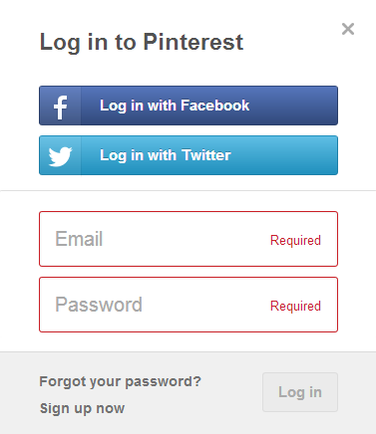
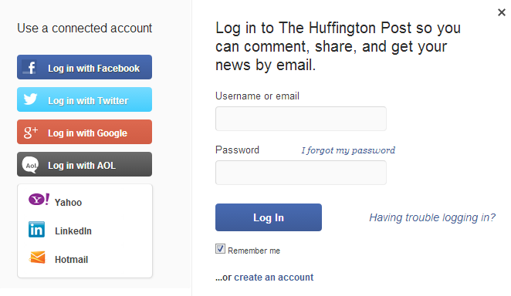
Single Sign-On Service

Slide 4
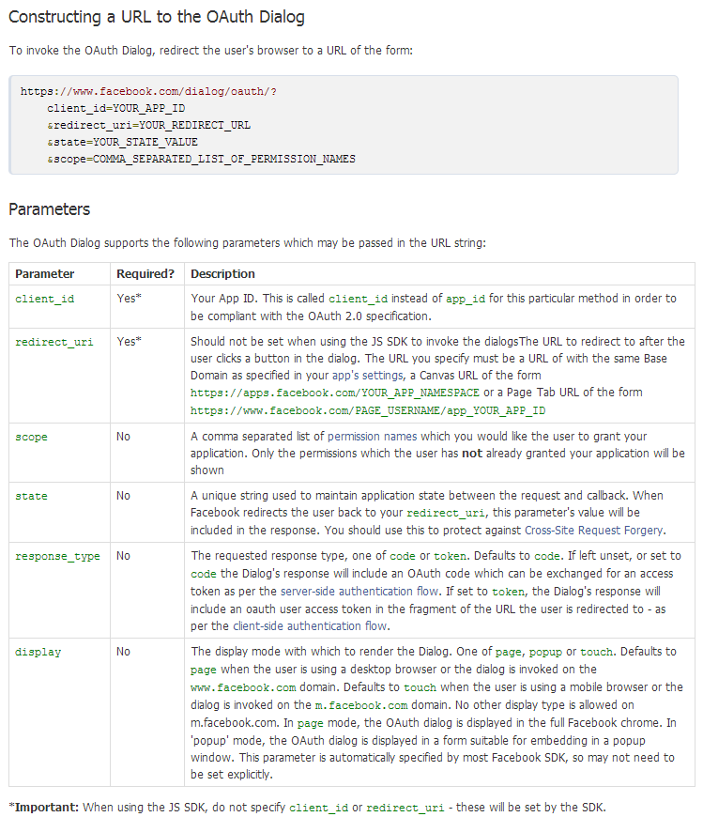
If the developers follow the guides properly, will the application be secure?
The requested response type, one of code or token. Defaults to code…
Facebook documentation example

Slide 5



Possible implementation
Possible Attack
Malicious
App Client
Foo App Client
1
dialog/oauth…
access_token
3
Facebook back end
2
access_token
3
access_token
6
Welcome, Alice!
exchange user info
access_token
5
exchange user info
4
4
user id/email
6
user id/email
5
Foo App Server
7
Welcome Alice?!

Slide 6
Video Demo

Slide 7



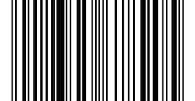


Who’s to blame?
Developers?
SDK providers?
Developer guide does not explicitly state that token flow MUST not be used for server-side authentication.

Slide 8
If developers follow the guides properly, will the applications be secure?
No.
Not because of vulnerabilities in SDKs.
Due to implicit assumptions about how to use them.
The requested response type, one of code or token. Defaults to code…
Facebook documentation example

Slide 9
Implicit Assumptions
Assumptions that are
  not clearly stated in the SDK’s developer guides;
  related to how the SDK should be used;
  essential for application’s security property.
Goal of this project:
systematically find these implicit assumptions

Slide 10
General Approach
Add necessary assumptions
Refine
Model
Enrich
Model
Add related
assertions
Assumptions
Model
Assertions
Iterative process
Iterative process
Verifier
Y
Counter-Example
N
Model
checks?
Y
More to model
N

Slide 11
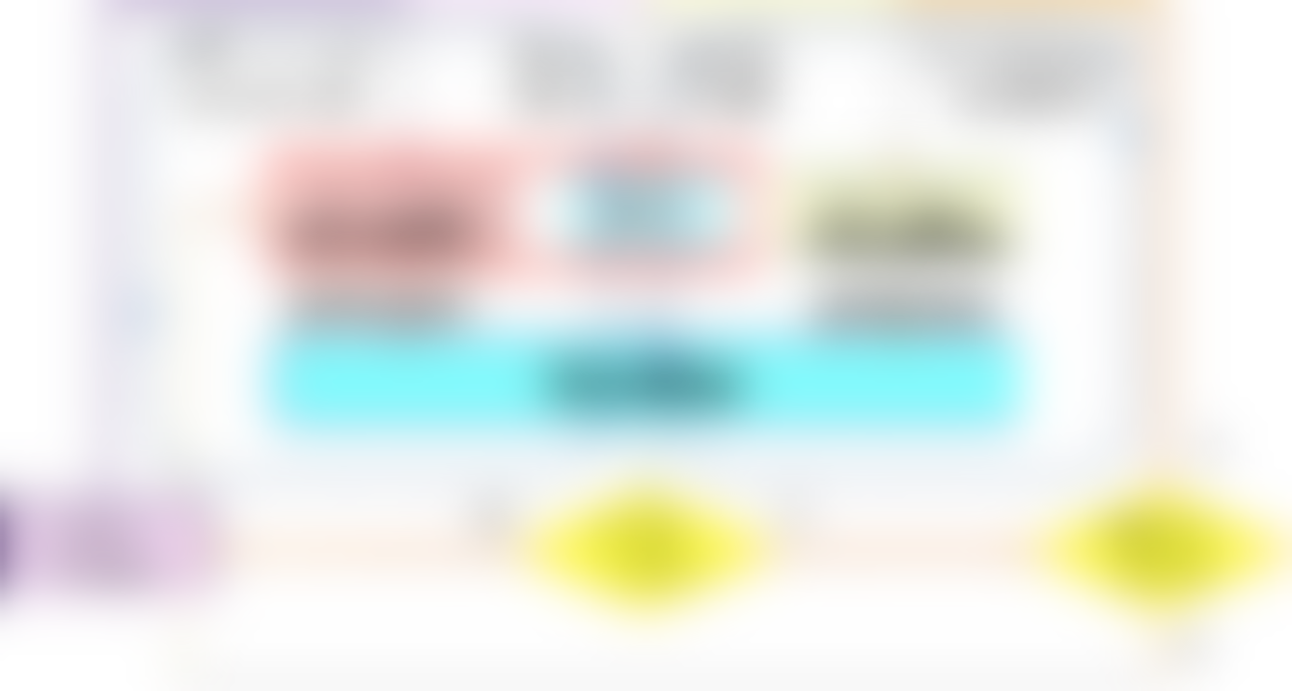

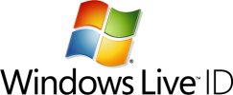
General Approach
Target: Single-Sign On Systems

Slide 12
System Architecture
FooApp_{C}
FooApp_{S}
Client SDK
Service SDK
Client runtime
Service runtime
Identity Provider (IdP)

Slide 13
Threat model
Mallory
FooApp_{C}
MalApp_{C}
FooApp_{S}
Client SDK
Service SDK
Client runtime
Service runtime
Identity Provider (IdP)

Slide 14
Desired Security Properties
Authentication
  Mallory cannot sign into Foo app as Alice.
Authorization
  Mallory cannot access data that Alice have not granted permission to Mallory.
Association
  The user identity, user’s permission (authorization result), and session identity must represent the same person.

Slide 15
3 security properties
Assumptions
Model
Assertions
Verifier
assert(logged_in_user != _Alice);

Slide 16
System Architecture
FooApp_{C}
FooApp_{S}
Client SDK
Service SDK
Client runtime
Service runtime
Identity Provider (IdP)

Slide 17
Modeling SDKs
FooApp_{C}
FooApp_{S}
Client SDK
Service SDK
Client runtime
Service runtime
Identity Provider (IdP)
Concrete module with src or documentation

Slide 18
Modeling underlying system layer
FooApp_{C}
FooApp_{S}
Client SDK
Service SDK
Client runtime
Service runtime
Identity Provider (IdP)
Concrete module with src or documentation
Black-box concrete module

Slide 19
Modeling Foo application
FooApp_{C}
FooApp_{S}
Client SDK
Service SDK
Client runtime
Service runtime
Identity Provider (IdP)
Concrete module with src or documentation
Abstract module subject to dev guide
Black-box concrete module

Slide 20
Modeling Mallory
Mallory
FooApp_{C}
MalApp_{C}
FooApp_{S}
Client SDK
Service SDK
Client runtime
Service runtime
Identity Provider (IdP)
Concrete module with src or documentation
Abstract module subject to dev guide
Black-box concrete module
Abstract module subject to knowledge pool

Slide 21
Modeling Mallory
Mallory
Test Harness
FooApp_{C}
MalApp_{C}
FooApp_{S}
Client SDK
Service SDK
Knowledge
Pool
Concrete
Modules
Client runtime
Service runtime
Identity Provider (IdP)
Concrete module with src or documentation
Abstract module subject to dev guide
Black-box concrete module
Abstract module subject to knowledge pool

Slide 22
SDK documentation
and previously uncovered assumptions
All relevant system components
SDK documentation
Basic system components
3 security properties
Assumptions
Model
Assertions
Verifier

Slide 23
SDK documentation
and previously uncovered assumptions
All relevant system components
3 security properties
Assumptions
Model
Assertions
  Boogie/BoogiePL: Symbolic execution engine
    Supports loop invariants and function pre/post conditions to enable unbounded verification
Verifier: Boogie^{[1]}
[1]: Boogie: An Intermediate Verification Language. http://research.microsoft.com/en-us/projects/boogie/

Slide 24
Results
Add necessary assumptions
Refine
Model
Enrich
Model
Add related
assertions
Assumptions
Model
Assertions
Verifier
Y
Counter-Example
N
Model
checks?
Y
More to model
N

Slide 25




Results overview
Explicated three SDKs: (6 months)
Many implicit assumptions were found:
Facebook SSO PHP SDK
5 cases reported,
4 fixed, 3 bounties (3x).
Windows 8 SDK for modern apps
One case reported;
documentation revised.
Windows Live connect SDK
Paragraph added to
OAuth 2.0 standard.
Majority of tested apps vulnerable due to failure to ensure at least one uncovered assumption.

Slide 26
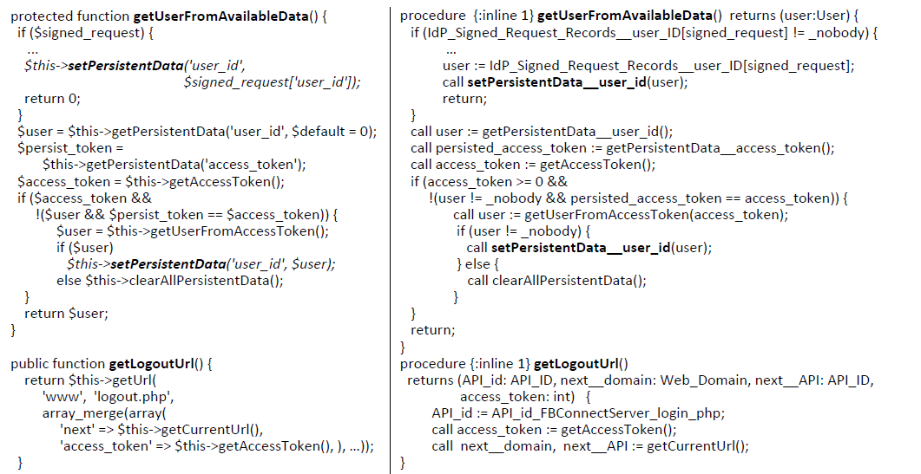
SDK models
Facebook PHP Source code
Boogie PL Model

Slide 27
API models
procedure {:inline 1} dialog_oauth(IdPLoggedInUser:User, client_id: AppID,
redirect_domain: Web_Domain, scope:Scope, response_type:ResponseType)
returns (r:int, Response_data: int)
modifies Access_Tokens__TokenValue, Access_Tokens__user_ID, Access_Tokens__Scope;
modifies Codes__user_ID,Codes__App_ID,Codes__Scope;
modifies …
{
var access_token:int, code:int, sr:int;
…
if (response_type==_Token || response_type==_Signed_Request){
havoc access_token; //it means "access_token := *;"
…
IdP_Signed_Request_signature[sr]:=ValidIdPSignature;
IdP_Signed_Request_oauth_token[sr]:=access_token;
IdP_Signed_Request_code[sr]:=code;
IdP_Signed_Request_user_ID[sr]:= IdPLoggedInUser;
IdP_Signed_Request_app_id[sr]:= client_id;
}
if (response_type==_Token) {
Response_data:=access_token;
} else if (response_type==_Code) {
Response_data:=code;
} else {
Response_data:=sr;
}
r:=200;
}
procedure {:inline 1} dialog_oauth(IdPLoggedInUser:User, client_id: AppID,
redirect_domain: Web_Domain, scope:Scope, response_type:ResponseType)
returns (r:int, Response_data: int)
modifies Access_Tokens__TokenValue, Access_Tokens__user_ID, Access_Tokens__Scope;
modifies Codes__user_ID,Codes__App_ID,Codes__Scope;
modifies …
{
var access_token:int, code:int, sr:int;
…
if (response_type==_Token || response_type==_Signed_Request){
havoc access_token; //it means "access_token := *;"
…
IdP_Signed_Request_signature[sr]:=ValidIdPSignature;
IdP_Signed_Request_oauth_token[sr]:=access_token;
IdP_Signed_Request_code[sr]:=code;
IdP_Signed_Request_user_ID[sr]:= IdPLoggedInUser;
IdP_Signed_Request_app_id[sr]:= client_id;
}
if (response_type==_Token) {
Response_data:=access_token;
} else if (response_type==_Code) {
Response_data:=code;
} else {
Response_data:=sr;
}
r:=200;
}
Facebook Dialog API documentation
Boogie model

Slide 28
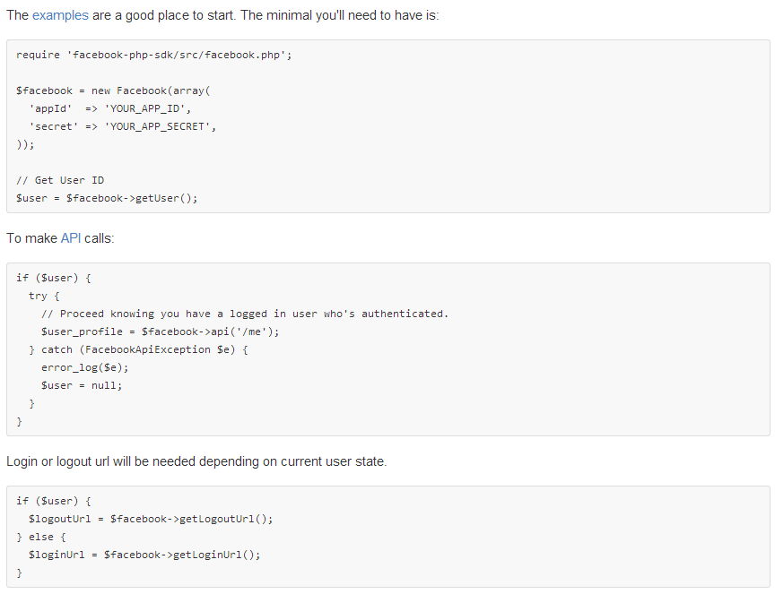
Example vulnerability from Facebook SDK
1
2
3

Slide 29
Example assumption from Facebook SDK
procedure {:inline 1} getLogoutUrl()
returns (API_id: API_ID, …)
modifies …;
{
var test_t:int ;
call access_token := getAccessToken();
call test_t := getApplicationAccessToken();
assume(access_token != test_t);
API_id := API_id_FBConnectServer_login_php;
…
return;
}
Assumption (in plain text):
getLogoutUrl() must not return an application access token to the client.
Assumption (in the model)
Best outcome:
Facebook fixed their SDK code so this assumption is not needed in the newer version.

Slide 30
Example assumption from Windows Live
function saveRefreshToken($refreshToken)
{
// save the refresh token associated with the user id on the site.
}
function handleTokenResponse($token, $error = null)
{
$authCookie = $_COOKIE[AUTHCOOKIE];
$cookieValues = parseQueryString($authCookie);
…
if (!empty($token->{ REFRESHTOKEN }))
{
saveRefreshToken($token->{ REFRESHTOKEN });
}
…
associate refresh token with the user ID obtained from the global variable $_COOKIE
function saveRefreshToken(…)
{
// save the refresh token associated with the user id on the site.
}
Two interpretations
associate refresh token with the user ID obtained from the refresh token passed into the function
original Live ID developer guide
procedure {:inline 1} saveRefreshToken (refresh_token_index: int, RP_Cookie_index: int)
modifies RP_Refresh_Token_index;
{
var user: User;
//call user := get_User_ID(RP_Cookie_index);
user := Refresh_Token__user_ID[refresh_token_index];
if (user == _nobody) {return;}
RP_Refresh_Token_index[user] := refresh_token_index;
}

Slide 31
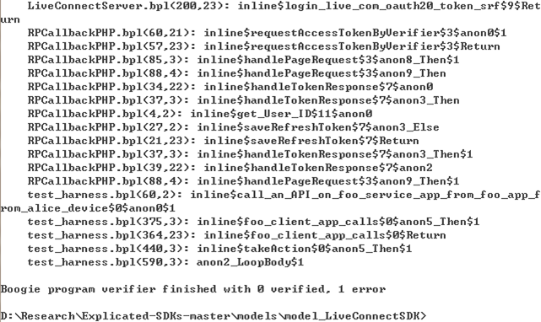
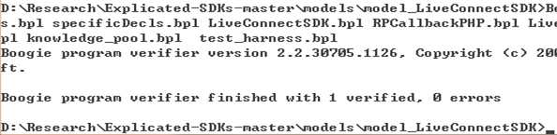
Example assumption from Windows Live
procedure {:inline 1} saveRefreshToken (refresh_token_index: int, RP_Cookie_index: int)
modifies RP_Refresh_Token_index;
{
var user: User;
call user := get_User_ID(RP_Cookie_index);
user := Refresh_Token__user_ID[refresh_token_index];
if (user == _nobody) {return;}
RP_Refresh_Token_index[user] := refresh_token_index;
}

Slide 32
Example assumption from Windows Live
function saveRefreshToken($refreshToken)
{
// save the refresh token and associate it with the user identified by your site credential system.
}
function handleTokenResponse($token, $error = null)
{
$authCookie = $_COOKIE[AUTHCOOKIE];
$cookieValues = parseQueryString($authCookie);
if (!empty($token))
…
new Live ID developer guide

Slide 33
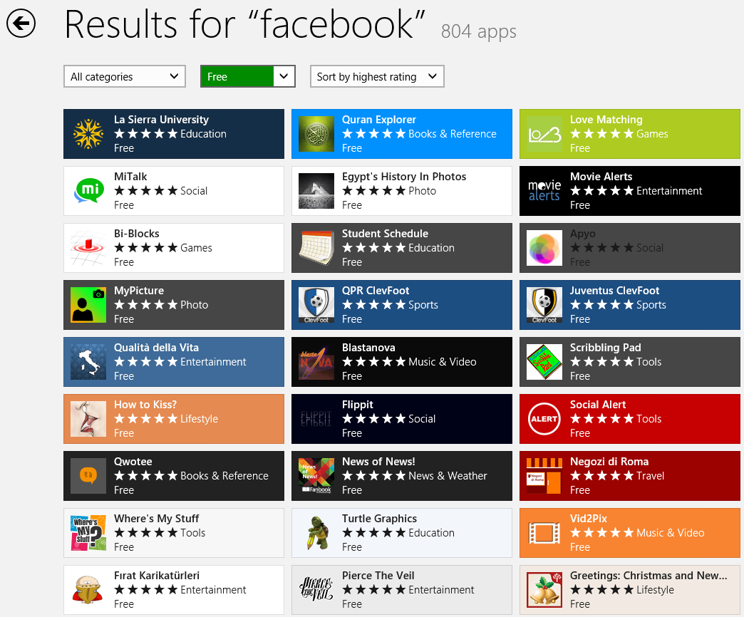
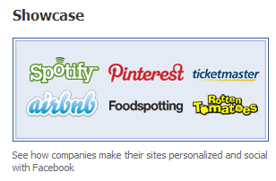
Testing Popular Apps
Facebook showcase applications
Popular Windows 8 modern applications using Facebook SSO

Slide 34



Testing Results
Test Set | Number of Apps | Vulnerable
Illustrative example | 27 | 21 (78%)
Assumption A1 (in the paper) | 7 | 6 (86%)
Assumption A6 (in the paper) | 21 | 14 (67%)

Slide 35
Conclusion
Missed implicit assumptions can lead to many vulnerabilities when integrating third-party services.
What we advocate: SDK providers explicate SDKs before release.
  Fix SDK Code
  Develop Automated Checker
  Improve SDK documentation

Slide 36
Thank you!
  Visit project website for more info:
  http://www.cs.virginia.edu/~yz8ra/ExplicatingSDKs_website/
  Models available at: https://github.com/sdk-security/Explicated-SDKs
Rui Wang¹*, Yuchen Zhou²*†,
(* Lead authors, †Speaker)
Shuo Chen¹, Shaz Qadeer¹, David Evans² and Yuri Gurevich¹
¹Microsoft Research and ²University of Virginia

