Slide 1
Understanding User Mobility Based on GPS Data
Yu Zheng
Microsoft Research Asia

Slide 2
Outline
Introduction
Architecture
Walk-Based Segmentation
Feature Extraction
Graph-based post-processing
Experiments
Conclusion

Slide 3
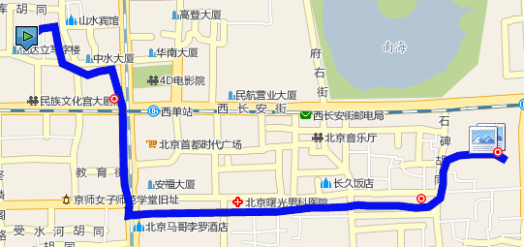
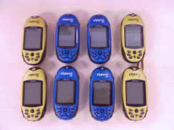
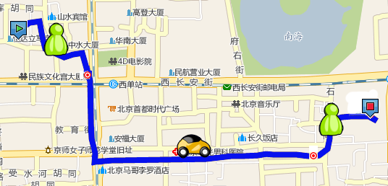
Introduction (1)
Goal & Results: Inferring transportation modes from raw GPS data
  Differentiate driving, riding a bike, taking a bus and walking
  Achieve a 0.75 inference accuracy (independent of other sensor data)
GPS log
Infer model

Slide 4
Introduction (2)
Motivation
  For users:
    Reflect on past events and understand their own life pattern
    Obtain more reference knowledge from others’ experiences
  For service provider:
    Classify trajectories of different transportation modes
    Enable smart-route design and recommendation
Difficulty
  Velocity-based method cannot handle this problem well (<0.5 accuracy)
  People usually transfer their transportation modes in a trip
  The observation of a mode is vulnerable to traffic condition and weather

Slide 5
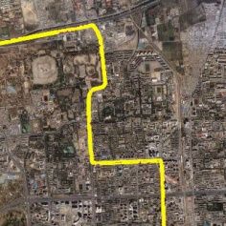
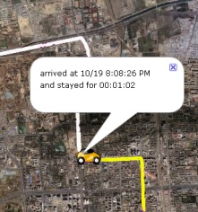
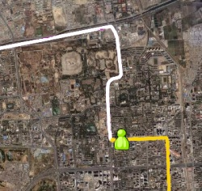
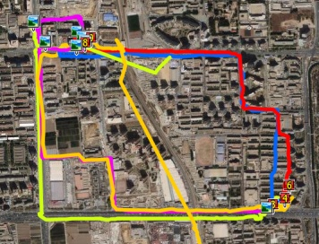
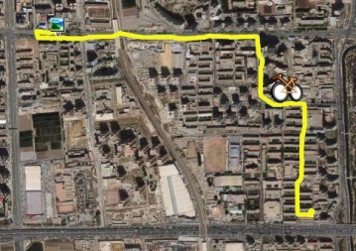
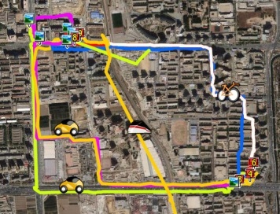
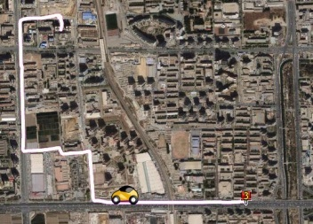

Slide 6
Introduction (2)
Contributions and insights
  A change point-based segmentation method
    Walk is a transition between different transportation modes
    Handle congestions to some extent
  A set of sophisticated features
    Robust to traffic condition
    Feed into a supervise learning-based inference model
  A graph-based post-processing
    Considering typical user behavior
    Employing location constrains of the real world
WWW 2008 (first version)

Slide 7
Architecture

Slide 8
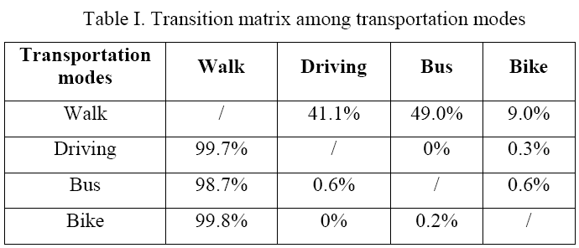
Walk-Based Segmentation
Commonsense knowledge from the real world
  Typically, people need to walk before transferring transportation modes
  Typically, people need to stop and then go when transferring modes

Slide 9
Walk-Based Segmentation
Change point-based Segmentation Algorithm
  Step 1: distinguish all possible Walk Points, non-Walk Points.
  Step 2: merge short segment composed by consecutive Walk Points or non-Walk points
  Step 3: merge consecutive Uncertain Segment to non-Walk Segment.
  Step 4: end point of each Walk Segment are potential change points

Slide 10
Feature Extraction (1)
Features
Category | Features | Significance
Basic Features | Dist | Distance of a segment
 | MaxVi | The ith maximal velocity of a segment
 | MaxAi | The ith maximal acceleration of a segment
 | AV | Average velocity of a segment
 | EV | Expectation of velocity of GPS points in a segment
 | DV | Variance of velocity of GPS points in a segment
Advanced Features | HCR | Heading Change Rate
 | SR | Stop Rate
 | VCR | Velocity Change Rate

Slide 11
Feature Extraction (2)
Our features are more discriminative than velocity
  Heading Change Rate (HCR)
  Stop Rate (SR)
  Velocity change rate (VCR)
  >65 accuracy

Slide 12
Graph-Based Post-Processing (1)
Using location-constraints to improve the inference performance??

Slide 13
Graph-Based Post-Processing (2)
Transition probability between different transportation modes
  P(Bike|Walk) and P(Bike|Driving)
Segment[i].P(Bike) = Segment[i].P(Bike) * P(Bike|Car)
Segment[i].P(Walk) = Segment[i].P(Walk) * P(Walk|Car)

Slide 14
Graph-Based Post-Processing (3)
Mine a implied road network from users’ GPS logs
  Use the location constraints and typical user behaviors as probabilistic cues
  Being independent of the map information

Slide 15
Graph-Based Post-Processing (4)

Slide 16
Experiments (1)
Framework of Experiments

Slide 17
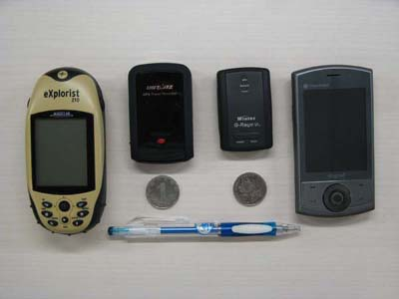
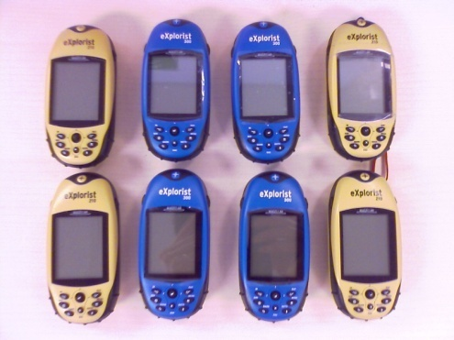
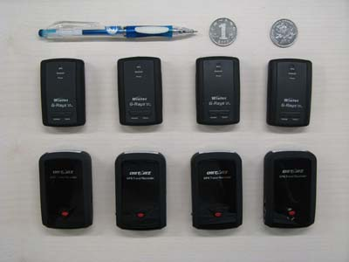
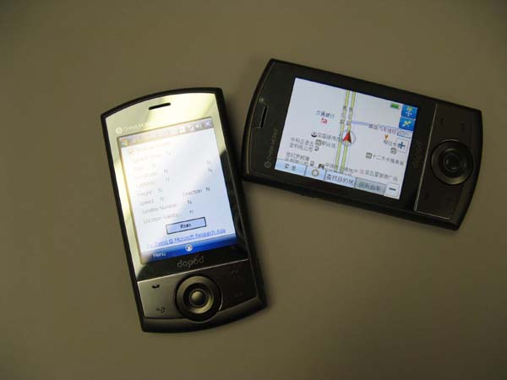
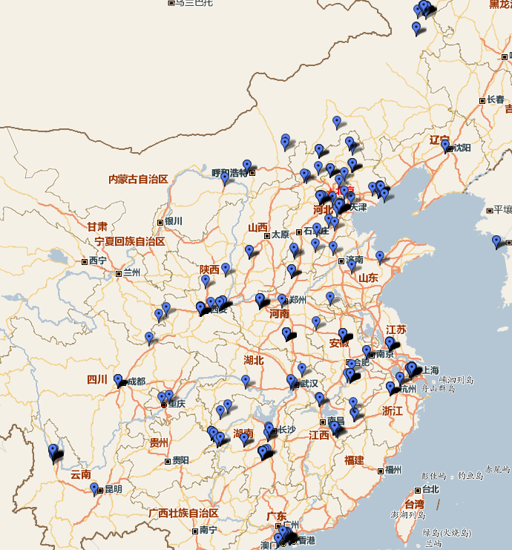
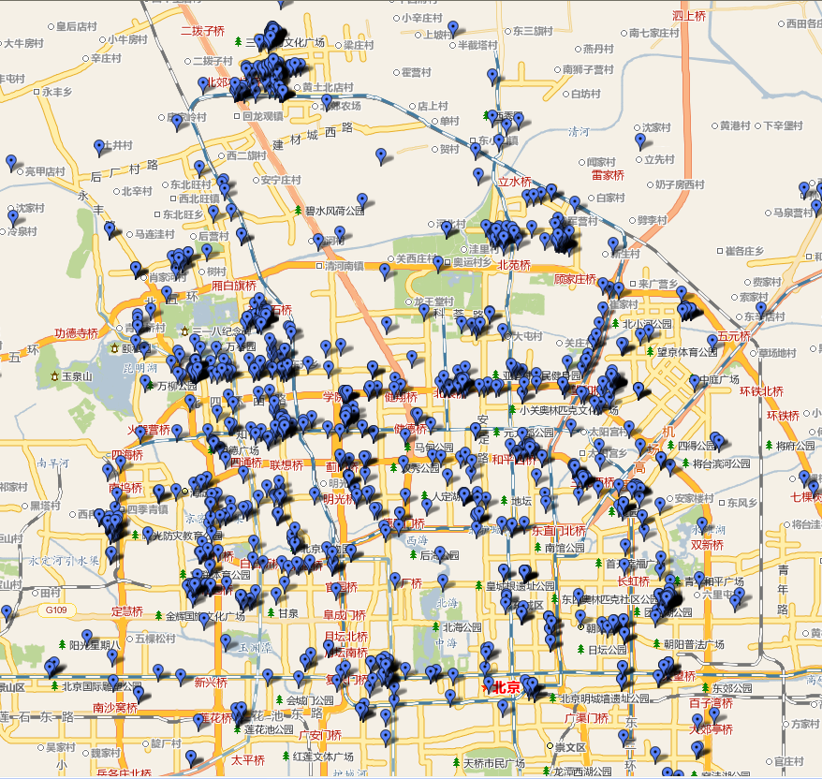
Data and Devices

Slide 18
Experiments (2)
Single Feature Exploration
Rank | Feature | A_{S} | A_{D} | Rank | Feature | A_{S} | A_{D}
1 | HCR | 0.345 | 0.561 | 8 | DV | 0.269 | 0.357
2 | SR | 0.335 | 0.561 | 9 | MaxV2 | 0.322 | 0.344
3 | AV | 0.382 | 0.547 | 10 | MaxV1 | 0.294 | 0.257
4 | VCR | 0.336 | 0.526 | 11 | MaxA2 | 0.239 | 0.217
5 | EV | 0.375 | 0.523 | 12 | MaxA1 | 0.259 | 0.208
6 | Dist | 0.302 | 0.499 | 13 | MaxA3 | 0.256 | 0.197
7 | MaxV3 | 0.334 | 0.365

Slide 19
Feature Combinations | Transportation mode |  | Chang Point
 | A_{S} | A_{D} | Precision | Recall
MaxA1 + MaxA2 + MaxA3 | 0.297 | 0.283 | 0.118 | 0.584
MaxV1 + MaxV2 + MaxV3 | 0.480 | 0.526 | 0.142 | 0.687
Distance + EV + AV | 0.480 | 0.550 | 0.227 | 0.582
Distance + EV + MaxV1 | 0.548 | 0.597 | 0.217 | 0.55
AV + EV + MaxV1 | 0.558 | 0.621 | 0.253 | 0.603
MaxV3 + MaxA3 + AV | 0.511 | 0.632 | 0.138 | 0.669
SR + HCR + VCR | 0.575 | 0.644 | 0.286 | 0.643
Basic Features | 0.618 | 0.673 | 0.284 | 0.681
Basic Features + Advanced Features | 0.635 | 0.715 | 0.373 | 0.724

Slide 20
 | A_{D} | CP/P | CP/R
Enhanced Features (EF) | 0.728 | 0.491 | 0.817
EF + normal post-processing | 0.741 | 0.508 | 0.818
EF + graph-based post-processing | 0.762 | 0.516 | 0.818

Slide 21
Ground truth | Predicted Results (KM)
 | Walk | Driving | Bus | Bike
Walk | 1026.4 | 122.1 | 386.5 | 357.3 | 0.543 | Recall
Driving | 42.6 | 2477.3 | 458.5 | 235.1 | 0.771
Bus | 34.8 | 164.7 | 1752.4 | 46.2 | 0.877
Bike | 49.3 | 113.5 | 31.9 | 1234.3 | 0.864
 | 0.891 | 0.861 | 0.666 | 0.659 | 0.762
 | Precision

