Slide 1



WiFi-NC: WiFi over Narrow Channels
Krishna Chintalapudi, Božidar Radunović
Vlad Balan, Michael Buettner,
Vishnu Navda, Ram Ramjee, Srinivas Yerramalli

Slide 2
Radically New Radio Design
Conventional Radio
WiFi-NC Radio
One radio uses one channel (20/40/80 MHz) at a time
One radio simultaneously uses several narrow channels
5MHz
Conventional
Radio
20
MHz
WiFi-NC
Radio
5MHz
5MHz
5MHz
Either transmits/receives from one device at a time
Simultaneously transmits and receives from several devices
A
B
A
B
C
Benefits: Efficiency, Coexistence, Non-contiguous spectrum access

Slide 3

Motivation for WiFi-NC

Slide 4
Trends in Wireless
Trend 1: Increase in encoding rates (e.g. MIMO)
Trend 2: Increase in bandwidths
Trend 3: Non-contiguous spectrum access

Slide 5
10x Data Rate ≠ 10x Throughput
To allow
fair access
At 54 Mbps Efficiency = 60%
Acknowledge receipt of packet
Medium
Access
Preamble
ACK
Data (1500 Bytes at 54Mbps)
SIFS
(101.5µs)
(20
µs)
(224 µs)
(44 µs)
DIFS
Efficiency decreases with increasing data rates
Data
To prepare the receiver
Receiver
Gets ready
To xmit ACK
Medium
Access
ACK
SIFS
(101.5µs)
(20
µs)
(20
µs)
(44 µs)
At 600 Mbps Efficiency = 10%
DIFS

Slide 6
High Efficiency in WiFi-NC
20
MHz
Use several low data rate narrow channels instead of one wide channel
1
2
3
4
5
WiFi-NC : Many low data rate narrow channels
1
2
20
MHz
3
4
5

Slide 7
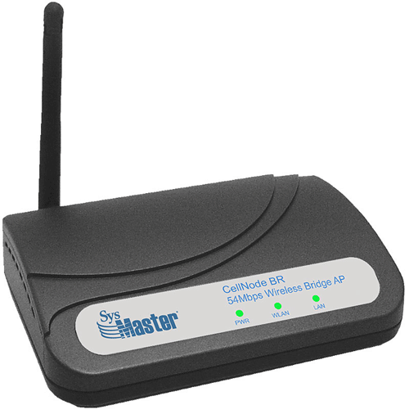
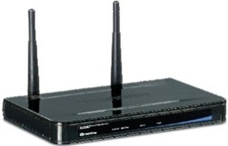
Coexistence Breaks with Wider Channels
B backs off to let A access but A cannot since C is still transmitting
Node B
(20 MHz)
20
40
Node A
(40 MHz)
B
B
B
20
C
C
C
Wide channels and narrow channels cannot coexist in WiFi
Node C
(20 MHz)
C backs off to let A access but A cannot since B is still transmitting
Node A Starves!
A can only transmit when both B and C are not transmitting

Slide 8
Current Standards are Inefficient
Backward compatible mode :
  In 802.11n, a/c upon detecting a narrow band device reduce channel width
  Avoids starvation but inefficient
Node B
(20 MHz)
Node B
(20 MHz)
20
20
80
Node A
(80 MHz)
Node A
(80 MHz)
20
20
20
Node C
(20 MHz)
Node C
(20 MHz)

Slide 9
Coexistence in WiFi-NC
Node B
(20 MHz)
A
A
A
20
B
A
B
Node A
(80 MHz)
C
A
C
20
A
A
A
Node C
(20 MHz)
80 MHz = 4 independent 20 MHz
Independent transmit, receive, CCA
All nodes have fair access in all parts of the spectrum!
40 MHz = 2 independent 20 MHz
Use wider channels
More Hz -> Higher data rate!

Slide 10

WiFi NC with Fragmented Spectrum
In Whitespaces spectrum is fragmented
Contiguous chunk of 20, 40 or 80 MHz may not be available
TV
Freq
(MHz)
10 MHz
TV
Time
WiFi-NC
  Transmits around by using independent channels
  Better use of non-contiguous spectrum
WiFi-NC
TV
Freq
(MHz)
WiFi-NC
10 MHz
TV
WiFi-NC
Time

Slide 11
Design Of WiFi-NC

Slide 12
Design Issues
Q: Why not a bunch of narrow band radios on each device?
Form-factor and cost
Guard Bands :
Radios need large guardbands between channels
5 x 4 = 20 MHz requires
3 x 5 = 15 MHz guards
43% spectral wastage!
Guard Band
3
5MHz
3
5MHz
3
5MHz
3
5MHz
3
Power
Radio 1
Radio 2
Radio 3
Radio 4
Frequency

Slide 13
Key Innovation : The Compound Radio
Conventional Radio
Digital Baseband
Creates narrow channels using digital signal processing
D
A
C
MIMO, OFDM,
Viterbi, QAM64
Analog Radio
Front End
Channelization
Advantages
Allows for extremely narrow guardbands (100Khz)
Digital Ckts - low cost and ease of implementation
Amenable to gains due to Moore’s law
Compound Radio
Digital Baseband
Digital
channel-ization
D
A
C
Analog Radio
Front End

Slide 14
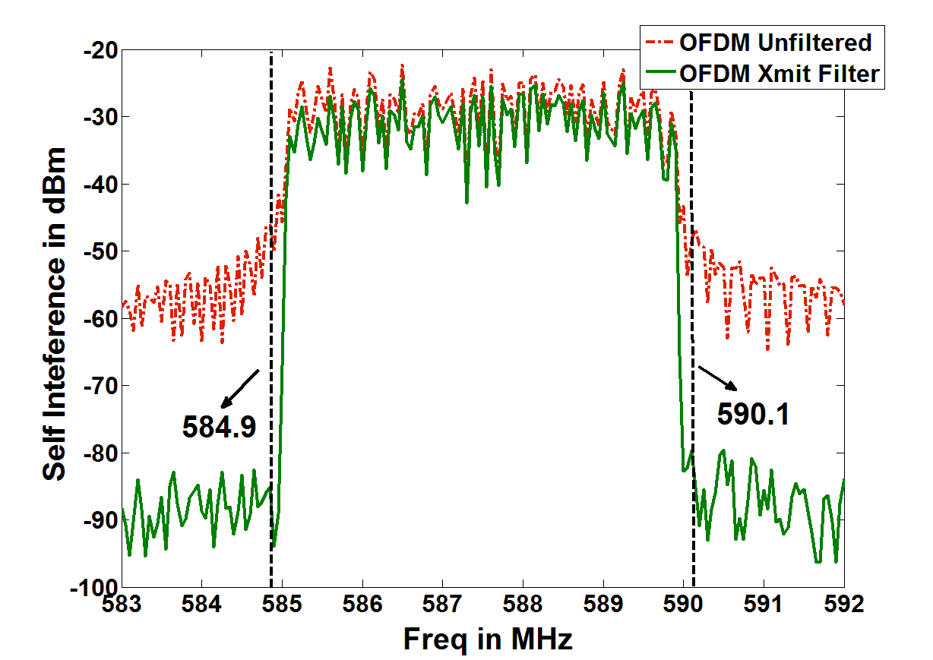
Design Challenge : Self Interference Leakage
In order to create a channel
Transmit Filters – to ensure there is not leakage into adjacent channels
Receive Filters – to receive only intended transmission
Power
Self
Interference
Self
Interference
B
-20dbm
A
-40dbm
C
Digital Elliptic Filters
60 dB
-85dbm
-100dbm
Noise Floor
Frequency (MHz)
Self Interference : Around -20 dbm
Interference Leakage at 100 KHz Guardband : Around -40 dbm
Noise Floor : Around -100 dbm
Isolation needed : 60 dB

Slide 15
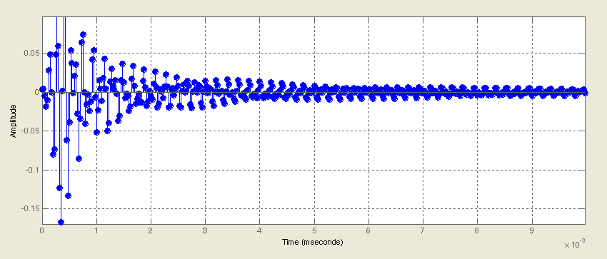
Other Design Challenges
2. Filter Induced Multipath
Sharp filters cause spreading in time similar to multipath
Use longer symbols/equilizers
3. Slot Dilation due to Dilated Preamble
Information travels slower in narrow channels
May result in increased slot widths
Speculative transmissions (WiFi-Nano)
Use a separate preamble for CCA
Preamble
MIMO
600 Mbps 40 MHz Channel
Sync
MIMO
Data
600 Mbps 5 MHz Channel
4. Processing Overheads
Having multiple receive paths can lead to excessive processing requirements
Use fractional data rate processing
Narrow
Channel
Packet
Processing
Narrow
Channel
Packet
Processing
Subsampler
5. ADC Bit Limitations
ADC should have enough resolution to detect weak signals during self-interference
Use analogue self interference cancellation

Slide 16
Performance Of WiFi-NC

Slide 17
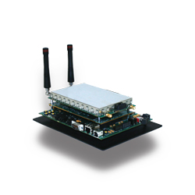
Narrow Band Wide Band Co-existence
16 QAM, ¾ Rate
6
Wide Band T2
Mbps
Narrow Band T1
Individual
Transmissions
T1 and T2
Sharing

Slide 18
Avoiding Starvation
16 QAM, ¾ Rate
15
A1 Agg
Node B
B
C
Mbps
A1
A1
B
C
Node A2
(WiFi)
Node A1
(WiFi-NC)
A2
Node C
WiFi
WiFi-NC

Slide 19
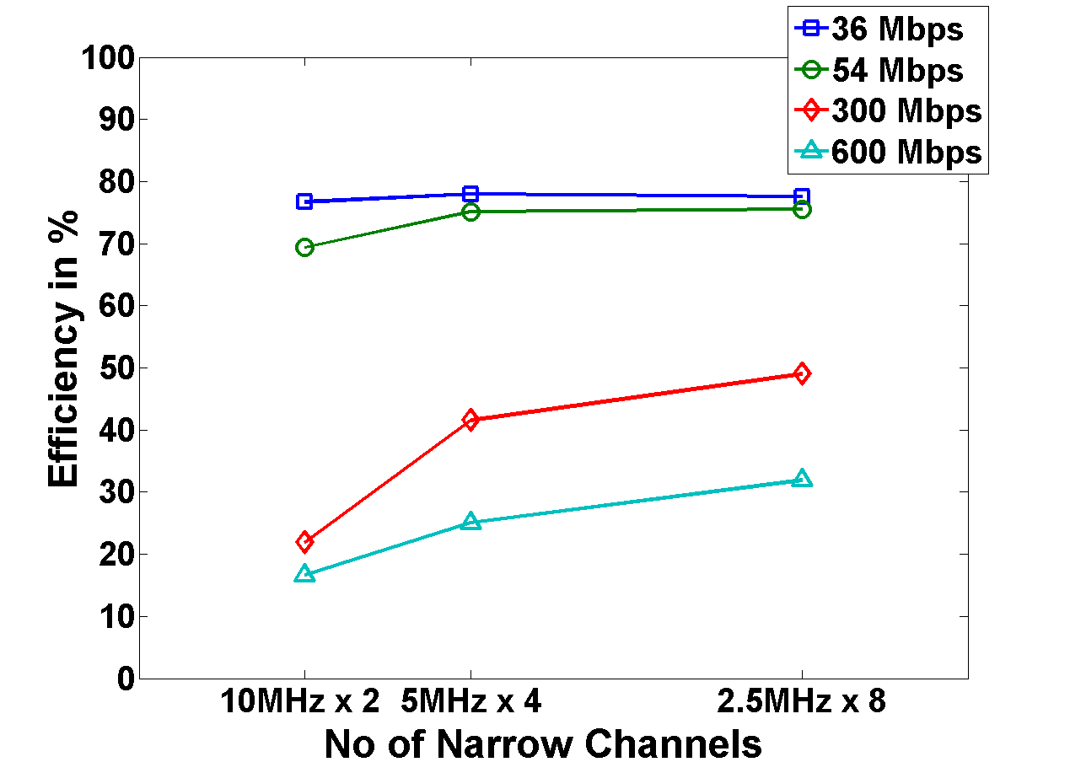
Efficiency of a single link on WiFi-NC on Testbed
600 Mbps
100%

Slide 20
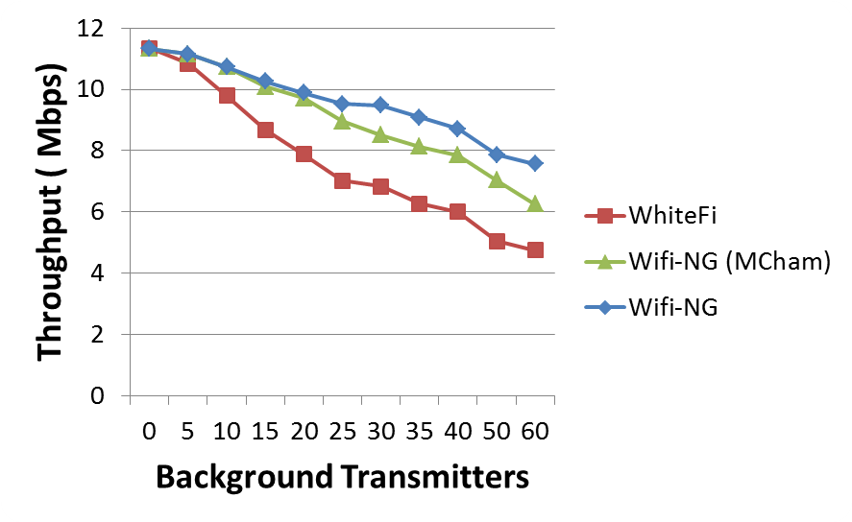
Performance of WiFi-NC in WhiteSpaces
}
Gains due to
non-contiguous
operation
}
Gains due to
Narrow channels
State-of-art (WhiteFi)
WiFi-NC (Contiguous)
WiFi-NC
No of Contending secondary Devices

Slide 21
Thank You

