Slide 1
Collaborative Filtering Meets Mobile Recommendation:
A User-centered Approach
Vincent W. Zheng†, Bin Cao†, Yu Zheng‡, Xing Xie‡, Qiang Yang†
†Hong Kong University of Science and Technology
‡Microsoft Research Asia
This work was done when Vincent was doing internship in Microsoft Research Asia.

Slide 2
Introduction
User GPS trajectories accumulated on the Web
Notes:
GPS becomes more and more popular -> more location data can be shared on the Web -> for example, a user can record his GPS data and display it on the map. He can also input some comments, indicating what he saw / what he did in the places he visited, so as to easily share the travel experience with other ppl.

Slide 3
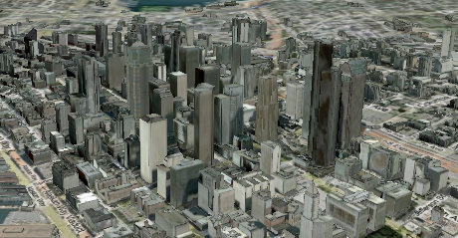

Motivation
Mobile Recommendation
Travel experience:
Some places are more
popular than the others
Big sale!
Nice food!
User activities:
“Nice food!” -->
Enjoy food there
From Bing 3D map
Notes:
With user location data, we can do mobile recommendation based on wisdom of crowd -> (1) some places popular than others, (2) some users indicate some places good for doing sth -> use them for recommendation

Slide 4
Goal
User-centric Recommendation
  Location Recommendation
    Question: I want to find nice food, where should I go?
  Activity Recommendation
    Question: I will visit the downtown, what can I do there?
Notes:
We consider 2 problems -> (1) user-centric loc recommendation, e.g. a user wants to do sth., where can he go? (2) user-centric act recommendation, e.g. a user wants to visit some place, what can he do there?

Slide 5
GPS Log Processing
GPS trajectories*
stay region r
Raw GPS points
Stay points
Stay regions
Stand for a geo-spot where a user
has stayed for a while
Preserve the sequence and vicinity info
Stand for a geo-region that
we may recommend
Discover the meaningful locations
* In GPS logs, we have some user comments associated with the trajectories. Shown later.
Notes:
Now we show how to do such recommendation given the raw GPS data. First, we can parse them into locations by extracting stay points and clustering them into stay regions

Slide 6
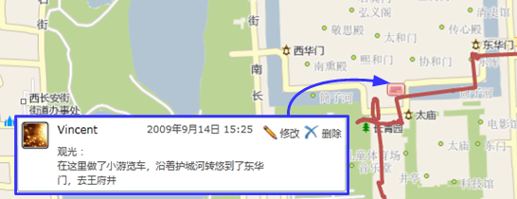
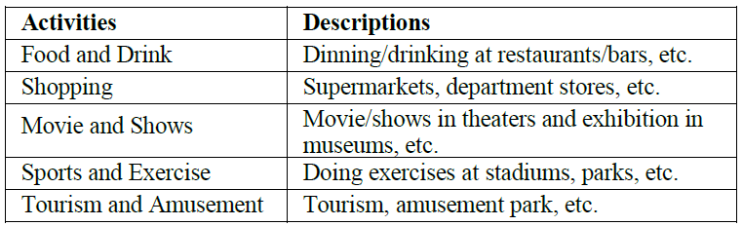
Data Modeling
User -> Location -> Activity
GPS: “39.903, 116.391, 14/9/2009 15:25”
Stay Region: “39.910, 116.400 (Forbidden City)”
“User Vincent: We took a tour bus to see around
along the forbidden city moat …”
Forbidden City
…
Bird’s Nest
Tourism
…
Activity: tourism
Vincent
+1
Alex
…
Notes:
Second, we model the user-location-activity relations. Some user goes to some place to do sth -> a tensor. Our goal is to fill the incomplete tensor (the tensor is incomplete becoz there are few annotated data, i.e. comments from the users)

Slide 7
How to Do Recommendation?
If the tensor is full, then for each user:
…
Bird’s Nest
…
Bird’s Nest
Tourism
…
Tourism
Vincent
Vincent
Alex
…
Forbidden City
Zhongguancun
Bird’s Nest
Location recommendation for Vincent
Tourism:
Forbidden City > Bird’s Nest > Zhongguancun
2 | 1 | 6
4 | 3 | 2
5 | 4 | 1
Shopping
Exhibition
Activity recommendation for Vincent
Forbidden City:
Tourism > Exhibition > Shopping
Tourism
Unfortunately, in practice, the tensor is usually sparse!

Slide 8
Our Collaborative Filtering Solution
Regularized Tensor and Matrix Decomposition
Users
Activities
Locations
Locations
Users
?
Users
Users
Features
Activities
Locations
Activities
Notes:
As the user-loc-act tensor is sparse, we consider to user other information, such as: user-user social network, user-loc visiting frequency (showing the popularity), loc-features (showing the location functionality), act-act correlations (showing the occurrence).

Slide 9
Related Work
Few work done before
  Either recommend some specific types of locations
    Shops [Takeuchi & Sugimoto 2006]
    Restaurants [Horozov, et al. 2006]
    Travel hot spots [Zheng et al. 2009]
  Or only recognize activity without location recommendation
    Outdoor activity recognition [Liao et al. 2005]
    Indoor activity recognition [Patterson et al. 2005]
  Or do not explicitly model the users
    Our previous solution [Zheng et al. 2010]
      See next slide!
Notes:
We introduced the main idea of this work, and fortunately there are few related papers working on this topic. E.g. most of the previous work either recommendation some specific types of loc’s or only recognize act w/o loc recommendation. We gave a solution on collaborative loc and act recommendation before in WWW’10, but it did not take user into account, so that it cannot give each user targeted recommendation.

Slide 10
Our Previous Solution at WWW’10
Collaborative Location and Activity Recommendation
Tourism
Exhibition
Shopping
User not explicitly modeled!
Not modeling each single user’s Loc-Act history
= a sum compression of our tensor
Forbidden City
5 | ? | ?
? | 1 | ?
1 | ? | 6
Bird’s Nest
Zhongguancun
Features
Activities
Activities
Locations
Locations
?
Activities
Notes:
Simply put, our previous modeled the loc-act relations, and employed some additional info such as loc-fea, act-act correlations to help do CF on the incomplete loc-act matrix. The biggest problem for this work is, there is no user encoded in the model.

Slide 11
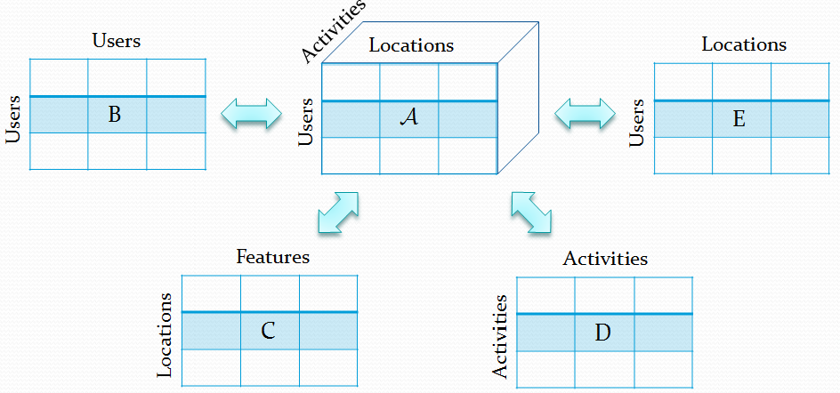

Our model
X
X, Y
Y
Z
Notes:
Different from our previous work, we encode the user info in the model, and are able to provide a regularized tensor and matrix decomposition framework to solve the CF problem. As shown in the objective function L, tensor A decomposed into some product of X, Y and Z, then X (low-dimensional representation of users) is shared by matrix B; together with Y (low-D representation of loc), it is also shared with E. Y is also shared by C w.r.t. loc, and Z (low-D representation of act) is shared by D. All substraction (e.g. A-[X,Y,Z] and C-YU^{T}) measure the decomposition loss, the trace terms (e.g. tr(X^{T}LX) and tr(Z^{T}LZ)) force the similar entity (e.g. user in X and act in Z) to have similar low-D representations. The 3rd row is regularization to prevent overfit.

Slide 12
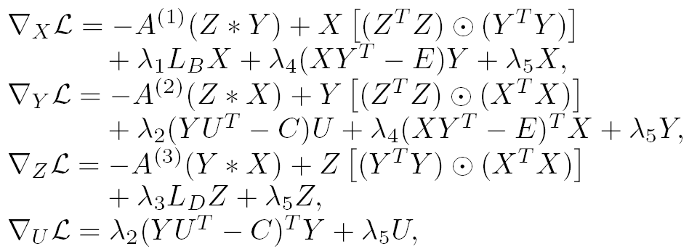
Optimization
Minimize the object function L(X, Y, Z, U)
  Gradient descent
  Complexity: O (T × (mnr + m² + r²))
    T is #(iteration), m is #(user), n is #(location), r is #(activity)
where
Notes:
The obj does not have closed form solution, so use numeric method such as gradient descent. The complexity of our algorithm is O(…).

Slide 13
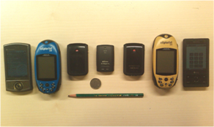
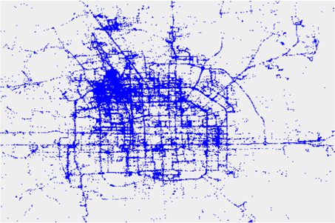
Experiments
Data
  2.5 years (2007.4-2009.10)
  164 users
  13K GPS trajectories, 140K km long
  530 comments
  After clustering, #(loc) = 168; #(user) = 164, #(act) = 5, #(loc_fea) = 14
  The user-loc-act tensor has 1.04% of the entries with values
Evaluation
  Ranking over the hold-out test dataset
  Metrics:
    Root Mean Square Error (RMSE)
    Normalized discounted cumulative gain (nDCG)
Notes:
We evaluated our algorithm in a large real-world dataset. Follow the slide.

Slide 14
Baselines – Category I
  Tensor -> Independent matrices [Herlocker et al. 1999]
  Baseline 1: UCF (user-based CF)
    CF on each user-loc matrix + Top N similar users for weighted average
  Baseline 2: LCF (location-based CF)
    CF on each loc-act matrix + Top N similar locations for weighted average
  Baseline 3: ACF (activity-based CF)
    CF on each loc-act matrix + Top N similar activities for weighted average
…
Act
Act
Loc
UCF
Loc
LCF
Loc
User
…
User
ACF
Notes:
We introduced some baselines for comparison. First category of baselines, we treat tensor as a set of independent matrices, so that we can do CF on each matrix separately. The 3 baselines are all memory-based methods, i.e. KNN.

Slide 15
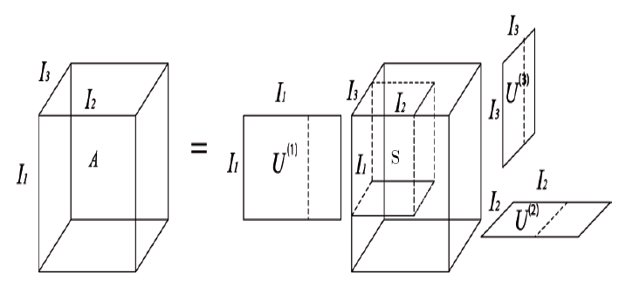
Baselines – Category II
Tensor-based CF
  Baseline 4: ULA (unifying user-loc-act CF) [Wang et al. 2006]
    Top N_{u} similar users, top N_{l} similar loc’s, top N_{a} similar act’s
    Similarities from additional matrices + Small cube for weight avarage
  Baseline 5: HOSVD (high order SVD) [Symeonidis et al. 2008]
    Singular value decomposition with matrix unfolding
Act
N_{l}
loc-fea
Loc
N_{u}
user-user
User
N_{a}
act-act
ULA
HOSVD
Notes:
The 2nd category of baselines is tensor-based. ULA is adapted from [Wang 06], its basic idea is to use top similar users, locs and acts for prediction (i.e. a cube in the big tensor). HOSVD is an extension to matrix SVD, and it is a model-based method with tensor decomposition.

Slide 16
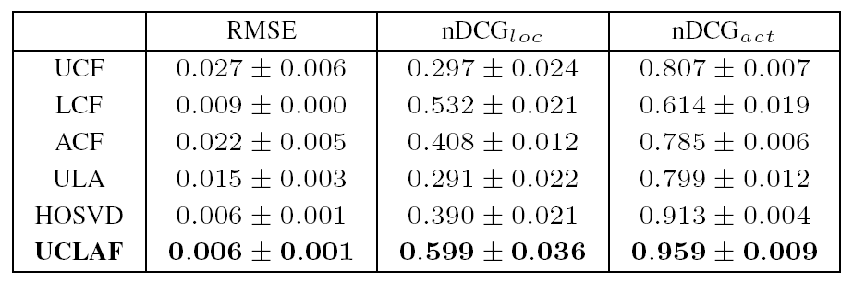
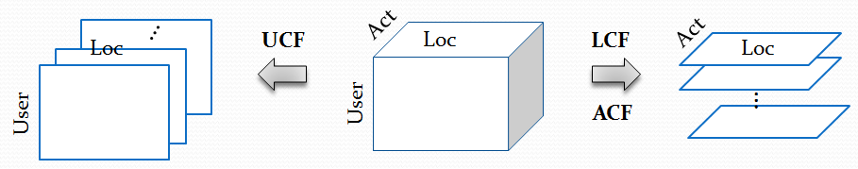
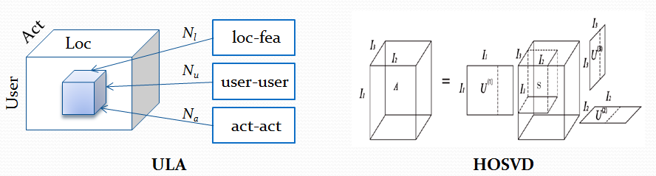
Comparison with Baselines
Reported in “mean ± std”
[Herlocker et al. 1999]
[Wang et al. 2006]
[Symeonidis et al. 2008]
Notes:
We reported the results in mean+/-std. For RMSE, the lower the better; for nDCG, the higher the better. We are the best in all 3 metrics (RMSE, nDCG for loc recommendation, nDCG for act recommendation). We are better than UCF/LCF/ACF because we consider user-loc-act in a whole instead of considering them separately. We are better than ULA and HOSVD, because our model is more sophisticated in encoding additional information and doing tensor decomposition.

Slide 17
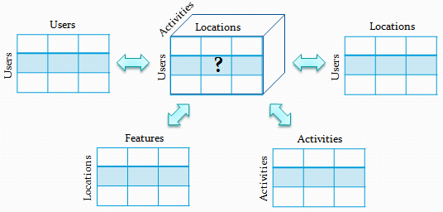
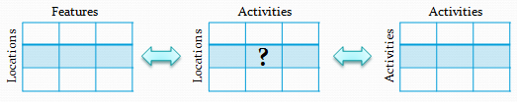
Comparison with Our Previous Solution at WWW’10
Current user-centric solution
Previous generic solution
Performance
 | Current Solution | Previous Solution
RMSE | 0.006 ±0.001 | 0.041 ±0.006
nDCG_{loc} | 0.576 ±0.043 | 0.552 ±0.027
nDCG_{act} | 0.931 ±0.009 | 0.885 ±0.019

Slide 18
Impacts of the user number
Evaluated on a fixed set of 25 users w.r.t. increasing #(user)
  Based on 10 trials, std not shown in the figures
nDCG_{loc}
nDCG_{act}
Notes:
In general, as the #(user) increases, the performances increase;
In nDCG_{loc} at #(users)=75, there is a minor decrease, maybe because of overfit
The performance increase is not huge, due to the possible reason that the (test) data are sparse.

Slide 19
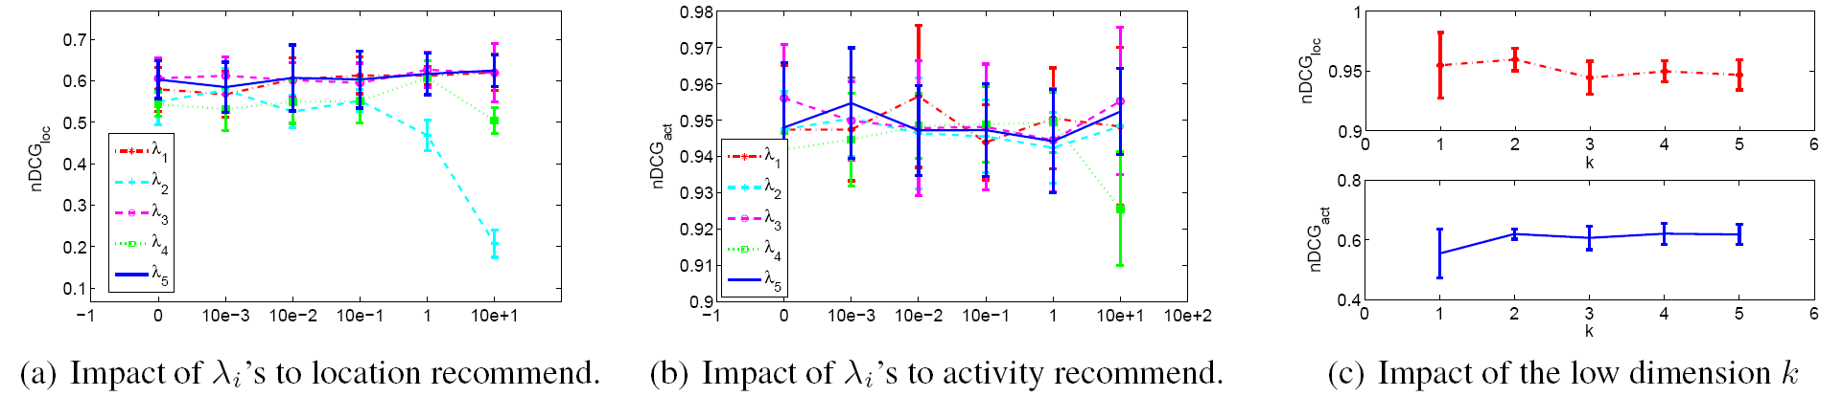
Impacts of the Model Parameters
Some observations
  Using additional info (i.e. λ_{i} > 0) is better than not (i.e. λ_{i} = 0)
  Not very sensitive to most parameters
    Model is robust + Contribution from additional info is limited
  As λ₂ increases, nDCG for loc recommendation greatly decreases
    Maybe because the loc-feature matrix is noisy in extracting the POIs
    Not directly related to act, so no similar observation for act recommendation
Notes:
Follow the slide

Slide 20
Conclusion
We showed how to mine knowledge from GPS data to answer
  If I want to do something, where should I go?
  If I will visit some place, what can I do there?
We extended our previous work for user-centric recommendation
  From “Location-Activity” to “User-Location-Activity”
  From “Matrix + Matrices” to “Tensor + Matrices”
We evaluated our system on a large GPS dataset
  19% improvement on location recommendation
  22% improvement on activity recommendation
  over the simple memory-based CF baseline (i.e. UCF, LCF, ACF)
Future Work
  Update the system online

Slide 21
Thanks!
Questions?
Vincent W. Zheng
vincentz@cse.ust.hk
http://www.cse.ust.hk/~vincentz

