Slide 1

Z3 Tapas:
Theory Combinations and Practical Applications
Nikolaj Bjørner
Microsoft Research
FSE &

Slide 2

This Talk
Applications:
  Dynamic Symbolic Execution
  Bit-precise Scalable Static Analysis
  and several others at Microsoft
Satisfiability Modulo Theories: SMT
  Model-based Theory Combination
Shameless, blatant propaganda for the SMT solver Z3

Slide 3
The Calculus of Computation*
At the core of every software analysis engine
is invariably a component using logical
formulas for describing states and
transformations between system states.
*Title of Bradley & Manna’s book

Slide 4
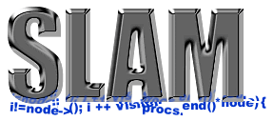




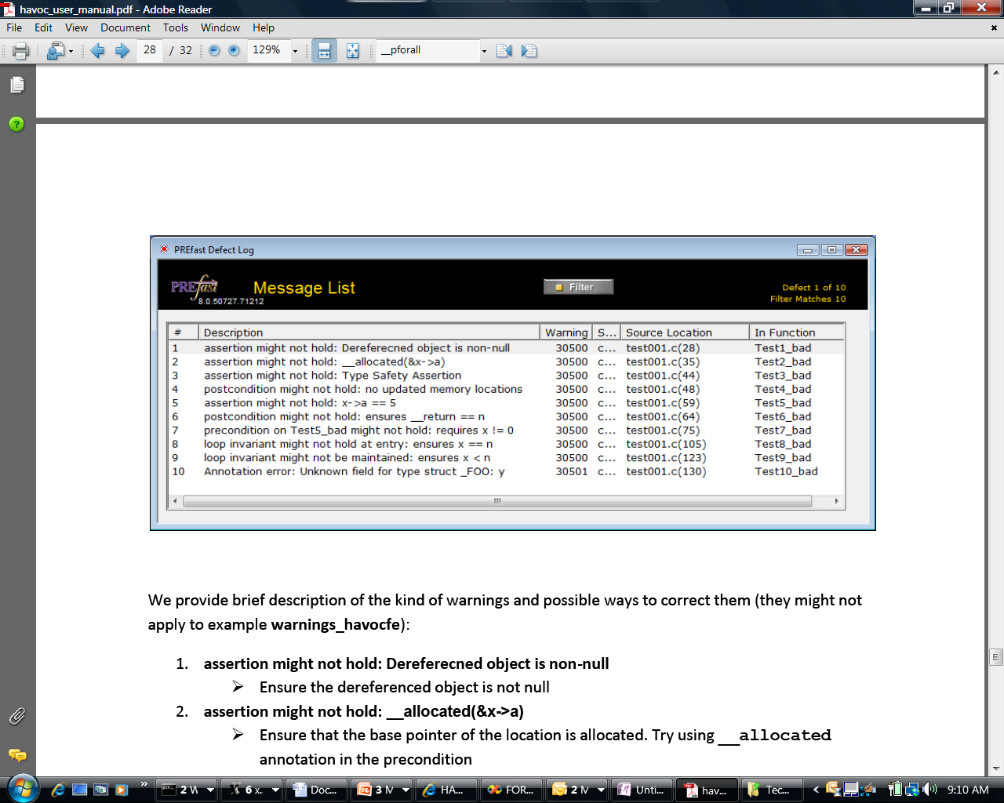

The Calculus of Computation
Some Microsoft engines:
SDV: The Static Driver Verifier
PREfix: The Static Analysis Engine for C/C++.
Pex: Program EXploration for .NET.
SAGE: Scalable Automated Guided Execution
Spec#: C# + contracts
VCC: Verifying C Compiler for the Viridian Hyper-Visor
HAVOC: Heap-Aware Verification of C-code.
SpecExplorer: Model-based testing of protocol specs.
Yogi: Dynamic symbolic execution + abstraction.
FORMULA: Model-based Design
F7: Refinement types for security protocols
M3: Model Program Modeling
VS3: Abstract interpretation and Synthesis
They all use the SMT solver Z3.
Hyper-V

Slide 5



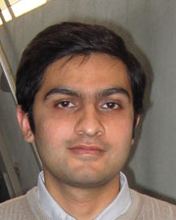











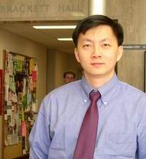

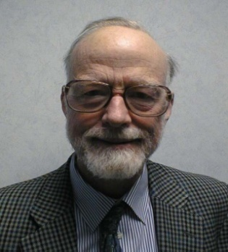


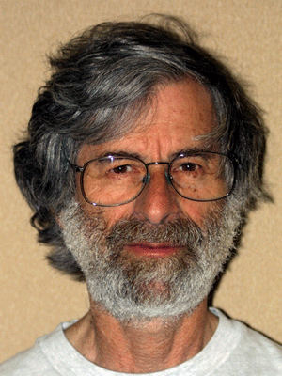










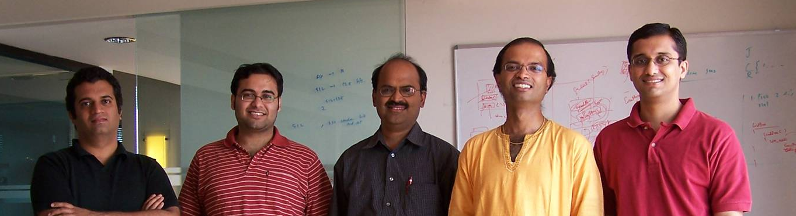





The inner Research Market @ MSFT

Slide 6
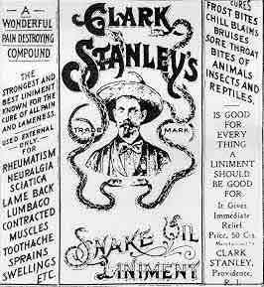
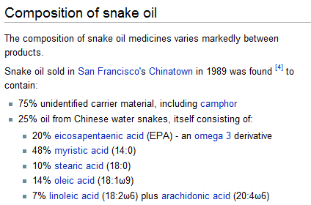
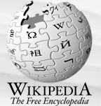
Message ☺
Microsoft’s SMT solver
Z3 is the snake oil when
rubbed on solves all
your problems
Z3 Components:
9% SAT solver
14% Quantifier engine
10% Equality and functions
10% Arrays
20% Arithmetic
10% Bit-vectors
….25% Secret Sauce

Slide 7
What is Z3?
Simplify
Theories
OCaml
Bit-Vectors
Arrays
SMT-LIB
.NET
Lin-arithmetic
Groebner basis
Native
Recursive Datatypes
Comb. Array Logic
C
Free (uninterpreted) functions
Quantifiers:
E-matching
Model Generation:
Finite Models
Quantifiers:
Super-position
Proof objects
Parallel Z3
Assumption tracking
By Leonardo de Moura & Nikolaj Bjørner http://research.microsoft.com/projects/z3

Slide 8
Z3: Some Microsoft Clients
.NET BCL
Hyper-V
Drivers
PEX
VCC
SLAM/SDV
Is this path feasible?
Hoare
Triples
Finite Program abstraction
Model
Proof

Slide 9
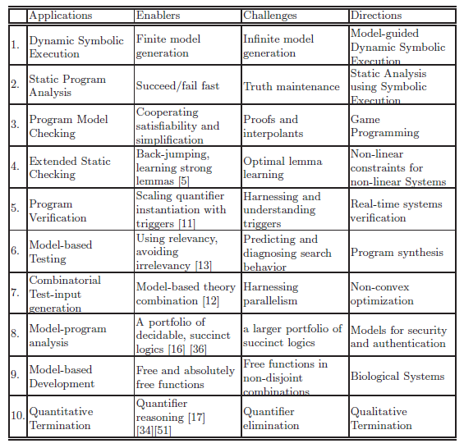

Slide 10
What is SMT?

Slide 11
Satisfiability Modulo Theories (SMT)
Array Theory
Arithmetic
Uninterpreted Functions

Slide 12
Application:
- Pex, SAGE, Yogi, Vigilante
Dynamic Symbolic Execution

Slide 13




Dynamic Symbolic Execution
Run Test and Monitor
Execution Path
Path Condition
seed
Test
Inputs
Known
Paths
New input
Constraint System
Solve
Unexplored path
Vigilante
SAGE
Nikolai Tillmann Peli de Halleux (Pex), Patrice Godefroid (SAGE)
Aditya Nori, Sriram Rajamani (Yogi), Jean Philippe Martin, Miguel Castro,
Manuel Costa, Lintao Zhang (Vigilante)

Slide 14
Test-case generation with SAGE for exploring x86 binaries
Internal user: “WEX Security team”
Use 100s of dedicated machines 24/7 for months
Apps: image processors, media players, file decoders,…
Bugs: Write/read A/Vs, Crash,…
Uncovered bugs not possible
with “black-box” methods.

Slide 15
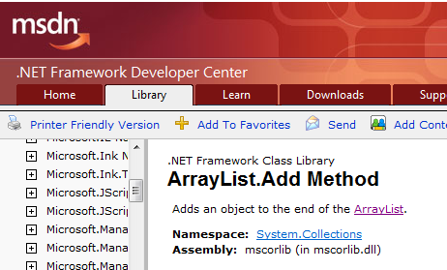
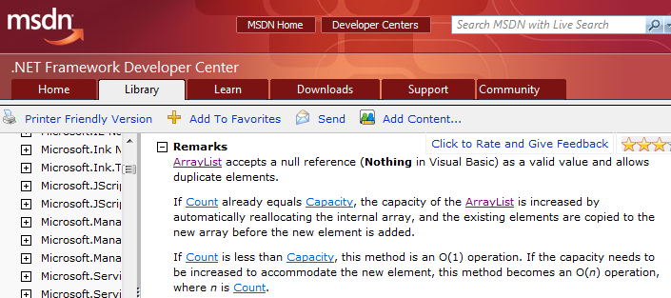
ArrayList with Pex: The Spec

Slide 16
ArrayList: AddItem Test
class ArrayListTest {
[PexMethod]
void AddItem(int c, object item) {
var list = new ArrayList(c);
list.Add(item);
Assert(list[0] == item); }
}
class ArrayList {
object[] items;
int count;
ArrayList(int capacity) {
if (capacity < 0) throw ...;
items = new object[capacity];
}
void Add(object item) {
if (count == items.Length)
ResizeArray();
items[this.count++] = item; }
...

Slide 17
ArrayList: Starting Pex …
class ArrayListTest {
[PexMethod]
void AddItem(int c, object item) {
var list = new ArrayList(c);
list.Add(item);
Assert(list[0] == item); }
}
 | Inputs
class ArrayList {
object[] items;
int count;
ArrayList(int capacity) {
if (capacity < 0) throw ...;
items = new object[capacity];
}
void Add(object item) {
if (count == items.Length)
ResizeArray();
items[this.count++] = item; }
...

Slide 18
ArrayList: Run 1, (0,null)
class ArrayListTest {
[PexMethod]
void AddItem(int c, object item) {
var list = new ArrayList(c);
list.Add(item);
Assert(list[0] == item); }
}
 | Inputs
 | (0,null)
class ArrayList {
object[] items;
int count;
ArrayList(int capacity) {
if (capacity < 0) throw ...;
items = new object[capacity];
}
void Add(object item) {
if (count == items.Length)
ResizeArray();
items[this.count++] = item; }
...

Slide 19
ArrayList: Run 1, (0,null)
class ArrayListTest {
[PexMethod]
void AddItem(int c, object item) {
var list = new ArrayList(c);
list.Add(item);
Assert(list[0] == item); }
}
 | Inputs | Observed Constraints
 | (0,null) | !(c<0)
class ArrayList {
object[] items;
int count;
ArrayList(int capacity) {
if (capacity < 0) throw ...;
items = new object[capacity];
}
void Add(object item) {
if (count == items.Length)
ResizeArray();
items[this.count++] = item; }
...
c < 0 → false

Slide 20
ArrayList: Run 1, (0,null)
class ArrayListTest {
[PexMethod]
void AddItem(int c, object item) {
var list = new ArrayList(c);
list.Add(item);
Assert(list[0] == item); }
}
 | Inputs | Observed Constraints
 | (0,null) | !(c<0) && 0==c
class ArrayList {
object[] items;
int count;
ArrayList(int capacity) {
if (capacity < 0) throw ...;
items = new object[capacity];
}
void Add(object item) {
if (count == items.Length)
ResizeArray();
items[this.count++] = item; }
...
0 == c → true

Slide 21
ArrayList: Run 1, (0,null)
class ArrayListTest {
[PexMethod]
void AddItem(int c, object item) {
var list = new ArrayList(c);
list.Add(item);
Assert(list[0] == item); }
}
 | Inputs | Observed Constraints
 | (0,null) | !(c<0) && 0==c
item == item → true
class ArrayList {
object[] items;
int count;
ArrayList(int capacity) {
if (capacity < 0) throw ...;
items = new object[capacity];
}
void Add(object item) {
if (count == items.Length)
ResizeArray();
items[this.count++] = item; }
...
This is a tautology,
i.e. a constraint that is always true,
regardless of the chosen values.
We can ignore such constraints.

Slide 22
ArrayList: Picking the next branch to cover
class ArrayListTest {
[PexMethod]
void AddItem(int c, object item) {
var list = new ArrayList(c);
list.Add(item);
Assert(list[0] == item); }
}
Constraints to solve | Inputs | Observed Constraints
 | (0,null) | !(c<0) && 0==c
!(c<0) && 0!=c
class ArrayList {
object[] items;
int count;
ArrayList(int capacity) {
if (capacity < 0) throw ...;
items = new object[capacity];
}
void Add(object item) {
if (count == items.Length)
ResizeArray();
items[this.count++] = item; }
...

Slide 23
ArrayList: Solve constraints using SMT solver
class ArrayListTest {
[PexMethod]
void AddItem(int c, object item) {
var list = new ArrayList(c);
list.Add(item);
Assert(list[0] == item); }
}
Constraints to solve | Inputs | Observed Constraints
 | (0,null) | !(c<0) && 0==c
!(c<0) && 0!=c | (1,null)
class ArrayList {
object[] items;
int count;
ArrayList(int capacity) {
if (capacity < 0) throw ...;
items = new object[capacity];
}
void Add(object item) {
if (count == items.Length)
ResizeArray();
items[this.count++] = item; }
...
Z3
Constraint solver
Z3 has decision procedures for
Arrays
Linear integer arithmetic
Bitvector arithmetic
…
(Everything but floating-point numbers)

Slide 24
ArrayList: Run 2, (1, null)
class ArrayListTest {
[PexMethod]
void AddItem(int c, object item) {
var list = new ArrayList(c);
list.Add(item);
Assert(list[0] == item); }
}
Constraints to solve | Inputs | Observed Constraints
 | (0,null) | !(c<0) && 0==c
!(c<0) && 0!=c | (1,null) | !(c<0) && 0!=c
class ArrayList {
object[] items;
int count;
ArrayList(int capacity) {
if (capacity < 0) throw ...;
items = new object[capacity];
}
void Add(object item) {
if (count == items.Length)
ResizeArray();
items[this.count++] = item; }
...
0 == c → false

Slide 25
ArrayList: Pick new branch
class ArrayListTest {
[PexMethod]
void AddItem(int c, object item) {
var list = new ArrayList(c);
list.Add(item);
Assert(list[0] == item); }
}
Constraints to solve | Inputs | Observed Constraints
 | (0,null) | !(c<0) && 0==c
!(c<0) && 0!=c | (1,null) | !(c<0) && 0!=c
c<0
class ArrayList {
object[] items;
int count;
ArrayList(int capacity) {
if (capacity < 0) throw ...;
items = new object[capacity];
}
void Add(object item) {
if (count == items.Length)
ResizeArray();
items[this.count++] = item; }
...

Slide 26
ArrayList: Run 3, (-1, null)
class ArrayListTest {
[PexMethod]
void AddItem(int c, object item) {
var list = new ArrayList(c);
list.Add(item);
Assert(list[0] == item); }
}
Constraints to solve | Inputs | Observed Constraints
 | (0,null) | !(c<0) && 0==c
!(c<0) && 0!=c | (1,null) | !(c<0) && 0!=c
c<0 | (-1,null)
class ArrayList {
object[] items;
int count;
ArrayList(int capacity) {
if (capacity < 0) throw ...;
items = new object[capacity];
}
void Add(object item) {
if (count == items.Length)
ResizeArray();
items[this.count++] = item; }
...

Slide 27
ArrayList: Run 3, (-1, null)
class ArrayListTest {
[PexMethod]
void AddItem(int c, object item) {
var list = new ArrayList(c);
list.Add(item);
Assert(list[0] == item); }
}
Constraints to solve | Inputs | Observed Constraints
 | (0,null) | !(c<0) && 0==c
!(c<0) && 0!=c | (1,null) | !(c<0) && 0!=c
c<0 | (-1,null) | c<0
class ArrayList {
object[] items;
int count;
ArrayList(int capacity) {
if (capacity < 0) throw ...;
items = new object[capacity];
}
void Add(object item) {
if (count == items.Length)
ResizeArray();
items[this.count++] = item; }
...
c < 0 → true

Slide 28

ArrayList: Run 3, (-1, null)
class ArrayListTest {
[PexMethod]
void AddItem(int c, object item) {
var list = new ArrayList(c);
list.Add(item);
Assert(list[0] == item); }
}
Constraints to solve | Inputs | Observed Constraints
 | (0,null) | !(c<0) && 0==c
!(c<0) && 0!=c | (1,null) | !(c<0) && 0!=c
c<0 | (-1,null) | c<0
class ArrayList {
object[] items;
int count;
ArrayList(int capacity) {
if (capacity < 0) throw ...;
items = new object[capacity];
}
void Add(object item) {
if (count == items.Length)
ResizeArray();
items[this.count++] = item; }
...

Slide 29
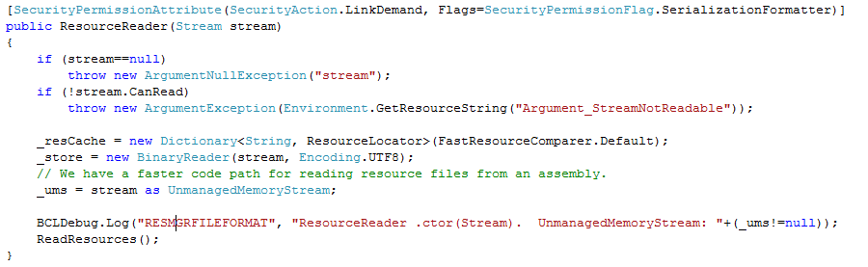
White box testing in practice
How to test this code?
(Real code from .NET base class libraries.)

Slide 30
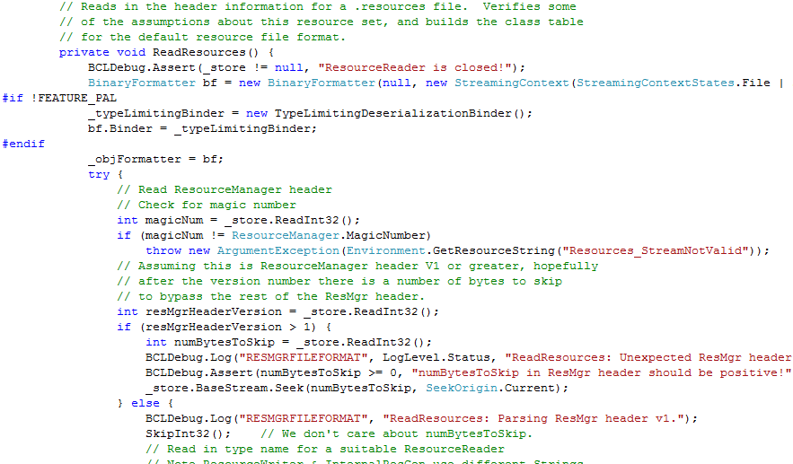
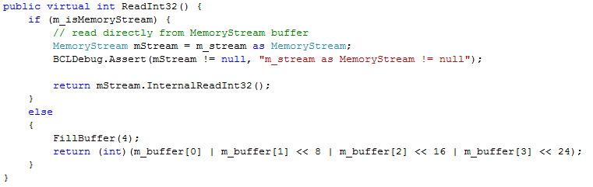
White box testing in practice

Slide 31
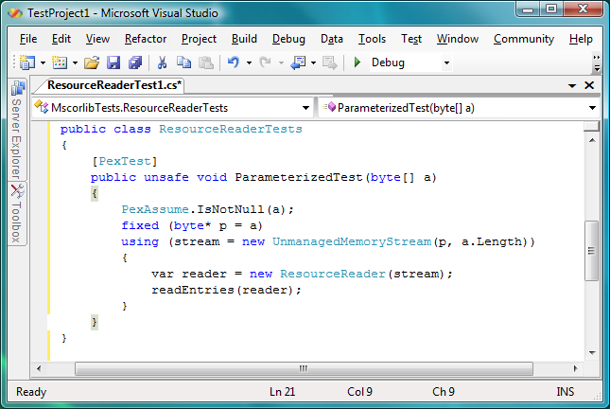
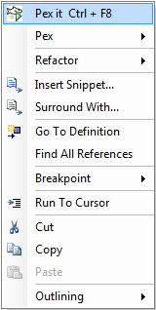
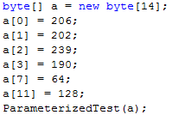
Pex – Test Input Generation Demo
Test input, generated by Pex
31

Slide 32
Test Input Generation by
Dynamic Symbolic Execution
Initially, choose Arbitrary
Run Test and
Monitor
Solve
Test
Inputs
Constraint System
Execution Path
Known
Paths
Choose an
Uncovered Path
Record
Path Condition
Result: small test suite,
high code coverage
Finds only real bugs
No false warnings

Slide 33
Test Input Generation by
Dynamic Symbolic Execution
a[0] = 0;
a[1] = 0;
a[2] = 0;
a[3] = 0;
…
Initially, choose Arbitrary
Run Test and
Monitor
Solve
Test
Inputs
Constraint System
Execution Path
Known
Paths
Choose an
Uncovered Path
Record
Path Condition
Result: small test suite,
high code coverage
Finds only real bugs
No false warnings

Slide 34

Test Input Generation by
Dynamic Symbolic Execution
Initially, choose Arbitrary
Path Condition:
… ⋀ magicNum != 0x95673948
Run Test and
Monitor
Solve
Test
Inputs
Constraint System
Execution Path
Known
Paths
Choose an
Uncovered Path
Record
Path Condition
Result: small test suite,
high code coverage
Finds only real bugs
No false warnings

Slide 35
Test Input Generation by
Dynamic Symbolic Execution
Initially, choose Arbitrary
Run Test and
Monitor
… ⋀ magicNum != 0x95673948
… ⋀ magicNum == 0x95673948
Solve
Test
Inputs
Constraint System
Execution Path
Known
Paths
Choose an
Uncovered Path
Record
Path Condition
Result: small test suite,
high code coverage
Finds only real bugs
No false warnings

Slide 36
Test Input Generation by
Dynamic Symbolic Execution
a[0] = 206;
a[1] = 202;
a[2] = 239;
a[3] = 190;
Initially, choose Arbitrary
Run Test and
Monitor
Solve
Test
Inputs
Constraint System
Execution Path
Known
Paths
Choose an
Uncovered Path
Record
Path Condition
Result: small test suite,
high code coverage
Finds only real bugs
No false warnings

Slide 37
Test Input Generation by
Dynamic Symbolic Execution
Initially, choose Arbitrary
Run Test and
Monitor
Solve
Test
Inputs
Constraint System
Execution Path
Known
Paths
Choose an
Uncovered Path
Record
Path Condition
Result: small test suite,
high code coverage
Finds only real bugs
No false warnings

Slide 38
Automatic Test Input Generation:
Whole-program, white box code analysis
Initially, choose Arbitrary
Run Test and
Monitor
Solve
Test
Inputs
Constraint System
Execution Path
Known
Paths
Choose an
Uncovered Path
Record
Path Condition
Result: small test suite,
high code coverage
Finds only real bugs
No false warnings

Slide 39
Application:
Bit-precise Scalable
Static Analysis
PREfix [Moy, B., Sielaff 2009]

Slide 40
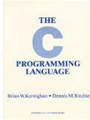
What is wrong here?
-INT_MIN= INT_MIN
3(INT_MAX+1)/4 +
(INT_MAX+1)/4
= INT_MIN
int binary_search(int[] arr, int low,
int high, int key)
while (low <= high)
{
// Find middle value
int mid = (low + high) / 2;
int val = arr[mid];
if (val == key) return mid;
if (val < key) low = mid+1;
else high = mid-1;
}
return -1;
}
void itoa(int n, char* s) {
if (n < 0) {
*s++ = ‘-’;
n = -n;
}
// Add digits to s
….
Package: java.util.Arrays
Function: binary_search
Book: Kernighan and Ritchie
Function: itoa (integer to ascii)

Slide 41
The PREfix Static Analysis Engine
int init_name(char **outname, uint n)
{
if (n == 0) return 0;
else if (n > UINT16_MAX) exit(1);
else if ((*outname = malloc(n)) == NULL) {
return 0xC0000095; // NT_STATUS_NO_MEM;
}
return 0;
}
int get_name(char* dst, uint size)
{
char* name;
int status = 0;
status = init_name(&name, size);
if (status != 0) {
goto error;
}
strcpy(dst, name);
error:
return status;
}
model for function init_name
outcome init_name_0:
guards: n == 0
results: result == 0
outcome init_name_1:
guards: n > 0; n <= 65535
results: result == 0xC0000095
outcome init_name_2:
guards: n > 0|; n <= 65535
constraints: valid(outname)
results: result == 0; init(*outname)
models
Can
Pre-condition be violated?
path for function get_name
guards: size == 0
constraints:
facts: init(dst); init(size); status == 0
paths
Yes: name is not initialized
pre-condition for function strcpy
init(dst) and valid(name)
C/C++ functions
warnings

Slide 42
Overflow on unsigned addition
m_nSize == m_nMaxSize == UINT_MAX
iElement = m_nSize;
if( iElement >= m_nMaxSize )
{
bool bSuccess = GrowBuffer( iElement+1 );
…
}
::new( m_pData+iElement ) E( element );
m_nSize++;
iElement + 1 == 0
Code was written for address space < 4GB
Write in unallocated memory

Slide 43
Using an overflown value as allocation size
Overflow check
ULONG AllocationSize;
while (CurrentBuffer != NULL) {
if (NumberOfBuffers > MAX_ULONG / sizeof(MYBUFFER)) { return NULL;
}
NumberOfBuffers++;
CurrentBuffer = CurrentBuffer->NextBuffer;
}
AllocationSize = sizeof(MYBUFFER)*NumberOfBuffers;
UserBuffersHead = malloc(AllocationSize);
Increment and exit from loop
Possible overflow

Slide 44
PREfix – Summary.
Integration of Z3 into PREfix
  A recent project with Yannick Moy.
  ☺: catches more bugs than old version of PREfix using incomplete ad-hoc solver.
  😐: complete solver for bit-vector operations incurs noticeable overhead compared to incomplete solver.
Ran v1 through “large Microsoft code-base”
  Filed a few dozen bugs during the first run.

Slide 45
Additional
applications

Slide 46





Extended Static Checking and Verification
Hyper-V
VCC
Boogie
Win. Modules
HAVOC
Verification
condition
Bug path
Rustan Leino, Mike Barnet, Michał Moskal, Shaz Qadeer,
Shuvendu Lahiri, Herman Venter,
Wolfram Schulte, Ernie Cohen,
Khatib Braghaven, Cedric Fournet, Andy Gordon, Nikhil Swamy
F7

Slide 47

Model-based Testing and Design
Example Microsoft protocol:
SMB2 (= remote file) Protocol Specification
200+ other Microsoft Protocols
Tools:
Symbolic Exploration of protocol
models to generate tests.
Pair-wise independent input
generation for constrained
algebraic data-types.
Design time model debugging using
Bounded Model Checking
Bounded Conformance Checking
Bounded Input-Output Model Programs
Adapter for testing
Scenarios (slicing)
Behavioral modeling
Scenarios (slicing)
Margus Veanes, Wolfgang Grieskamp

Slide 48
Theory Combinations

Slide 49
Satisfiability Modulo Theories (SMT)
Array Theory
Arithmetic
Uninterpreted Functions

Slide 50
Research around Z3
Decision Procedures
Modular Difference Logic is Hard TR 08 B, Blass Gurevich, Muthuvathi.
Linear Functional Fixed-points. CAV 09 B. & Hendrix.
A Priori Reductions to Zero for Strategy-Independent Gröbner Bases SYNASC 09 M& Passmore.
Efficient, Generalized Array Decision Procedures FMCAD 09 M & B
Combining Decision Procedures
Model-based Theory Combination SMT 07 M & B. .
Accelerating Lemma learning using DPLL(U) LPAR 08 B, Dutetre & M
Proofs, Refutations and Z3 IWIL 08 M & B
On Locally Minimal Nullstellensatz Proofs. SMT 09 M & Passmore.
A Concurrent Portfolio Approach to SMT Solving CAV 09 Wintersteiger, Hamadi & M
Quantifiers, quantifiers, quantifiers
Efficient E-matching for SMT Solvers. . CADE 07 M & B.
Relevancy Propagation. TR 07 M & B.
Deciding Effectively Propositional Logic using DPLL and substitution sets IJCAR 08 M & B.
Engineering DPLL(T) + saturation. IJCAR 08 M & B.
Complete instantiation for quantified SMT formulas CAV 09 Ge & M.
On deciding satisfiability by DPLL( Γ+ T) and unsound theorem proving.
CADE 09 Bonachina, M & Lynch. .
.
.
.
Sorry, I can’t cover it all here

Slide 51
A Combination History
Foundations
Efficiency using rewriting
1979 Nelson, Oppen - Framework
1996 Tinelli & Harindi. N.O Fix
2000 Barrett et.al N.O + Rewriting
2002 Zarba & Manna. “Nice” Theories
2004 Ghilardi et.al. N.O. Generalized
1984 Shostak. Theory solvers
1996 Cyrluk et.al Shostak Fix #1
1998 B. Shostak with Constraints
2001 Rueß & Shankar Shostak Fix #2
2004 Ranise et.al. N.O + Superposition
2001: Moskewicz et.al. Efficient DPLL made guessing cheap
2006 Bruttomesso et.al. Delayed Theory Combination
2007 de Moura & B. Model-based Theory Combination

Slide 52
Main components of modern SMT Solvers
Purification

Slide 53
Main components of modern SMT Solvers
Purification

Slide 54
Main components of modern SMT Solvers
Purification
Arithmetic
Arrrays
Functions

Slide 55
Main components of modern SMT Solvers
Propositional Abstraction

Slide 56
Main components of modern SMT Solvers
Propositional Assignment
Using SAT solver

Slide 57
Main components of modern SMT Solvers
Theory Solving
Arithmetic
Arrays
Theories exchange equalities between shared variables. But how?
Free functions
⊥

Slide 58
A Combination History
Foundations
Efficiency using rewriting
1979 Nelson, Oppen - Framework
1996 Tinelli & Harindi. N.O. Fix
2000 Barrett et.al N.O + Rewriting
2002 Zarba & Manna. Nice Theories
1984 Shostak. Theory solvers
1996 Cyrluk et.al Shostak Fix #1
1998 B. Shostak with Constraints
2001 Rueß & Shankar Shostak Fix #2
2004 Ranise et.al. N.O + Superposition
2001: Efficient DPLL made guessing cheap
2006 Bruttomesso et.al. Delayed Theory Combination
2007 de Moura & B. Model-based Theory Combination

Slide 59
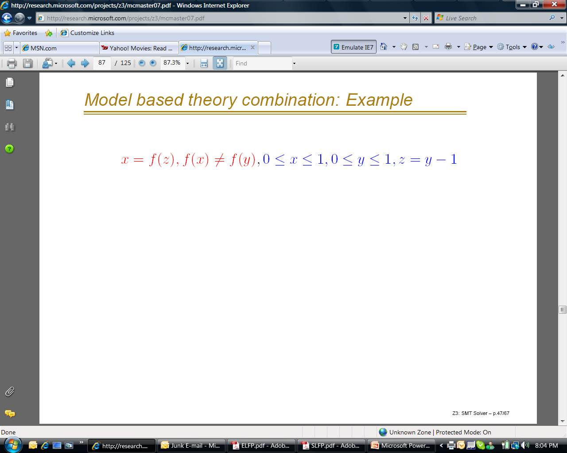
Model-based Combination
The running example was easy.
But what about:
Either x = 0 or x = 1.
y = 0 or y = 1 (when x,y are integers)
Arithmetic module needs to somehow learn
that x≠y. - Integer linear arithmetic is non-convex.

Slide 60
Model-based combination
Delayed Theory Combination solution
[2006 Bruttomesso et.al.]
Add equality literals for every pair of
shared variables:
  ☺: Solvers work completely independently.
  ☺: Works with non-convex theories.
  ☹: O(n²) up-front cost. No use of propagation.

Slide 61
Model-based combination
Idea:
  Have solvers produce models.
  Use models to introduce equalities on demand.
  If M |= Γ, M |= x = y then guess x = y
☺: No up-front O(n²) cost of adding equalities
☺: Works with non-convex theories
☺: Models are conservative approximations
M |= Γ, Γ |= x = y implies M |=x = y

Slide 62
Model-based - Example

Slide 63
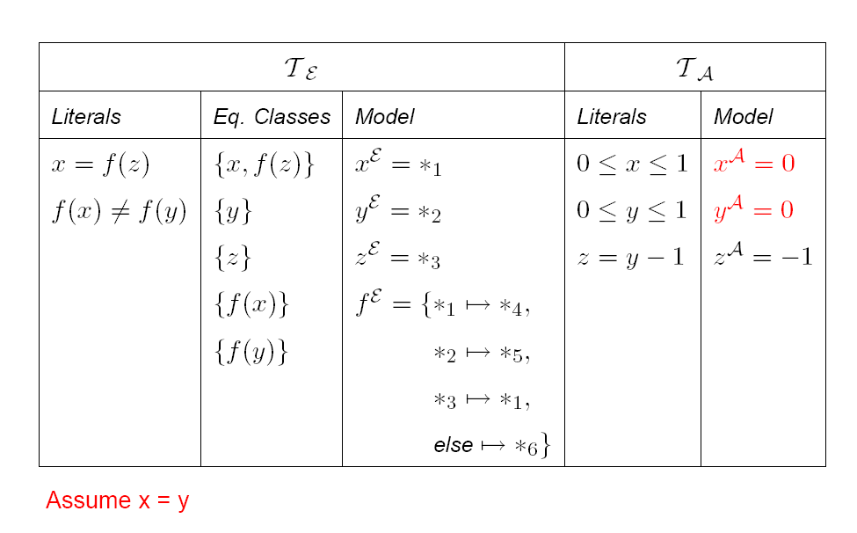
Model-based - Example

Slide 64
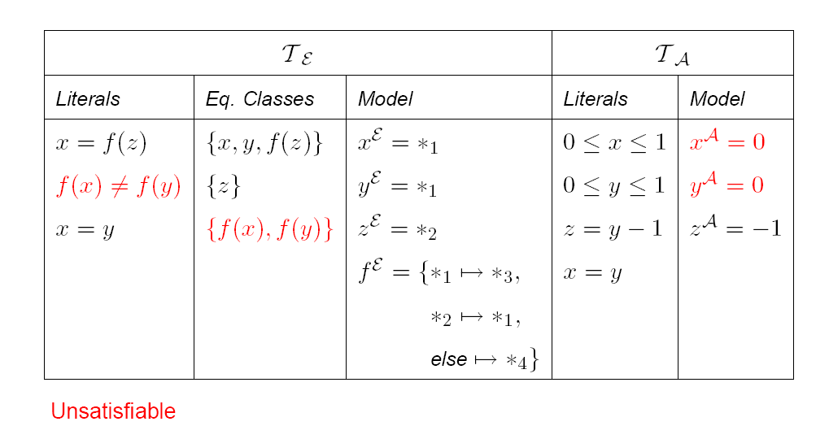
Model-based - Example

Slide 65
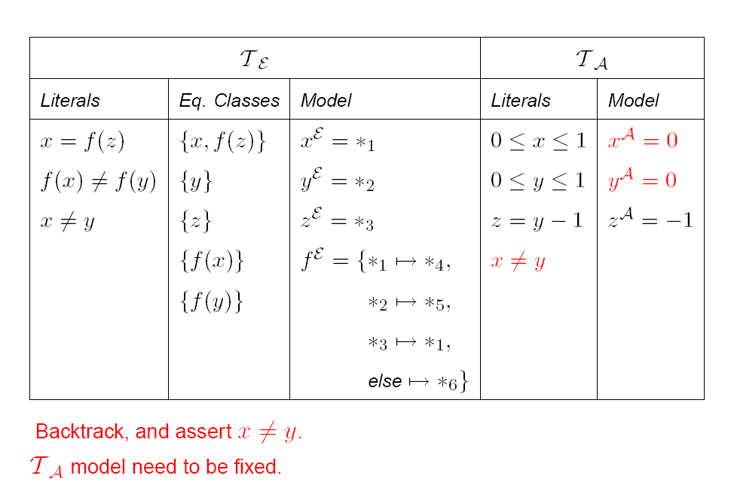
Model-based - Example

Slide 66
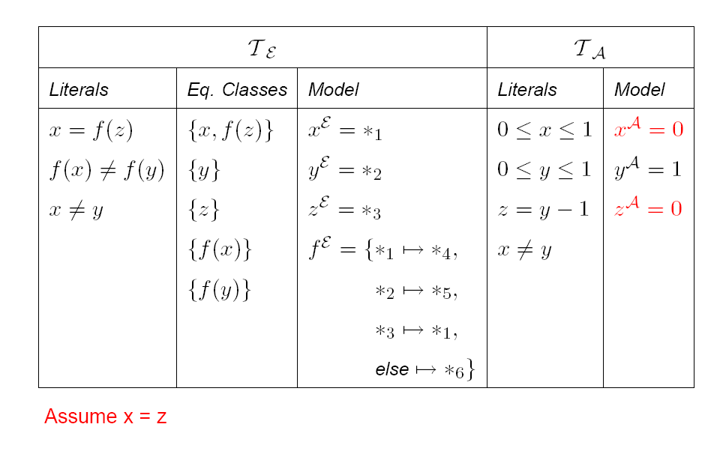
Model-based - Example

Slide 67
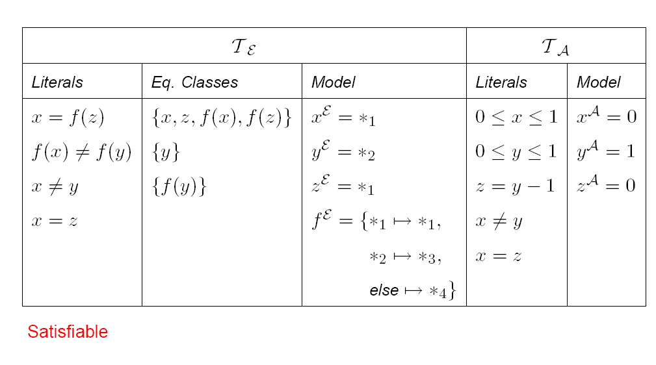
Model-based - Example

Slide 68

Conclusions
SMT solvers are a great fit for software tools
Current main applications:
  Test-case generation.
  Verifying compilers.
  Model Checking & Predicate Abstraction.
  Model-based testing and development
Future opportunities in SMT research and applications abound

Slide 69
Conclusions
SMT solvers are a great fit for software tools
Applications related to FORMATS?
  Dynamic Simulation
  Variants of Bounded-Model Checking
  Abstractions
  Model-based testing and development
Future opportunities in SMT research and applications abound

