Slide 1

Applications of SMT Solving at Microsoft
Nikolaj Bjørner
Microsoft Research
FSE &

Slide 2

This Talk
Using Decision Engines for Software @ Microsoft.
  Dynamic Symbolic Execution
  Bit-precise Scalable Static Analysis
  and several others
What is Important for Decision Engines
  The sweet spot for SMT solvers
  Shameless, blatant propaganda for the SMT solver Z3

Slide 3
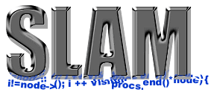




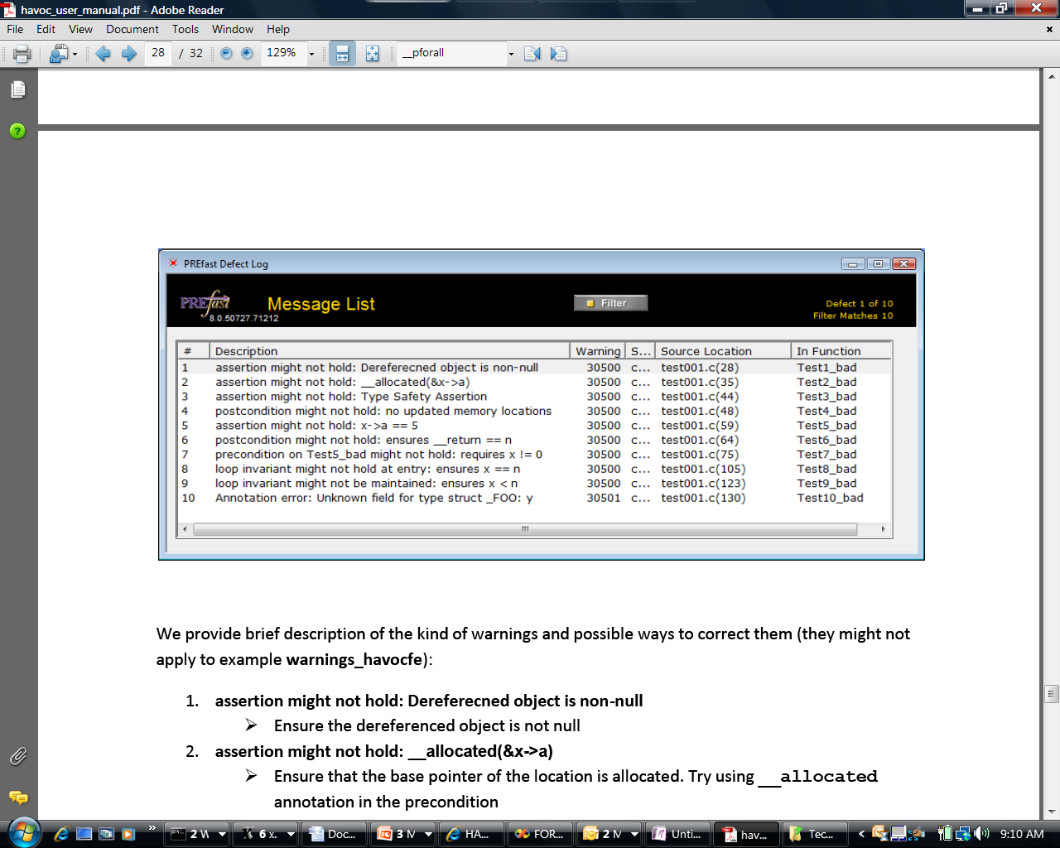

A Decision Engine for Software
Some Microsoft engines:
SDV: The Static Driver Verifier
PREfix: The Static Analysis Engine for C/C++.
Pex: Program EXploration for .NET.
SAGE: Scalable Automated Guided Execution
Spec#: C# + contracts
VCC: Verifying C Compiler for the Viridian Hyper-Visor
HAVOC: Heap-Aware Verification of C-code.
SpecExplorer: Model-based testing of protocol specs.
Yogi: Dynamic symbolic execution + abstraction.
FORMULA: Model-based Design
F7: Refinement types for security protocols
M3: Model Program Modeling
VS3: Abstract interpretation and Synthesis
They all use the SMT solver Z3.
Hyper-V

Slide 4
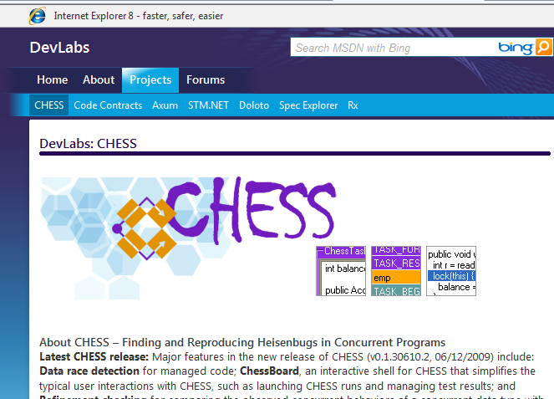
.. Ok Z3 is not everything ..yet
Model Checker
For Multi-threaded
Software
k-bounded exhaustive
Cuzz:
Randomized

Slide 5


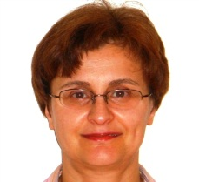
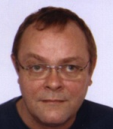

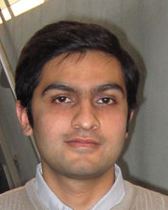

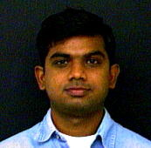

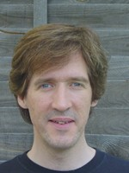




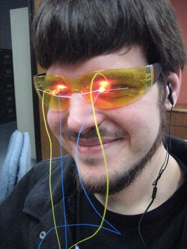


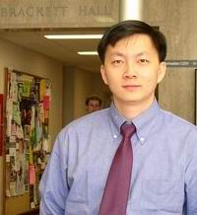

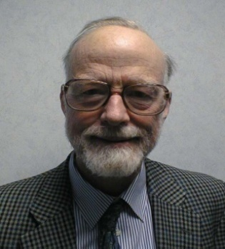
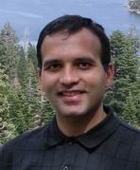
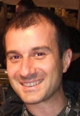
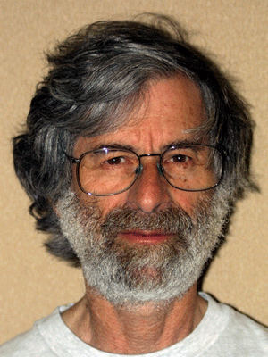



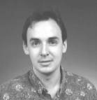
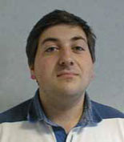
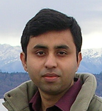





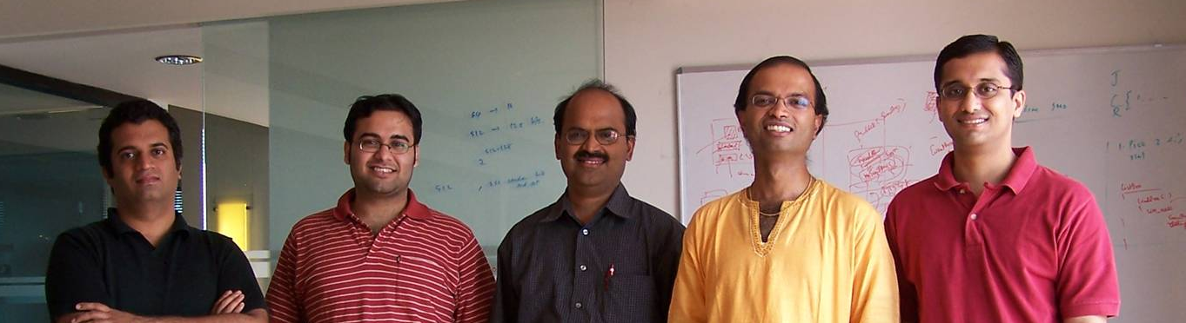





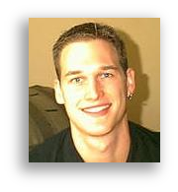
The Inner Research Market @ MSFT

Slide 6
What is Z3?
Simplify
Theories
OCaml
Bit-Vectors
Arrays
SMT-LIB
.NET
Lin-arithmetic
Groebner basis
Recursive Datatypes
Comb. Array Logic
C
Native
Free (uninterpreted) functions
F# quote
Quantifiers:
E-matching
Model Generation:
Finite Models
Quantifiers:
Super-position
Proof objects
Parallel Z3
Assumption tracking
By Leonardo de Moura & Nikolaj Bjørner http://research.microsoft.com/projects/z3

Slide 7
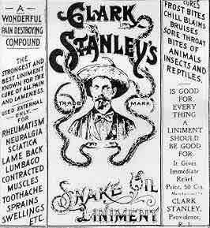
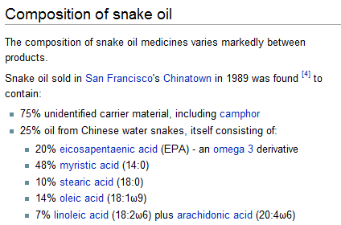
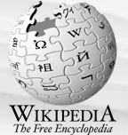
Message ☺
Microsoft’s SMT solver
Z3 is the snake oil when
rubbed on solves all
your problems
Z3 Components:
9% SAT solver
14% Quantifier engine
10% Equality and functions
10% Arrays
20% Arithmetic
10% Bit-vectors
….25% Secret Sauce
……2% Super Secret Sauce

Slide 8
Z3: Some Microsoft Clients
.NET BCL
Hyper-V
Drivers
PEX
VCC
SLAM/SDV
Is this path feasible?
Hoare
Triples
Finite Program abstraction
Model
Proof

Slide 9
Z3 Aspirations
  Engines for progressively
  succinct (first-order) frameworks
  What is still decidable?
  Encoding theories in less
  succinct frameworks.
  Efficiency…
Undecidable
(First-order logic)
NEXPTime-complete
(EPR)
PSpace-complete
(QBF)
NP-complete
(Propositional logic)
P-time
(Equality)

Slide 10
Z3/SMT Aspirations
  Encoding efficiently supported theories in less succinct frameworks.
  What is still
  decidable?
  Engines for progressively
  succinct (first-order) frameworks
Do more with less
P-time
NP
PSpace
Nexp-time
Undecidable

Slide 11
What is SMT?

Slide 12
Satisfiability Modulo Theories (SMT)
Array Theory
Arithmetic
Uninterpreted Functions

Slide 13
Domains from programs
Bits and bytes
Numbers
Arrays
Records
Heaps
Data-types
Object inheritance

Slide 14
Application:
- Pex, SAGE, Yogi, Vigilante
Dynamic Symbolic Execution

Slide 15




Dynamic Symbolic Execution
Run Test and Monitor
Execution Path
Path Condition
seed
Test
Inputs
Known
Paths
New input
Constraint System
Solve
Unexplored path
Vigilante
SAGE
Nikolai Tillmann Peli de Halleux (Pex), Patrice Godefroid (SAGE)
Aditya Nori, Sriram Rajamani (Yogi), Jean Philippe Martin, Miguel Castro,
Manuel Costa, Lintao Zhang (Vigilante)

Slide 16
Test-case generation with SAGE for exploring x86 binaries
Internal user: “WEX Security team”
Use 100s of dedicated machines 24/7 for months
Apps: image processors, media players, file decoders,…
Bugs: Write/read A/Vs, Crash,…
Uncovered bugs not possible
with “black-box” methods.

Slide 17
ABCDE: Application Beneficiary Challenge Direction Enabler
Enabler
Finite model
generation
Application
Direction
Dynamic
Symbolic
Execution
Model-guided
Dynamic
Symbolic Execution
Beneficiary
Using Template
models
SAGE
Challenge

Slide 18
Application:
Bit-precise Scalable
Static Analysis
PREfix [Moy, B., Sielaff 2010]

Slide 19
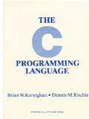
What is wrong here?
-INT_MIN= INT_MIN
3(INT_MAX+1)/4 +
(INT_MAX+1)/4
= INT_MIN
int binary_search(int[] arr, int low,
int high, int key)
while (low <= high)
{
// Find middle value
int mid = (low + high) / 2;
int val = arr[mid];
if (val == key) return mid;
if (val < key) low = mid+1;
else high = mid-1;
}
return -1;
}
void itoa(int n, char* s) {
if (n < 0) {
*s++ = ‘-’;
n = -n;
}
// Add digits to s
….
Package: java.util.Arrays
Function: binary_search
Book: Kernighan and Ritchie
Function: itoa (integer to ascii)

Slide 20
The PREfix Static Analysis Engine
int init_name(char **outname, uint n)
{
if (n == 0) return 0;
else if (n > UINT16_MAX) exit(1);
else if ((*outname = malloc(n)) == NULL) {
return 0xC0000095; // NT_STATUS_NO_MEM;
}
return 0;
}
int get_name(char* dst, uint size)
{
char* name;
int status = 0;
status = init_name(&name, size);
if (status != 0) {
goto error;
}
strcpy(dst, name);
error:
return status;
}
model for function init_name
outcome init_name_0:
guards: n == 0
results: result == 0
outcome init_name_1:
guards: n > 0; n <= 65535
results: result == 0xC0000095
outcome init_name_2:
guards: n > 0|; n <= 65535
constraints: valid(outname)
results: result == 0; init(*outname)
models
Can
Pre-condition be violated?
path for function get_name
guards: size == 0
constraints:
facts: init(dst); init(size); status == 0
paths
Yes: name is not initialized
pre-condition for function strcpy
init(dst) and valid(name)
C/C++ functions
warnings

Slide 21
Overflow on unsigned addition
m_nSize == m_nMaxSize == UINT_MAX
iElement = m_nSize;
if( iElement >= m_nMaxSize )
{
bool bSuccess = GrowBuffer( iElement+1 );
…
}
::new( m_pData+iElement ) E( element );
m_nSize++;
iElement + 1 == 0
Code was written for address space < 4GB
Write in unallocated memory

Slide 22
Using an overflowed value as allocation size
Overflow check
ULONG AllocationSize;
while (CurrentBuffer != NULL) {
if (NumberOfBuffers > MAX_ULONG / sizeof(MYBUFFER)) { return NULL;
}
NumberOfBuffers++;
CurrentBuffer = CurrentBuffer->NextBuffer;
}
AllocationSize = sizeof(MYBUFFER)*NumberOfBuffers;
UserBuffersHead = malloc(AllocationSize);
Increment and exit from loop
Possible overflow

Slide 23
PREfix – Summary.
Integration of Z3 into PREfix
  A recent project with Yannick Moy.
  ☺: catches more bugs than old version of PREfix using incomplete ad-hoc solver.
  😐: complete solver for bit-vector operations incurs overhead compared to incomplete solver.
Ran v1 through “large Microsoft code-base”
  Filed a few dozen bugs during the first run.

Slide 24
ABCDE
Enabler
FAST, Precise
Solver
Application
Direction
Static
Program
Analysis
Static Analysis
Using
Symbolic Execution
EFFICIENT Truth
Maintainance
Beneficiary
PREfix
Challenge

Slide 25
Application:
- Spec#, VCC, HAVOC
Program
Verification

Slide 26





Extended Static Checking and Verification
Hyper-V
VCC
Boogie
Win. Modules
HAVOC
Verification
condition
Bug path
Rustan Leino, Mike Barnet, Michał Moskal, Shaz Qadeer,
Shuvendu Lahiri, Herman Venter,
Wolfram Schulte, Ernie Cohen,
Khatib Braghaven, Cedric Fournet, Andy Gordon, Nikhil Swamy
F7/FINE

Slide 27

Tool Chain: Boogie
#include <vcc2.h>
typedef struct _BITMAP {
UINT32 Size; // Number of bits …
PUINT32 Buffer; // Memory to store …
// private invariants
invariant(Size > 0 && Size % 32 == 0)
…
$ref_cnt(old($s), #p) == $ref_cnt($s, #p) && $ite.bool($set_in(#p, $owns(old($s), owner)),
$ite.bool($set_in(#p, owns),
$st_eq(old($s), $s, #p),
$wrapped($s, #p, $typ(#p)) &&
$timestamp_is_now($s, #p)),
$ite.bool($set_in(#p, owns),
$owner($s, #p) == owner && $closed($s,
Annotated C
Boogie
Verification Condition Generator
http://vcc.codeplex.com/

Slide 28


Tool Chain: Z3
(FORALL (v lv x lxv w a b)
(QID bv:e:c4)
(PATS
($bv_extract
($bv_concat
($bv_extract v lv x lv) lxv w x)
lv a b))
(IMPLIES
(AND
Boogie
Z3
FOL
Using Z3’s support for quantifier instantiation + theories

Slide 29
VCC Performance Trends Nov 08 – Mar 09
Modification in invariant checking
Switch to Z3 v2
Z3 v2 update
Attempt to improve Boogie/Z3 interaction
Switch to Boogie2

Slide 30
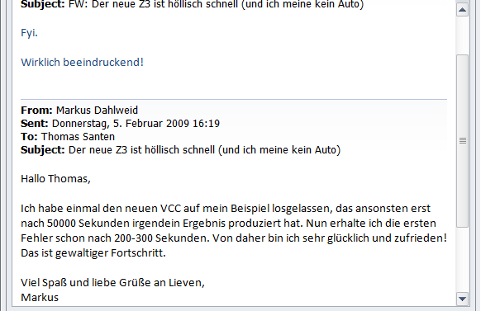
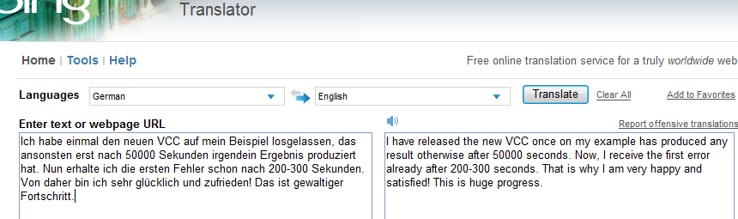
The Importance of Speed

Slide 31
ABCDE
Enabler
Quantifier
Instantiation
Application
Direction
Trusted OS
With
Certificates
Program
Verification
Quantifier
Heuristics and Completeness
Challenge

Slide 32
Application:
- FORMULA
Model-Based
Design

Slide 33
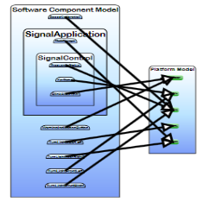
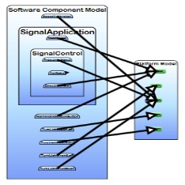
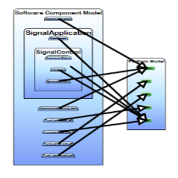
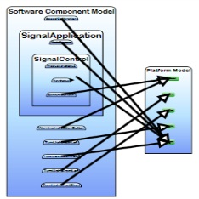
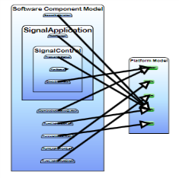
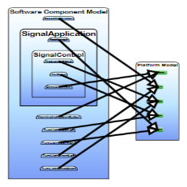
FORMULA: Design Space Exploration
Use Design Space Exploration to identify valid candidate architectures

Slide 34
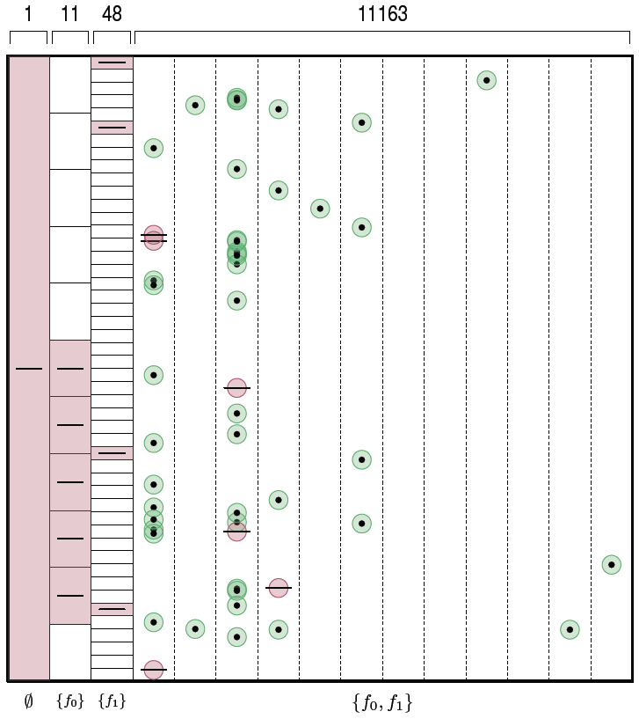
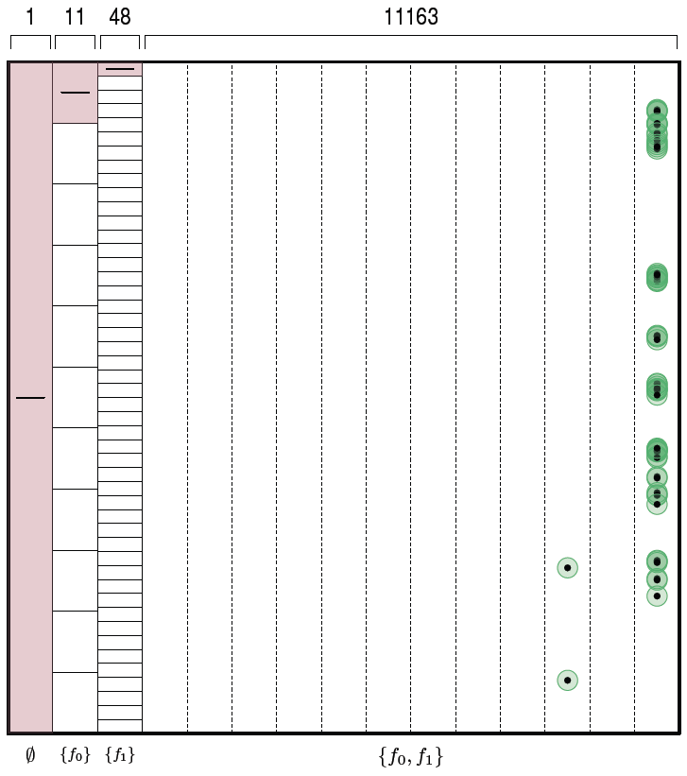
FORMULA: Diversified Search
SMT Formula
Subtract all
isomorphic
solutions
SMT Formula
Z3 Solver
Subtract all
isomorphic
solutions
Diversify and
Constrain
Search Space
Remember this model

Slide 35
ABCDE
Enabler
Generating
Finite Models
Application
Direction
Embedded
Real-time
systems
Model-Based
Design
Quantifier
Elimination
Challenge

Slide 36
Application:
- SpecExplorer, M3
Model-Based
Testing

Slide 37
Model-based Testing and Design
Example Microsoft protocol:
SMB2 (= remote file) Protocol Specification
200+ other Microsoft Protocols
Tools:
Symbolic Exploration of protocol
models to generate tests.
Pair-wise independent input
generation for constrained
algebraic data-types.
Design time model debugging using
Bounded Model Checking
Bounded Conformance Checking
Bounded Input-Output Model Programs
Adapter for testing
Scenarios (slicing)
Behavioral modeling
Scenarios (slicing)
Margus Veanes, Wolfgang Grieskamp

Slide 38
Next steps – Model-based Testing
Enabler
Search only
Relevant Space
Application
Direction
Model-based
Testing
Program
Synthesis
Search StrategIES
Challenge

Slide 39
Selected Z3
Technologies

Slide 40
Research around Z3
Decision Procedures
Modular Difference Logic is Hard TR 08 B, Blass Gurevich, Muthuvathi.
Linear Functional Fixed-points. CAV 09 B. & Hendrix.
A Priori Reductions to Zero for Strategy-Independent Gröbner Bases SYNASC 09 M& Passmore.
Efficient, Generalized Array Decision Procedures FMCAD 09 M & B
Combining Decision Procedures
Model-based Theory Combination SMT 07 M & B. .
Accelerating Lemma learning using DPLL(U) LPAR 08 B, Dutetre & M
Proofs, Refutations and Z3 IWIL 08 M & B
On Locally Minimal Nullstellensatz Proofs. SMT 09 M & Passmore.
A Concurrent Portfolio Approach to SMT Solving CAV 09 Wintersteiger, Hamadi & M
Quantifiers, quantifiers, quantifiers
Efficient E-matching for SMT Solvers. . CADE 07 M & B.
Relevancy Propagation. TR 07 M & B.
Deciding Effectively Propositional Logic using DPLL(Sx) IJCAR 08 M & B.
Engineering DPLL(T) + saturation. IJCAR 08 M & B.
Complete instantiation for quantified SMT formulas CAV 09 Ge & M.
On deciding satisfiability by DPLL( Γ+ T). CADE 09 Bonachina, M & Lynch.
Linear Quantifier Elimination as Abstract Decision Proc. IJCAR 10, B. .
.
.
.

Slide 41
Model-based Theory Combination
Foundations
Efficiency using rewriting
1979 Nelson, Oppen - Framework
1996 Tinelli & Harindi. N.O Fix
2000 Barrett et.al N.O + Rewriting
2002 Zarba & Manna. “Nice” Theories
2004 Ghilardi et.al. N.O. Generalized
1984 Shostak. Theory solvers
1996 Cyrluk et.al Shostak Fix #1
1998 B. Shostak with Constraints
2001 Rueß & Shankar Shostak Fix #2
2004 Ranise et.al. N.O + Superposition
2001: Moskewicz et.al. Efficient DPLL made guessing cheap
2006 Bruttomesso et.al. Delayed Theory Combination
2007 de Moura & B. Model-based Theory Combination
2010 Jovanovic & Barrett. Sharing is Caring

Slide 42
Combinatory Array Logic
A basis of operations
[FMCAD 2009]

Slide 43
Combinatory Array Logic
Derived operations

Slide 44
Efficient E-graph Matching
Match: read(write(A,I,V),I) = read(write(a,g(c),c),f(d,a))
  Assuming
  E = { g(a) = f(b, c), b = d, a = c }
Efficiency through:
  Code trees:
  Runtime program specialization.
  Inverted path indexing:
  When new equality enters, walk from sub-terms upwards to roots in index.
[CADE 2007]

Slide 45
Efficient E-graph Matching
Match: read(write(A,I,V),I) = read(write(a,g(c),c),f(b,a))
  Assuming
  E = { g(a) = f(b, c), b = d, a = c }
Efficiency through:
  Code trees:
  Runtime program specialization.
  Inverted path indexing:
  When new equality enters, walk from sub-terms upwards to roots in index.
[CADE 2007]

Slide 46
Efficient E-graph Matching
Match: read(write(A,I,V),I) = read(write(a,g(c),c),f(b,c))
  Assuming
  E = { g(a) = f(b, c), b = d, a = c }
Efficiency through:
  Code trees:
  Runtime program specialization.
  Inverted path indexing:
  When new equality enters, walk from sub-terms upwards to roots in index.
[CADE 2007]

Slide 47
Efficient E-graph Matching
Match: read(write(A,I,V),I) = read(write(a,g(c),c),g(a))
  Assuming
  E = { g(a) = f(b, c), b = d, a = c }
Efficiency through:
  Code trees:
  Runtime program specialization.
  Inverted path indexing:
  When new equality enters, walk from sub-terms upwards to roots in index.
[CADE 2007]

Slide 48
Efficient E-graph Matching
Match: read(write(A,I,V),I) = read(write(a,g(c),c),g(c))
  Assuming
  E = { g(a) = f(b, c), b = d, a = c }
Efficiency through:
  Code trees:
  Runtime program specialization.
  Inverted path indexing:
  When new equality enters, walk from sub-terms upwards to roots in index.
[CADE 2007]

Slide 49
Linear quantifier Elimination as an Abstract Decision Procedure
SMT for QE has some appeal:
  Just use SMT(LA/LIA) for closed formulas.
Algorithms:
Fourier
Motzkin
Resolution
Omega
Test
Case split+
Virtual subst
Loos-Weisphening
Cooper
Case split+
Resolution
Abstract
Decision Proc
Abstract
Decision Proc
[IJCAR 2010]

Slide 50

Conclusions
SMT solvers are a great fit for software tools
Current main applications:
  Test-case generation.
  Verifying compilers.
  Model Checking & Predicate Abstraction.
  Model-based testing and development
Future opportunities in SMT research and applications abound

