Slide 1



Nikolaj Bjørner
Senior Researcher
Microsoft Research
Redmond
Modern Satisfiability Modulo Theories Solvers in Program Analysis

Slide 2
Lectures
Friday 15:45–17:15
Arrays, Polynomials,
Quantifiers, Fixed-points,..
Summary

Slide 3
Plan
Arrays
Polynomials
Quantifiers
Fixed-points

Slide 4
Takeaways
Learn Additional decision procedures
Modeling with quantifiers and solving

Slide 5
Symbolic Reasoning
High computational Complexity
Practical problems often have structure that can be exploited.
Undecidable (FOL + LIA)
Semi Decidable (FOL)
NEXPTIME (EPR)
PSPACE (QBF)
NP (SAT)
Notes:
Logic is about deriving irrefutable conclusions from a set of premises.

Slide 6
Research around Z3
Decision Procedures
Modular Difference Logic is Hard TR 08 B, Blass Gurevich, Muthuvathi.
Linear Functional Fixed-points. CAV 09 B. & Hendrix.
A Priori Reductions to Zero for Strategy-Independent Gröbner Bases SYNASC 09 M& Passmore.
Efficient, Generalized Array Decision Procedures FMCAD 09 M & B
Quantifier Elimination as an Abstract Decision Procedure IJCAR 10, B
Cutting to the Chase CADE 11, Jojanovich, M
Polynomials IJCAR 12, Jojanovich, M
Combining Decision Procedures
Model-based Theory Combination SMT 07 M & B. .
Proofs, Refutations and Z3 IWIL 08 M & B
On Locally Minimal Nullstellensatz Proofs. SMT 09 M & Passmore.
A Concurrent Portfolio Approach to SMT Solving CAV 09 Wintersteiger, Hamadi & M
Conflict Directed Theory Resolution Cambridge Univ. Press 12, M & B
Quantifiers, quantifiers, quantifiers
Efficient E-matching for SMT Solvers. CADE 07 M & B.
Relevancy Propagation. TR 07 M & B.
Deciding Effectively Propositional Logic using DPLL and substitution sets IJCAR 08 M & B.
Engineering DPLL(T) + saturation. IJCAR 08 M & B.
Complete instantiation for quantified SMT formulas CAV 09 Ge & M.
On deciding satisfiability by DPLL( Γ+ T) and unsound theorem proving. CADE 09 Bonachina, M & Lynch.
Generalized PDR SAT 12 Hoder & B..
.
.
.

Slide 7
Arrays

Slide 8
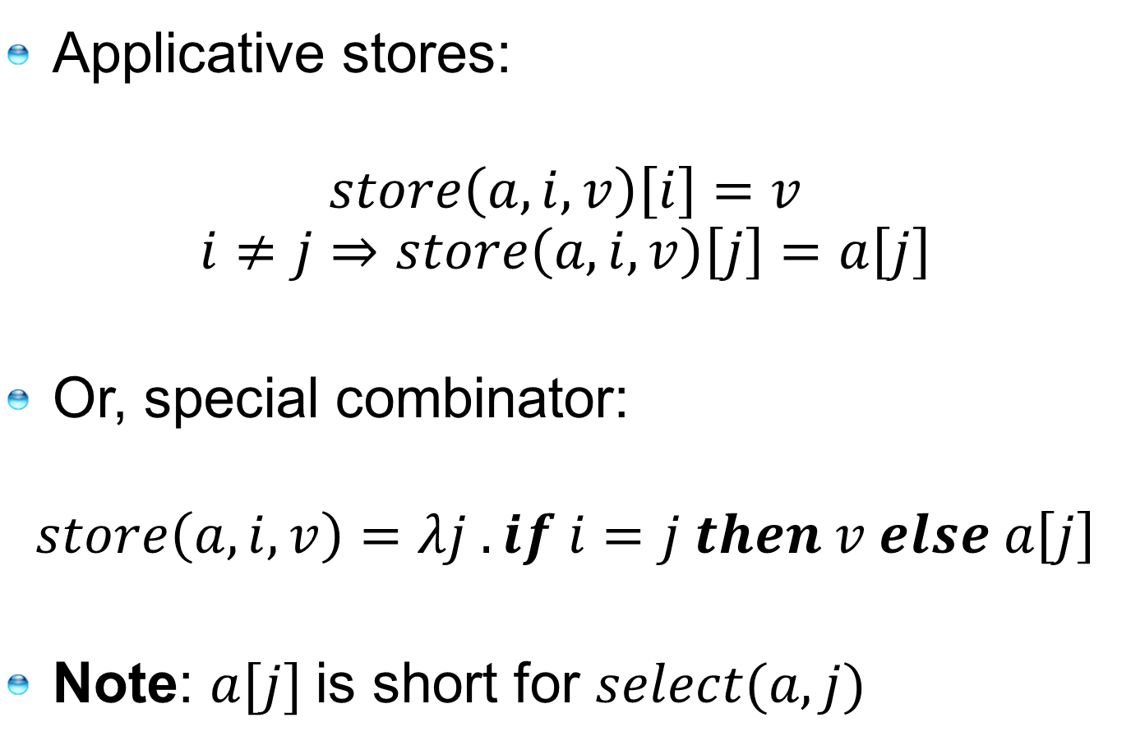
Arrays
Applicative stores:
$$store\left(a,i,v\right)\left[i\right]=v$$
$$i≠j⇒store\left(a,i,v\right)\left[j\right]=a\left[j\right]$$
Or, special combinator:
$$store\left(a,i,v\right)=λj . if i=j then v else a\left[j\right]$$
Note: $a[j]$is short for $select(a,j)$

Slide 9
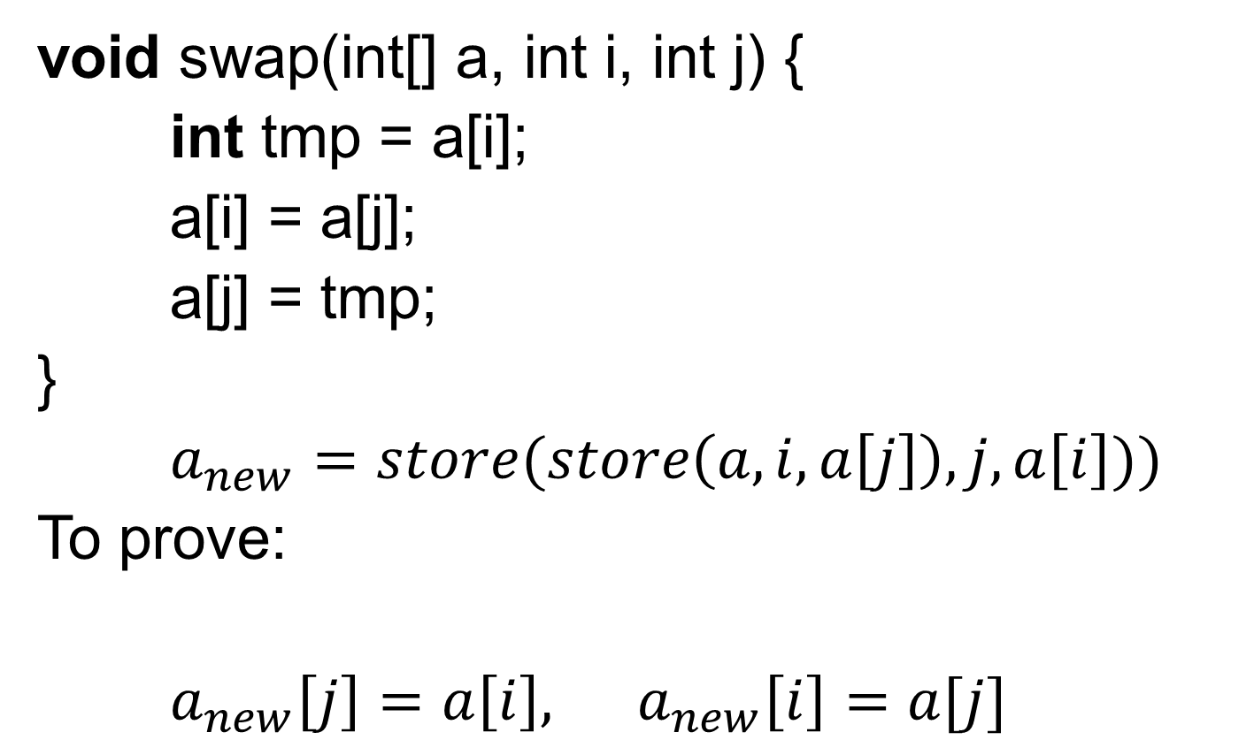
A program using arrays
void swap(int[] a, int i, int j) {
int tmp = a[i];
a[i] = a[j];
a[j] = tmp;
}
$a_{new}=store(store\left(a,i,a\left[j\right]\right),j,a\left[i\right]))$
To prove:
$a_{new}\left[j\right]=a\left[i\right], a_{new}\left[i\right]=a[j]$

Slide 10
What are arrays?
Special combinator:
Existential fragment is decidable by reduction to congruence closure using finite set of instances.
Idea: models for select (_[ ]) are finite maps
$$store\left(a,i,v\right)=λj . if i=j then v else a\left[j\right]$$

Slide 11
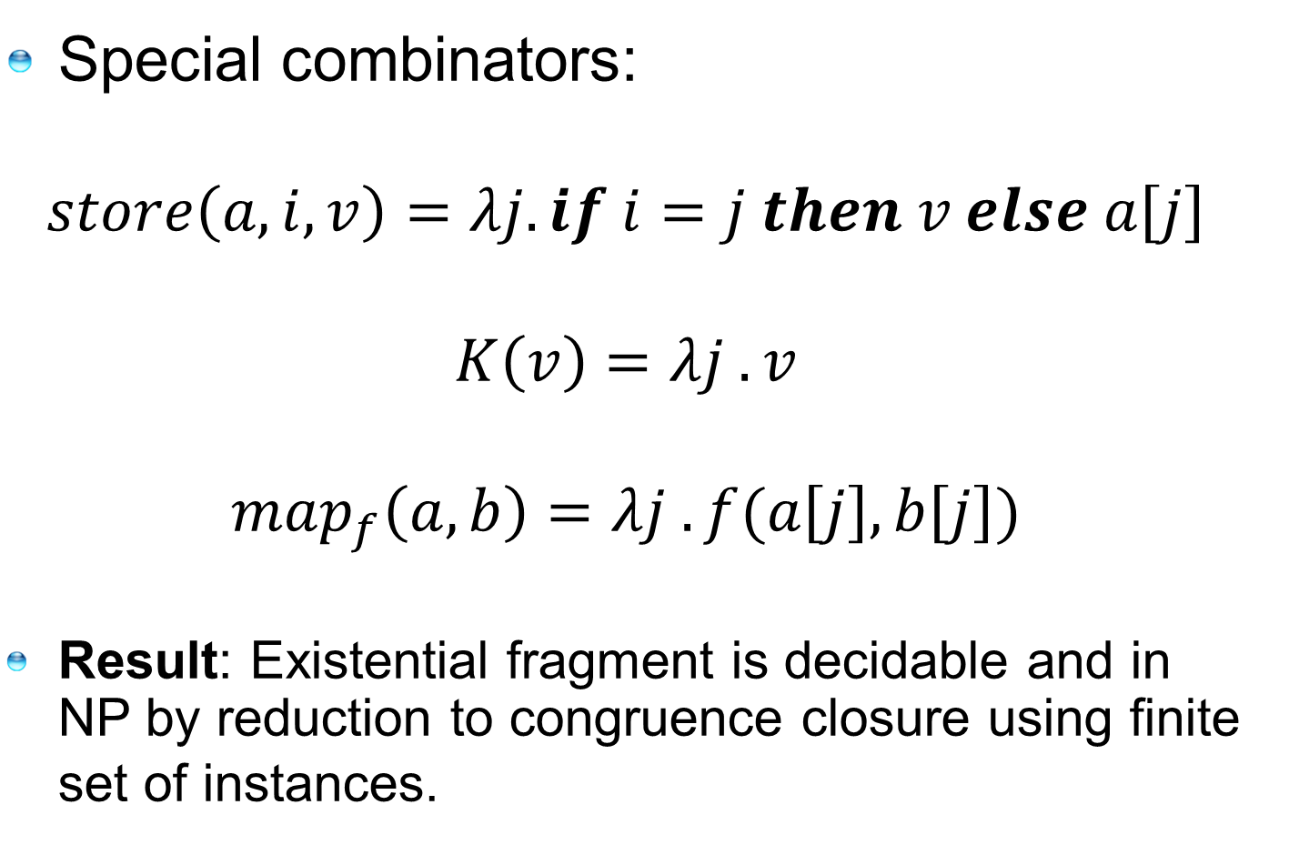
What else are arrays?
Special combinators:
$$store\left(a,i,v\right)=λj. if i=j then v else a\left[j\right]$$
$$K\left(v\right)=λj . v$$
$$map_{f}\left(a,b\right)=λj . f(a\left[j\right],b\left[j\right])$$
Result: Existential fragment is decidable and in NP by reduction to congruence closure using finite set of instances.

Slide 12
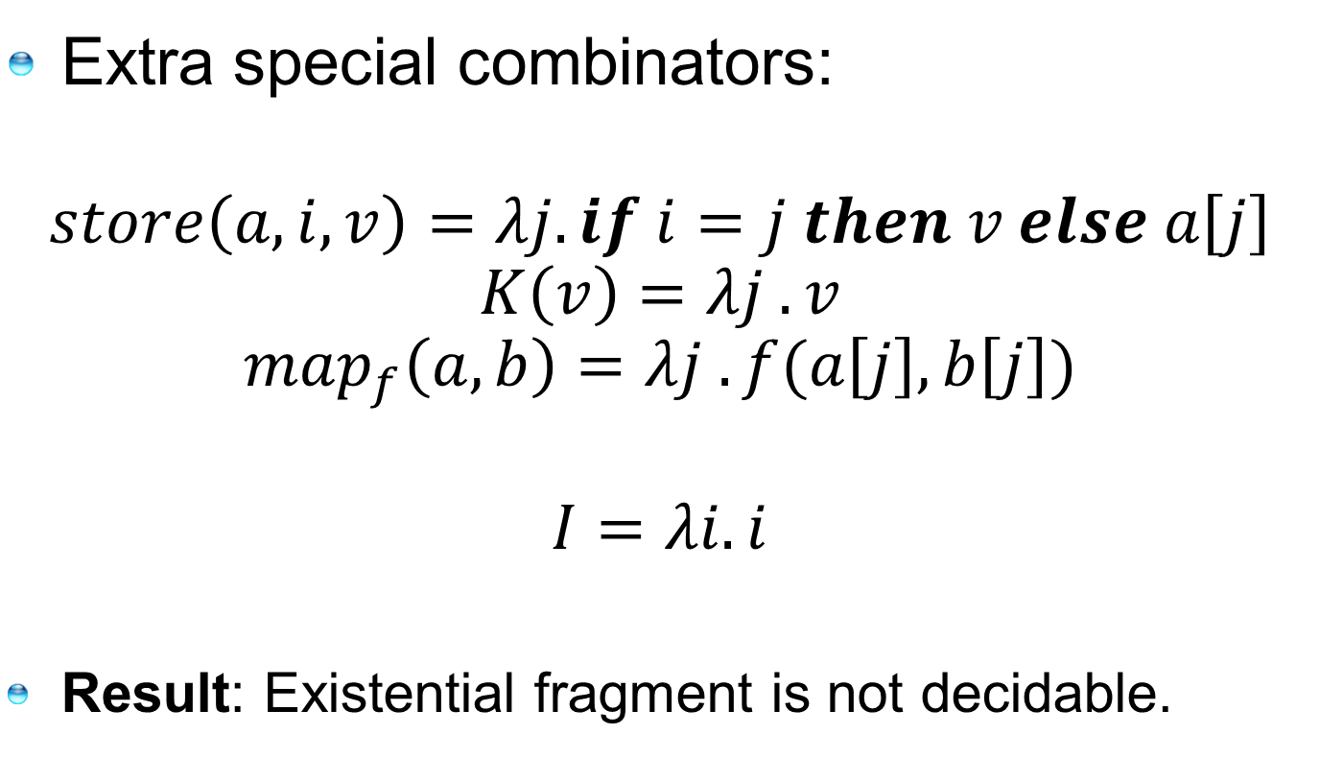
What else are arrays++?
Extra special combinators:
$$store\left(a,i,v\right)=λj. if i=j then v else a\left[j\right]$$
$$K\left(v\right)=λj . v$$
$$map_{f}\left(a,b\right)=λj . f(a\left[j\right],b\left[j\right])$$
$$I=λi.i$$
Result: Existential fragment is not decidable.

Slide 13
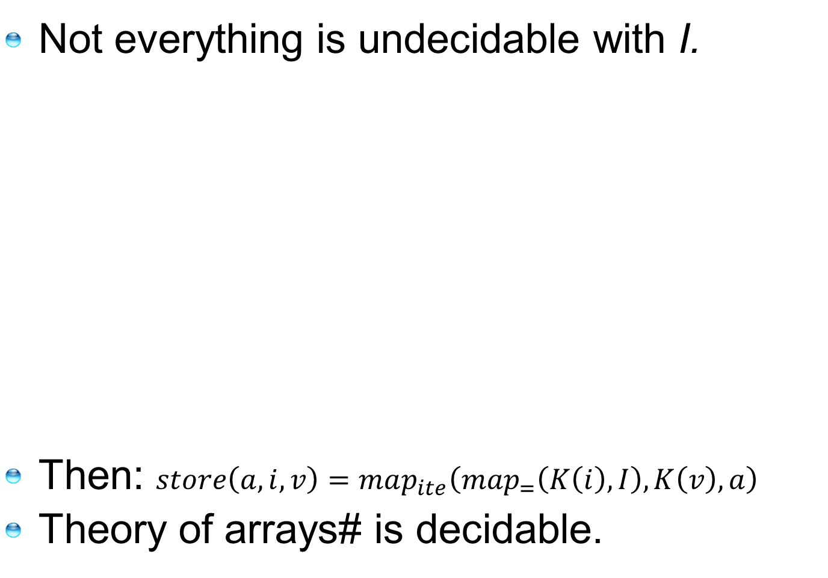
… But there are arrays#:
Not everything is undecidable with I.
Then: $store\left(a,i,v\right)=map_{ite}\left(map_{=}\left(K\left(i\right), I\right), K\left(v\right), a\right)$
Theory of arrays# is decidable.

Slide 14
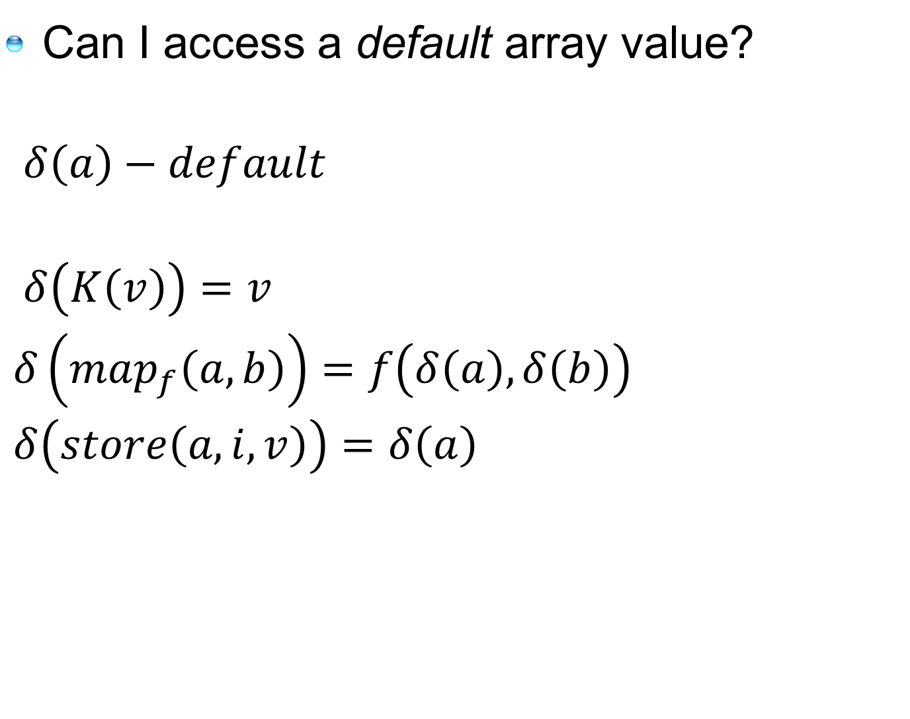
Last combinator for the road…
Can I access a default array value?
$δ\left(a\right)−default$
$δ\left(K\left(v\right)\right)=v$
$δ\left(map_{f}\left(a,b\right)\right)=f\left(δ\left(a\right),δ\left(b\right)\right)$
$δ\left(store\left(a,i,v\right)\right)=δ\left(a\right)$
Only sound for infinite domains

Slide 15


Let’s use CAL:
Simple set and bag operations:
But not cardinality |A|, power-set 2^{A}, …
$$∅=K\left(false\right)$$
$$\left\{a\right\}=store\left(∅, a, true\right)$$
$$a∈A=A\left[a\right]$$
$$A∪B=map_{∨}\left(A,B\right)$$
$$A∩B=map_{∧}\left(A,B\right)$$
$$finite\left(A\right)=(δ\left(A\right)=false)$$
$$∅=K\left(0\right)$$
$$\left\{a\right\}=store\left(∅, a, 1\right)$$
$$multi(a,A)=A\left[a\right]$$
$$A∪B=map_{+}\left(A,B\right)$$
$$A∩B=map_{min}\left(A,B\right)$$
$$finite\left(A\right)=(δ\left(A\right)=0)$$

Slide 16
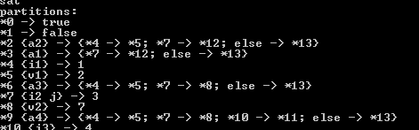
A reduction approach
Use saturation rules to reduce arrays
to the theory of un-interpreted functions
Extract models for arrays as finite graphs

Slide 17
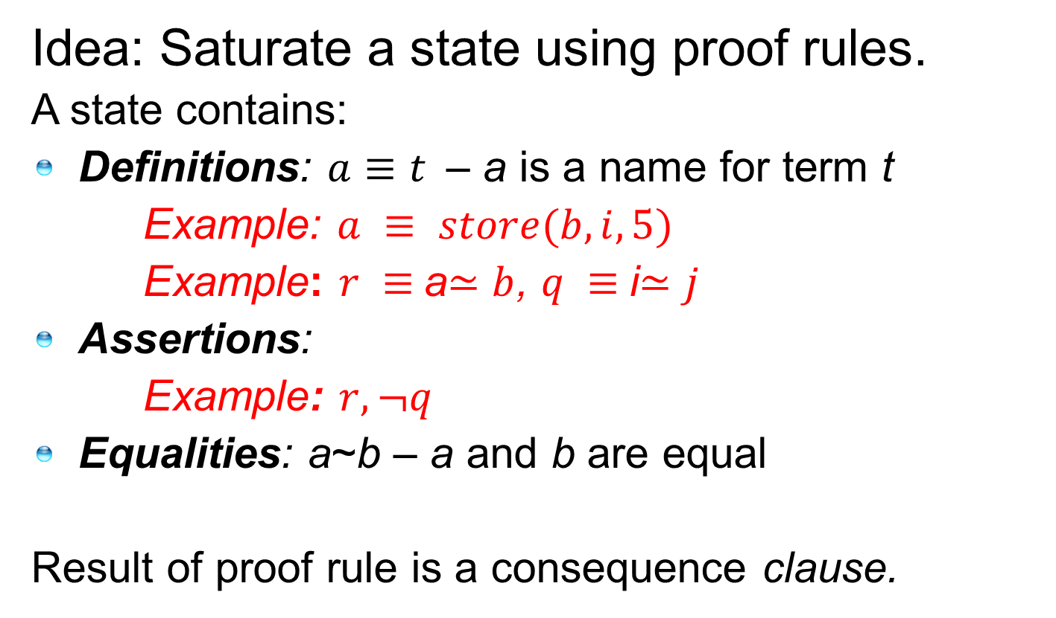
Array Saturation Rules
Idea: Saturate a state using proof rules.
A state contains:
Definitions: $a≡t$– a is a name for term t
Example: $a ≡ store(b,i,5)$
Example: $r ≡$a$≃b$, $q ≡$i$≃j$
Assertions:
  Example: $r, ¬q$
Equalities: a~b – a and b are equal
Result of proof rule is a consequence clause.

Slide 18
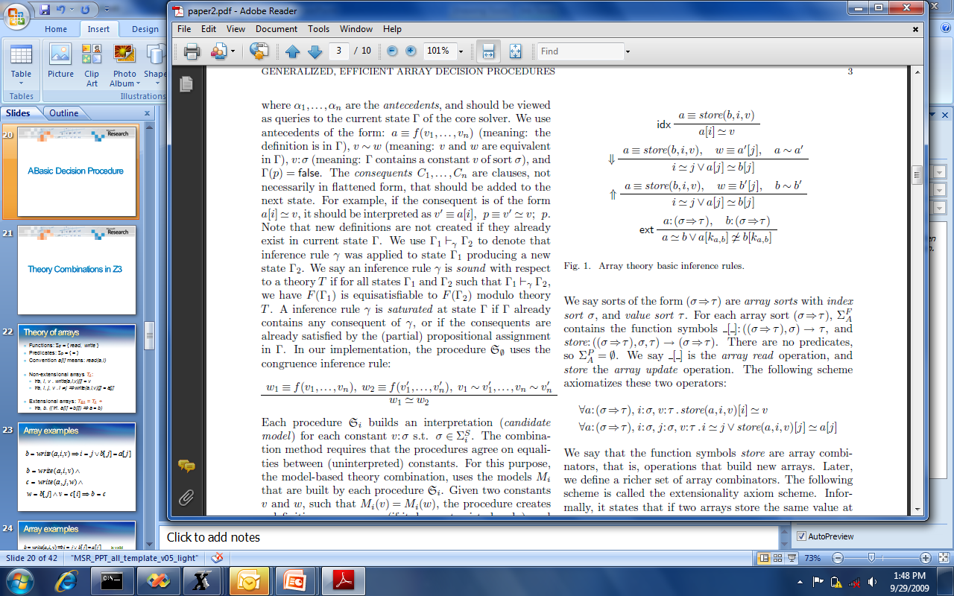
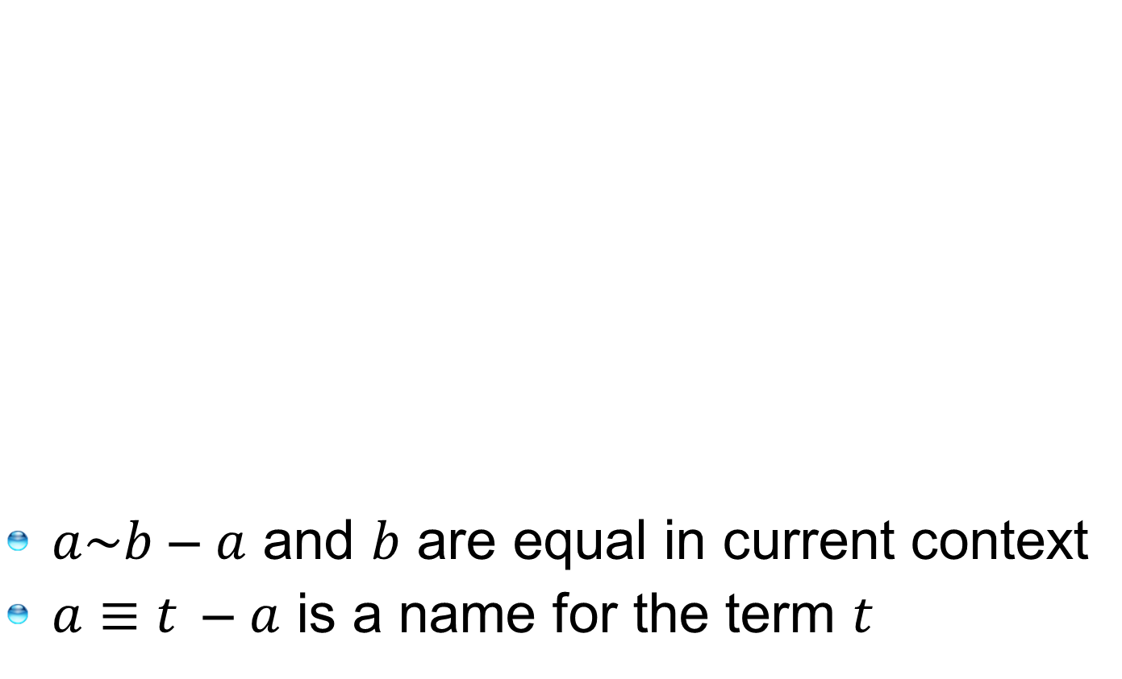
Array Saturation Rules
$a\sim b$ – $a$ and $b$ are equal in current context
$a≡t$– $a$ is a name for the term $t$

Slide 19
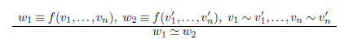
Congruence Closure

Slide 20
Bottlenecks
Bottleneck:
Extensionality axiom is instantiated on every pair of array variables.
Bottleneck:
Upwards propagation distributes index over all modifications of same array.

Slide 21
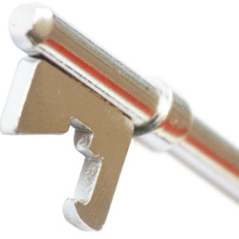
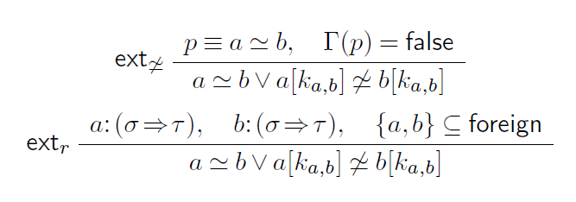

Bottlenecks and
Bottleneck: Extensionality axiom is instantiated on every pair of array variables.
Optimization: Restrict to variables asserted different, or shared.

Slide 22
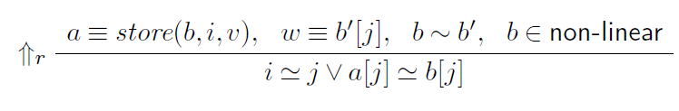
Bottlenecks and
Bottleneck: Upwards propagation distributes index over all modifications of same array.
Optimization: Only use ⇑ for updates where ancestor has multiple children. Formulas from programs are well-behaved.

Slide 23
Polynomials
Dejan Jojanovich,
Leonardo de Moura
IJCAR 2012

Slide 24
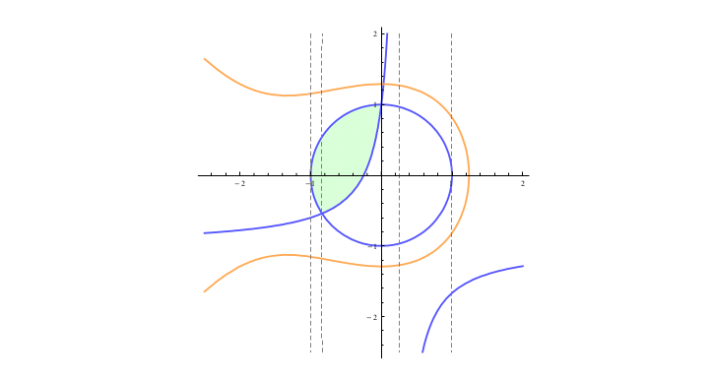



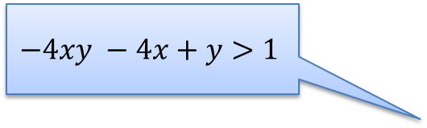
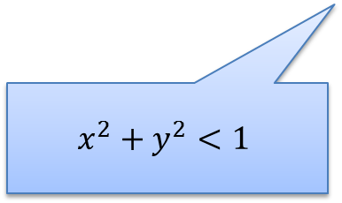
Non-linear arithmetic
One of key ideas: Use partial solution to guide the search
Feasible Region
$$x^{3}+2x^{2}+3y^{2}−5<0$$
Starting search
Partial solution:
$$x=0.5$$
$$−4xy −4x+y>1$$
What is the core?
$$x^{2}+y^{2}<1$$
Can we extend it to $y$?

Slide 25
Quantifiers

Slide 26



Equality-Matching
$\begin{matrix} & p_{(∀…\text{)}} \\ ∧ & a=g\left(b,b\right) \\ ∧ & b=c \\ ∧ & f\left(a\right)≠c \\ ∧ & p_{(∀x\text{ ...}\text{)}}→f\left(g\left(b,b\right)\right)=b\end{matrix}$
$$\begin{matrix} & (∀x f\left(g\left(c,x\right)\right)=x\text{)} \\ ∧ & a=g\left(b,b\right) \\ ∧ & b=c \\ ∧ & f\left(a\right)≠c \\ ∧ & \left(∀x f\left(g\left(x\right)\right)=x\right)→f\left(g\left(b,b\right)\right)=b\end{matrix}$$
$g\left(c,x\right)$ matches $g\left(b,b\right)$
with substitution $\left[x↦b\right]$
modulo $b=c$
[de Moura, B. CADE 2007]

Slide 27
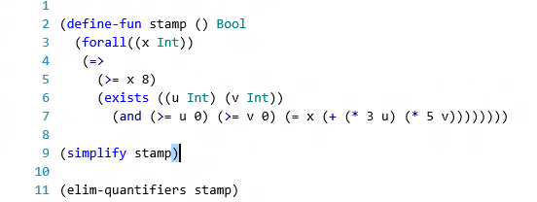
Quantifier Elimination
Presburger Arithmetic,
Algebraic Data-types,
Quadratic polynomials
SMT integration to prune branches
[B. IJCAR 2010]

Slide 28
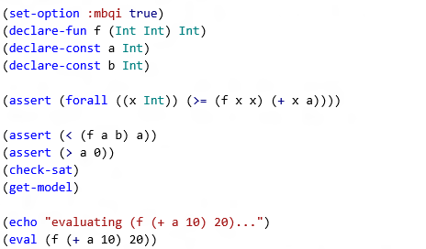
MBQI: Model based Quantifier Instantiation
[de Moura, Ge. CAV 2008]
[Bonachnia, Lynch, de Moura CADE 2009]
[de Moura, B. IJCAR 2010]

Slide 29
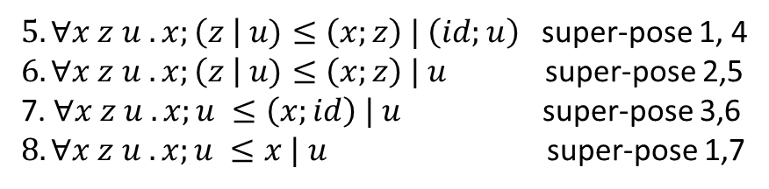
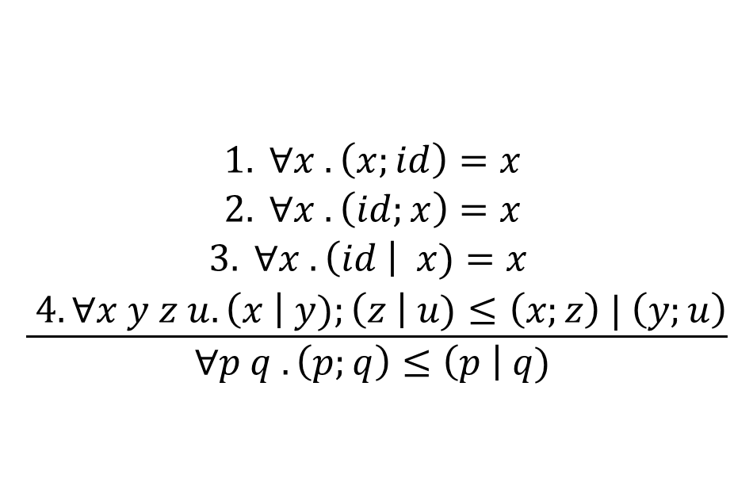
Superposition
$$\frac{\begin{aligned}1. ∀x . \left(x;id\right)=x \\ 2. ∀x . \left(id;x\right)=x \\ 3. ∀x . \left(id \right| x)=x \\ 4. ∀x y z u.\left(x \right| y);\left(z \right| u)≤\left(x;z\right) | \left(y;u\right)\end{aligned}}{∀p q .\left(p;q\right)≤\left(p \right| q) }$$
$5. ∀x z u .x;\left(z \right| u)≤\left(x;z\right) | \left(id;u\right)$ super-pose 1, 4
$6. ∀x z u .x;\left(z \right| u)≤\left(x;z\right) | u$ super-pose 2,5
7. $∀x z u .x;u ≤\left(x;id\right) | u$ super-pose 3,6
$8. ∀x z u .x;u ≤x | u$ super-pose 1,7
[de Moura, B. IJCAR 2008]
(disabled in release 4.1)

Slide 30
Solving Fixed-points
[Hoder, B SAT 2012]

Slide 31
Motivation: Recursive Procedures
mc(x) = x-10 if x > 100
mc(x) = mc(mc(x+11)) if x ≤ 100
assert (mc(x) ≥ 91)

Slide 32
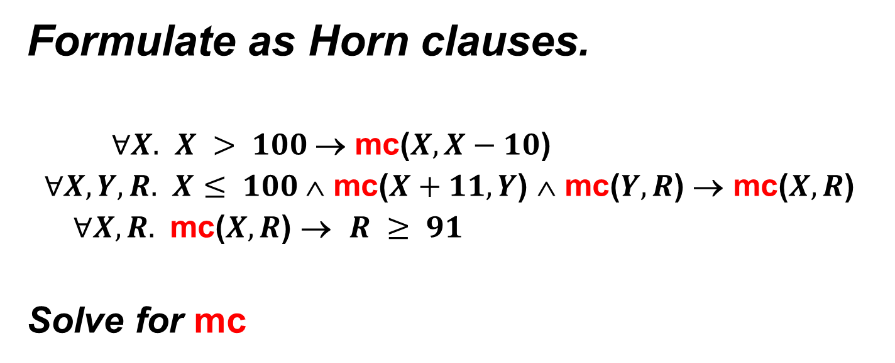
Motivation: Recursive Procedures
Formulate as Horn clauses.
$∀X.$ $X > 100$→ mc($X,X−10$)
$∀X,Y,R.$ $X≤ 100$∧ mc($X+11,Y$) ∧ mc($Y,R$) → mc($X,R$)
$∀X,R.$ mc($X,R$) → $R ≥ 91$
Solve for mc

Slide 33
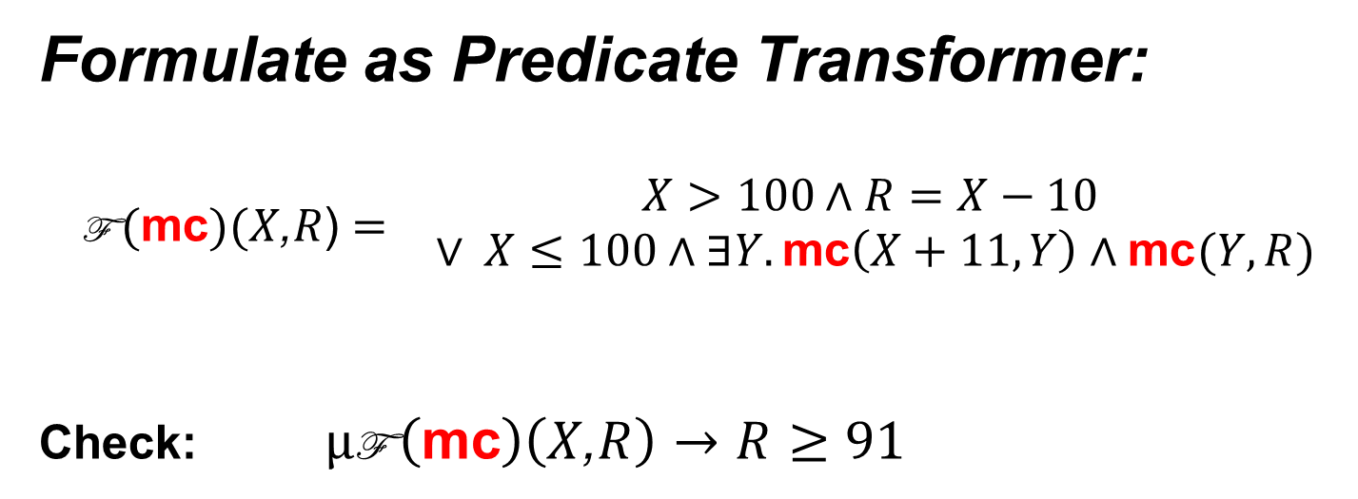
Motivation: Recursive Procedures
Formulate as Predicate Transformer:
$$\begin{matrix}\text{F} (\text{mc})(X\text{,}R\text{)}= & \begin{matrix}X>100∧R=X−10 \\ ∨ X≤100∧∃Y. \text{mc}\left(X+11,Y\right)∧\text{mc}(Y,R)\end{matrix}\end{matrix}$$
Check: $μ\text{F} \left(\text{mc}\right)\left(X\text{,}R\right)→R≥91$

Slide 34
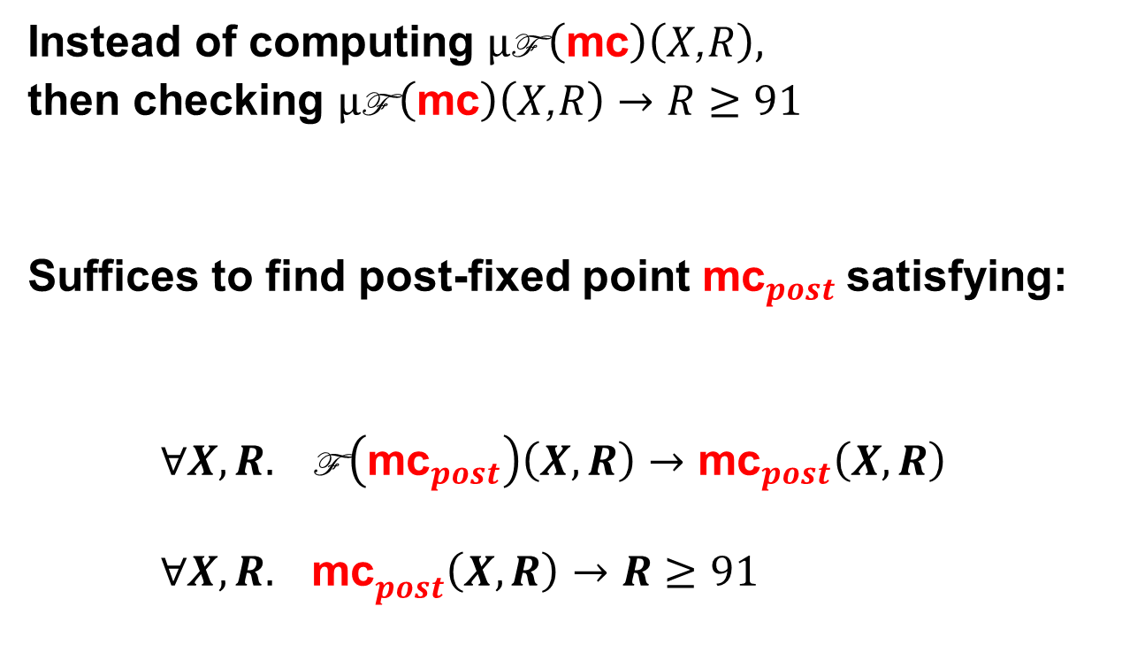
Motivation: Recursive Procedures
Instead of computing $μ\text{F} \left(\text{mc}\right)\left(X\text{,}R\right),$
then checking $μ\text{F} \left(\text{mc}\right)\left(X\text{,}R\right)→R≥91$
Suffices to find post-fixed point ${\text{mc}}_{post}$satisfying:
$∀X,R. \text{F} \left({\text{mc}}_{post}\right)\left(X,R\right)→{\text{mc}}_{post}\left(X,R\right)$
${∀X,R. \text{mc}}_{post}\left(X,R\right)→R≥91$

Slide 35
Program Verification as SMT
[Bjørner, McMillan, Rybalchenko, SMT workshop 2012]
Program Verification (Safety)
as Solving fixed-points
as Satisfiability of Horn clauses

Slide 36
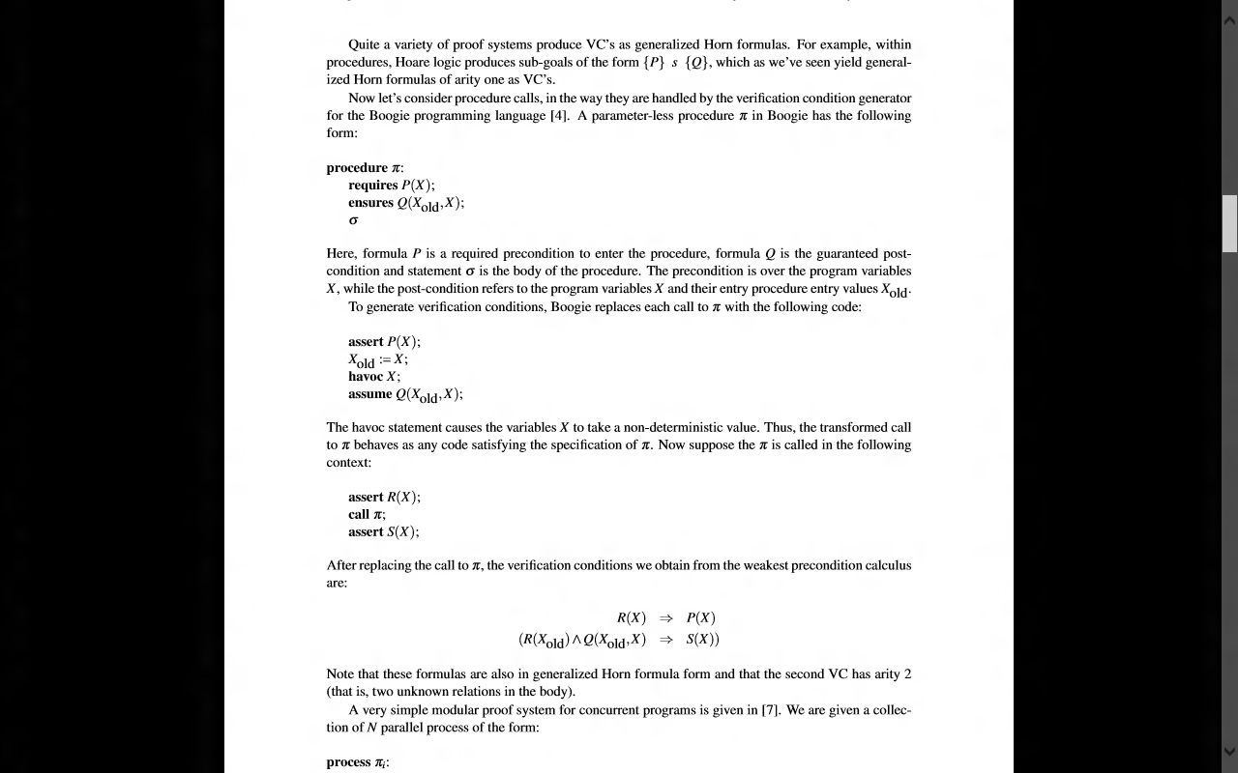
Procedures ⇒ Horn Formulas
Summary as commands
Verifying procedure calls

Slide 37
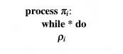
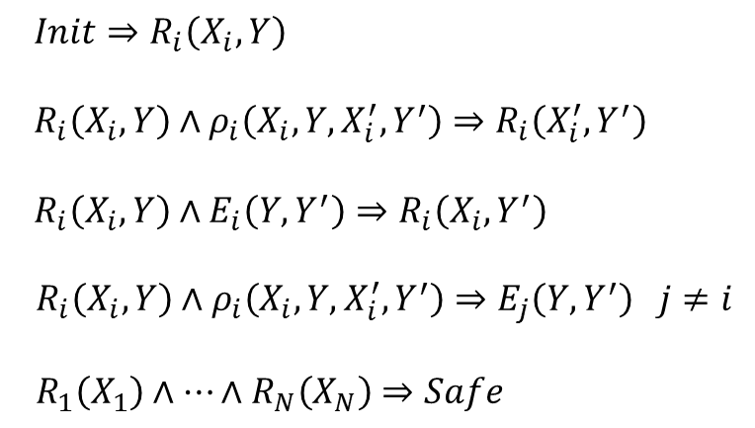
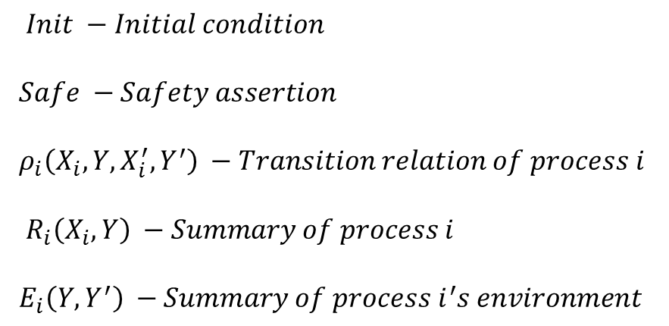

Modular Concurrency ⇒ Horn Clauses
$Init −Initial condition$
$Safe −Safety assertion$
$ρ_{i}\left(X_{i}, Y,X_{i}^{′},Y^{′}\right) −Transition relation of process i$
${ R}_{i}\left(X_{i}, Y\right) −Summary of process i$
$E_{i}\left(Y,Y^{′}\right) −Summary of process i{}_{}^{′}s environment$
$Init⇒R_{i}\left(X_{i}, Y\right)$
${ R}_{i}\left(X_{i},Y\right)∧ρ_{i}\left(X_{i}, Y,X_{i}^{′},Y^{′}\right)⇒R_{i}\left(X_{i}^{′},Y^{′}\right)$
$R_{i}\left(X_{i}, Y\right)∧E_{i}\left(Y,Y^{′}\right)⇒R_{i}\left(X_{i}, Y^{′}\right)$
$R_{i}\left(X_{i},Y\right)∧ρ_{i}\left(X_{i}, Y,X_{i}^{′},Y^{′}\right)⇒E_{j}\left(Y,Y^{′}\right) j≠i$
$R_{1}\left(X_{1}\right)∧…∧R_{N}\left(X_{N}\right)⇒Safe$
[Predicate Abstraction and
Refinement for Verifying
Multi-Threaded Programs
Ashutosh Gupta, Corneliu Popeea,
Andrey Rybalchenko, POPL 2011]

Slide 38

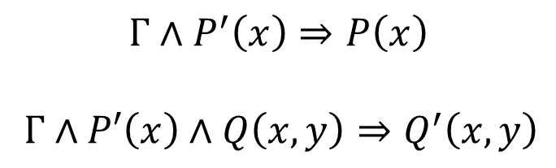
⇒ Horn Clauses
$$Γ⊢\left\{ x:τ \right|P(x)\}→\left\{ y:σ \right| Q(x,y) \}≺\left\{ x:τ \right|P′(x)\}→\left\{ y:σ \right| Q′(x,y) \}$$
Extract sufficient Horn Conditions
$$Γ∧P^{′}\left(x\right)⇒P\left(x\right)$$
$Γ∧P′\left(x\right)∧Q\left(x,y\right)⇒Q^{′}\left(x,y\right)$

Slide 39
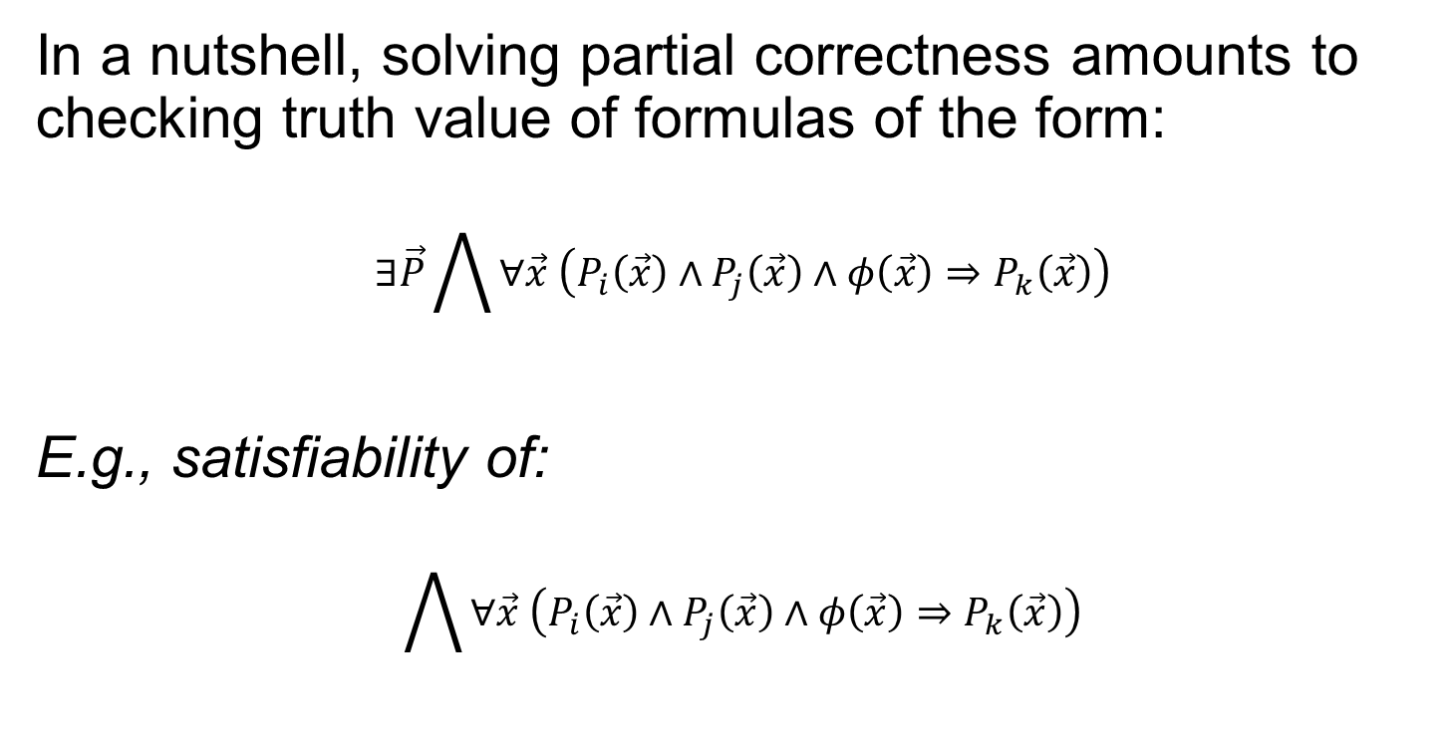
Generalized Horn Formulas
In a nutshell, solving partial correctness amounts to checking truth value of formulas of the form:
$$∃\vec{P}\bigwedge{∀\vec{x} \left(P_{i}\left(\vec{x}\right)∧P_{j}\left(\vec{x}\right)∧φ\left(\vec{x}\right)⇒P_{k}\left(\vec{x}\right)\right)}$$
E.g., satisfiability of:
$$\bigwedge{∀\vec{x} \left(P_{i}\left(\vec{x}\right)∧P_{j}\left(\vec{x}\right)∧φ\left(\vec{x}\right)⇒P_{k}\left(\vec{x}\right)\right)}$$

Slide 40
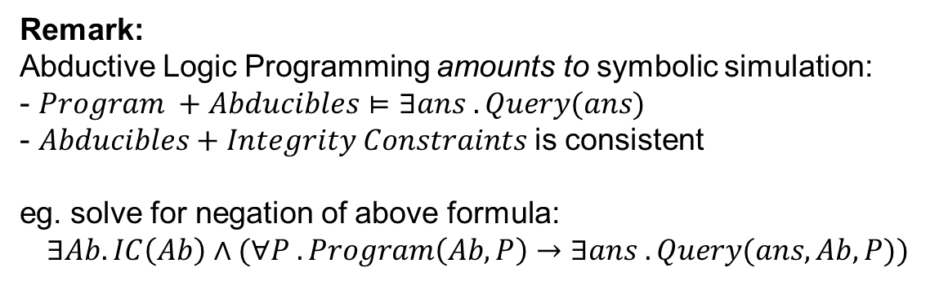
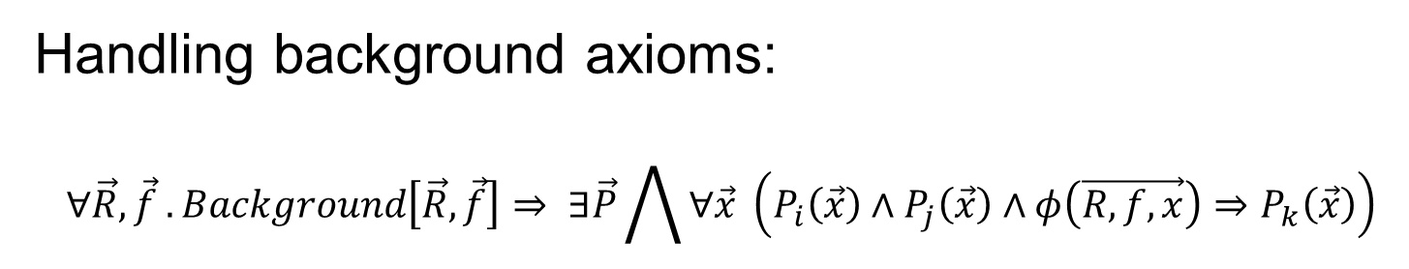
Generalized Horn Formulas
Handling background axioms:
$$∀\vec{R},\vec{f} . Background\left[\vec{R},\vec{f}\right]⇒ ∃\vec{P}\bigwedge{∀\vec{x} \left(P_{i}\left(\vec{x}\right)∧P_{j}\left(\vec{x}\right)∧φ\left(\vec{R, f, x}\right)⇒P_{k}\left(\vec{x}\right)\right)}$$
Remark:
Abductive Logic Programming amounts to symbolic simulation:
- $Program +Abducibles⊨∃ans . Query(ans)$
- $Abducibles+Integrity Constraints$is consistent
eg. solve for negation of above formula:
$$∃Ab. IC\left(Ab\right)∧(∀P . Program\left(Ab,P\right)→∃ans .Query(ans,Ab,P))$$

Slide 41
A New PDR Engine for Fixedpoints
PDR (aka. IC3) – Property Directed Reachability algorithm
Breakthrough in Symbolic Model Checking of Hardware [Aaron Bradley, VMCAI 2011]
Transition Decomposes main steps
System ÷ priority queue
Formulation
Procedures Regular vs. Push Down systems
Beyond Linear Real Arithmetic
Propositional - Timed Automata Decision Procedure
Logic - Interpolants from models
Original Algorithm Description in code.
Tough to digest. Rule + strategy description could help deconstruct the steps.
Original Algorithm Applies to Hardware (Finite State Automata).
Software has procedure calls.
Original Algorithm is for Finite State Systems
Open question what it meant to incorporate
Infinite State systems (= theories)
[Hoder & Bjørner, SAT 2012]

Slide 42
PDR as a Transition System
Objective is to solve for R such that
$\text{F} \left(R\right)\left(X\right)→R\left(X\right)$ $R\left(X\right)→Safe\left(X\right), ∀X$
Elements of PDR encoded as transitions:
Over-approximate reachable states
$$R_{0} ≔\text{F} \left(false\right), R_{1}→R_{2}→…{→R}_{N}$$
Search for counter-examples to $Safe$
Resolve and Propagate conflicts

Slide 43
PDR as a Transition System
Objective is to solve for R such that
$\text{F} \left(R\right)\left(X\right)→R\left(X\right)$ $R\left(X\right)→Safe\left(X\right), ∀X$
Initialize:
Main invariant:
$$\begin{matrix}Safe & & & & R_{1}≔true & & \\ & ↖ & & ↗ & & ↖ & \\ & & R_{0} ≔\text{F} \left(false\right) & & & & \text{F} \left(R_{0}\right)\end{matrix}$$
$$\begin{matrix}Safe & & & & R_{i+1} & & \\ & ↖ & & ↗ & & ↖ & \\ & & R_{i} & & & & \text{F} \left(R_{i}\right)\end{matrix}$$

Slide 44
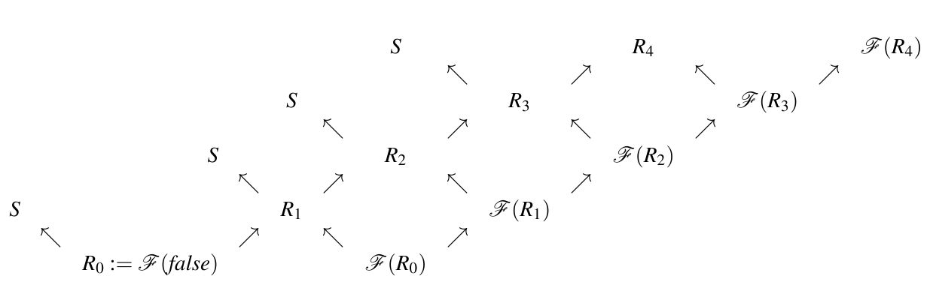
PDR a visual overview
Is valid?
Search for over-approximations of states

Slide 45

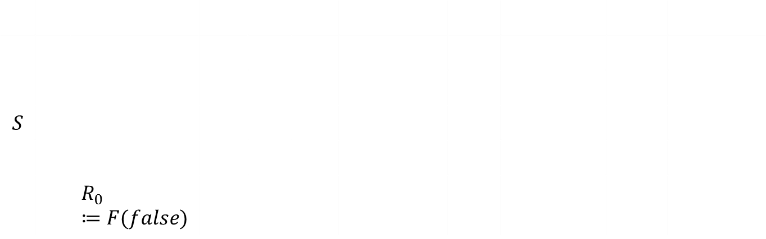
PDR
Is valid?
$$S$$
 |  | $$R_{0}≔F(false)$$
Initially: N = 0, start with $R_{0}$

Slide 46


PDR
Is valid?
$$S$$
 | $$↖$$
 |  | $$R_{0}≔F(false)$$
Unfold to the next level if $R_{0}⇒S$

Slide 47
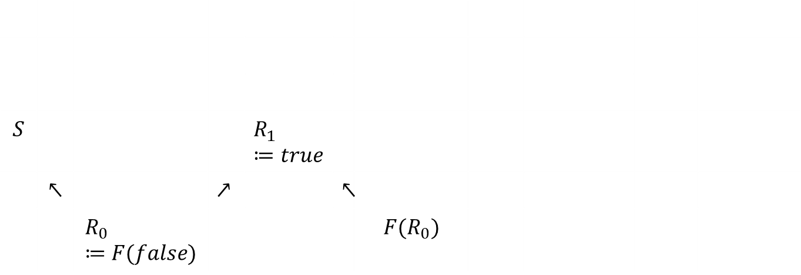
PDR
Is valid?
$$S$$ |  |  |  | $$R_{1}≔true$$
 | $$↖$$ |  | $$↗$$ |  | $$↖$$
 |  | $$R_{0}≔F(false)$$ |  |  |  | $$F(R_{0})$$
Main Invariant is established for N = 1

Slide 48
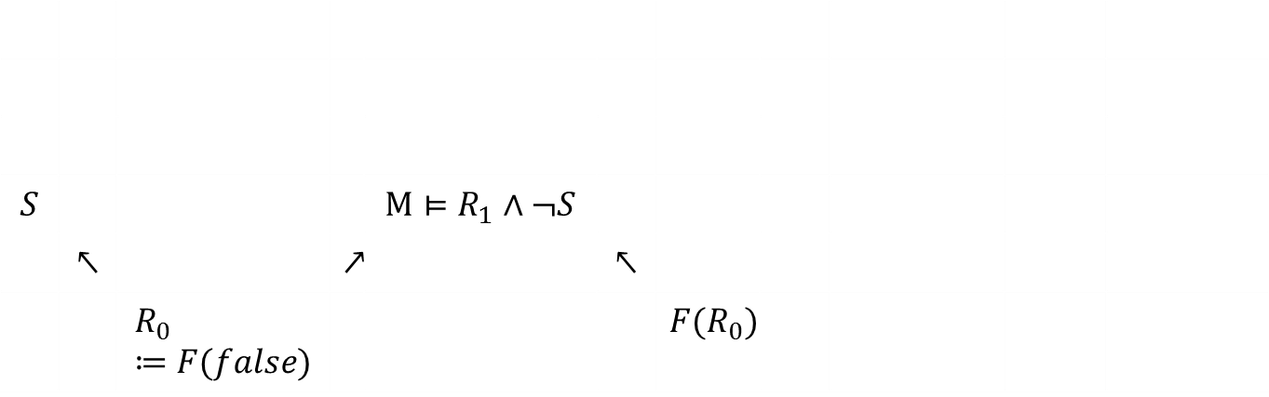
PDR
Is valid?
$$S$$ |  |  |  | $${M⊨R}_{1}∧¬S$$
 | $$↖$$ |  | $$↗$$ |  | $$↖$$
 |  | $$R_{0}≔F(false)$$ |  |  |  | $$F(R_{0})$$
Model $candidate when R_{1}∧¬S is SAT with model M$

Slide 49

PDR
Is valid?
$$S$$ |  |  |  | $$R_{1}≔R_{1}∧φ$$
 | $$↖$$ |  | $$↗$$ |  | $$↖$$
 |  | $$R_{0}≔F(false)$$ |  |  |  | $$F(R_{0})$$
C$onflict when {F(R}_{0})⇒φ, φ⇒¬M are Valid$,$for some ¬φ⊆M$

Slide 50
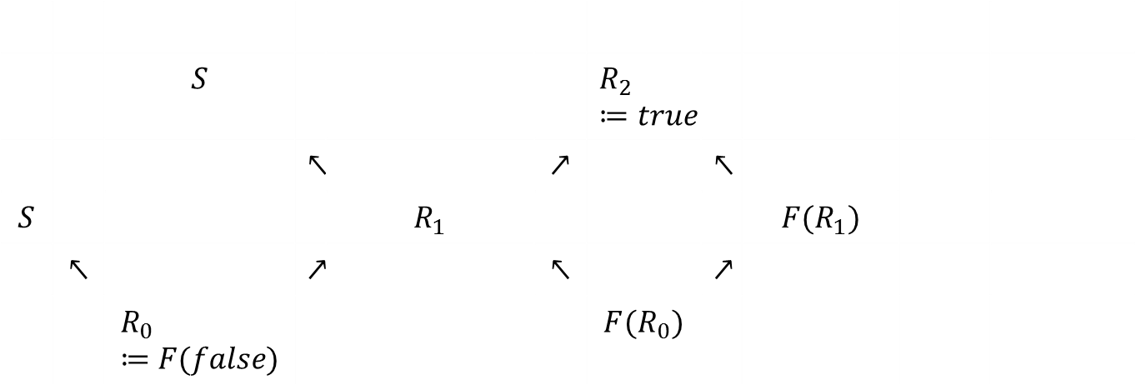

PDR
Is valid?
 |  | $$S$$ |  |  |  | $$R_{2}≔true$$
 |  |  | $$↖$$ |  | $$↗$$ |  | $$↖$$
$$S$$ |  |  |  | $$R_{1}$$ |  |  |  | $$F(R_{1})$$
 | $$↖$$ |  | $$↗$$ |  | $$↖$$ |  | $$↗$$
 |  | $$R_{0}≔F(false)$$ |  |  |  | $$F(R_{0})$$
Unfold to the next level if $R_{1}⇒S$

Slide 51
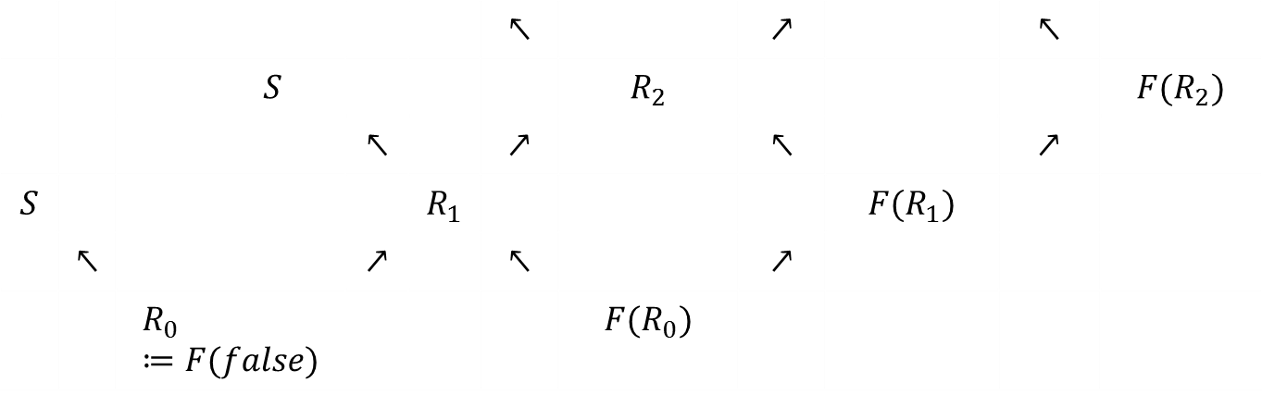
PDR
Is valid?
 |  |  |  |  | $$↖$$ |  | $$↗$$ |  | $$↖$$
 |  | $$S$$ |  |  |  | $$R_{2}$$ |  |  |  | $$F(R_{2})$$
 |  |  | $$↖$$ |  | $$↗$$ |  | $$↖$$ |  | $$↗$$
$$S$$ |  |  |  | $$R_{1}$$ |  |  |  | $$F(R_{1})$$
 | $$↖$$ |  | $$↗$$ |  | $$↖$$ |  | $$↗$$
 |  | $$R_{0}≔F(false)$$ |  |  |  | $$F(R_{0})$$
Etc.

Slide 52
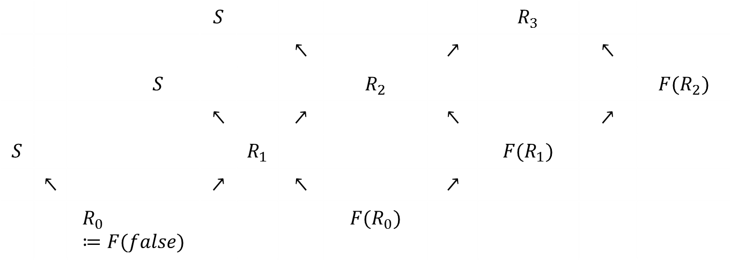
PDR
Is valid?
 |  |  | $$S$$ |  |  |  |  | $$R_{3}$$
 |  |  |  |  | $$↖$$ |  | $$↗$$ |  | $$↖$$
 |  | $$S$$ |  |  |  | $$R_{2}$$ |  |  |  | $$F(R_{2})$$
 |  |  | $$↖$$ |  | $$↗$$ |  | $$↖$$ |  | $$↗$$
$$S$$ |  |  |  | $$R_{1}$$ |  |  |  | $$F(R_{1})$$
 | $$↖$$ |  | $$↗$$ |  | $$↖$$ |  | $$↗$$
 |  | $$R_{0}≔F(false)$$ |  |  |  | $$F(R_{0})$$
Etc.

Slide 53




PDR
Is valid?
$R_{2}$ implies $S$
$R_{2}$ is a post-fixed point
 |  |  | $$S$$ |  |  |  |  | $$R_{3}$$
 |  |  |  |  | $$↖$$ |  | $$↗↙$$ |  | $$↖$$
 |  | $$S$$ |  |  |  | $$R_{2}$$ |  |  |  | $$F(R_{2})$$
 |  |  | $$↖$$ |  | $$↗$$ |  | $$↖$$ |  | $$↗$$
$$S$$ |  |  |  | $$R_{1}$$ |  |  |  | $$F(R_{1})$$
 | $$↖$$ |  | $$↗$$ |  | $$↖$$ |  | $$↗$$
 |  | $$R_{0}≔F(false)$$ |  |  |  | $$F(R_{0})$$
Valid Formula is valid if $R_{3}⇒R_{2}$

Slide 54
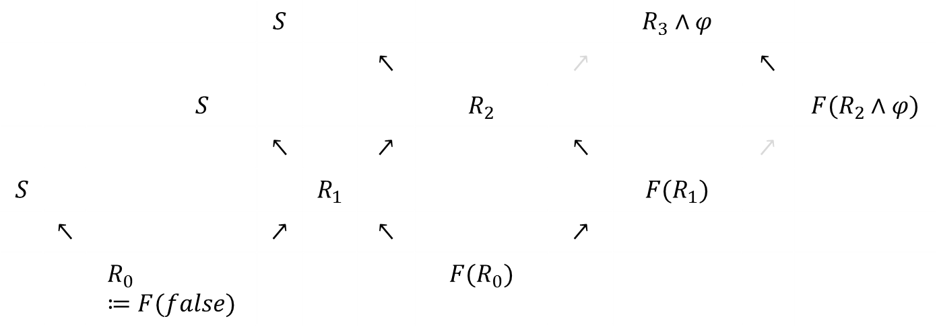

PDR
Is valid?
 |  |  | $$S$$ |  |  |  |  | $$R_{3}∧φ$$
 |  |  |  |  | $$↖$$ |  | $$↗$$ |  | $$↖$$
 |  | $$S$$ |  |  |  | $$R_{2}$$ |  |  |  | $$F(R_{2}∧φ)$$
 |  |  | $$↖$$ |  | $$↗$$ |  | $$↖$$ |  | $$↗$$
$$S$$ |  |  |  | $$R_{1}$$ |  |  |  | $$F(R_{1})$$
 | $$↖$$ |  | $$↗$$ |  | $$↖$$ |  | $$↗$$
 |  | $$R_{0}≔F(false)$$ |  |  |  | $$F(R_{0})$$
Induction w$hen {F(R}_{2}∧φ)⇒φ$

Slide 55
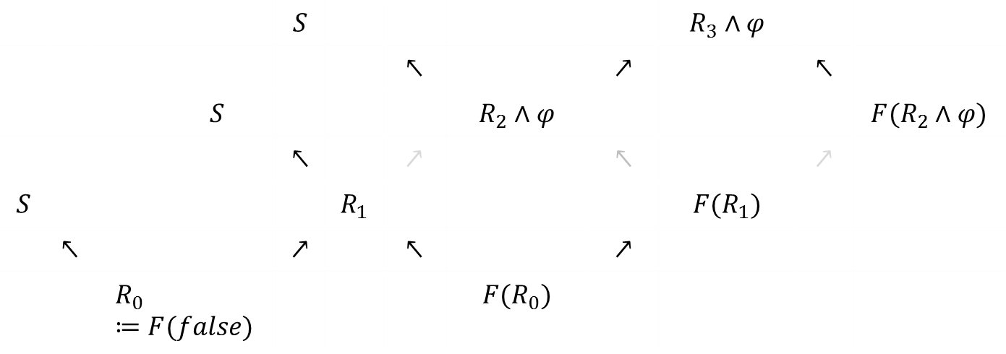

PDR
Is valid?
 |  |  | $$S$$ |  |  |  |  | $$R_{3}∧φ$$
 |  |  |  |  | $$↖$$ |  | $$↗$$ |  | $$↖$$
 |  | $$S$$ |  |  |  | $$R_{2}∧φ$$ |  |  |  | $$F(R_{2}∧φ)$$
 |  |  | $$↖$$ |  | $$↗$$ |  | $$↖$$ |  | $$↗$$
$$S$$ |  |  |  | $$R_{1}$$ |  |  |  | $$F(R_{1})$$
 | $$↖$$ |  | $$↗$$ |  | $$↖$$ |  | $$↗$$
 |  | $$R_{0}≔F(false)$$ |  |  |  | $$F(R_{0})$$
Induction w$hen {F(R}_{2}∧φ)⇒φ$

Slide 56
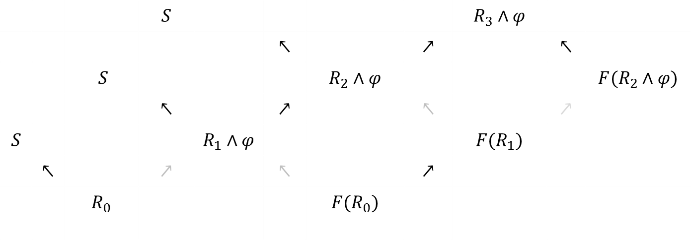
PDR
Is valid?
 |  |  | $$S$$ |  |  |  |  | $$R_{3}∧φ$$
 |  |  |  |  | $$↖$$ |  | $$↗$$ |  | $$↖$$
 |  | $$S$$ |  |  |  | $$R_{2}∧φ$$ |  |  |  | $$F(R_{2}∧φ)$$
 |  |  | $$↖$$ |  | $$↗$$ |  | $$↖$$ |  | $$↗$$
$$S$$ |  |  |  | $$R_{1}∧φ$$ |  |  |  | $$F(R_{1})$$
 | $$↖$$ |  | $$↗$$ |  | $$↖$$ |  | $$↗$$
 |  | $$R_{0}$$ |  |  |  | $$F(R_{0})$$
Induction w$hen {F(R}_{2}∧φ)⇒φ$

Slide 57
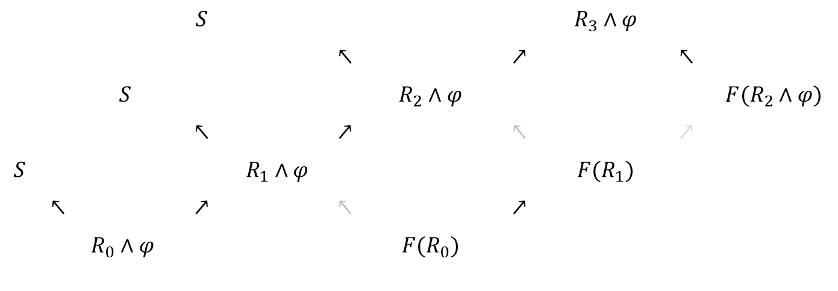
PDR
Is valid?
 |  |  | $$S$$ |  |  |  |  | $$R_{3}∧φ$$
 |  |  |  |  | $$↖$$ |  | $$↗$$ |  | $$↖$$
 |  | $$S$$ |  |  |  | $$R_{2}∧φ$$ |  |  |  | $$F(R_{2}∧φ)$$
 |  |  | $$↖$$ |  | $$↗$$ |  | $$↖$$ |  | $$↗$$
$$S$$ |  |  |  | $$R_{1}∧φ$$ |  |  |  | $$F(R_{1})$$
 | $$↖$$ |  | $$↗$$ |  | $$↖$$ |  | $$↗$$
 |  | $$R_{0}∧φ$$ |  |  |  | $$F(R_{0})$$
Induction w$hen {F(R}_{2}∧φ)⇒φ$

Slide 58

PDR
Is valid?
Monotonicity of F
 |  |  | $$S$$ |  |  |  |  | $$R_{3}∧φ$$
 |  |  |  |  | $$↖$$ |  | $$↗$$ |  | $$↖$$
 |  | $$S$$ |  |  |  | $$R_{2}∧φ$$ |  |  |  | $$F(R_{2}∧φ)$$
 |  |  | $$↖$$ |  | $$↗$$ |  | $$↖$$ |  | $$↗$$
$$S$$ |  |  |  | $$R_{1}∧φ$$ |  |  |  | $$F(R_{1}∧φ)$$
 | $$↖$$ |  | $$↗$$ |  | $$↖$$ |  | $$↗$$
 |  | $$R_{0}∧φ$$ |  |  |  | $$F(R_{0}∧φ)$$
Induction w$hen {F(R}_{2}∧φ)⇒φ$

Slide 59

PDR
Is valid?
 |  |  | $$S$$ |  |  |  |  | $$R_{3}∧φ$$
 |  |  |  |  | $$↖$$ |  | $$↗$$ |  | $$↖$$
 |  | $$S$$ |  |  |  | $$R_{2}∧φ$$ |  |  |  | $$F(R_{2}∧φ)$$
 |  |  | $$↖$$ |  | $$↗$$ |  | $$↖$$ |  | $$↗$$
$$S$$ |  |  |  | $$R_{1}∧φ$$ |  |  |  | $$F(R_{1}∧φ)$$
 | $$↖$$ |  | $$↗$$ |  | $$↖$$ |  | $$↗$$
 |  | $$R_{0}∧φ$$ |  |  |  | $$F(R_{0}∧φ)$$
Induction w$hen {F(R}_{2}∧φ)⇒φ$

Slide 60

PDR
Is valid?
 |  |  | $$S$$ |  |  |  |  | $$R_{3}∧φ$$
 |  |  |  |  | $$↖$$ |  | $$↗$$ |  | $$↖$$
 |  | $$S$$ |  |  |  | $$R_{2}∧φ$$ |  |  |  | $$F(R_{2}∧φ)$$
 |  |  | $$↖$$ |  | $$↗$$ |  | $$↖$$ |  | $$↗$$
$$S$$ |  |  |  | $$R_{1}∧φ$$ |  |  |  | $$F(R_{1}∧φ)$$
 | $$↖$$ |  | $$↗$$ |  | $$↖$$ |  | $$↗$$
 |  | $$R_{0}∧φ$$ |  |  |  | $$F(R_{0}∧φ)$$
Induction w$hen {F(R}_{2}∧φ)⇒φ$

Slide 61


PDR
Is valid?
 |  |  | $$S$$ |  |  |  |  | $${M⊨R}_{3}∧¬S$$
 |  |  |  |  | $$↖$$ |  | $$↗$$ |  | $$↖$$
 |  | $$S$$ |  |  |  | $${M, M′⊨F(R}_{2})$$ |  |  |  | $$F(R_{2})$$
 |  |  | $$↖$$ |  | $$↗$$ |  | $$↖$$ |  | $$↗$$
$$S$$ |  |  |  | $$R_{1}$$ |  |  |  | $$F(R_{1})$$
 | $$↖$$ |  | $$↗$$ |  | $$↖$$ |  | $$↗$$
 |  | $$R_{0}≔F(false)$$ |  |  |  | $$F(R_{0})$$
Decide $next unfolding of model, backwards$

Slide 62


PDR
Is valid?
 |  |  | $$S$$ |  |  |  |  | $${M⊨R}_{3}∧¬S$$
 |  |  |  |  | $$↖$$ |  | $$↗$$ |  | $$↖$$
 |  | $$S$$ |  |  |  | $${M, M′⊨F(R}_{2})$$ |  |  |  | $$F(R_{2})$$
 |  |  | $$↖$$ |  | $$↗$$ |  | $$↖$$ |  | $$↗$$
$$S$$ |  |  |  | $$M, M^{′},M′′⊨$$ $$F\left(R_{1}\right)$$ |  |  |  | $$F(R_{1})$$
 | $$↖$$ |  | $$↗$$ |  | $$↖$$ |  | $$↗$$
 |  | $$R_{0}$$ |  |  |  | $$F(R_{0})$$
Decide $next unfolding of model, backwards$

Slide 63


Non-linear fixed-points
Recall:
$$\begin{matrix}\text{F} (\text{mc})(X\text{,}R\text{)}= & \begin{matrix}X>100∧R=X−10 \\ ∨ X≤100∧∃Y. \text{mc}\left(X+11,Y\right)∧\text{mc}(Y,R)\end{matrix}\end{matrix}$$
Is $\text{mc}\left(X,R\right)∧R<91$ feasible?
Start with summary $\text{mc}\left(Y,R\right) ≔\text{true}$
$\text{Is} true ∧R<91$ feasible?
Yes, e.g., $R=90⊨$ $R<91$
Is $R=90$ reachable? (in $μ\text{F} \left(\text{mc}\right))$

Slide 64







Non-linear transformers
M(87)
= M(M(98))
= M(M(M(109)))
= M(M(99))
= M(M(M(110)))
= M(M(100))
= M(M(M(111)))
= M(M(101))
= M(91)
= M(M(102))
= M(92)
= M(M(103))
= M(93) …
$$R=90$$
$$X=98 ∧$$
$$R=91$$
$$X=91∧$$
$$R=90$$
Benchmarks
from the SLAM
Research toolkit
$$X=109$$
$$R=99$$
$$X=99$$
$$R=91$$
$$X=102$$
$$R=92$$
$$X=92$$
$$R=90$$
Checking against $R_{1}, R_{2}, …{,R}_{N}$ controls depth, but potentially wide tree.
Our approach: build DAG by sharing states.
Sharing is cheap, even no sharing works on Bebop

Slide 65


Search: Mile-high perspective
Modern SMT solver
Decisions: Assignments
Conflict Clauses
Conflict
Resolution
$$Init →\text{SP}\left(Init\right)→$$
$$\text{WP}\left(Bad\right)←Bad$$
Fixedpoint solver
Conflict
Resolution

Slide 66



Arithmetic
Mutual Exclusion
$$⇔$$
Clauses have model
R(0,0,0,0). Initial states
T(L,M,Y1,Y2,L’,M’,Y1’,Y2’)∧R(L,M,Y1,Y2) → R(L’,M’,Y1’,Y2’) Reachable states
R(2,2,Y1,Y2) → false Is unsafe state reachable?
Step(L,L’,Y1,Y2,Y1’) → T(L,M,Y1,Y2,L’,M,Y1’,Y2) P₁ takes a step
Step(M,M’,Y2,Y1,Y2’) → T(L,M,Y1,Y2,L,M’,Y1,Y2’) P₂ takes a step
Step(0,1,Y1,Y2,Y2+1). $ℓ_{0}:y≔\hat{y}+1;goto ℓ_{1}$
(Y1 $≤$ Y2 $∨$ Y2 = 0) → Step(1,2,Y1,Y2,Y1). $ℓ_{1}:await \hat{y}=0∨y≤\hat{y} ;goto ℓ_{2}$
Step(2,3,Y1,Y2,Y1). $ℓ_{2}:critical ;goto ℓ_{3}$
Step(3,0,Y1,Y2,0). $ℓ_{3}:y ≔0;goto ℓ_{0}$

Slide 67







Search: Mile-high perspective
Conflict Resolution
Conflict Propagation
Conflict Propagation
$$I$$
$$\text{F} (I)$$
$${\text{F}}^{ 2}(I)$$
${\text{B}}^{2}\left(¬S\right)$
$$\text{B}\left(¬S\right)$$
$$¬S$$

Slide 68











PDR(T): Conflict Resolution
Conflict Resolution
$$L=1$$
$$M=1$$
$$Y1=1$$
$$Y2=0$$
$$L=2$$
$$M=2$$
$$L=0$$
$$M=0$$
$$Y2=0$$
$$Y1=0$$
$$L=0$$
$$M=1$$
$$Y2=0$$
$$L=1$$
$$M=2$$
$$Y2=0$$
$$Y2≥Y1+1∧Y1≥0$$
$$Y2≤0$$
$$Y2≥1$$
$$Y2≤0$$
$$∧$$
$∧$ $∧$
Conflict Resolution
Get Generalization from Farkas Lemma
Eg., resolve away blue internal variables

Slide 69



PDR(T): Conflict Resolution
Conflict Resolution
Conflict Propagation
Conflict Propagation
$$L=0$$
$$M=0$$
$$Y2=0$$
$$Y1=0$$
$$L=0$$
$$M=1$$
$$Y2=0$$
$$L=1$$
$$M=1$$
$$Y1=1$$
$$Y2=0$$
$$L=1$$
$$M=2$$
$$Y2=0$$
$$L=2$$
$$M=2$$
$$M=1 →Y2≥1$$
$$M=1 →Y2≥1$$
$$M=1 →Y2≥1$$

Slide 70

PDR(T): Generalization from T-lemmas
Can we satisfy?
$R(0,0,0,0).$ Initial states
$T\left(L,M,Y1,Y2,L’,M’,Y1’,Y2’\right), R\left(L,M,Y1,Y2\right)→R\left(L’,M’,Y1’,Y2’\right)$ Reachable states
$R\left(L,M,Y1,Y2\right) → ¬\left(L=2∧M=2\right).$ Unsafe state is unreachable
$\underset{\text{M}}{\underbrace{L=0∧M=1∧Y2=0}} ∧\underset{Pre}{\underbrace{\text{F} \left(R_{0}\right)}}$ is unsatisfiable
E.g., there is unsat core of: $\underset{\text{M}}{\underbrace{\bigwedge_{j}{{c_{j}≤x}_{j}≤c_{j}}}} ∧$ $\underset{Pre}{\underbrace{\text{F} \left(R_{i}\right)}}$
Unsat proof uses T-lemmas
$$\left(\underset{From ¬\text{M}}{\underbrace{5>x_{1}∨3<x_{3}}}∨\underset{From ¬Pre}{\underbrace{x_{1}−x_{2}>2∨{2x}_{2}−x_{3}>1}}\right)$$

Slide 71

PDR(T): Generalization from T-lemmas
Can we satisfy?
$R(0,0,0,0).$ Initial states
$T\left(L,M,Y1,Y2,L’,M’,Y1’,Y2’\right), R\left(L,M,Y1,Y2\right)→R\left(L’,M’,Y1’,Y2’\right)$ Reachable states
$R\left(L,M,Y1,Y2\right) → ¬\left(L=2∧M=2\right).$ Unsafe state is unreachable
Unsat proof uses T-lemmas
$$\left(\underset{From ¬\text{M}}{\underbrace{5>x_{1}∨3<x_{3}}}∨\underset{From ¬Pre}{\underbrace{x_{1}−x_{2}>2∨{2x}_{2}−x_{3}>1}}\right)$$
$\begin{matrix}2⋅\left(−x_{1}≤−5\right) \\ x_{3}≤3 \\ {2⋅(x}_{1}−x_{2}≤2) \\ {2x}_{2}−x_{3}≤1 \\ \end{matrix}$ $\begin{matrix}−2x_{1}≤−10 \\ x_{3}≤3 \\ {2x}_{1}−{2x}_{2}≤4 \\ \begin{aligned}{2x}_{2}−x_{3}≤1 \\ −−−−−−\end{aligned} \\ 0≤−2\end{matrix}$ ${ \underset{\begin{aligned}Block any model \\ satisfying this \end{aligned}}{\underbrace{2x_{1}−x_{3}≤5}}}_{}$

Slide 72

PDR(LRA): Timed automata
Observation:
PDR + Model refinement using Farkas strengthening
is a decision procedure for timed push-down systems
Justification:
Every lemma produced is a sum of differences from the input
~
Acyclic path in difference graph.
$⇒$ Finite set of Farkas lemmas possible.

Slide 73
N+1 degrees of separation
Objective:
synthesize inductive invariant proving property.
Reaching objective with interpolants:
Synthesize interpolants, use for proving invariants. Be admired.
Synthesize interpolants, evaluate on random formulas. Admire them.
Write papers about interpolants. Admire the theorems.
Review papers about generating interpolants. Watch Kevin Bacon.
Reaching objective with PDR:
…. Nevertheless, interpolants sneak in.

Slide 74

What is a Craig Interpolant?
Suppose $A⇒B$
A Craig Interpolant is formula $I:$
$Lang\left(I\right)⊆Lang\left(A\right)∩Lang\left(B\right)$
$A⇒I, I⇒B$
Horn version. Establish satisfiability of:
$∀x,y. A[x,y]⇒I\left(x\right),$
$∀x,z. I\left(x\right)⇒B[x,z]$
and find solution for $I.$

Slide 75

PDR(T): Interpolants as a side-effect
Intermediary solutions: $∀X. \text{F} \left(false\right)\left(X\right)→R_{1}\left(X\right),$
$∀X. \text{F} \left(R_{1}\right)\left(X\right)→R_{2}\left(X\right),$
$∀X. \text{F} \left(R_{2}\right)\left(X\right)→R_{3}\left(X\right),$
$∀X.$ ${ R}_{3}\left(X\right)→Safe\left(X\right),$
Observation: Farkas strengthening computes
a “DAG interpolant” for LRA
i.e., solves for non-recursive Horn clauses

Slide 76
Summary: PDR
Symbolic Software Model Checking as:
Quantified Horn Clause Satisfiability Modulo Theories
PDR Generalized:
as an abstract Transition System
for Horn Clause Satisfiability over Theory of Arithmetic
  Using Farkas to generalize failed counter-example traces
  Difference Logic – a Model Checking algorithm for Timed Automata
  Interpolants from Model refinements
  - Propagate also properties for predicates (so far inefficient)
http://rise4fun.com/Z3Py/tutorial/fixedpoints

Slide 77


Slide 78
Summary
Deduction with SMT solvers is central to
software analysis, testing and verification tools
Many problems can be reduced to an SMT problem
Research on SMT:
Efficient algorithms, data-structures, programming
Raise the bar of supported theories
Raise the bar of reduction (e.g., model checking as SMT)
Common algorithmic traits:
- Cooperation between model and proof search.

