Slide 2
Satisfiability Modulo Theories for Program Exploration
Nikolaj Bjørner Leonardo de Moura
Nikolai Tillmann
Microsoft Research
August 11’th 2008

Slide 3
Take-away
Bit-level support is critical for program exploration
… but this is far from the only useful domain
The SMT solver Z3 combines solvers for a variety of domains

Slide 4
Domains from programs
Bits and bytes
Numbers
Arrays
Records
Heaps
Data-types
Object inheritance

Slide 5
Satisfiability Modulo Theories (SMT)
Arithmetic
Arrays
Free Functions

Slide 6
Z3: Core System Components
Text
C
.NET
OCaml
Theories
Bit-Vectors
Rewriting Simplification
Arithmetic
Arrays
E-matching
Core Theory
Partial orders
Tuples
SAT solver

Slide 7
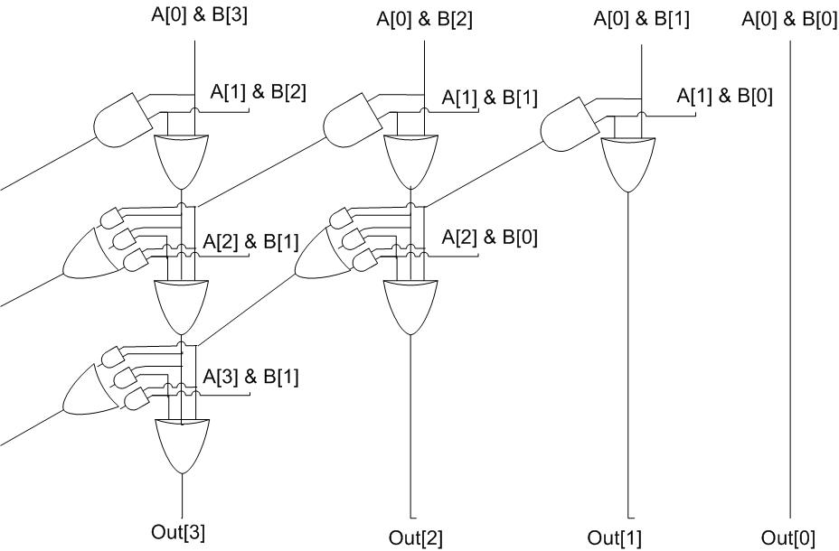
Bit-vector support in Z3
Pre-processing by simplification
Bit-vector operations are compiled into circuits
Core Theory propagates equalities between bit-vectors
Relevancy propagation used to selectively enable gates for propositional splitting

Slide 8
Dynamic Symbolic Execution with Pex
Test input generator
  Pex starts from parameterized unit tests
  Generated tests are emitted as traditional unit tests
Dynamic symbolic execution framework
  Analysis of .NET instructions (byte-code)
  Instrumentation happens automatically at JIT time
  Using SMT-solver Z3 to check satisfiability and generate models = test inputs

Slide 9
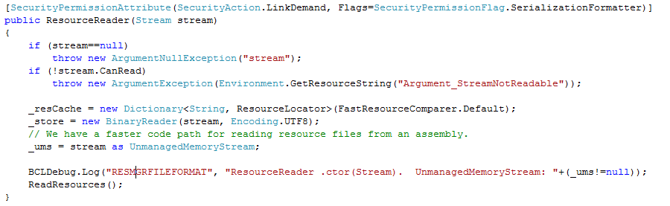
White box testing with Pex
How to test this code?
(Real code from .NET base class libraries.)

Slide 10
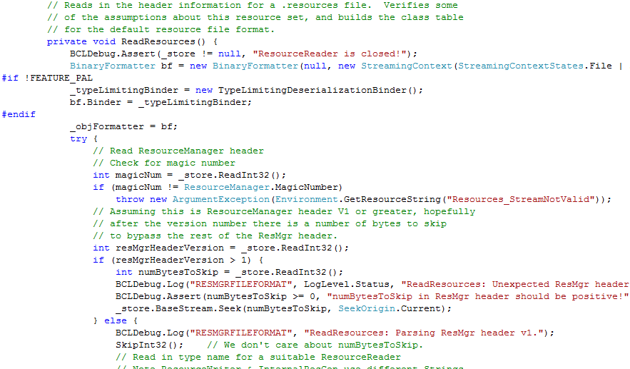
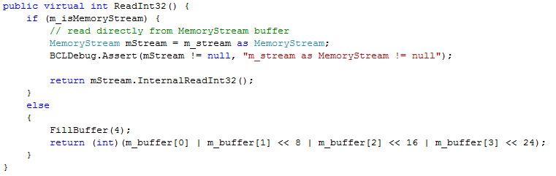
White box testing in practice

Slide 11
The Resource Reader
Demo
… in action

Slide 12
Test Input Generation by
Dynamic Symbolic Execution
Initially, choose Arbitrary
Run Test and
Monitor
Solve
Test
Inputs
Constraint System
Execution Path
Known
Paths
Choose an
Uncovered Path
Record
Path Condition
Result: small test suite,
high code coverage
Finds only real bugs
No false warnings

Slide 13
Test Input Generation by
Dynamic Symbolic Execution
a[0] = 0;
a[1] = 0;
a[2] = 0;
a[3] = 0;
…
Initially, choose Arbitrary
Run Test and
Monitor
Solve
Test
Inputs
Constraint System
Execution Path
Known
Paths
Choose an
Uncovered Path
Record
Path Condition
Result: small test suite,
high code coverage
Finds only real bugs
No false warnings

Slide 14

Test Input Generation by
Dynamic Symbolic Execution
Initially, choose Arbitrary
Path Condition:
… ⋀ magicNum != 0x95673948
Run Test and
Monitor
Solve
Test
Inputs
Constraint System
Execution Path
Known
Paths
Choose an
Uncovered Path
Record
Path Condition
Result: small test suite,
high code coverage
Finds only real bugs
No false warnings

Slide 15
Test Input Generation by
Dynamic Symbolic Execution
Initially, choose Arbitrary
Run Test and
Monitor
… ⋀ magicNum != 0x95673948
… ⋀ magicNum == 0x95673948
Solve
Test
Inputs
Constraint System
Execution Path
Known
Paths
Choose an
Uncovered Path
Record
Path Condition
Result: small test suite,
high code coverage
Finds only real bugs
No false warnings

Slide 16
Test Input Generation by
Dynamic Symbolic Execution
a[0] = 206;
a[1] = 202;
a[2] = 239;
a[3] = 190;
Initially, choose Arbitrary
Run Test and
Monitor
Solve
Test
Inputs
Constraint System
Execution Path
Known
Paths
Choose an
Uncovered Path
Record
Path Condition
Result: small test suite,
high code coverage
Finds only real bugs
No false warnings

Slide 17
Test Input Generation by
Dynamic Symbolic Execution
Initially, choose Arbitrary
Run Test and
Monitor
Solve
Test
Inputs
Constraint System
Execution Path
Known
Paths
Choose an
Uncovered Path
Record
Path Condition
Result: small test suite,
high code coverage
Finds only real bugs
No false warnings

Slide 18
Automatic Test Input Generation:
Whole-program, white box code analysis
Initially, choose Arbitrary
Run Test and
Monitor
Solve
Test
Inputs
Constraint System
Execution Path
Known
Paths
Choose an
Uncovered Path
Record
Path Condition
Result: small test suite,
high code coverage
Finds only real bugs
No false warnings

Slide 19
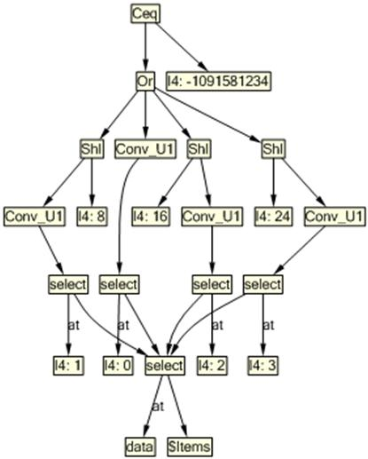
Domains
Bit-vectors
Heaps
Integers
Quantifiers

Slide 20
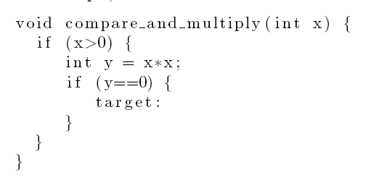
Bit-vectors
Is Target reachable?
Yes: x = 2¹⁶ … of course

Slide 21
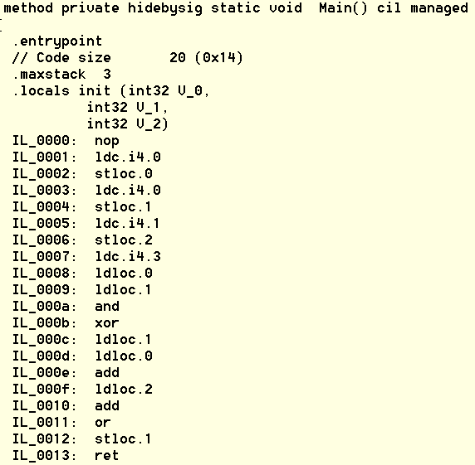
Bit-vectors abound in CIL

Slide 22
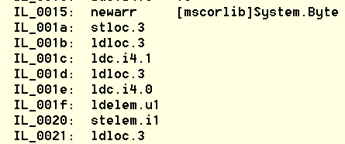
Arrays abound in CIL

Slide 23
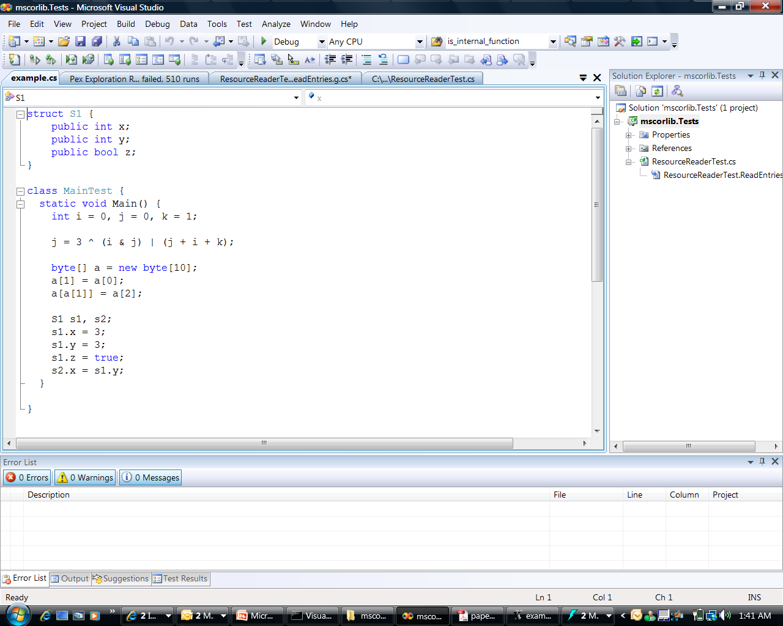
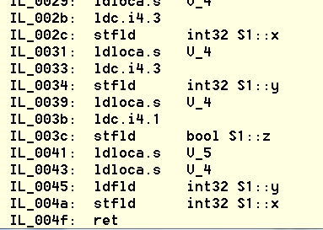
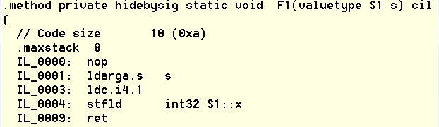
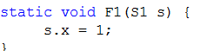
Tuples abound in CIL

Slide 24
Integers – do not abound in CIL
But used for modeling the .NET type system
  In Pex: $Type : Object -> Class
  Object – is an integer
  Class – is an integer

Slide 25
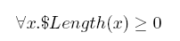
Quantifiers
Used for constraining values
Example: we want to allocate a byte array
data
Allocate $Length(data) bytes

Slide 26
Minimization
Not all models returned by Z3 are useful test inputs.
Values used for allocating arrays are preferably small.
  Otherwise, test runs will just exercise out of memory exceptions and not useful code paths.
Approach: use programmatic API with Push/Pop to control context

Slide 27
Minimization
int Minimize(TermAst a, int lo, int hi) {
while (lo < hi) {
int mid = (lo+hi)/2;
Console.WriteLine("lo: {0}, hi: {1}, mid: {2}",lo,hi,mid);
z3.Push();
z3.AssertCnstr(Num(lo) <= a & a < Num(mid));
TypeSafeModel model = null;
if (LBool.True == z3.CheckAndGetModel(ref model)) {
hi = model.GetNumeralValueInt(model.Eval(a));
model.Dispose();
}
else lo = mid;
z3.Pop();
}
return lo;
}

Slide 28
Constraint Solving: Z3
Rich Combination: Solvers for uninterpreted functions with equalities, linear integer arithmetic, bitvector arithmetic, arrays, tuples
Formulas may be a big conjunction
  Pre-processing step
  Eliminate variables and simplify input format
Universal quantifiers
  Used to model custom theories, e.g. .NET type system
Model generation
  Models used as test inputs
Incremental solving
  Given a formula F, find a model M, that minimizes the value of the variables x₀ … x_{n}
  Push / Pop of contexts for model minimization
Programmatic API
  For small constraint systems, text through pipes would add huge overhead

Slide 29
Conclusions
Bit-level support is critical for program exploration
… but this is far from the only useful domain
The SMT solver Z3 combines solvers for a variety of domains

Slide 30
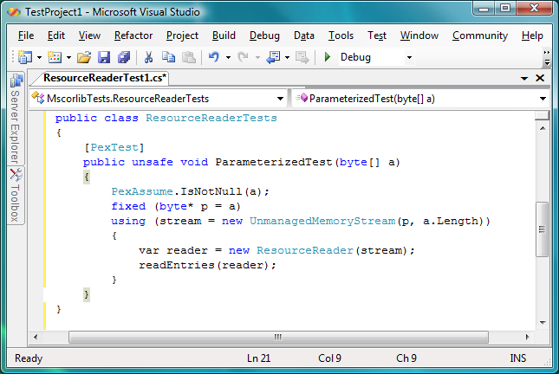
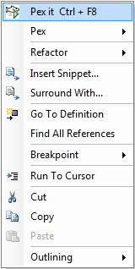
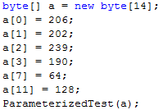
ResourceReader Test Input Generation
Test input, generated by Pex
30

