Slide 1
Clock-RSM: Low-Latency Inter-Datacenter State Machine Replication Using Loosely Synchronized Physical Clocks
Jiaqing Du, Daniele Sciascia, Sameh Elnikety
Willy Zwaenepoel, Fernando Pedone
EPFL, University of Lugano, Microsoft Research

Slide 2
Replicated State Machines (RSM)
Strong consistency
  Execute same commands in same order
  Reach same state from same initial state
Fault tolerance
  Store data at multiple replicas
  Failure masking / fast failover

Slide 3

Geo-Replication
High latency among replicas
Messaging dominates replication latency
Data Center
Data Center
Data Center
Data Center
Data Center

Slide 4
Leader-Based Protocols
Order commands by a leader replica
Require extra ordering messages at follower
client request
client reply
Follower
Ordering
Ordering
Leader
Replication
  High latency for geo replication

Slide 5

Clock-RSM
Orders commands using physical clocks
Overlaps ordering and replication
client request
client reply
Ordering + Replication
  Low latency for geo replication

Slide 6
Outline
Clock-RSM
Comparison with Paxos
Evaluation
Conclusion

Slide 7
Outline
Clock-RSM
Comparison with Paxos
Evaluation
Conclusion

Slide 8
Property and Assumption
Provides linearizability
Tolerates failure of minority replicas
Assumptions
  Asynchronous FIFO channels
  Non-Byzantine faults
  Loosely synchronized physical clocks

Slide 9

Protocol Overview
client request
client reply
Clock-RSM
cmd2
cmd1
cmd1.ts = Clock()
PrepOK
cmd2
cmd1
cmd2
cmd1
cmd2
cmd1
cmd2.ts = Clock()
cmd2
cmd1
client request
client reply

Slide 10
Major Message Steps
Prep: Ask everyone to log a command
PrepOK: Tell everyone after logging a command
cmd1 committed?
client request
Prep
R₀
cmd1.ts = 24
R₁
PrepOK
PrepOK
R₂
R₃
PrepOK
R₄
cmd2.ts = 23
PrepOK
client request

Slide 11
Commit Conditions
A command is committed if
  Replicated by a majority
  All commands ordered before are committed
Wait until three conditions hold
  C1: Majority replication
  C2: Stable order
  C3: Prefix replication

Slide 12
C1: Majority Replication
More than half replicas log cmd1
Replicated by R₀, R₁, R₂
client request
Prep
R₀
cmd1.ts = 24
PrepOK
R₁
PrepOK
R₂
R₃
R₄
  1 RTT: between R₀ and majority

Slide 13
C2: Stable Order
Replica knows all commands ordered before cmd1
  Receives a greater timestamp from every other replica
client request
cmd1 is stable at R₀
cmd1.ts = 24
R₀
R₁
23
24
25
R₂
25
Prep / PrepOK / ClockTime
R₃
25
R₄
25
  0.5 RTT: between R₀ and farthest peer

Slide 14
C3: Prefix Replication
All commands ordered before cmd1 are replicated
by a majority
cmd2 is replicated by R₁, R₂, R₃
client request
R₀
cmd1.ts = 24
PrepOk
R₁
PrepOk
PrepOk
R₂
Prep
Prep
R₃
Prep
R₄
cmd2.ts = 23
client request
  1 RTT: R₄ to majority + majority to R₀

Slide 15
Overlapping Steps
client reply
client request
Prep
cmd1.ts = 24
R₀
PrepOk
PrepOK
R₁
Majority replication
23
24
25
Log(cmd1)
Prep
PrepOk
PrepOK
R₂
Stable order
25
Log(cmd1)
Prep
R₃
Prefix replication
25
R₄
25
Latency of cmd1 : about 1 RTT to majority

Slide 16
Commit Latency
Step | Latency
Majority replication | 1 RTT (majority1)
Stable order | 0.5 RTT (farthest)
Prefix replication | 1 RTT (majority2)
Overall latency = MAX{ 1 RTT (majority1), 0.5 RTT (farthest), 1 RTT (majority2) }
If 0.5 RTT (farthest) < 1 RTT (majority),
then overall latency ≈ 1 RTT (majority).

Slide 17
Topology Examples
Farthest
R₄
R₃
Farthest
R₄
R₁
R₃
R₂
R₀
R₁
Majority1
client request
R₂
R₀
Majority1
client request

Slide 18
Outline
Clock-RSM
Comparison with Paxos
Evaluation
Conclusion

Slide 19
Paxos 1: Multi-Paxos
Single leader orders commands
  Logical clock: 0, 1, 2, 3, ...
client request
client reply
R₀
Forward
Commit
R₁
Leader R₂
Prep
PrepOK
R₃
R₄
Latency at followers: 2 RTTs (leader & majority)

Slide 20
Paxos 2: Paxos-bcast
Every replica broadcasts PrepOK
  Trades off message complexity for latency
client request
client reply
R₀
Forward
R₁
PrepOK
Leader R₂
Prep
R₃
R₄
Latency at followers: 1.5 RTTs (leader & majority)

Slide 21
Clock-RSM vs. Paxos
With realistic topologies, Clock-RSM has
  Lower latency at Paxos follower replicas
  Similar / slightly higher latency at Paxos leader
Protocol | Latency
Clock-RSM | All replicas: 1 RTT (majority) if 0.5 RTT (farthest) < 1 RTT (majority)
Paxos-bcast | Leader: 1 RTT (majority) Follower: 1.5 RTTs (leader & majority)

Slide 22
Outline
Clock-RSM
Comparison with Paxos
Evaluation
Conclusion

Slide 23
Experiment Setup
Replicated key-value store
Deployed on Amazon EC2
Ireland (IR)
Japan (JP)
California (CA)
Virginia (VA)
Singapore (SG)

Slide 24
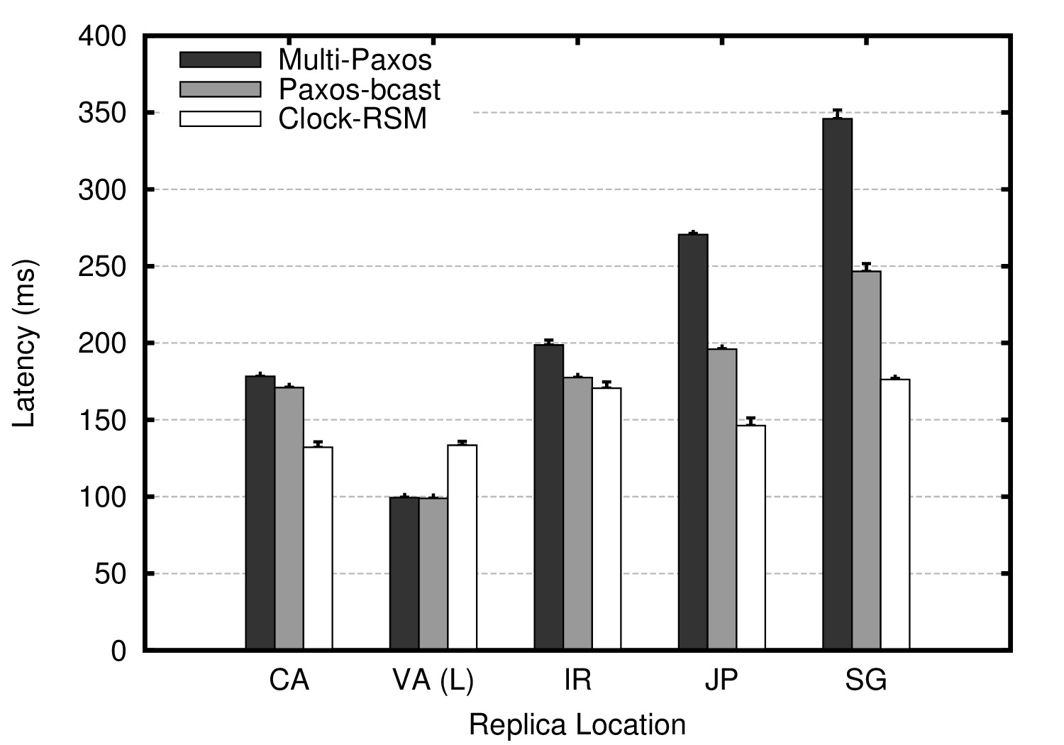
Latency (1/2)
All replicas serve client requests

Slide 25
Overlapping vs. Separate Steps
IR
JP
CA
VA
SG
Clock-RSM latency: max of three
client request
IR
JP
CA
VA (L)
SG
client request
Paxos-bcast latency: sum of three

Slide 26
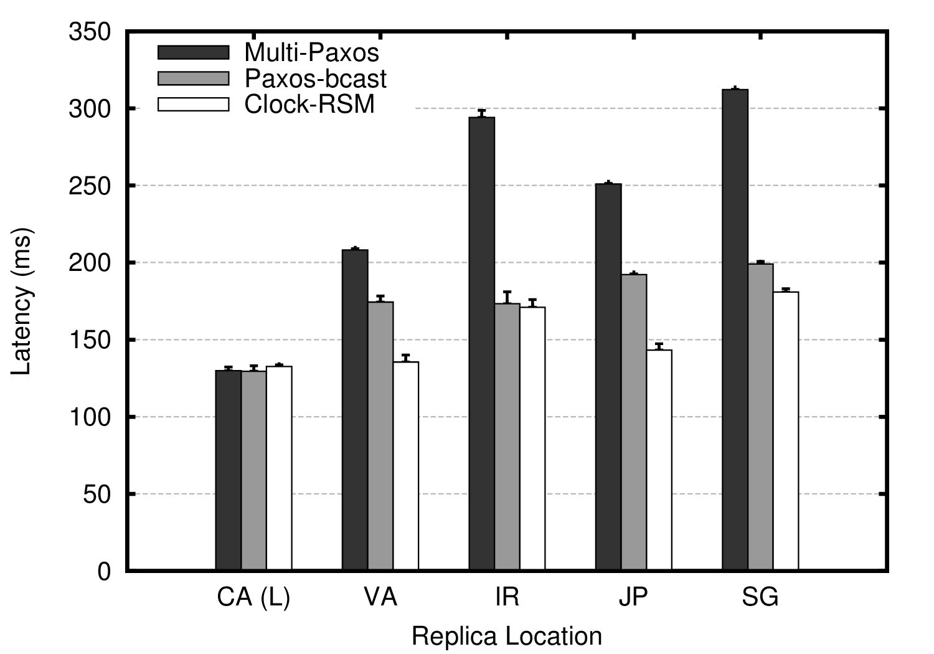
Latency (2/2)
Paxos leader is changed to CA

Slide 27
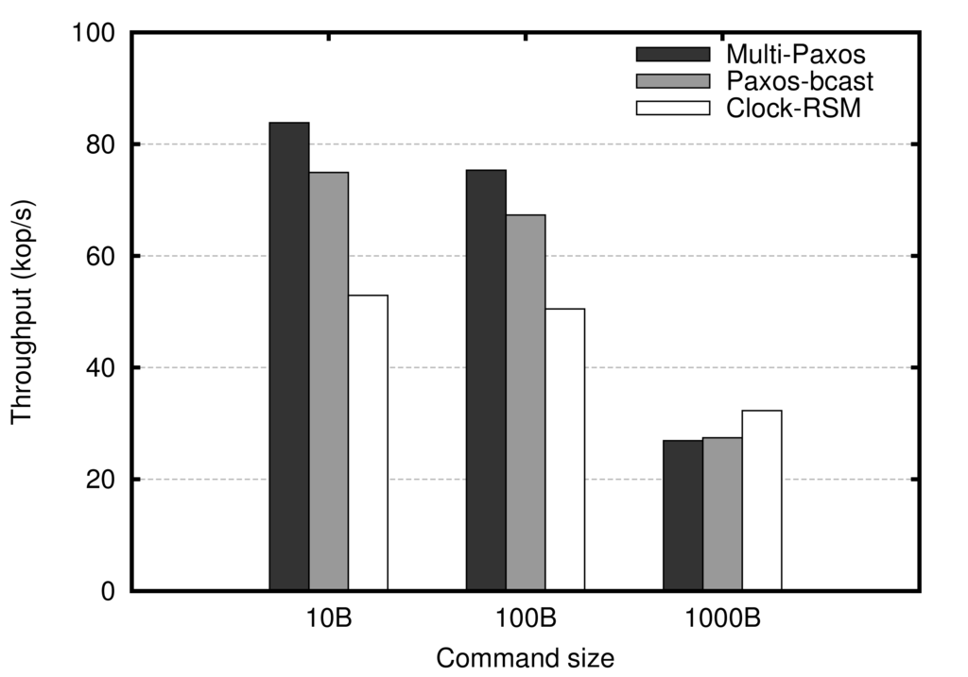
Throughput
Five replicas on a local cluster
Message batching is key

Slide 28
Also in the Paper
A reconfiguration protocol
Comparison with Mencius
Latency analysis of protocols

Slide 29
Conclusion
Clock-RSM: low latency geo-replication
  Uses loosely synchronized physical clocks
  Overlaps ordering and replication
Leader-based protocols can incur high latency

