Slide 1

Pattern Recognition
and Machine Learning
Chapter 2: Probability distributions

Slide 2





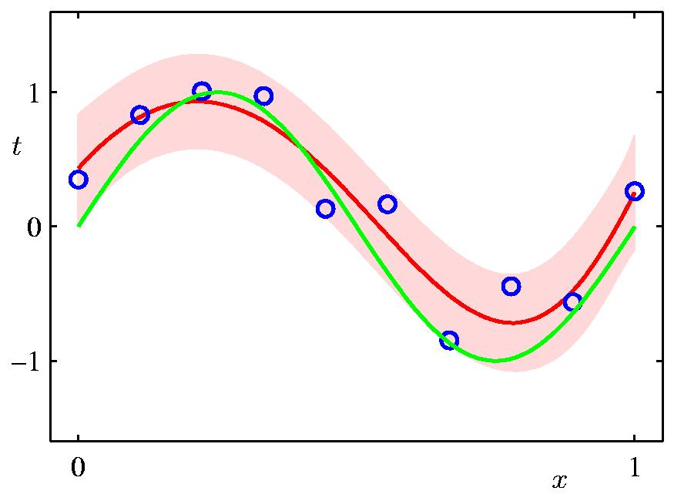
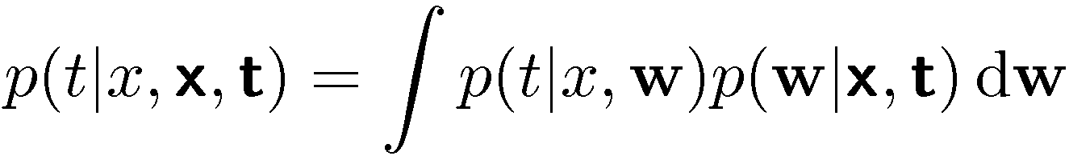
Parametric Distributions
Basic building blocks:
Need to determine given
Representation: or ?
Recall Curve Fitting

Slide 3

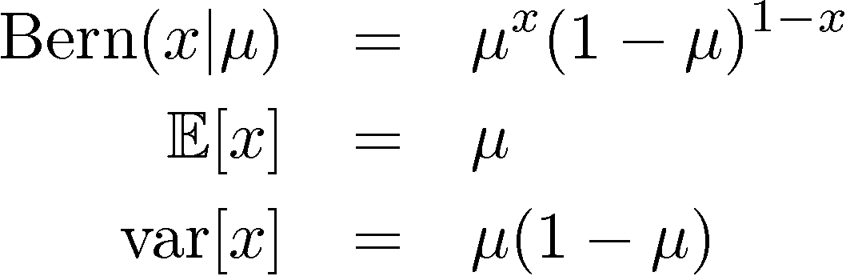
Binary Variables (1)
Coin flipping: heads=1, tails=0
Bernoulli Distribution

Slide 4

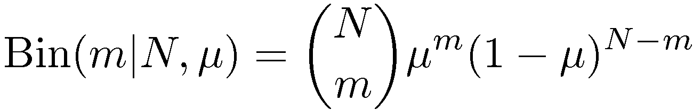
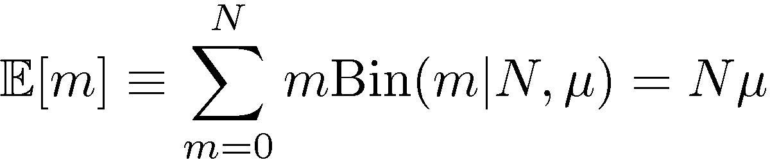
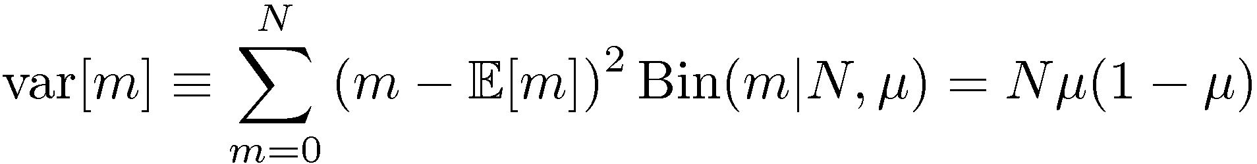
Binary Variables (2)
N coin flips:
Binomial Distribution

Slide 5
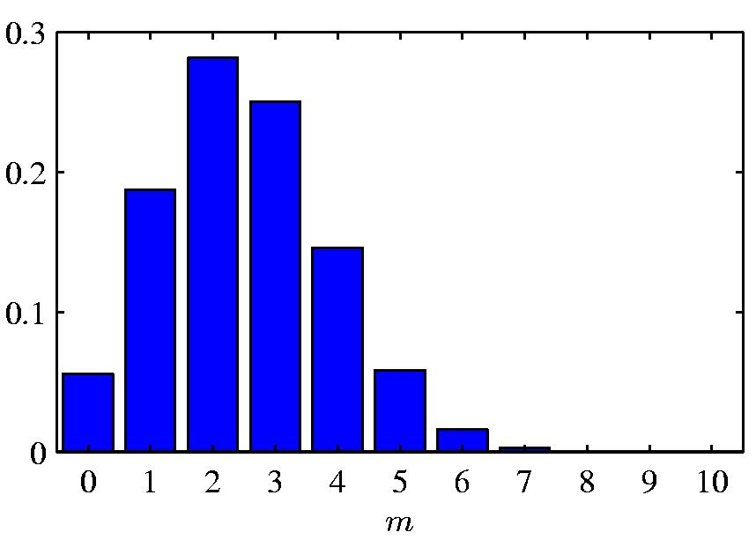

Binomial Distribution

Slide 6
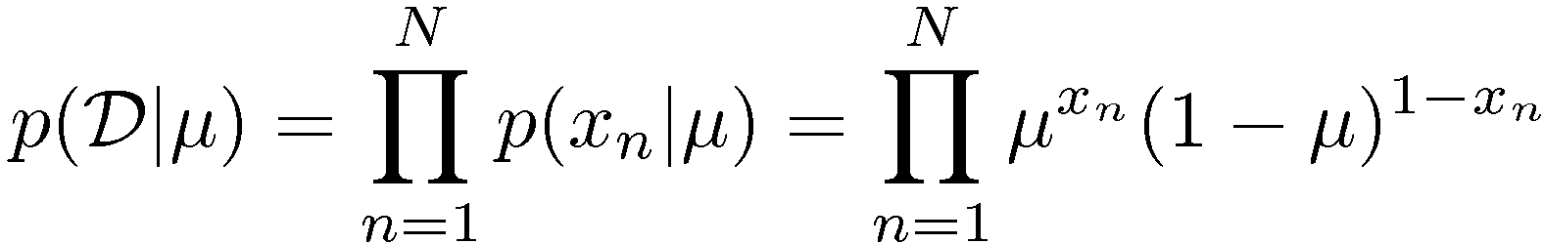
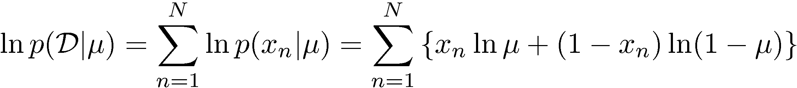
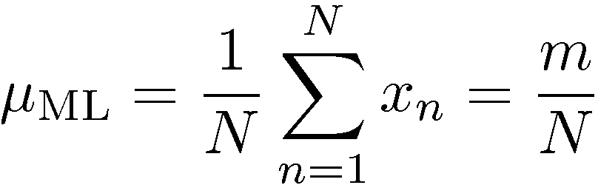
Parameter Estimation (1)
ML for Bernoulli
Given:

Slide 7
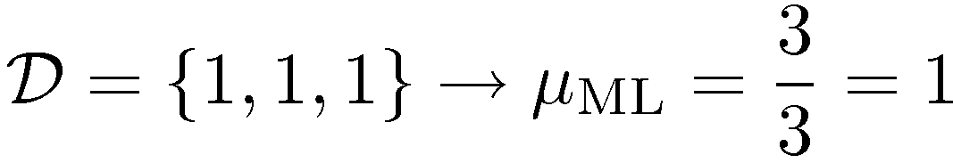
Parameter Estimation (2)
Example:
Prediction: all future tosses will land heads up
Overfitting to D

Slide 8

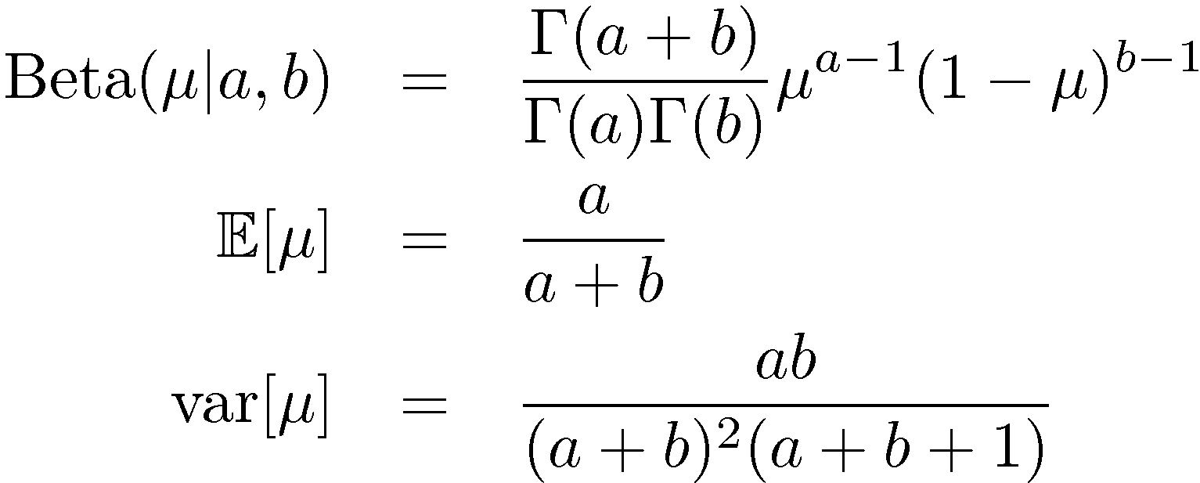
Beta Distribution
Distribution over .

Slide 9
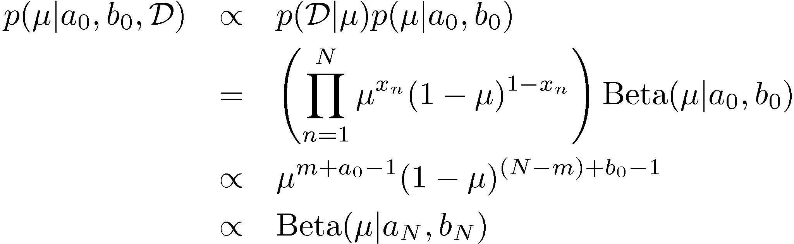
Bayesian Bernoulli
The Beta distribution provides the conjugate prior for the Bernoulli distribution.

Slide 10
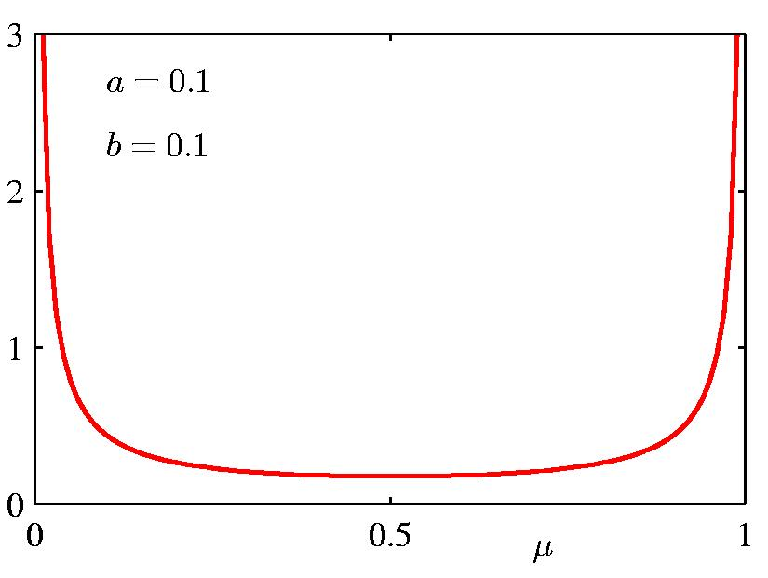
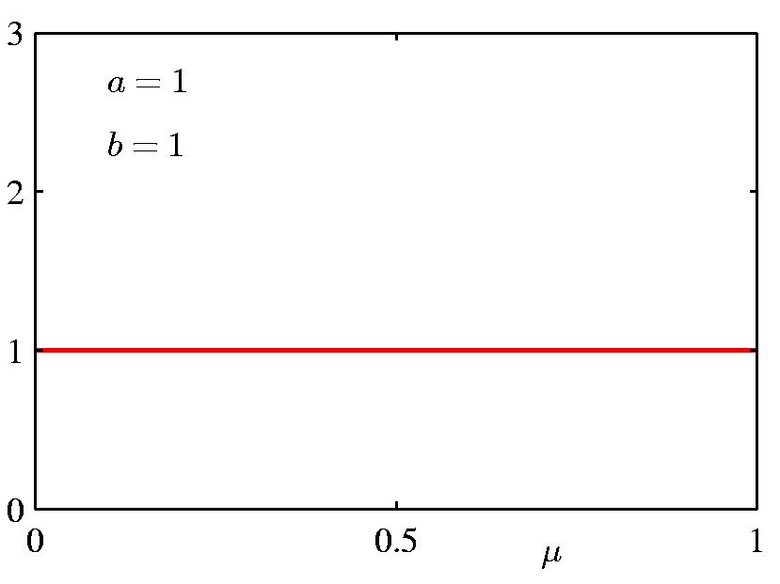
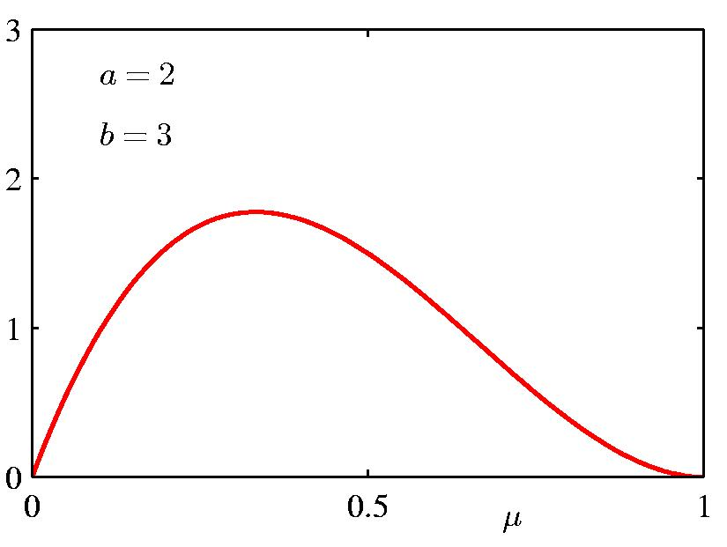
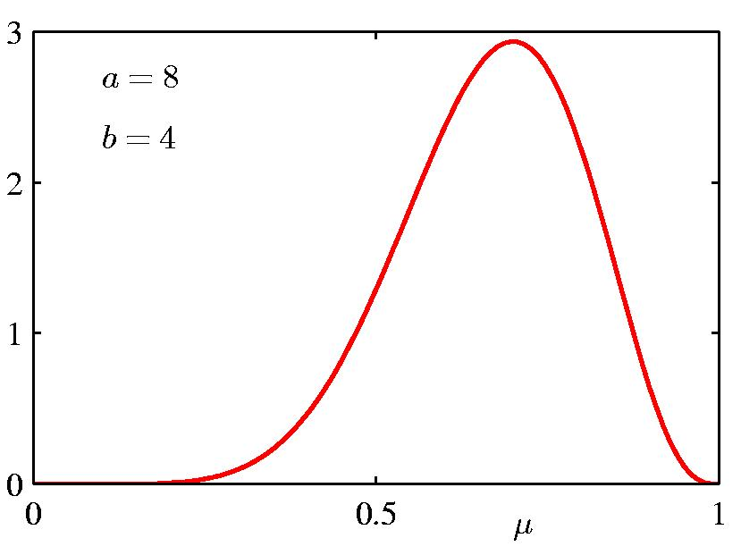
Beta Distribution

Slide 11
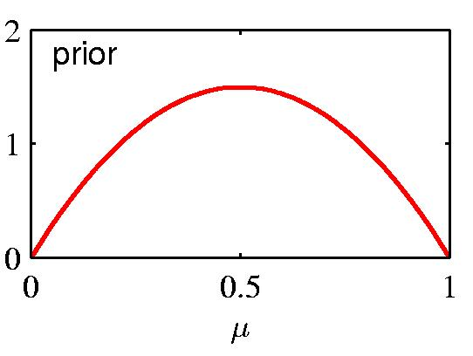
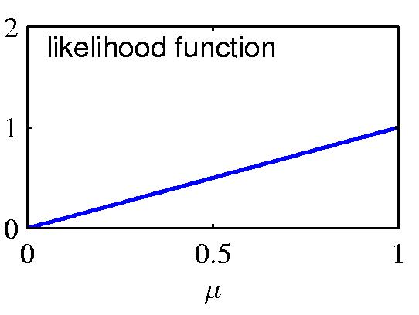
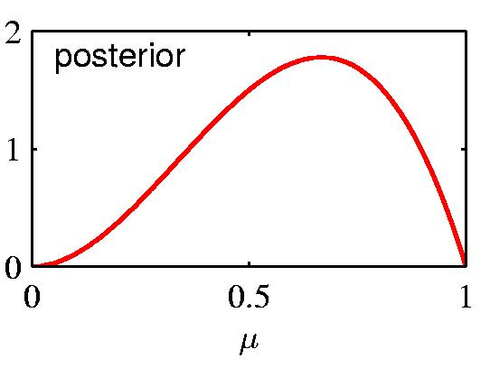
Prior ∙ Likelihood = Posterior

Slide 12
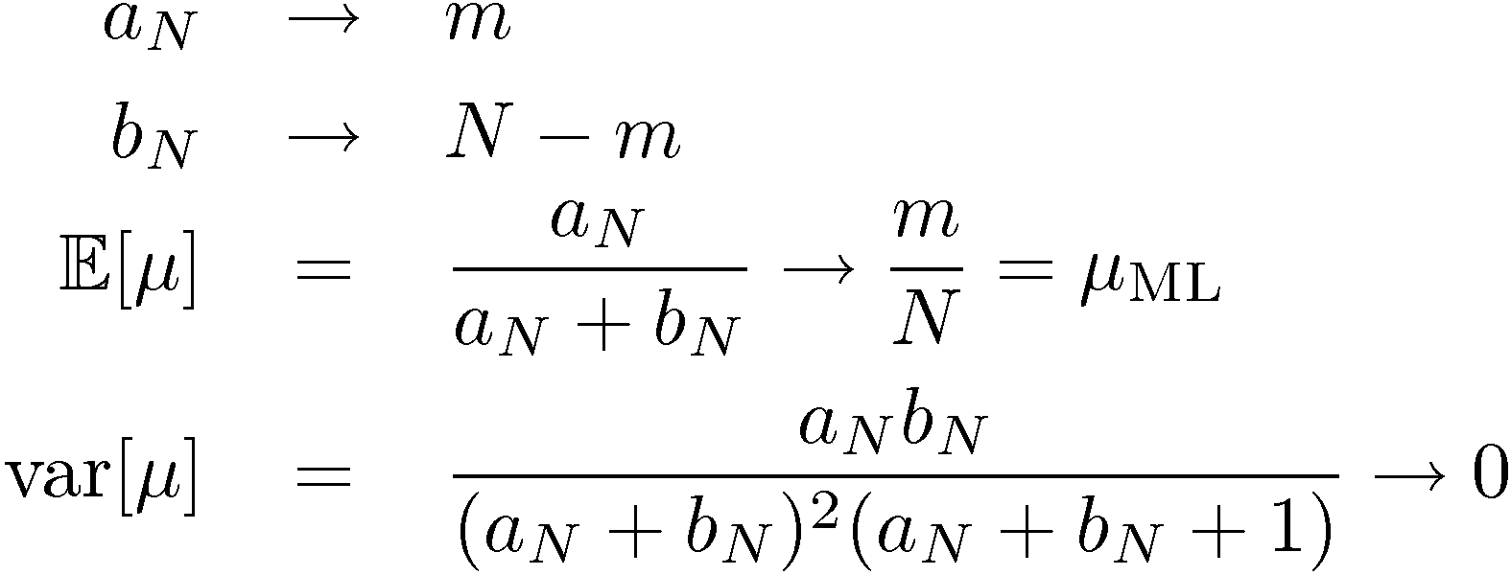
Properties of the Posterior
As the size of the data set, N , increase

Slide 13
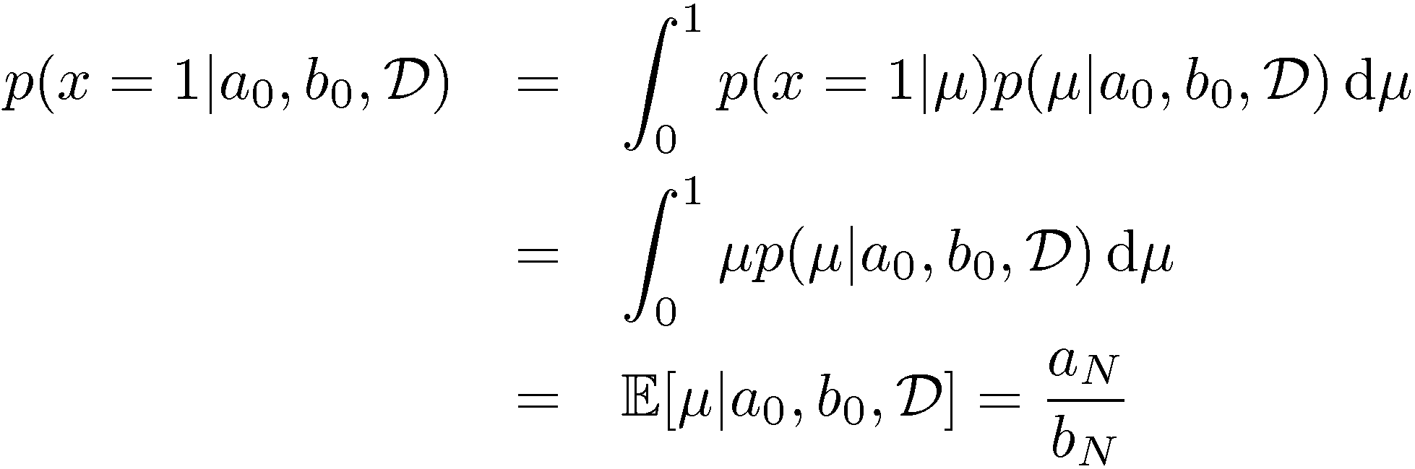
Prediction under the Posterior
What is the probability that the next coin toss will land heads up?

Slide 14
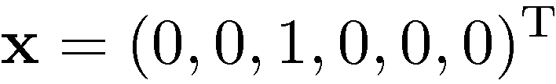
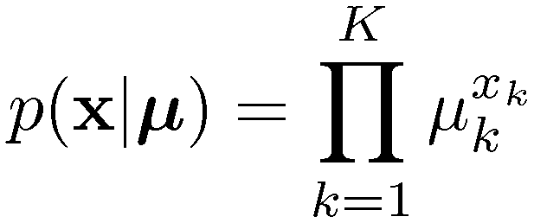
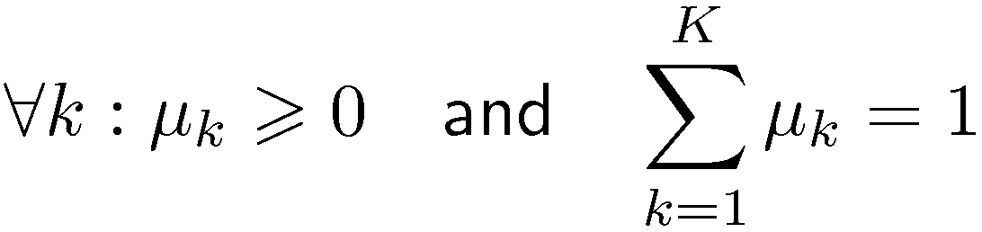
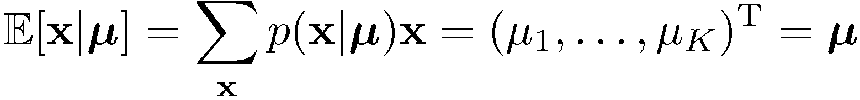
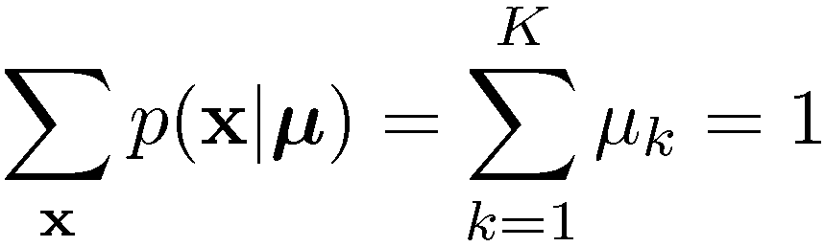
Multinomial Variables
1-of-K coding scheme:

Slide 15

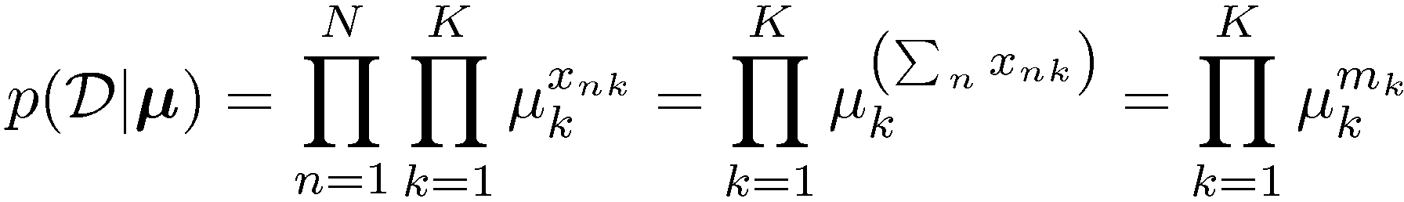

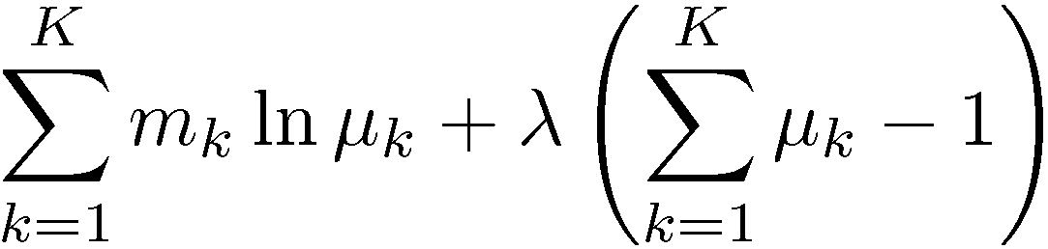
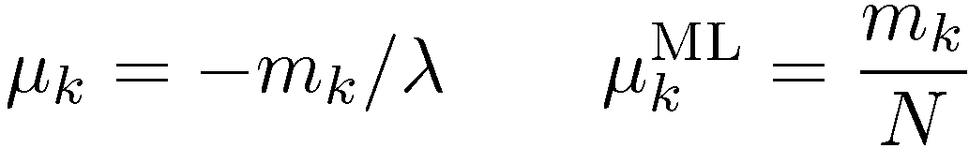
ML Parameter estimation
Given:
Ensure , use a Lagrange multiplier, ¸.

Slide 16
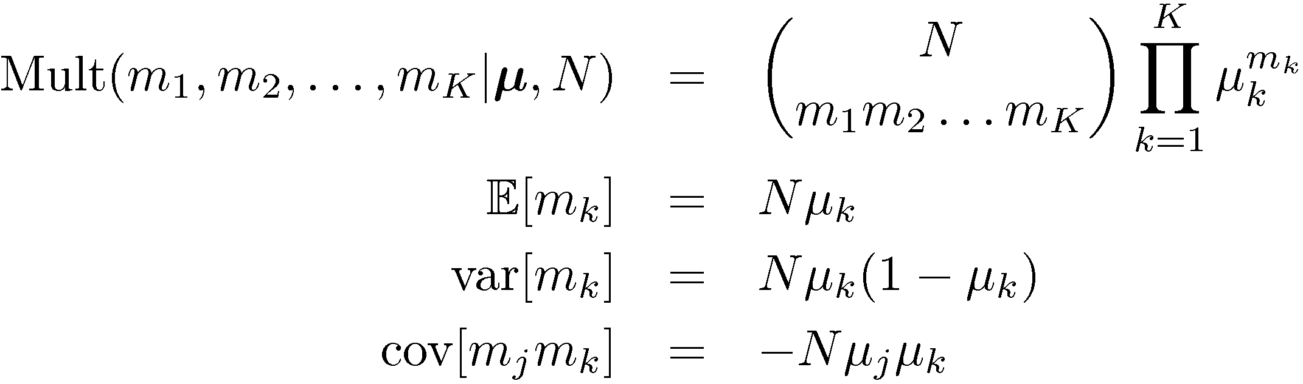
The Multinomial Distribution

Slide 17
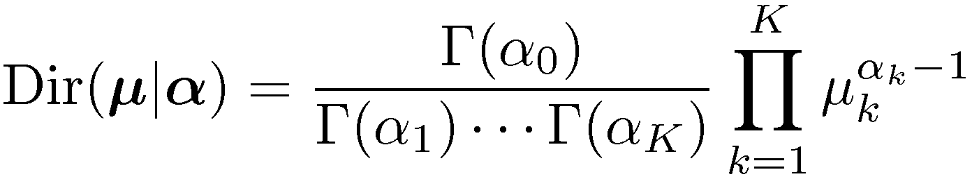
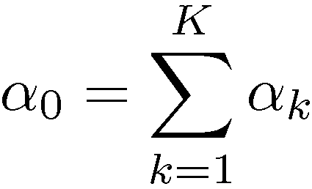
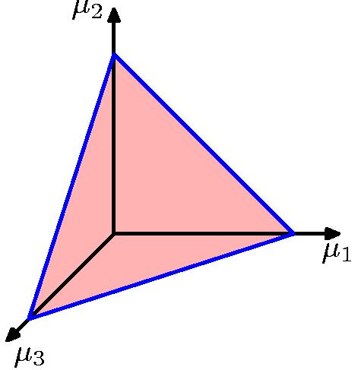
The Dirichlet Distribution
Conjugate prior for the multinomial distribution.

Slide 18
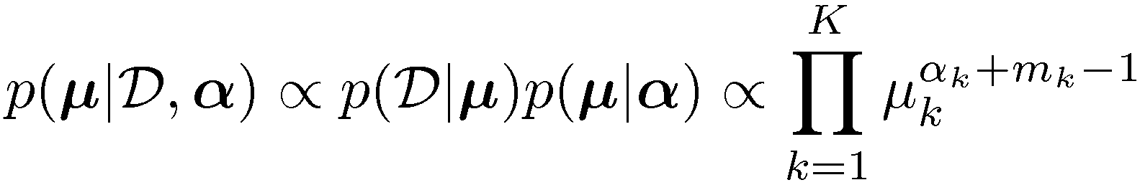
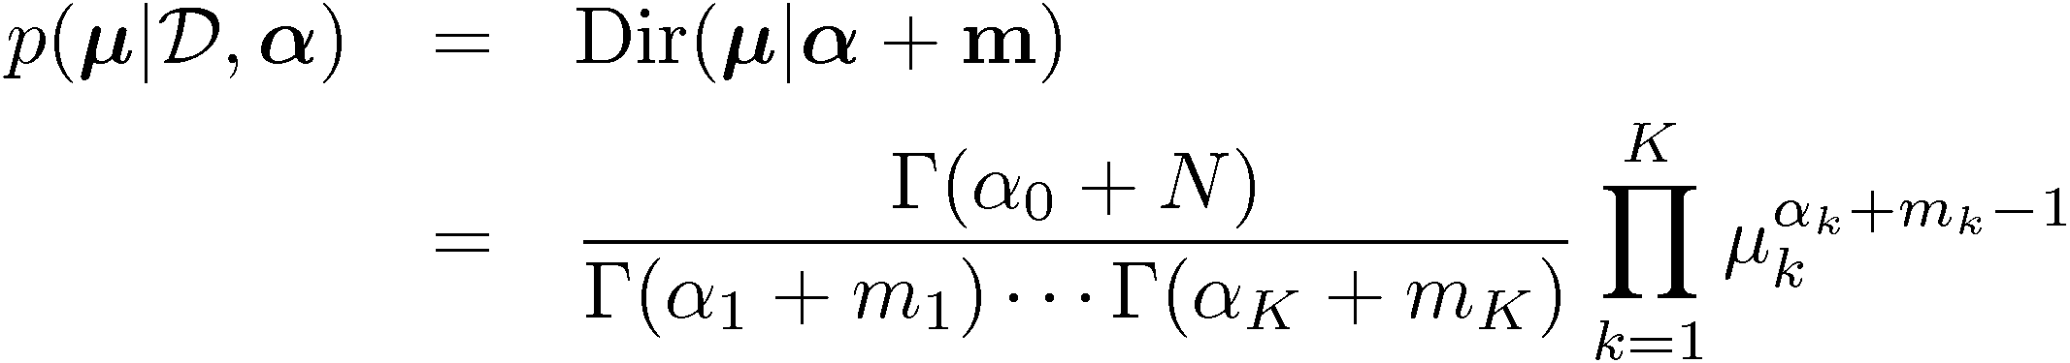
Bayesian Multinomial (1)

Slide 19
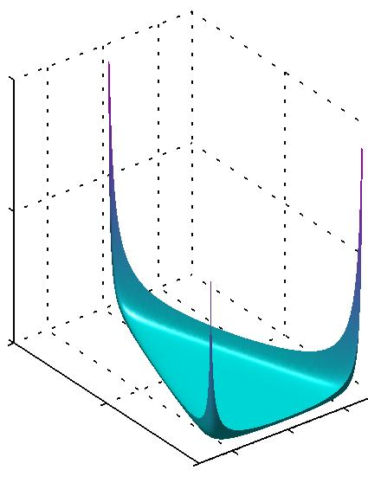
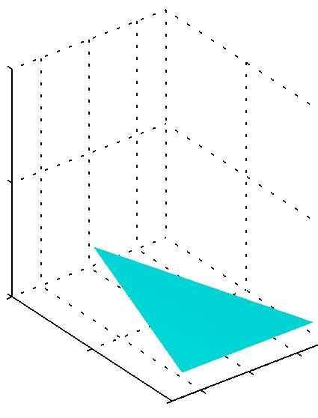
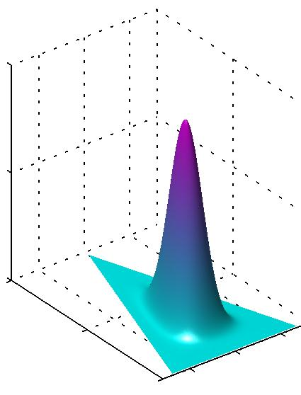



Bayesian Multinomial (2)

Slide 20
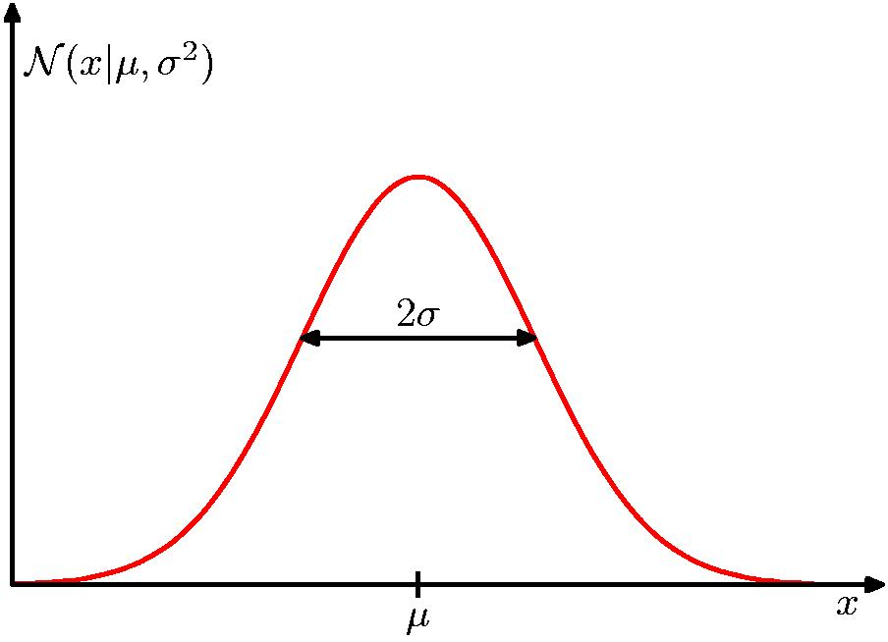
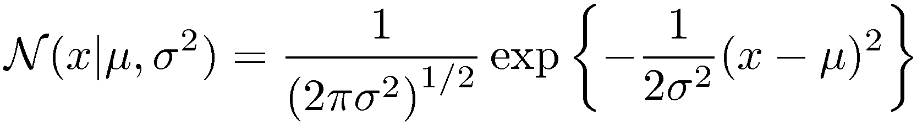
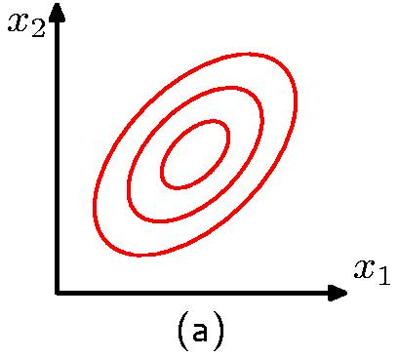
The Gaussian Distribution

Slide 21
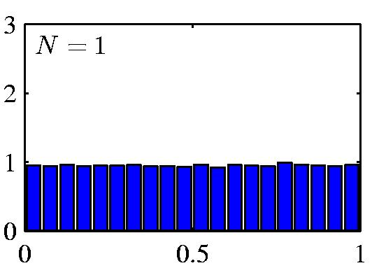
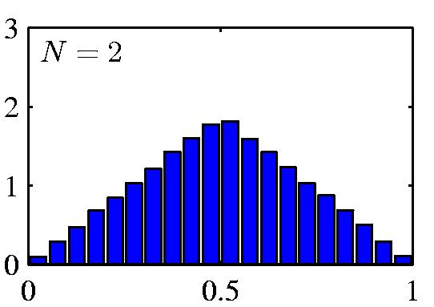
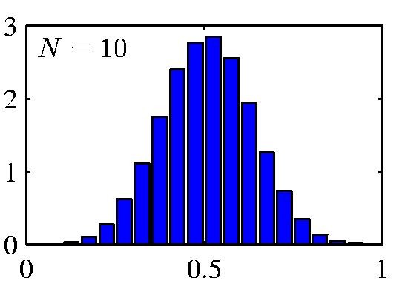
Central Limit Theorem
The distribution of the sum of N i.i.d. random variables becomes increasingly Gaussian as N grows.
Example: N uniform [0,1] random variables.

Slide 22
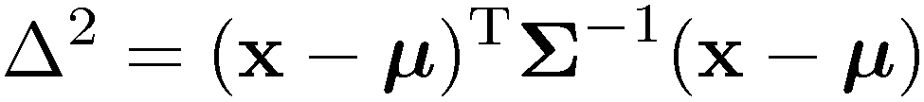
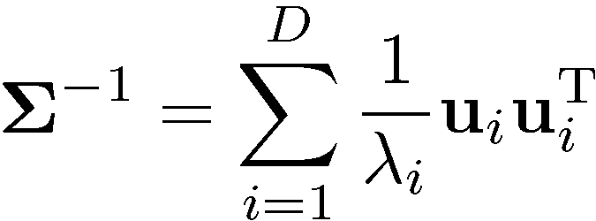
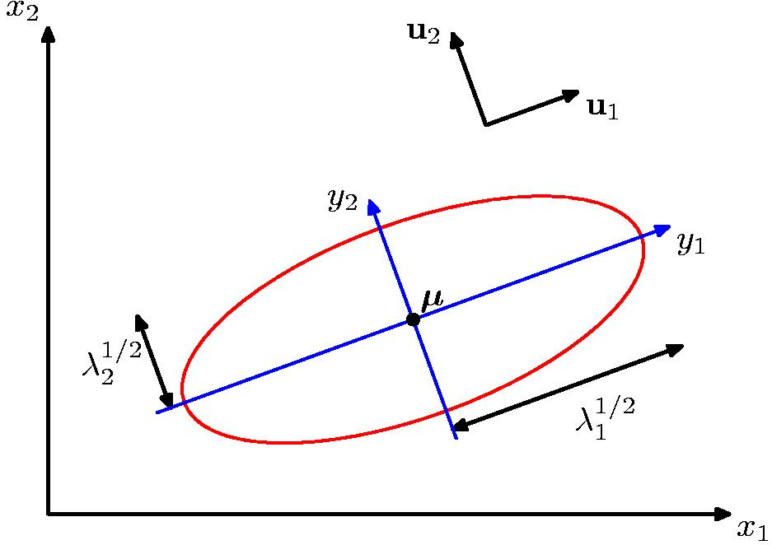
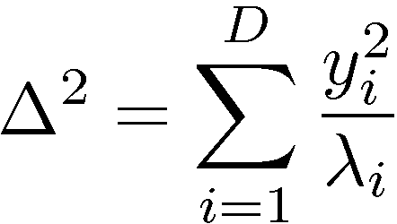
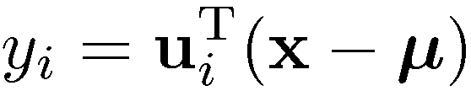
Geometry of the Multivariate Gaussian

Slide 23


Moments of the Multivariate Gaussian (1)
thanks to anti-symmetry of z

Slide 24



Moments of the Multivariate Gaussian (2)

Slide 25






Partitioned Gaussian Distributions

Slide 26


Partitioned Conditionals and Marginals

Slide 27


Partitioned Conditionals and Marginals

Slide 28



Bayes’ Theorem for Gaussian Variables
Given
we have
where

Slide 29


Maximum Likelihood for the Gaussian (1)
Given i.i.d. data , the log likeli-hood function is given by
Sufficient statistics

Slide 30



Maximum Likelihood for the Gaussian (2)
Set the derivative of the log likelihood function to zero,
and solve to obtain
Similarly

Slide 31


Maximum Likelihood for the Gaussian (3)
Under the true distribution
Hence define

Slide 32

Sequential Estimation
Contribution of the N ^{th} data point, x_{N}
correction given x_{N}
correction weight
old estimate

Slide 33

The Robbins-Monro Algorithm (1)
Consider µ and z governed by p(z,µ) and define the regression function
Seek µ? such that f(µ?) = 0.

Slide 34

The Robbins-Monro Algorithm (2)
Assume we are given samples from p(z,µ), one at the time.

Slide 35

The Robbins-Monro Algorithm (3)
Successive estimates of µ? are then given by
Conditions on a_{N} for convergence :

Slide 36

Robbins-Monro for Maximum Likelihood (1)
Regarding
as a regression function, finding its root is equivalent to finding the maximum likelihood solution µ_{ML}. Thus

Slide 37


Robbins-Monro for Maximum Likelihood (2)
Example: estimate the mean of a Gaussian.
The distribution of z is Gaussian with mean ¹ { ¹_{ML}.
For the Robbins-Monro update equation, a_{N} = ¾²=N.

Slide 38


Bayesian Inference for the Gaussian (1)
Assume ¾² is known. Given i.i.d. data
, the likelihood function for
¹ is given by
This has a Gaussian shape as a function of ¹ (but it is not a distribution over ¹).

Slide 39



Bayesian Inference for the Gaussian (2)
Combined with a Gaussian prior over ¹,
this gives the posterior
Completing the square over ¹, we see that

Slide 40


Bayesian Inference for the Gaussian (3)
… where
Note:

Slide 41

Bayesian Inference for the Gaussian (4)
Example: for N = 0, 1, 2 and 10.

Slide 42

Bayesian Inference for the Gaussian (5)
Sequential Estimation
The posterior obtained after observing N { 1 data points becomes the prior when we observe the N ^{th} data point.

Slide 43

Bayesian Inference for the Gaussian (6)
Now assume ¹ is known. The likelihood function for ¸ = 1/¾² is given by
This has a Gamma shape as a function of ¸.

Slide 44





Bayesian Inference for the Gaussian (7)
The Gamma distribution

Slide 45




Bayesian Inference for the Gaussian (8)
Now we combine a Gamma prior, ,
with the likelihood function for ¸ to obtain
which we recognize as with

Slide 46

Bayesian Inference for the Gaussian (9)
If both ¹ and ¸ are unknown, the joint likelihood function is given by
We need a prior with the same functional dependence on ¹ and ¸.

Slide 47

Bayesian Inference for the Gaussian (10)
The Gaussian-gamma distribution
Quadratic in ¹.
Linear in ¸.
Gamma distribution over ¸.
Independent of ¹.

Slide 48

Bayesian Inference for the Gaussian (11)
The Gaussian-gamma distribution

Slide 49


Bayesian Inference for the Gaussian (12)
Multivariate conjugate priors
¹ unknown, ¤ known: p(¹) Gaussian.
¤ unknown, ¹ known: p(¤) Wishart,
¤ and ¹ unknown: p(¹,¤) Gaussian-Wishart,

Slide 50

Student’s t-Distribution
where
Infinite mixture of Gaussians.

Slide 51


Student’s t-Distribution

Slide 52


Student’s t-Distribution
Robustness to outliers: Gaussian vs t-distribution.

Slide 53



Student’s t-Distribution
The D-variate case:
where .
Properties:

Slide 54

Periodic variables
Examples: calendar time, direction, …
We require

Slide 55


von Mises Distribution (1)
This requirement is satisfied by
where
is the 0th order modified Bessel function of the 1st kind.

Slide 56


von Mises Distribution (4)

Slide 57




Maximum Likelihood for von Mises
Given a data set, , the log likelihood function is given by
Maximizing with respect to µ₀ we directly obtain
Similarly, maximizing with respect to m we get
which can be solved numerically for m_{ML}.

Slide 58


Mixtures of Gaussians (1)
Old Faithful data set
Single Gaussian
Mixture of two Gaussians

Slide 59



Mixtures of Gaussians (2)
Combine simple models
into a complex model:
Component
Mixing coefficient
K=3

Slide 60



Mixtures of Gaussians (3)

Slide 61

Mixtures of Gaussians (4)
Determining parameters ¹, §, and ¼ using maximum log likelihood
Solution: use standard, iterative, numeric optimization methods or the expectation maximization algorithm (Chapter 9).
Log of a sum; no closed form maximum.

Slide 62

The Exponential Family (1)
where ´ is the natural parameter and
so g(´) can be interpreted as a normalization coefficient.

Slide 63



The Exponential Family (2.1)
The Bernoulli Distribution
Comparing with the general form we see that
and so
Logistic sigmoid

Slide 64


The Exponential Family (2.2)
The Bernoulli distribution can hence be written as
where

Slide 65





The Exponential Family (3.1)
The Multinomial Distribution
where, , and
NOTE: The ´ _{k} parameters are not independent since the corresponding ¹_{k} must satisfy

Slide 66





The Exponential Family (3.2)
Let . This leads to
and
Here the ´ _{k} parameters are independent. Note that
and
Softmax

Slide 67

The Exponential Family (3.3)
The Multinomial distribution can then be written as
where

Slide 68


The Exponential Family (4)
The Gaussian Distribution
where

Slide 69



ML for the Exponential Family (1)
From the definition of g(´) we get
Thus

Slide 70



ML for the Exponential Family (2)
Give a data set, , the likelihood function is given by
Thus we have
Sufficient statistic

Slide 71

Conjugate priors
For any member of the exponential family, there exists a prior
Combining with the likelihood function, we get
Prior corresponds to º pseudo-observations with value Â.

Slide 72



Noninformative Priors (1)
With little or no information available a-priori, we might choose a non-informative prior.
  ¸ discrete, K-nomial :
  ¸2[a,b] real and bounded:
  ¸ real and unbounded: improper!
A constant prior may no longer be constant after a change of variable; consider p(¸) constant and ¸=´²:

Slide 73

Noninformative Priors (2)
Translation invariant priors. Consider
For a corresponding prior over ¹, we have
for any A and B. Thus p(¹) = p(¹ { c) and p(¹) must be constant.

Slide 74


Noninformative Priors (3)
Example: The mean of a Gaussian, ¹ ; the conjugate prior is also a Gaussian,
As , this will become constant over ¹ .

Slide 75



Noninformative Priors (4)
Scale invariant priors. Consider and make the change of variable
For a corresponding prior over ¾, we have
for any A and B. Thus p(¾) / 1/¾ and so this prior is improper too. Note that this corresponds to p(ln ¾) being constant.

Slide 76
Noninformative Priors (5)
Example: For the variance of a Gaussian, ¾², we have
If ¸ = 1/¾² and p(¾) / 1/¾ , then p(¸) / 1/ ¸.
We know that the conjugate distribution for ¸ is the Gamma distribution,
A noninformative prior is obtained when a₀ = 0 and b₀ = 0.

Slide 77
Nonparametric Methods (1)
Parametric distribution models are restricted to specific forms, which may not always be suitable; for example, consider modelling a multimodal distribution with a single, unimodal model.
Nonparametric approaches make few assumptions about the overall shape of the distribution being modelled.

Slide 78


Nonparametric Methods (2)
Histogram methods partition the data space into distinct bins with widths ¢_{i} and count the number of observations, n_{i}, in each bin.
Often, the same width is used for all bins, ¢_{i} = ¢.
¢ acts as a smoothing parameter.
In a D-dimensional space, using M bins in each dimen-sion will require M^{D} bins!

Slide 79




Nonparametric Methods (3)
Assume observations drawn from a density p(x) and consider a small region R containing x such that
The probability that K out of N observations lie inside R is Bin(KjN,P ) and if N is large
If the volume of R, V, is sufficiently small, p(x) is approximately constant over R and
Thus
V small, yet K>0, therefore N large?

Slide 80


Nonparametric Methods (4)
Kernel Density Estimation: fix V, estimate K from the data. Let R be a hypercube centred on x and define the kernel function (Parzen window)
It follows that
and hence

Slide 81



Nonparametric Methods (5)
To avoid discontinuities in p(x), use a smooth kernel, e.g. a Gaussian
Any kernel such that
will work.
h acts as a smoother.

Slide 82


Nonparametric Methods (6)
Nearest Neighbour Density Estimation: fix K, estimate V from the data. Consider a hypersphere centred on x and let it grow to a volume, V ?, that includes K of the given N data points. Then
K acts as a smoother.

Slide 83
Nonparametric Methods (7)
Nonparametric models (not histograms) requires storing and computing with the entire data set.
Parametric models, once fitted, are much more efficient in terms of storage and computation.

Slide 84





K-Nearest-Neighbours for Classification (1)
Given a data set with N_{k} data points from class C_{k} and , we have
and correspondingly
Since , Bayes’ theorem gives

Slide 85


K-Nearest-Neighbours for Classification (2)
K = 3
K = 1

Slide 86




K-Nearest-Neighbours for Classification (3)
K acts as a smother
For , the error rate of the 1-nearest-neighbour classifier is never more than twice the optimal error (obtained from the true conditional class distributions).

