Slide 1

Transfer Knowledge between cities
Ying Wei§, Yu Zheng^{Ɨ}, Qiang Yang§
^{Ɨ}Microsoft Research, Beijing, China
§Hong Kong University of Science and Technology
§{yweiad, qyang}@cse.ust.hk, ^{Ɨ}yuzheng@microsoft.com

Slide 2
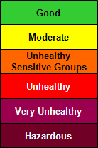
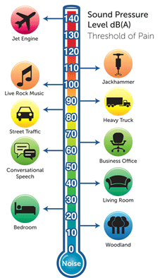
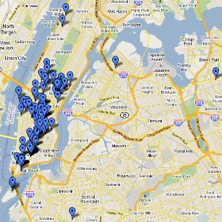
Motivation
Urban computing tasks need to unlock the power of a diversity of datasets in a city.
predict air quality
modality
diagnose noise level

Slide 3

Motivation
The data required in a city could be insufficient.
  E.g., predicting air quality in Baoding
    Label scarcity
    Structured modality missing
    Within modality insufficiency
Baoding

Slide 4
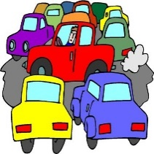
Motivation
Can we transfer knowledge from a city where data are sufficient, say Beijing, to Baoding?
Beijing
transfer
Very unhealthy
Baoding

Slide 5
































Framework
$${DB}_{S}^{1}$$
$${DB}_{S}^{2}$$
$${DB}_{S}^{3}$$
$${DB}_{S}^{4}$$
$$S^{1}$$
$$S^{2}$$
$$S^{3}$$
$$S^{4}$$
source city
original feature extraction
$$N^{s}$$
$$S^{1}$$
$$S^{2}$$
$$S^{3}$$
$$S^{4}$$
graph clustering based dictionary learning
$$D^{1}$$
$$D^{2}$$
$$D^{3}$$
$$D^{4}$$
transfer
$$D^{1}$$
$$D^{2}$$
$$D^{3}$$
$$D^{4}$$
$$k$$
$$T^{1}$$
$$T^{2}$$
$$T^{3}$$
$$T^{1}$$
$$T^{2}$$
$$T^{3}$$
target city
original feature extraction
$$N^{t}$$
$${DB}_{T}^{1}$$
$${DB}_{T}^{2}$$
$${DB}_{T}^{3}$$

Slide 6



















Framework
$${DB}_{S}^{1}$$
$${DB}_{S}^{2}$$
$${DB}_{S}^{3}$$
$${DB}_{S}^{4}$$
sparse coding model
source city
$${\hat{S}}^{1}$$
$${\hat{S}}^{2}$$
$${\hat{S}}^{3}$$
$${\hat{S}}^{4}$$
original feature extraction
$$N^{s}$$
$$S^{1}$$
$$S^{2}$$
$$S^{3}$$
$$S^{4}$$
graph clustering based dictionary learning
$$k$$
$$k$$
$$k$$
$$k$$
transfer
$$D^{1}$$
$$D^{2}$$
$$D^{3}$$
$$D^{4}$$
Multimodal Transfer Adaboost
sparse coding model
$${\hat{T}}^{MP}$$
0.9 | 0.9
0.2 | 0.4
0.6 | 0.8
$$T^{1}$$
$$T^{2}$$
$$T^{3}$$
max pooling
$$N^{t}$$
target city
original feature extraction
$${\hat{T}}^{1}$$
$${\hat{T}}^{2}$$
$${\hat{T}}^{3}$$
$$k$$
0.8 | 0.2
0.1 | 0.4
0.6 | 0.3
0.9 | 0.7
0.2 | 0.1
0.4 | 0.8
0.1 | 0.9
0.2 | 0.1
$$N^{t}$$
final classifier
$${DB}_{T}^{1}$$
$${DB}_{T}^{2}$$
$${DB}_{T}^{3}$$
$$k$$
$$k$$
$$k$$
results

Slide 7












Graph clustering based dictionary learning
graph construction
intra-edges: the same feature, similarity based
inter-edges: different features distance based
submodular graph clustering
averaging
$$d_{1}^{1}$$
$$d_{1}^{4}$$
$$d_{2}^{1}$$
$$d_{2}^{4}$$
$$D^{4}$$
$$d_{k}^{1}$$
$$d_{k}^{4}$$
$$D^{1}$$
dictionary inference
$$p^{1}$$
$$p^{4}$$
$$k$$
$$k$$

Slide 8



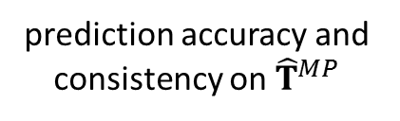























Multimodal Transfer Adaboost
$${\hat{S}}^{1}$$
$${\hat{S}}^{2}$$
$${\hat{S}}^{3}$$
$${\hat{S}}^{4}$$
$$w_{1}^{1}(1)$$
$$w_{1}^{2}(1)$$
$$w_{1}^{3}(1)$$
$$w_{1}^{4}(1)$$
$$N^{s}$$
$$w_{N^{s}}^{1}(1)$$
$$w_{N^{s}}^{2}(1)$$
$$w_{N^{s}}^{3}(1)$$
$$w_{N^{s}}^{4}(1)$$
initial
sample weights
$$k$$
$$k$$
$$k$$
$$k$$
$${\hat{T}}^{MP}$$
$$v_{1}(1)$$
$$N^{t}$$
$$v_{N^{t}}(1)$$
$$k$$
classifiers
$$h^{1}(1)$$
$$h^{2}(1)$$
$$h^{3}(1)$$
$$h^{4}(1)$$
$${\hat{T}}^{MP}$$
prediction accuracy and consistency on ${\hat{T}}^{MP}$
$$ε(1)$$
$$consistency(1)$$

Slide 9


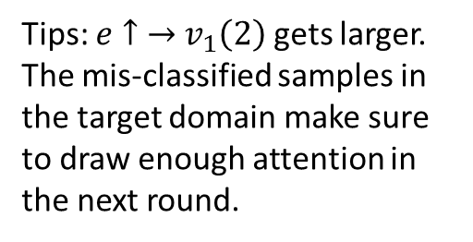










Multimodal Transfer Adaboost
$${\hat{S}}^{1}$$
$${\hat{S}}^{2}$$
$${\hat{S}}^{3}$$
$${\hat{S}}^{4}$$
$$w_{1}^{1}(1)$$
$$w_{1}^{2}(1)$$
$$w_{1}^{3}(1)$$
$$w_{1}^{4}(1)$$
$$N^{s}$$
$$w_{N^{s}}^{1}(1)$$
$$w_{N^{s}}^{2}(1)$$
$$w_{N^{s}}^{3}(1)$$
$$w_{N^{s}}^{4}(1)$$
update
weights
$$k$$
$$k$$
$$k$$
$$k$$
error1
$$h^{1}(1)$$
$${\hat{T}}^{MP}$$
error2
$$h^{2}(1)$$
$$v_{1}(1)$$
error3
$$max$$
$$e$$
$$h^{3}(1)$$
error4
$$v_{N^{t}}(1)$$
$$h^{4}(1)$$
$$k$$
Tips: $e↑$ $→$ $v_{1}\left(2\right)$ gets larger.
The mis-classified samples in the target domain make sure to draw enough attention in the next round.
$v_{1}\left(2\right)= v_{1}\left(1\right)∗{β(1)}^{1−e}$
$$ε(1)$$
$$β\left(1\right)<0.5$$
$$consistency(1)$$

Slide 10




















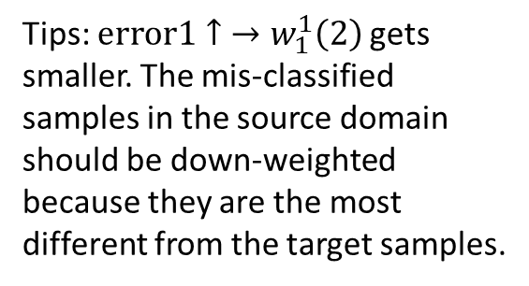






Multimodal Transfer Adaboost
$${\hat{S}}^{1}$$
$${\hat{S}}^{3}$$
$$h^{1}(1)$$
$$w_{1}^{1}(1)$$
error1
$$h^{3}(1)$$
$$w_{1}^{3}(1)$$
error2
$$N^{s}$$
$$w_{N^{s}}^{1}(1)$$
$$w_{N^{s}}^{3}(1)$$
update
weights
$$k$$
$$k$$
$${\hat{S}}^{2}$$
$${\hat{S}}^{4}$$
$$h^{2}(1)$$
$$w_{1}^{2}(1)$$
error3
$$h^{4}(1)$$
$$w_{1}^{4}(1)$$
error4
$$w_{N^{s}}^{2}(1)$$
$$w_{N^{s}}^{4}(1)$$
$$k$$
$$k$$
Tips: $error1↑$ $→w_{1}^{1}\left(2\right)$ gets smaller. The mis-classified samples in the source domain should be down-weighted because they are the most different from the target samples.
$w_{1}^{1}(2)=w_{1}^{1}(1)∗β^{error1}$
$w_{1}^{2}(2)=w_{1}^{2}(1)∗β^{error2}$
$w_{1}^{3}(2)=w_{1}^{3}(1)∗β^{error3}$
$w_{1}^{4}(2)=w_{1}^{4}(1)∗β^{error4}$
$$ε(1)$$
$$β<1$$
$$consistency(1)$$

