Slide 1

Forecasting Citywide Crowd Flows using Big Data
Minh Hoang, Yu Zheng, Ambuj Singh
mhoang@cs.ucsb.edu
SIGSPATIAL 2016

Slide 2
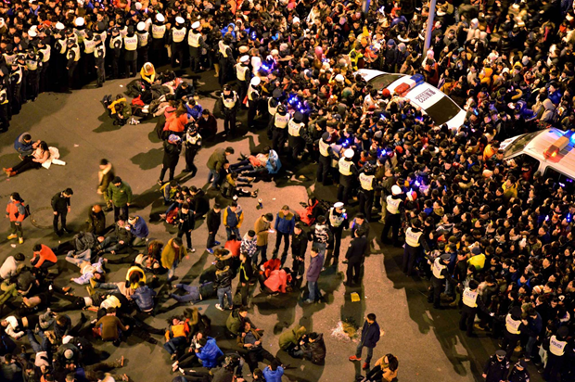
Shanghai Stampede
New Year Celebration 2015

Slide 3
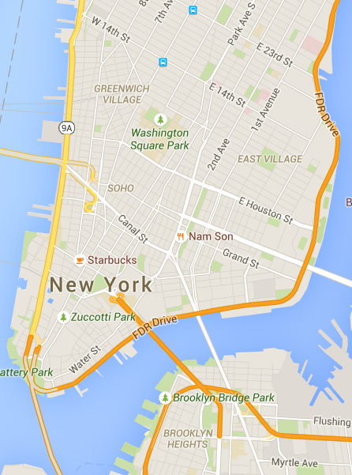
Occupy Wall Street, Sep, 2014
8am Sep, 17, 2014

Slide 4
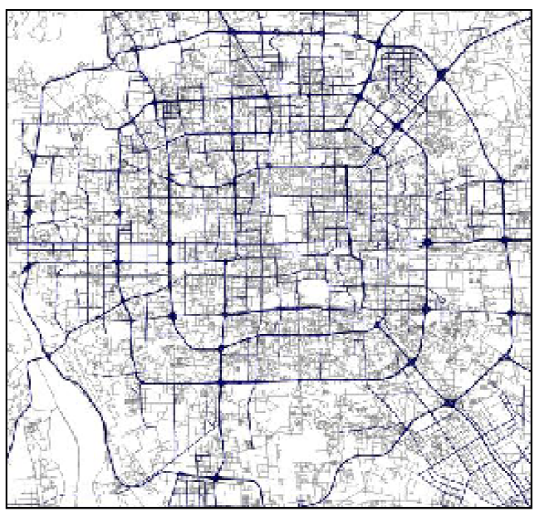
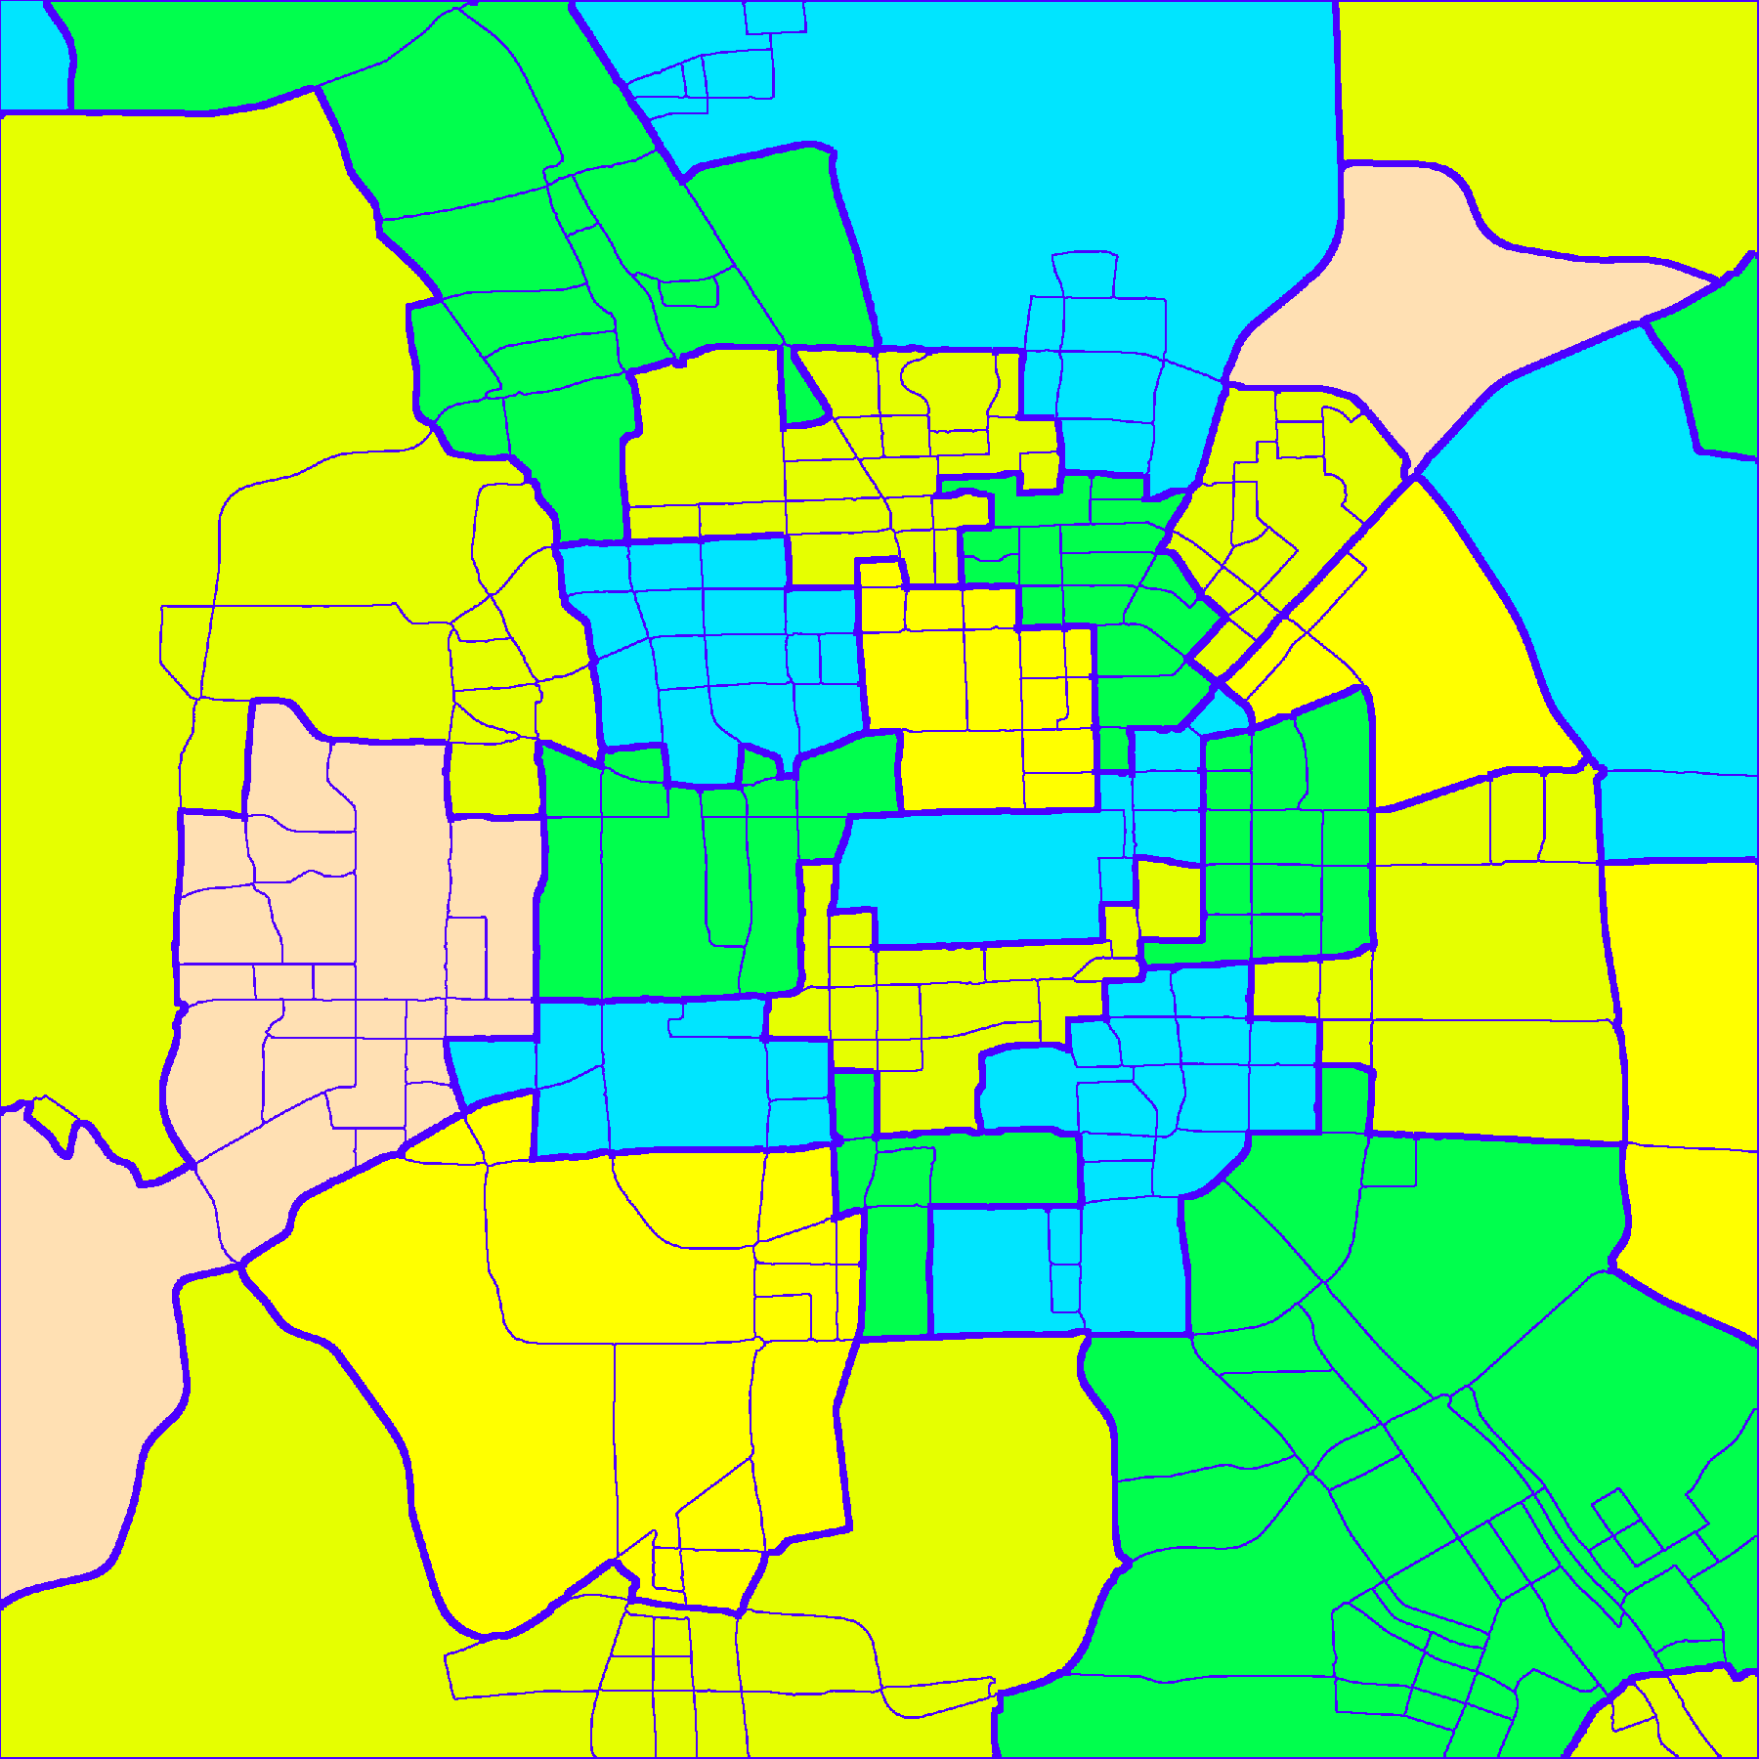
Macroscopic city traffic prediction
Traffic prediction
for roads/freeway
Flow of crowds prediction
for regions
Microscopic view
not useful for city planning
+ ignore where/when
traffic flow starts and ends
+ low-level information overload
+ high prediction cost
Macroscopic prediction
for urban planning
+ understand regional functions
+ distribute resources/services
+ detect city-scale anomaly
+ lower prediction cost

Slide 5
Forecasting Citywide Crowd Flows
A region
Other regions
End-flow
End
Start
New-flow
Other regions

Slide 6
Challenges
A region
Other regions
End-flow
End
Start
New-flow
Other regions
+ Scalable solution
+ Meaningful regions
1. How to find regions?
2. How to make predictions?
+ Different crowd flow patterns
+ Spatio-temporal dependencies
+ Robust to missing/noisy data

Slide 7
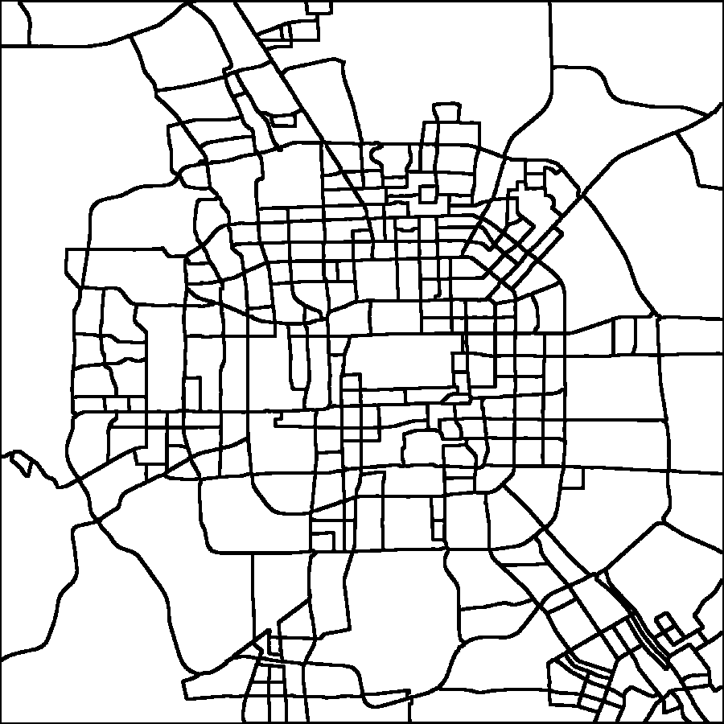
Finding regions: Map segmentation
Regions are city blocks bound by roads
Road network
Low-level regions
Map segmentation
Drawbacks:
Too many regions
Regions has varying sizes & crowd volumes
→ Not scalable
→ Information overload
→ Hard to distribute resources

Slide 8
Finding regions: Clustering regions
Low-level regions
High-level regions
Clustering
High-level regions = Groups of city blocks that
Are adjacent on the geographical map
Have similar crowd flow patterns
Have considerable total crowd flow volumes

Slide 9

Finding regions
Clustering low-level regions
Low-level region graph
High-level regions
Graph
clustering
Flow volume
Node == low-level region
Edge == adjacency on map
Node weight == Sum(flows)
Edge weight == Spearman(flows)
Flow similarity
Clustering objectives:
Edge cut minimization
Cluster balancing: Clusters with
similar sum of node weights
Group low-level regions
with similar patterns
High-level regions have
comparable volumes

Slide 10
Insights from Regional Crowd Flows
One day
New flow
End flow
7
Residential Area
(Leave in the morning, come back at night)
19
Tourist Attractions
(Forbidden city)
26
Regions in Beijing
#regions is chosen by
elbow method
City center
New ~ end

Slide 11
Predicting crowd flows
Intra-region Patterns
May 04-17, 2015
Mon Tue Wed Thu Fri Sat Sun
Mon Tue Wed Thu Fri Sat Sun
New-flow
Seasonal patterns: Daily & Weekly
6am
New-flow
New-flow
3pm
Trend: Different hours in day have different trends

Slide 12
Predicting crowd flows
Inter-region Patterns
3
New-flow
Decrease
Increase
Decrease
1
End-flow
June 3rd, 2015
Increase
Neighboring regions affect each other

Slide 13
Predicting crowd flows
Affect of weather & holidays

Slide 14
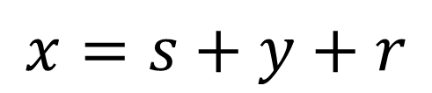
Predicting crow flows
Flow decomposition
$$x=s+y+r$$
Crowd flow = Seasonal + Trend + Residual
Normal/holiday
Temporal Model
Spatio-temporal Model
Intra-region
patterns
Transit Graph
Weather

Slide 15
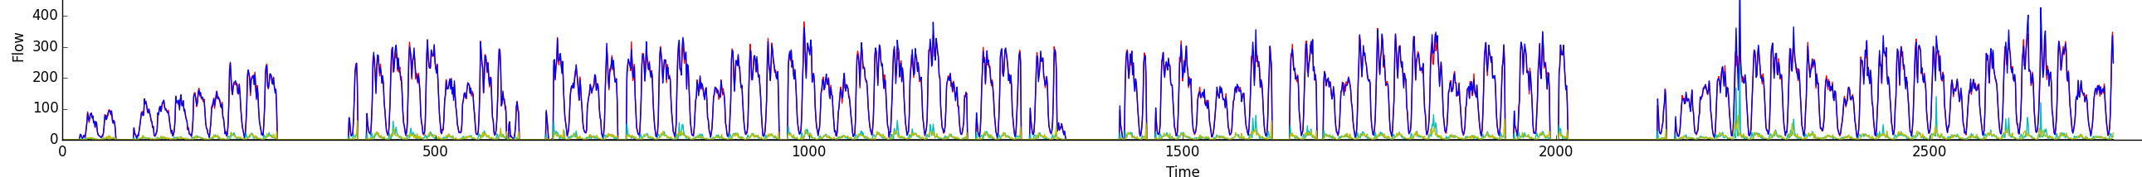
Missing & noisy data
Flow of a region during Feb-May, 2014. Red arrows == missing
Use probabilistic model
Gaussian Markov Random Field

Slide 16
Gaussian Markov Random Field (GMRF)
Vector x follows a multivariate Gaussian distribution
Time series
Mean
Covariance
Matrix
Precision
Matrix
Markov properties
→ Graph G captures conditional independence among x_{i}
Sparse G → Sparse Q
→ Fast learning
with MCMC sampling
to maximize a posteriori

Slide 17



Crowd flow = Seasonal + Trend + Residual
Seasonal model as a cyclic GMRF
Smooth changes between:
1. Consecutive timestamps
2. First & last timestamps
$$Δs_{i}=(s_{i}−s_{i−1})\sim N(μ,κ^{−1})$$
$$(s_{1}−s_{n})\sim N(μ,κ^{−1})$$
Gaussian
s₁
s₇
s₂
s₆
s₃
s₅
s₄
$$Δs^{new}$$
Seasonal time series s
with period F = 7

Slide 18


Crowd flow = Seasonal + Trend + Residual
Trend model as a GMRF
Gaussian
Smooth changes between
consecutive timestamps
$$Δy_{i}=(y_{i}−y_{i−1})\sim N(μ,κ^{−1})$$
$$Δy^{new}$$
y₁
y₂
y₃
y₄
y₅
y₆
y₇
e.g. the new flow at 6am of every Monday

Slide 19
Crowd flow = Seasonal + Trend + Residual
Spatio-temporal residual model r
Current Region R
Next Region
R’
Residual
transit flow
Regression
Σ
residual
flow r
History of
same region
Hour in day
1..24
Trip duration
d
Weather
Day type
Weekday?
Weekend?
Holidays?
Transit tensor factorization (PARAFAC)
Solved by counting → Fast
Day type 1
R
R’
Day type 1
Day type 2
Day type 3

Slide 20
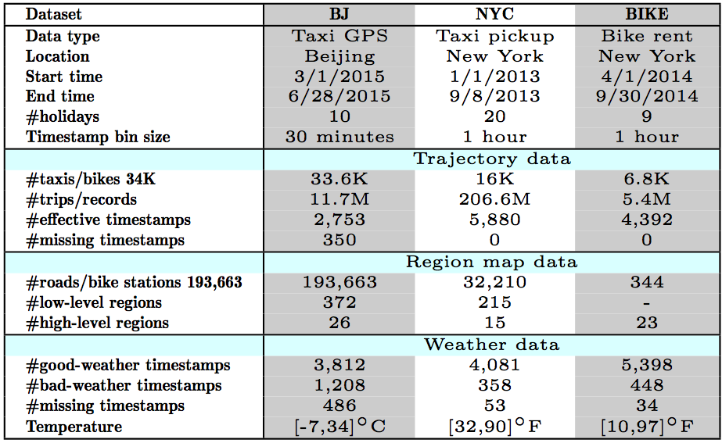
Experiment settings
Please see full experimental results in the paper

Slide 21
More people bike when the weather is nice
End-flow
R9
Temperature (ºF)
Seasonal + Trend
R8
80
R6
40
R7
Apr. 21
Jun. 30
Sep. 22
R2
R5
R3
5am
8pm
5am
8pm
5am
8pm
R1
R4
Change of seasonal pattern in R9 (Monday, sunny)

Slide 22
People don’t want to bike when it rains in NYC
FCCF
End-flow
5am
9am
1pm
5pm
9pm
Weather

Slide 23
Occupy Wall Street (Sep. 17, 2014)
R9
R2
R5
R7
R4
R8
R6
R7
R2
6
8
10
6
8
10
6
8
10
6
8
10
New-flow
R5
R1
R3
R1
R4
True crowd flow
7am
11am
Seasonal + Trend
End-flow
Our predictions

Slide 24

Thank you!
Minh Hoang
mhoang@cs.ucsb.edu
Code & data are available here:

