Slide 1
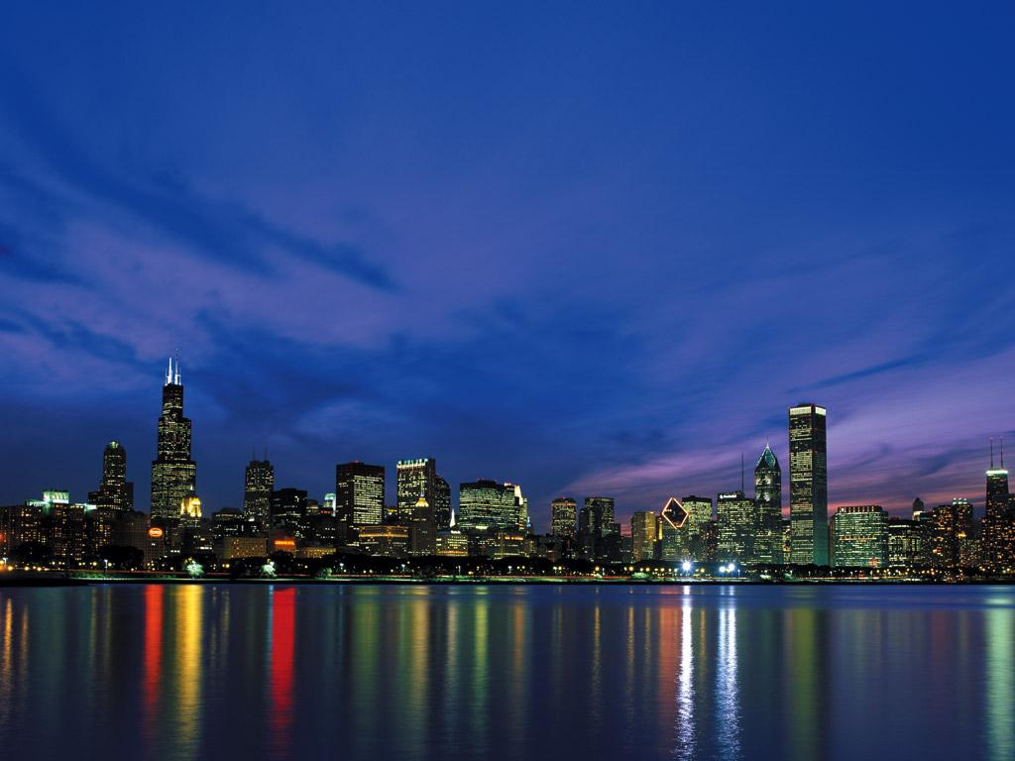
Artificial Intelligence
in the Open World
Eric Horvitz
Presidential Lecture
July 2008

Slide 2
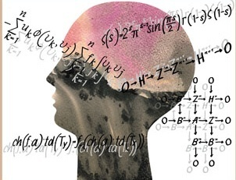
Rich Intellectual History of AI
18th
- Julien Offray de La Mettrie
L’homme machine (1747)
- Charles Babbage
Difference Machine, Analytical Engine
- Turing, von Neumann, Weiner, et al.
- Newell, Simon, Rochester, McCarthy, et al.
19th
20th

Slide 3
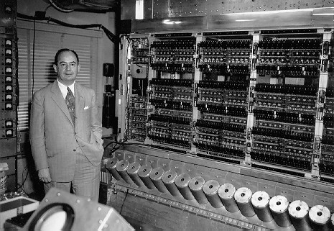
Computation as Basis of Thought & Intelligent Behavior
Theories of computability
General purpose computer

Slide 4
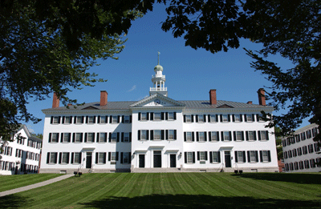
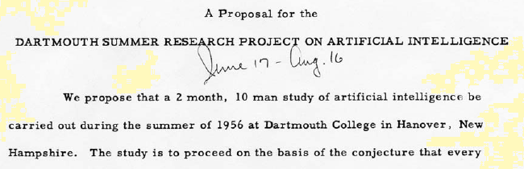

Slide 5
Dartmouth Meeting
Machine methods of forming abstractions from sensory and other data
Carrying out activities which may best be described as self-improvement
Manipulating words according to rules of reasoning and rules of conjecture
Developing a theory of the complexity for various aspects of intelligence

Slide 6
Paradigms of Computational Intelligence
“AI”
Decision sciences / OR
Optimization
Logic
Computability
General purpose computer

Slide 7
Paradigms of Computational Intelligence
Satisficing
High-level symbols
Logic
“AI”
Decision sciences / OR
Optimization
Logic
Computability
General purpose computer
Notes:
A new paradigm was forming, explicitly branching AI away from the more numerical decision sciences and operations research…. …into a worldview that included valuable and novel focuses on high-level symbols, logical inference, and cognitive psychology… Computers were used to explore heuristic models of human cognition, as well as well-defined, structured, closed-world puzzle-like problems, game playing, and theorem proving, including proofs for theorems in Euclidean geometry.

Slide 8
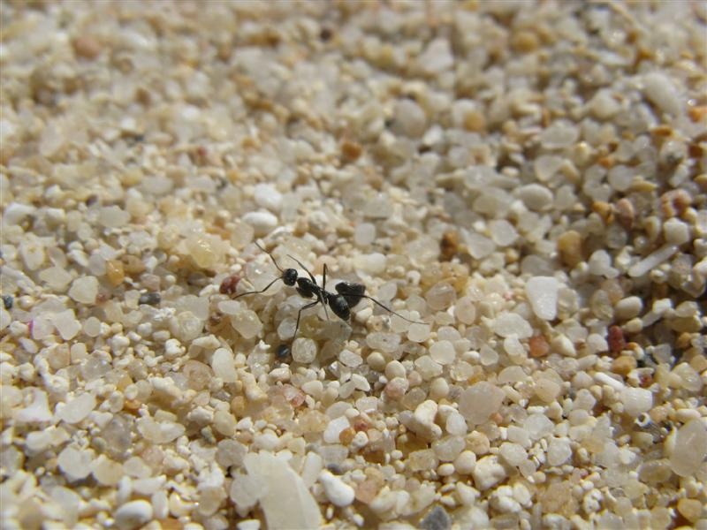
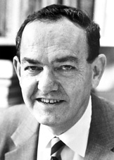
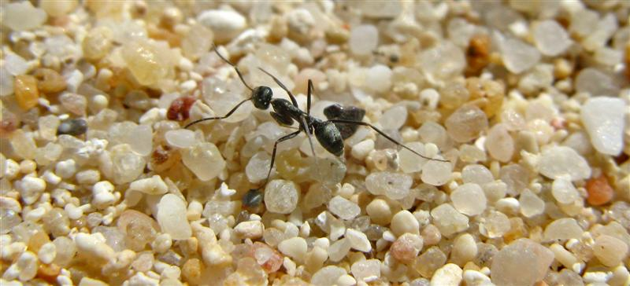
Grappling with Incompleteness
in an Open World

Slide 9
Grappling with Incompleteness
in an Open World
Bounded rationality (Simon, et al).
  Hopelessly incomplete knowledge of …
    Preferences
    State of world
    Outcomes of action

Slide 10
Enduring Perspective: Intelligence amidst Inescapable Incompleteness
Limited agents immersed in complex universes
  Limited representations
  Limited time and memory

Slide 11
Stepping into the Open World
Key technical challenges
AI moving into the world
AI research community

Slide 12
Stepping into the Open World
Key technical challenges
AI moving into the world
AI research community

Slide 13
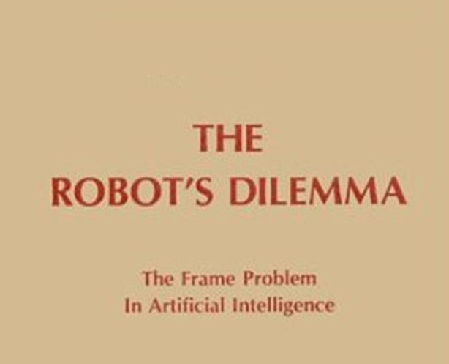

Stepping into the Open World

Slide 14
Relevance & Attention in Open Worlds
Frame problem
How to limit the scope of the reasoning required to derive the consequences of an action?
  Qualification problem
    All preconditions required for actions to have intended effects
  Ramification problem
    All effects of action
Nonmonotonic logics, representation of fluents

Slide 15
Paradigms of Computational Intelligence
Satisficing
High-level symbols
High-level symbols
Logic
Logic
“AI”
Uncertainty
UAI
Decision sciences / OR
Decision sciences / OR
Optimization
Logic
Computability
General purpose computer

Slide 16
Paradigms of Computational Intelligence
Satisficing
Optimization
High-level symbols
High-level symbols
Logic
Logic
“AI”
Probability
Utility
UAI
MEU
Decision sciences / OR
Optimization
Logic
Computability
General purpose computer

Slide 17
Paradigms of Computational Intelligence
Satisficing
Optimization
High-level symbols
High-level symbols
Logic
Logic
“AI”
Probability
Utility
UAI
MEU
Decision sciences / OR
Optimization
Logic
Computability
General purpose computer

Slide 18
Paradigms of Computational Intelligence
Satisficing
Optimization
High-level symbols
High-level symbols
Logic
Logic
“AI”
Probability
Utility
UAI
MEU
Decision sciences / OR
Optimization
Logic
Computability
General purpose computer

Slide 19
Uncertainty as Organizing Principle
Incompleteness is inescapable
Uncertainty is ubiquitous
  State of world
  Outcome of action
  Problem solving itself
Push unknown & unrepresented details into probabilities and propagate

Slide 20
Uncertainty as Organizing Principle
Machinery for handling
uncertainty & resource limitations foundational in intelligence

Slide 21
Expressive Representations of Uncertainty
Graphical models for representing beliefs
    d-separation
    Sound and complete algorithm for identifying all independencies entailed by the graph.
Battery
Fuel
p(B)
p(F)
Gauge
p(G|F,B)
TurnOver
p(T|B)
Start
p(S|F,T)

Slide 22
Representing Problems of Action
Maximum expected utility (MEU)
Influence diagrams (Howard & Matheson, 1975)
Action A
Utility
World
State H
E₁
E₂
E₃
E_{n}

Slide 23
Reasoning about Beliefs and Actions over Time
A₁,t₁
A₃,t₃
State of
World H, t_{o}
State of
World H, t₂
State of
World H, t₄
E_{1,} t_{o}
E_{2,} t_{o}
E_{n,} t_{o}
E_{1,} t’
E_{2,} t’
E_{n,} t’
E_{1,} t’’
E_{2,} t’’
E_{n,} t’’

Slide 24
Reasoning about Beliefs and Actions over Time
Plan {(A₁,t₁)...(A_{n},t_{n})}
Utility
A₁,t₁
A₃,t₃
State of
World H, t_{o}
State of
World H, t₂
State of
World H, t₄
E_{1,} t_{o}
E_{2,} t_{o}
E_{n,} t_{o}
E_{1,} t’
E_{2,} t’
E_{n,} t’
E_{1,} t’’
E_{2,} t’’
E_{n,} t’’

Slide 25
Acceleration of Machine Learning: Discovering Structure and Concepts
e.g., Structure search
Measure of model likelihood
*

Slide 26
Identification of Hidden Variables
“Unknown” variables discovered
?
?

Slide 27
…and the Bottleneck
Beauty
Insights arising in tight situations
Bounded rationality → Bounded optimality
Economics of computation
Flexible computational strategies
Principles of reflection
Insights
Notes:
Immersing decision makers in the real world also meant contending with time…and in some early work with trying to run probabilistic inference in time-critical medical situations pushed for some new thinking about reasoning and action under limited resources.

Slide 28
Economics of Flexible Computation
Utility of
action
• Immediate value of result
t
Deadline!

Slide 29
Economics of Flexible Computation
Utility of
action
• Immediate value of result
• Net value of result
t
• Cost of delay

Slide 30
Economics of Flexible Computation
Utility of
action
• Immediate value of result
• Net value of result
t
• Cost of delay

Slide 31
Economics of Flexible Computation
Utility of
action
• Immediate value of result
• Net value of result
t
• Cost of delay

Slide 32
Flexible Procedures
Utility of
action
• Immediate value of result
• Net value of result
Should I think more about this?
?
t
What’s the next best computational action?
Expected value of computation

Slide 33
Foundations of Reflection
Expected value of computation

Slide 34
Foundations of Reflection
Expected value of computation

Slide 35
Foundations of Reflection
Expected value of computation

Slide 36
Foundations of Reflection
Expected value of computation

Slide 37
Foundations of Reflection
Expected value of computation

Slide 38
Foundations of Reflection
Expected value of computation

Slide 39
Foundations of Reflection
Expected value of computation
Partition of resources

Slide 40
Foundations of Reflection
Expected value of computation
metalevel
object level

Slide 41
Real-World:
Uncertain performance & Cost of Delay
Tractable EVC in time-critical medical decisions
1.0
Treat patient for respiratory failure now!
0.8
EVC
EV Metareasoning >
EV Default
0.6
Probability
0.4
Upper bound
0.2
Lower bound
0.0
0
10
20
30
40
Computation Time

Slide 42
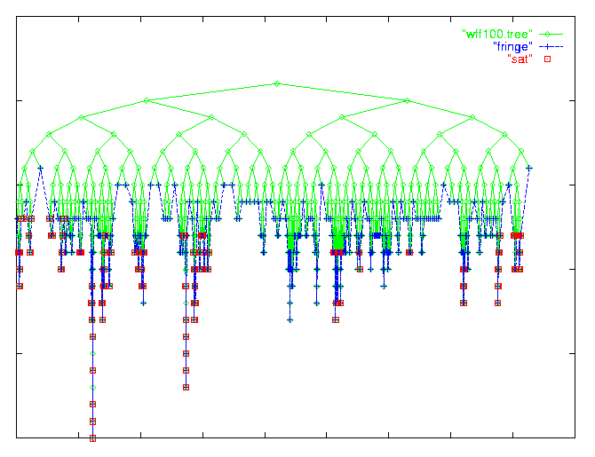
Learning about Instances & Reasoning from a Stream of Problems
e.g., Machine learning & SAT solvers
  Grappling with long tails
  Dynamic restart policy in SAT solvers (Kautz, et al)
(a b c) ( b d ) (b c e) . . .

Slide 43

Open-World AI

Slide 44
Toward Situated, Flexible,
Long-Lived Systems
Flexible adaptation to varying and dynamic situations
  Streams of observations and challenges over different time frames
  Broad variation, uncertainty in goals, time criticality, available actions
  Learning about new objects, predicates, goals, preferences
…and about perception & reasoning

Slide 45
Time

Slide 46
Time

Slide 47
Time

Slide 48
Time

Slide 49
Flexible adaptation to varying tasks, situations, environments
  Situation A
  Situation B
  Situation C
A,E-->MEU

Slide 50
Flexible adaptation to varying tasks, situations, environments
  Situation A
  Situation B
  Situation C
A’,E’-->MEU

Slide 51
Flexible adaptation to varying tasks, situations, environments
  Situation A
  Situation B
  Situation C
A’’,E’’-->MEU

Slide 52
Attentional Challenge: Coordinate Sensing, Reflection, Action, Learning
Standing challenge…
Value of information
Value of computation
Value of learning

Slide 53
Challenge: Lifelong Learning
Tradeoff local costs of exploration, labeling for long-term gains
Decisions about information collection
t_{o}
Recognized
events
?
Information value
Perceptual
Exploration

Slide 54
Challenge: Handle Streams of Problems
Policies for using all time…incl. idle time
  How to best use available time to solve future problems?
  How to trade current problem solving for solving future problems?
Notes:
“Buzz” of extended awareness in time

Slide 55
Stream of Problem Instances
Time

Slide 56
Stream of Problem Instances
Time

Slide 57
Stream of Problem Instances
Time

Slide 58
Stream of Problem Instances
Time

Slide 59
Trading Off Present for Future
Time

Slide 60
Trading Off Present for Future
Time

Slide 61
Trading Off Present for Future
Time

Slide 62
Trading Off Present for Future
Time

Slide 63
Trading Off Present for Future
Time

Slide 64
Trading Off Present for Future
Time

Slide 65
Trading Off Present for Future
Time

Slide 66
Challenge:
Frame – and Framing Problem
What goals, preferences, …objects, predicates, relationships should be in a decision model?
How can tractable, relevant models be constructed automatically?
How can the system learn about the frame?

Slide 67
Automated Framing & Execution of Local Decision Problems

Slide 68
Automated Framing & Execution of Local Decision Problems

Slide 69
Automated Framing & Execution of Local Decision Problems

Slide 70
Automated Framing & Execution of Decision Problems

Slide 71
Propositional Probabilistic
Representations
First-Order Logic
Representations

Slide 72
Propositional Probabilistic
Representations
First-Order Logic
Representations

Slide 73
Knowledge-Based Model Construction
Context-sensitive propositional models from first-order knowledge base
First-Order Knowledge Base
{(DX $x $z) |_{p} (ABN $x $y) }
{(ABN $x BP) |_{p} (BP $x $z) ^ (AGE $x)}
{(ABN $x BP) |_{p} (BP $x $z) ^ (AGE $x )}
……
Deductive
Inference
Situation!
Propositional Model
(BP Tom 144/90)
Probabilistic
Inference
Event probabilities
Best actions
(ABN Tom BP)
(DX Tom HPN )

Slide 74
Learning & First-Order
Probabilistic Representations
Generate objects, relations, models
  Plan recognition networks
  Probabilistic relational models
  Markov logic networks
  BLOG: Probabilistic models with unknown objects

Slide 75
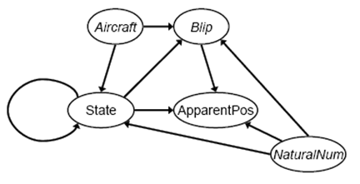
Reasoning about …and Expecting the Unknown
  Probabilistic Models with Unknown Objects
Brian Milch, et al.

Slide 76
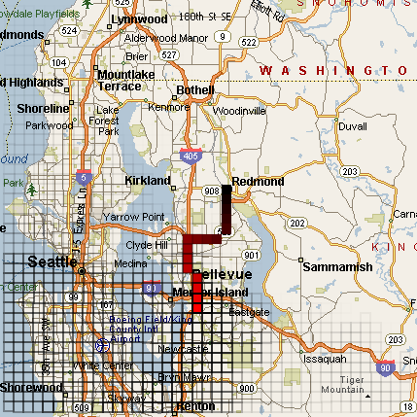
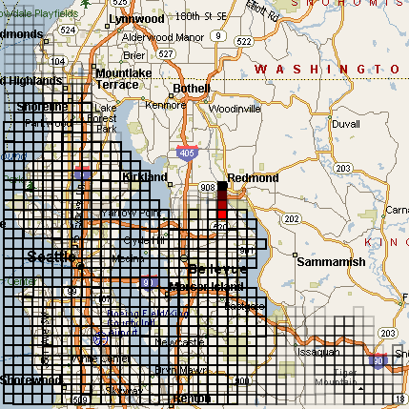
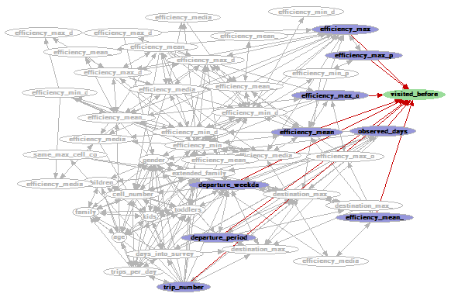
Reasoning about …and Expecting the Unknown

Slide 77
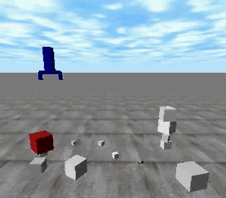
Extending Proficiency in a Messy World
Assume unmodeled objects, relations, noise
Continue to extend models with experiences
(video)
Pasula, Zettlemoyer, Kaelbling

Slide 78
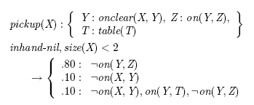
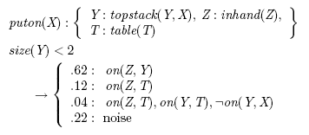
Extending Proficiency in an Open World
Assume unmodeled objects, relations, noise
Continue to extend models with experiences
Pasula, Zettlemoyer, Kaelbling

Slide 79
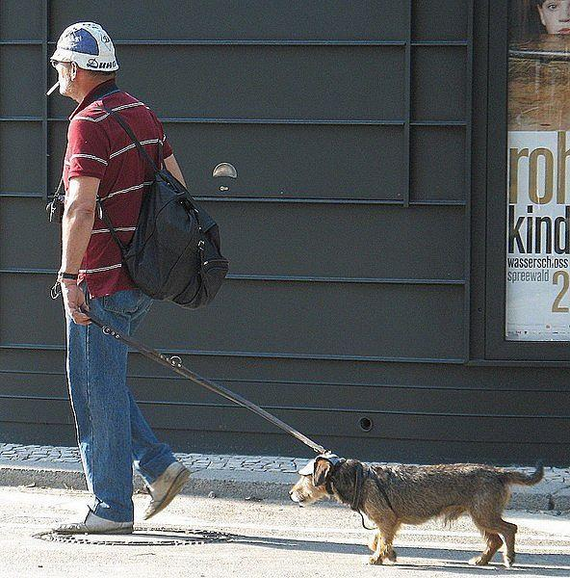
Extending Perceptual Proficiency with Shape Prototypes and Deformations
MAN
“man
walking
dog”
DOG
G. Elidan, G. Heitz, and D. Koller

Slide 80

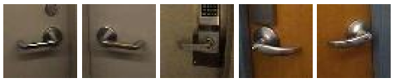
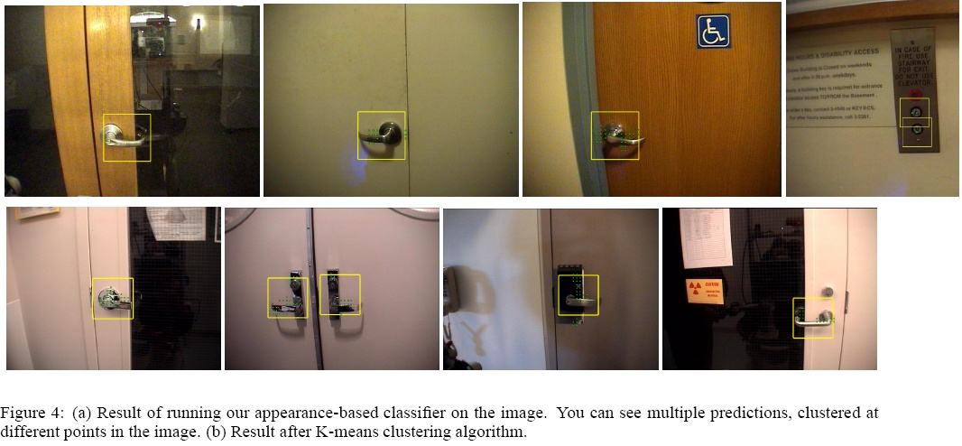

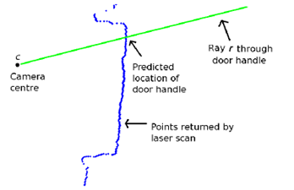
Proficiency via Transfer in Open Worlds
Transferring prior knowledge to new situations
Klingbeil, Saxena, Ng, et al.

Slide 81
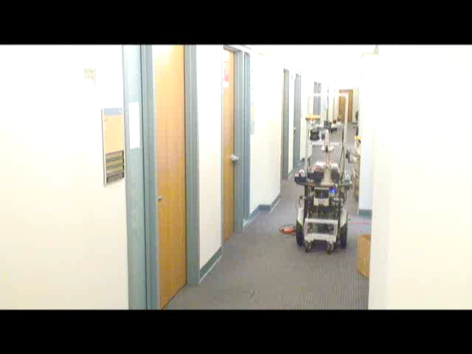
Proficiency via Transfer in Open Worlds
Transferring prior knowledge to new situations
(video)
Klingbeil, Saxena, Ng, et al.

Slide 82
Prospering in the Open World
To know that you do not know is the best.
Lao Tzu
Modeling model competencies, limitations, extensions
Context-sensitive failures & successes
Models of anomaly & surprise
Value of prototypes, analogy, transfer
Learning objects, predicates, preferences, goals in noisy environments

Slide 83

Value of Open-World Challenges
AAAI / CVPR Semantic Robot Vision Challenge
  Robots must perform a scavenger hunt in a previously-unknown indoor environment.
- scientific calculator
- Ritter Sport Marzipan
- DVD “Shrek”
- DVD “Gladiator”
- CD “Hey Eugene”
- electric iron
.
.
.
Web access

Slide 84

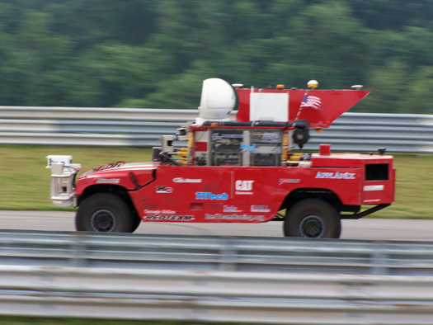
Value of Open-World Challenges
2004 DARPA Challenge: Sandstorm
Closed world vs open world model
  Model of anomaly, surprise
  Thinking out of the box?

Slide 85
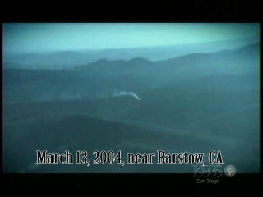
Where there’s Smoke…
2004 DARPA Challenge: Sandstorm
Closed world vs open world model
  Model of anomaly, surprise
  Thinking out of the box?
(video)

Slide 86
Stepping into the Open World
Key technical challenges
AI moving into the world
AI research community

Slide 87
AI Moving into the World:
Trends & Directions
Robust services in dynamic settings
Human-computer collaboration
Integrative intelligence
Sciences
Harnessing Web content & structure

Slide 88
Robust Services in Dynamic Settings
Context-sensitive competencies & policies
Example: Traffic prediction & routing
“Sensor”
Prediction
challenge

Slide 89
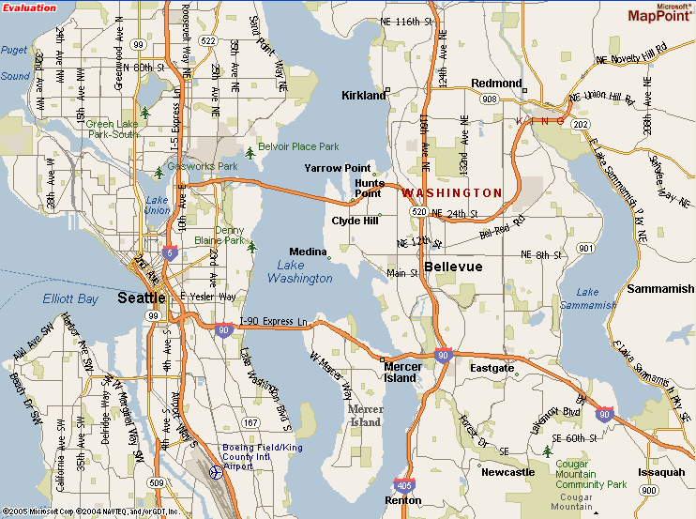
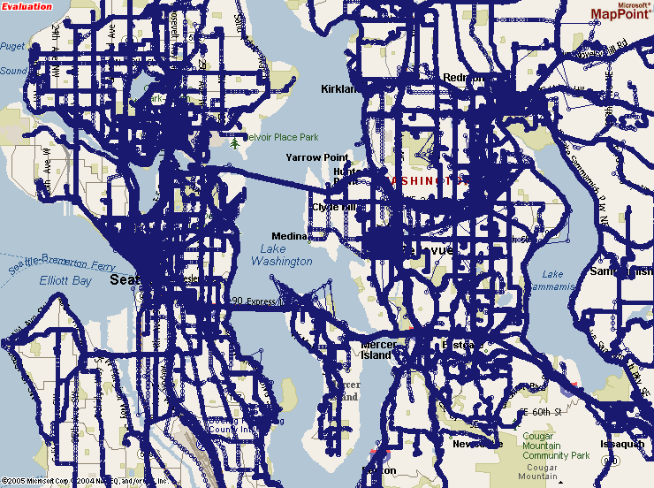
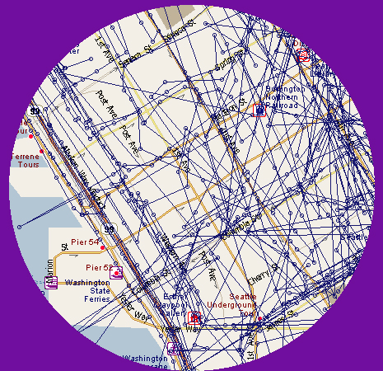
Multiuser Location Survey
~4.5 years of data collection
Case library
2,349,600 points
~300,000 km
~20,000 trips

Slide 90
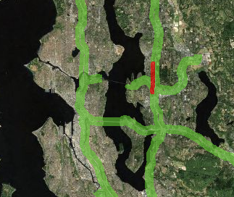
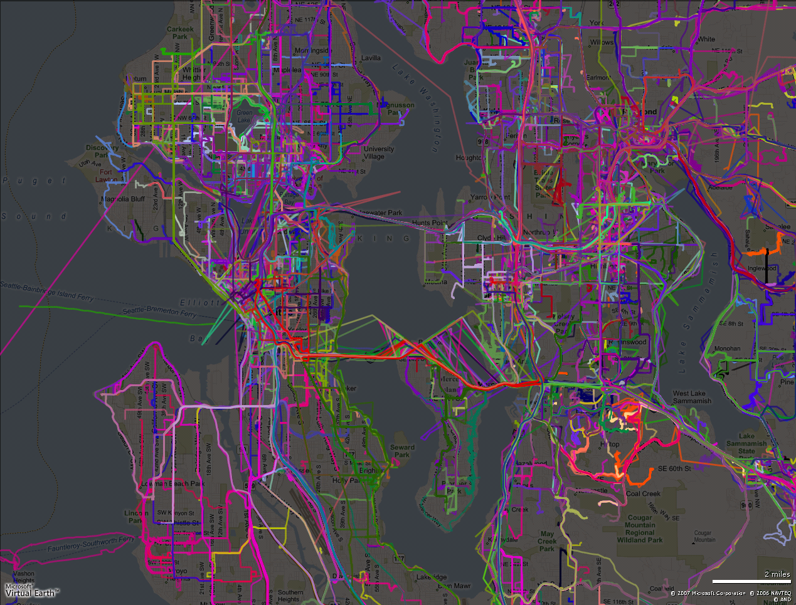

Slide 91
ClearFlow
72 cities in North America
Roads speeds assigned to ~60 million streets across North America every few minutes
Baltimore
Jacksonville
Boston
Greensboro
Washington, D.C.
Nashville
Miami
West Palm Beach
Tampa
New Orleans
Orlando
Tucson
San Diego
Albuquerque
Minneapolis
Colorado Springs
St. Louis
Allentown
Denver
Harrisburg
Cleveland
Wilkes-Barre
Portland
Buffalo
Sacramento
Dayton
Seattle
Fresno
Atlanta
Grand Rapids
Birmingham
Toledo
Indianapolis
Greenville
Las Vegas
Memphis
Pittsburgh
Louisville
Philadelphia
Norfolk
Dallas/Ft. Worth
Columbus
Detroit
Charlotte
Houston
Hartford
Los Angeles
Raleigh-Durham
New York
Richmond
San Francisco
Tulsa
Chicago
Albany
Oklahoma City
Lincoln
Phoenix
Omaha
Providence
Little Rock
Salt Lake City
Mobile
Cincinnati
Portsmouth-Manchester
San Antonio
Rochester
Milwaukee
Syracuse
Austin
Spokane
Kansas City
Toronto

Slide 92
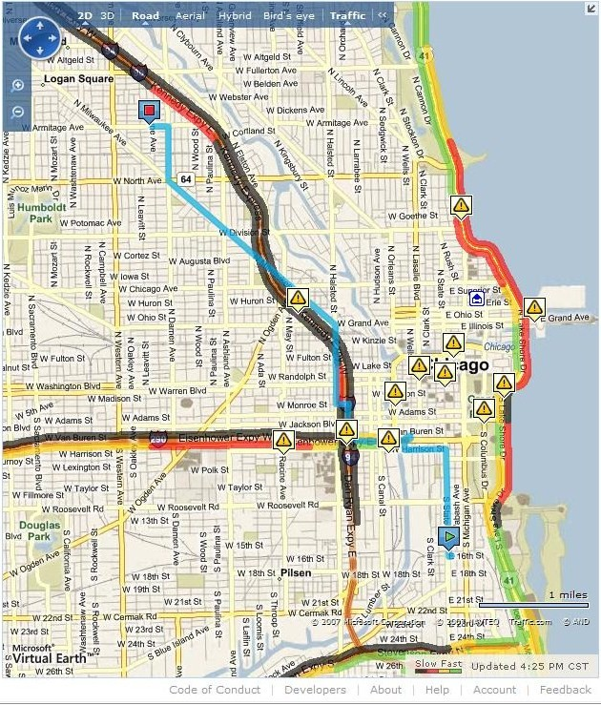
Chicago
Default

Slide 93
Chicago
Clearflow

Slide 94
Planning while the Sands are Shifting
Lab: Temporal models forecast future speeds and uncertainties
Path planning with changing situation
Variances, robustness, flexibility
… finding paths with contingencies
t
t
t

Slide 95
Human-Computer Collaboration in Open Worlds

Slide 96
Grounding
Converging on shared references, beliefs, and intentions
STOP
*&(#))(@%+
%%$#*%$#
*&%*&(^*^
&*%^*&+#
STOP
*&(#))(@%+
%%$#*%$#
*&(#)@%+ !
?
*&(#))(@%+
STOP

Slide 97
Grounding on Beliefs
H₁
H₂
E₁
E₂
E₃
E₄
Debiasing human judgment
Tutoring, advising, education
Human expectation & surprise
Ideal display & alerting
H₁
H₂
E₂
E₃
E₄

Slide 98
Mixed-Initiative Collaboration
Interleaving of contributions from machine and human to jointly solve problems.
  Problem recognition, decomposition, coordination
α
β

Slide 99
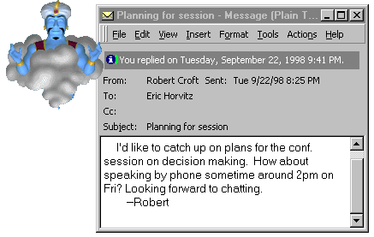
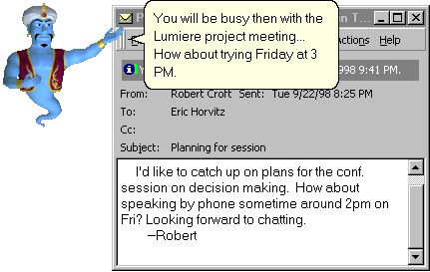
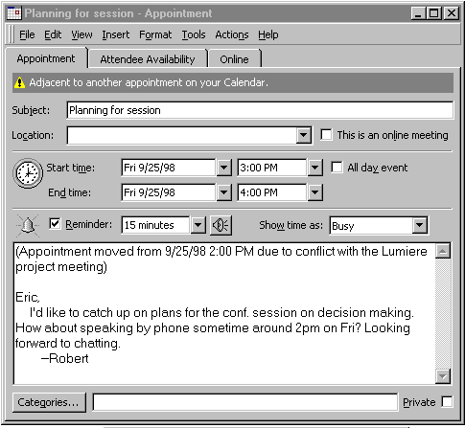
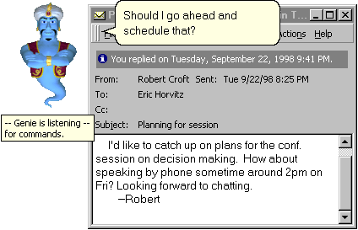
Mixed-Initiative Collaboration
Interleaving of contributions from machine and human to jointly solve problems.
  Problem recognition, decomposition, coordination

Slide 100
Complementary Computing
Consider systems of people & computation
Policies for coordinating contributions
Task markets for humans, computers, sensors, effectors
Planner
α
β

Slide 101
Adaptive Policies in an Automated Reception System
Changing dialog competencies
Changing load on staff
Speech recognition
competency
Preferences
Human resources
Complementary
Computing
Policy

Slide 102
Learning about Human Cognition for Augmenting Human Abilities
20th Century cognitive psychology:
Characterizable limitations & bottlenecks
Human
Cognition
Promise of sensing & reasoning
Abilities & efficiencies
Computation
Attention
Learning
Memory

Slide 103
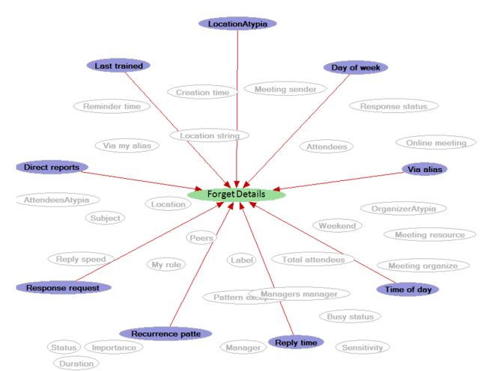
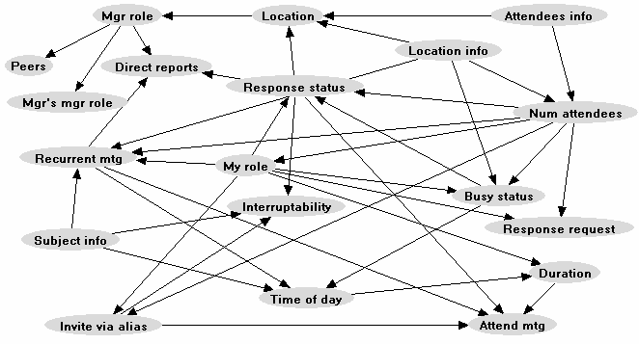
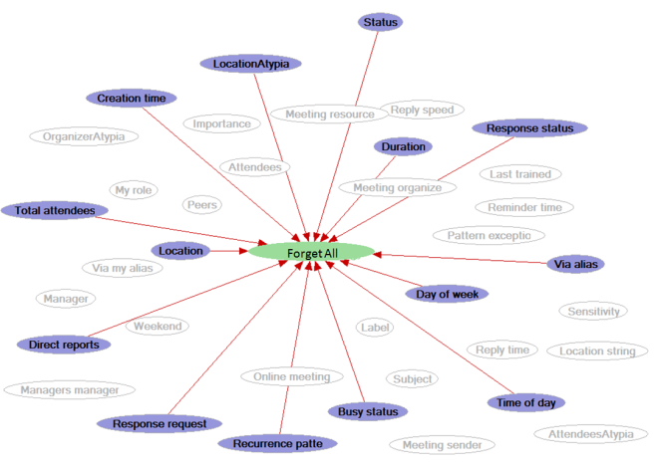
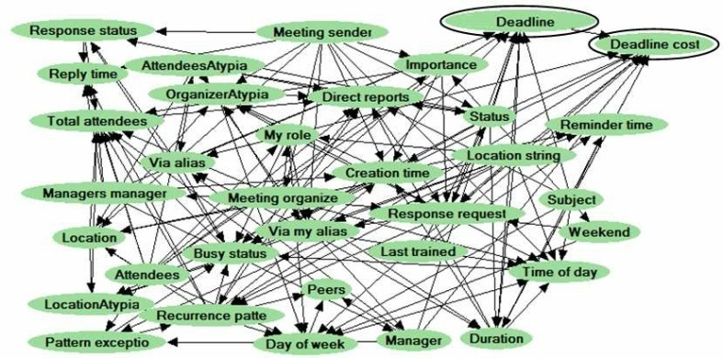
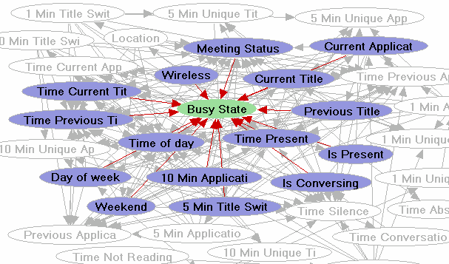
Models of Memory in Reminding
Models of context-sensitive relevance / value
Model of forgetting
Cost of interruption
Reminders at ideal times

Slide 104
Integrative Intelligence
Opportunity: More comprehensive, “integrative intelligences,” probing open world
Sensing & symbols
Goals & preferences
Action execution, monitoring
Learning, semi- and unsupervised
Interaction of components

Slide 105
Integrative Intelligence
Opportunity: More comprehensive, “integrative intelligences,” probing open world
Weaving together components that have been developed separately
NLP
Robot motion / manipulation
Localization
Speech generation
Speech recognition
Planning
Vision
Learning
Inference

Slide 106
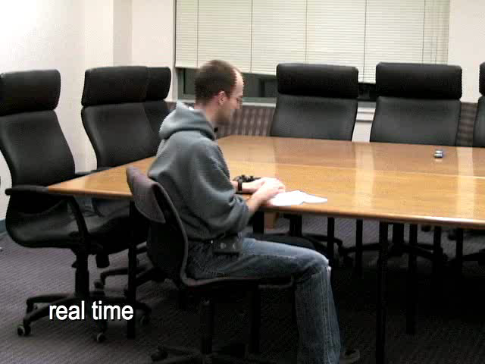
Integrative Intelligence
Vision, manipulation, navigation, learning
(video)
Ng, et al.
Notes:
Briefly, we worked on various algorithms for mobile manipulation
(specifically opening doors, described below), object recognition (using a
learned strategy for steering a pan-tilt-zoom camera to maximize expected
information gain, so as to find/recognize objects in the environment),
depth perception from a single still image (learning to estimate 3d
space/positions of obstacles from a single image), learned grasping
strategies (a learning algorithm for selecting the best "grasp" to pick up
an object, even if the object is a novel shaped one that the robot's never
seen before), and an MDP-based spoken dialog system. By putting all these
together, we're demonstrated the robot fetching an item in response to a
verbal request.
In terms of learning to do new things, examples include that the robot is
able to open novel doors; recognizes novel objects from known object
classes (i.e., is trained to recognize coffee mugs, staplers, etc. via
supervised learning); and is able to grasp objects of novel shapes (using
its cameras and other sensors to perceive the environment, it has picked
up some very strange shaped objects, including ones very different from
anything like what we trained it on).

Slide 107
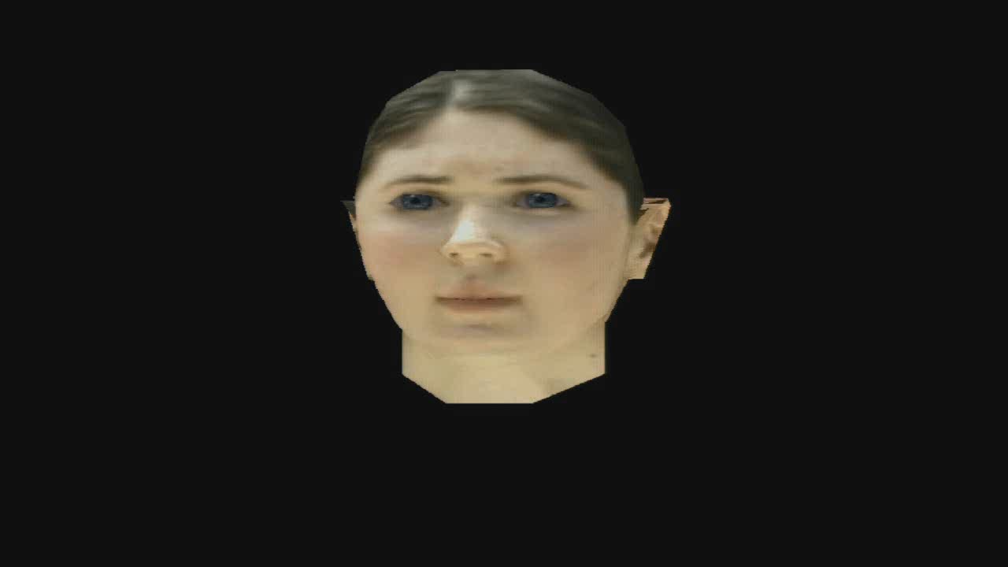
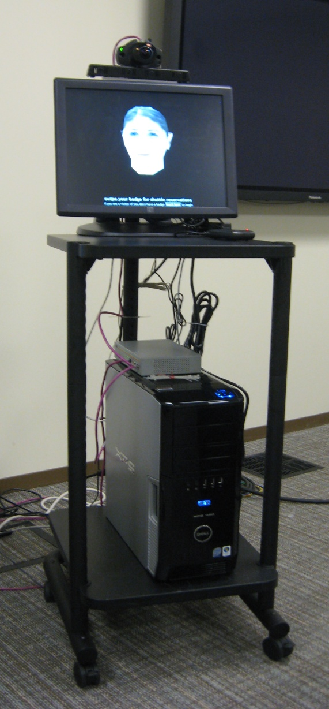
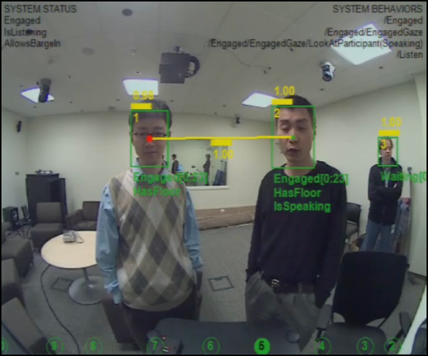
Integrative Intelligence
wide-angle camera
4-element microphone array
touch screen
card reader
speakers
Speech
Synthesis
Avatar
Synthesis
Speech
Recognition
Tracker
Output
Management
Conversational
Scene
Analysis
Behavioral control
Dialog management &
Interaction Planning
Models of user frustration, task time
Receptionist: Bohus, H., et al.
Machine learning about interaction

Slide 108
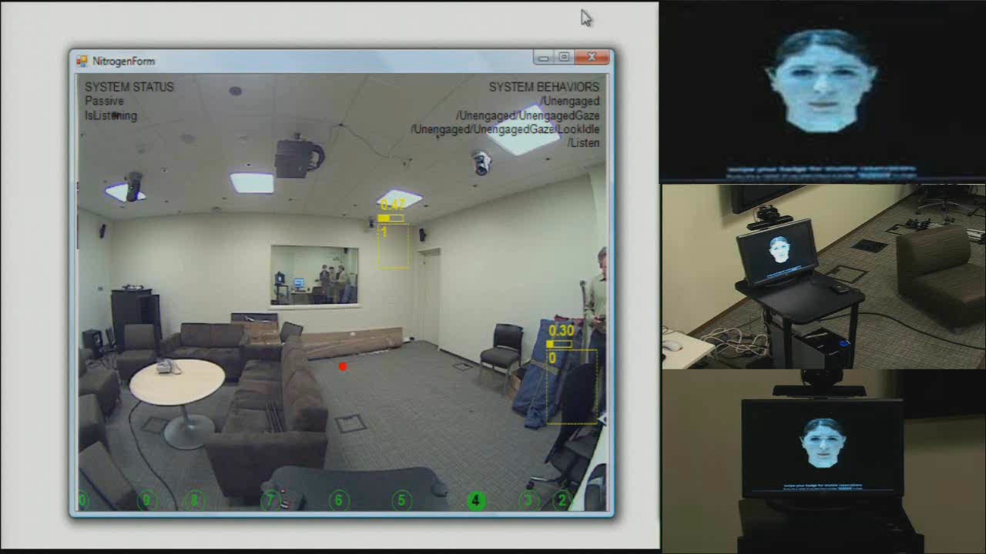
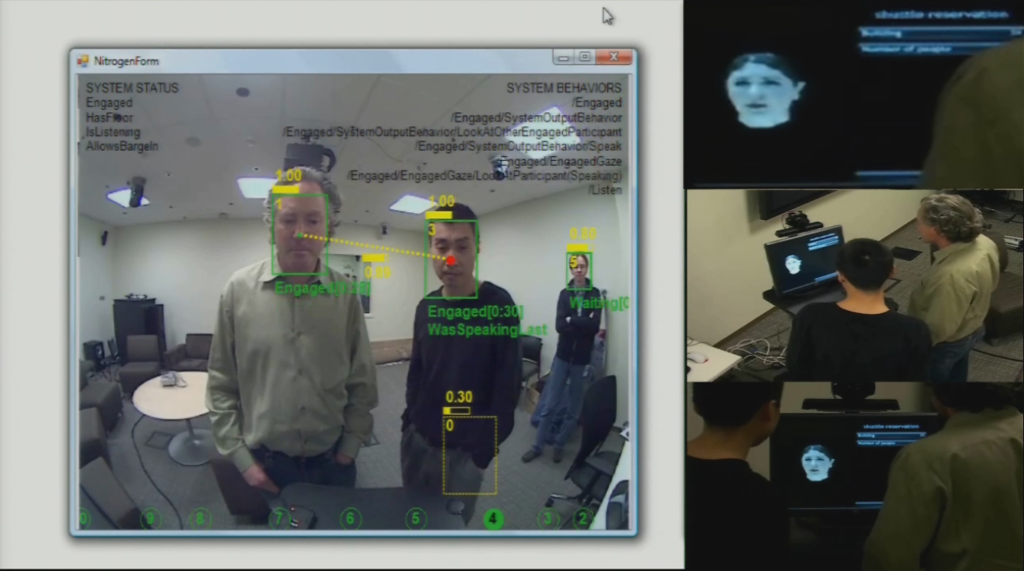
Integrative Intelligence
infer, track and verify
group relationships
behavioral model
for gaze
(video)

Slide 109
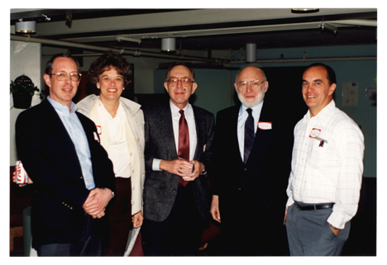
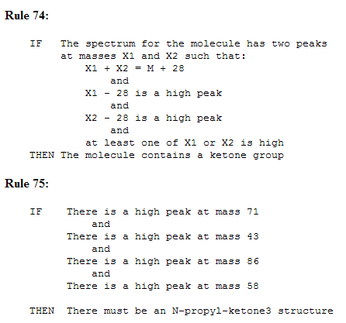
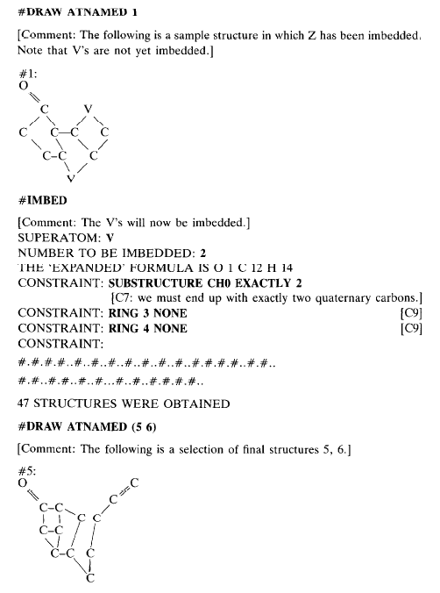
Transformation of Science
Scientific discovery & confirmation
Learning & inference
Triage of experimentation
Dendral
Planner, hypothesis generator, confirmation

Slide 110
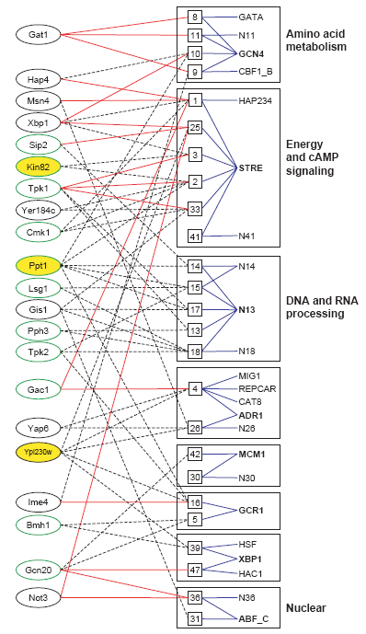
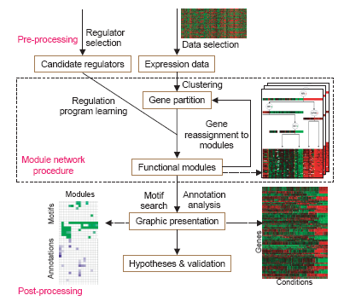

Learning about Structure & Function
Segal, Pe'er, Regev, Koller, Friedman, et al.

Slide 111



Insights From & About Neurobiology

Slide 112

A Study in Representation
Form of the model for predicting fMRI activation for arbitrary noun stimuli. fMRI activation is predicted in a two-step process. The first step encodes the meaning of the input stimulus word in terms of intermediate semantic features whose values are extracted from a large corpus of text exhibiting typical word use. The second step predicts the fMRI image as a linear combination of the fMRI signatures associated with each of these intermediate semantic features
Mitchell, et al.

Slide 113

A Study in Representation
Mitchell, et al.

Slide 114

Coming Era of Neuroinformatics

Slide 115

Coming Era of Neuroinformatics
(video)
Reid, et al.

Slide 116



Toward a Computational Microscope
(video)
Kapoor, H., et al.

Slide 117

Toward a Computational Microscope
(video)
Kapoor, H., et al.

Slide 118


Learning to Harness the Web

Slide 119
Learning to Harness the Web
?
Results
Web
!
Learning &
Decision making

Slide 120



Learning to Harness the Web
“Where is the Orinoco River?"
15
10
5
0
Value
0
5
10
15
20
25
-5
-10
-15
Total Queries
Azari, H., Dumais

Slide 121



AI in the Open World: Responsibilities
Social value & quality of life
Privacy, democracy, freedom
Long-term AI futures

Slide 122
AI in the Open World: Responsibilities
AAAI Presidential Panel on
Long-Term AI Futures
“…Deliberation will include reflection about concerns about long-term outcomes, and, if warranted, on potential recommendations for guiding research and on creating policies that might constrain or bias the behaviors of autonomous and semi-autonomous systems so as to address the concerns…”

Slide 123
Stepping into the Open World
Key technical challenges
AI moving into the world
AI research community

Slide 124
Evolution of Subdisciplines
Uncertain
Reasoning
Decision
Making
Logic
Machine
Learning &
Datamining
Diagnosis
Planning
Artificial
Intelligence
Qualitative
Reasoning
Distributed
AI
Metareasoning
& Control
Real-Time
Reasoning
Search
Temporal
Reasoning
Knowledge
Representation
Rationality
Constraint
Satisfaction
Cognitive
Science

Slide 125
Evolution of Specialty Areas
Vision
Speech
Recognition
Natural
Language
Search &
Retrievel
User
Modeling
Artificial
Intelligence
Artificial
Intelligence
Intelligent
User Interfaces
Ecommerce
AI in Medicine
Sensor
Networks
AI in Education
Computational
Neuroscience
AI and Law
Satisfiability
& Hardness
Robotics
Ubiquitous
Computing
Game
Playing

Slide 126
Evolution of Communities
AAMAS
UAI
EC
Vision
Speech
Recognition
Natural
Language
COLT
Search &
Retrievel
User
Modeling
NIPS
Artificial
Intelligence
Artificial
Intelligence
RSS
CVPR
Intelligent
User Interfaces
Ecommerce
COGSCI
AI in Medicine
Sensor
Networks
ICML
KDD
AI in Education
Computational
Neuroscience
SAT
INTERSPEECH
ACL
IUI
AI and Law
Satisfiability
& Hardness
AIED
Robotics
UM
Ubiquitous
Computing
Game
Playing

Slide 127
On the Nature of the Organization
Herb Simon, 1947
“Three bricklayers were asked what they were doing.
“Laying bricks,”
“Building a wall,”
“Helping to build a great cathedral”
…were their respective answers.”

Slide 128



Slide 129





