Slide 1
Reasoning about Comprehensions with
First-Order SMT Solvers
K. Rustan M. Leino
Microsoft Research, Redmond
Rosemary Monahan
National University of Ireland, Maynooth
SAC 2009
9 Mar 2009
Honolulu, HI, USA

Slide 2
Goal
Automatic program verification
  program + specifications
  automatically lead to proofs/refutations
…with support for:
  modern programming language features
  expressive specifications
In this paper:
  We add support for common
  comprehension expressions

Slide 3
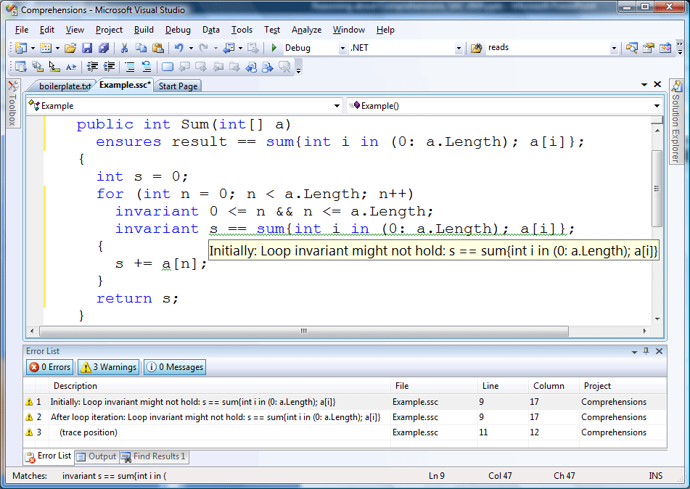
Demo

Slide 4
Challenges
Comprehensions are like higher-order bindings
Automatic provers use first-order logic

Slide 5

Solution: Template functions
Introduce a first-order function for each comprehension template
Examples:
= f(0, N, a, b)
free variables
bounds

Slide 6


Solution: Template functions
Introduce a first-order function for each comprehension template
Examples:
same template,
different parameterizations
= f(0, N, a, b)
= g(0, N, a)
= g(12, 100, b)

Slide 7
Solution (cont.): Axioms
Generate axioms that define the template functions
Examples
  Empty range
  (∀lo,hi,a • hi ≤ lo ⇒ f(lo,hi,a) = 0)
  Induction
  (∀lo,hi,a • lo ≤ hi ⇒
  f(lo,hi+1,a) = f(lo,hi,a) + a[hi])
  Range split
  (∀lo,mid,hi,a • lo ≤ mid ≤ hi ⇒
  f(lo,mid,a) + f(mid,hi,a) = f(lo,hi,a))

Slide 8
Using logical quantifiers with an SMT solver
Universal quantifiers are instantiated to produce more ground facts
Matching triggers guide the instantiation

Slide 9
Trigger engineering
(∀a • f(0,0,a) = 0)
(∀lo,hi,a • hi ≤ lo ⇒ f(lo,hi,a) = 0)

Slide 10
Trigger engineering
(∀lo,mid,hi,a • lo ≤ mid ≤ hi ⇒
f(lo,mid,a) + f(mid,hi,a) = f(lo,hi,a))
(∀lo,mid,hi,a • lo ≤ mid ≤ hi ⇒
f(lo,mid,a) + f(mid,hi,a) = f(lo,hi,a))

Slide 11
Implementation, experiments
Implementation in Spec#
  sum, product, count, min, max
Verification of several examples from
the Dijkstra & Feijen textbook
Teaching

Slide 12
Performance
Program | Boogie 2 + Simplify | Boogie 2 + Z3 v. 1.3 | Boogie 2 + Z3 v.2
Sum0 | 0.142 | 0.044 | 0.045
Sum1 | 0.147 | 0.047 | 0.042
Sum2 | 0.136 | 0.056 | 0.047
Sum3 | 0.190 | 0.048 | 0.043
Factorial | 0.125 | X | 0.118
CoincidenceCount0 | 11.3 | 23.7 | 1.62
CoincidenceCount1 | 24.5 | > 1200 | 723
CoincidenceCount2 | 18.0 | 11.6 | 164.7
MinSegmentSum* | 27.7 | 11.75 | 94.2
*) /inductiveMinMax:4
Notes:
CoincidenceCount0 – CoincidenceCount.ssc
CoincidenceCount1 – CoincidenceCountEfficient2.ssc
CoincidenceCount2 – CoincidenceCountAlterIntervariant.ssc

Slide 13
Conclusions
Higher-order features can be usefully encoded in first-order logic for SMT solvers
Good trigger engineering is crucial
  Read this paper!
Future work
  Support general λ-expressions, collection comprehensions
  Verify more programs
Download Spec# and teach
  http://research.microsoft.com/specsharp

