Slide 1
Personalized Mathematical Word Problem Generation
Oleksandr Polozov* Eleanor O’Rourke* Adam M. Smith*
Luke Zettlemoyer* Sumit Gulwani^{ǂ} Zoran Popović*
* University of Washington
^{ǂ} Microsoft Research

Slide 2
Word Problems
Suzy is ten years older than Billy, and next year she will be twice as old as Billy. How old is Suzy now?
Evelyn went to the store 8 times last month. She buys 11 stickers each time she goes to the store. How many stickers did Evelyn buy last month?
You attended high school for 4 years. Each year you bought 7 new textbooks. How many textbooks do you have at home now?
Best known way to teach mathematical modelling skills.

Slide 3
Word Problems
Suzy is ten years older than Billy, and next year she will be twice as old as Billy. How old is Suzy now?
Notoriously difficult as compared to algebra!
Evelyn went to the store 8 times last month. She buys 11 stickers each time she goes to the store. How many stickers did Evelyn buy last month?
You attended high school for 4 years. Each year you bought 7 new textbooks. How many textbooks do you have at home now?

Slide 4
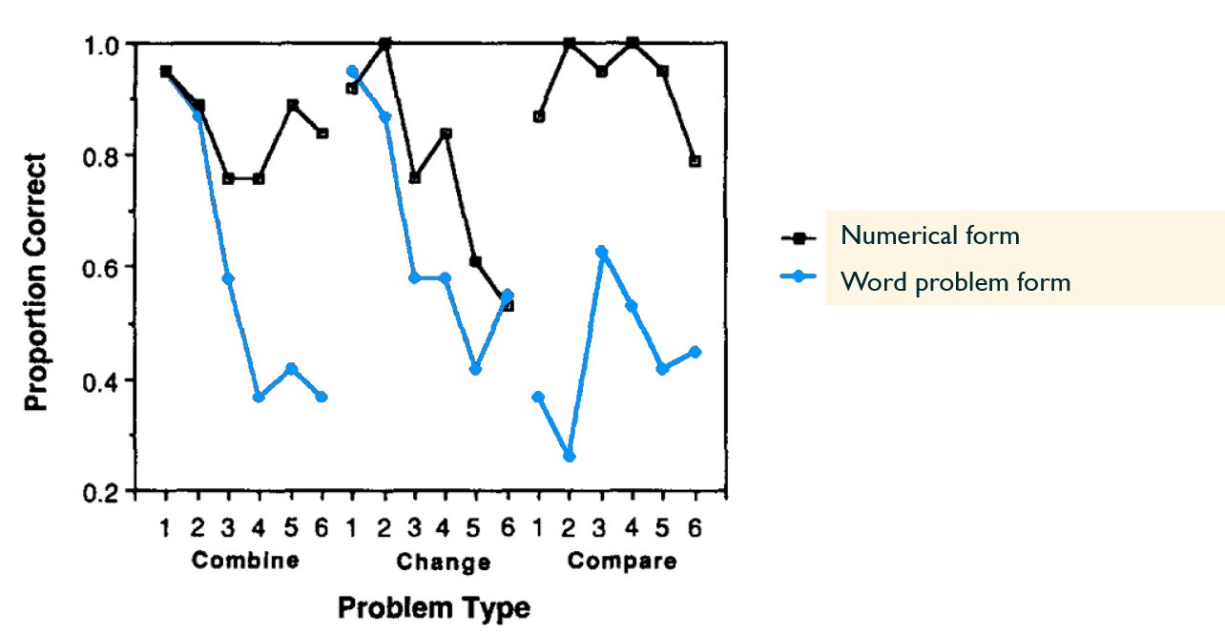
Word Problems
Suzy is ten years older than Billy, and next year she will be twice as old as Billy. How old is Suzy now?
Notoriously difficult as compared to algebra!
Evelyn went to the store 8 times last month. She buys 11 stickers each time she goes to the store. How many stickers did Evelyn buy last month?
You attended high school for 4 years. Each year you bought 7 new textbooks. How many textbooks do you have at home now?

Slide 5

Word Problems
Suzy is ten years older than Billy, and next year she will be twice as old as Billy. How old is Suzy now?
Evelyn went to the store 8 times last month. She buys 11 stickers each time she goes to the store. How many stickers did Evelyn buy last month?
Notoriously difficult as compared to algebra!
Perceived as boring, artificial, unconnected to the students’ lives $⟹$ not learnt
You attended high school for 4 years. Each year you bought 7 new textbooks. How many textbooks do you have at home now?

Slide 6
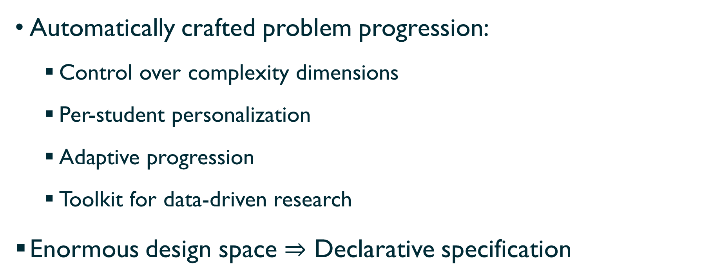
Computer-Aided Pedagogy
Automatically crafted problem progression:
  Control over complexity dimensions
  Per-student personalization
  Adaptive progression
  Toolkit for data-driven research
Enormous design space $⇒$ Declarative specification

Slide 7




Workflow
5 problems
Test multiplication:
$$x=y⋅z$$
Time/travel only
Simple language
…
Fantasy/SciFi world
Use me and my friends
as characters
5 problems
Test multiplication:
$$x=y⋅z$$
Problem
Generator

Slide 8
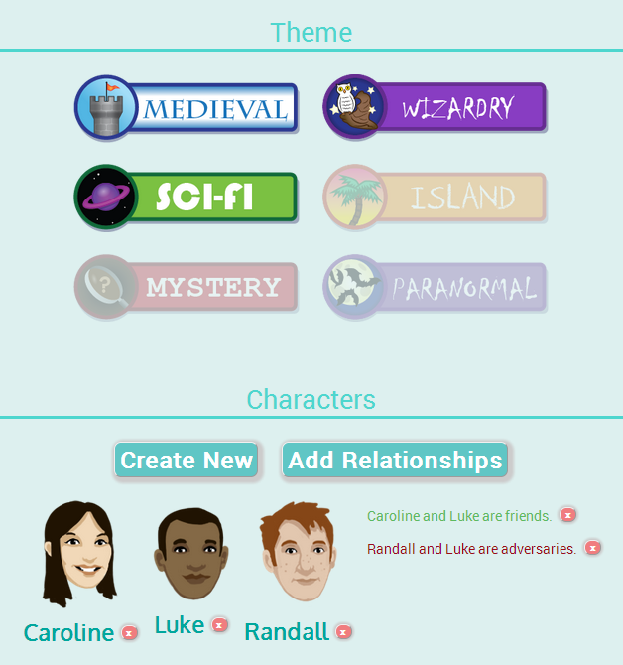
Duke Randall’s countryside consists of 11 towers, surrounded by 3 villages each. He and baron Luke are at war. Luke has already occupied 16 villages with the help of wizard Caroline. How
many villages are still unoccupied by the baron?

Slide 9
Workflow
5 problems
Test multiplication:
$$x=y⋅z$$
Time/travel only
Simple language
…
Fantasy/SciFi world
Use me and my friends
as characters
5 problems
Test multiplication:
$$x=y⋅z$$
Logic Generation
Language Generation

Slide 10
Problem Generator
Problem Logic Generation
Natural Language Generation
Plot generation
Discourse tropes
Sentence ordering
Reference resolution

Slide 11
Problem Generator
Problem Logic Generation
Natural Language Generation
Plot generation
Discourse tropes
Sentence ordering
Reference resolution
Notes:
Describe the Logic generation first.
The logic of a problem is all generated using answer-set programming, and this process is done in steps.

Slide 12
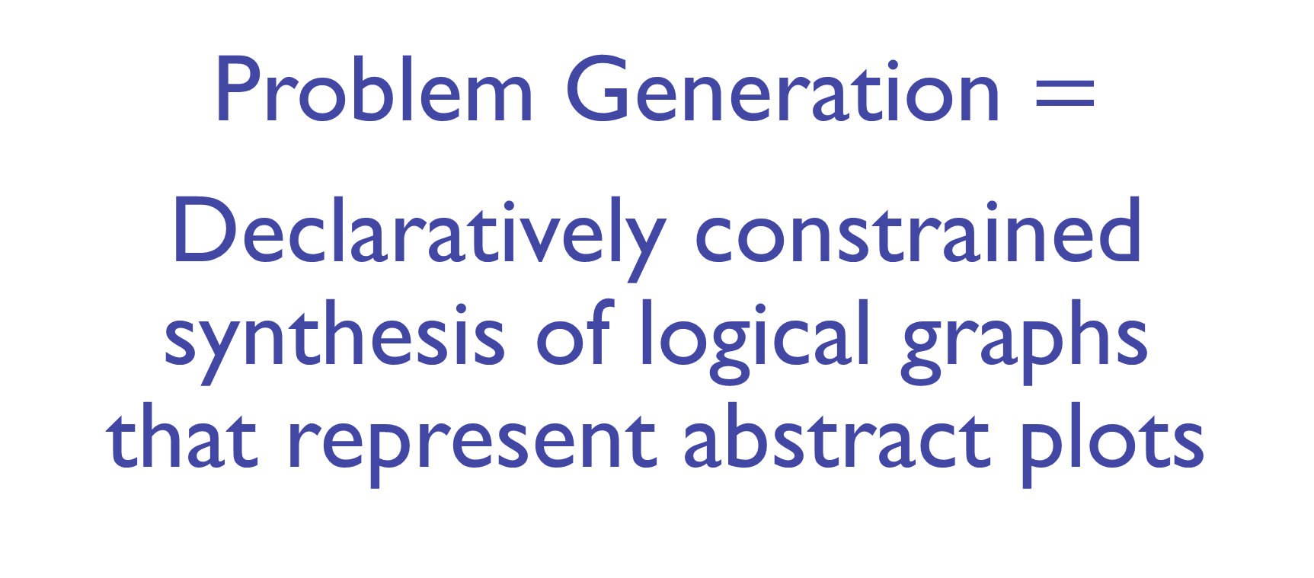
Problem Generation $=$
Declaratively constrained synthesis of logical graphs
that represent abstract plots

Slide 13
Problem Logic Generation
Math: addition
Setting: Fantasy
Character: Ellie

Slide 14
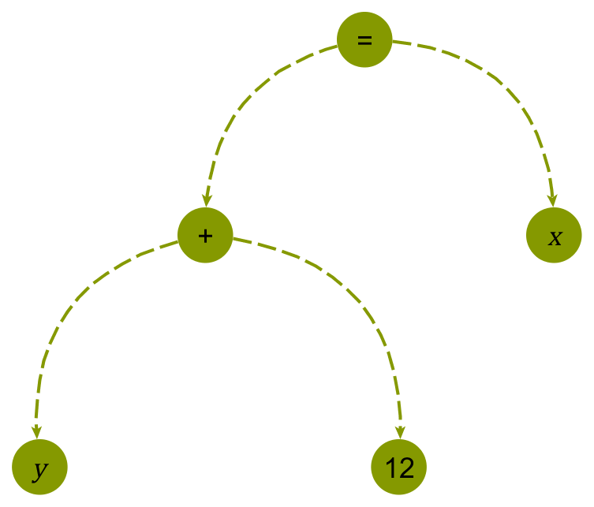
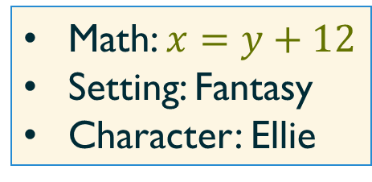
Step 1: Equation
Math: $x=y+12$
Setting: Fantasy
Character: Ellie

Slide 15
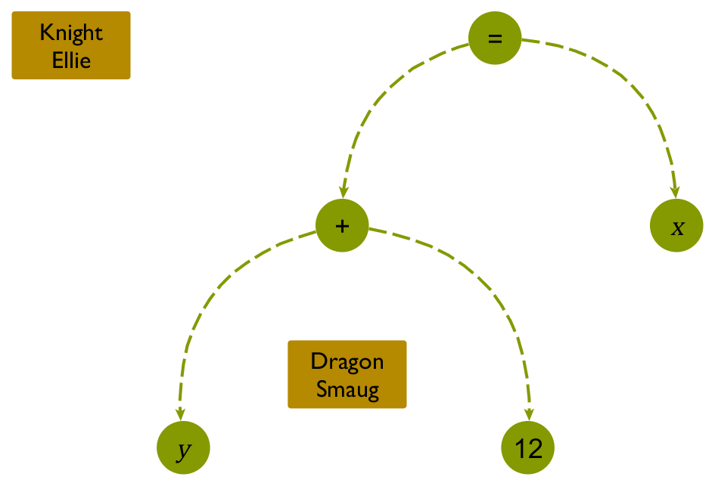
Step 2: Plot Relations
Math: $x=y+12$
Setting: Fantasy
Character: Ellie

Slide 16
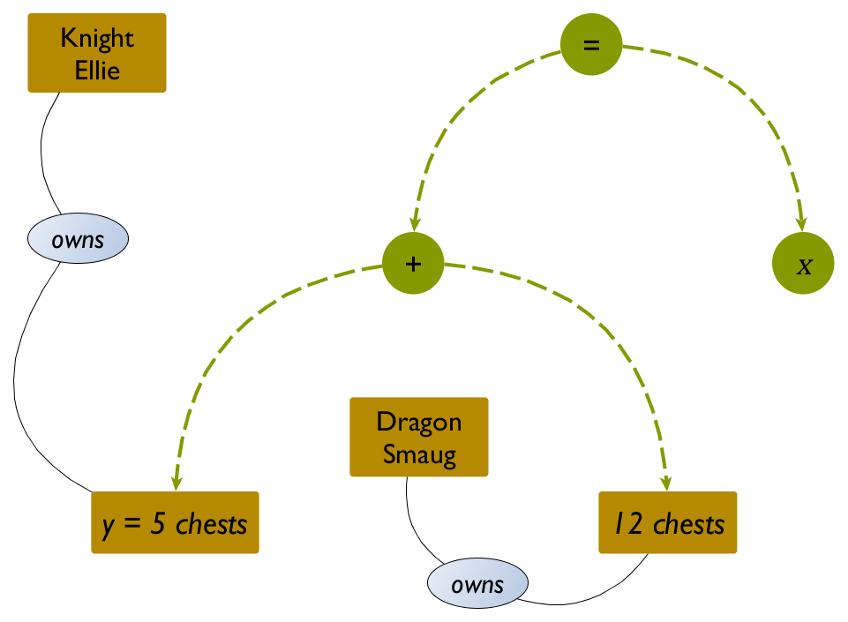
Step 2: Plot Relations
Math: $x=y+12$
Setting: Fantasy
Character: Ellie

Slide 17
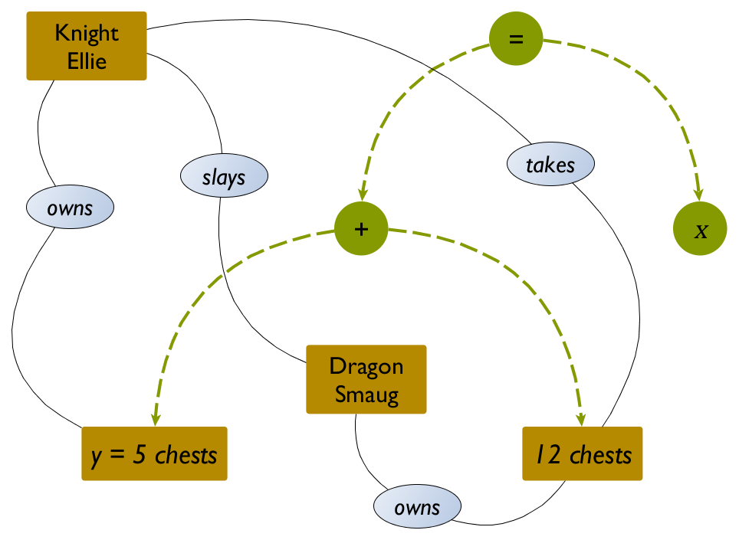
Step 2: Plot Relations
Math: $x=y+12$
Setting: Fantasy
Character: Ellie

Slide 18
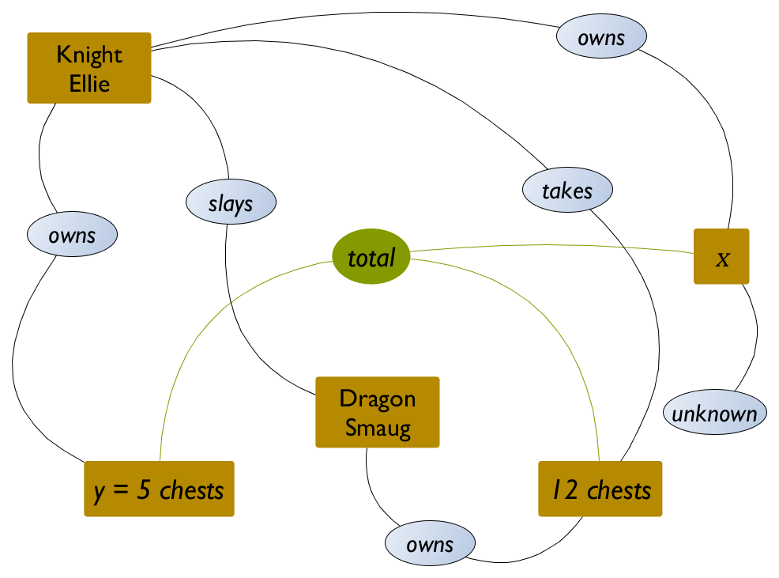
Step 2: Plot Relations
Math: $x=y+12$
Setting: Fantasy
Character: Ellie

Slide 19

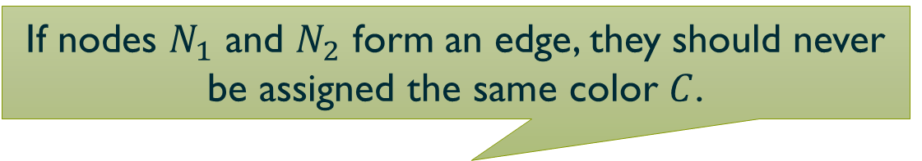

Answer Set Programming
Illustration: Graph Coloring
problem instance
problem encoding
node(a). node(b).
node(c). node(d).
edge(a, b). edge(b, c). edge(a, c). edge(c, d).
color(red).
color(blue).
color(green).
1 { assign(N, C): color(C) } 1 $←$ node(N).
$←$ edge(N1, N2),
assign(N1, C),
assign(N2, C).
For each node $N$: nondeterministically pick and assign exactly $1$ color $C$ among all existing colors.
If nodes $N_{1}$ and $N_{2}$ form an edge, they should never be assigned the same color $C$.

Slide 20
Ontology
% Type TWarrior <: TPerson belongs to a fantasy setting.
type(setting(fantasy), t_warrior, t_person).
% Relation Slays(slayer: TWarrior, victim: TMonster) belongs to a fantasy setting.
relation(setting(fantasy), r_slays(t_warrior, t_monster)).
% Arguments slayer and victim in Slays relation can only be adversaries in the plot.
only_relationship(r_slays, adversary(1, 2)).
% TotalCount(total: TCountable, count1: TCountable, count2: TCountable)
relation(setting(common), r_total_count(t_countable, t_countable, t_countable)).
% TotalCount mathematically represents the tree “total = count1 + count2”.
math_skeleton(r_total_count, eq(1, plus(2, 3))).

Slide 21



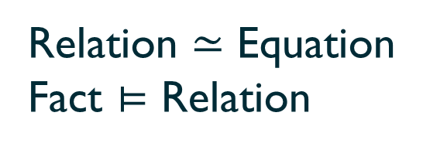









$$1$$
$$≃$$
$$⊨$$
$${\text{arg}}_{1}$$
$$2$$
$$3$$
Total:
$$=$$
$${\text{arg}}_{2}$$
$$+$$
Relation $≃$ Equation
Fact $⊨$ Relation
$${\text{arg}}_{3}$$
$$⟹$$
Fact$⊨$ Equation

Slide 22

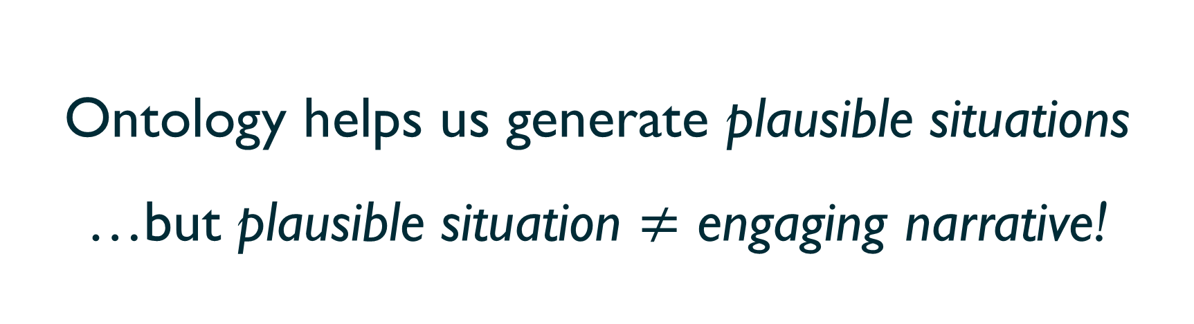
Ontology helps us generate plausible situations
…but plausible situation $≠$ engaging narrative!
# of satisfying answer sets: up to ${10}^{9}$. Most are insensible.

Slide 23
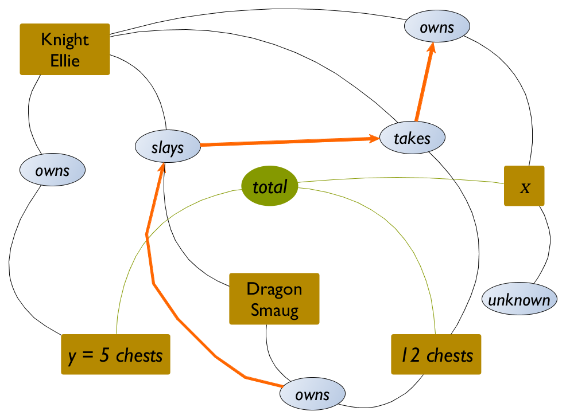
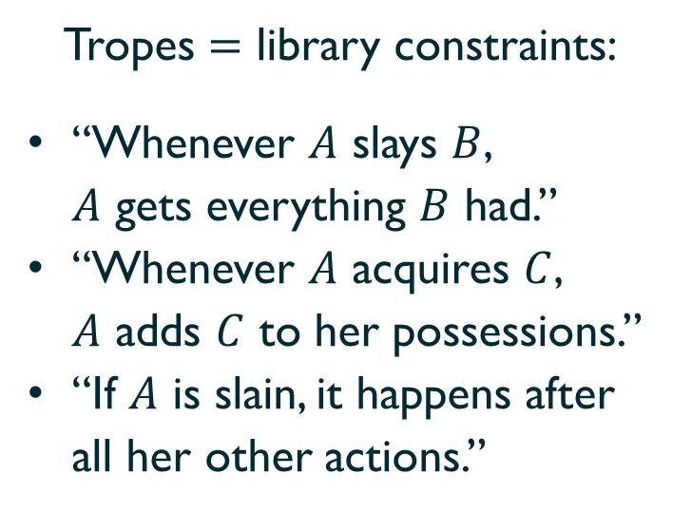
Step 3: Discourse Tropes
Math: $x=y+12$
Setting: Fantasy
Character: Ellie
Tropes $=$ library constraints:
“Whenever $A$ slays $B$,
$A$ gets everything $B$ had.”
“Whenever $A$ acquires $C$,
$A$ adds $C$ to her possessions.”
“If $A$ is slain, it happens after
all her other actions.”

Slide 24
Step 3: Discourse Tropes
“A warrior slays a monster only if the monster has some treasures.”
$$∀m, w:\text{Slays}\left(m, w\right)⟹\left[∃t:\text{Owns}(m, t)\right]$$
discourse(
forall( vars(m, w),
premise(r_slays(w, m)),
exists( vars(t),
conclusion(r_owns(m, t))))).

Slide 25
Discourse trope validation
$$∃ \text{graph} 𝒢=〈ℰ,ℱ〉: \text{Valid}\left(𝒢\right) ∧ \text{Fits}\left(𝒢, Reqs\right)∧$$
$$∀ \text{entities} \vec{x}⊂ℰ: Φ\left(\vec{x}\right) ⟹ \left[∃\vec{y}⊂ℰ: Ψ\left(\vec{x},\vec{y}\right)\right]$$

Slide 26

Discourse trope validation
$$∃ \text{graph} 𝒢=〈ℰ,ℱ〉: \text{Valid}\left(𝒢\right) ∧ \text{Fits}\left(𝒢, Reqs\right)∧$$
$$∀ \text{entities} \vec{x}⊂ℰ: Φ_{1}\left(\vec{x}\right) ⟹ \left[∃\vec{y}⊂ℰ: Ψ_{1}\left(\vec{x},\vec{y}\right)\right]∧$$
Library
$$⋮$$
$$∀ \text{entities} \vec{x}⊂ℰ: Φ_{n}\left(\vec{x}\right) ⟹ \left[∃\vec{y}⊂ℰ: Ψ_{n}\left(\vec{x},\vec{y}\right)\right]$$
  3 Boolean quantifiers (3QBF) $⟹$ Beyond the capabilities of ASP (not in NP)!

Slide 27
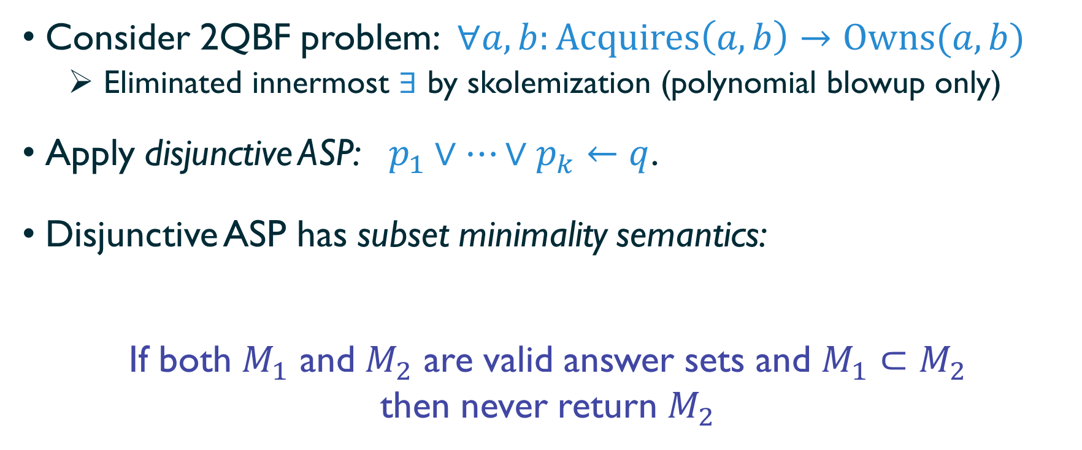
Saturation technique
Consider 2QBF problem: $∀a,b:\text{Acquires}\left(a, b\right)→\text{Owns}(a, b)$
  Eliminated innermost $∃$ by skolemization (polynomial blowup only)
Apply disjunctive ASP: $p_{1}∨…∨p_{k}←q$.
Disjunctive ASP has subset minimality semantics:
If both $M_{1}$ and $M_{2}$ are valid answer sets and $M_{1}⊂M_{2}$
then never return $M_{2}$

Slide 28
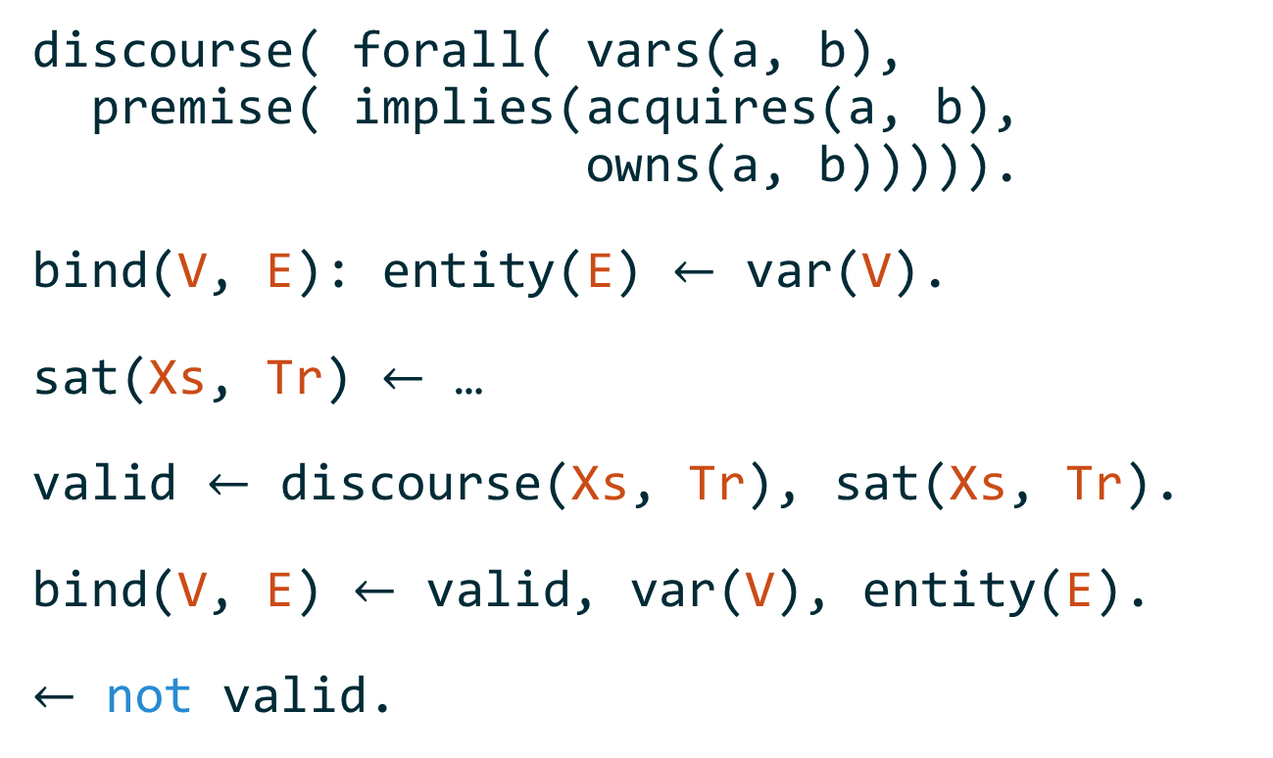
Saturation technique
var(a). var(b).
discourse( forall( vars(a, b),
premise( implies(acquires(a, b),
owns(a, b))))).
bind(V, E): entity(E) $←$ var(V).
sat(Xs, Tr) $←$ …
valid $←$ discourse(Xs, Tr), sat(Xs, Tr).
bind(V, E) $←$ valid, var(V), entity(E).
$←$ not valid.

Slide 29
Saturation technique
discourse( forall( vars(a, b),
premise( implies(acquires(a, b),
owns(a, b))))).
bind(V, E): entity(E) $←$ var(V).
sat(Xs, Tr) $←$ …
valid $←$ discourse(Xs, Tr), sat(Xs, Tr).
bind(V, E) $←$ valid, var(V), entity(E).
$←$ not valid.
(Disjunctively) assign each formal variable (“a” & “b”) to some entity in the graph

Slide 30
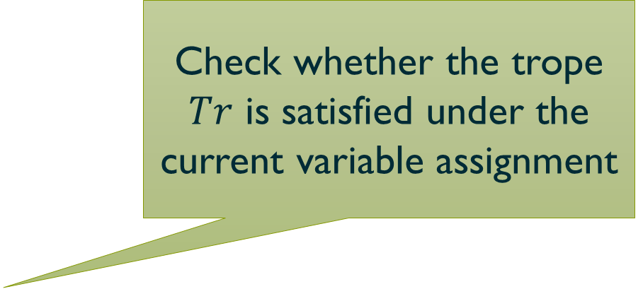
Saturation technique
discourse( forall( vars(a, b),
premise( implies(acquires(a, b),
owns(a, b))))).
bind(V, E): entity(E) $←$ var(V).
sat(Xs, Tr) $←$ …
valid $←$ discourse(Xs, Tr), sat(Xs, Tr).
bind(V, E) $←$ valid, var(V), entity(E).
$←$ not valid.
Check whether the trope $Tr$ is satisfied under the current variable assignment

Slide 31
Saturation technique
discourse( forall( vars(a, b),
premise( implies(acquires(a, b),
owns(a, b))))).
bind(V, E): entity(E) $←$ var(V).
sat(Xs, Tr) $←$ …
valid $←$ discourse(Xs, Tr), sat(Xs, Tr).
bind(V, E) $←$ valid, var(V), entity(E).
$←$ not valid.
If the trope is not satisfied, the assignment is invalid

Slide 32
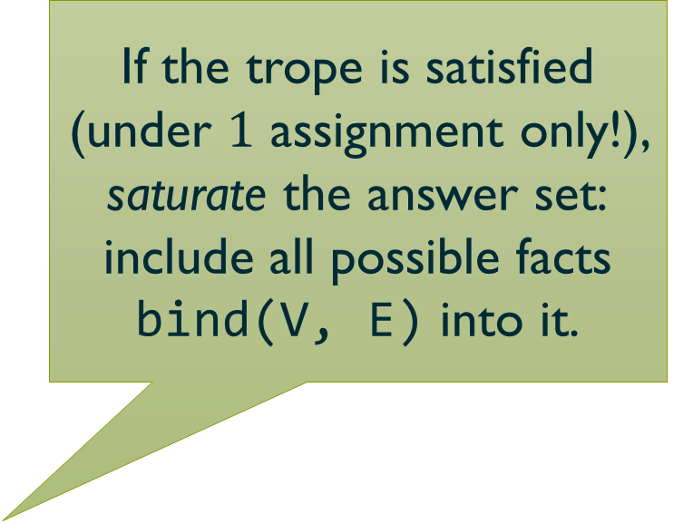
Saturation technique
discourse( forall( vars(a, b),
premise( implies(acquires(a, b),
owns(a, b))))).
bind(V, E): entity(E) $←$ var(V).
sat(Xs, Tr) $←$ …
valid $←$ discourse(Xs, Tr), sat(Xs, Tr).
bind(V, E) $←$ valid, var(V), entity(E).
$←$ not valid.
If the trope is satisfied (under $1$ assignment only!), saturate the answer set:
include all possible facts bind(V, E) into it.

Slide 33


Saturation technique
bind(a, knight).
bind(b, 12 chests).
bind(a, knight).
bind(b, dragon).
$$…$$
valid
valid
bind(a, knight)
bind(b, knight) bind(a, dragon)
bind(a, 12 chests)
bind(b, x)
$$M$$

Slide 34
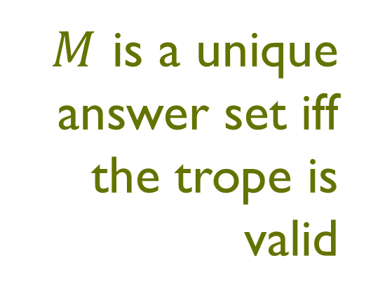
Saturation technique
bind(a, knight).
bind(b, 12 chests).
bind(a, knight).
bind(b, dragon).
$$…$$
valid
valid
$M$ is a unique answer set iff the trope is valid
bind(a, knight)
bind(b, knight) bind(a, dragon)
bind(a, 12 chests)
bind(b, x)

Slide 35
Saturation technique
bind(a, knight).
bind(b, 12 chests).
bind(a, knight).
bind(b, dragon).
bind(a, dragon).
bind(b, sheep).
$$…$$
not valid
valid
valid
✘
bind(a, knight)
bind(b, knight) bind(a, dragon)
bind(a, 12 chests)
bind(b, x)
$$M$$

Slide 36
Problem Generator
Problem Logic Generation
Natural Language Generation
Plot generation
Discourse tropes
Sentence ordering
Reference resolution

Slide 37
Natural Language Generation
Dragon Smaug has 12 chests of treasures.
Knight Ellie has 5 chests of treasures.
Knight Ellie slays Dragon Smaug.
Knight Ellie takes 12 chests of treasures.
How many chests of treasures does Knight Ellie have?

Slide 38
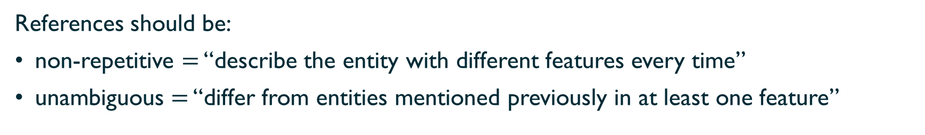
Natural Language Generation: Entity References
Dragon Smaug has 12 chests of treasures.
Knight Ellie has 5 chests of treasures.
She slays the dragon.
Ellie takes his treasures.
How many chests does the knight have?
References should be:
non-repetitive $=$ “describe the entity with different features every time”
unambiguous $=$ “differ from entities mentioned previously in at least one feature”

Slide 39
Final problem
Dragon Smaug has 12 chests of treasures. Knight Ellie has 5 chests of treasures.
She slays the dragon, and takes his treasures.
How many chests does the knight have?

Slide 40
Evaluation
Focus on content quality, not personalization effects
25 Singapore Math problems vs. 25 autogenerated problems
(with equivalent complexity distribution)
Two MTurk studies, 1000 participants each:
  Mathematical applicability (solution time, correctness)
  Linguistic aspects (subject-evaluated, Likert scale)

Slide 41
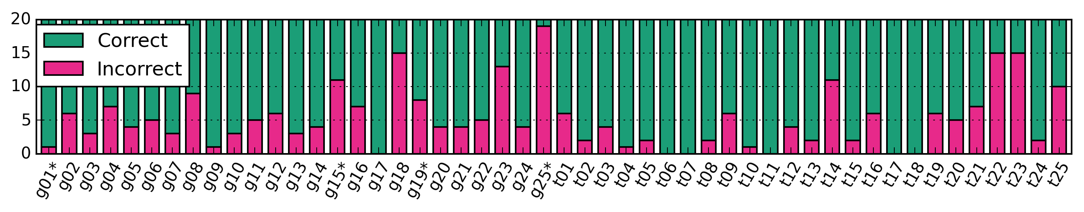
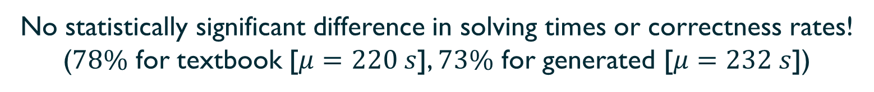
Mathematical applicability
Generated
Textbook
No statistically significant difference in solving times or correctness rates!
($78\%$ for textbook [$μ=220 s$], $73\%$ for generated [$μ=232 s$])

Slide 42

Linguistic comprehensibility
Forced-choice Likert scale ($1=$ “Strong minus”, $4=$ “Strong plus”):
  How comprehensible is the problem? How well did you understand the plot?
  How logical/natural is the sentence order?
  When the problem refers to an actor (e.g. with a pronoun, a name), is it clear who is being mentioned?
  Do the numbers in the problem fit its story (e.g. it would not make sense for a knight to be 5 years old)?
Expectation: generated problems are noticeably worse (they are generated!).
Goal: they are still comprehensible above a comfortable threshold (mean $≥3$).
✓
✓
Reality: Mean rating for generated: $3.45−3.65$
Mean rating for textbook: $3.90−3.92$

Slide 43

Summary
#43
Problem Generation $=$ synthesis of constrained logical graphs
  Domain-independent
  Sensible (thanks to discourse tropes)
State-of-the-art quality problems
  As solvable as textbook
  Slightly more artificial language (as expected ☺)
Total control over the complexity dimensions
  Customized problem progression
  Personalization
What’s next? Adaptive curriculum!
Thank you!
polozov@cs.washington.edu

Slide 44
Backup

Slide 45
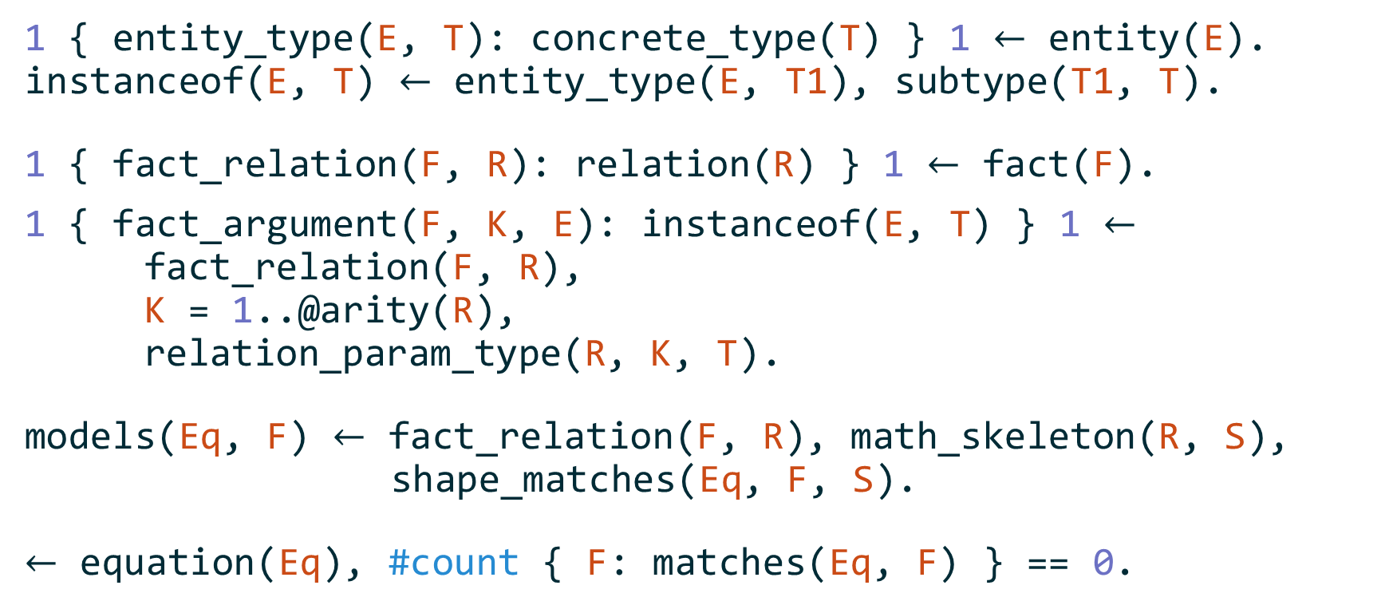
Plot generation as Graph isomorphism
1 { entity_type(E, T): concrete_type(T) } 1 $←$ entity(E).
instanceof(E, T) $←$ entity_type(E, T1), subtype(T1, T).
1 { fact_relation(F, R): relation(R) } 1 $←$ fact(F).
1 { fact_argument(F, K, E): instanceof(E, T) } 1 $←$
fact_relation(F, R),
K = 1..@arity(R),
relation_param_type(R, K, T).
models(Eq, F) $←$ fact_relation(F, R), math_skeleton(R, S),
shape_matches(Eq, F, S).
$←$ equation(Eq), #count { F: matches(Eq, F) } == 0.

Slide 46
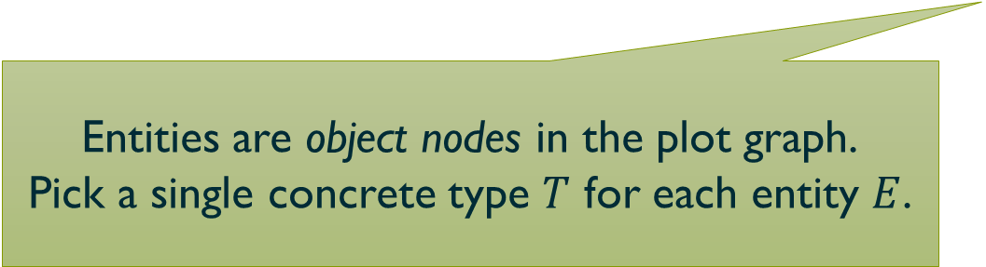
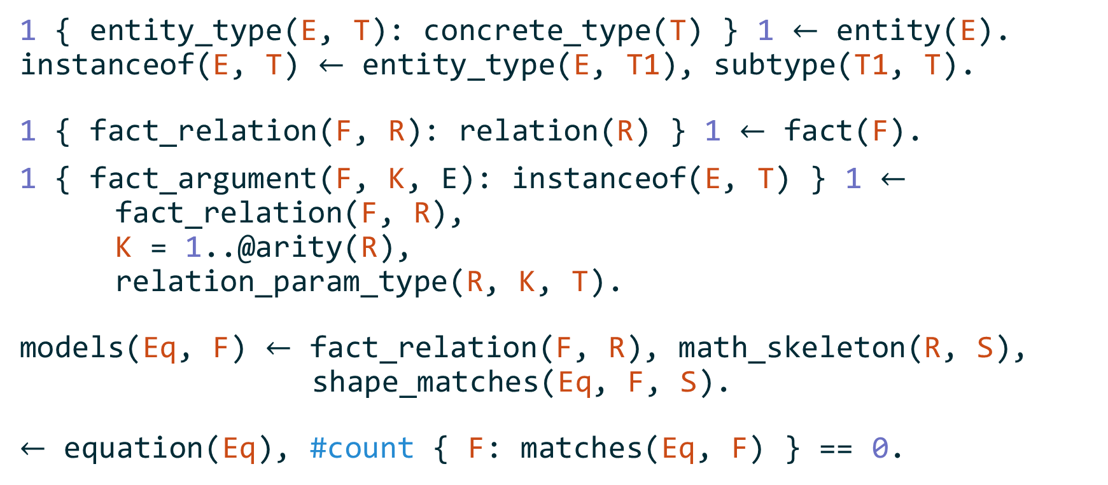
Plot generation as Graph isomorphism
1 { entity_type(E, T): concrete_type(T) } 1 $←$ entity(E).
instanceof(E, T) $←$ entity_type(E, T1), subtype(T1, T).
1 { fact_relation(F, R): relation(R) } 1 $←$ fact(F).
1 { fact_argument(F, K, E): instanceof(E, T) } 1 $←$
fact_relation(F, R),
K = 1..@arity(R),
relation_param_type(R, K, T).
models(Eq, F) $←$ fact_relation(F, R), math_skeleton(R, S),
shape_matches(Eq, F, S).
$←$ equation(Eq), #count { F: matches(Eq, F) } == 0.
Entities are object nodes in the plot graph.
Pick a single concrete type $T$ for each entity $E$.

Slide 47
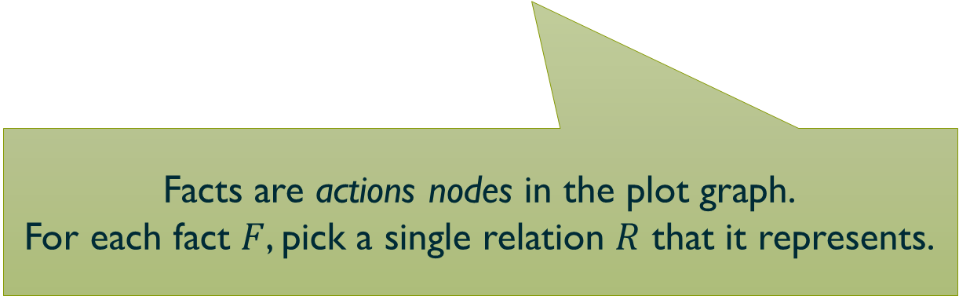
Plot generation as Graph isomorphism
1 { entity_type(E, T): concrete_type(T) } 1 $←$ entity(E).
instanceof(E, T) $←$ entity_type(E, T1), subtype(T1, T).
1 { fact_relation(F, R): relation(R) } 1 $←$ fact(F).
1 { fact_argument(F, K, E): instanceof(E, T) } 1 $←$
fact_relation(F, R),
K = 1..@arity(R),
relation_param_type(R, K, T).
models(Eq, F) $←$ fact_relation(F, R), math_skeleton(R, S),
shape_matches(Eq, F, S).
$←$ equation(Eq), #count { F: matches(Eq, F) } == 0.
Facts are actions nodes in the plot graph.
For each fact $F$, pick a single relation $R$ that it represents.

Slide 48
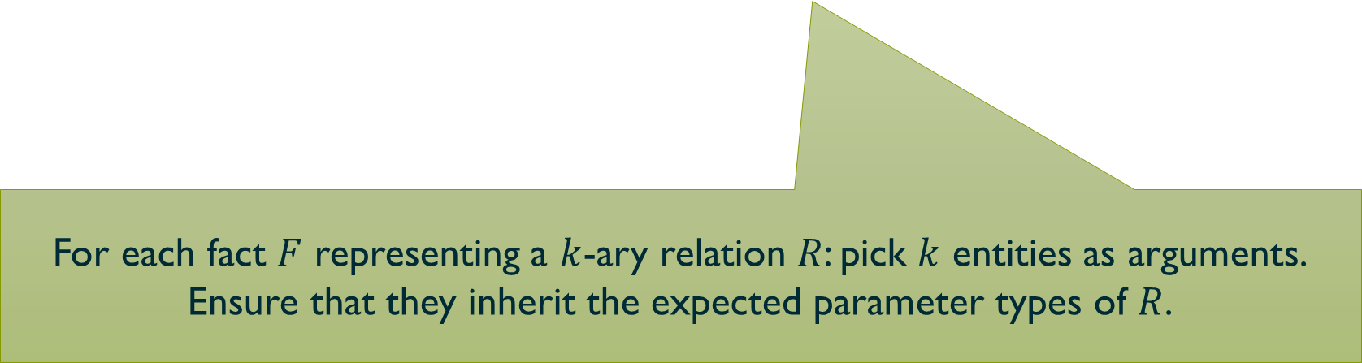
Plot generation as Graph isomorphism
1 { entity_type(E, T): concrete_type(T) } 1 $←$ entity(E).
instanceof(E, T) $←$ entity_type(E, T1), subtype(T1, T).
1 { fact_relation(F, R): relation(R) } 1 $←$ fact(F).
1 { fact_argument(F, K, E): instanceof(E, T) } 1 $←$
fact_relation(F, R),
K = 1..@arity(R),
relation_param_type(R, K, T).
models(Eq, F) $←$ fact_relation(F, R), math_skeleton(R, S),
shape_matches(Eq, F, S).
$←$ equation(Eq), #count { F: matches(Eq, F) } == 0.
For each fact $F$ representing a $k$-ary relation $R$: pick $k$ entities as arguments.
Ensure that they inherit the expected parameter types of $R$.

Slide 49
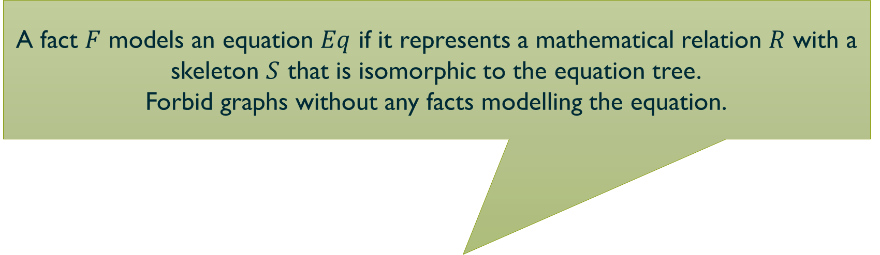
Plot generation as Graph isomorphism
A fact $F$ models an equation $Eq$ if it represents a mathematical relation $R$ with a skeleton $S$ that is isomorphic to the equation tree.
Forbid graphs without any facts modelling the equation.
1 { entity_type(E, T): concrete_type(T) } 1 $←$ entity(E).
instanceof(E, T) $←$ entity_type(E, T1), subtype(T1, T).
1 { fact_relation(F, R): relation(R) } 1 $←$ fact(F).
1 { fact_argument(F, K, E): instanceof(E, T) } 1 $←$
fact_relation(F, R),
K = 1..@arity(R),
relation_param_type(R, K, T).
models(Eq, F) $←$ fact_relation(F, R), math_skeleton(R, S),
shape_matches(Eq, F, S).
$←$ equation(Eq), #count { F: matches(Eq, F) } == 0.

Slide 50
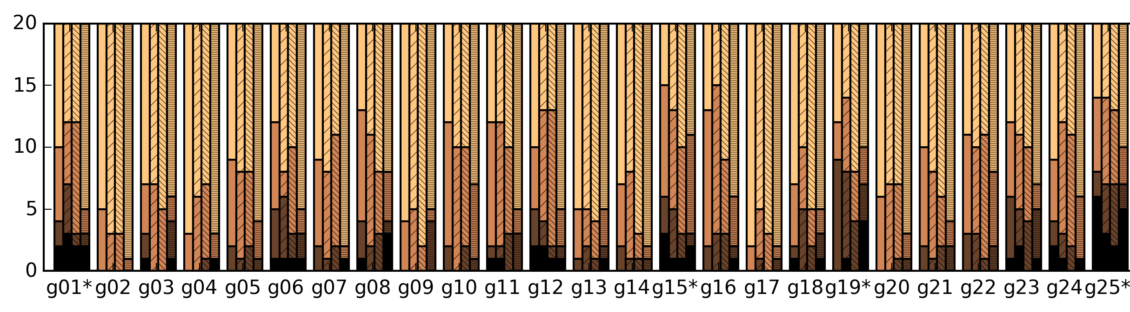
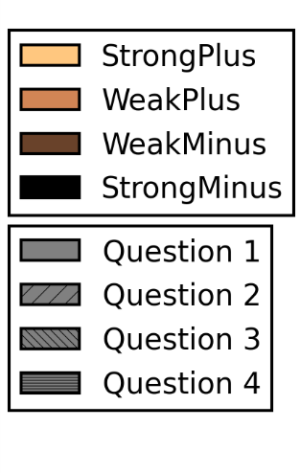
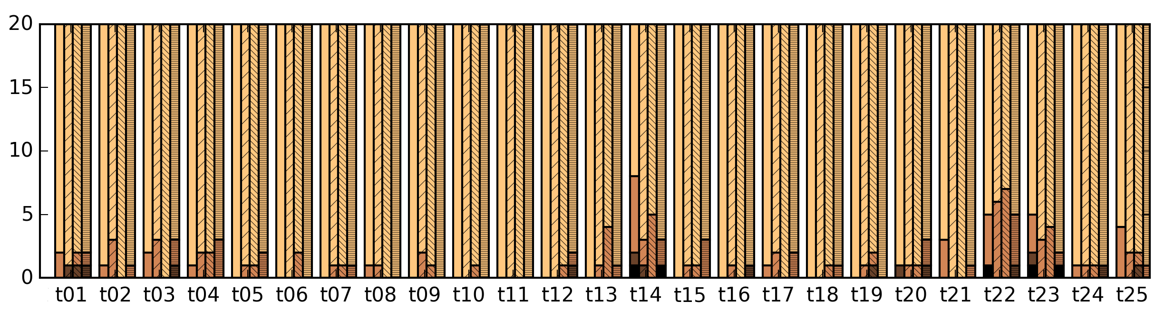
Linguistic comprehensibility

Slide 51
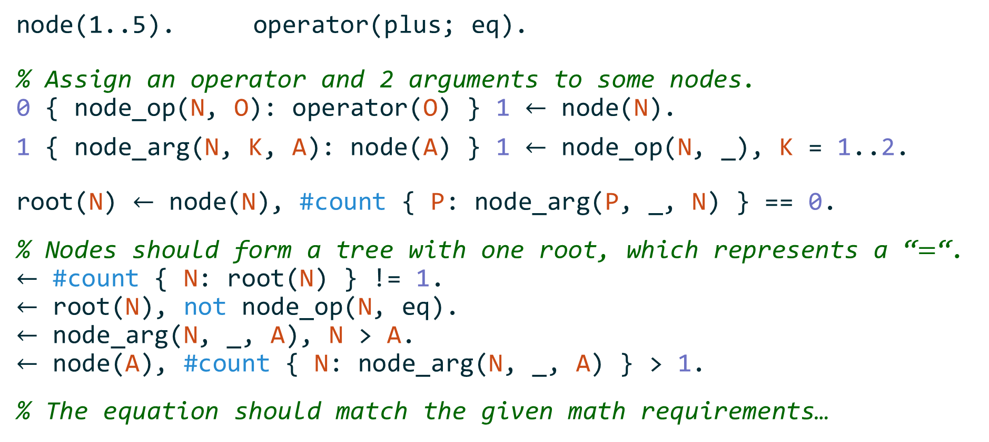
Equation generation
node(1..5). operator(plus; eq).
% Assign an operator and 2 arguments to some nodes.
0 { node_op(N, O): operator(O) } 1 $←$ node(N).
1 { node_arg(N, K, A): node(A) } 1 $←$ node_op(N, _), K = 1..2.
root(N) $←$ node(N), #count { P: node_arg(P, _, N) } == 0.
% Nodes should form a tree with one root, which represents a “$=$“.
$←$ #count { N: root(N) } != 1.
$←$ root(N), not node_op(N, eq).
$←$ node_arg(N, _, A), N > A.
$←$ node(A), #count { N: node_arg(N, _, A) } > 1.
% The equation should match the given math requirements…

