Slide 1





Teaching Finite Automata with AutomataTutor
Rajeev Alur (Penn), Loris D’Antoni (Penn), Sumit Gulwani (MSR), Bjoern Hartmann (Berkeley), Dileep Kini (UIUC), Mahesh Viswanathan (UIUC)

Slide 2
Why finite automata?
Part of any CS curriculum
Regexp and other models build on automata
Students don’t like Automata
Hard and tedious to grade

Slide 3
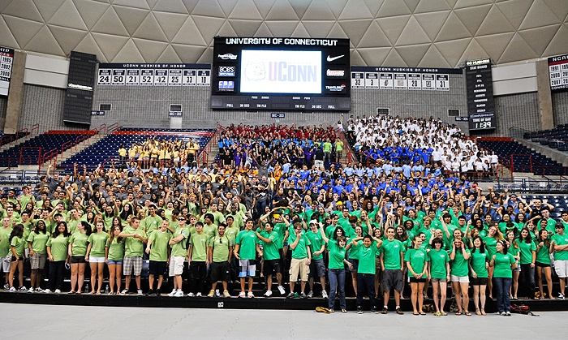



Draw the DFA accepting the language:
{ s | ‘ab’ appears in s exactly 2 times }
Teaching
Assistant
+
=

Slide 4
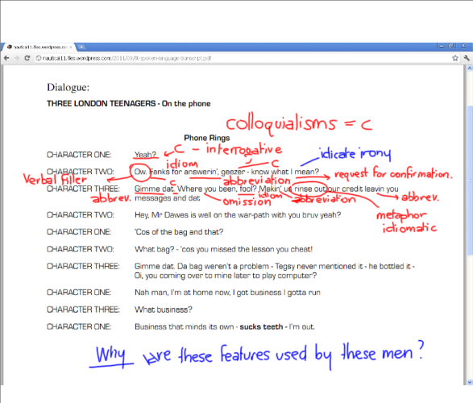
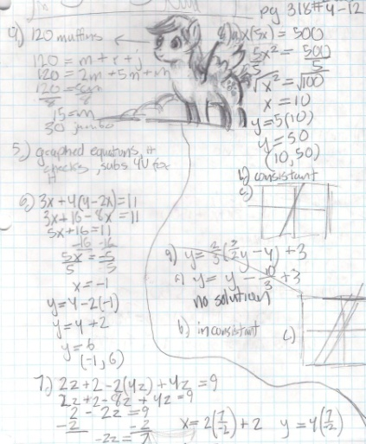



Teaching
Assistant
+
=
Teaching
Assistant
+
+
=

Slide 5
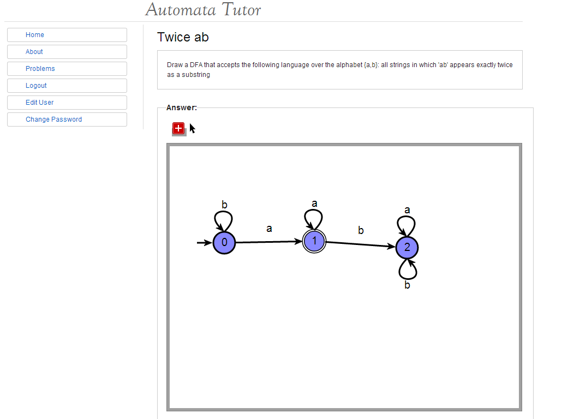
automatatutor.com

Slide 6
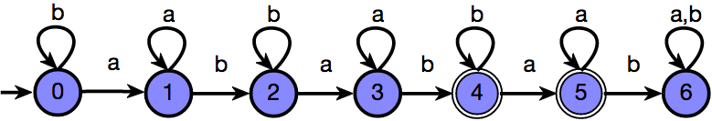
Draw the DFA accepting the language:
{ s | ‘ab’ appears in s exactly 2 times }
Solution:

Slide 7
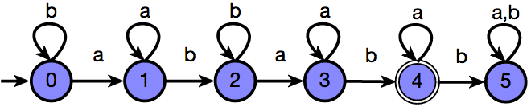
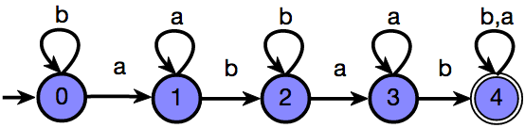
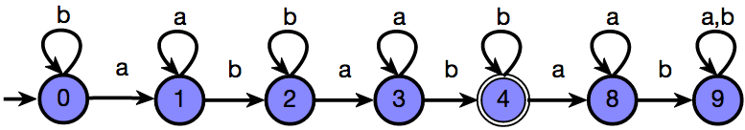

Slide 8
Your DFA accepts the language
{ s | ‘ab’ appears in s at least 2 times }
Grade: 6/10

Slide 9
You need to change the acceptance condition of one state
Grade: 9/10

Slide 10
How does it work?

Slide 11
3 types of mistakes:
Problem syntactic mistake
  You solved a slightly different problem
Solution syntactic mistake
  There is a typo in your solution
Solution semantic mistake
  Your solution is wrong on few test cases

Slide 12
1. Problem Syntactic Mistake
The problem description was
{ s | ‘ab’ appears in s exactly 2 times }
The student instead drew DFA for
{ s | ‘ab’ appears in s at least 2 times }
INTUITION: find the distance between the two language descriptions

Slide 13
Feedback via Synthesis
SYNTHESIZE LOGIC DESCRIPTION
indOf(ab)=2
indOf(ab)≥2
FIND MINIMAL EDIT
Replace ≥ with =
CONVERT TO ENGLISH
{ s | ‘ab’ appears in s at least 2 times }

Slide 14
indOf(‘ab’)=2
Classical algorithm from MSO to DFA
??

Slide 15
From DFA to Logic
Enumerate all the predicates
For each predicate build DFA
Check for equivalence with target DFA
Search pruning and speeding:
Avoid trivially equivalent predicates (A V B, B V A)
Approximate equivalence using set of test strings

Slide 16
2. Solution Syntactic Mistake
The student forgot one final state
INTUITION: find the smallest number of syntactic modification to fix solutions

Slide 17
DFA Edit Difference
Compute DFA edit distance:
  Number of edits necessary to transform the DFA into a correct one
An edit is
  Make a state (non)final
  Add a new state
  Redirect a transition

Slide 18
DFA Edit Difference:
How to compute it?
We try every possible edit and check for equivalence
Speed up equivalence by using test set of strings
The problem of finding DFAED is in NP
(is it NP-hard?)

Slide 19
3. Solution Semantic Mistake
The student didn’t see that the ‘a’ loop might not be traversed
INTUITION: find on how many strings the student is wrong

Slide 20
Approximate Density
S = correct solution A = student attempt
Compute Symmetric Difference: D = S\A U A\S
Measure relative size of D with respect to S Size(D,S) = lim_{n->∞} D^{n}/S^{n}
Size(D,S) is not computable in general (the limit oscillates)
Approximate the limit to finite n

Slide 21
Does it work?

Slide 22

Are the computed grades fair?
  YES [IJCAI13]
Is the computed feedback helpful?
  YES (in some sense) [submitted to TOCHI14]
Is anyone else (beside me) going to use the tool?
  It seems like a YES (Penn, UIUC, Reykjavik)

Slide 23
Are the computed grades fair?

Slide 24
Grades Evaluation 1/2
H1, H2 = human graders
N =naïve grader
T = tool
Tool is closer to humans than humans are to each other

Slide 25
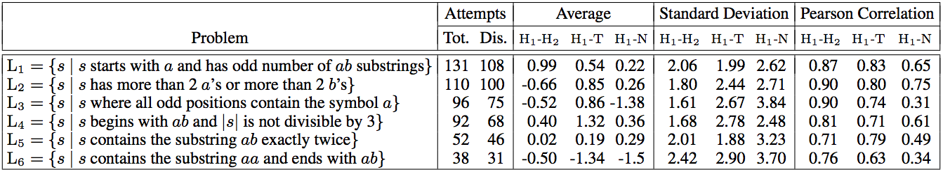
Grades Evaluation 2/2
H1, H2 = human graders
N =naïve grader
T = tool
Tool and humans look indistinguishable

Slide 26
Pro’s and Cons
Pros:
On disagreeing cases, human grader often realized that his grade was inaccurate
Identical solutions receive same grades and correct attempts awarded max score (unlike human)
Cons:
For now limited to small DFAs
When two types of mistakes happen at same time, the tool can’t figure it out

Slide 27
Is the computed feedback helpful?

Slide 28
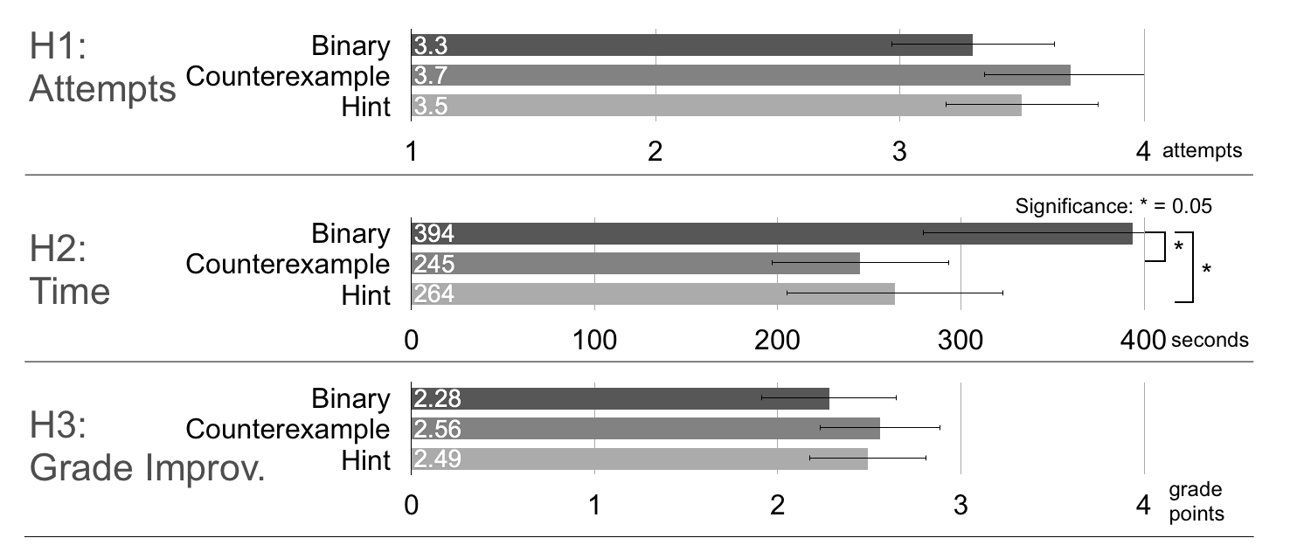

Slide 29
How to test whether students are engaged?
Setup:
4 mandatory homework problems
18 practice problems
Question:
How often does a student give up on a practice problem based on his type of feedback?
Results:
Binary Feedback: 44 % of the time
Counterexample: 27 % of the time
Hint Feedback: 33 % of the time

Slide 31
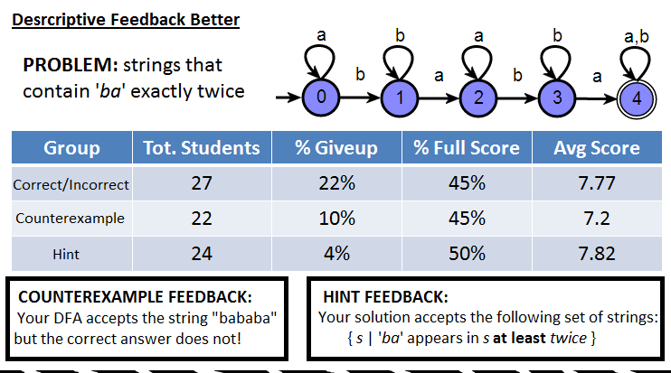

Slide 32
Is anyone else (besides me) going to use the tool?

Slide 33
Univ. of Reykjavik test
We used the previous experiment’s results to improve the tool and we removed sources of confusion.

Slide 34
4.40
4.31
4.34
2.09

Slide 35
Univ. of Reykjavik test
I thought the feedback was absolutely Excellent.
It helped me solve a couple of exercises, helped me with the extreme/end cases.
I liked its subtle hints.
It was short, simple and to the point!
…This is a far superior way to learn new things rather than read about something …
I hope this way of teaching will be implemented in all schools
Sometimes the feedback was confusing

Slide 36
What’s next?

Slide 37
A tutoring system?
A student (Alexander Weinert) worked on it at Berkeley as part of Sanjit Seshia’s class
NFA constructions?
A student (Matt Weaver) is working on it over the summer at Penn
Regular expressions?

Slide 38
Conclusions
AutomataTutor.com: a tool that grades DFA constructions fully automatically and provides students with personalized feedback
We will fully deploy it by Fall14.

