Slide 1


Automating
Repetitive Tasks
for the Masses
Sumit Gulwani
Invited Talk @ POPL 2015

Slide 2





The New Opportunity
2 orders of magnitude more end users
Struggle with simple repetitive tasks
Need domain-specific expert systems
Traditional customer for PL technology
End Users
(non-programmers with access to computers)
Software developer

Slide 3
Two application areas
Program Synthesis for End users
  Data manipulation using Examples and Natural Language
Intelligent Tutoring Systems
  Problem Generation
  Feedback Generation
PL techniques can play a significant role
Language design
Search algorithms
in conjunction with cross-disciplinary techniques from ML, HCI

Slide 4

Program Synthesis
An old problem, but more significant today.
Diverse computational platforms & languages.
Enabling technology: Better algorithms
and faster machines
Goal: Synthesize a program in the underlying domain-specific language (DSL) from user intent using some search algorithm.
Synthesis can revolutionize end-user programming if we:
target the right set of application domains
  Data manipulation
allow the right intent specification mechanism
  Examples, Natural Language
can tame the huge search space for real-time interaction
  Domain-specific search algorithms
PPDP 2010 [Invited talk paper]: “Dimensions in Program Synthesis”;

Slide 5





Data Manipulation
Data locked up in silos in various formats
  Great flexibility in organizing (hierarchical) data for viewing but challenging to manipulate and reason about the data.
A typical workflow might involve one or more following steps
  Extraction
  Transformation
  Querying
  Formatting
PBE and PBNL can enable delightful data wrangling.

Slide 6

Key Technical Challenges
Search Algorithm
Intent
Program
Challenge 1: Ambiguous/under-specified intent might result in unintended programs.
Challenge 2: Designing of efficient search algorithms.

Slide 7

Challenge 1: Handling Ambiguity
Solution 1: Synthesize multiple programs
& rank them using machine learning.
General Principles for ranking
Prefer shorter programs.
  Fewer conditionals.
  Shorter string expressions, regular expressions.
Prefer programs with fewer constants.
Ranking Strategies
Baseline: Pick any minimal sized program using minimal number of constants.
Machine Learning: Score programs using a weighted combination of program features.
  Weights are learned using training data.

Slide 8
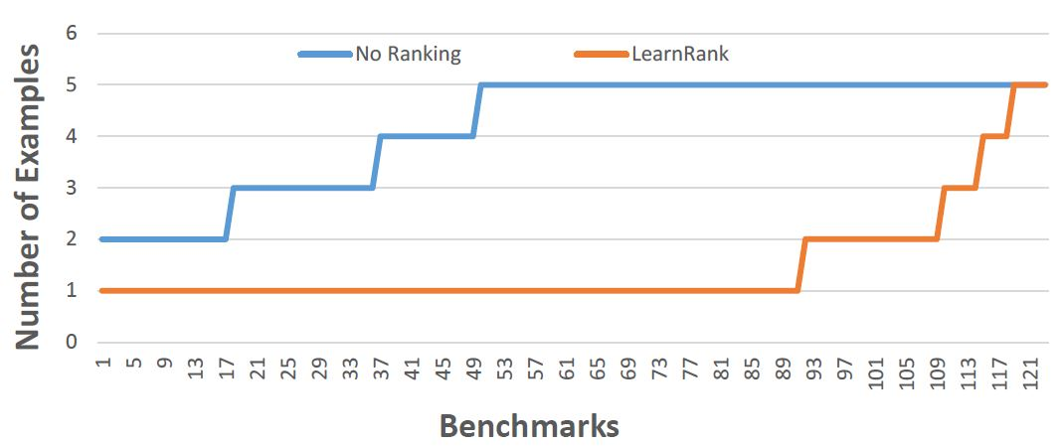
Experimental Comparison of Ranking Strategies
Baseline
Learning
Strategy | Average # of examples required
Baseline | 4.17
Learning | 1.48
Technical Report: “Predicting a correct program in Programming by Example”
Rishabh Singh, Sumit Gulwani

Slide 9

Challenge 1: Handling ambiguity
Solution 2: Enable interactive debugging session
Make it easy to inspect output correctness
  User can accordingly provide more examples
Show programs
  in any desired programming language
  in English
Computer initiated interactivity
  Highlight less confident entries in the output.
  Ask directed questions based on distinguishing inputs.

Slide 10
FlashExtract Demo

Slide 11
PBE/PBNL tools for Data Manipulation
Extraction
FlashExtract: Extract data from text files, web pages [PLDI 2014; Powershell convert-from-string API]
FlashRelate: Extract data from spreadsheets
Transformation
Flash Fill: Excel feature for Syntactic String Transformations [POPL 2011]
Semantic String Transformations [VLDB 2012]
Number Transformations [CAV 2013]
Querying
NLyze: an Excel programming-by-natural-lang add-in [SIGMOD 2014]
Formatting
Table re-formatting [PLDI 2011]
FlashFormat: a Powerpoint add-in [AAAI 2014]

Slide 12
FlashRelate + NLyze Demo

Slide 13
Challenge 2: Efficient search algorithm
Issues
Efficient design requires domain insights.
Robust implementation requires engineering.
DSL extensions/modifications are not easy.
Solution: DSL parameterized synthesis algorithm
Much like parser generators
SyGus [Alur et.al, FMCAD 2013] and Rosette [Torlak et.al., PLDI 2014] are great initial efforts but too general.
Should exploit domain-specific insights related to PBE.

Slide 14
The FlashMeta Framework
A DSL parameterized synthesis framework
Key observations
Many PBE algorithms employ a hierarchical divide and conquer strategy, wherein synthesis problem for an expression F(e1,e2) is reduced to synthesis problems for sub-expressions e1 and e2.
  The divide-and-conquer strategy can be refactored out.
Reduction depends on the logical properties of operator F.
  Operator properties can be captured in a modular manner for reuse inside other DSLs.
Technical report: “A Framework for Inductive Program Synthesis”
Alex Polozov, Sumit Gulwani

Slide 15
Comparison of FlashMeta with hand-tuned implementations
Lines of Code (K)
Development time (months)
Project
FlashFill
FlashExtractText
FlashNormalize
FlashExtractWeb
Original | FlashMeta
12 | 3
7 | 4
17 | 2
N/A | 2.5
Original | FlashMeta
9 | 1
8 | 1
7 | 2
N/A | 1.5
Running time of FlashMeta implementations vary between 0.5-3x of the corresponding original implementation.
Faster because of some free optimizations
Slower because of larger feature sets & a generalized framework

Slide 16
New Directions in Program Synthesis (Summary)
Multi-modal programming models that
  Allow different intent forms like examples & natural language.
  Leverage multiple synthesizers to enable bigger tasks.
  Support debugging experience such as active learning, paraphrasing, and editing of synthesized programs.
DSL parameterized synthesis algorithms
  Challenging to develop/maintain a domain-specific synthesizer.
    Efficient algorithm design requires non-trivial domain insights.
    Robust implementation requires serious engineering resources.
  Synthesizer designer simply experiments with a DSL. An efficient search algorithm is automatically generated (much like parser generation from CFG description).

Slide 17




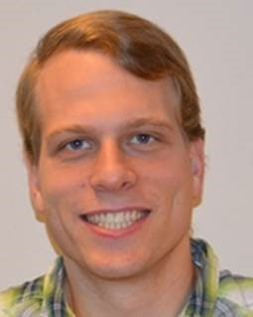
The Stupendo Fantabulously FantasticalTeam
FlashMeta Framework Concept Design
NLyze
Dialogues
Alex Polozov
Mark Marron
FlashProg UI
Effects
Working too hard!
Gustavo Soares
Mikael Mayer

Slide 18




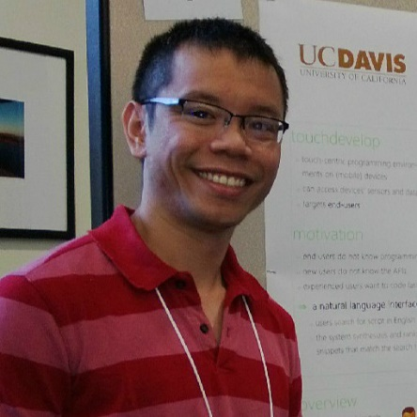
The Stupendo Fantabulously FantasticalTeam
FlashRelate actors
Ted Hart
Dan Barowy
Ben Zorn
FlashExtract actors
Maxim Grechkin
In the job market now!
Vu Le

Slide 19



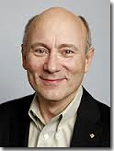
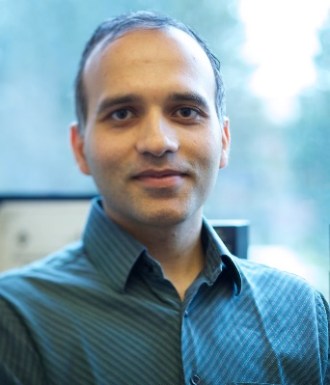
The Stupendo Fantabulously FantasticalTeam
FlashFill actors
Dileep Kini
Rishabh Singh
Recently graduated
Overhead director
Generous producers
Rico Malvar
Ben Zorn

Slide 20
Two application areas
Program Synthesis for End users
  Data manipulation using Examples and Natural Language
Intelligent Tutoring Systems
  Problem Generation
  Feedback Generation
PL techniques can play a significant role
Language design
Search algorithms
in conjunction with cross-disciplinary techniques from ML, HCI

Slide 21
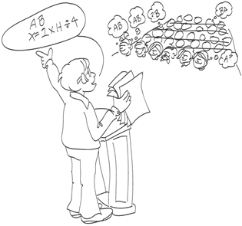
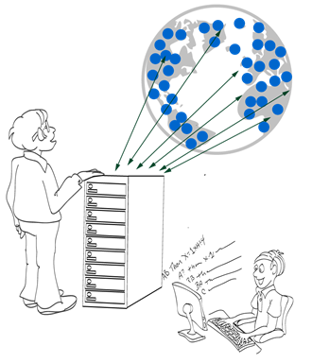
Intelligent Tutoring Systems
Repetitive tasks
Problem Generation
Feedback Generation
Various subject domains
Math, Logic
Automata, Programming
Language Learning
CACM 2014; “Example-based Learning in Computer-aided STEM Education”;

Slide 22

Problem Generation
Motivation
Problems similar to a given problem.
  Avoid copyright issues
  Prevent cheating in MOOCs (Unsynchronized instruction)
Problems of a given difficulty level and concept usage.
  Generate progressions
  Generate personalized workflows
Key Ideas
Test input generation techniques

Slide 23
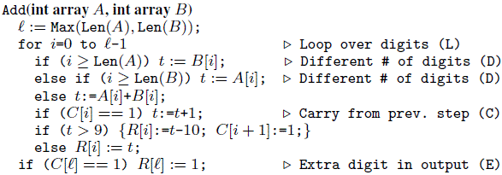
Problem Generation: Addition Procedure
Concept | Trace Characteristic | Sample Input
Single digit addition | L | 3+2
Multiple digit w/o carry | LL+ | 1234 +8765
Single carry | L* (LC) L* | 1234 + 8757
Two single carries | L* (LC) L+ (LC) L* | 1234 + 8857
Double carry | L* (LCLC) L* | 1234 + 8667
Triple carry | L* (LCLCLCLC) L* | 1234 + 8767
Extra digit in i/p & new digit in o/p | L* CLDCE | 9234 + 900
CHI 2013: “A Trace-based Framework for Analyzing and Synthesizing Educational Progressions”; Andersen, Gulwani, Popovic.

Slide 24
Problem Generation
Motivation
Problems similar to a given problem.
  Avoid copyright issues
  Prevent cheating in MOOCs (Unsynchronized instruction)
Problems of a given difficulty level and concept usage.
  Generate progressions
  Generate personalized workflows
Key Ideas
Test input generation techniques
Template-based generalization

Slide 25
Problem Generation: Algebra (Trigonometry)
$$\text{Example} \text{Problem}\text{:}{ \left(\sec{x+ \cos{x}}\right) \left(\sec{x−\cos{x}}\right)}= \tan^{2}{x+\sin^{2}{x}}$$
$$\text{Query}\text{: }\left(T_{1}\left(x\right)±T_{2}(x)\right) \left(T_{3}\left(x\right)±T_{4}\left(x\right)\right)=T_{5}^{2}\left(x\right)±T_{6}^{2}(x)$$
$${ T}_{1}≠T_{5}$$
New problems generated:
$$\left(\csc{x}+\cos{x}\right)\left(\csc{x}−\cos{x}\right)=\cot^{2}{x}+\sin^{2}{x}$$
$$(\csc{x−\sin{x)(\csc{x+\sin{x)=\cot^{2}{x+\cos^{2}{x}}}}} }$$
$$(\sec{x+\sin{x)(\sec{x−\sin{x)=\tan^{2}{x+\cos^{2}{x}}}}}}$$
:
$$(\tan{x+\sin{x)(\tan{x−\sin{x)=\tan^{2}{x −\sin^{2}{x} }}}}}$$
$$(\csc{x+\cos{x)(\csc{x−\cos{x)=\csc^{2}{x −\cos^{2}{x}}}}}}$$
:
AAAI 2012: “Automatically generating algebra problems”;
Singh, Gulwani, Rajamani.

Slide 26
Problem Generation: Algebra (Limits)
$$\text{Example} \text{Problem}\text{:} \lim_{n→∞}{\sum_{i=0}^{n}{\frac{2i^{2}+i+1}{5^{i}}= \frac{5}{2}} }$$
$$\text{Query}\text{:} \lim_{n→∞}{\sum_{i=0}^{n}{\frac{C_{0}i^{2}+C_{1}i+C_{2}}{{C_{3}}^{i}}= \frac{C_{4}}{C_{5}}} }$$
$${ C}_{0}≠0 ∧ \gcd\left(C_{0},C_{1},C_{2}\right)=\gcd\left(C_{4},C_{5}\right)=1$$
New problems generated:
$$\lim_{n→∞}{\sum_{i=0}^{n}{\frac{3i^{2}+2i+1}{7^{i}}= \frac{7}{3} }\lim_{n→∞}{\sum_{i=0}^{n}{\frac{3i^{2}+3i+1}{4^{i}}=4 } }}$$
$$\lim_{n→∞}{\sum_{i=0}^{n}{\frac{i^{2}}{3^{i}}= \frac{3}{2}} \lim_{n→∞}{\sum_{i=0}^{n}{\frac{5i^{2}+3i+3}{6^{i}}=6 } }}$$

Slide 27
Problem Generation: Algebra (Determinant)
$$\text{Ex}\text{. }\text{Problem} \left|\begin{matrix}{\left(x+y\right)}^{2} & zx & zy \\ zx & {\left(y+z\right)}^{2} & xy \\ yz & xy & {\left(z+x\right)}^{2}\end{matrix}\right|{ }=2xyz {\left(x+y+z\right)}^{3}$$
$$\text{Query} \left|\begin{matrix}F_{0}(x,y,z) & F_{1}(x,y,z) & F_{2}(x,y,z) \\ F_{3}(x,y,z) & F_{4}(x,y,z) & F_{5}(x,y,z) \\ F_{6}(x,y,z) & F_{7}(x,y,z) & F_{8}(x,y,z)\end{matrix}\right|{ }=C_{10}F_{9}(x,y,z)$$
$${ F}_{i}≔F_{j}\left[x→y;y→z;z→x\right] where \left(i,j\right)∈\{\left(4,0\right), \left(8,4\right), \left(5,1\right),…\}$$
New problems generated:
$$\left|\begin{matrix}y^{2} & x^{2} & {\left(y+x\right)}^{2} \\ {\left(z+y\right)}^{2} & z^{2} & y^{2} \\ z^{2} & {\left(x+z\right)}^{2} & x^{2}\end{matrix}\right|{ }=2{\left(xy+yz+zx\right)}^{3}$$
$$\left|\begin{matrix}yz+y^{2} & xy & xy \\ yz & zx+z^{2} & yz \\ zx & zx & xy+x^{2}\end{matrix}\right|{ }=4x^{2}y^{2}z^{2}$$

Slide 28
Problem Generation
Motivation
Problems similar to a given problem.
  Avoid copyright issues
  Prevent cheating in MOOCs (Unsynchronized instruction)
Problems of a given difficulty level and concept usage.
  Generate progressions
  Generate personalized workflows
Key Ideas
Test input generation techniques
Template-based generalization

Slide 29
Problem Generation: Sentence Completion
The principal characterized his pupils as _________ because they were pampered and spoiled by their indulgent parents.
The commentator characterized the electorate as _________ because it was unpredictable and given to constantly shifting moods.
(a) cosseted (b) disingenuous (c) corrosive (d) laconic (e) mercurial
One of the problems is a real problem from SAT (standardized US exam),
while the other one was automatically generated!
From problem 1, we generate:
template T₁ = *₁ characterized *₂ as *₃ because *₄
We specialize T₁ to
template T₂ = *₁ characterized *₂ as mercurial because *₄
Problem 2 is an instance of T₂
found using web search!
KDD 2014: “LaSEWeb: Automating Search Strategies Over Semi-structured Web Data”; Alex Polozov, Sumit Gulwani

Slide 30

Feedback Generation
Motivation
Make teachers more effective.
  Save them time.
  Provide immediate insights on where students are struggling.
Can enable rich interactive experience for students.
  Generation of hints.
  Pointer to simpler problems depending on kind of mistakes.
Different kinds of feedback:
Counterexamples

Slide 31
Feedback Generation
Motivation
Make teachers more effective.
  Save them time.
  Provide immediate insights on where students are struggling.
Can enable rich interactive experience for students.
  Generation of hints.
  Pointer to simpler problems depending on kind of mistakes.
Different kinds of feedback:
Counterexamples
Nearest correct solution

Slide 32
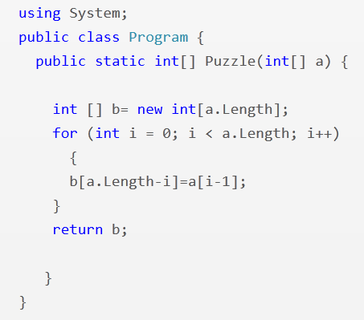
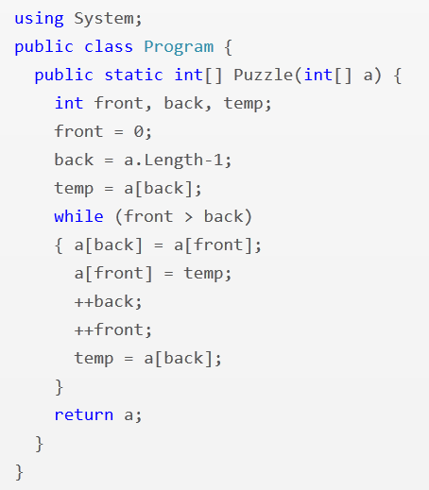
Feedback Synthesis: Programming (Array Reverse)
i = 1
i <= a.Length
front <= back
--back
PLDI 2013: “Automated Feedback Generation for Introductory Programming Assignments”; Singh, Gulwani, Solar-Lezama

Slide 33
Some Results
13,365 incorrect attempts for 13 Python problems.
(obtained from Introductory Programming course at MIT and its MOOC version on the EdX platform)
Average time for feedback = 10 seconds
Feedback generated for 64% of those attempts.
Reasons for failure to generate feedback
  Large number of errors
  Timeout (4 min)
Tool accessible at: http://sketch1.csail.mit.edu/python-autofeedback/

Slide 34
Feedback Generation
Motivation
Make teachers more effective.
  Save them time.
  Provide immediate insights on where students are struggling.
Can enable rich interactive experience for students.
  Generation of hints.
  Pointer to simpler problems depending on kind of mistakes.
Different kinds of feedback:
Counterexamples
Nearest correct solution
Strategy-level feedback

Slide 35
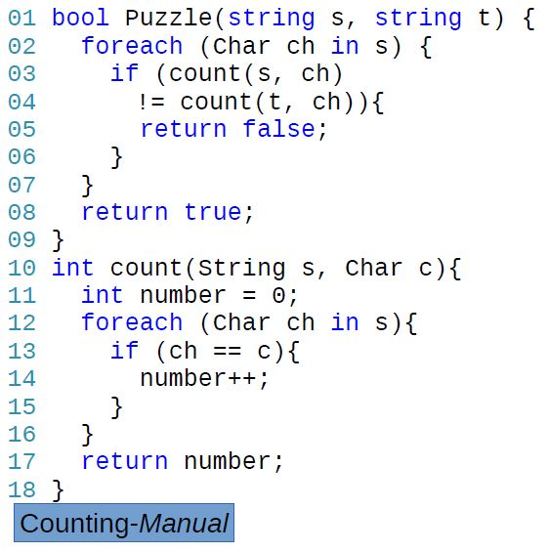
Anagram Problem: Counting Strategy
Problem: Are two input strings permutations of each other?
Strategy: For every character in one string, count and compare the number of occurrences in another. O(n²)
Feedback: “Count the number of characters in each string in a pre-processing phase to amortize the cost.”

Slide 36
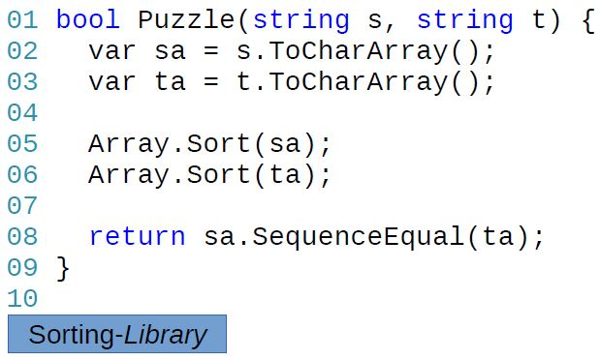
Anagram Problem: Sorting Strategy
Problem: Are two input strings permutations of each other?
Strategy: Sort and compare the two input strings. O(n²)
Feedback: “Instead of sorting, compare occurrences of each character.”

Slide 37
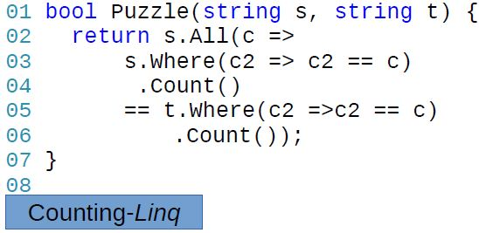
Different implementations: Counting strategy

Slide 38
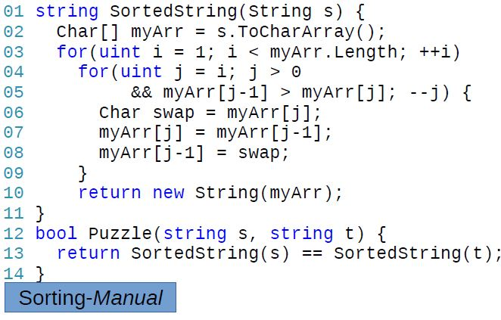
Different implementations: Sorting strategy

Slide 39
Strategy-level Feedback Generation
Teacher documents various strategies and associated feedback.
  Strategies can potentially be automatically inferred from student data.
Computer identifies the strategy used by a student implementation and passes on the associated feedback.
  Different implementations that employ the same strategy produce the same sequence of “key values”.
FSE 2014: “Feedback Generation for Performance Problems in Introductory Programming Assignments” Gulwani, Radicek, Zuleger

Slide 40
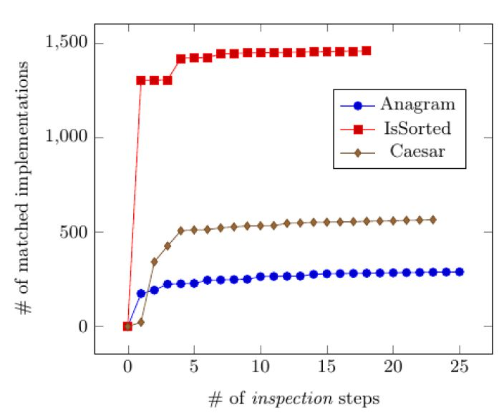
Some Results: Documentation of teacher effort
# of matched implementations
# of inspection steps
When a student implementation doesn’t match any strategy:
the teacher inspects it to refine or add a (new) strategy.

Slide 41
Feedback Generation
Motivation
Make teachers more effective.
  Save them time.
  Provide immediate insights on where students are struggling.
Can enable rich interactive experience for students.
  Generation of hints.
  Pointer to simpler problems depending on kind of mistakes.
Different kinds of feedback:
Counterexamples
Nearest correct solution
Strategy-level feedback
Nearest problem description (corresponding to student solution)

Slide 42
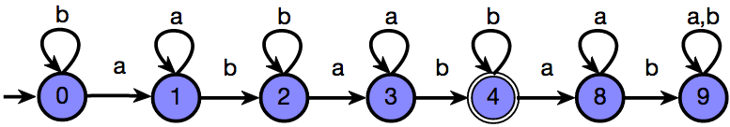
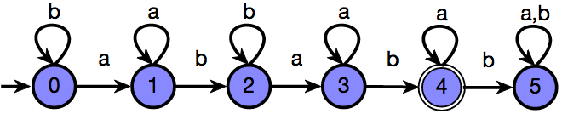
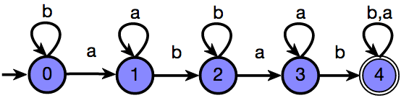
Feedback Synthesis: Finite State Automata
Draw a DFA that accepts: { s | ‘ab’ appears in s exactly 2 times }
Grade: 9/10
Feedback: One more state should be made final
Attempt 1
Based on nearest correct solution
Grade: 6/10
Feedback: The DFA is incorrect on the string ‘ababb’
Attempt 2
Based on counterexamples
Grade: 5/10
Feedback: The DFA accepts {s | ‘ab’ appears in s at least 2 times}
Attempt 3
Based on nearest problem description
IJCAI 2013: “Automated Grading of DFA Constructions”;
Alur, d’Antoni, Gulwani, Kini, Viswanathan

Slide 43
Some Results
800+ attempts to 6 automata problems (obtained from automata course at UIUC) graded by tool and 2 instructors.
95% problems graded in <6 seconds each
Out of 131 attempts for one of those problems:
  6 attempts: instructors were incorrect (gave full marks to an incorrect attempt)
  20 attempts: instructors were inconsistent (gave different marks to syntactically equivalent attempts)
  34 attempts: >= 3 point discrepancy between instructor & tool; in 20 of those, instructor agreed that tool was more fair.
Instructors concluded that tool should be preferred over humans for consistency & scalability.
Tool accessible at: http://www.automatatutor.com/

Slide 44
New Directions in Intelligent Tutoring Systems
Domain-specific natural language understanding to deal with word problems.
Leverage large amounts of student data.
  Repair incorrect solution using a nearest correct solution [DeduceIt/Aiken et.al./UIST 2013]
  Clustering for power-grading [CodeWebs/Nguyen et.al./WWW 2014]
Leverage large populations of students and teachers.
  Peer-grading
Notes:
DeduceIt
CodeWebs

Slide 45

Automating Repetitive Tasks for the Masses
Billions of non-programmers now have computing devices.
PL techniques can also directly address repetitive needs of these end-users.
Language design
Search algorithms
Two important applications with large scale societal impact.
End-User Programming using examples and natural language: data manipulation, programming of smartphones and robots
Intelligent Tutoring Systems: problem & feedback synthesis
References:
“Spreadsheet Data Manipulation using Examples”; CACM 2012
“Example-based Learning in Computer-aided STEM Education”; CACM 2014

