Slide 1
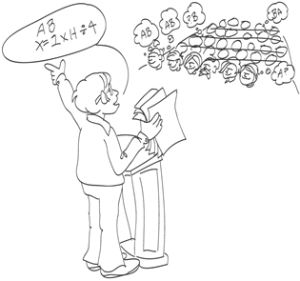
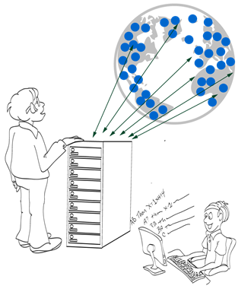


Example-based Learning in
Computer-aided Education
Sumit Gulwani
sumitg@microsoft.com
Affiliations: Researcher @ Microsoft Research
Adjunct Faculty @ IIT Kanpur
December 2013
Technology for Education (T4E) Conference

Slide 2
Reference
Example-based Learning in Computer-aided STEM Education
MSR Technical Report MSR-TR-2013-50
To appear in CACM

Slide 3
Example-based Learning
Human learning is often structured around examples.
  Students master various concepts using examples.
  Teachers guess student misconceptions from erroneous demonstrations or provide feedback using counter-examples.
Example-based reasoning also used in Computer-aided Programming (CAP).
  Program analysis: test input generation for bug finding
  Program synthesis: programming by example
    e.g., Flash Fill: an Excel 2013 feature [POPL 2011, CACM 2012]
Example-based reasoning techniques developed in CAP community can help automate several tasks in Education.
  Implications: CAP research can fuel research in Computer-aided Education & vice versa.

Slide 4
Computer-aided Education
Various tasks
Problem Generation
Solution Generation
Feedback Generation
Various subject-domains
Arithmetic, Algebra, Geometry
Programming, Automata, Logic
Language Learning
...

Slide 5
Content Classification
Procedural
  Mathematical Procedures
    Addition, Long division, GCD/LCM, Gaussian Elimination
  Algorithmic Procedures
    Students asked to show understanding of classical algorithms on specific inputs.
      BFS, insertion sort, shortest path
      translating regular expression into an automaton.
Conceptual
  Proofs
    Algebraic theorems, Natural deduction, Non-regularity
  Constructions
    Geometric ruler/compass based constructions, Automata constructions, Algorithms

Slide 6
Problem Generation

Slide 7
Problem Generation
Motivation
Problems similar to a given problem.
  Avoid copyright issues
  Prevent cheating in MOOCs (Unsynchronized instruction)
Problems of a given difficulty level and concept usage.
  Generate progressions
  Generate personalized workflows
Key Ideas
Procedural Content: Test input generation techniques

Slide 8
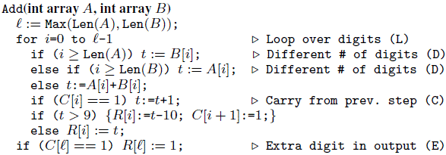
Problem Generation: Addition Procedure
Concept
Single digit addition
Multiple digit w/o carry
Single carry
Two single carries
Double carry
Triple carry
Extra digit in i/p & new digit in o/p
Reference: A Trace-based Framework for Analyzing and Synthesizing Educational Progressions; CHI 2013; Andersen, Gulwani, Popovic.

Slide 9
Problem Generation: Addition Procedure
Concept | Trace Characteristic
Single digit addition | L
Multiple digit w/o carry | LL+
Single carry | L* (LC) L*
Two single carries | L* (LC) L+ (LC) L*
Double carry | L* (LCLC) L*
Triple carry | L* (LCLCLCLC) L*
Extra digit in i/p & new digit in o/p | L* CLDCE
Reference: A Trace-based Framework for Analyzing and Synthesizing Educational Progressions; CHI 2013; Andersen, Gulwani, Popovic.

Slide 10
Problem Generation: Addition Procedure
Concept | Trace Characteristic | Sample Input
Single digit addition | L | 3+2
Multiple digit w/o carry | LL+ | 1234 +8765
Single carry | L* (LC) L* | 1234 + 8757
Two single carries | L* (LC) L+ (LC) L* | 1234 + 8857
Double carry | L* (LCLC) L* | 1234 + 8667
Triple carry | L* (LCLCLCLC) L* | 1234 + 8767
Extra digit in i/p & new digit in o/p | L* CLDCE | 9234 + 900
Reference: A Trace-based Framework for Analyzing and Synthesizing Educational Progressions; CHI 2013; Andersen, Gulwani, Popovic.

Slide 11
Problem Generation
Motivation
Problems similar to a given problem.
  Avoid copyright issues
  Prevent cheating in MOOCs (Unsynchronized instruction)
Problems of a given difficulty level and concept usage.
  Generate progressions
  Generate personalized workflows
Key Ideas
Procedural Content: Test input generation techniques
Conceptual Content
  Template based generalization

Slide 12
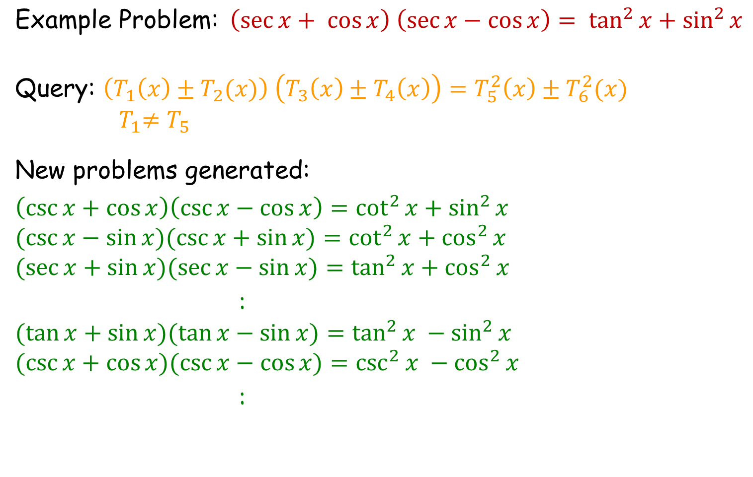
Trigonometry Problem
$$\text{Example} \text{Problem}\text{:}{ \left(\sec{x+ \cos{x}}\right) \left(\sec{x−\cos{x}}\right)}= \tan^{2}{x+\sin^{2}{x}}$$
$$\text{Query}\text{: }\left(T_{1}\left(x\right)±T_{2}(x)\right) \left(T_{3}\left(x\right)±T_{4}\left(x\right)\right)=T_{5}^{2}\left(x\right)±T_{6}^{2}(x)$$
$${ T}_{1}≠T_{5}$$
New problems generated:
$$\left(\csc{x}+\cos{x}\right)\left(\csc{x}−\cos{x}\right)=\cot^{2}{x}+\sin^{2}{x}$$
$$(\csc{x−\sin{x)(\csc{x+\sin{x)=\cot^{2}{x+\cos^{2}{x}}}}} }$$
$$(\sec{x+\sin{x)(\sec{x−\sin{x)=\tan^{2}{x+\cos^{2}{x}}}}}}$$
:
$$(\tan{x+\sin{x)(\tan{x−\sin{x)=\tan^{2}{x −\sin^{2}{x} }}}}}$$
$$(\csc{x+\cos{x)(\csc{x−\cos{x)=\csc^{2}{x −\cos^{2}{x}}}}}}$$
:
Reference: Automatically generating algebra problems;
AAAI 2012; Rohit Singh, Sumit Gulwani, Sriram Rajamani.

Slide 13
Trigonometry Problem
$$\text{Example} \text{Problem}\text{:}{ \left(\sec{x+ \cos{x}}\right) \left(\sec{x−\cos{x}}\right)}= \tan^{2}{x+\sin^{2}{x}}$$
$$\text{Query}\text{: }\left(T_{1}\left(x\right)±T_{2}(x)\right) \left(T_{3}\left(x\right)±T_{4}\left(x\right)\right)=T_{5}^{2}\left(x\right)±T_{6}^{2}(x)$$
$${ T}_{1}≠T_{5}$$
New problems generated:
$$\left(\csc{x}+\cos{x}\right)\left(\csc{x}−\cos{x}\right)=\cot^{2}{x}+\sin^{2}{x}$$
$$(\csc{x−\sin{x)(\csc{x+\sin{x)=\cot^{2}{x+\cos^{2}{x}}}}} }$$
$$(\sec{x+\sin{x)(\sec{x−\sin{x)=\tan^{2}{x+\cos^{2}{x}}}}}}$$
:
$$(\tan{x+\sin{x)(\tan{x−\sin{x)=\tan^{2}{x −\sin^{2}{x} }}}}}$$
$$(\csc{x+\cos{x)(\csc{x−\cos{x)=\csc^{2}{x −\cos^{2}{x}}}}}}$$
:
Reference: Automatically generating algebra problems;
AAAI 2012; Rohit Singh, Sumit Gulwani, Sriram Rajamani.

Slide 14
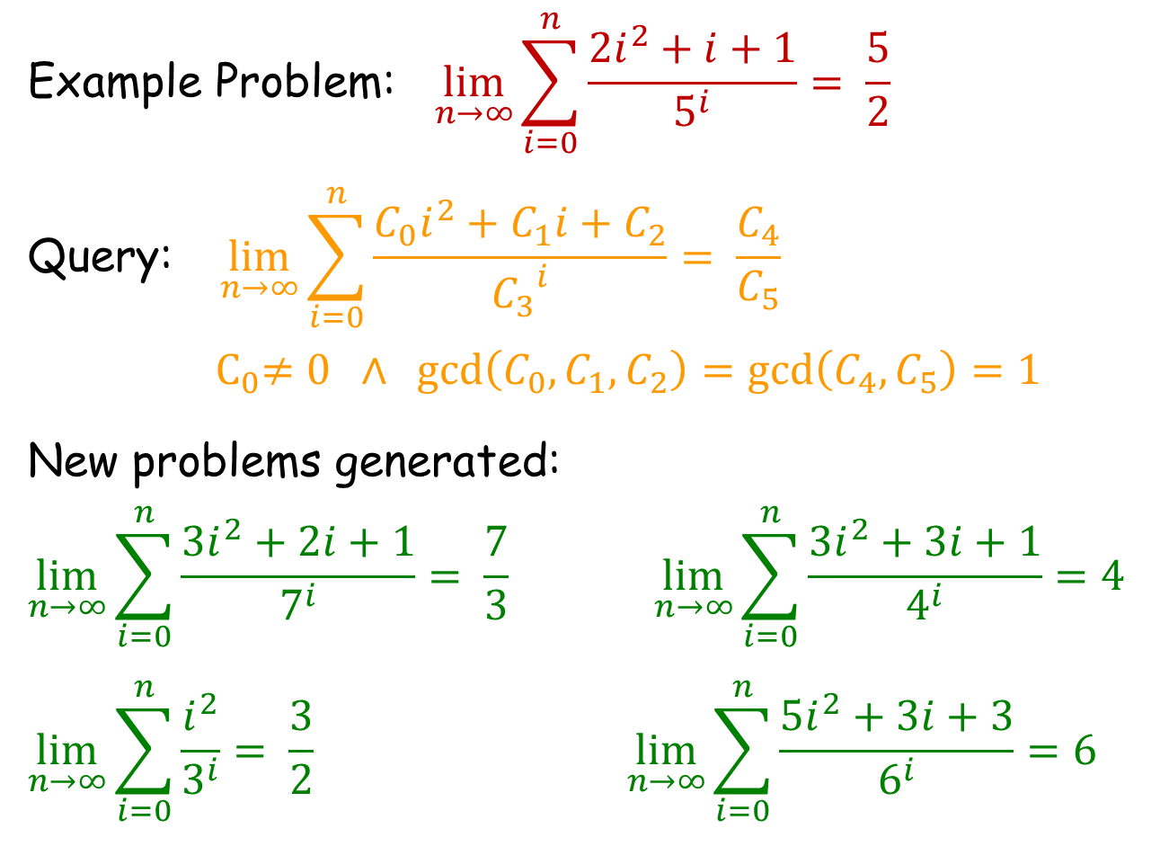
Limits/Series Problem
$$\text{Example} \text{Problem}\text{:} \lim_{n→∞}{\sum_{i=0}^{n}{\frac{2i^{2}+i+1}{5^{i}}= \frac{5}{2}} }$$
$$\text{Query}\text{:} \lim_{n→∞}{\sum_{i=0}^{n}{\frac{C_{0}i^{2}+C_{1}i+C_{2}}{{C_{3}}^{i}}= \frac{C_{4}}{C_{5}}} }$$
$${ C}_{0}≠0 ∧ \gcd\left(C_{0},C_{1},C_{2}\right)=\gcd\left(C_{4},C_{5}\right)=1$$
New problems generated:
$$\lim_{n→∞}{\sum_{i=0}^{n}{\frac{3i^{2}+2i+1}{7^{i}}= \frac{7}{3} }\lim_{n→∞}{\sum_{i=0}^{n}{\frac{3i^{2}+3i+1}{4^{i}}=4 } }}$$
$$\lim_{n→∞}{\sum_{i=0}^{n}{\frac{i^{2}}{3^{i}}= \frac{3}{2}} \lim_{n→∞}{\sum_{i=0}^{n}{\frac{5i^{2}+3i+3}{6^{i}}=6 } }}$$

Slide 15
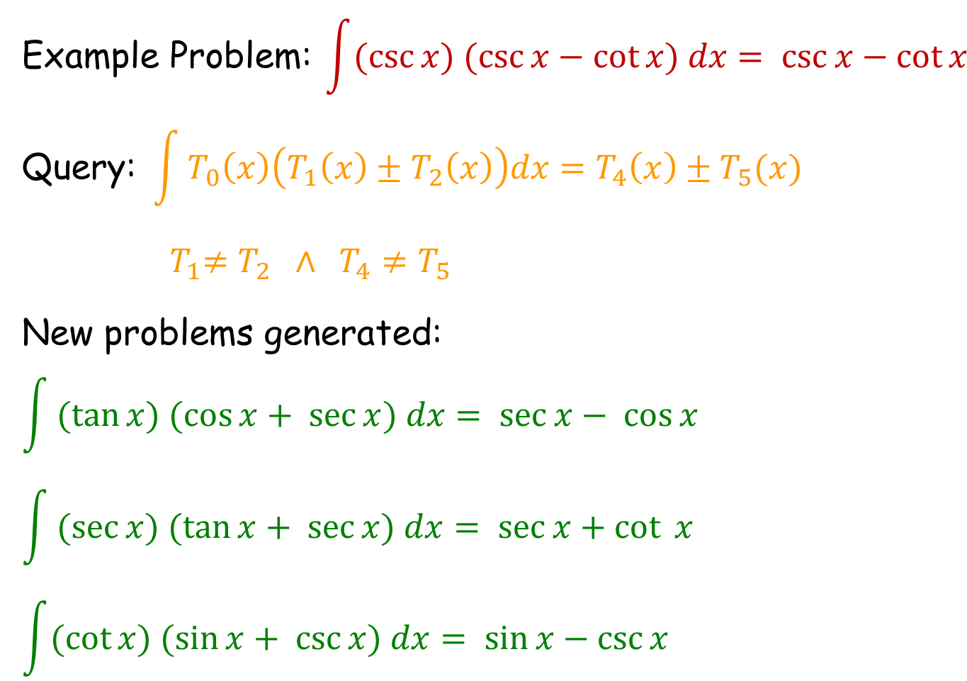
Integration Problem
$$\text{Example} \text{Problem}\text{:} \int{(\csc{x) (\csc{x−\cot{x) dx= \csc{x}−\cot{x}}}}}{ }$$
$$\text{Query}\text{: }\int{T_{0}\left(x\right)\left(T_{1}\left(x\right)±T_{2}\left(x\right)\right)dx=T_{4}\left(x\right)±T_{5}(x)}$$
$${ T}_{1}≠T_{2} ∧ T_{4}≠T_{5}$$
New problems generated:
$$\int{(tan{x) (\cos{x}+ \sec{x) dx= \sec{x}− \cos{x}}}}$$
$$\int{(sec{x) (\tan{x}+ \sec{x) dx= \sec{x}+\cot{ x}}}}$$
$$\int{(\cot{x) (\sin{x+ \csc{x) dx= \sin{x−\csc{x}}}}}}$$

Slide 16
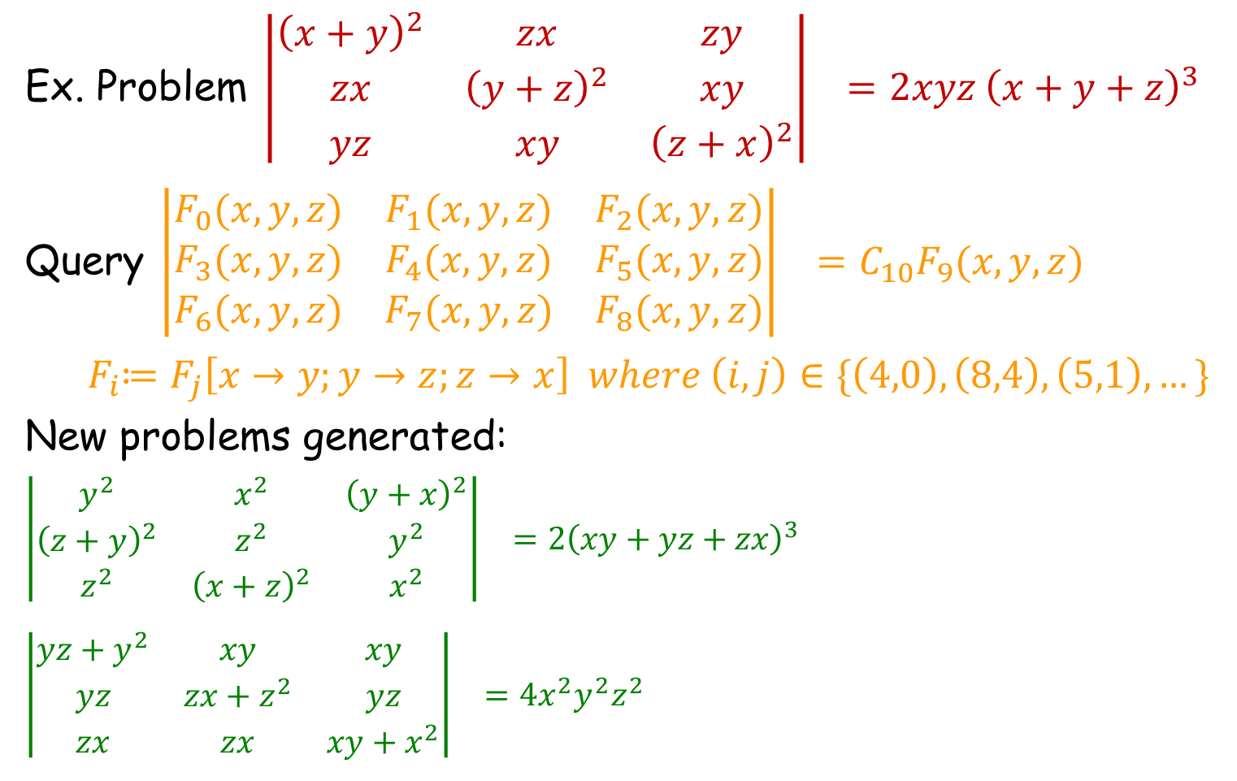
Determinant Problem
$$\text{Ex}\text{. }\text{Problem} \left|\begin{matrix}{\left(x+y\right)}^{2} & zx & zy \\ zx & {\left(y+z\right)}^{2} & xy \\ yz & xy & {\left(z+x\right)}^{2}\end{matrix}\right|{ }=2xyz {\left(x+y+z\right)}^{3}$$
$$\text{Query} \left|\begin{matrix}F_{0}(x,y,z) & F_{1}(x,y,z) & F_{2}(x,y,z) \\ F_{3}(x,y,z) & F_{4}(x,y,z) & F_{5}(x,y,z) \\ F_{6}(x,y,z) & F_{7}(x,y,z) & F_{8}(x,y,z)\end{matrix}\right|{ }=C_{10}F_{9}(x,y,z)$$
$${ F}_{i}≔F_{j}\left[x→y;y→z;z→x\right] where \left(i,j\right)∈\{\left(4,0\right), \left(8,4\right), \left(5,1\right),…\}$$
New problems generated:
$$\left|\begin{matrix}y^{2} & x^{2} & {\left(y+x\right)}^{2} \\ {\left(z+y\right)}^{2} & z^{2} & y^{2} \\ z^{2} & {\left(x+z\right)}^{2} & x^{2}\end{matrix}\right|{ }=2{\left(xy+yz+zx\right)}^{3}$$
$$\left|\begin{matrix}yz+y^{2} & xy & xy \\ yz & zx+z^{2} & yz \\ zx & zx & xy+x^{2}\end{matrix}\right|{ }=4x^{2}y^{2}z^{2}$$

Slide 17
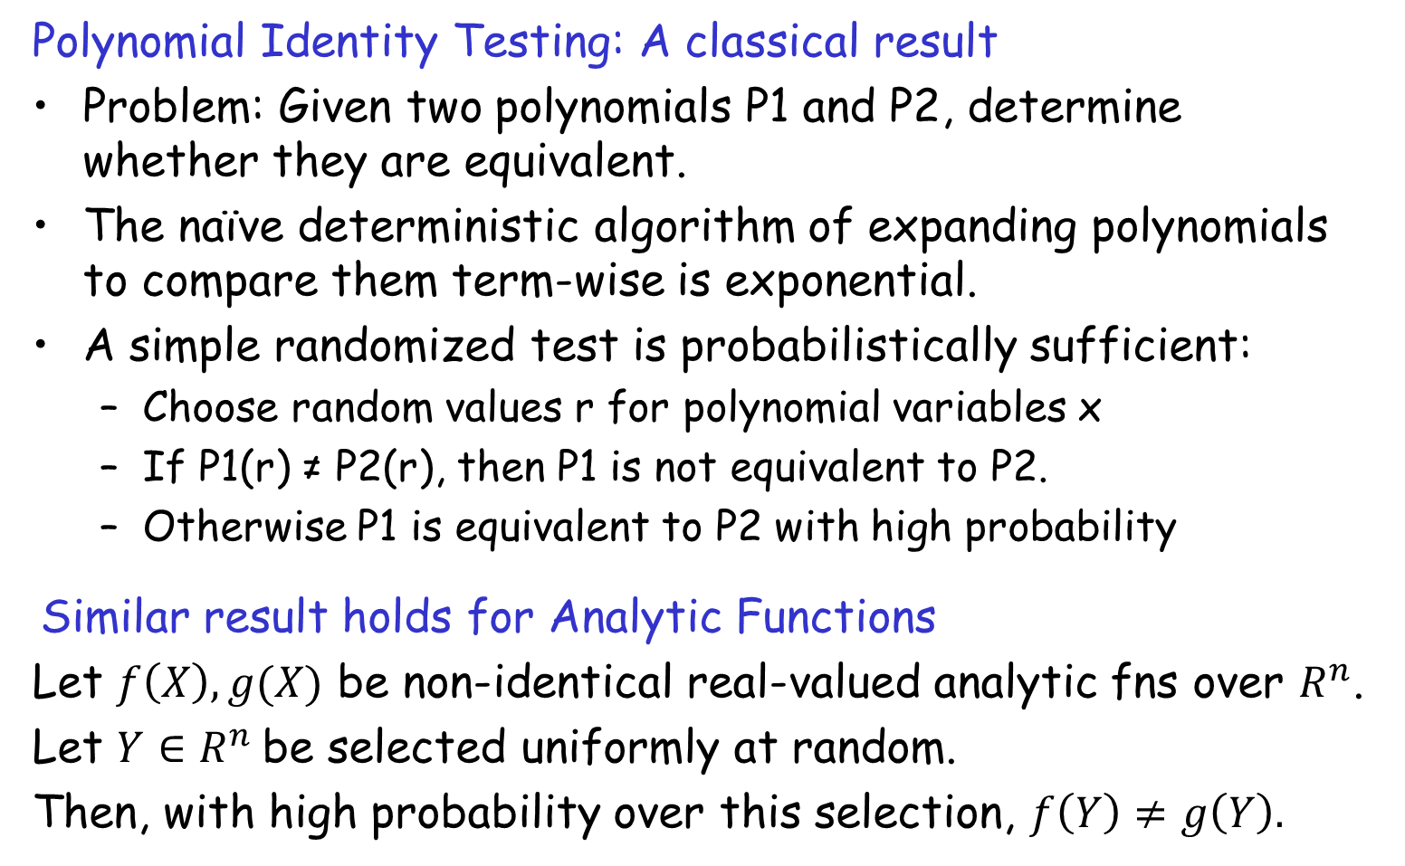
Randomized Identity Testing
Polynomial Identity Testing: A classical result
Problem: Given two polynomials P1 and P2, determine whether they are equivalent.
The naïve deterministic algorithm of expanding polynomials to compare them term-wise is exponential.
A simple randomized test is probabilistically sufficient:
  Choose random values r for polynomial variables x
  If P1(r) ≠ P2(r), then P1 is not equivalent to P2.
  Otherwise P1 is equivalent to P2 with high probability
Similar result holds for Analytic Functions
Let $f\left(X\right), g(X)$ be non-identical real-valued analytic fns over $R^{n}$.
Let $Y∈R^{n}$be selected uniformly at random.
Then, with high probability over this selection, $f\left(Y\right)≠g\left(Y\right).$

Slide 18
Problem Generation
Motivation
Problems similar to a given problem.
  Avoid copyright issues
  Prevent cheating in MOOCs (Unsynchronized instruction)
Problems of a given difficulty level and concept usage.
  Generate progressions
  Generate personalized workflows
Key Ideas
Procedural Content: Test input generation techniques
Conceptual Content
  Template based generalization

Slide 19
Problem Generation: Sentence Completion
The principal characterized his pupils as _________ because they were pampered and spoiled by their indulgent parents.
The commentator characterized the electorate as _________ because it was unpredictable and given to constantly shifting moods.
(a) cosseted
(b) disingenuous
(c) corrosive
(d) laconic
(e) mercurial
One of the problems is a real problem from SAT (standardized US exam),
while the other one was automatically generated!
From problem 1, we generate template T₁: *₁ characterized *₂ as *₃ because *₄
We specialize T₁ to template T₂: *₁ characterized *₂ as mercurial because *₄
Problem 2 is an instance of T₂.

Slide 20
Problem Generation
Motivation
Problems similar to a given problem.
  Avoid copyright issues
  Prevent cheating in MOOCs (Unsynchronized instruction)
Problems of a given difficulty level and concept usage.
  Generate progressions
  Generate personalized workflows
Key Ideas
Procedural Content: Test input generation techniques
Conceptual Content
  Template based generalization
  Symbolic methods (solution generation in reverse)

Slide 21
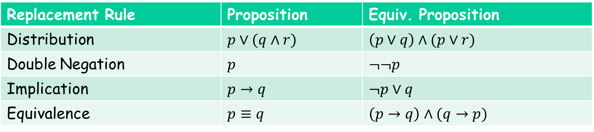
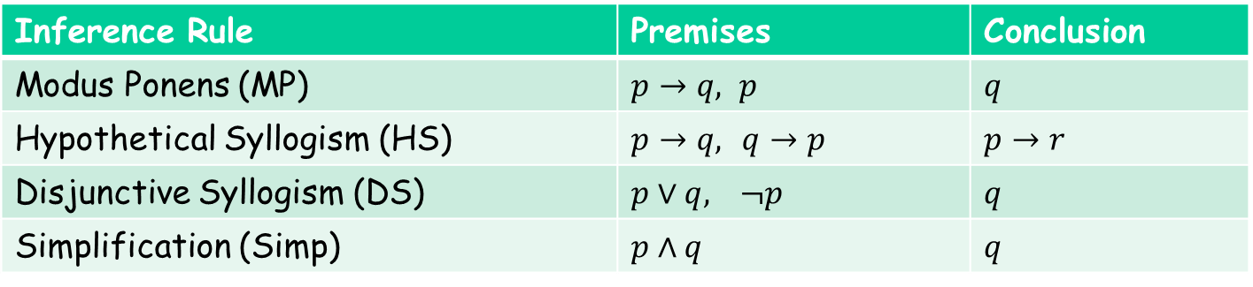

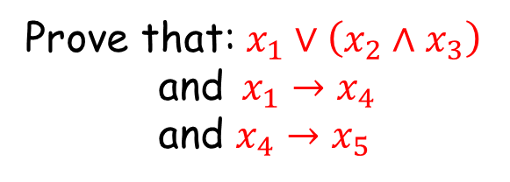
Natural Deduction
Prove that: $x_{1}∨\left(x_{2}∧x_{3}\right)$
and$x_{1}→x_{4}$
and $x_{4}→x_{5}$
implies $x_{2}∨x_{5}$
Inference Rule | Premises | Conclusion
Modus Ponens (MP) | $p→q, p$ | $$q$$
Hypothetical Syllogism (HS) | $p→q,$ $q→p$ | $$p→r$$
Disjunctive Syllogism (DS) | $p∨q,$ $¬p$ | $$q$$
Simplification (Simp) | $$p∧q$$ | $$q$$
Replacement Rule | Proposition | Equiv. Proposition
Distribution | $p∨(q∧r)$ | $$\left(p∨q\right)∧(p∨r)$$
Double Negation | $$p$$ | $$¬¬p$$
Implication | $$p→q$$ | $$¬p∨q$$
Equivalence | $$p≡q$$ | $$\left(p→q\right)∧(q→p)$$
Reference: Automatically Generating Problems and Solutions for Natural Deduction
IJCAI 2013; Umair Ahmed, Sumit Gulwani, Amey Karkare

Slide 22
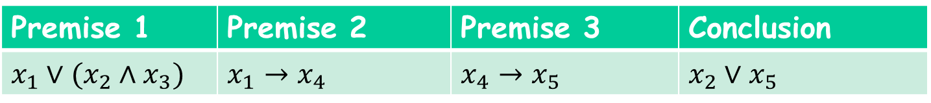
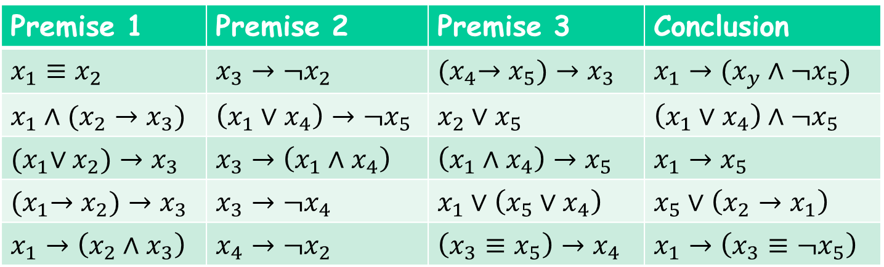
Similar Problem Generation: Natural Deduction
Similar Problems = those that have a minimal proof with the same sequence of inference rules as used by a minimal proof of given problem.
Premise 1 | Premise 2 | Premise 3 | Conclusion
$$x_{1}∨(x_{2}∧x_{3})$$ | $$x_{1}→x_{4}$$ | $$x_{4}→x_{5}$$ | $$x_{2}∨x_{5}$$
Similar Problems
Premise 1 | Premise 2 | Premise 3 | Conclusion
$$x_{1}≡x_{2}$$ | $$x_{3}→¬x_{2}$$ | $${(x}_{4}→x_{5})→x_{3}$$ | $$x_{1}→(x_{y}∧¬x_{5})$$
$$x_{1}∧(x_{2}→x_{3})$$ | $$\left(x_{1}∨x_{4}\right)→¬x_{5}$$ | $$x_{2}∨x_{5}$$ | $$\left(x_{1}∨x_{4}\right)∧¬x_{5}$$
$${(x}_{1}∨x_{2})→x_{3}$$ | $$x_{3}→\left(x_{1}∧x_{4}\right)$$ | $$\left(x_{1}∧x_{4}\right)→x_{5}$$ | $$x_{1}→x_{5}$$
$${(x}_{1}→x_{2})→x_{3}$$ | $$x_{3}→¬x_{4}$$ | $$x_{1}∨\left(x_{5}∨x_{4}\right)$$ | $$x_{5}∨\left(x_{2}→x_{1}\right)$$
$$x_{1}→\left(x_{2}∧x_{3}\right)$$ | $$x_{4}→¬x_{2}$$ | $$\left(x_{3}≡x_{5}\right)→x_{4}$$ | $$x_{1}→\left(x_{3}≡¬x_{5}\right)$$

Slide 23
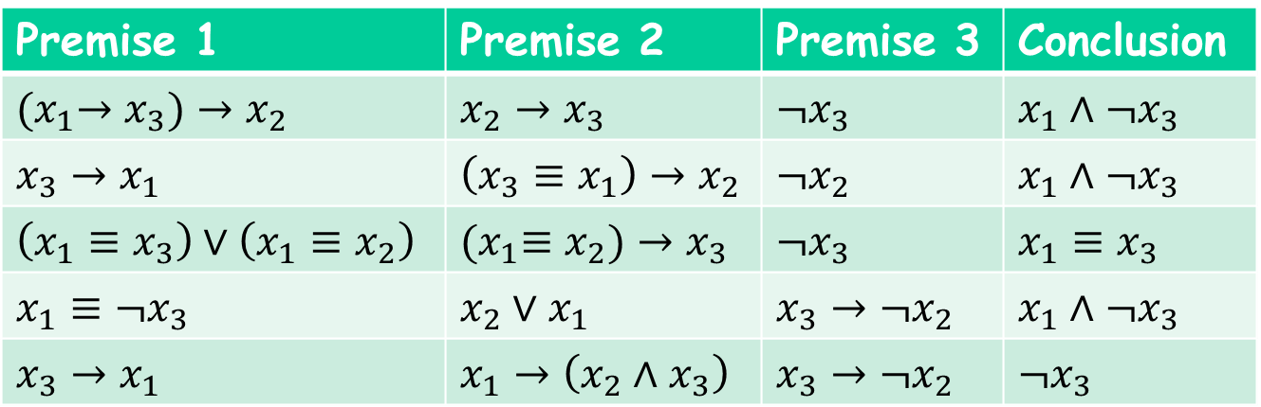

Parameterized Problem Generation: Natural Deduction
Parameters:
# of premises = 3, Size of propositions $≤$ 4
# of variables = 3, # of inference steps = 2
Inference rules = { DS, HS }
Parameterized Problems
Premise 1 | Premise 2 | Premise 3 | Conclusion
$${(x}_{1}→x_{3})→x_{2}$$ | $$x_{2}→x_{3}$$ | $$¬x_{3}$$ | $$x_{1}∧¬x_{3}$$
$$x_{3}→x_{1}$$ | $$\left(x_{3}≡x_{1}\right)→x_{2}$$ | $$¬x_{2}$$ | $$x_{1}∧¬x_{3}$$
$$\left(x_{1}≡x_{3}\right)∨\left(x_{1}≡x_{2}\right)$$ | $${(x}_{1}≡x_{2})→x_{3}$$ | $$¬x_{3}$$ | $$x_{1}≡x_{3}$$
$$x_{1}≡¬x_{3}$$ | $$x_{2}∨x_{1}$$ | $$x_{3}→¬x_{2}$$ | $$x_{1}∧¬x_{3}$$
$$x_{3}→x_{1}$$ | $$x_{1}→\left(x_{2}∧x_{3}\right)$$ | $$x_{3}→¬x_{2}$$ | $$¬x_{3}$$

Slide 24
Solution Generation

Slide 25
Solution Generation
Motivation
Generate sample solutions to new problems.
Generate customized solutions or complete unfinished ones.
Inform solution characteristics during problem generation.
Key Ideas
Procedural Content: Programming by Demonstration

Slide 26
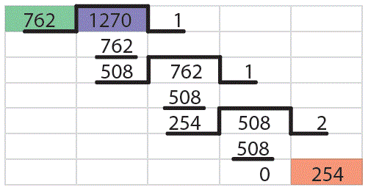
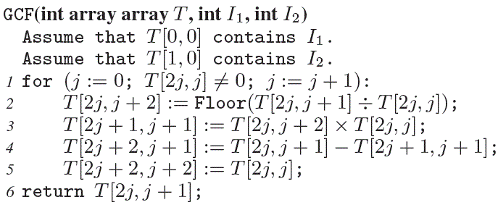
Solution Generation: GCF Computation
Time-stamped sequence of (location, value) pairs
Programming by Demonstration
Spreadsheet Program
Can also be used to synthesize incorrect procedures from buggy traces!
Reference: Programming by Demonstration framework applied to procedural math problems; Technical Report; Andersen, Gulwani, Popovic.

Slide 27
Solution Generation
Motivation
Generate sample solutions to new problems.
Generate customized solutions or complete unfinished ones.
Inform solution characteristics during problem generation.
Key Ideas
Procedural Content: Programming by Demonstration
Conceptual Content
  Perform reasoning over models (vs. abstract symbolic reasoning).
  Reduce solution space to solutions with small length.

Slide 28
Ruler/Compass based Geometry Constructions
Given a triangle XYZ, construct circle C such that C passes through X, Y, and Z.
C
L1
L2
N
Z
X
Y
Reference: Synthesizing Geometry Constructions
PLDI 2011; Gulwani, Korthikanti, Tiwari

Slide 29
Other Examples of Geometry Constructions
Draw a regular hexagon given a side.
Given 3 parallel lines, draw an equilateral triangle whose vertices lie on the parallel lines.
Given 4 points, draw a square whose sides contain those points.

Slide 30
A Geometry Construction is a straight-line program!
Types: Point, Line, Circle
Methods:
Ruler(Point, Point) -> Line
Compass(Point, Point) -> Circle
Intersect(Circle, Circle) -> Pair of Points
Intersect(Line, Circle) -> Pair of Points
Intersect(Line, Line) -> Point
Geometry Program: A straight-line composition of the above methods.

Slide 31
Example: Geometry Program
Given a triangle XYZ, construct circle C such that C passes through X, Y, and Z.
C1 = Compass(X,Y);
C2 = Compass(Y,X);
<P1,P2> = Intersect(C1,C2);
L1 = Ruler(P1,P2);
D1 = Compass(Z,X);
D2 = Compass(X,Z);
<R1,R2> = Intersect(D1,D2);
L2 = Ruler(R1,R2);
N = Intersect(L1,L2);
C = Compass(N,X);
C
L1
L2
N
C1
C2
P1
D1
Z
R1
X
Y
R2
D2
P2

Slide 32
Specification for Geometry Constructions
Spec = (Precondition, Postcondition), where each is an equality/inequality predicate over distance/slope constructs.
Example:
Given a triangle XYZ, construct circle C such that C passes through X, Y, and Z.
Precondition:
Slope(X,Y) ≠ Slope(X,Z) Æ Slope(X,Y) ≠ Slope(Z,X)
Postcondition:
LiesOn(X,C) Æ LiesOn(Y,C) Æ LiesOn(Z,C)
where LiesOn(X,C) ´ Distance(X,Center(C)) = Radius(C)

Slide 33
Idea 1: Search using random concrete models
Synthesis Algorithm:
// First obtain a random input-output example.
Choose I’ randomly from the set { I | Pre(I) }.
Compute O’ s.t. Post(I’,O’) using numerical methods.
// Now obtain a construction that can generate O’ from I’ (using exhaustive search).
S := I’;
While (S does not contain O’)
S := S [ { M(O₁,O₂) | O_{i} 2 S, M 2 Methods }
Output construction steps for O’.

Slide 34
Idea 2: Use high-level abstractions to reduce size
Given a triangle XYZ, construct circle C such that C passes through X, Y, and Z.
C1 = Compass(X,Y);
C2 = Compass(Y,X);
<P1,P2> = Intersect(C1,C2);
L1 = Ruler(P1,P2);
D1 = Compass(Z,X);
D2 = Compass(X,Z);
<R1,R2> = Intersect(D1,D2);
L2 = Ruler(R1,R2);
N = Intersect(L1,L2);
C = Compass(N,X);
L1 = PBisector(X,Y);
L2 = PBisector(X,Z);
N = Intersect(L1,L2);
C = Compass(N,X);

Slide 35
Feedback Generation

Slide 36
Feedback Generation
Motivation
Makes teachers more effective.
  Saves them time.
  Provides immediate insights on where students are struggling.
Can enable rich interactive experience for students.
  Generation of hints.
  Pointer to simpler problems depending on kind of mistake.
Key Ideas:
Procedural Content: Use PBE techniques to learn buggy procedures in a student’s mind.

Slide 37
Feedback Generation for Procedural Problems
Ashlock identified buggy computational patterns for various procedures. Following are some bugs for addition.
  Add each column and write the sum below each column, even if it is greater than nine.
  Add each column, from left to right. If the sum > 9, write the tens digit beneath the column and the ones digit above the column to the right.
Van Lehn identified >100 bugs in subtraction alone.
Key Idea: Use Programming by Demonstration technology (also used for solution synthesis for procedural problems) for synthesizing such buggy procedures.

Slide 38
Feedback Generation
Motivation
Makes teachers more effective.
  Saves them time.
  Provides immediate insights on where students are struggling.
Can enable rich interactive experience for students.
  Generation of hints.
  Pointer to simpler problems depending on kind of mistake.
Key Ideas:
Procedural Content: Use PBE techniques to learn buggy procedures in a student’s mind.
Conceptual Content: Various feedback metrics
  Counterexamples: Inputs on which the solution is not correct

Slide 39
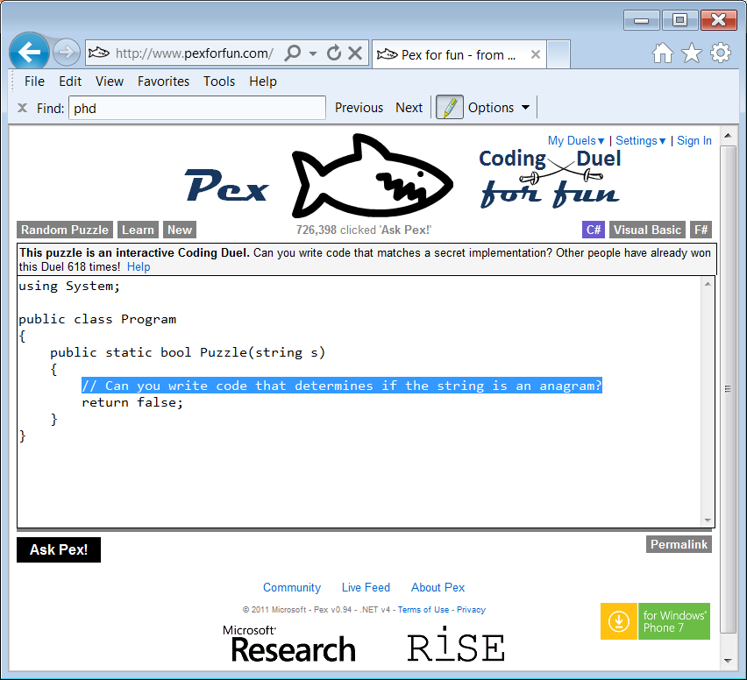
Counterexample based Feedback: PexForFun

Slide 40
Buggy Program for Array Reverse
using System;
public class Program {
public static int[] Puzzle(int[] a) {
int[] b = new int[a.Length];
int count = 0;
for(int i=a.Length; i < a.Length; i--)
{
b[count] = a[i];
count++;
}
return b;
} }
6:28::50 AM

Slide 41
Buggy Program for Array Reverse
using System;
public class Program {
public static int[] Puzzle(int[] a) {
int[] b = new int[a.Length];
int count = 0;
for(int i=a.Length-1; i < a.Length-1; i--)
{
b[count] = a[i];
count++;
}
return b;
} }
6:32::01 AM

Slide 42
Buggy Program for Array Reverse
using System;
public class Program {
public static int[] Puzzle(int[] a) {
int[] b = new int[a.Length];
int count = 0;
for(int i=a.Length-1; i < a.Length-1; i--)
{
b[count] = a[i];
count++;
}
return b;
} }
6:32::32 AM
No change! Sign of Frustation?

Slide 43
Buggy Program for Array Reverse
using System;
public class Program {
public static int[] Puzzle(int[] a) {
int[] b = new int[a.Length];
int count = 0;
for(int i=a.Length; i <= a.Length; i--)
{
b[count] = a[i];
count++;
}
return b;
} }
6:33::19 AM

Slide 44
Buggy Program for Array Reverse
using System;
public class Program {
public static int[] Puzzle(int[] a) {
int[] b = new int[a.Length];
int count = 0;
for(int i=a.Length; i < a.Length; i--)
{ Console.Writeline(i);
b[count] = a[i];
count++;
}
return b;
} }
6:33::55 AM
Same as initial attempt except Console.Writeline!

Slide 45
Buggy Program for Array Reverse
using System;
public class Program {
public static int[] Puzzle(int[] a) {
int[] b = new int[a.Length];
int count = 0;
for(int i=a.Length; i < a.Length; i--)
{ Console.Writeline(i);
b[count] = a[i];
count++;
}
return b;
} }
6:34::06 AM
No change! Sign of Frustation?

Slide 46
Buggy Program for Array Reverse
using System;
public class Program {
public static int[] Puzzle(int[] a) {
int[] b = new int[a.Length];
int count = 0;
for(int i=a.Length; i <= a.Length; i--)
{ Console.Writeline(i);
b[count] = a[i];
count++;
}
return b;
} }
6:34::56 AM
The student has tried this before!

Slide 47
Buggy Program for Array Reverse
using System;
public class Program {
public static int[] Puzzle(int[] a) {
int[] b = new int[a.Length];
int count = 0;
for(int i=a.Length; i < a.Length; i--)
{
b[count] = a[i];
count++;
}
return b;
} }
6:36::24 AM
Same as initial attempt!

Slide 48
Buggy Program for Array Reverse
using System;
public class Program {
public static int[] Puzzle(int[] a) {
int[] b = new int[a.Length];
int count = 0;
for(int i=a.Length-1; i < a.Length-1; i--)
{
b[count] = a[i];
count++;
}
return b;
} }
6:37::39 AM
The student has tried this before!

Slide 49
Buggy Program for Array Reverse
using System;
public class Program {
public static int[] Puzzle(int[] a) {
int[] b = new int[a.Length];
int count = 0;
for(int i=a.Length; i > 0; i--)
{
b[count] = a[i];
count++;
}
return b;
} }
6:38::11 AM
Almost correct! (a[i-1] instead of a[i] in loop body)

Slide 50
Buggy Program for Array Reverse
using System;
public class Program {
public static int[] Puzzle(int[] a) {
int[] b = new int[a.Length];
int count = 0;
for(int i=a.Length; i >= 0; i--)
{
b[count] = a[i];
count++;
}
return b;
} }
6:38::44 AM
Student going in wrong direction!

Slide 51
Buggy Program for Array Reverse
using System;
public class Program {
public static int[] Puzzle(int[] a) {
int[] b = new int[a.Length];
int count = 0;
for(int i=a.Length; i < a.Length; i--)
{
b[count] = a[i];
count++;
}
return b;
} }
6:39::33 AM
Back to bigger error!

Slide 52
Buggy Program for Array Reverse
using System;
public class Program {
public static int[] Puzzle(int[] a) {
int[] b = new int[a.Length];
int count = 0;
for(int i=a.Length; i < a.Length; i--)
{
b[count] = a[i];
count++;
}
return b;
} }
6:39::45 AM
No change! Frustation!

Slide 53
Buggy Program for Array Reverse
using System;
public class Program {
public static int[] Puzzle(int[] a) {
int[] b = new int[a.Length];
int count = 0;
for(int i=a.Length; i < a.Length; i--)
{
b[count] = a[i];
count++;
}
return b;
} }
6:40::27 AM
No change! More Frustation!!

Slide 54
Buggy Program for Array Reverse
using System;
public class Program {
public static int[] Puzzle(int[] a) {
int[] b = new int[a.Length];
int count = 0;
for(int i=a.Length; i < a.Length; i--)
{
b[count] = a[i];
count++;
}
return b;
} }
6:40::57 AM
No change! Too Frustated now!!! Gives up.

Slide 55
Counterexamples are not sufficient!
"Not only did it take 1-2 weeks to grade problem, but the comments were entirely unhelpful in actually helping us fix our errors. …. Apparently they don't read the code -- they just ran their tests and docked points mercilessly. What if I just had a simple typo, but my algorithm was fine? ....“
- Student Feedback from MIT 6.00 course, 2013.

Slide 56
Feedback Generation
Motivation
Makes teachers more effective.
  Saves them time.
  Provides immediate insights on where students are struggling.
Can enable rich interactive experience for students.
  Generation of hints.
  Pointer to simpler problems depending on kind of mistake.
Key Ideas:
Procedural Content: Use PBE techniques to learn buggy procedures in a student’s mind.
Conceptual Content: Various feedback metrics
  Counterexamples: Inputs on which the solution is not correct.
  Edit distance to a nearest correct solution.

Slide 57
Correction Model for Programming Assignments
Array Index: v[a] -> v[{a+1, a-1}]
Increment: v++ -> { ++v, v--, --v }
Conditional: a op b -> a ops b
where ops = { <, >, <=, >=, ==, != }
Initialization: v=n -> v={n+1, n-1, 0}
Return Value: return v -> return ?v
Key Idea: Finding minimal set of such changes that convert a buggy solution into a correct one is phrased as a sketch problem.
Reference: Automated Feedback Generation for Introductory Programming Assignments; PLDI 2013; Singh, Gulwani, Solar-Lezama

Slide 58
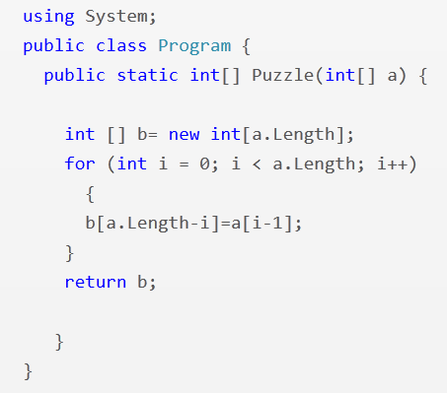
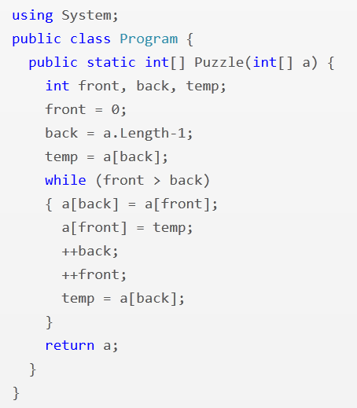
Array Reverse
i = 1
i <= a.Length
front <= back
--back

Slide 59
Experimental Results
13,365 incorrect attempts for 13 Python problems.
(obtained from Introductory Programming course at MIT and its MOOC version on the EdX platform)
Average time for feedback = 10 seconds
Feedback generated for 64% of those attempts.
Reasons for failure to generate feedback
  Completely incorrect solutions
  Big conceptual errors
  Timeout (4 min)
Tool accessible at: http://sketch1.csail.mit.edu/python-autofeedback/

Slide 60
Feedback Synthesis
Motivation
Makes teachers more effective.
  Saves them time.
  Provides immediate insights on where students are struggling.
Can enable rich interactive experience for students.
  Generation of hints.
  Pointer to simpler problems depending on kind of mistake.
Key Ideas:
Procedural Content: Use PBE techniques to learn buggy procedures in a student’s mind.
Conceptual Content: Various feedback metrics
  Counterexamples: Inputs on which the solution is not correct.
  Edit distance to a nearest correct solution.
  Edit distance to the problem description (of a nearest corresponding problem description).

Slide 61
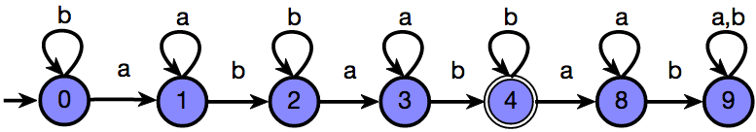
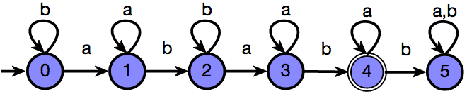
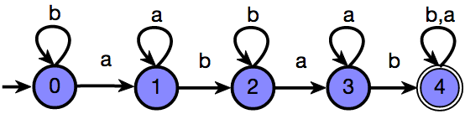
Finite State Automata
Draw a DFA that accepts: { s | ‘ab’ appears in s exactly 2 times }
Grade: 9/10
Feedback: One more state should be made final
Attempt 1
Based on Edit-distance to a correct solution
Grade: 6/10
Feedback: The DFA is incorrect on the string ‘ababb’
Attempt 2
Based on counterexamples
Grade: 5/10
Feedback: The DFA accepts {s | ‘ab’ appears in s at least 2 times}
Attempt 3
Based on Edit-distance to the problem description
Reference: Automated Grading of DFA Constructions,
IJCAI 2013; Alur, d’Antoni, Gulwani, Kini, Viswanathan

Slide 62
Experimental Results
800+ attempts to 6 automata problems (obtained from automata course at UIUC) graded by tool and 2 instructors.
Out of 131 attempts for one of those problems:
  6 attempts: instructors were incorrect (gave full marks to an incorrect attempt)
  20 attempts: instructors were inconsistent (gave different marks to syntactically equivalent attempts)
  34 attempts: >= 3 point discrepancy between instructor and tool; in 20 of those, instructor agreed that tool was more fair.
More agreement between instructor/tool than instructors.
Instructors concluded that tool should be preferred over humans for consistency & scalability.
Tool accessible at: http://www.automatatutor.com/

Slide 63
Computer Aided Education: Conclusion
Technical Perspective
  Aspects: Problem/Solution/Feedback Generation
  Domains: Math, Programming, Logic, Language Learning, ...
Inter-disciplinary research area
  Computer-aided Programming techniques
  Natural language processing (for word problems)
  Machine learning (leverage large amounts of student data)
  HCI (leverage large populations of students and teachers)
Value Proposition:
  Short term: Improve Education (personalized + interactive)
  Long Term: Ultra-intelligent computer, Model of human mind,
  Inter-stellar travel ☺

