Slide 1
Characterizing and Supporting
Cross-Device Search Tasks
Yu Wang¹, Xiao Huang², Ryen White³
¹ Emory University, yuwang@emory.edu
² Microsoft Bing, xiaohua@microsoft.com
³ Microsoft Research, ryenw@microsoft.com

Slide 2
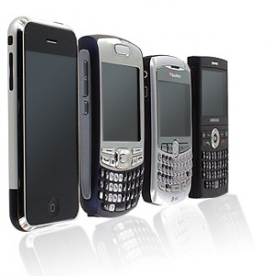
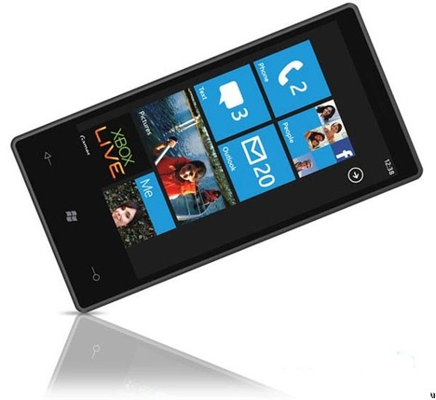



Motivation
Multi-device usage is becoming common
People can search anytime, anywhere
We usually study one device at a time (primarily desktop)
Here we examine cross-device searching …
Smartphone
Desktop
Slate

Slide 3
Search Activity over a Single Day
Analyzing desktop-only one could observe some events
Richer picture of behavior by considering multi-device use
Focus on switches (transitions) between devices
Our belief: Engine can help on post-switch device if it can anticipate post-switch task resumption
italian
restaurants
in seattle
fine dining in
seattle, wa
barolo menu
restaurants

Slide 4
Our Definition of Device Switching
Search sessions with 30 minute inactivity timeout
Time
Search session
Median time
Search session
Desktop
Mobile
Last query in the session
“pre-switch” query
First query in the session
“post-switch” query
Time interval
< 6 hours
Remove noisy
switches

Slide 5
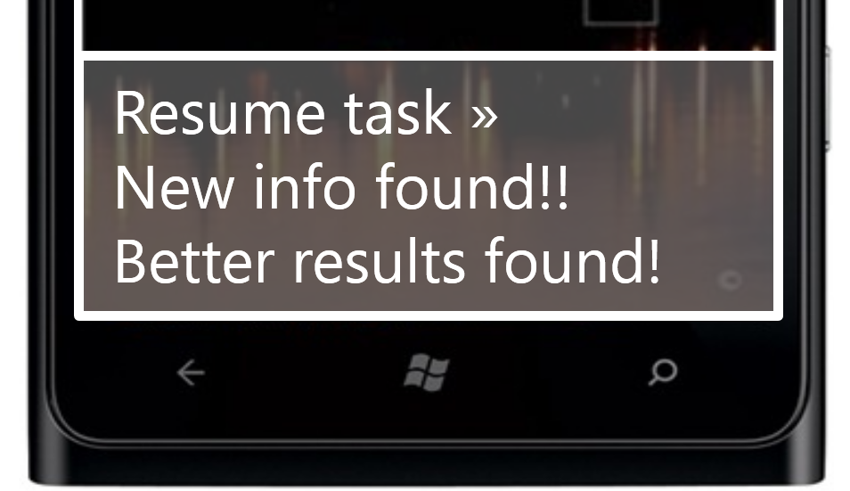
Challenges and Opportunities
Challenges:
  Switching is expensive for a user
  User has to remember what has been searched on task
  Re-typing is time consuming, sometimes very difficult if in motion
Opportunities:
    How a search engine could help with switching
      Predict cross-device task continuation
      Use prediction to capitalize on between device downtime
    Why not just always use downtime?
      Additional actions (e.g., run queries, crowdsourced answers) expensive
      Only want to do it when confident that user will resume

Slide 6
Analyzing Cross-Device Search
Subset of users who are signed in to Microsoft Bing
Users who used both devices during one month period
Number of Days |  | 31
Number of Users |  | 39,081
Number of Sessions | Desktop | 709,610
 | Mobile | 301,028
 | Total | 1,010,638
Number of Queries | Desktop | 3,023,582
 | Mobile | 667,091
 | Total | 3,690,673
Number of Switches |  | 158,324

Slide 7

Transitions (within 6 hours)
Volume of Desktop-to-Mobile $≈$ Mobile-to-Desktop
Different query switches $>>$ Same query switches
2x same-query D-to-M as M-to-D
  Many desktop search tasks will be carried over to mobile.
  More support for D-to-M is needed.
 | Desktop-to-Mobile | Mobile-to-Desktop
Same-query switch | 10,480 (6.6%) | 5,282 (3.3%)
Different-query switch | 69,441 (43.9%) | 73,121 (46.2%)

Slide 8
What do cross-device tasks look like?

Slide 9
Characterizing Cross-Device Search
Focus on Desktop-to-Mobile
Temporal:
  When do users switch
  How long elapses between pre- and post-switch
Topical:
  Topic shifts during switches
Geospatial:
  Physical location before and after device switch

Slide 10
Temporal
Time between pre- and post-switch queries as a function of hour in the day, of pre-switch query
Most switches initiated late afternoon, end early evening
Gap between pre- and post-switch queries varies with time:
  Short gaps are more likely late evening and early morning
  Long gaps are more likely during work hours (9-6)
Engine can use temporal features to predict task resumption

Slide 11
Topical
Query topics estimated from Bing runtime classifiers
Sustainability = Pr(topic post-switch | topic pre-switch)
Lift over background (sustainability / overall topic popularity):
Category | Lift
Clothes and Shoes | 82.240
Weather | 77.528
Books | 66.180
Video Games | 42.478
Health | 39.608
Recipes | 31.827
Celebrities | 30.342
Restaurant | 19.576
Movie | 18.305
Sports | 15.595
Music | 14.429
Travel | 7.805
Location | 5.364
Image | 3.467
Local | 3.117
Navigational | 1.710
Most likely to
be resumed
post-switch,
if pre-switch
Purchasing (need to try on clothes/shoes)
Weather forecasts
Entertainment while mobile
Sustainability
Overall popularity
Least likely to
be resumed
post-switch,
if pre-switch
General interest on mobile, popular
irrespective of pre-switch topic

Slide 12
Geospatial
Examine physical location before and after switch
Caveat: Uses RevIP and cellphone provider geocoding
  At town/city level, not GPS based
67% stay within same city, 33% move to different city
Movement during post-switch session:
Single query session | Multiple query session
 | Moving session | Stationary session
60.6% | 5.3% | 34.2%
Must be moving quickly given
how location is estimated

Slide 13
Can we predict cross-device tasks?

Slide 14
Predicting Cross-Device Search Tasks
Predict whether the user will resume the task in the
pre-switch session on another device
Two main points of interest:
  Once you leave the pre-switch engine
  Once you reach post-switch engine (homepage)
Different types of support offered at each (more later)
Pre-switch query
Search history
Desktop session
Transition
Mobile session

Slide 15
Prediction Experiment
Different features to predict cross-device task resumption
Pre-switch query
Search history
Desktop session
Transition
Mobile session
History
+Pre-switch session
+Pre-switch query
+Transition
+Post-switch session
Baseline – Desktop feature only

Slide 16
Prediction Experiment
MART classifier
Features
  Behavioral, Topical, Temporal, Geospatial
Cross-validation at the user level
Training data
  Automatic: Machine learned model using query similarity features
    17k judgments, 9.5% of the labeled switches were on same task
  Human labeled: 5 judges reviewing pre- and post-switch behavior
    800 judgments, 15% of the labeled switches were on same task
Dropped nav. queries (personal freq > 5, global freq > 10)
  Represent long-term interests, not search tasks

Slide 17
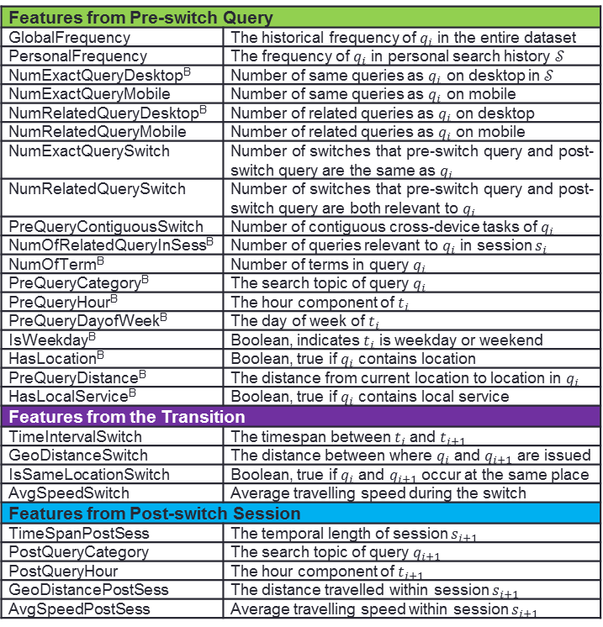
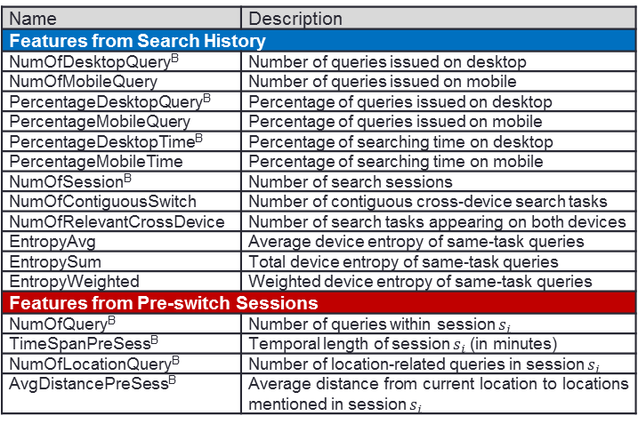
Feature Dictionary
Name | Description
Features from Search History
NumOfDesktopQuery^{B} | Number of queries issued on desktop
NumOfMobileQuery | Number of queries issued on mobile
PercentageDesktopQuery^{B} | Percentage of queries issued on desktop
PercentageMobileQuery | Percentage of queries issued on mobile
PercentageDesktopTime^{B} | Percentage of searching time on desktop
PercentageMobileTime | Percentage of searching time on mobile
NumOfSession^{B} | Number of search sessions
NumOfContiguousSwitch | Number of contiguous cross-device search tasks
NumOfRelevantCrossDevice | Number of search tasks appearing on both devices
EntropyAvg | Average device entropy of same-task queries
EntropySum | Total device entropy of same-task queries
EntropyWeighted | Weighted device entropy of same-task queries
Features from Pre-switch Sessions
NumOfQuery^{B} | Number of queries within session $s_{i}$
TimeSpanPreSess^{B} | Temporal length of session $s_{i}$ (in minutes)
NumOfLocationQuery^{B} | Number of location-related queries in session $s_{i}$
AvgDistancePreSess^{B} | Average distance from current location to locations mentioned in session $s_{i}$
Features from Pre-switch Query
GlobalFrequency | The historical frequency of $q_{i}$ in the entire dataset
PersonalFrequency | The frequency of $q_{i}$ in personal search history $𝒮$
NumExactQueryDesktop^{B} | Number of same queries as $q_{i}$ on desktop in $𝒮$
NumExactQueryMobile | Number of same queries as $q_{i}$ on mobile
NumRelatedQueryDesktop^{B} | Number of related queries as $q_{i}$ on desktop
NumRelatedQueryMobile | Number of related queries as $q_{i}$ on mobile
NumExactQuerySwitch | Number of switches that pre-switch query and post-switch query are the same as $q_{i}$
NumRelatedQuerySwitch | Number of switches that pre-switch query and post-switch query are both relevant to $q_{i}$
PreQueryContiguousSwitch | Number of contiguous cross-device tasks of $q_{i}$
NumOfRelatedQueryInSess^{B} | Number of queries relevant to $q_{i}$ in session $s_{i}$
NumOfTerm^{B} | Number of terms in query $q_{i}$
PreQueryCategory^{B} | The search topic of query $q_{i}$
PreQueryHour^{B} | The hour component of $t_{i}$
PreQueryDayofWeek^{B} | The day of week of $t_{i}$
IsWeekday^{B} | Boolean, indicates $t_{i}$ is weekday or weekend
HasLocation^{B} | Boolean, true if $q_{i}$ contains location
PreQueryDistance^{B} | The distance from current location to location in $q_{i}$
HasLocalService^{B} | Boolean, true if $q_{i}$ contains local service
Features from the Transition
TimeIntervalSwitch | The timespan between $t_{i}$ and $t_{i+1}$
GeoDistanceSwitch | The distance between where $q_{i}$ and $q_{i+1}$ are issued
IsSameLocationSwitch | Boolean, true if $q_{i}$ and $q_{i+1}$ occur at the same place
AvgSpeedSwitch | Average travelling speed during the switch
Features from Post-switch Session
TimeSpanPostSess | The temporal length of session $s_{i+1}$
PostQueryCategory | The search topic of query $q_{i+1}$
PostQueryHour | The hour component of $t_{i+1}$
GeoDistancePostSess | The distance travelled within session $s_{i+1}$
AvgSpeedPostSess | Average travelling speed within session $s_{i+1}$
Note: No cross-device query similarity
features were included in the model
→ Also part of the automatic labeling
^{B} = baseline features

Slide 18
Findings (Automatic Labeling)
Feature Grouping | Accuracy | Positive Precision | Positive Recall | AUC
Baseline - Desktop Only | 0.903 | 0.337 | 0.037 | 0.646
History | 0.880 | 0.250 | 0.142 | 0.661
+ Pre-switch Session | 0.899 | 0.381 | 0.130 | 0.679
+ Pre-switch Query | 0.907** | 0.504** | 0.145** | 0.757**
+ Transition | 0.910** | 0.544** | 0.184** | 0.781**
+ Post-switch Session | 0.910 | 0.568 | 0.169 | 0.806
Note: Similar findings for human labeling and when navigational
queries retained (although smaller gains)

Slide 20
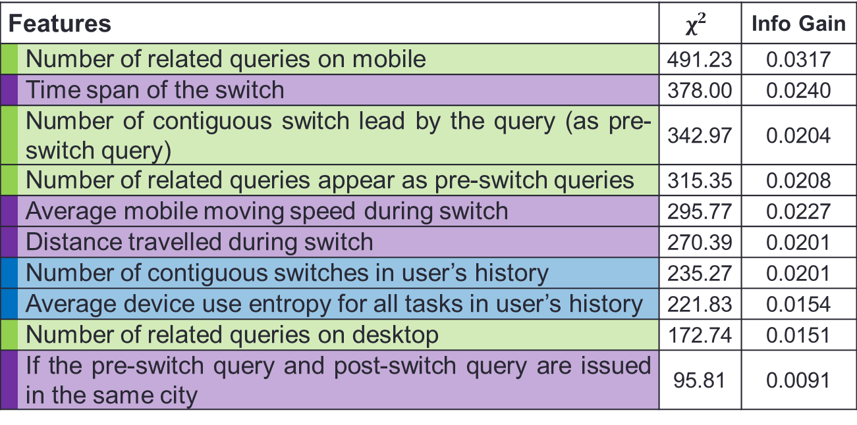
Feature Analysis
Top 10 features for predicting contiguous search tasks
Features |  | $$χ^{2}$$ | Info Gain
 | Number of related queries on mobile | 491.23 | 0.0317
 | Time span of the switch | 378.00 | 0.0240
 | Number of contiguous switch lead by the query (as pre-switch query) | 342.97 | 0.0204
 | Number of related queries appear as pre-switch queries | 315.35 | 0.0208
 | Average mobile moving speed during switch | 295.77 | 0.0227
 | Distance travelled during switch | 270.39 | 0.0201
 | Number of contiguous switches in user’s history | 235.27 | 0.0201
 | Average device use entropy for all tasks in user’s history | 221.83 | 0.0154
 | Number of related queries on desktop | 172.74 | 0.0151
 | If the pre-switch query and post-switch query are issued in the same city | 95.81 | 0.0091
 | Pre-switch query |  | Transition |  | History

Slide 21
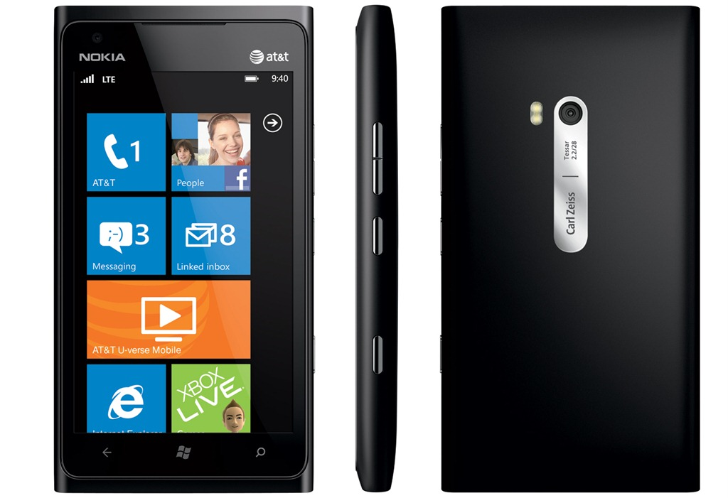

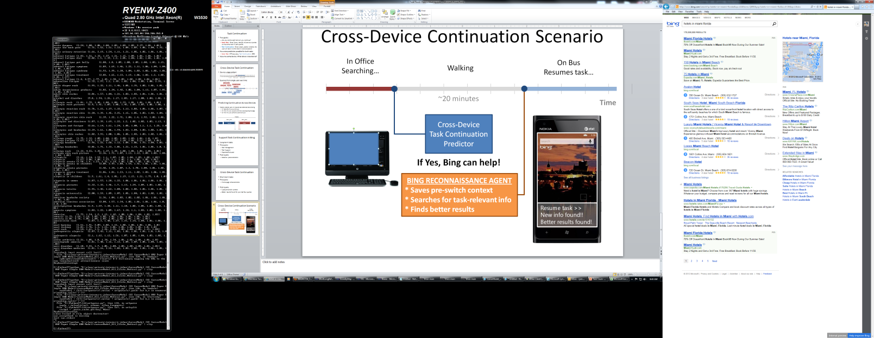
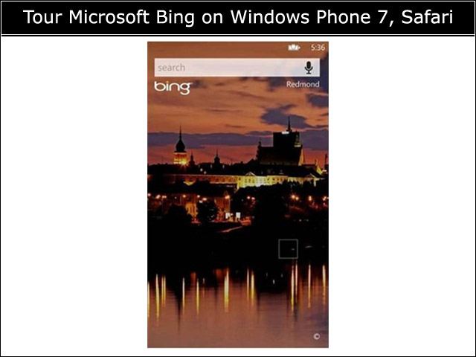
Enabled Scenario: Exploit Downtime
Being able to predict task resumption enables scenarios such as
In Office
(on PC)
Stops
Task
Resumes
Task
On Bus
(on SmartPhone)
Walking to bus stop
Time
~20 minutes
Task Continuation Predictor
Will user resume task immediately on mobile?
If Yes, then the search engine can help …
Resume task »
New info found!!
Better results found!

Slide 22
What Can Engine do to Help?
Search engine can perform actions on the users’ behalf to capitalize on the downtime during the switch, e.g.,
Predict resumption at end of pre-switch session:
Proactively save recent session state
Try different ranking algorithms
Pose the query to a question answering site
Alert the user if better results found
Predict at start of post-switch session:
Provide the user with the option to
explicitly resume task on homepage

Slide 23
Summary and Takeaways
Multi-device usage increasingly popular
Cross-device search is prevalent
  15% of (non-navigational) switches are on same task
Characterized some aspects of cross-device tasks
Built predictive models of cross-device task resumption
Provides a search engine with opportunity to help searchers by using between-device downtime

