Slide 1
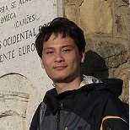


A Relational Platform for Efficient Large-Scale Video Analytics
Yao Lu, Aakanksha Chowdhery, Srikanth Kandula

Slide 2
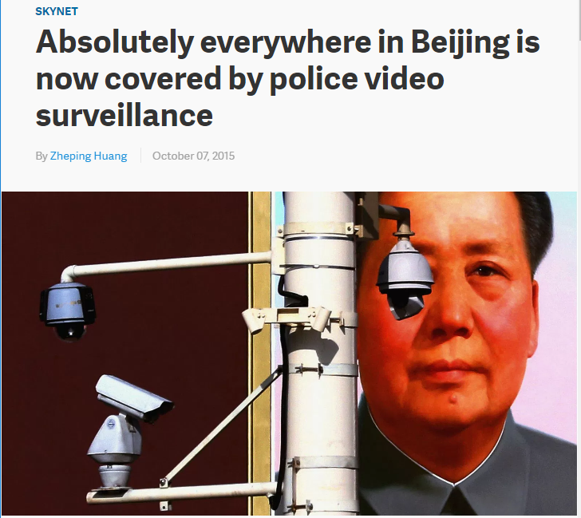
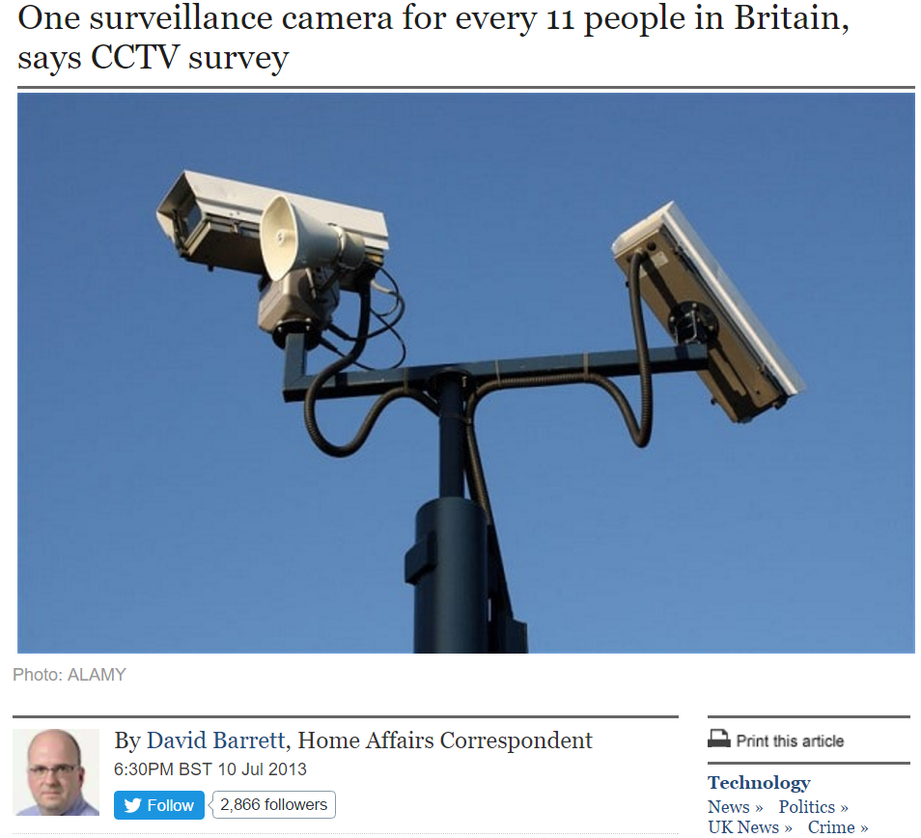
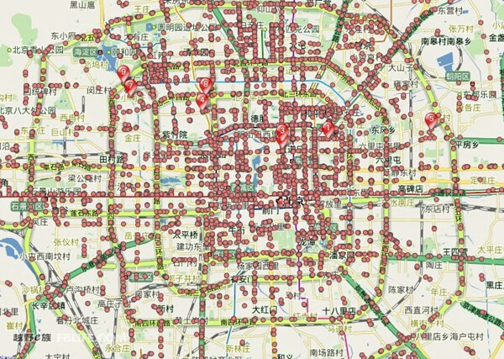
Cameras are ubiquitous; video analysis is a big-data problem

Slide 3
Cameras are ubiquitous; video analysis is a big-data problem
  1Mbps per camera, 10K cameras?
  103 TB/day!
Analytics over city-scale cameras’ video requires big-data processing

Slide 4
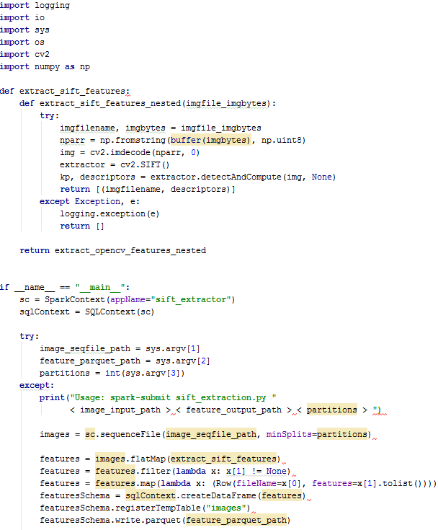
Video analytics in big-data systems
Closed solutions: Omnicast, ProVigil, etc.
Open solutions: MapReduce, Spark, etc.
Spark example
Define application logic
Initialize Spark
User specifies input, parallelism etc.
Declares pipeline
Optimizing vision programs is a manual process convolving systems and application details.

Slide 5
Our goal
Make processing video feeds from many cameras easy and efficient
Auto-scaling and optimization of queries
Vision engineers need not worry about //ism etc.
End-users simply declare queries

Slide 6
Optasia: Design
Leverage relational QO for vision queries
Vision tasks ⇒ declarative dataflow
Query optimization to dedup, auto //ize …
Enhancing parallelism (eg chunk-level)

Slide 7
Wrapping vision modules as relational UDOs
User-defined Operator type | Relational analog
Extractor, Processor | Select and/or Project
Reducer | GroupBy and/or Aggregate
Combiner | Join

Slide 8
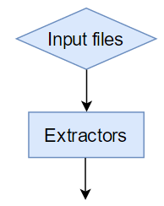

Extractors ingest data
$rawdata $←$ EXTRACT CameraID :int,
FrameID :int,
Frame :binary
FROM @"/videos/*.avi"
USING VideoExtractor();
CameraID | FrameID | Frame
C1 | 1 | [JPEG content]
C1 | 2 | [JPEG content]
C1 | 3 | [JPEG content]
C1 | 4 | [JPEG content]
/videos/1.avi
/videos/2.avi
/videos/3.avi
/videos/4.avi
VideoExtractor()
VideoExtractor()
CameraID | FrameID | Frame
C2 | 1 | [JPEG content]
C2 | 2 | [JPEG content]
C2 | 3 | [JPEG content]
C2 | 4 | [JPEG content]
VideoExtractor()
VideoExtractor()
$rawdata

Slide 9
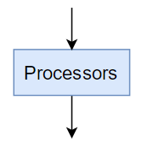
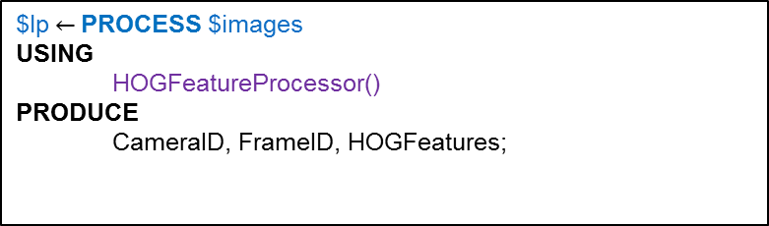
Processors are row manipulators
$lp$←$ PROCESS $images
USING
HOGFeatureProcessor()
PRODUCE
CameraID, FrameID, HOGFeatures;
frameId | Frame
1 | [JPEG content]
2 | [JPEG content]
3 | [JPEG content]
4 | [JPEG content]
frameId | HOGfeat
1 | HOG(frame 1)
2 | HOG(frame 2)
3 | HOG(frame 3)
4 | HOG(frame 4)
HOGProcessor()
HOGProcessor()
HOGProcessor()
HOGProcessor()
$images
$HOGfeat

Slide 10
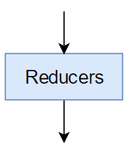

Reducers operate over groups of rows
$cars $←$ REDUCE
ON
CameraID
USING
TrackingReducer()
PRODUCE
FrameID :int, CarBlob :binary;
frameId | Frame
1 | [JPEG content]
2 | [JPEG content]
3 | [JPEG content]
FrameID | CarBlob
1 | Track(frame 1,2,3)
5 | Track(frame 4,5,6)
TrackingReducer()
$cars
$images

Slide 11
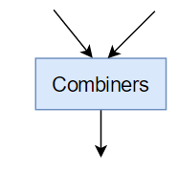

Combiners join two or more rowsets
$distance $←$
COMBINE
$images_1, $images_2
ON
$images_1.frameId = $images_2.frameId
USING
MatchingCombiner()
PRODUCE
FrameID :int, Distance :float;
frameId | Frame
1 | [JPEG content]
2 | [JPEG content]
frameId | distance
1 | dist(frame 1.1, 2.1)
2 | dist(frame 1.2, 2.2)
MatchingCombiner()
MatchingCombiner()
$images_1
$distance
frameId | Frame
1 | [JPEG content]
2 | [JPEG content]
$images_2

Slide 12
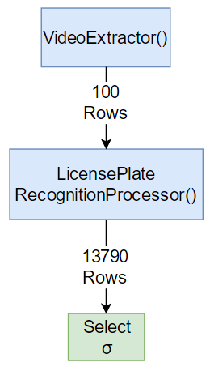

Pipelines (and queries) are declarative compositions
Example:
License Plate Recognition
$rawdata $←$ EXTRACT camId :int,
frameId :int,
frame :binary
FROM @"/videos/*.avi"
USING VideoExtractor();
$lp$←$ PROCESS $rawdata
USING LicensePlateRecognitionProcessor()
PRODUCE camId, frameId, LP;
SELECT camId, frameId FROM $lp
WHERE $lp.LP = "ABC1234";
10K frames
Vision engineer writes pipeline
End-user queries

Slide 13

Query optimization
Cascades-style cost-based query optimizer
  Transformation rules generate alternatives, e.g., predicate push-down
  $ε_{1}$→𝑆→𝐹𝑖𝑙𝑡𝑒𝑟→$ε_{2}$ ⇒ $ε_{1}$→𝐹𝑖𝑙𝑡𝑒𝑟→𝑆→$ε_{2}$
  UDOs annotated with cost etc.

Slide 14
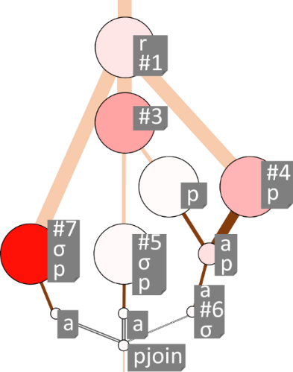
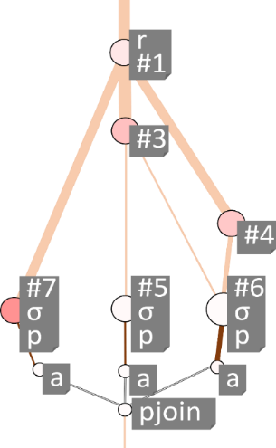
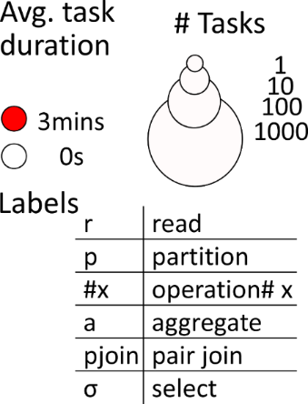
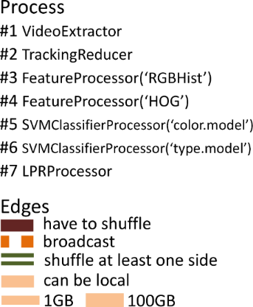

Query optimization
Cascades-style cost-based query optimizer
  Transformation rules generate alternatives, e.g., predicate push-down
  $ε_{1}$→𝑆→𝐹𝑖𝑙𝑡𝑒𝑟→$ε_{2}$ ⇒ $ε_{1}$→𝐹𝑖𝑙𝑡𝑒𝑟→𝑆→$ε_{2}$
  UDOs annotated with cost etc.
  Auto parallelization, 1 GB vs. 100 GB:
10 GB
1 GB

Slide 15
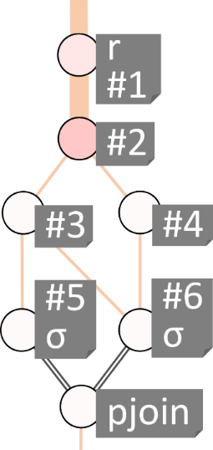
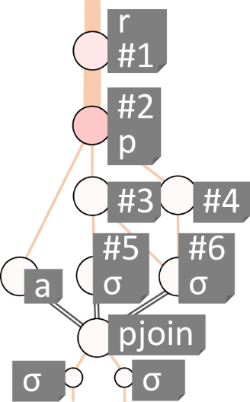
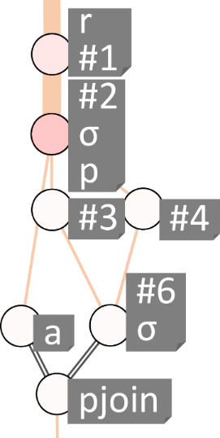
Query optimization (contd.)
  Query de-duplication
  Merge common modules across pipelines and queries.
Amber alert
Combined query
Traffic violation

Slide 16
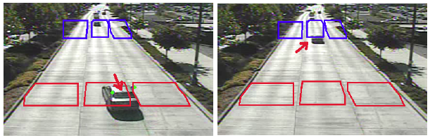
Chunk-level parallelism
Contextual analysis is limited to camera-level parallelism
Idea: context of video processing is bounded in time
Partition into overlapping chunks

Slide 17
Chunk-level parallelism
Contextual analysis is limited to camera-level parallelism
Idea: context of video processing is bounded in time
Partition into overlapping chunks
Processor

Slide 18
System
Implemented state-of-art vision modules as dataflow operators
Built vision pipelines, using above modules, for
  License plate recognition
  Vehicle color/type recognition
  Traffic flow mapping
  Object re-identification
Query optimization extends SCOPE
Module Functionality | Operator Category | Specifics
Feature Extraction | Processor | RGB Histogram, HOG, PyramidSILTPHist PyramidHSVHist
Classifier/regressor | Processor | Linear SVM, Random Forest
Classifier/regressor | Combiner | XQDA for Re-ID
Keypoint Extraction | Processor | Shi-Tomasi, SIFT
Tracker | Reducer | KLT, CamShift
Segmentation | Processor | MOG, Binarization

Slide 19
Summarizing Design
Leverage relational QO for vision queries
Vision tasks ⇒ declarative dataflow
Query optimization over UDOs
Enhancing parallelism (eg chunk-level)

Slide 20
Evaluation
Sample end-user queries

Slide 21
Sample end-user queries
Example query: Amber alert (“red honda civic with license AB*92*”)
Other examples in paper and code release
SELECT
CameraID,
FrameID,
$Licenses.conf * $VehicleType.conf * $VehicleColor.conf AS Confidence
FROM $Licenses, $VehicleType, $VehicleColor
ON $Licenses.{CameraId, FrameId}=$VehicleType.{CameraId, FrameId} &
$Licenses.{CameraId, FrameId}=$VehicleColor.{CameraId, FrameId}
WHERE
$Licenses.plate LIKE l & $VehicleType.type=v & $VehicleColor.color=c;

Slide 22
Evaluation
Sample vision queries
Benchmarking vision pipelines

Slide 23
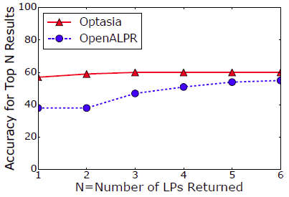


Benchmarking vision pipelines
License plate recognition:
Vehicle type & color recognition:
Vehicle counting

Slide 24
Evaluation
Sample vision queries
Benchmarking vision pipelines
Benchmarking end-to-end system

Slide 25
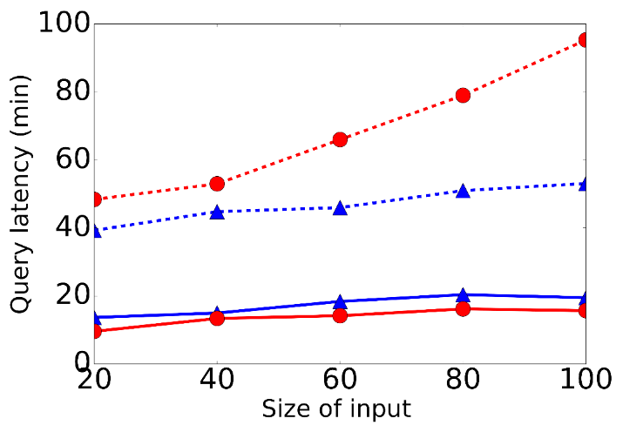
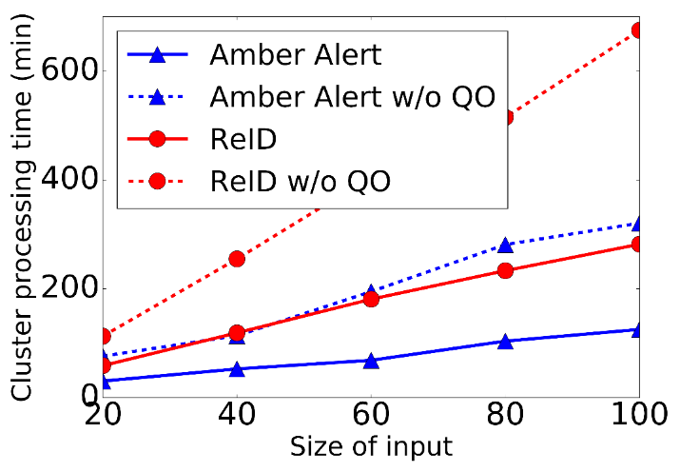
Benchmarking Optasia
Data: 100GB of traffic surveillance videos.
Queries
  Amber alert retrieves vehicles given color (red, etc.), type (SUV, etc.), and license plate number
  Re-ID matches and tracks certain vehicles across two cameras.
Faster query completion and lower usage of cluster resources
Notes:
as the number of input videos
increases for each query. Further, query optimization ensures the most efficient
cluster resource utilization in terms of processing time

Slide 26
Benchmarking Optasia
De-duplication
Cluster use remains unchanged due to effective de-duplication.

Slide 27
Benchmarking Optasia
Chunk-level parallelism
Chunking increases high degree of parallelism (but overheads catch up)

Slide 28
Conclusion
Video analytics in big-data systems is challenging
Optasia: a user-friendly & efficient system
  Leverages relational QO for vision queries
    Relational wrappers for vision modules
    Query optimization to de-dup, //ization, etc.
    Enhanced parallelism (eg chunk-level)
Evaluation shows gains in scalability and accuracy
Code and demo at http://yao.lu/optasia

