Slide 1


Problem Generation & Feedback Generation
Invited Talk @ ASSESS 2014
Workshop collocated with KDD 2014
Sumit Gulwani
Microsoft Research, Redmond

Slide 2
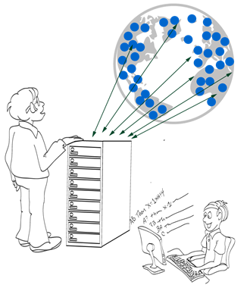
Computer-aided Education
Various tasks
Problem Generation
Solution Generation
Feedback Generation
Various subject-domains
Arithmetic, Algebra, Geometry
Programming, Automata, Logic
Language Learning
...
CACM 2014; “Example-based Learning in Computer-aided STEM Education”; Gulwani

Slide 3
Content Classification
Procedural
  Mathematical Procedures
    Addition, Long division, GCD/LCM, Gaussian Elimination
  Algorithmic Procedures
    Students asked to show understanding of classical algorithms on specific inputs.
      BFS, insertion sort, shortest path
      translating regular expression into an automaton.
Conceptual
  Proofs
    Algebraic theorems, Natural deduction, Non-regularity
  Constructions
    Geometric ruler/compass based constructions, Automata constructions, Algorithms

Slide 4
Problem Generation

Slide 5
Problem Generation
Motivation
Problems similar to a given problem.
  Avoid copyright issues
  Prevent cheating in MOOCs (Unsynchronized instruction)
Problems of a given difficulty level and concept usage.
  Generate progressions
  Generate personalized workflows
Key Ideas
Procedural Content: Test input generation techniques

Slide 6
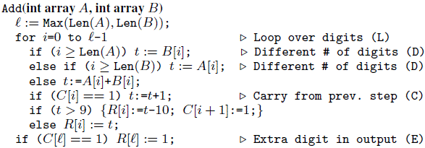
Problem Generation: Addition Procedure
Concept
Single digit addition
Multiple digit w/o carry
Single carry
Two single carries
Double carry
Triple carry
Extra digit in i/p & new digit in o/p
CHI 2013: “A Trace-based Framework for Analyzing and Synthesizing Educational Progressions”; Andersen, Gulwani, Popovic.

Slide 7
Problem Generation: Addition Procedure
Concept | Trace Characteristic
Single digit addition | L
Multiple digit w/o carry | LL+
Single carry | L* (LC) L*
Two single carries | L* (LC) L+ (LC) L*
Double carry | L* (LCLC) L*
Triple carry | L* (LCLCLCLC) L*
Extra digit in i/p & new digit in o/p | L* CLDCE
CHI 2013: “A Trace-based Framework for Analyzing and Synthesizing Educational Progressions”; Andersen, Gulwani, Popovic.

Slide 8
Problem Generation: Addition Procedure
Concept | Trace Characteristic | Sample Input
Single digit addition | L | 3+2
Multiple digit w/o carry | LL+ | 1234 +8765
Single carry | L* (LC) L* | 1234 + 8757
Two single carries | L* (LC) L+ (LC) L* | 1234 + 8857
Double carry | L* (LCLC) L* | 1234 + 8667
Triple carry | L* (LCLCLCLC) L* | 1234 + 8767
Extra digit in i/p & new digit in o/p | L* CLDCE | 9234 + 900
CHI 2013: “A Trace-based Framework for Analyzing and Synthesizing Educational Progressions”; Andersen, Gulwani, Popovic.

Slide 9
Problem Generation
Motivation
Problems similar to a given problem.
  Avoid copyright issues
  Prevent cheating in MOOCs (Unsynchronized instruction)
Problems of a given difficulty level and concept usage.
  Generate progressions
  Generate personalized workflows
Key Ideas
Procedural Content: Test input generation techniques
Conceptual Content
  Template based generalization

Slide 10
Problem Synthesis: Algebra (Trigonometry)
$$\text{Example} \text{Problem}\text{:}{ \left(\sec{x+ \cos{x}}\right) \left(\sec{x−\cos{x}}\right)}= \tan^{2}{x+\sin^{2}{x}}$$
$$\text{Query}\text{: }\left(T_{1}\left(x\right)±T_{2}(x)\right) \left(T_{3}\left(x\right)±T_{4}\left(x\right)\right)=T_{5}^{2}\left(x\right)±T_{6}^{2}(x)$$
$${ T}_{1}≠T_{5}$$
New problems generated:
$$\left(\csc{x}+\cos{x}\right)\left(\csc{x}−\cos{x}\right)=\cot^{2}{x}+\sin^{2}{x}$$
$$(\csc{x−\sin{x)(\csc{x+\sin{x)=\cot^{2}{x+\cos^{2}{x}}}}} }$$
$$(\sec{x+\sin{x)(\sec{x−\sin{x)=\tan^{2}{x+\cos^{2}{x}}}}}}$$
:
$$(\tan{x+\sin{x)(\tan{x−\sin{x)=\tan^{2}{x −\sin^{2}{x} }}}}}$$
$$(\csc{x+\cos{x)(\csc{x−\cos{x)=\csc^{2}{x −\cos^{2}{x}}}}}}$$
:
AAAI 2012: “Automatically generating algebra problems”;
Singh, Gulwani, Rajamani.

Slide 11
Problem Synthesis: Algebra (Trigonometry)
$$\text{Example} \text{Problem}\text{:}{ \left(\sec{x+ \cos{x}}\right) \left(\sec{x−\cos{x}}\right)}= \tan^{2}{x+\sin^{2}{x}}$$
$$\text{Query}\text{: }\left(T_{1}\left(x\right)±T_{2}(x)\right) \left(T_{3}\left(x\right)±T_{4}\left(x\right)\right)=T_{5}^{2}\left(x\right)±T_{6}^{2}(x)$$
$${ T}_{1}≠T_{5}$$
New problems generated:
$$\left(\csc{x}+\cos{x}\right)\left(\csc{x}−\cos{x}\right)=\cot^{2}{x}+\sin^{2}{x}$$
$$(\csc{x−\sin{x)(\csc{x+\sin{x)=\cot^{2}{x+\cos^{2}{x}}}}} }$$
$$(\sec{x+\sin{x)(\sec{x−\sin{x)=\tan^{2}{x+\cos^{2}{x}}}}}}$$
:
$$(\tan{x+\sin{x)(\tan{x−\sin{x)=\tan^{2}{x −\sin^{2}{x} }}}}}$$
$$(\csc{x+\cos{x)(\csc{x−\cos{x)=\csc^{2}{x −\cos^{2}{x}}}}}}$$
:
AAAI 2012: “Automatically generating algebra problems”;
Singh, Gulwani, Rajamani.

Slide 12
Problem Synthesis: Algebra (Limits)
$$\text{Example} \text{Problem}\text{:} \lim_{n→∞}{\sum_{i=0}^{n}{\frac{2i^{2}+i+1}{5^{i}}= \frac{5}{2}} }$$
$$\text{Query}\text{:} \lim_{n→∞}{\sum_{i=0}^{n}{\frac{C_{0}i^{2}+C_{1}i+C_{2}}{{C_{3}}^{i}}= \frac{C_{4}}{C_{5}}} }$$
$${ C}_{0}≠0 ∧ \gcd\left(C_{0},C_{1},C_{2}\right)=\gcd\left(C_{4},C_{5}\right)=1$$
New problems generated:
$$\lim_{n→∞}{\sum_{i=0}^{n}{\frac{3i^{2}+2i+1}{7^{i}}= \frac{7}{3} }\lim_{n→∞}{\sum_{i=0}^{n}{\frac{3i^{2}+3i+1}{4^{i}}=4 } }}$$
$$\lim_{n→∞}{\sum_{i=0}^{n}{\frac{i^{2}}{3^{i}}= \frac{3}{2}} \lim_{n→∞}{\sum_{i=0}^{n}{\frac{5i^{2}+3i+3}{6^{i}}=6 } }}$$

Slide 13
Problem Synthesis: Algebra (Integration)
$$\text{Example} \text{Problem}\text{:} \int{(\csc{x) (\csc{x−\cot{x) dx= \csc{x}−\cot{x}}}}}{ }$$
$$\text{Query}\text{: }\int{T_{0}\left(x\right)\left(T_{1}\left(x\right)±T_{2}\left(x\right)\right)dx=T_{4}\left(x\right)±T_{5}(x)}$$
$${ T}_{1}≠T_{2} ∧ T_{4}≠T_{5}$$
New problems generated:
$$\int{(tan{x) (\cos{x}+ \sec{x) dx= \sec{x}− \cos{x}}}}$$
$$\int{(sec{x) (\tan{x}+ \sec{x) dx= \sec{x}+\cot{ x}}}}$$
$$\int{(\cot{x) (\sin{x+ \csc{x) dx= \sin{x−\csc{x}}}}}}$$

Slide 14
Problem Synthesis: Algebra (Determinant)
$$\text{Ex}\text{. }\text{Problem} \left|\begin{matrix}{\left(x+y\right)}^{2} & zx & zy \\ zx & {\left(y+z\right)}^{2} & xy \\ yz & xy & {\left(z+x\right)}^{2}\end{matrix}\right|{ }=2xyz {\left(x+y+z\right)}^{3}$$
$$\text{Query} \left|\begin{matrix}F_{0}(x,y,z) & F_{1}(x,y,z) & F_{2}(x,y,z) \\ F_{3}(x,y,z) & F_{4}(x,y,z) & F_{5}(x,y,z) \\ F_{6}(x,y,z) & F_{7}(x,y,z) & F_{8}(x,y,z)\end{matrix}\right|{ }=C_{10}F_{9}(x,y,z)$$
$${ F}_{i}≔F_{j}\left[x→y;y→z;z→x\right] where \left(i,j\right)∈\{\left(4,0\right), \left(8,4\right), \left(5,1\right),…\}$$
New problems generated:
$$\left|\begin{matrix}y^{2} & x^{2} & {\left(y+x\right)}^{2} \\ {\left(z+y\right)}^{2} & z^{2} & y^{2} \\ z^{2} & {\left(x+z\right)}^{2} & x^{2}\end{matrix}\right|{ }=2{\left(xy+yz+zx\right)}^{3}$$
$$\left|\begin{matrix}yz+y^{2} & xy & xy \\ yz & zx+z^{2} & yz \\ zx & zx & xy+x^{2}\end{matrix}\right|{ }=4x^{2}y^{2}z^{2}$$

Slide 15
Synthesis Algorithm for Finding Instantiations
Enumerate all possible choices for the various holes.
Test the validity of an instantiation using random testing.
Why does this work?
  Background: Classic Polynomial Identity Testing
  Problem: Given two polynomials P1 and P2, determine whether they are equivalent.
  The naïve deterministic algorithm of expanding polynomials to compare them term-wise is exponential.
  A simple randomized test is probabilistically sufficient:
    Choose random values r for polynomial variables x
    If P1(r) ≠ P2(r), then P1 is not equivalent to P2.
    Otherwise P1 is equivalent to P2 with high probability.
  New Result
  Above approach also extends to analytic functions.

Slide 16
Problem Generation
Motivation
Problems similar to a given problem.
  Avoid copyright issues
  Prevent cheating in MOOCs (Unsynchronized instruction)
Problems of a given difficulty level and concept usage.
  Generate progressions
  Generate personalized workflows
Key Ideas
Procedural Content: Test input generation techniques
Conceptual Content
  Template based generalization

Slide 17
Problem Synthesis: Sentence Completion
The principal characterized his pupils as _________ because they were pampered and spoiled by their indulgent parents.
The commentator characterized the electorate as _________ because it was unpredictable and given to constantly shifting moods.
(a) cosseted (b) disingenuous (c) corrosive (d) laconic (e) mercurial
One of the problems is a real problem from SAT (standardized exam),
while the other one was automatically generated!
From problem 1, we get template T₁: *₁ characterized *₂ as *₃ because *4
We specialize T₁ to template T₂: *₁ characterized *₂ as mercurial because *₄
Problem 2 is an instance of T₂
found using web search!
KDD 2014: “LaSEWeb: Automating search strategies over semi-structured web data”
Alex Polozov, Sumit Gulwani

Slide 18
Problem Generation
Motivation
Problems similar to a given problem.
  Avoid copyright issues
  Prevent cheating in MOOCs (Unsynchronized instruction)
Problems of a given difficulty level and concept usage.
  Generate progressions
  Generate personalized workflows
Key Ideas
Procedural Content: Test input generation techniques
Conceptual Content
  Template based generalization
  Symbolic methods (solution generation in reverse)

Slide 19
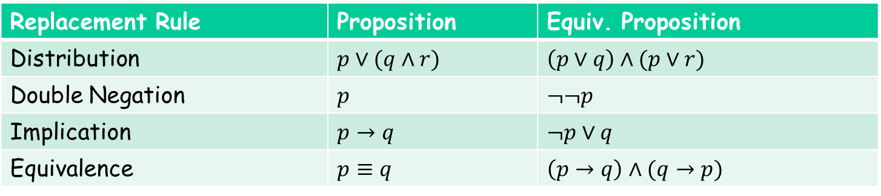
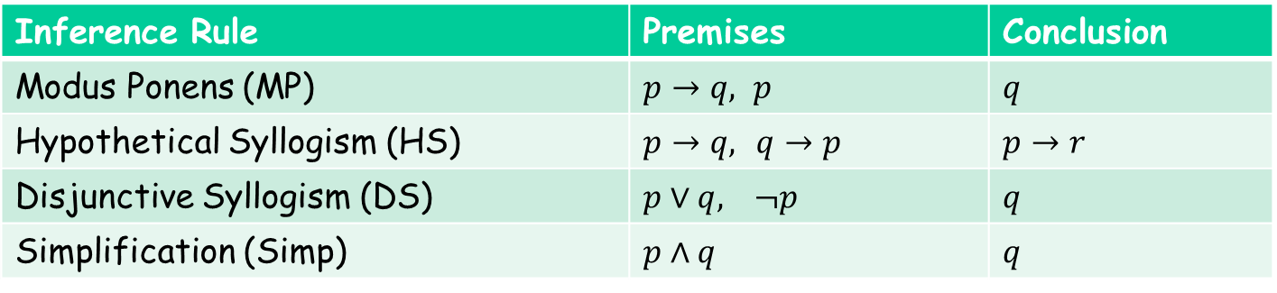

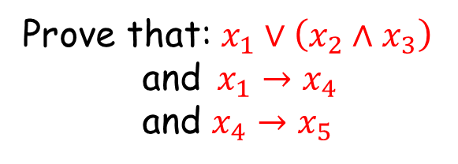
Natural Deduction
Prove that: $x_{1}∨\left(x_{2}∧x_{3}\right)$
and$x_{1}→x_{4}$
and $x_{4}→x_{5}$
implies $x_{2}∨x_{5}$
Inference Rule | Premises | Conclusion
Modus Ponens (MP) | $p→q, p$ | $$q$$
Hypothetical Syllogism (HS) | $p→q,$ $q→p$ | $$p→r$$
Disjunctive Syllogism (DS) | $p∨q,$ $¬p$ | $$q$$
Simplification (Simp) | $$p∧q$$ | $$q$$
Replacement Rule | Proposition | Equiv. Proposition
Distribution | $p∨(q∧r)$ | $$\left(p∨q\right)∧(p∨r)$$
Double Negation | $$p$$ | $$¬¬p$$
Implication | $$p→q$$ | $$¬p∨q$$
Equivalence | $$p≡q$$ | $$\left(p→q\right)∧(q→p)$$
IJCAI 2013: “Automatically Generating Problems and Solutions for Natural Deduction” Umair Ahmed, Sumit Gulwani, Amey Karkare

Slide 20
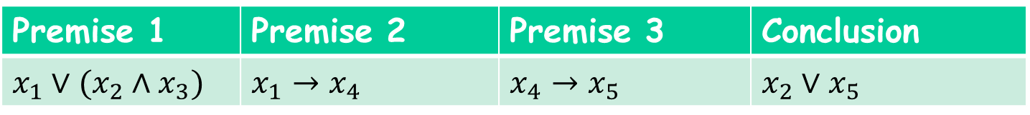
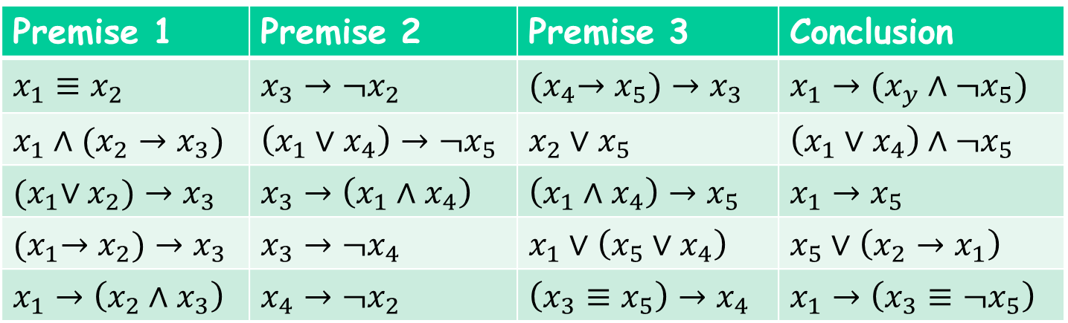
Similar Problem Generation: Natural Deduction
Similar Problems = those that have a minimal proof with the same sequence of inference rules as used by a minimal proof of given problem.
Premise 1 | Premise 2 | Premise 3 | Conclusion
$$x_{1}∨(x_{2}∧x_{3})$$ | $$x_{1}→x_{4}$$ | $$x_{4}→x_{5}$$ | $$x_{2}∨x_{5}$$
Similar Problems
Premise 1 | Premise 2 | Premise 3 | Conclusion
$$x_{1}≡x_{2}$$ | $$x_{3}→¬x_{2}$$ | $${(x}_{4}→x_{5})→x_{3}$$ | $$x_{1}→(x_{y}∧¬x_{5})$$
$$x_{1}∧(x_{2}→x_{3})$$ | $$\left(x_{1}∨x_{4}\right)→¬x_{5}$$ | $$x_{2}∨x_{5}$$ | $$\left(x_{1}∨x_{4}\right)∧¬x_{5}$$
$${(x}_{1}∨x_{2})→x_{3}$$ | $$x_{3}→\left(x_{1}∧x_{4}\right)$$ | $$\left(x_{1}∧x_{4}\right)→x_{5}$$ | $$x_{1}→x_{5}$$
$${(x}_{1}→x_{2})→x_{3}$$ | $$x_{3}→¬x_{4}$$ | $$x_{1}∨\left(x_{5}∨x_{4}\right)$$ | $$x_{5}∨\left(x_{2}→x_{1}\right)$$
$$x_{1}→\left(x_{2}∧x_{3}\right)$$ | $$x_{4}→¬x_{2}$$ | $$\left(x_{3}≡x_{5}\right)→x_{4}$$ | $$x_{1}→\left(x_{3}≡¬x_{5}\right)$$

Slide 21
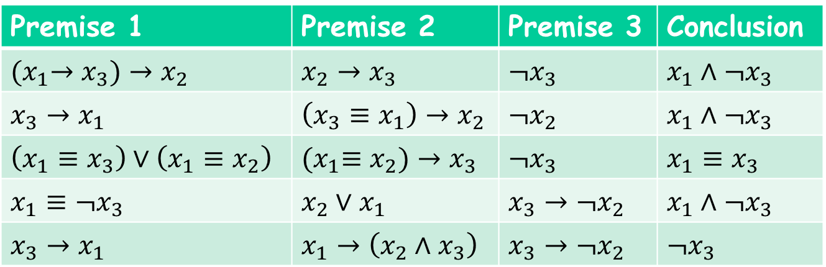

Parameterized Problem Generation: Natural Deduction
Parameters:
# of premises = 3, Size of propositions $≤$ 4
# of variables = 3, # of inference steps = 2
Inference rules = { DS, HS }
Parameterized Problems
Premise 1 | Premise 2 | Premise 3 | Conclusion
$${(x}_{1}→x_{3})→x_{2}$$ | $$x_{2}→x_{3}$$ | $$¬x_{3}$$ | $$x_{1}∧¬x_{3}$$
$$x_{3}→x_{1}$$ | $$\left(x_{3}≡x_{1}\right)→x_{2}$$ | $$¬x_{2}$$ | $$x_{1}∧¬x_{3}$$
$$\left(x_{1}≡x_{3}\right)∨\left(x_{1}≡x_{2}\right)$$ | $${(x}_{1}≡x_{2})→x_{3}$$ | $$¬x_{3}$$ | $$x_{1}≡x_{3}$$
$$x_{1}≡¬x_{3}$$ | $$x_{2}∨x_{1}$$ | $$x_{3}→¬x_{2}$$ | $$x_{1}∧¬x_{3}$$
$$x_{3}→x_{1}$$ | $$x_{1}→\left(x_{2}∧x_{3}\right)$$ | $$x_{3}→¬x_{2}$$ | $$¬x_{3}$$

Slide 22
Feedback Generation
Motivation
Makes teachers more effective.
  Saves them time.
  Provides immediate insights on where students are struggling.
Can enable rich interactive experience for students.
  Generation of hints.
  Pointer to simpler problems depending on kind of mistake.
Key Ideas:
Procedural Content: Use PBE techniques to learn buggy procedures in a student’s mind.
Conceptual Content: Various feedback metrics
  Counterexamples: Inputs on which the solution is not correct

Slide 23
Counterexamples are not sufficient!
"Not only did it take 1-2 weeks to grade problem, but the comments were entirely unhelpful in actually helping us fix our errors. …. Apparently they don't read the code -- they just ran their tests and docked points mercilessly. What if I just had a simple typo, but my algorithm was fine? ....“
- Student Feedback from MIT 6.00 course, 2013.

Slide 24
Feedback Generation
Motivation
Makes teachers more effective.
  Saves them time.
  Provides immediate insights on where students are struggling.
Can enable rich interactive experience for students.
  Generation of hints.
  Pointer to simpler problems depending on kind of mistake.
Key Ideas:
Procedural Content: Use PBE techniques to learn buggy procedures in a student’s mind.
Conceptual Content: Various feedback metrics
  Counterexamples: Inputs on which the solution is not correct.
  Nearest correct solution.

Slide 25
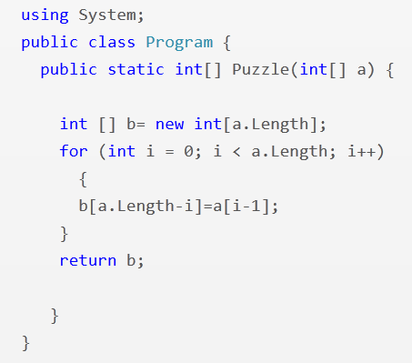
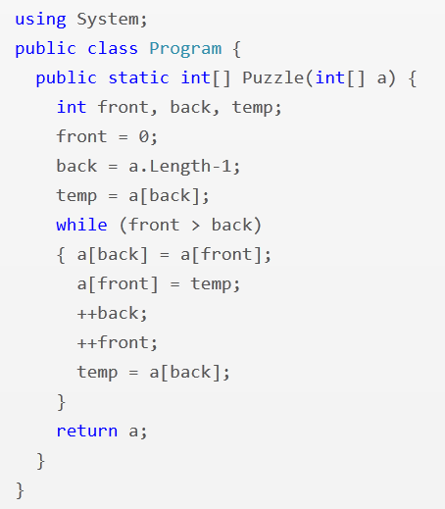
Feedback Synthesis: Programming (Array Reverse)
i = 1
i <= a.Length
front <= back
--back
PLDI 2013: “Automated Feedback Generation for Introductory Programming Assignments” Singh, Gulwani, Solar-Lezama

Slide 26
Experimental Results
13,365 incorrect attempts for 13 Python problems.
(obtained from Introductory Programming course at MIT and its MOOC version on the EdX platform)
Average time for feedback = 10 seconds
Feedback generated for 64% of those attempts.
Reasons for failure to generate feedback
  Completely incorrect solutions
  Big conceptual errors
  Timeout (4 min)
Tool accessible at: http://sketch1.csail.mit.edu/python-autofeedback/

Slide 27
Feedback Synthesis
Motivation
Makes teachers more effective.
  Saves them time.
  Provides immediate insights on where students are struggling.
Can enable rich interactive experience for students.
  Generation of hints.
  Pointer to simpler problems depending on kind of mistake.
Key Ideas:
Procedural Content: Use PBE techniques to learn buggy procedures in a student’s mind.
Conceptual Content: Various feedback metrics
  Counterexamples: Inputs on which the solution is not correct.
  Nearest correct solution.
  Nearest problem description (corresponding to student solution).

Slide 28
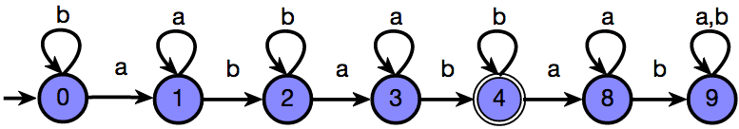
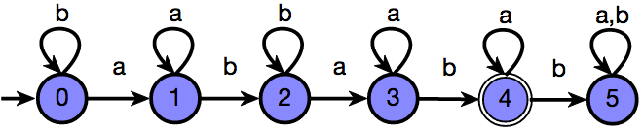
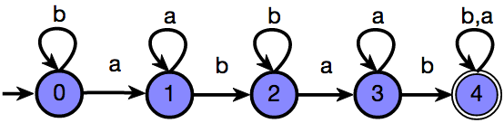
Feedback Synthesis: Finite State Automata
Draw a DFA that accepts: { s | ‘ab’ appears in s exactly 2 times }
Grade: 9/10
Feedback: One more state should be made final
Attempt 1
Based on nearest correct solution
Grade: 6/10
Feedback: The DFA is incorrect on the string ‘ababb’
Attempt 2
Based on counterexamples
Grade: 5/10
Feedback: The DFA accepts {s | ‘ab’ appears in s at least 2 times}
Attempt 3
Based on nearest problem description
IJCAI 2013: “Automated Grading of DFA Constructions”;
Alur, d’Antoni, Gulwani, Kini, Viswanathan

Slide 29
Experimental Results
800+ attempts to 6 automata problems (obtained from automata course at UIUC) graded by tool and 2 instructors.
95% problems graded in <6 seconds each
Out of 131 attempts for one of those problems:
  6 attempts: instructors were incorrect (gave full marks to an incorrect attempt)
  20 attempts: instructors were inconsistent (gave different marks to syntactically equivalent attempts)
  34 attempts: >= 3 point discrepancy between instructor & tool; in 20 of those, instructor agreed that tool was more fair.
Instructors concluded that tool should be preferred over humans for consistency & scalability.
Tool accessible at: http://www.automatatutor.com/

Slide 30
Other directions in Computer-aided Education

Slide 31
Natural Language Understanding
Dealing with word problems.
Dealing with subject domains with more textual content as in language learning and social sciences.
Conversational interaction with students.
Can likely borrow techniques from domain-specific NL understanding developed for end-user programming:
Spreadsheet Formulas [SIGMOD 2014]
Smartphone Scripts [MobiSys 2013]

Slide 32
Machine Learning
Leverage large amounts of student data
Gather sample solutions
Identify commonly made mistakes
Identify effective learning pathways
  Concept ordering
  Nature of feedback
  Personalized levels

Slide 33
Crowdsourcing
Leverage large populations of students and teachers
Peer grading
Tutoring
Problem collection

Slide 34
Evaluating Impact
Student learning outcomes
  Faster, Better, More, Happier?
Cost of developing an intelligent tutoring system
  Build general frameworks that alleviate the cost of development of domain-specific content and tools

Slide 35
Conclusion
Computer-aided Education
  Aspects: Problem/Solution/Feedback Generation
  Domains: Math, Programming, Logic, Language Learning, ...
Inter-disciplinary research area
  Logical reasoning and search techniques
  Natural language understanding (for word problems)
  Machine learning (leverage large amounts of student data)
  Crowdsourcing (leverage large populations of students/teachers)
CACM 2014: “Example-based Learning in Computer-aided STEM Education”; Gulwani

