Slide 1

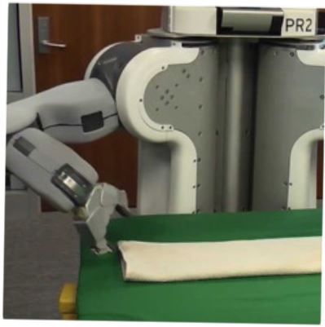

Programming by Examples:
Applications, Ambiguity Resolution, Approach
Sumit Gulwani
Berkeley lecture
Nov 2015

Slide 2
Collaborators
Dan Barowy
Ted Hart
Daniel Perelman
Alex Polozov
Dileep Kini
Vu Le
Mikael Mayer
Mohammad Raza
Danny Simmons
Rishabh Singh
Gustavo Soares
Ben Zorn

Slide 3
Reference
“Programming by Examples (and its applications in Data Wrangling)”,
Gulwani; 2016; In Verification and Synthesis of Correct and Secure Systems; IOS Press
[based on Marktoberdorf Summer School 2015 Lecture Notes]

Slide 4
Key messages
Data wrangling is a killer application for PBE today!
  99% of end users are non-programmers.
  Data scientists spend 80% time in cleaning data.
Ambiguity Resolution is an integral part of PBE
  Ranking (ML)
  User interaction models (HCI)
Approach
  Domain-specific language
  Divide-and-conquer based deductive search paradigm

Slide 5
Key messages
Application
Ambiguity Resolution
Approach

Slide 6





The New Opportunity
Two orders of magnitude more End Users
Struggle with simple repetitive tasks
PBE can play a significant role! (in conjunction with ML, HCI)
Traditional customer for PL technology
End Users
(non-programmers with access to computers)
Software developer

Slide 7


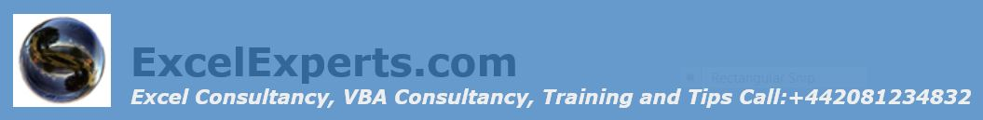

Spreadsheet help forums

Slide 8




Typical help-forum interaction
300_w30_aniSh_c1_b → w30
300_w5_aniSh_c1_b → w5
=MID(B1,5,2)
=MID(B1,5,2)
=MID(B1,FIND(“_”,$B:$B)+1, FIND(“_”,REPLACE($B:$B,1,FIND(“_”,$B:$B),””))-1)

Slide 9
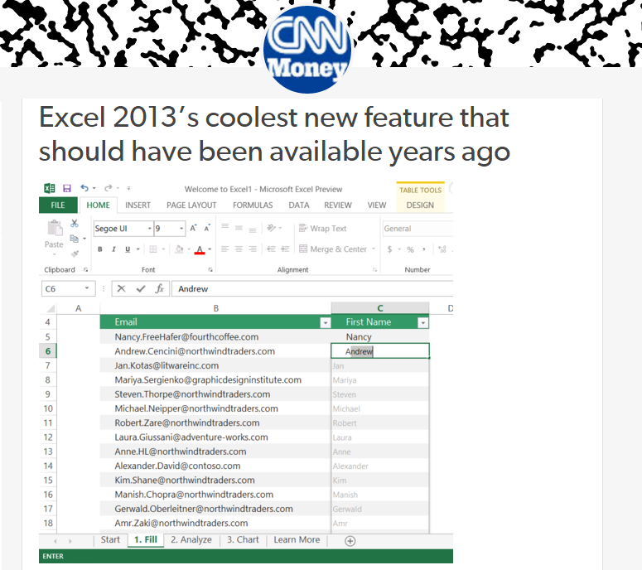
Flash Fill (Excel 2013 feature) demo
“Automating string processing in spreadsheets using input-output examples”; POPL 2011; Sumit Gulwani

Slide 10
Number Transformations
Input | Output (Round to 2 decimal places)
123.4567 | 123.46
123.4 | 123.40
78.234 | 78.23
Excel/C#:
Python/C:
Java:
#.00
.2f
#.##
Input | Output (Nearest lower half hour)
0d 5h 26m | 5:00
0d 4h 57m | 4:30
0d 4h 27m | 4:00
0d 3h 57m | 3:30
Synthesizing Number Transformations from Input-Output Examples;
CAV 2012; Singh, Gulwani

Slide 11
Semantic String Transformations
MarkupRec Table
Id | Name | Markup
S33 | Stroller | 30%
B56 | Bib | 45%
D32 | Diapers | 35%
W98 | Wipes | 40%
A46 | Aspirator | 30%
Input v₁ | Input v₂ | Output (Price + Markup*Price)
Stroller | 10/12/2010 | $145.67 + 0.30*145.67
Bib | 23/12/2010 | $3.56 + 0.45*3.56
Diapers | 21/1/2011
Wipes | 2/4/2009
Aspirator | 23/2/2010
CostRec Table
Id | Date | Price
S33 | 12/2010 | $145.67
S33 | 11/2010 | $142.38
B56 | 12/2010 | $3.56
D32 | 1/2011 | $21.45
W98 | 4/2009 | $5.12
Learning Semantic String Transformations from Examples;
VLDB 2012; Singh, Gulwani

Slide 12

Data is the new Oil
Sources:
Digital revolution
Cloud computing, IoT
Social media
New currency of the digital world that enables business decisions, advertising, recommendations.
Raw data needs to be extracted and refined to enable monetization!

Slide 13








Data Wrangling
Extraction
Transformation
Formatting
Data scientists spend 80% of their time wrangling data.
Raw data locked up in many formats.
Flexible organization for viewing but challenging to manipulate.
Processed data for drawing insights and driving decisions.
PBE can enable easier & faster wrangling!

Slide 14

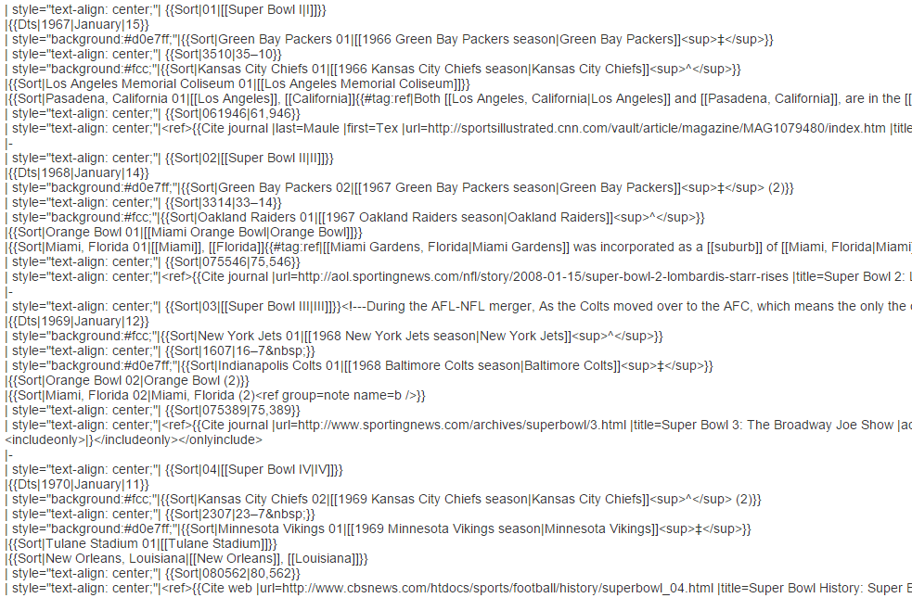
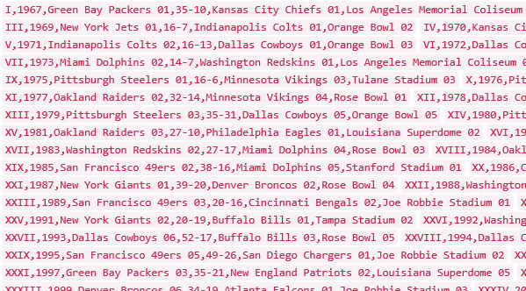
Data Science Class Assignment
To get Started!

Slide 15
FlashExtract Demo
  Recently shipped inside two Microsoft products
  Powershell convertFrom-string cmdlet
  Azure OMS custom field extractor
“FlashExtract: A Framework for data extraction by examples”;
PLDI 2014; Vu Le, Sumit Gulwani

Slide 16
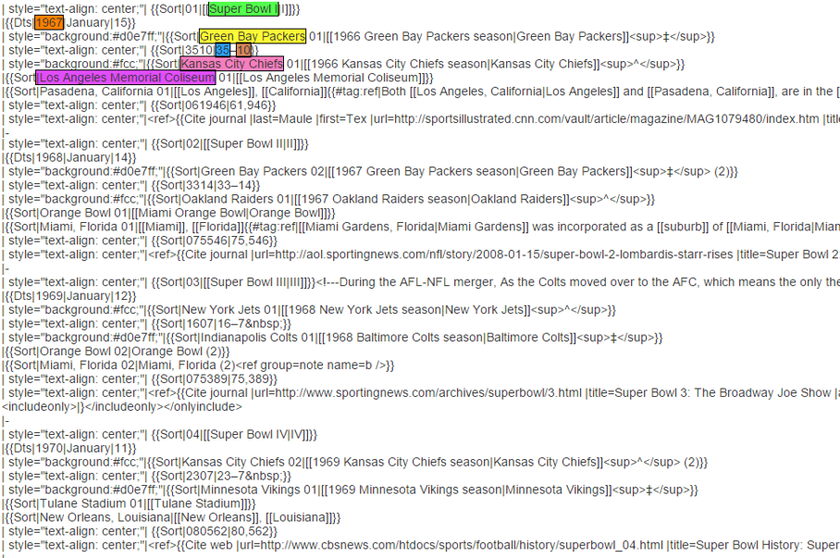
FlashExtract

Slide 17
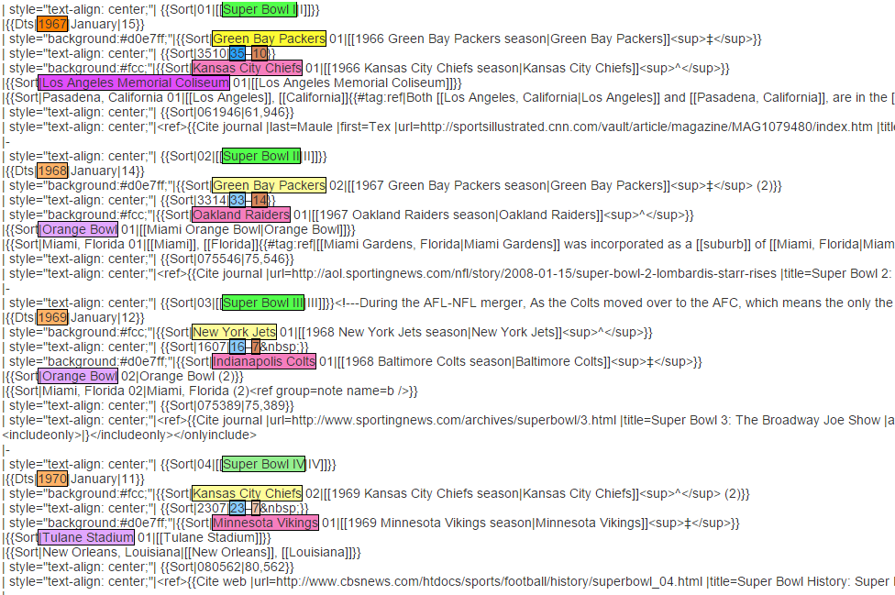
FlashExtract

Slide 18
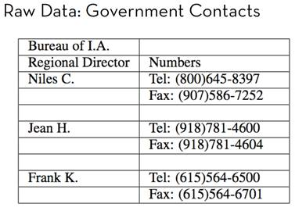
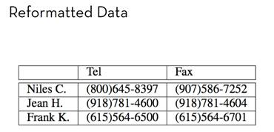
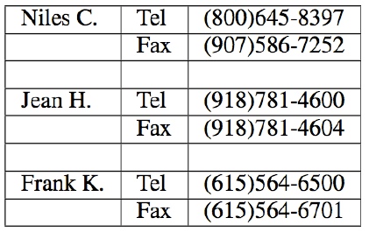
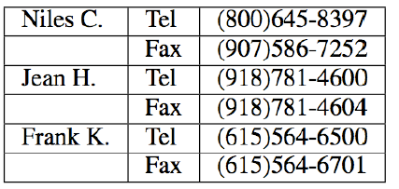
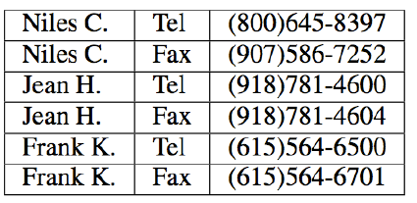
Trifacta: small, guided steps
Table Re-formatting
Start with:
End goal:
FlashRelate
4. Pivot Number on Type
Trifacta provides a series of small transformations:
1. Split on “:” Delimiter
2. Delete Empty Rows
3. Fill Values Down
From: Skills of the Agile Data Wrangler (tutorial by Hellerstein and Heer)

Slide 19
FlashRelate Demo
“FlashRelate: Extracting Relational Data from Semi-Structured Spreadsheets Using Examples”;
PLDI 2015; Barowy, Gulwani, Hart, Zorn

Slide 20
Table Layout Transformations
PROJ | CAT | SPONSOR | DEPT | ELTS | DATE
SPEC | OOH | Infiniti | Design | Elt 1 | 11/10
SPEC | OOH | Infiniti | Desing | Elt 2
SPEC | Print |  | Design | Elt 3 | 11/30
SPEC | Print |  | Design | Elt 4 | 11/30
SPEC | Print | Infiniti | Design | Elt 5 | 11/30
 |  | SPEC
 |  | OOH
Infiniti | Design | Elt 1 | 11/10
Infiniti | Desing | Elt 2
 |  | Print
 | Design | Elt 3 | 11/30
 | Design | Elt 4 | 11/30
Infiniti | Design | Elt 5 | 11/30
“Spreadsheet Table Transformations from Examples”, PLDI 2011; Harris, Gulwani

Slide 21
Table Layout Transformations
 | Art&Des | CreateArt | English | Geo.
Alice | B | A | A | A*
Bob | C | B | C | C
Alice | Art&Des | B
 | CreateArt | A
 | English | A
 | Geo. | A*
Bob | Art&Des | C
 | CreateArt | B
 | English | C
 | Geo. | C
“Spreadsheet Table Transformations from Examples”, PLDI 2011; Harris, Gulwani

Slide 22
PBE tools for Data Manipulation
Extraction
FlashExtract: Extract data from text files, web pages [PLDI 2014]
  Powershell convertFrom-string cmdlet
  Azure OMS custom field extractor
Transformation
Flash Fill: Excel 2013 feature for Syntactic String Transforms [POPL 2011, CAV 2015]
Semantic String Transformations [VLDB 2012]
Number Transformations [CAV 2013]
FlashNormalize: Text normalization [IJCAI 2015]
Formatting
FlashRelate: Extract data from spreadsheets [PLDI 2015]
Table layout transformations [PLDI 2011]
FlashFormat: a Powerpoint add-in [AAAI 2014]

Slide 23
Key messages
Data wrangling is a killer application for PBE today!
  99% of end users are non-programmers.
  Data scientists spend 80% time in cleaning data.
Ambiguity Resolution
Approach

Slide 24

PBE Architecture
Example-based specification
Program
Search Algorithm
Ambiguous/under-specified intent may result in unintended programs!

Slide 25
Key messages
Data wrangling is a killer application for PBE today!
  99% of end users are non-programmers.
  Data scientists spend 80% time in cleaning data.
Ambiguity Resolution is an integral part of PBE
  Ranking (ML)
Approach

Slide 26

Basic ranking scheme
Prefer programs with simpler Kolmogorov complexity
Prefer fewer constants.
Prefer smaller constants.
Input | Output
Rishabh Singh | Rishabh
Ben Zorn | Ben
1st Word
If (input = “Rishabh Singh”) then “Rishabh” else “Ben”
“Rishabh”

Slide 27
Challenges with Basic ranking scheme
Prefer programs with simpler Kolmogorov complexity
Prefer fewer constants.
Prefer smaller constants.
Input | Output
Rishabh Singh | Singh, Rishabh
Ben Zorn | Zorn, Ben
2nd Word + “, ‘’ + 1st Word
“Singh, Rishabh”
How to select between
Fewer larger constants vs. More smaller constants?
  Idea: Associate numeric weights with constants.

Slide 28
Challenges with Basic ranking scheme
Prefer programs with simpler Kolmogorov complexity
Prefer fewer constants.
Prefer smaller constants.
Input | Output
Missing page numbers, 1993 | 1993
64-67, 1995 | 1995
1st Number from the beginning
1st Number from the end
How to select between
Same number of same-sized constants?
Idea: Examine data features (in addition to program features)

Slide 29
Machine learning based ranking scheme
Rank score of a program: Weighted combination of various features.
Weights are learned using machine learning.
Program features
Number of constants
Size of constants
Features over user data: Similarity of generated output (or even intermediate values) over various user inputs
IsYear, Numeric Deviation, Number of characters
IsPersonName
“Predicting a correct program in Programming by Example”;
[CAV 2015] Rishabh Singh, Sumit Gulwani

Slide 30


Need for a fall-back mechanism
“It's a great concept, but it can also lead to lots of bad data. I think many users will look at a few "flash filled" cells, and just assume that it worked. … Be very careful.”
“most of the extracted data will be fine. But there might be exceptions that you don't notice unless you examine the results very carefully.”

Slide 31
Key messages
Data wrangling is a killer application for PBE today!
  99% of end users are non-programmers.
  Data scientists spend 80% time in cleaning data.
Ambiguity Resolution is an integral part of PBE
  Ranking (ML)
  User interaction models (HCI)
Approach

Slide 32

User Interaction Models for Ambiguity Resolution
Make it easy to inspect output correctness
  User can accordingly provide more examples
Show programs
  in any desired programming language; in English
  Enable effective navigation between programs
Computer initiated interactivity (Active learning)
  Highlight less confident entries in the output.
  Ask directed questions based on distinguishing inputs.
“User Interaction Models for Disambiguation in Programming by Example”,
[UIST 2015] Mayer, Soares, Grechkin, Le, Marron, Polozov, Singh, Zorn, Gulwani

Slide 33
FlashExtract Demo
(User Interaction Models)

Slide 34
Key messages
Data wrangling is a killer application for PBE today!
  99% of end users are non-programmers.
  Data scientists spend 80% time in cleaning data.
Ambiguity Resolution is an integral part of PBE
  Ranking (ML)
  User interaction models (HCI)
Approach

Slide 35
PBE Architecture
Example-based specification
Ordered set of Programs
Program
Ranking
Function
Search Algorithm
Challenge 1: Ambiguous/under-specified intent may result in unintended programs.
Challenge 2: Designing efficient search strategy.

Slide 36
Challenge 2: Efficient search strategy
Key Ideas
Restrict search to an appropriately designed domain-specific language (DSL) specified as a grammar.
  Expressive enough to cover wide range of tasks
  Restricted enough to enable efficient search
“Spreadsheet Data Manipulation using Examples” [CACM 2012 Research Highlights] Gulwani, Harris, Singh

Slide 37
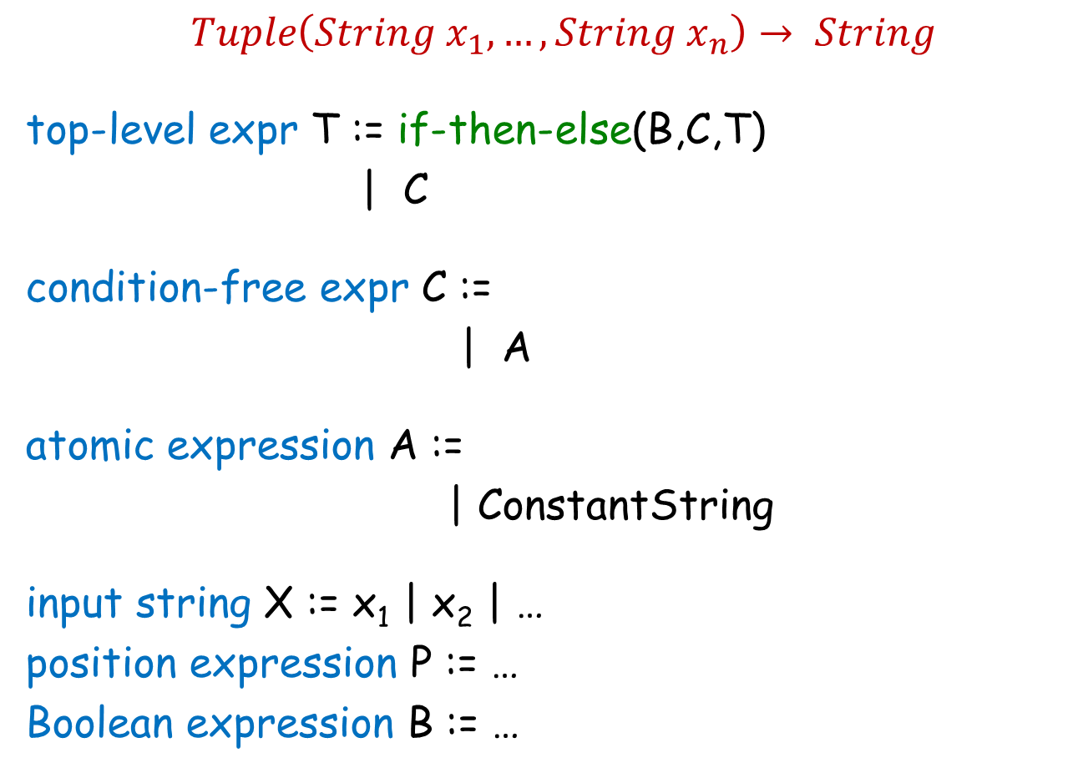
FlashFill DSL
$Tuple\left(String x_{1},…,String x_{n}\right)→ String$
top-level expr T := if-then-else(B,C,T)
| C
condition-free expr C :=
| A
atomic expression A :=
| ConstantString
input string X := x₁ | x₂ | …
position expression P := …
Boolean expression B := …
Concatenate(A, C)
SubStr(X, P, P)
“Automating string processing in spreadsheets using input-output examples”; POPL 2011; Gulwani

Slide 38
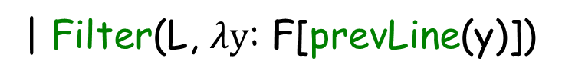
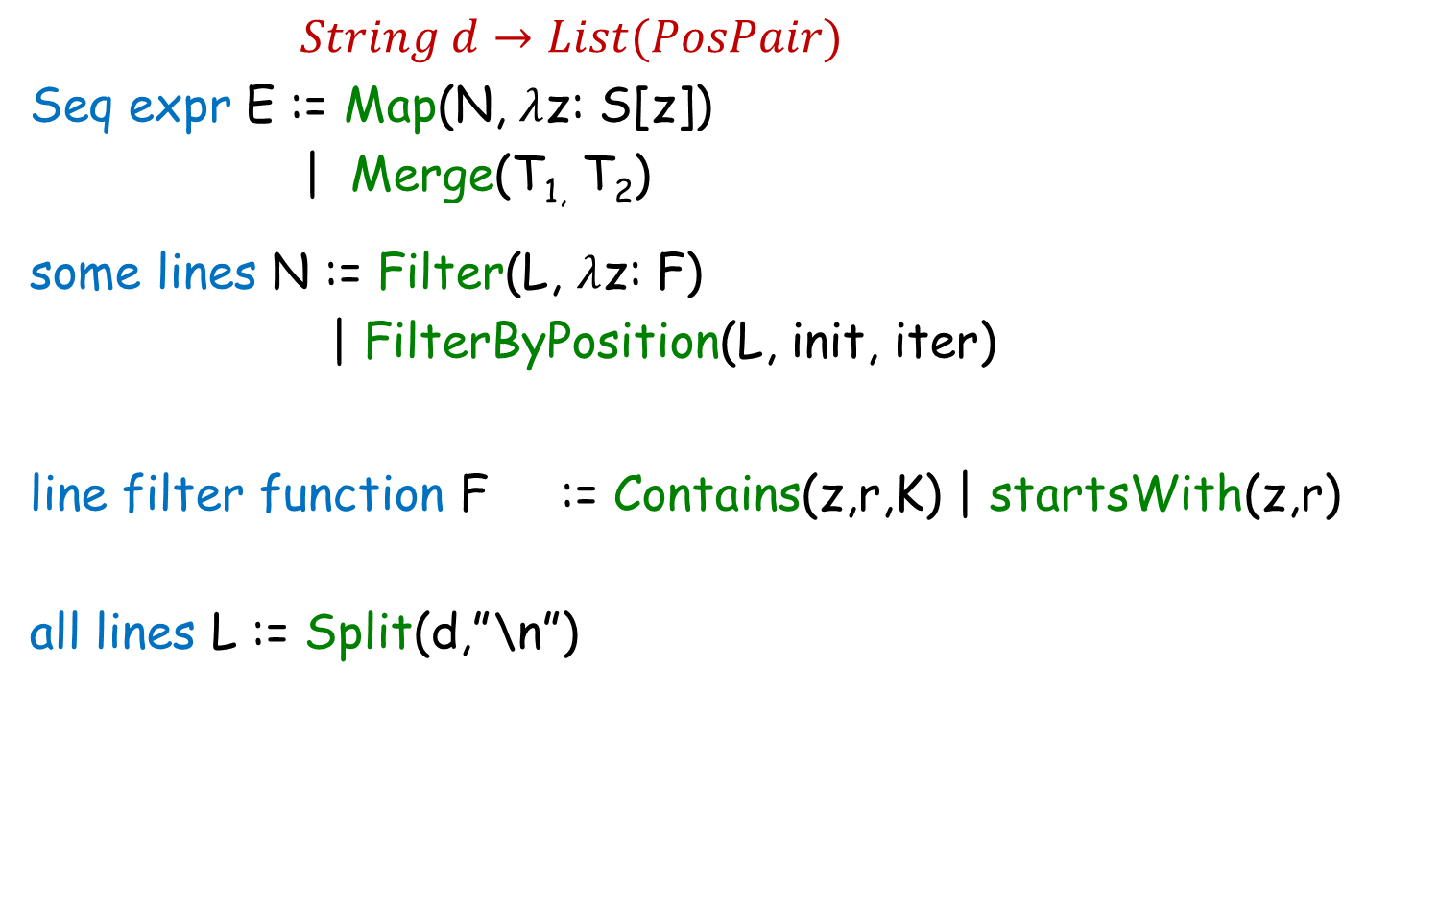
FlashExtract DSL
$String d→List(PosPair)$
Seq expr E := Map(N, $λ$z: S[z])
| Merge(T_{1,} T₂)
some lines N := Filter(L, $λ$z: F)
| FilterByPosition(L, init, iter)
line filter function F := Contains(z,r,K) | startsWith(z,r)
all lines L := Split(d,”\n”)
[z])
| Filter(L, $λy$: F[prevLine(y)])
[z]
substr expr S[z] :=
“FlashExtract: A Framework for data extraction by examples”;
PLDI 2014; Vu Le, Sumit Gulwani

Slide 39
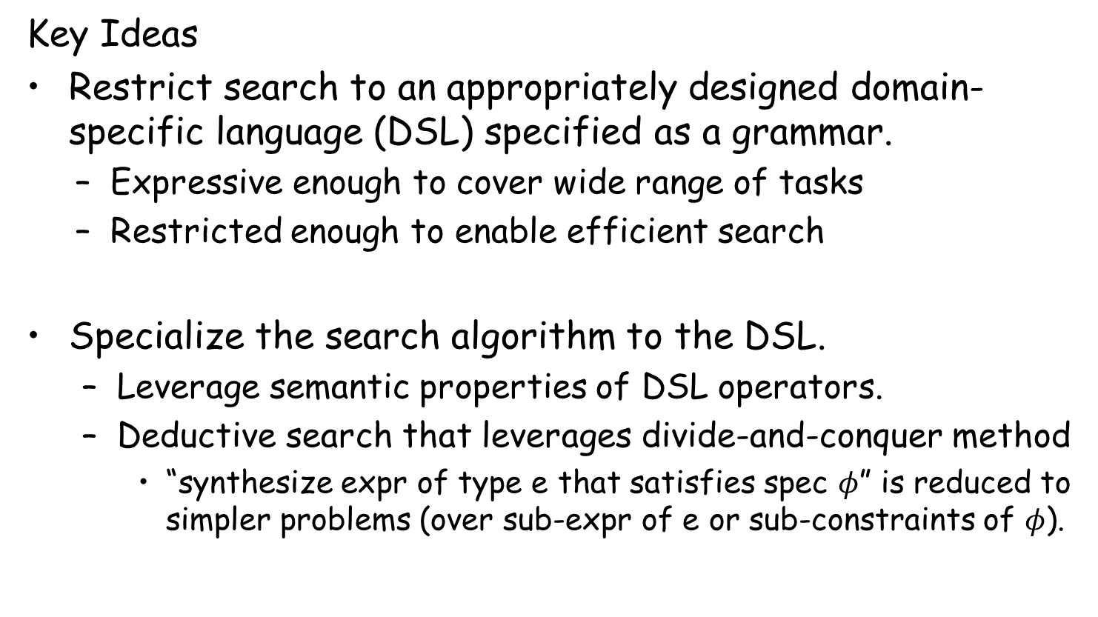
Challenge 2: Efficient search strategy
Key Ideas
Restrict search to an appropriately designed domain-specific language (DSL) specified as a grammar.
  Expressive enough to cover wide range of tasks
  Restricted enough to enable efficient search
Specialize the search algorithm to the DSL.
  Leverage semantic properties of DSL operators.
  Deductive search that leverages divide-and-conquer method
    “synthesize expr of type e that satisfies spec $φ$” is reduced to simpler problems (over sub-expr of e or sub-constraints of $φ$).
“Spreadsheet Data Manipulation using Examples” [CACM 2012 Research Highlights] Gulwani, Harris, Singh

Slide 40




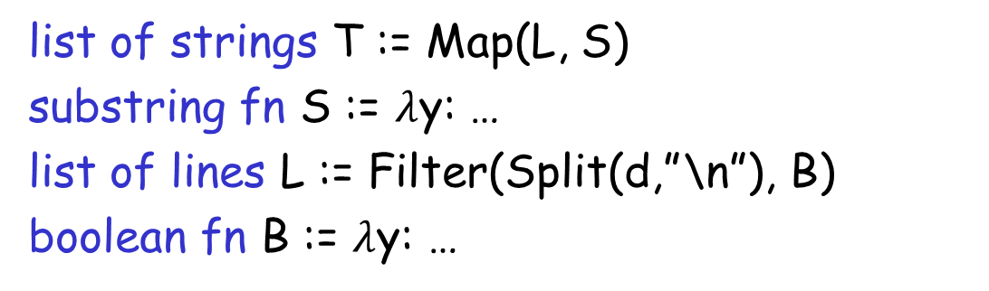

Problem Reduction
list of strings T := Map(L, S)
substring fn S := $λ$y: …
list of lines L := Filter(Split(d,”\n”), B)
boolean fn B := $λ$y: …
FlashExtract DSL
$$⋈$$
Spec for S
Spec for T
Spec for L
$$∧$$

Slide 41

Problem Reduction
substring expr E := SubStr(y, P₁, P₂)
position expr P := K | Pos(y, R₁, R₂, K)
SubStr grammar
$$⋈$$
Spec for E
Spec for P₁
Spec for P₂
Redmond, WA
Redmond, WA

Slide 42
PBE Architecture
Example-based specification
Ordered set of Programs
Program
Ranking
Function
Search Algorithm
Challenge 1: Ambiguous/under-specified intent may result in unintended programs.
Challenge 2: Designing efficient search strategy.
Challenge 3: Lowering the barrier to design & development.

Slide 43
Challenge 3: Lowering the barrier
Developing a domain-specific robust search method is costly:
Requires domain-specific algorithmic insights.
Robust implementation requires good engineering.
DSL extensions/modifications are not easy.
Key Ideas:
PBE algorithms employ a divide and conquer strategy, where synthesis problem for an expression F(e1,e2) is reduced to synthesis problems for sub-expressions e1 and e2.
  The divide-and-conquer strategy can be refactored out.
Reduction depends on the logical properties of operator F.
  Operator properties can be captured in a modular manner for reuse inside other DSLs.
“FlashMeta: A Framework for Inductive Program Synthesis” [OOPSLA 2015] Polozov, Gulwani

Slide 44
Programming by Examples
Example-based specification
Ordered set of Programs
Ranking
Function
Search Algorithm
DSL
Challenge 1: Ambiguous/under-specified intent may result in unintended programs.
Challenge 2: Designing efficient search strategy.
Challenge 3: Lowering the barrier to design & development.

Slide 45
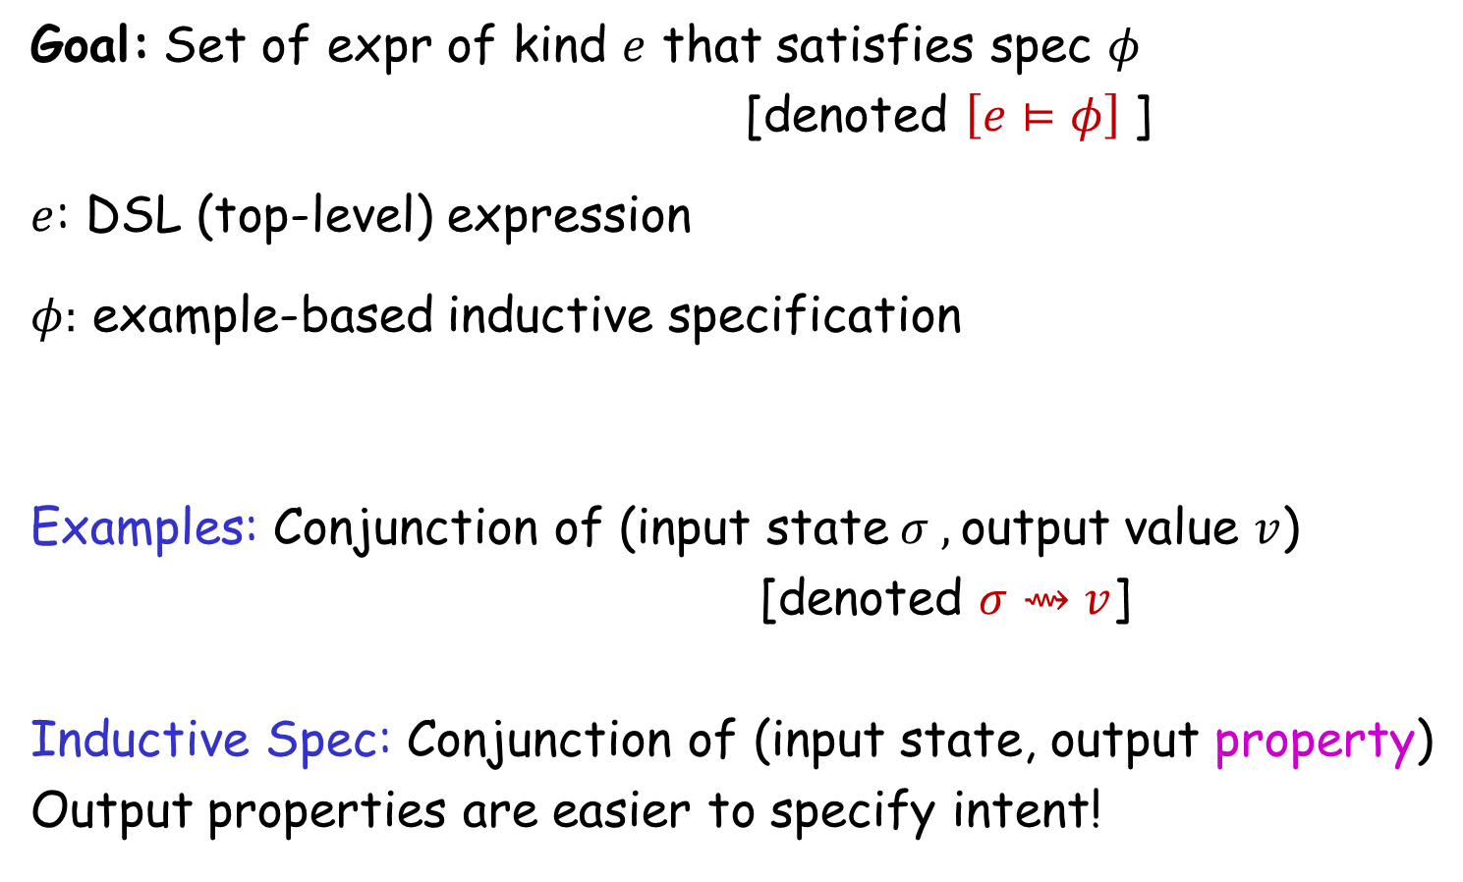
Search Strategy
Goal: Set of expr of kind $e$ that satisfies spec $φ$
[denoted $\left[e⊨φ\right]$]
$e$: DSL (top-level) expression
$φ:$ example-based inductive specification
Examples: Conjunction of (input state$σ ,$output value $v$)
[denoted $σ⇝v$]
Inductive Spec: Conjunction of (input state, output property)
Output properties are easier to specify intent!

Slide 46

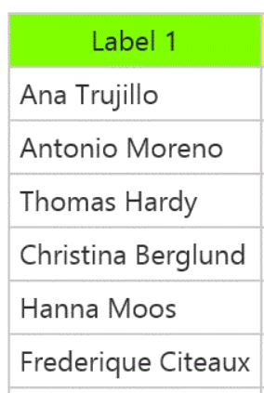

Output properties
Task
Elements belonging to the output list
Elements not belonging to the output list
Contiguous subsequence of the output list
Prefix of the output list

Slide 47

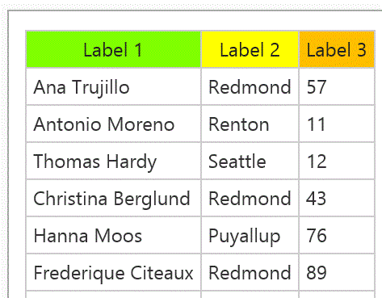
Output properties
Task
Prefix of the output table (seq of records)
We do not require explicit (magenta) record boundaries in which case the spec is:
Prefixes of projections of the output table

Slide 48
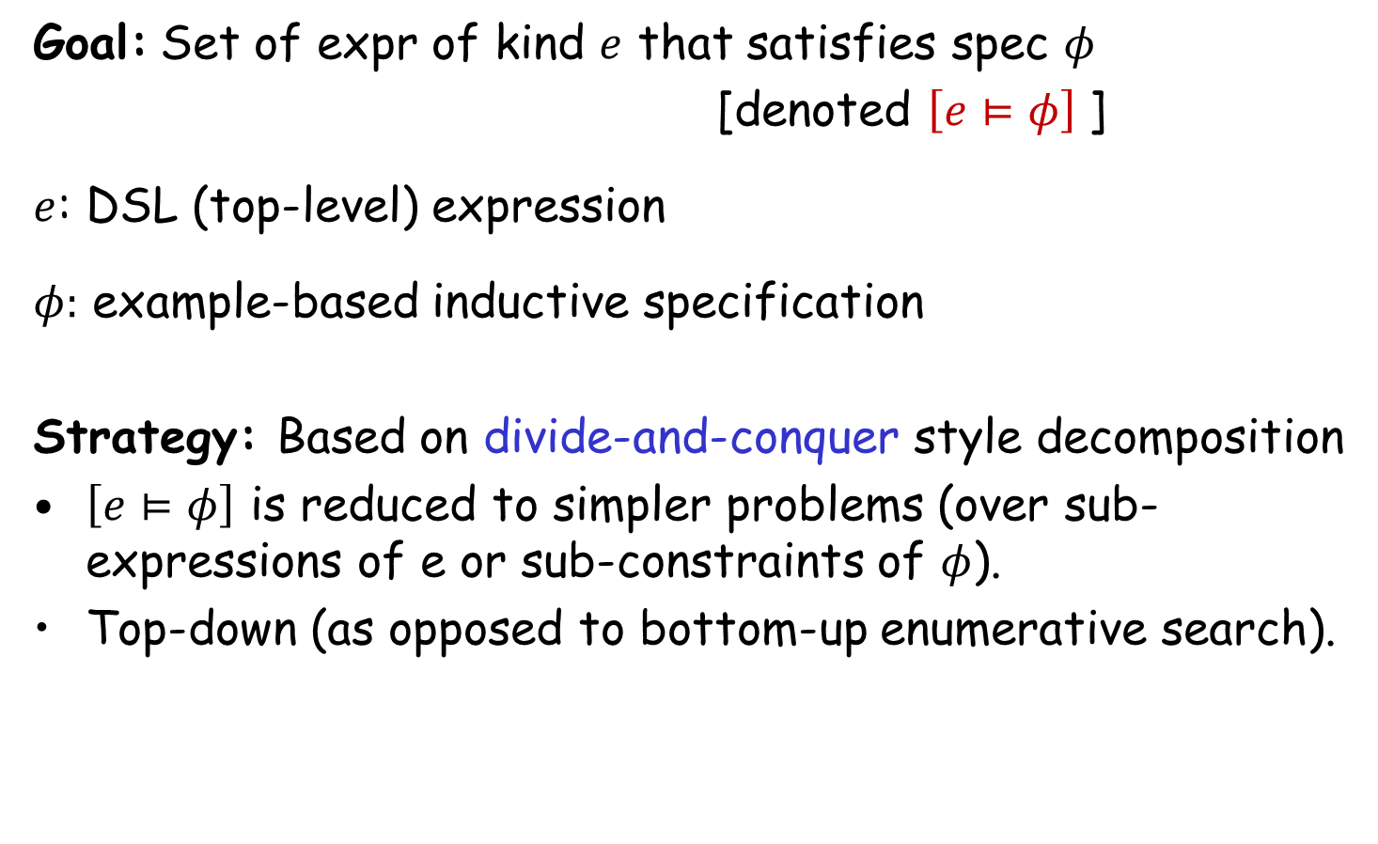
Search Strategy
Goal: Set of expr of kind $e$ that satisfies spec $φ$
[denoted $\left[e⊨φ\right]$]
$e$: DSL (top-level) expression
$φ:$ example-based inductive specification
Strategy: Based on divide-and-conquer style decomposition
$\left[e⊨φ\right]$ is reduced to simpler problems (over sub-expressions of e or sub-constraints of $φ$).
Top-down (as opposed to bottom-up enumerative search).

Slide 49
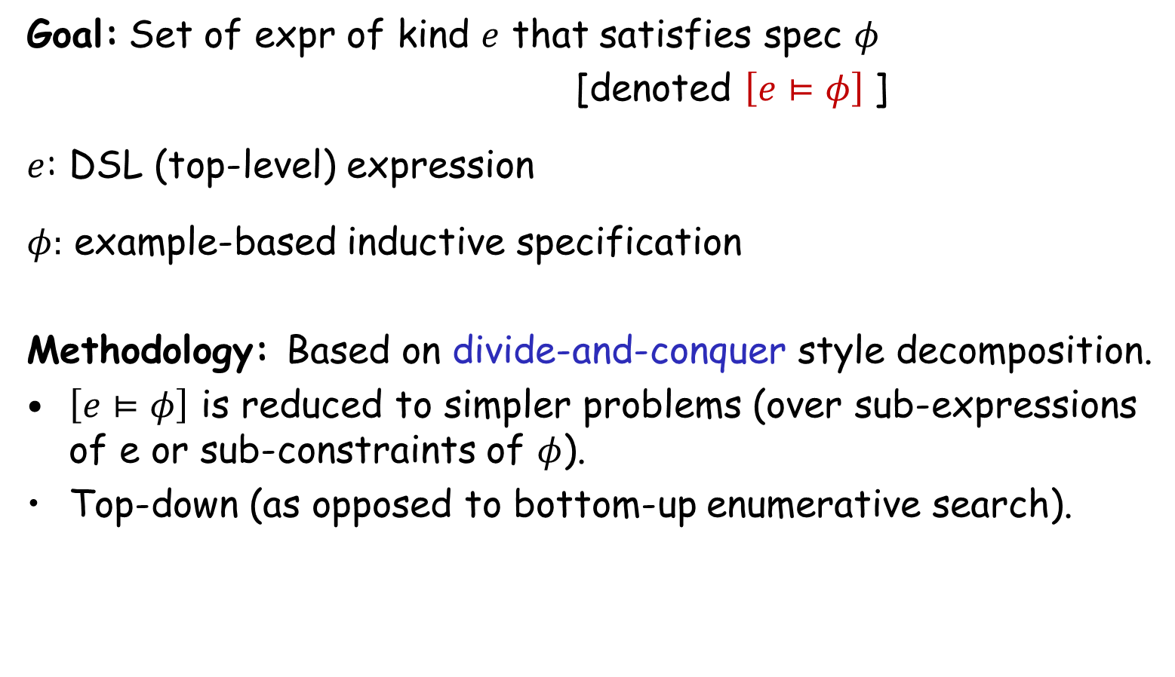
Search Strategy
Goal: Set of expr of kind $e$ that satisfies spec $φ$
[denoted $\left[e⊨φ\right]$]
$e$: DSL (top-level) expression
$φ:$ example-based inductive specification
Methodology: Based on divide-and-conquer style decomposition.
$\left[e⊨φ\right]$ is reduced to simpler problems (over sub-expressions of e or sub-constraints of $φ$).
Top-down (as opposed to bottom-up enumerative search).
Key concepts in problem reduction: VSAs & Witness functions

Slide 50
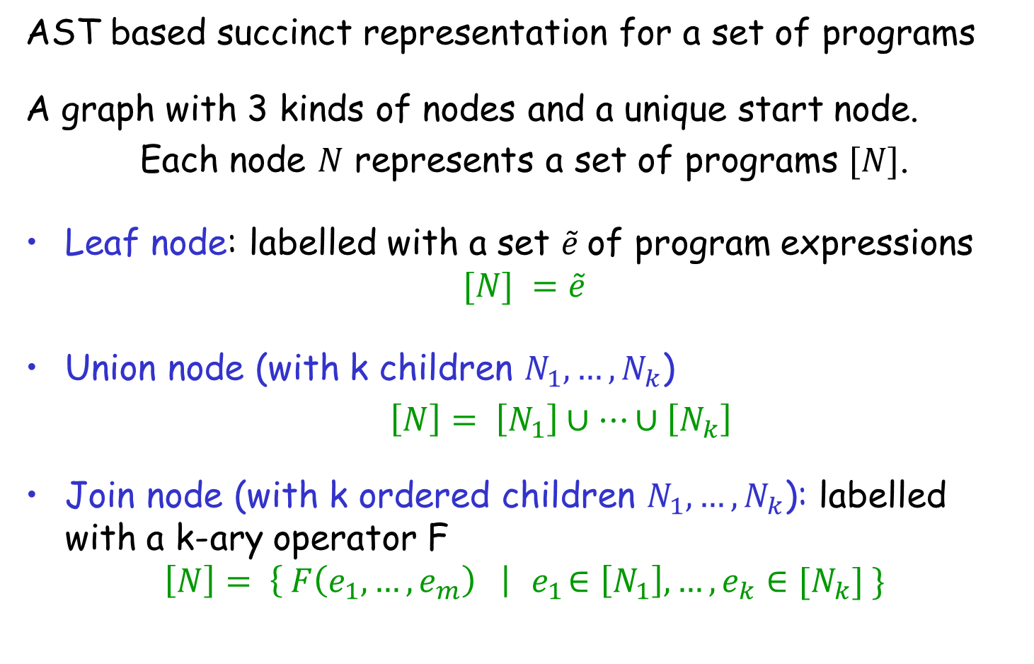
Version Space Algebra (VSA)
AST based succinct representation for a set of programs
A graph with 3 kinds of nodes and a unique start node.
Each node $N$ represents a set of programs $[N]$.
Leaf node: labelled with a set $\tilde{e}$of program expressions
$$[N] =\tilde{e}$$
Union node (with k children $N_{1}, …, N_{k}$)
$\left[N\right]= \left[N_{1}\right]∪…∪\left[N_{k}\right]$
Join node (with k ordered children $N_{1}, …, N_{k}$): labelled with a k-ary operator F
$$\left[N\right]= \left\{ F\left(e_{1}, …, e_{m}\right) \right|{ e}_{1}∈\left[N_{1}\right], …, e_{k}∈[N_{k}] \}$$

Slide 51
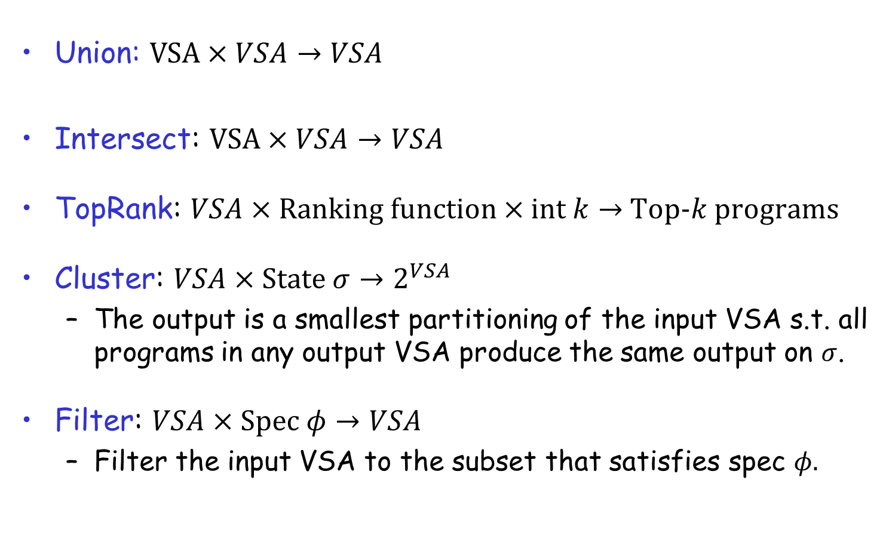
VSA Operations
Union: $VSA×VSA→VSA$
Intersect: $VSA×VSA→VSA$
TopRank: $VSA×Ranking function×int k→$ Top-$k$ programs
Cluster: $VSA×State σ→2^{VSA}$
  The output is a smallest partitioning of the input VSA s.t. all programs in any output VSA produce the same output on $σ$.
Filter: $VSA×Spec φ→VSA$
  Filter the input VSA to the subset that satisfies spec $φ.$

Slide 52



Problem Reduction Rules
$$\left[e⊨φ\right]=$$
where $e$ is a non-terminal defined as $e ≔e_{1} | e_{2}$
$$\left[e⊨φ_{1}∧φ_{2}\right] =$$
$$Union(\left[e_{1}⊨φ\right], \left[e_{2}⊨φ\right])$$
$$Intersect(\left[e⊨φ_{1}\right], \left[e⊨φ_{2}\right])$$

Slide 53
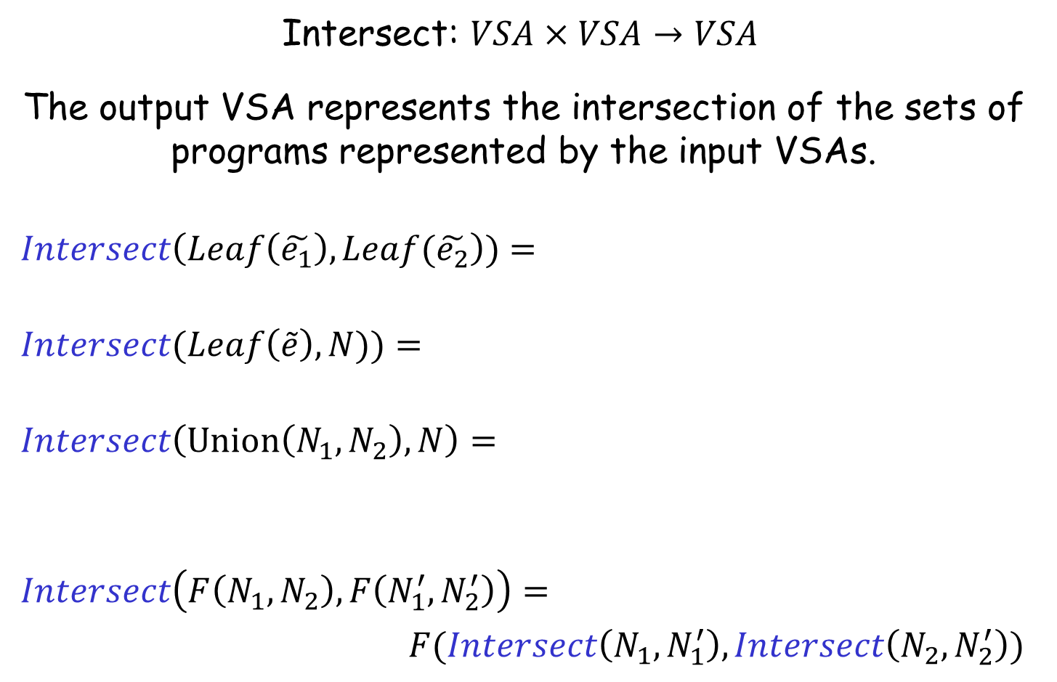


Intersect Operation
Intersect: $VSA×VSA→VSA$
The output VSA represents the intersection of the sets of programs represented by the input VSAs.
$$Intersect\left(Leaf\left(\tilde{e_{1}}\right), Leaf(\tilde{e_{2}}\right))=$$
$$Intersect(Leaf\left(\tilde{e}\right), N))=$$
$$Intersect\left(Union\left(N_{1},N_{2}\right), N\right)=$$
$$Intersect\left(F\left(N_{1},N_{2}\right), F\left(N_{1}^{′}, N_{2}^{′}\right)\right)=$$
$F(Intersect\left(N_{1},N_{1}^{′}\right), Intersect\left(N_{2},N_{2}^{′}\right))$
$$Leaf\left(\tilde{e_{1}}∩\tilde{e_{2}}\right)$$
$$\{ e∈\tilde{e }| e∈\left[N\right] \}$$
$$Union(Intersect\left(N_{1},N\right),Intersect\left(N_{2},N\right))$$

Slide 54


Problem Reduction Rules
$$\left[e⊨φ\right]=$$
where $e$ is a non-terminal defined as $e ≔e_{1} | e_{2}$
$$\left[e⊨φ_{1}∧φ_{2}\right] =$$
$\left[e⊨φ_{1}∧φ_{2}\right] =$
$$Union(\left[e_{1}⊨φ\right], \left[e_{2}⊨φ\right])$$
$$Intersect(\left[e⊨φ_{1}\right], \left[e⊨φ_{2}\right])$$
$$Filter(\left[e⊨φ_{1}\right], φ_{2})$$

Slide 55
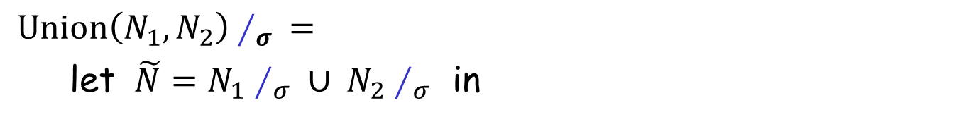

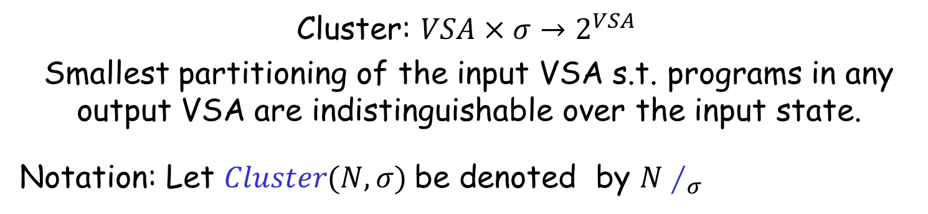
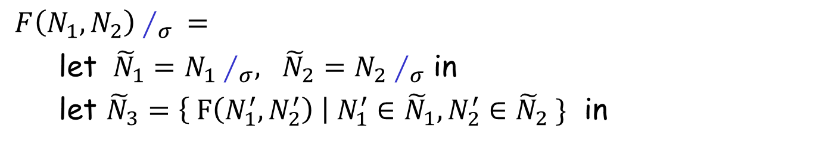

Cluster Operation
Cluster: $VSA×σ→2^{VSA}$
Smallest partitioning of the input VSA s.t. programs in any output VSA are indistinguishable over the input state.
Notation: Let $Cluster(N,σ)$be denoted by $N∕_{σ}$
$Union\left(N_{1},N_{2}\right)∕_{σ} =$
let $\tilde{N}=N_{1}∕_{σ} ∪ N_{2}∕_{σ}$ in
$Merge(\tilde{N},σ)$
$F\left(N_{1},N_{2}\right)∕_{σ} =$
let ${\tilde{N}}_{1}=N_{1}∕_{σ}, {\tilde{N}}_{2}=N_{2}∕_{σ}$ in
let ${\tilde{N}}_{3}=\left\{ F\left(N_{1}^{′},N_{2}^{′}\right) \right| N_{1}^{′}∈{\tilde{N}}_{1}, N_{2}^{′}∈{\tilde{N}}_{2} \}$ in
$Merge({\tilde{N}}_{3},σ)$
$Merge\left(\tilde{N},σ \right)$unites VSAs in $\tilde{N}$that have same behavior on $σ$.

Slide 56

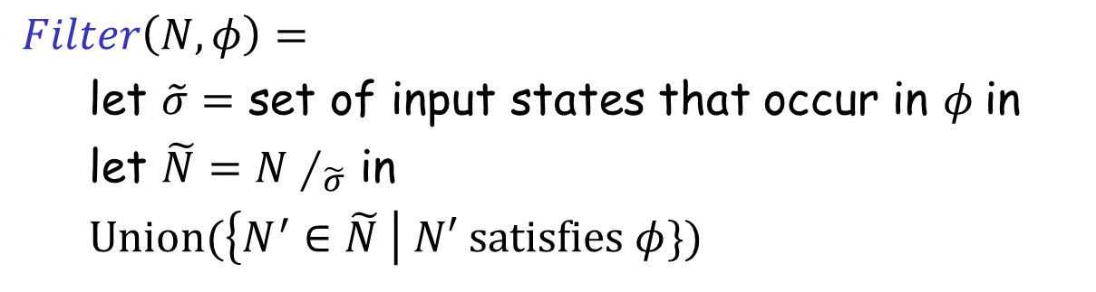
Filter Operation
Filter: $VSA×φ→VSA$
  Filter the input VSA to the subset that satisfies $φ.$
$Filter\left(N,φ\right)=$
let $\tilde{σ}=$ set of input states that occur in $φ$in
let $\tilde{N}=N∕_{\tilde{σ}}$ in
$Union(\left\{N^{′}∈\tilde{N} \right| N′ satisfies φ\})$

Slide 57
Problem Reduction Rules
$$\left[e⊨φ\right]=$$
where $e$ is a non-terminal defined as $e ≔e_{1} | e_{2}$
$$\left[e⊨φ_{1}∧φ_{2}\right] =$$
$\left[e⊨φ_{1}∧φ_{2}\right] =$
$$Union(\left[e_{1}⊨φ\right], \left[e_{2}⊨φ\right])$$
$$Intersect(\left[e⊨φ_{1}\right], \left[e⊨φ_{2}\right])$$
$$Filter(\left[e⊨φ_{1}\right], φ_{2})$$

Slide 58
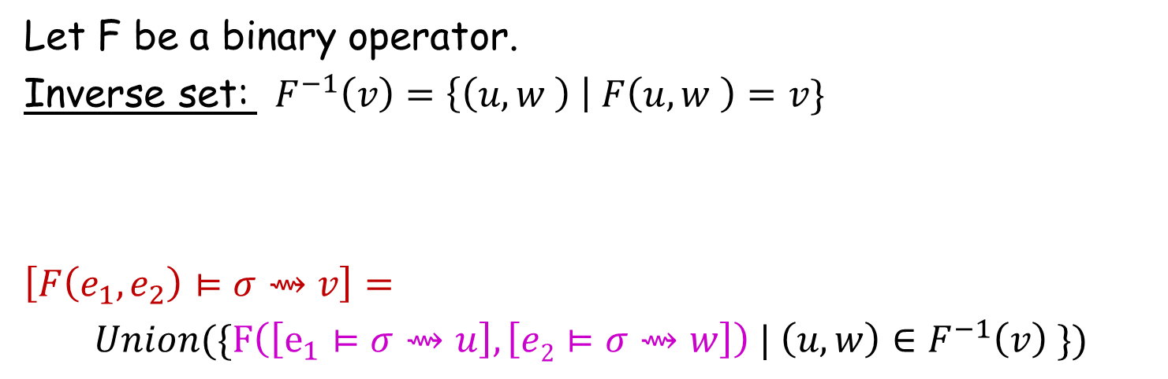
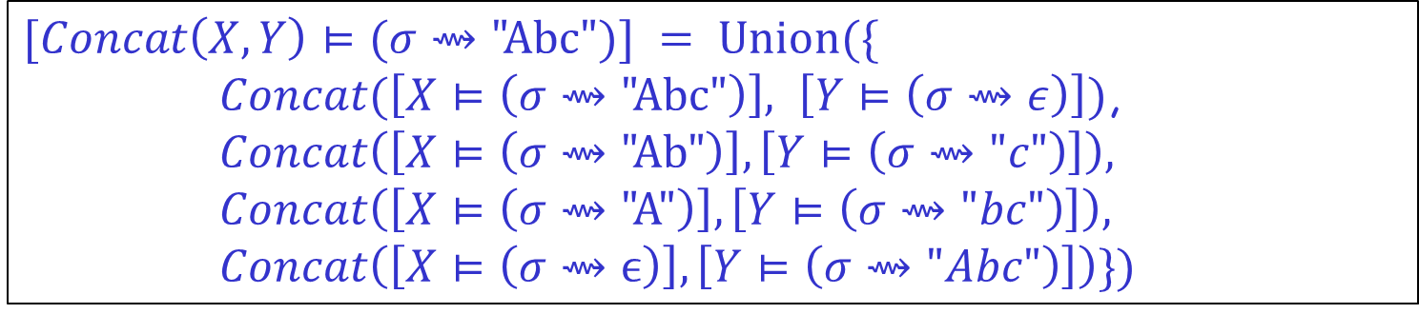
Problem Reduction Rules
Let F be a binary operator.
Inverse set: $F^{−1}\left(v\right)=\left\{\left(u,w \right) \right| F\left(u,w \right)=v\}$
$$\left[F\left(e_{1},e_{2}\right)⊨σ⇝v\right]=$$
$Union(\{F\left(\left[e_{1}⊨σ⇝u\right], \left[e2⊨σ⇝w\right]\right) | \left(u,w\right)∈F^{−1}\left(v\right) \})$
$$\{\left( \text{"}\text{Abc}\text{",}ϵ\right), ("Ab\text{","}\text{c}\text{"), ("}\text{A}\text{","}\text{bc}\text{"), (}ϵ,\text{"}\text{Abc}\text{")\}}$$
$$Concat^{−1}\left(\text{"}\text{Abc}\text{"}\right)=$$
$$[Concat\left(X,Y\right)⊨(σ⇝\text{"}\text{Abc}")] = Union(\{$$
$Concat(\left[X⊨\left(σ⇝\text{"}\text{Abc}\text{"}\right)\right], \left[Y⊨\left(σ⇝ε\right)\right])$,
$$Concat\left(\left[X⊨\left(σ⇝\text{"}\text{Ab}\text{"}\right)\right],\left[Y⊨\left(σ⇝"c"\right)\right]\right),$$
$$Concat\left(\left[X⊨\left(σ⇝\text{"}\text{A}\text{"}\right)\right],\left[Y⊨\left(σ⇝"bc"\right)\right]\right),$$
$$Concat\left(\left[X⊨\left(σ⇝ϵ\right)\right],\left[Y⊨\left(σ⇝"Abc"\right)\right]\right)\})$$

Slide 59
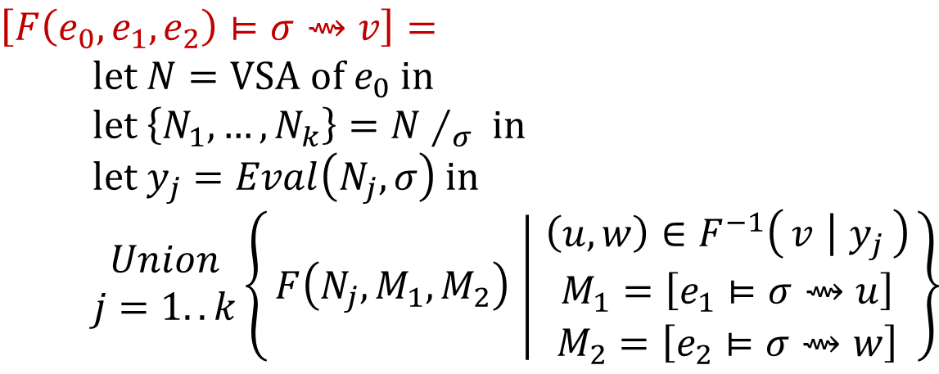
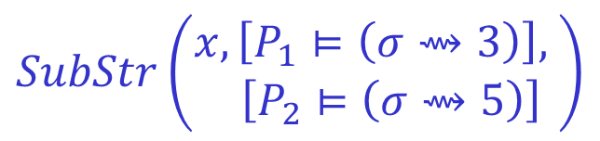

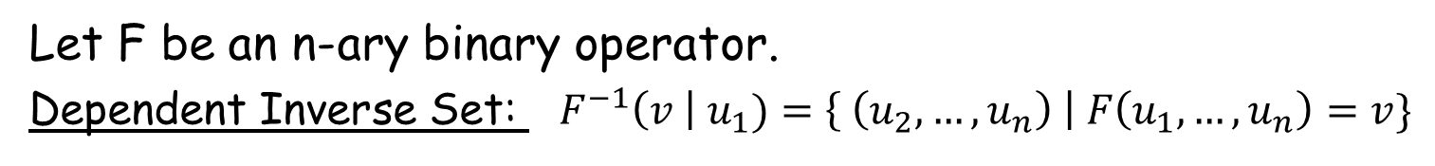
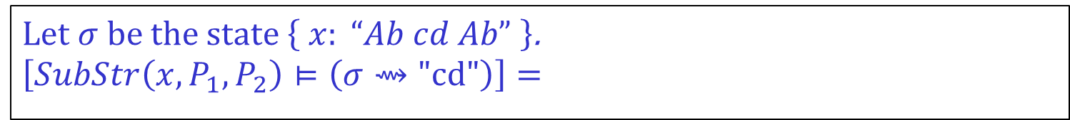
Problem Reduction Rules
Let F be an n-ary binary operator.
Dependent Inverse Set: ${ F}^{−1}\left(v \right| u_{1})=\left\{ \left(u_{2},…, u_{n}\right) \right| F\left(u_{1},…,u_{n}\right)=v\}$
$$\{ \left(0,2\right), (6,8) \}$$
$$SubStr^{−1}\left(\text{"}\text{Ab}\text{"} \right| "Ab cd Ab")=$$
$$\left[F\left(e_{0},e_{1},e_{2}\right)⊨σ⇝v\right]= \\ \text{let} N=\text{VSA} \text{of} e_{0} \text{in} \\ \text{let} \left\{N_{1},…, N_{k}\right\}=N∕_{σ} \text{in} \\ \text{let} y_{j}=Eval\left(N_{j},σ\right) \text{in} \\ \begin{matrix}Union \\ j=1..k\end{matrix}\left\{F\left(N_{j},M_{1},M_{2}\right) ∣ \begin{matrix}\left(u,w\right)∈F^{−1}\left(v ∣ y_{j}\right) \\ M_{1}=\left[e_{1}⊨σ⇝u\right] \\ M_{2}=\left[e_{2}⊨σ⇝w\right]\end{matrix}\right\}$$
Let $σ$be the state $\left\{ x: “Ab cd Ab” \right\}$.
$$\left[SubStr\left(x,P_{1},P_{2}\right)⊨\left(σ⇝\text{"}\text{cd}\text{"}\right)\right]=$$
$$SubStr\left(\begin{aligned}x,\left[P_{1}⊨\left(σ⇝3\right)\right], \\ \left[P_{2}⊨\left(σ⇝5\right)\right]\end{aligned}\right)$$

Slide 60

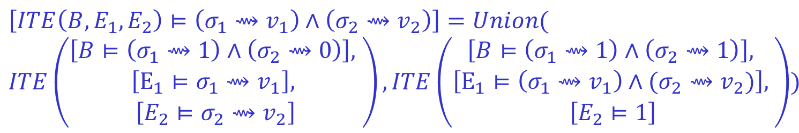
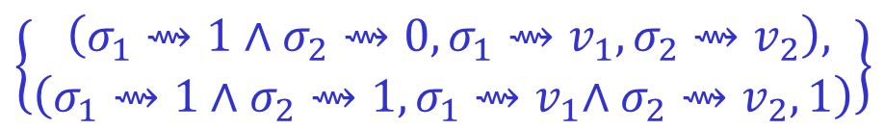
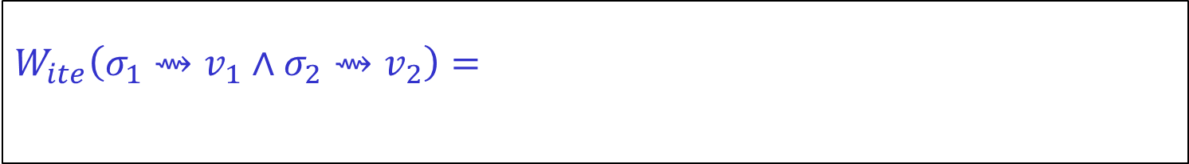
Problem Reduction Rules
Let F be an n-ary operator.
Witness Function: $W_{F}\left(φ\right)=\left\{\left(φ_{1},…,φ_{n}\right) \right| ∀g_{i}⊨φ_{i}: F\left(g_{1},…, g_{n}\right)⊨φ \}$
$$\left[F\left(e_{1},e_{2}\right)⊨φ\right]=$$
$$W_{ite}\left(σ_{1}⇝v_{1}∧σ_{2}⇝v_{2}\right)=$$
$$\left\{\begin{aligned} \left(σ_{1}⇝1∧σ_{2}⇝0,σ_{1}{⇝v}_{1},σ_{2}⇝v_{2}\right), \\ \left(σ_{1}⇝1∧σ_{2}⇝1,σ_{1}{⇝v}_{1}∧σ_{2}⇝v_{2}, 1\right)\end{aligned}\right\}$$
$$Union(\left\{F\left(\left[e_{1}⊨φ_{1}\right], \left[e2⊨φ_{2}\right]\right) \right| \left(φ_{1},φ_{2}\right)∈W_{F}\left(φ\right)\})$$
$$\left[ITE\left(B,E_{1},E_{2}\right)⊨\left(σ_{1}⇝v_{1}\right)∧\left(σ_{2}⇝v_{2}\right)\right]=Union($$
$$ITE\left(\begin{aligned}\left[B⊨\left(σ_{1}⇝1\right)∧\left(σ_{2}⇝0\right)\right], \\ \begin{aligned}\left[E_{1}⊨σ_{1}⇝v_{1}\right], \\ \left[E_{2}⊨σ_{2}⇝v_{2}\right]\end{aligned}\end{aligned}\right), ITE\left(\begin{aligned}\begin{aligned}\left[B⊨\left(σ_{1}⇝1\right)∧\left(σ_{2}⇝1\right)\right], \\ \left[E_{1}⊨\left(σ_{1}⇝v_{1}\right)∧(σ_{2}⇝v_{2})\right], \end{aligned} \\ \left[E_{2}⊨1\right]\end{aligned}\right))$$

Slide 61
FlashMeta Framework
Provides efficient implementations of VSA operations
Provides a library of witness functions
Role of synthesis designer
Can add new operators and witness functions.
Can provide ranking strategies.
Can specify tactics to resolve non-determinism in search
  Which witness function to use?
  How to order search branches?

Slide 62
Comparison of FlashMeta with hand-tuned implementations
Lines of Code (K)
Development time (months)
Project
FlashFill
FlashExtractText
FlashRelate
FlashNormalize
FlashExtractWeb
Original | FlashMeta
12 | 3
7 | 4
5 | 2
17 | 2
N/A | 2.5
Original | FlashMeta
9 | 1
8 | 1
8 | 1
7 | 2
N/A | 1.5
Running time of FlashMeta implementations vary between 0.5-3x of the corresponding original implementation.
Faster because of some free optimizations
Slower because of larger feature sets & a generalized framework

Slide 63
PROSE
Microsoft FlashMeta SDK
A Framework for creating Inductive Synthesizers
PROSE: PROgram Synthesis using Examples
https://microsoft.github.io/prose

Slide 64

The PROSE Team
Adam Smith
Vu Le
Sumit Gulwani
Danny Simmons
Daniel Perelman
Mohammad Raza
Alex Polozov

Slide 65
Deductive Synthesis vs Inductive Synthesis
Deductive Synthesis
Refers to synthesis using deductive methods.
Has traditionally been applied to synthesis in the presence of logical specifications.
Inductive Synthesis
Refers to synthesis from inductive (example-based) specifications.
Various kinds of techniques have been applied including constraint solving, stochastic, and enumerative search.
This talk describes techniques for synthesis from inductive specifications using deductive methods!

Slide 66
PBE vs Machine Learning
Traditional PBE | Traditional Machine Learning
Requires few examples. | Requires too many examples
Generates human readable and editable models. | Generates black-box models
Models are deterministic and intended to work correctly. | Models are probabilistic and aimed for high precision.
Generally does not handle noise. | Can handle noise in input data.
Opportunity: Combine complementary strengths of PBE & ML.
generalization via probabilistic models.
can be useful in data cleaning.

Slide 67
Key messages
Data wrangling is a killer application for PBE today!
  99% of end users are non-programmers.
  Data scientists spend 80% time in cleaning data.
Ambiguity Resolution is an integral part of PBE
  Ranking (ML)
  User interaction models (HCI)
Approach
  Domain-specific language
  Divide-and-conquer based deductive search paradigm

