Slide 1



Formal Methods
in
Data Wrangling & Education
Sumit Gulwani
Invited Talk @ CBSoft
Sep 2015

Slide 2



The New Opportunity
Traditional customer for PL community
Two orders of magnitude more computer users.
Struggle with repetitive tasks.
End Users
Software developer
Formal methods can play a significant role!
(in conjunction with ML, HCI)

Slide 3




Spreadsheet help forums

Slide 4




Typical help-forum interaction
300_w30_aniSh_c1_b → w30
300_w5_aniSh_c1_b → w5
=MID(B1,5,2)
=MID(B1,5,2)
=MID(B1,FIND(“_”,$B:$B)+1, FIND(“_”,REPLACE($B:$B,1,FIND(“_”,$B:$B),””))-1)

Slide 5
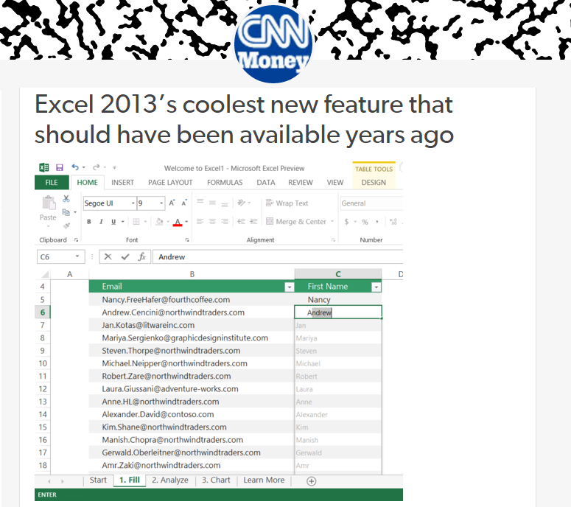
Flash Fill (Excel 2013 feature) demo
“Automating string processing in spreadsheets using input-output examples”; POPL 2011; Sumit Gulwani

Slide 6

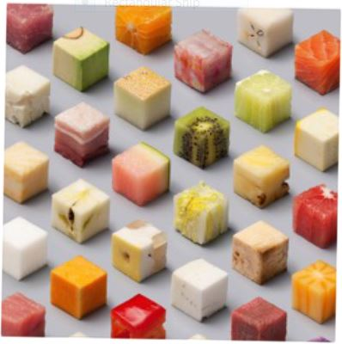






Data Wrangling
Data locked up in silos in various formats
  Flexible organization for viewing but challenging to manipulate.
Wrangling workflow: Extraction, Transformation, Formatting
Data scientists spend 80% of their time wrangling data.
Programming by Examples (PBE) can enable easier & faster data wrangling experience.

Slide 7

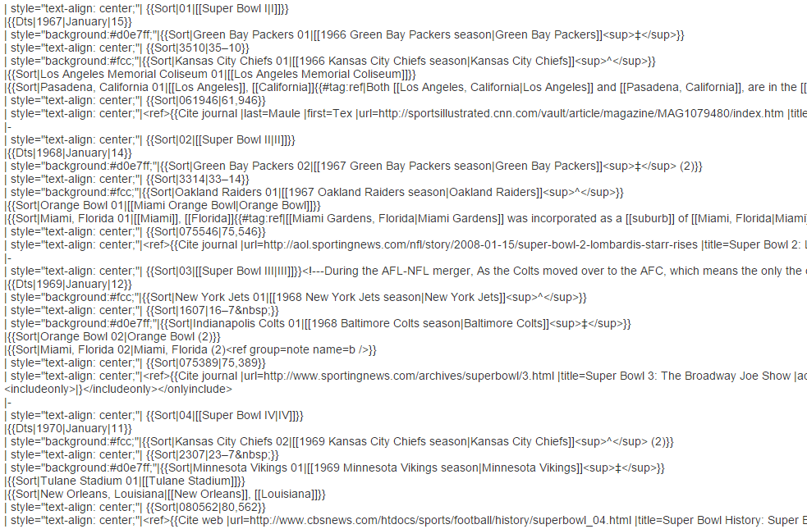
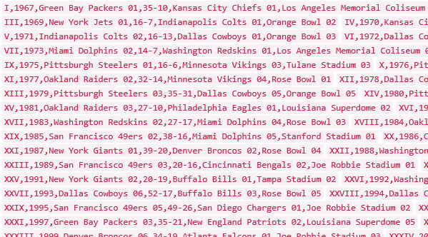
Data Science Class Assignment
To get Started!

Slide 8
FlashExtract Demo
“FlashExtract: A Framework for data extraction by examples”;
PLDI 2014; Vu Le, Sumit Gulwani

Slide 9
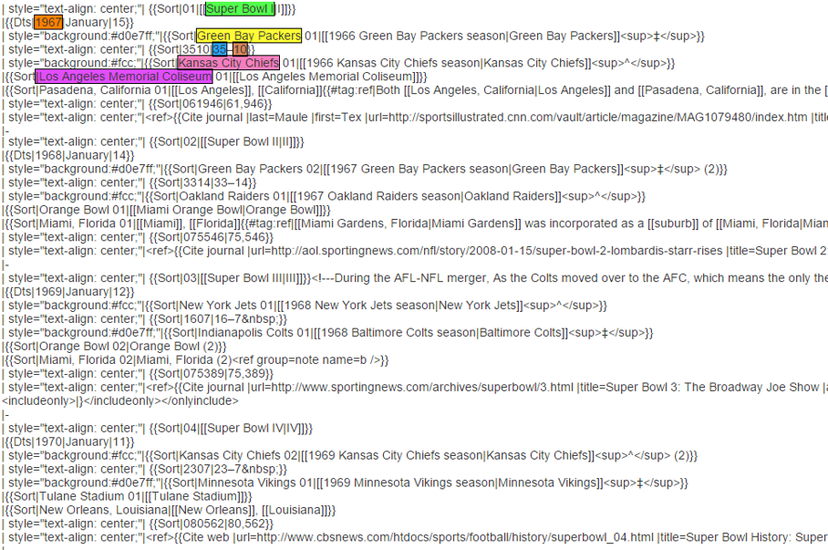
FlashExtract

Slide 10
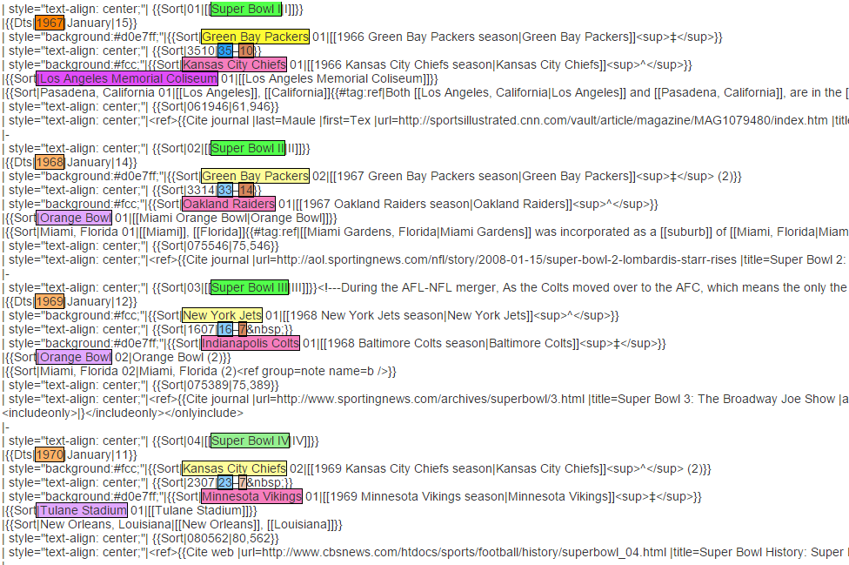
FlashExtract

Slide 11
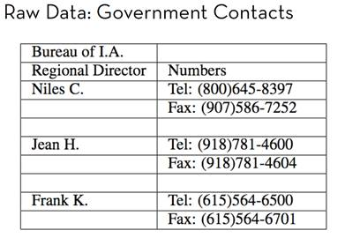
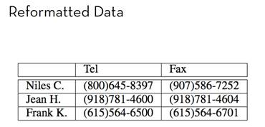
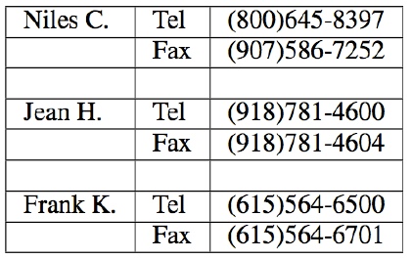
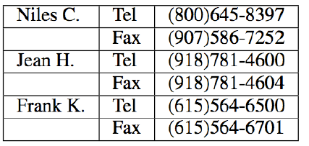
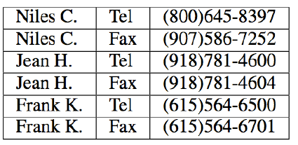
Trifacta: small, guided steps
Table Re-formatting
Start with:
End goal:
FlashRelate
4. Pivot Number on Type
Trifacta provides a series of small transformations:
1. Split on “:” Delimiter
2. Delete Empty Rows
3. Fill Values Down
From: Skills of the Agile Data Wrangler (tutorial by Hellerstein and Heer)

Slide 12
FlashRelate Demo
“FlashRelate: Extracting Relational Data from Semi-Structured Spreadsheets Using Examples”;
PLDI 2015; Barowy, Gulwani, Hart, Zorn

Slide 13
PBE tools for Data Manipulation
Extraction
FlashExtract: Extract data from text files, web pages [PLDI 2014; Powershell convertFrom-string cmdlet
Transformation
Flash Fill: Excel feature for Syntactic String Transformations [POPL 2011, CAV 2015]
Semantic String Transformations [VLDB 2012]
Number Transformations [CAV 2013]
FlashNormalize: Text normalization [IJCAI 2015]
Formatting
FlashRelate: Extract data from spreadsheets [PLDI 2015, PLDI 2011]
FlashFormat: a Powerpoint add-in [AAAI 2014]

Slide 14

Programming by Examples
Example-based specification
Program
Search Algorithm
Challenge 1: Ambiguous/under-specified intent may result in unintended programs.

Slide 15
Dealing with Ambiguity
Ranking
  Synthesize multiple programs and rank them.

Slide 16

Ranking Scheme
Rank score of a program: Weighted combination of various features.
Weights are learned using machine learning.
Program features
Number of constants
Size of constants
Features over user data: Similarity of generated output (or even intermediate values) over various user inputs
IsYear, Numeric Deviation, Number of characters
IsPersonName
“Predicting a correct program in Programming by Example”;
[CAV 2015] Rishabh Singh, Sumit Gulwani

Slide 17
FlashFill Ranking Demo

Slide 18


Need for a fall-back mechanism
“It's a great concept, but it can also lead to lots of bad data. I think many users will look at a few "flash filled" cells, and just assume that it worked. … Be very careful.”
“most of the extracted data will be fine. But there might be exceptions that you don't notice unless you examine the results very carefully.”

Slide 19
Dealing with Ambiguity
Ranking
  Synthesize multiple programs and rank them.
User Interaction Models
  Communicate actionable information to the user.

Slide 20

User Interaction Models for Ambiguity Resolution
Make it easy to inspect output correctness
  User can accordingly provide more examples
Show programs
  in any desired programming language; in English
  Enable effective navigation between programs
Computer initiated interactivity (Active learning)
  Highlight less confident entries in the output.
  Ask directed questions based on distinguishing inputs.
“User Interaction Models for Disambiguation in Programming by Example”,
[UIST 2015] Mayer, Soares, Grechkin, Le, Marron, Polozov, Singh, Zorn, Gulwani

Slide 21
FlashExtract Demo
(User Interaction Models)

Slide 22
Programming by Examples
Example-based specification
Program
Search Algorithm
Challenge 1: Ambiguous/under-specified intent may result in unintended programs.
Challenge 2: Designing efficient search algorithm

Slide 23
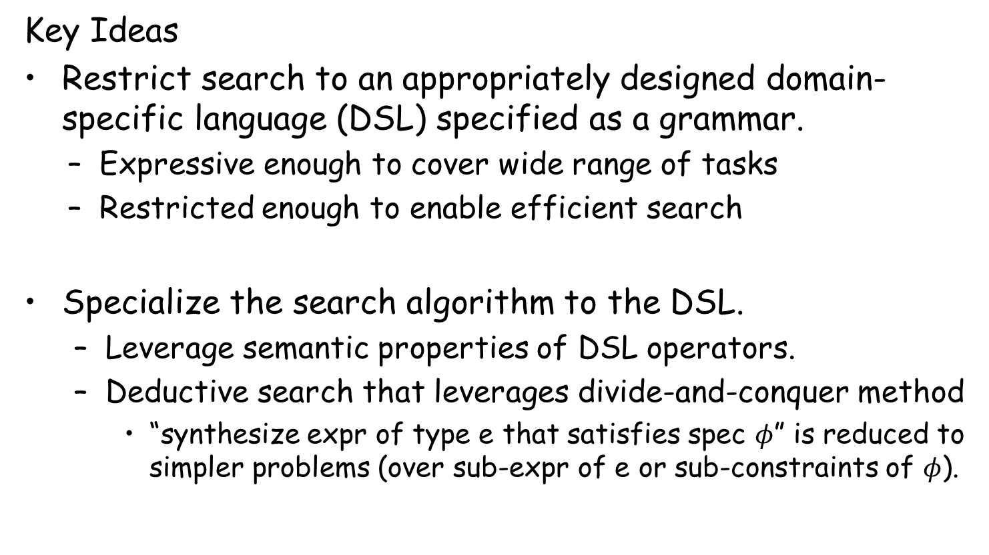
Challenge 2: Efficient search algorithm
Key Ideas
Restrict search to an appropriately designed domain-specific language (DSL) specified as a grammar.
  Expressive enough to cover wide range of tasks
  Restricted enough to enable efficient search
Specialize the search algorithm to the DSL.
  Leverage semantic properties of DSL operators.
  Deductive search that leverages divide-and-conquer method
    “synthesize expr of type e that satisfies spec $φ$” is reduced to simpler problems (over sub-expr of e or sub-constraints of $φ$).
“Spreadsheet Data Manipulation using Examples” [CACM 2012 Research Highlights] Gulwani, Harris, Singh

Slide 24
Programming by Examples
Example-based specification
Program
Search Algorithm
Challenge 1: Ambiguous/under-specified intent may result in unintended programs.
Challenge 2: Designing an efficient search algorithm.
Challenge 3: Lowering the barrier to design & development.

Slide 25
Challenge 3: Lowering the barrier
Developing a domain-specific robust search method is costly:
Requires domain-specific algorithmic insights.
Robust implementation requires good engineering.
DSL extensions/modifications are not easy.
Key Ideas:
PBE algorithms employ a divide and conquer strategy, where synthesis problem for an expression F(e1,e2) is reduced to synthesis problems for sub-expressions e1 and e2.
  The divide-and-conquer strategy can be refactored out.
Reduction depends on the logical properties of operator F.
  Operator properties can be captured in a modular manner for reuse inside other DSLs.

Slide 26
The FlashMeta Framework
A generic search algorithm parameterized by DSL, ranking features, strategy choices.
Much like parser generators
SyGus [Alur et.al, FMCAD 2013] and Rosette [Torlak et.al., PLDI 2014] are great initial efforts but too general.
“FlashMeta: A Framework for Inductive Program Synthesis”
[OOPSLA 2015] Alex Polozov, Sumit Gulwani

Slide 27
Comparison of FlashMeta with hand-tuned implementations
Lines of Code (K)
Development time (months)
PBE technology
FlashFill
FlashExtractText
FlashNormalize
FlashExtractWeb
Original | FlashMeta
12 | 3
7 | 4
17 | 2
N/A | 2.5
Original | FlashMeta
9 | 1
8 | 1
7 | 2
N/A | 1.5
Running time of FlashMeta implementations vary between 0.5-3x of the corresponding original implementation.
Faster because of some free optimizations
Slower because of larger feature sets & a generalized framework

Slide 28

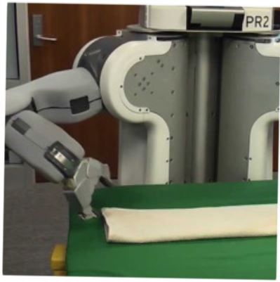
Future directions in Programming by Examples
Other application domains (E.g., robotics).
Integration with existing programming environments.
Multi-modal intent specification using combination of Examples and NL.

Slide 29

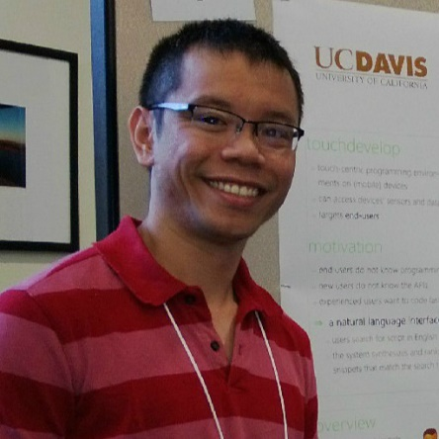


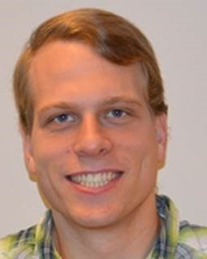
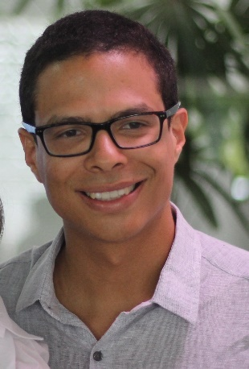



Collaborators
Dan Barowy
Maxim Grechkin
Ted Hart
Dileep Kini
Vu Le
Mikael Mayer
Alex Polozov
Rishabh Singh
Gustavo Soares
Ben Zorn

Slide 30

The New Opportunity
Traditional customer for our community
Two orders of magnitude more computer users.
Struggle with repetitive tasks.
End Users
Software developer
Students & Teachers
Formal methods can play a significant role!
(in conjunction with ML, HCI)

Slide 31
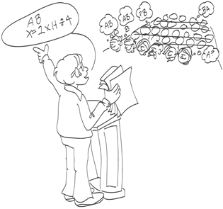
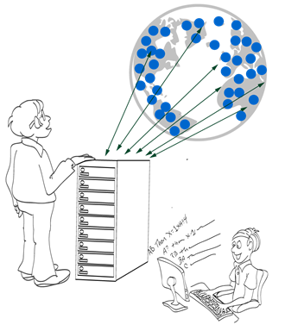
Intelligent Tutoring Systems
Repetitive tasks
Problem Generation
Feedback Generation
Various subject domains
Math, Logic
Automata, Programming
Language Learning
[CACM 2014] “Example-based Learning in Computer-aided STEM Education”;

Slide 32

Problem Generation
Motivation
Problems similar to a given problem.
  Avoid copyright issues
  Prevent cheating in MOOCs (Unsynchronized instruction)
Problems of a given difficulty level and concept usage.
  Generate progressions
  Generate personalized workflows
Key Ideas
Test input generation techniques

Slide 33
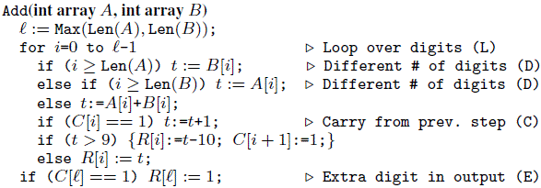
Problem Generation: Addition Procedure
Concept | Trace Characteristic | Sample Input
Single digit addition | L | 3+2
Multiple digit w/o carry | LL+ | 1234 +8765
Single carry | L* (LC) L* | 1234 + 8757
Two single carries | L* (LC) L+ (LC) L* | 1234 + 8857
Double carry | L* (LCLC) L* | 1234 + 8667
Triple carry | L* (LCLCLCLC) L* | 1234 + 8767
Extra digit in i/p & new digit in o/p | L* CLDCE | 9234 + 900
“A Trace-based Framework for Analyzing and Synthesizing Educational Progressions” [CHI 2013] Andersen, Gulwani, Popovic.

Slide 34
Problem Generation
Motivation
Problems similar to a given problem.
  Avoid copyright issues
  Prevent cheating in MOOCs (Unsynchronized instruction)
Problems of a given difficulty level and concept usage.
  Generate progressions
  Generate personalized workflows
Key Ideas
Test input generation techniques
Template-based generalization

Slide 35
Problem Generation: Algebra (Trigonometry)
$$\text{Example} \text{Problem}\text{:}{ \left(\sec{x+ \cos{x}}\right) \left(\sec{x−\cos{x}}\right)}= \tan^{2}{x+\sin^{2}{x}}$$
$$\text{Query}\text{: }\left(T_{1}\left(x\right)±T_{2}(x)\right) \left(T_{3}\left(x\right)±T_{4}\left(x\right)\right)=T_{5}^{2}\left(x\right)±T_{6}^{2}(x)$$
$${ T}_{1}≠T_{5}$$
New problems generated:
$$\left(\csc{x}+\cos{x}\right)\left(\csc{x}−\cos{x}\right)=\cot^{2}{x}+\sin^{2}{x}$$
$$(\csc{x−\sin{x)(\csc{x+\sin{x)=\cot^{2}{x+\cos^{2}{x}}}}} }$$
$$(\sec{x+\sin{x)(\sec{x−\sin{x)=\tan^{2}{x+\cos^{2}{x}}}}}}$$
:
$$(\tan{x+\sin{x)(\tan{x−\sin{x)=\tan^{2}{x −\sin^{2}{x} }}}}}$$
$$(\csc{x+\cos{x)(\csc{x−\cos{x)=\csc^{2}{x −\cos^{2}{x}}}}}}$$
:
AAAI 2012: “Automatically generating algebra problems”;
Singh, Gulwani, Rajamani.

Slide 36
Problem Generation: Algebra (Limits)
$$\text{Example} \text{Problem}\text{:} \lim_{n→∞}{\sum_{i=0}^{n}{\frac{2i^{2}+i+1}{5^{i}}= \frac{5}{2}} }$$
$$\text{Query}\text{:} \lim_{n→∞}{\sum_{i=0}^{n}{\frac{C_{0}i^{2}+C_{1}i+C_{2}}{{C_{3}}^{i}}= \frac{C_{4}}{C_{5}}} }$$
$${ C}_{0}≠0 ∧ \gcd\left(C_{0},C_{1},C_{2}\right)=\gcd\left(C_{4},C_{5}\right)=1$$
New problems generated:
$$\lim_{n→∞}{\sum_{i=0}^{n}{\frac{3i^{2}+2i+1}{7^{i}}= \frac{7}{3} }\lim_{n→∞}{\sum_{i=0}^{n}{\frac{3i^{2}+3i+1}{4^{i}}=4 } }}$$
$$\lim_{n→∞}{\sum_{i=0}^{n}{\frac{i^{2}}{3^{i}}= \frac{3}{2}} \lim_{n→∞}{\sum_{i=0}^{n}{\frac{5i^{2}+3i+3}{6^{i}}=6 } }}$$

Slide 37
Problem Generation: Algebra (Determinant)
$$\text{Ex}\text{. }\text{Problem} \left|\begin{matrix}{\left(x+y\right)}^{2} & zx & zy \\ zx & {\left(y+z\right)}^{2} & xy \\ yz & xy & {\left(z+x\right)}^{2}\end{matrix}\right|{ }=2xyz {\left(x+y+z\right)}^{3}$$
$$\text{Query} \left|\begin{matrix}F_{0}(x,y,z) & F_{1}(x,y,z) & F_{2}(x,y,z) \\ F_{3}(x,y,z) & F_{4}(x,y,z) & F_{5}(x,y,z) \\ F_{6}(x,y,z) & F_{7}(x,y,z) & F_{8}(x,y,z)\end{matrix}\right|{ }=C_{10}F_{9}(x,y,z)$$
$${ F}_{i}≔F_{j}\left[x→y;y→z;z→x\right] where \left(i,j\right)∈\{\left(4,0\right), \left(8,4\right), \left(5,1\right),…\}$$
New problems generated:
$$\left|\begin{matrix}y^{2} & x^{2} & {\left(y+x\right)}^{2} \\ {\left(z+y\right)}^{2} & z^{2} & y^{2} \\ z^{2} & {\left(x+z\right)}^{2} & x^{2}\end{matrix}\right|{ }=2{\left(xy+yz+zx\right)}^{3}$$
$$\left|\begin{matrix}yz+y^{2} & xy & xy \\ yz & zx+z^{2} & yz \\ zx & zx & xy+x^{2}\end{matrix}\right|{ }=4x^{2}y^{2}z^{2}$$

Slide 38
Problem Generation: Sentence Completion
The principal characterized his pupils as _________ because they were pampered and spoiled by their indulgent parents.
The commentator characterized the electorate as _________ because it was unpredictable and given to constantly shifting moods.
(a) cosseted (b) disingenuous (c) corrosive (d) laconic (e) mercurial
One of the problems is a real problem from SAT (standardized US exam),
while the other one was automatically generated!
From problem 1, we generate:
template T₁ = *₁ characterized *₂ as *₃ because *₄
We specialize T₁ to
template T₂ = *₁ characterized *₂ as mercurial because *₄
Problem 2 is an instance of T₂
found using web search!
KDD 2014: “LaSEWeb: Automating Search Strategies Over Semi-structured Web Data”; Alex Polozov, Sumit Gulwani

Slide 39

Feedback Generation
Motivation
Make teachers more effective.
  Save them time.
  Provide immediate insights on where students are struggling.
Can enable rich interactive experience for students.
  Generation of hints.
  Pointer to simpler problems depending on kind of mistakes.
Different kinds of feedback:
Counterexamples

Slide 40
Feedback Generation
Motivation
Make teachers more effective.
  Save them time.
  Provide immediate insights on where students are struggling.
Can enable rich interactive experience for students.
  Generation of hints.
  Pointer to simpler problems depending on kind of mistakes.
Different kinds of feedback:
Counterexamples
Nearest correct solution

Slide 41
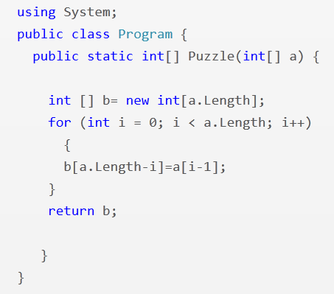
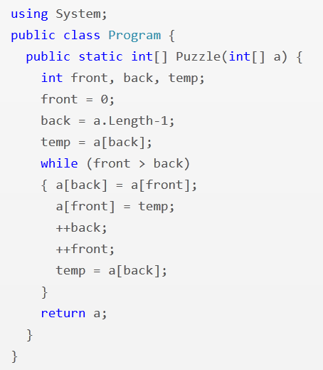
Feedback Synthesis: Programming (Array Reverse)
i = 1
i <= a.Length
front <= back
--back
PLDI 2013: “Automated Feedback Generation for Introductory Programming Assignments”; Singh, Gulwani, Solar-Lezama

Slide 42
Some Results
13,365 incorrect attempts for 13 Python problems.
(obtained from Introductory Programming course at MIT and its MOOC version on the EdX platform)
Average time for feedback = 10 seconds
Feedback generated for 64% of those attempts.
Reasons for failure to generate feedback
  Large number of errors
  Timeout (4 min)
Tool accessible at: http://sketch1.csail.mit.edu/python-autofeedback/

Slide 43
Feedback Generation
Motivation
Make teachers more effective.
  Save them time.
  Provide immediate insights on where students are struggling.
Can enable rich interactive experience for students.
  Generation of hints.
  Pointer to simpler problems depending on kind of mistakes.
Different kinds of feedback:
Counterexamples
Nearest correct solution
Strategy-level feedback

Slide 44
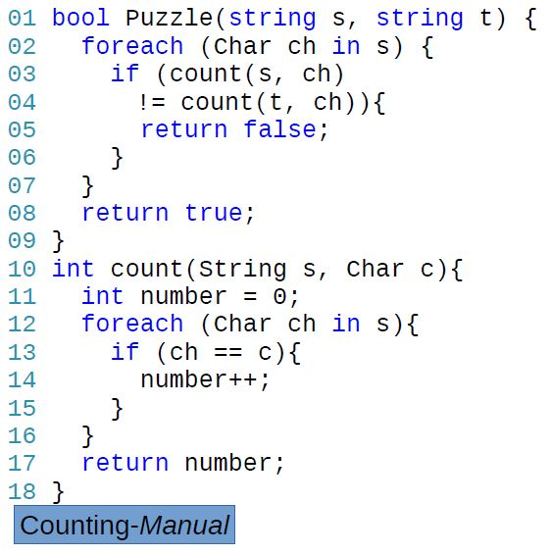
Anagram Problem: Counting Strategy
Problem: Are two input strings permutations of each other?
Strategy: For every character in one string, count and compare the number of occurrences in another. O(n²)
Feedback: “Count the number of characters in each string in a pre-processing phase to amortize the cost.”

Slide 45
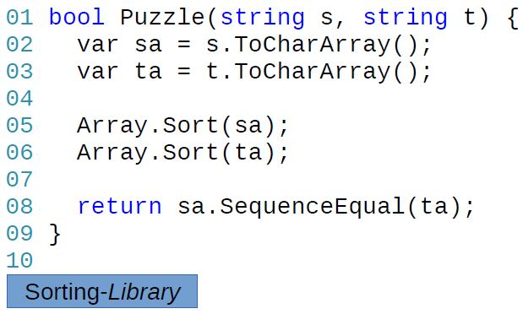
Anagram Problem: Sorting Strategy
Problem: Are two input strings permutations of each other?
Strategy: Sort and compare the two input strings. O(n²)
Feedback: “Instead of sorting, compare occurrences of each character.”

Slide 46
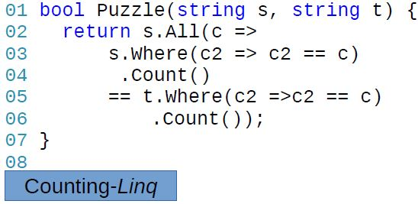
Different implementations: Counting strategy

Slide 47
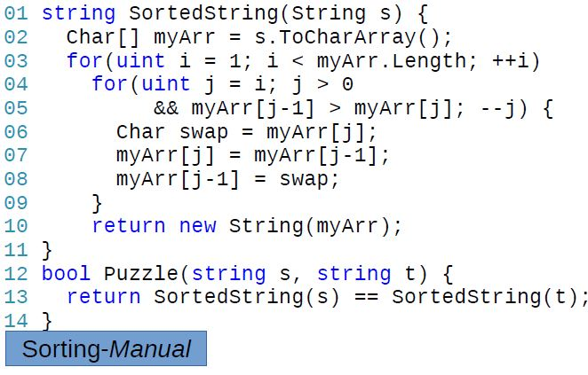
Different implementations: Sorting strategy

Slide 48
Strategy-level Feedback Generation
Teacher documents various strategies and associated feedback.
  Strategies can potentially be automatically inferred from student data.
Computer identifies the strategy used by a student implementation and passes on the associated feedback.
  Different implementations that employ the same strategy produce the same sequence of “key values”.
FSE 2014: “Feedback Generation for Performance Problems in Introductory Programming Assignments” Gulwani, Radicek, Zuleger

Slide 49
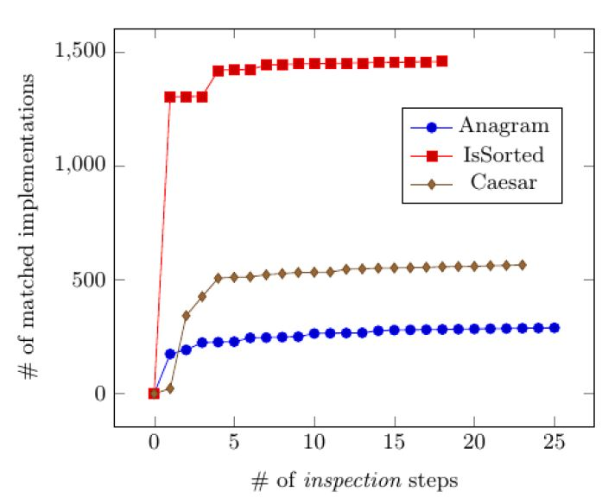
Some Results: Documentation of teacher effort
# of matched implementations
# of inspection steps
When a student implementation doesn’t match any strategy:
the teacher inspects it to refine or add a (new) strategy.

Slide 50
Feedback Generation
Motivation
Make teachers more effective.
  Save them time.
  Provide immediate insights on where students are struggling.
Can enable rich interactive experience for students.
  Generation of hints.
  Pointer to simpler problems depending on kind of mistakes.
Different kinds of feedback:
Counterexamples
Nearest correct solution
Strategy-level feedback
Nearest problem description (corresponding to student solution)

Slide 51
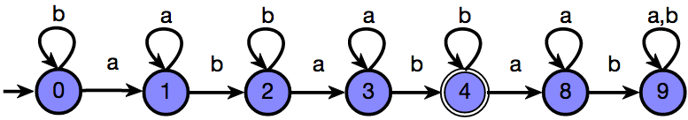
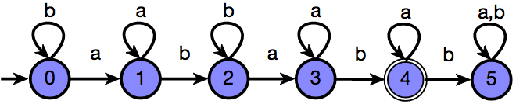
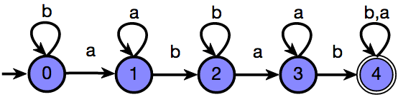
Feedback Synthesis: Finite State Automata
Draw a DFA that accepts: { s | ‘ab’ appears in s exactly 2 times }
Grade: 9/10
Feedback: One more state should be made final
Attempt 1
Based on nearest correct solution
Grade: 6/10
Feedback: The DFA is incorrect on the string ‘ababb’
Attempt 2
Based on counterexamples
Grade: 5/10
Feedback: The DFA accepts {s | ‘ab’ appears in s at least 2 times}
Attempt 3
Based on nearest problem description
IJCAI 2013: “Automated Grading of DFA Constructions”;
Alur, d’Antoni, Gulwani, Kini, Viswanathan

Slide 52
Some Results
Tool has been used at 10+ Universities.
An initial case study: 800+ attempts to 6 automata problems graded by tool and 2 instructors.
95% problems graded in <6 seconds each
Out of 131 attempts for one of those problems:
  6 attempts: instructors were incorrect (gave full marks to an incorrect attempt)
  20 attempts: instructors were inconsistent (gave different marks to syntactically equivalent attempts)
  34 attempts: >= 3 point discrepancy between instructor & tool; in 20 of those, instructor agreed that tool was more fair.
Instructors concluded that tool should be preferred over humans for consistency & scalability.
Tool accessible at: http://www.automatatutor.com/

Slide 53
Future Directions in Intelligent Tutoring Systems
Domain-specific natural language understanding to deal with word problems.
Leverage large amounts of student data.
  Repair incorrect solution using a nearest correct solution [DeduceIt/Aiken et.al./UIST 2013]
  Clustering for power-grading [CodeWebs/Nguyen et.al./WWW 2014]
Leverage large populations of students and teachers.
  Peer-grading
Notes:
DeduceIt
CodeWebs

Slide 54

Conclusion
Billions of non-programmers now have computing devices.
  But they struggle with repetitive tasks.
Formal methods play a significant role in developing solutions to automate repetitive tasks for the masses!
  Language design, Search algorithms, Test input generation
Two important applications with large scale societal impact.
End-User Programming using examples: Data wrangling
Intelligent Tutoring Systems: Problem & Feedback synthesis

