Slide 1


Applications of Inductive Programming
in Data Wrangling
Sumit Gulwani
Dagstuhl Seminar
Oct 2015

Slide 2


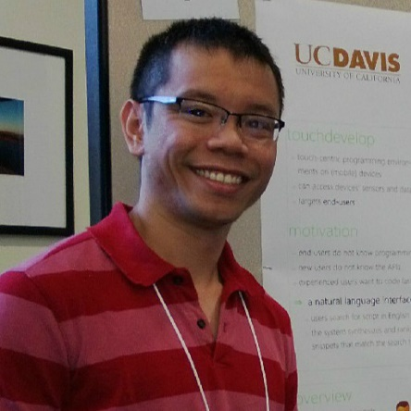






Collaborators
Dan Barowy
Bill Harris
Ted Hart
Dileep Kini
Vu Le
Mikael Mayer
Alex Polozov
Rishabh Singh
Gustavo Soares
Ben Zorn

Slide 3
Reference
“Programming by Examples (and its applications in Data Wrangling)”,
Gulwani; 2016; In Verification and Synthesis of Correct and Secure Systems; IOS Press
[based on Marktoberdorf Summer School 2015 Lecture Notes]

Slide 4





The New Opportunity
Two orders of magnitude more End Users
Struggle with simple repetitive tasks
Inductive Programming can play a significant role! (in conjunction with ML, HCI)
Traditional customer for PL technology
End Users
(non-programmers with access to computers)
Software developer

Slide 5




Spreadsheet help forums

Slide 6




Typical help-forum interaction
300_w30_aniSh_c1_b → w30
300_w5_aniSh_c1_b → w5
=MID(B1,5,2)
=MID(B1,5,2)
=MID(B1,FIND(“_”,$B:$B)+1, FIND(“_”,REPLACE($B:$B,1,FIND(“_”,$B:$B),””))-1)

Slide 7
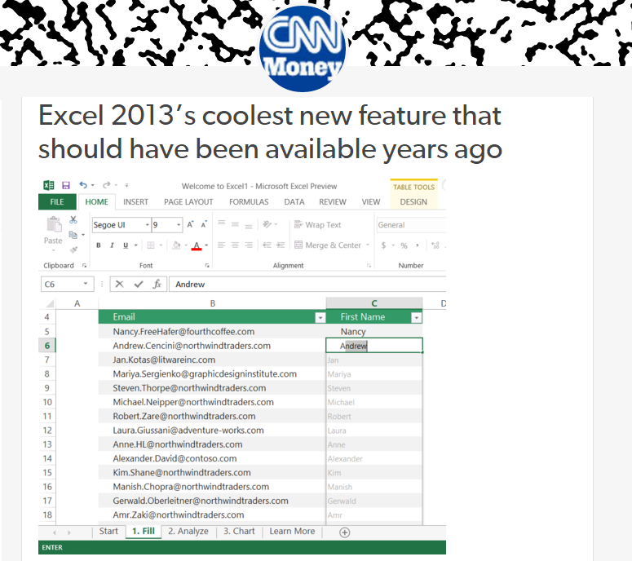
Flash Fill (Excel 2013 feature) demo
“Automating string processing in spreadsheets using input-output examples”; POPL 2011; Sumit Gulwani

Slide 8
Number Transformations
Input | Output (Round to 2 decimal places)
123.4567 | 123.46
123.4 | 123.40
78.234 | 78.23
Excel/C#:
Python/C:
Java:
#.00
.2f
#.##
Input | Output (Nearest lower half hour)
0d 5h 26m | 5:00
0d 4h 57m | 4:30
0d 4h 27m | 4:00
0d 3h 57m | 3:30
Synthesizing Number Transformations from Input-Output Examples;
CAV 2012; Singh, Gulwani

Slide 9
Semantic String Transformations
MarkupRec Table
Id | Name | Markup
S33 | Stroller | 30%
B56 | Bib | 45%
D32 | Diapers | 35%
W98 | Wipes | 40%
A46 | Aspirator | 30%
Input v₁ | Input v₂ | Output (Price + Markup*Price)
Stroller | 10/12/2010 | $145.67 + 0.30*145.67
Bib | 23/12/2010 | $3.56 + 0.45*3.56
Diapers | 21/1/2011
Wipes | 2/4/2009
Aspirator | 23/2/2010
CostRec Table
Id | Date | Price
S33 | 12/2010 | $145.67
S33 | 11/2010 | $142.38
B56 | 12/2010 | $3.56
D32 | 1/2011 | $21.45
W98 | 4/2009 | $5.12
Learning Semantic String Transformations from Examples;
VLDB 2012; Singh, Gulwani

Slide 10

Data is the new Oil
Sources:
Digital revolution
Cloud computing, IoT
Social media
New currency of the digital world that enables business decisions, advertising, recommendations.
Raw data needs to be extracted and refined to enable monetization!

Slide 11

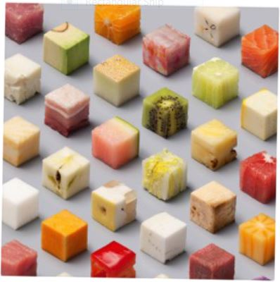

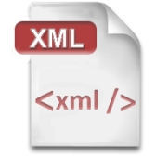




Data Wrangling
Extraction
Transformation
Formatting
Data scientists spend 80% of their time wrangling data.
Raw data locked up in many formats.
Flexible organization for viewing but challenging to manipulate.
Processed data for drawing insights and driving decisions.
Inductive Programming can enable easier & faster wrangling!

Slide 12

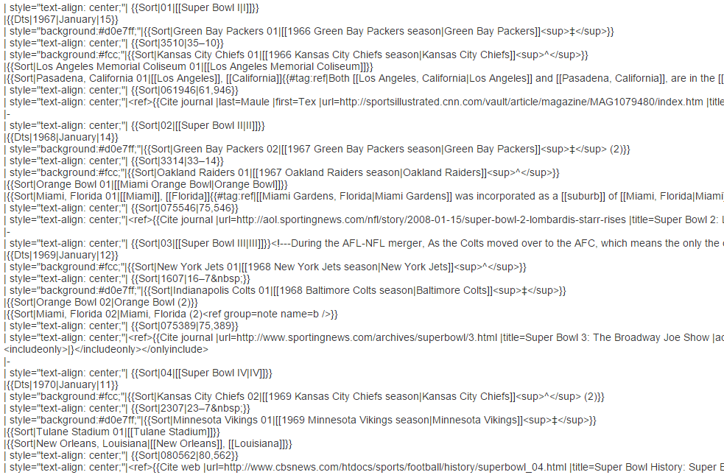
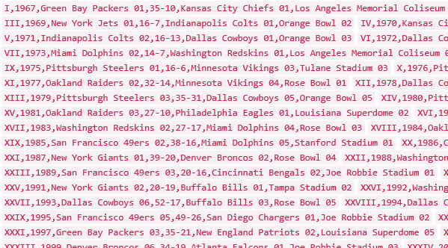
Data Science Class Assignment
To get Started!

Slide 13
FlashExtract Demo
  Recently shipped inside two Microsoft products
  Powershell convertFrom-string cmdlet
  Azure OMS custom field extractor
“FlashExtract: A Framework for data extraction by examples”;
PLDI 2014; Vu Le, Sumit Gulwani

Slide 14
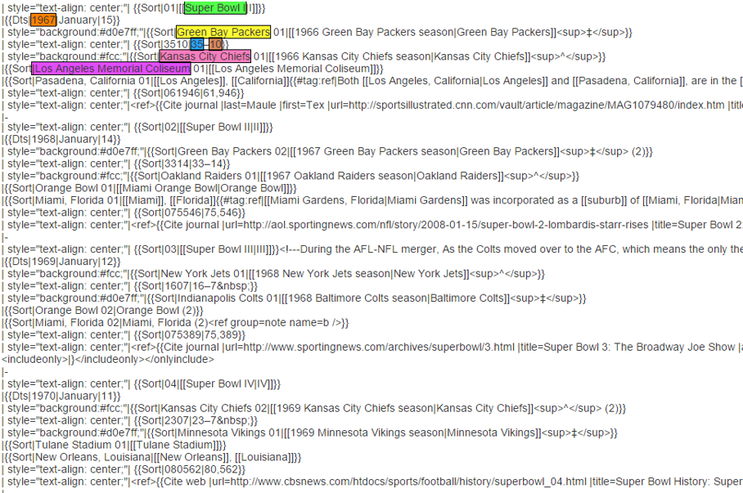
FlashExtract

Slide 15
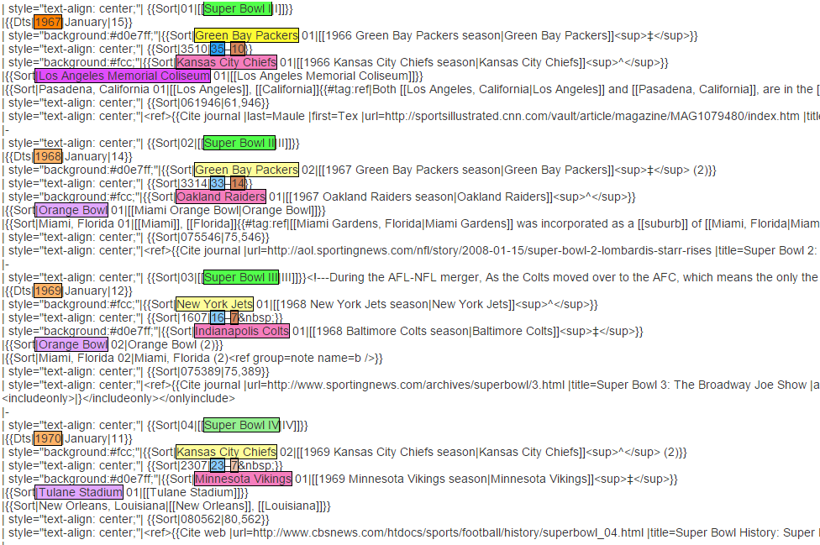
FlashExtract

Slide 16
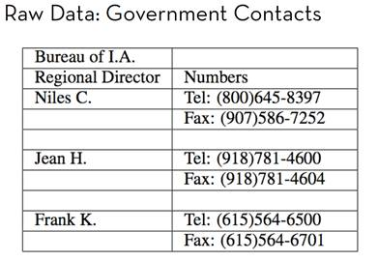
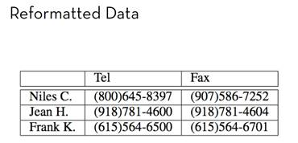
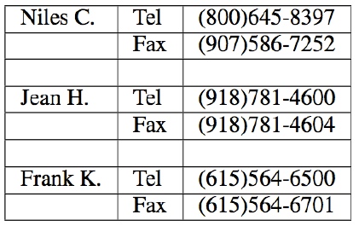
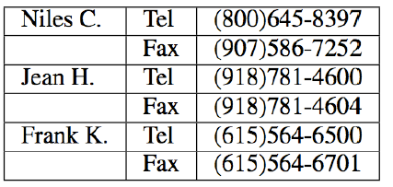
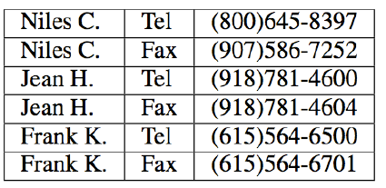
Trifacta: small, guided steps
Table Re-formatting
Start with:
End goal:
FlashRelate
4. Pivot Number on Type
Trifacta provides a series of small transformations:
1. Split on “:” Delimiter
2. Delete Empty Rows
3. Fill Values Down
From: Skills of the Agile Data Wrangler (tutorial by Hellerstein and Heer)

Slide 17
FlashRelate Demo
“FlashRelate: Extracting Relational Data from Semi-Structured Spreadsheets Using Examples”;
PLDI 2015; Barowy, Gulwani, Hart, Zorn

Slide 18
Table Layout Transformations
PROJ | CAT | SPONSOR | DEPT | ELTS | DATE
SPEC | OOH | Infiniti | Design | Elt 1 | 11/10
SPEC | OOH | Infiniti | Desing | Elt 2
SPEC | Print |  | Design | Elt 3 | 11/30
SPEC | Print |  | Design | Elt 4 | 11/30
SPEC | Print | Infiniti | Design | Elt 5 | 11/30
 |  | SPEC
 |  | OOH
Infiniti | Design | Elt 1 | 11/10
Infiniti | Desing | Elt 2
 |  | Print
 | Design | Elt 3 | 11/30
 | Design | Elt 4 | 11/30
Infiniti | Design | Elt 5 | 11/30
“Spreadsheet Table Transformations from Examples”, PLDI 2011; Harris, Gulwani

Slide 19
Table Layout Transformations
 | Art&Des | CreateArt | English | Geo.
Alice | B | A | A | A*
Bob | C | B | C | C
Alice | Art&Des | B
 | CreateArt | A
 | English | A
 | Geo. | A*
Bob | Art&Des | C
 | CreateArt | B
 | English | C
 | Geo. | C
“Spreadsheet Table Transformations from Examples”, PLDI 2011; Harris, Gulwani

Slide 20
PBE tools for Data Manipulation
Extraction
FlashExtract: Extract data from text files, web pages [PLDI 2014]
  Powershell convertFrom-string cmdlet
  Azure OMS custom field extractor
Transformation
Flash Fill: Excel 2013 feature for Syntactic String Transforms [POPL 2011, CAV 2015]
Semantic String Transformations [VLDB 2012]
Number Transformations [CAV 2013]
FlashNormalize: Text normalization [IJCAI 2015]
Formatting
FlashRelate: Extract data from spreadsheets [PLDI 2015]
Table layout transformations [PLDI 2011]
FlashFormat: a Powerpoint add-in [AAAI 2014]

Slide 21
Two key messages
Data wrangling is a killer application for inductive programming today!
Ambiguity resolution needs to be an integral part of inductive programming techniques.

Slide 22

Inductive Programming
Example-based specification
Program
Search Algorithm
Ambiguous/under-specified intent may result in unintended programs!

Slide 23
Dealing with Ambiguity
Ranking
  Synthesize multiple programs and rank them.

Slide 24

Basic ranking scheme
Prefer programs with simpler Kolmogorov complexity
Prefer fewer constants.
Prefer smaller constants.
Input | Output
Rishabh Singh | Rishabh
Ben Zorn | Ben
1st Word
If (input = “Rishabh Singh”) then “Rishabh” else “Ben”
“Rishabh”

Slide 25
Challenges with Basic ranking scheme
Prefer programs with simpler Kolmogorov complexity
Prefer fewer constants.
Prefer smaller constants.
Input | Output
Rishabh Singh | Singh, Rishabh
Ben Zorn | Zorn, Ben
2nd Word + “, ‘’ + 1st Word
“Singh, Rishabh”
How to select between
Fewer larger constants vs. More smaller constants?
  Idea: Associate numeric weights with constants.

Slide 26
Challenges with Basic ranking scheme
Prefer programs with simpler Kolmogorov complexity
Prefer fewer constants.
Prefer smaller constants.
Input | Output
Missing page numbers, 1993 | 1993
64-67, 1995 | 1995
1st Number from the beginning
1st Number from the end
How to select between
Same number of same-sized constants?
Idea: Examine data features (in addition to program features)

Slide 27
Machine learning based ranking scheme
Rank score of a program: Weighted combination of various features.
Weights are learned using machine learning.
Program features
Number of constants
Size of constants
Features over user data: Similarity of generated output (or even intermediate values) over various user inputs
IsYear, Numeric Deviation, Number of characters
IsPersonName
“Predicting a correct program in Programming by Example”;
[CAV 2015] Rishabh Singh, Sumit Gulwani

Slide 28


Need for a fall-back mechanism
“It's a great concept, but it can also lead to lots of bad data. I think many users will look at a few "flash filled" cells, and just assume that it worked. … Be very careful.”
“most of the extracted data will be fine. But there might be exceptions that you don't notice unless you examine the results very carefully.”

Slide 29
Dealing with Ambiguity
Ranking
  Synthesize multiple programs and rank them.
User Interaction Models
  Communicate actionable information to the user.

Slide 30

User Interaction Models for Ambiguity Resolution
Make it easy to inspect output correctness
  User can accordingly provide more examples
Show programs
  in any desired programming language; in English
  Enable effective navigation between programs
Computer initiated interactivity (Active learning)
  Highlight less confident entries in the output.
  Ask directed questions based on distinguishing inputs.
“User Interaction Models for Disambiguation in Programming by Example”,
[UIST 2015] Mayer, Soares, Grechkin, Le, Marron, Polozov, Singh, Zorn, Gulwani

Slide 31
FlashExtract Demo
(User Interaction Models)

Slide 32
Two key messages
Data wrangling is a killer application for inductive programming today!
  99% of end users are non-programmers.
  Data scientists spend 80% time in cleaning data.
Ambiguity resolution needs to be an integral part of inductive programming techniques.
  Cross-disciplinary inspiration from ML and HCI
“Programming by Examples (and its applications in Data Wrangling)”, 2016; Gulwani
[based on Marktoberdorf Summer School 2015 Lecture Notes]

