Slide 1

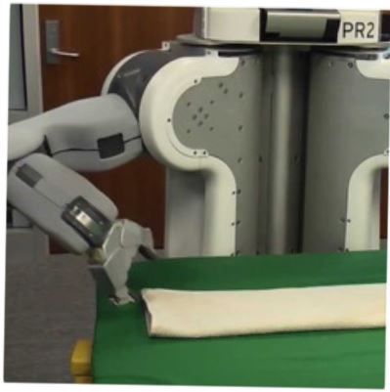

Deductive Techniques for synthesis
from Inductive Specifications
Sumit Gulwani
Dagstuhl Seminar
Oct 2015

Slide 2









Collaborators
Dan Barowy
Bill Harris
Ted Hart
Dileep Kini
Vu Le
Mikael Mayer
Alex Polozov
Rishabh Singh
Gustavo Soares
Ben Zorn

Slide 3
Reference
“Programming by Examples (and its applications in Data Wrangling)”,
Gulwani; 2016; In Verification and Synthesis of Correct and Secure Systems; IOS Press
[based on Marktoberdorf Summer School 2015 Lecture Notes]

Slide 4
Deductive Synthesis vs Inductive Synthesis
Deductive Synthesis
Refers to synthesis using deductive methods.
Has traditionally been applied to synthesis in the presence of logical specifications.
Inductive Synthesis
Refers to synthesis from inductive (example-based) specifications.
Various kinds of techniques have been applied including constraint solving, stochastic, and enumerative search.
This talk describes techniques for synthesis from inductive specifications using deductive methods!

Slide 5

PBE Architecture
Example-based specification
Ordered set of Programs
Program
Ranking
Function
Search Algorithm
Challenge 1: Ambiguous/under-specified intent may result in unintended programs.
Challenge 2: Designing efficient search strategy.

Slide 6
Challenge 2: Efficient search strategy
Key Ideas
Restrict search to an appropriately designed domain-specific language (DSL) specified as a grammar.
  Expressive enough to cover wide range of tasks
  Restricted enough to enable efficient search
“Spreadsheet Data Manipulation using Examples” [CACM 2012 Research Highlights] Gulwani, Harris, Singh

Slide 7
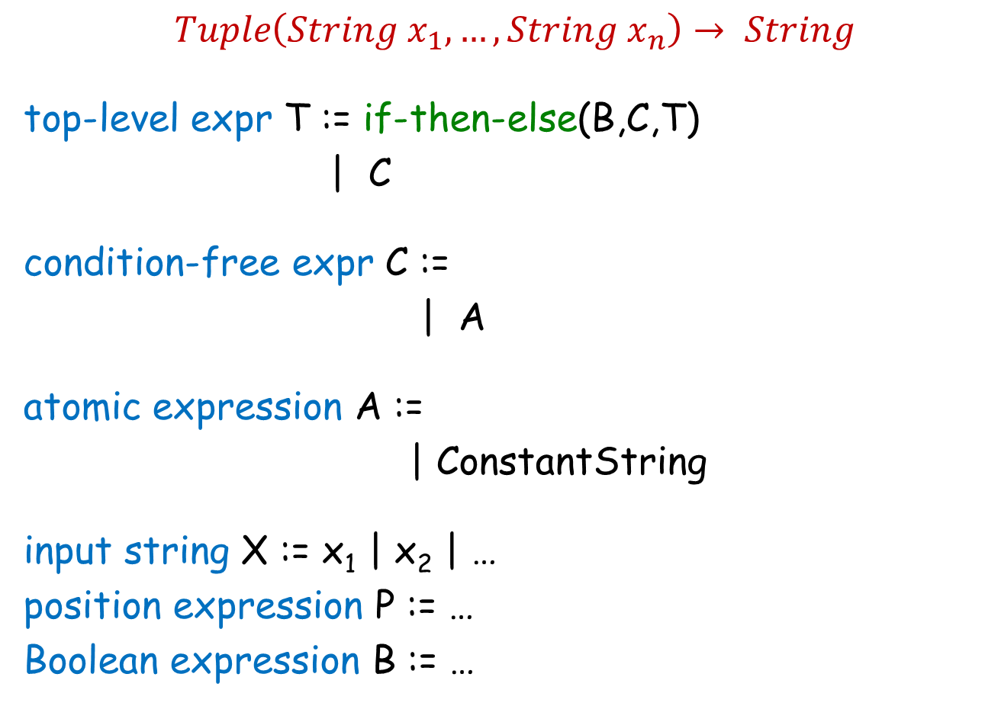
FlashFill DSL
$Tuple\left(String x_{1},…,String x_{n}\right)→ String$
top-level expr T := if-then-else(B,C,T)
| C
condition-free expr C :=
| A
atomic expression A :=
| ConstantString
input string X := x₁ | x₂ | …
position expression P := …
Boolean expression B := …
Concatenate(A, C)
SubStr(X, P, P)
“Automating string processing in spreadsheets using input-output examples”; POPL 2011; Gulwani

Slide 8
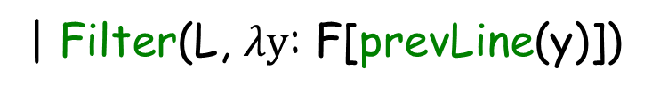
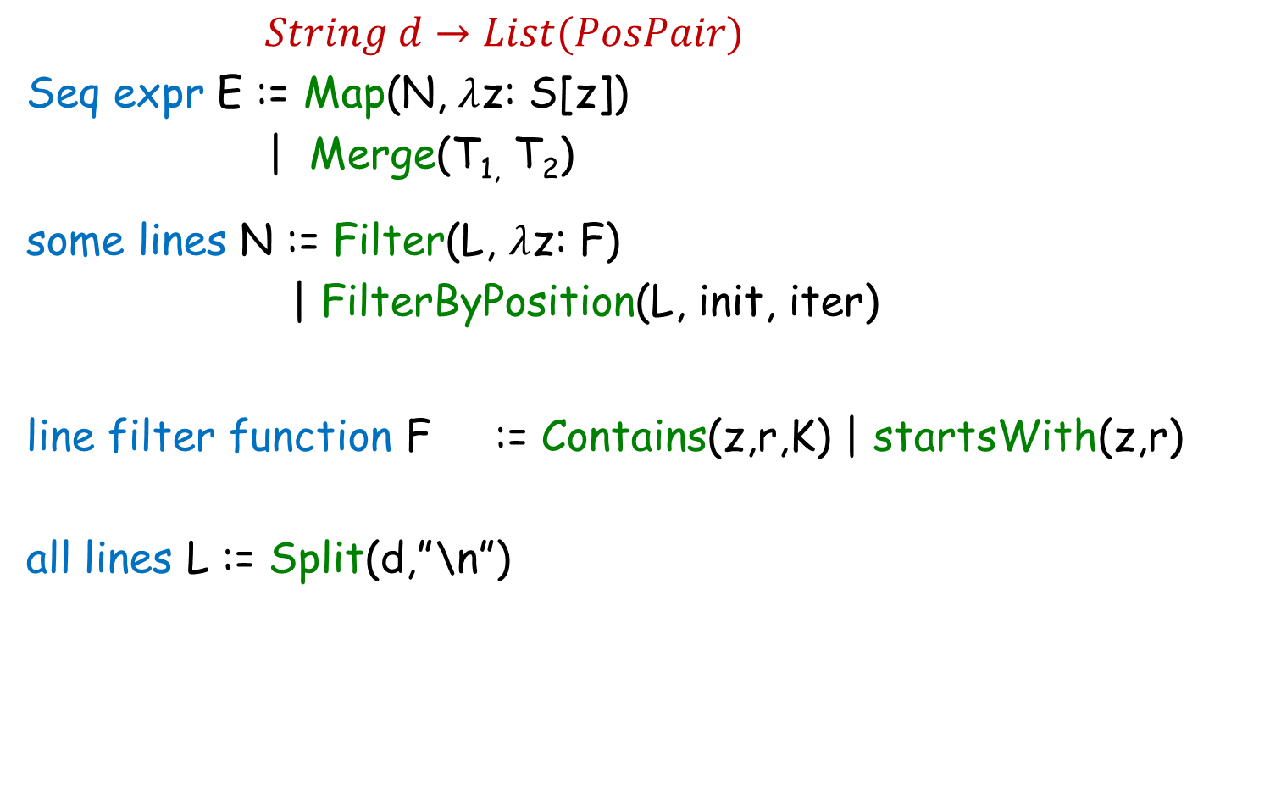
FlashExtract DSL
$String d→List(PosPair)$
Seq expr E := Map(N, $λ$z: S[z])
| Merge(T_{1,} T₂)
some lines N := Filter(L, $λ$z: F)
| FilterByPosition(L, init, iter)
line filter function F := Contains(z,r,K) | startsWith(z,r)
all lines L := Split(d,”\n”)
[z])
| Filter(L, $λy$: F[prevLine(y)])
[z]
substr expr S[z] :=
“FlashExtract: A Framework for data extraction by examples”;
PLDI 2014; Vu Le, Sumit Gulwani

Slide 9
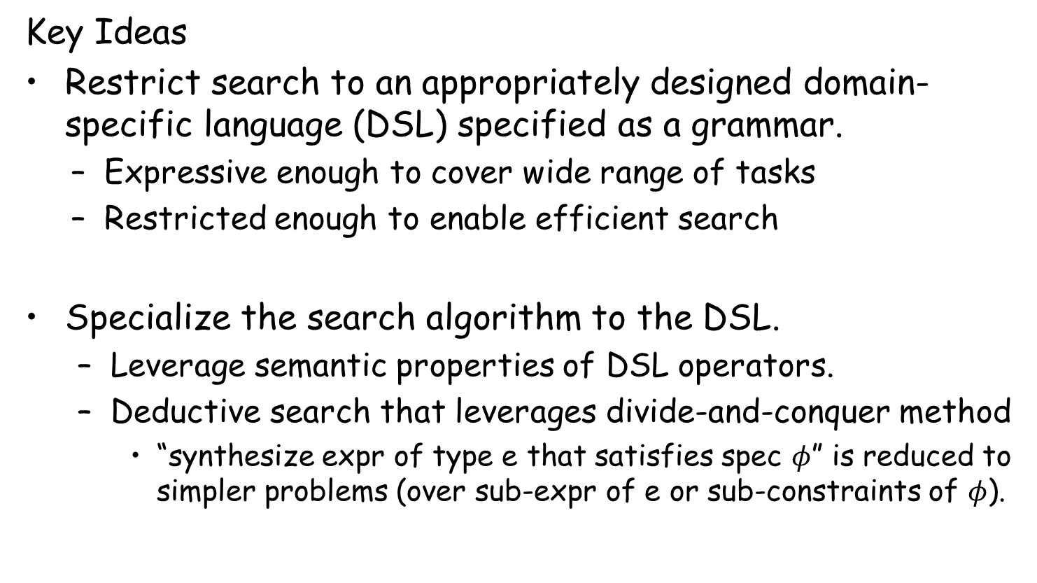
Challenge 2: Efficient search strategy
Key Ideas
Restrict search to an appropriately designed domain-specific language (DSL) specified as a grammar.
  Expressive enough to cover wide range of tasks
  Restricted enough to enable efficient search
Specialize the search algorithm to the DSL.
  Leverage semantic properties of DSL operators.
  Deductive search that leverages divide-and-conquer method
    “synthesize expr of type e that satisfies spec $φ$” is reduced to simpler problems (over sub-expr of e or sub-constraints of $φ$).
“Spreadsheet Data Manipulation using Examples” [CACM 2012 Research Highlights] Gulwani, Harris, Singh

Slide 10
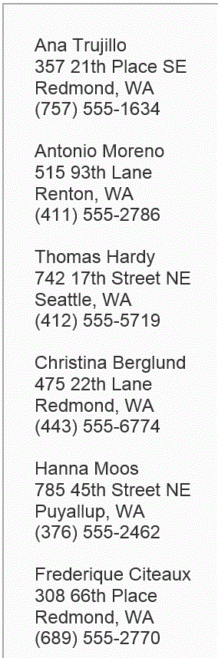



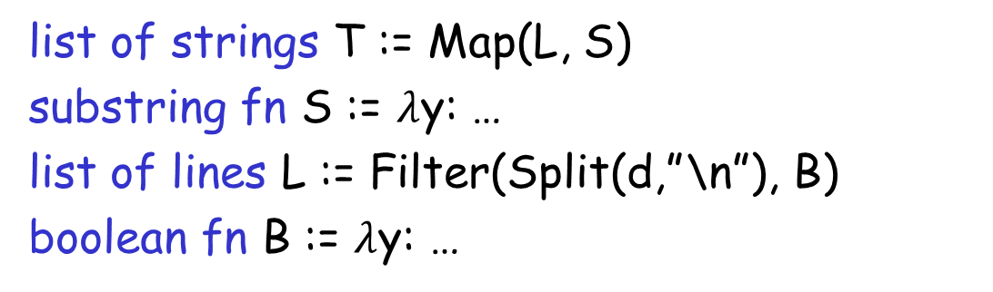

Problem Reduction
list of strings T := Map(L, S)
substring fn S := $λ$y: …
list of lines L := Filter(Split(d,”\n”), B)
boolean fn B := $λ$y: …
FlashExtract DSL
$$⋈$$
Spec for S
Spec for T
Spec for L
$$∧$$

Slide 11

Problem Reduction
substring expr E := SubStr(y, P₁, P₂)
position expr P := K | Pos(y, R₁, R₂, K)
SubStr grammar
$$⋈$$
Spec for E
Spec for P₁
Spec for P₂
Redmond, WA
Redmond, WA

Slide 12
Programming by Examples
Example-based specification
Program
Search Algorithm
Challenge 1: Ambiguous/under-specified intent may result in unintended programs.
Challenge 2: Designing efficient search strategy.
Challenge 3: Lowering the barrier to design & development.

Slide 13
Challenge 3: Lowering the barrier
Developing a domain-specific robust search method is costly:
Requires domain-specific algorithmic insights.
Robust implementation requires good engineering.
DSL extensions/modifications are not easy.
Key Ideas:
PBE algorithms employ a divide and conquer strategy, where synthesis problem for an expression F(e1,e2) is reduced to synthesis problems for sub-expressions e1 and e2.
  The divide-and-conquer strategy can be refactored out.
Reduction depends on the logical properties of operator F.
  Operator properties can be captured in a modular manner for reuse inside other DSLs.
“FlashMeta: A Framework for Inductive Program Synthesis” [OOPSLA 2015] Polozov, Gulwani

Slide 14
Programming by Examples
Example-based specification
Program
Search Algorithm
DSL
Challenge 1: Ambiguous/under-specified intent may result in unintended programs.
Challenge 2: Designing efficient search strategy.
Challenge 3: Lowering the barrier to design & development.

Slide 15
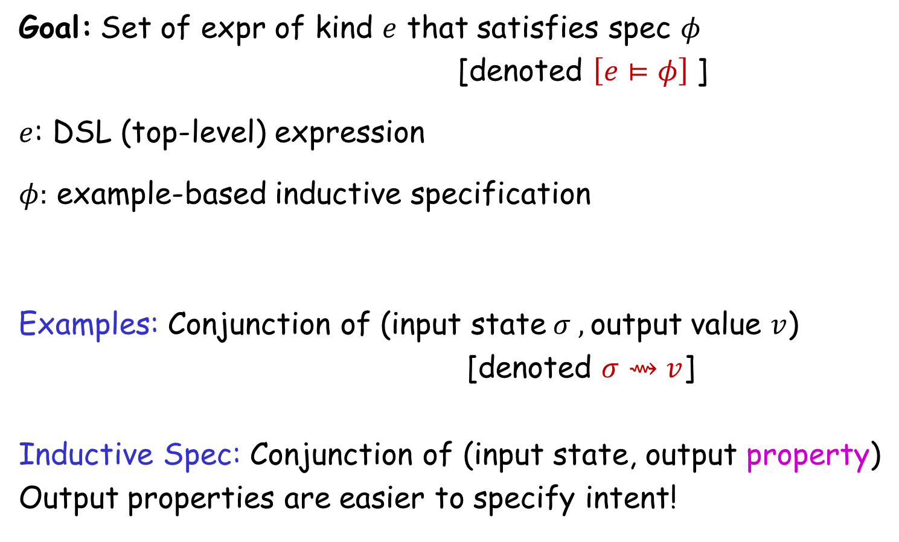
Search Strategy
Goal: Set of expr of kind $e$ that satisfies spec $φ$
[denoted $\left[e⊨φ\right]$]
$e$: DSL (top-level) expression
$φ:$ example-based inductive specification
Examples: Conjunction of (input state$σ ,$output value $v$)
[denoted $σ⇝v$]
Inductive Spec: Conjunction of (input state, output property)
Output properties are easier to specify intent!

Slide 16
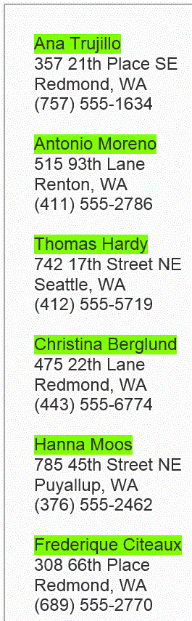
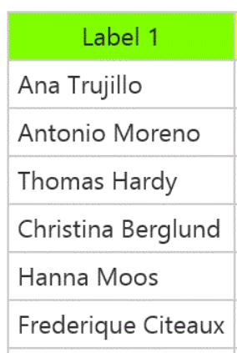

Output properties
Task
Elements belonging to the output list
Elements not belonging to the output list
Contiguous subsequence of the output list
Prefix of the output list

Slide 17
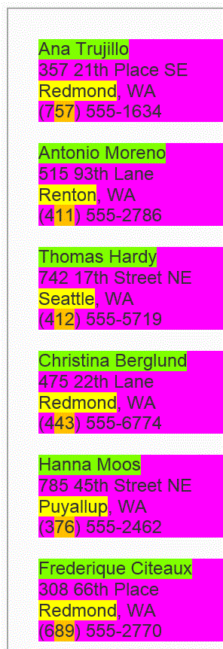
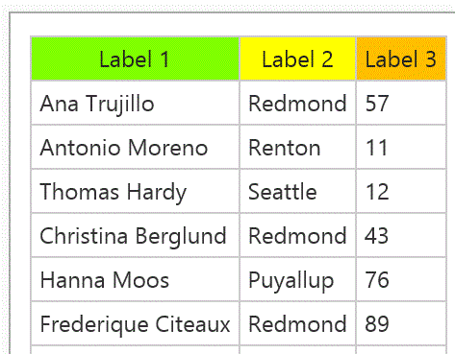
Output properties
Task
Prefix of the output table (seq of records)
We do not require explicit (magenta) record boundaries in which case the spec is:
Prefixes of projections of the output table

Slide 18
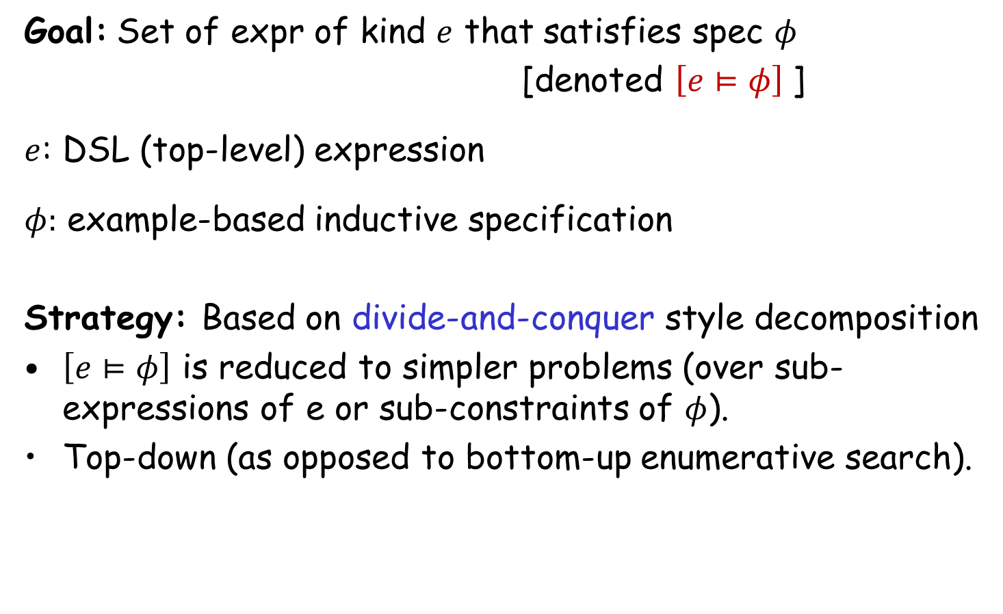
Search Strategy
Goal: Set of expr of kind $e$ that satisfies spec $φ$
[denoted $\left[e⊨φ\right]$]
$e$: DSL (top-level) expression
$φ:$ example-based inductive specification
Strategy: Based on divide-and-conquer style decomposition
$\left[e⊨φ\right]$ is reduced to simpler problems (over sub-expressions of e or sub-constraints of $φ$).
Top-down (as opposed to bottom-up enumerative search).

Slide 19
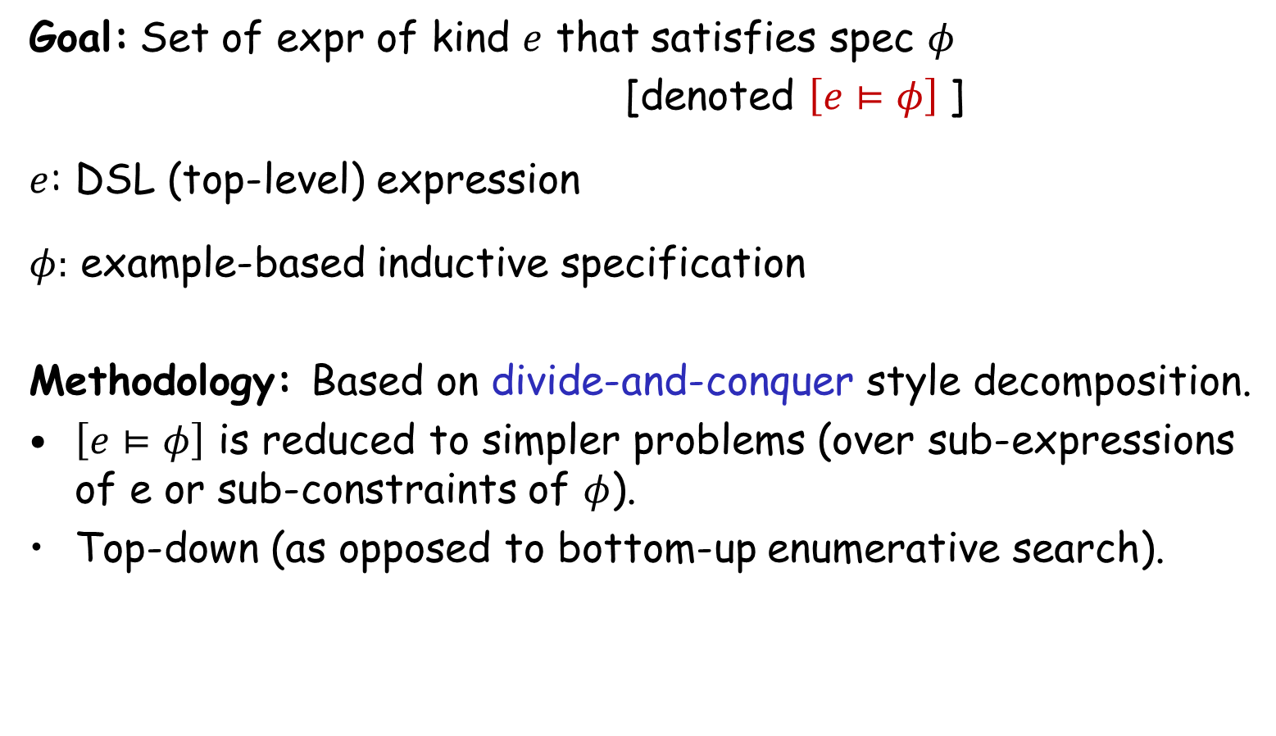
Search Strategy
Goal: Set of expr of kind $e$ that satisfies spec $φ$
[denoted $\left[e⊨φ\right]$]
$e$: DSL (top-level) expression
$φ:$ example-based inductive specification
Methodology: Based on divide-and-conquer style decomposition.
$\left[e⊨φ\right]$ is reduced to simpler problems (over sub-expressions of e or sub-constraints of $φ$).
Top-down (as opposed to bottom-up enumerative search).
Key concepts in problem reduction: VSAs & Witness functions

Slide 20
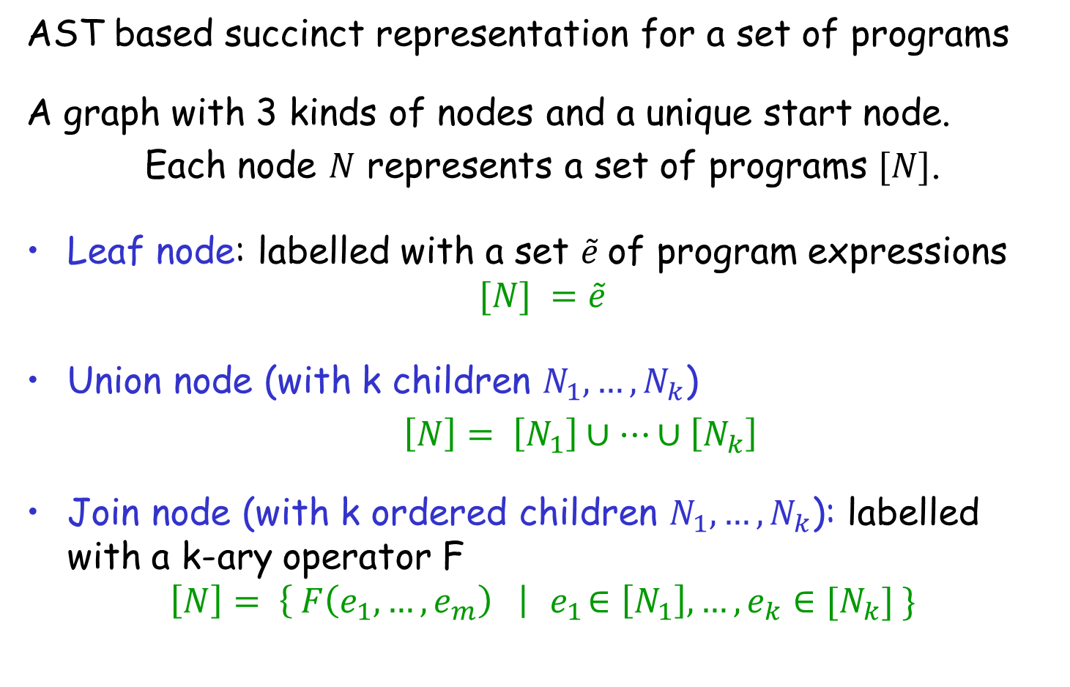
Version Space Algebra (VSA)
AST based succinct representation for a set of programs
A graph with 3 kinds of nodes and a unique start node.
Each node $N$ represents a set of programs $[N]$.
Leaf node: labelled with a set $\tilde{e}$of program expressions
$$[N] =\tilde{e}$$
Union node (with k children $N_{1}, …, N_{k}$)
$\left[N\right]= \left[N_{1}\right]∪…∪\left[N_{k}\right]$
Join node (with k ordered children $N_{1}, …, N_{k}$): labelled with a k-ary operator F
$$\left[N\right]= \left\{ F\left(e_{1}, …, e_{m}\right) \right|{ e}_{1}∈\left[N_{1}\right], …, e_{k}∈[N_{k}] \}$$

Slide 21
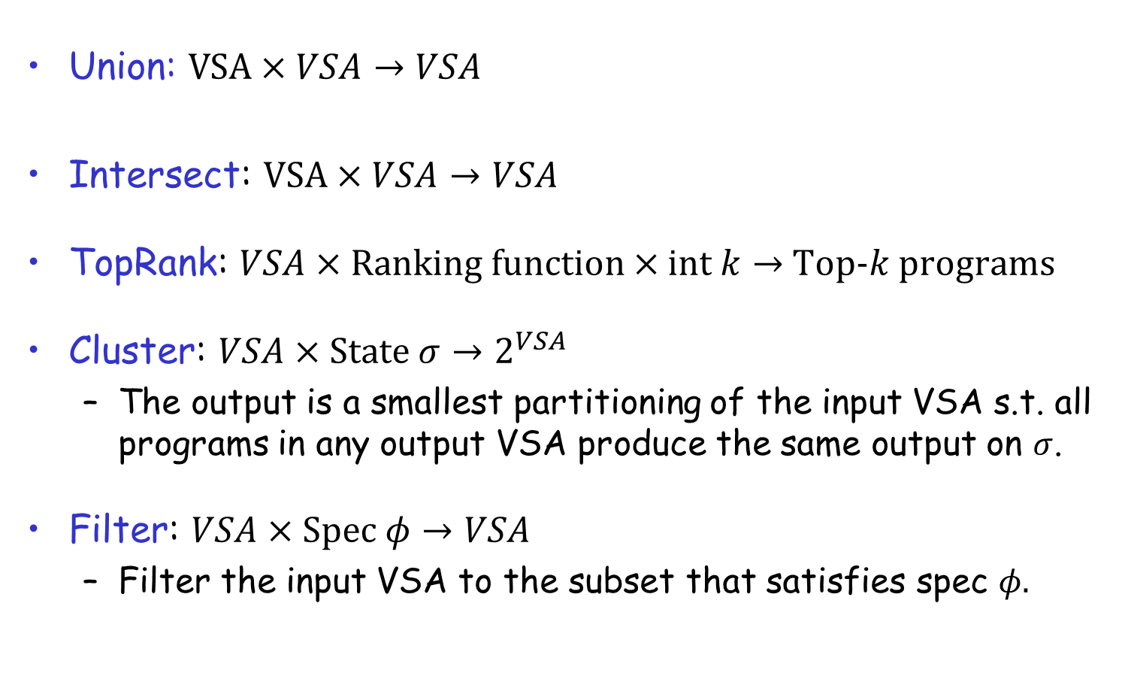
VSA Operations
Union: $VSA×VSA→VSA$
Intersect: $VSA×VSA→VSA$
TopRank: $VSA×Ranking function×int k→$ Top-$k$ programs
Cluster: $VSA×State σ→2^{VSA}$
  The output is a smallest partitioning of the input VSA s.t. all programs in any output VSA produce the same output on $σ$.
Filter: $VSA×Spec φ→VSA$
  Filter the input VSA to the subset that satisfies spec $φ.$

Slide 22



Problem Reduction Rules
$$\left[e⊨φ\right]=$$
where $e$ is a non-terminal defined as $e ≔e_{1} | e_{2}$
$$\left[e⊨φ_{1}∧φ_{2}\right] =$$
$$Union(\left[e_{1}⊨φ\right], \left[e_{2}⊨φ\right])$$
$$Intersect(\left[e⊨φ_{1}\right], \left[e⊨φ_{2}\right])$$

Slide 23
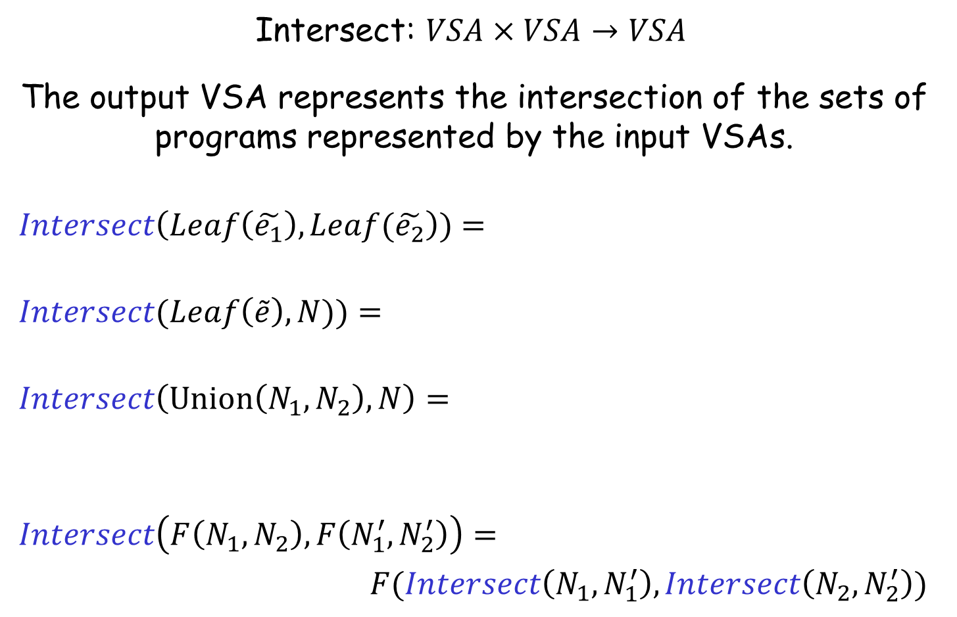


Intersect Operation
Intersect: $VSA×VSA→VSA$
The output VSA represents the intersection of the sets of programs represented by the input VSAs.
$$Intersect\left(Leaf\left(\tilde{e_{1}}\right), Leaf(\tilde{e_{2}}\right))=$$
$$Intersect(Leaf\left(\tilde{e}\right), N))=$$
$$Intersect\left(Union\left(N_{1},N_{2}\right), N\right)=$$
$$Intersect\left(F\left(N_{1},N_{2}\right), F\left(N_{1}^{′}, N_{2}^{′}\right)\right)=$$
$F(Intersect\left(N_{1},N_{1}^{′}\right), Intersect\left(N_{2},N_{2}^{′}\right))$
$$Leaf\left(\tilde{e_{1}}∩\tilde{e_{2}}\right)$$
$$\{ e∈\tilde{e }| e∈\left[N\right] \}$$
$$Union(Intersect\left(N_{1},N\right),Intersect\left(N_{2},N\right))$$

Slide 24


Problem Reduction Rules
$$\left[e⊨φ\right]=$$
where $e$ is a non-terminal defined as $e ≔e_{1} | e_{2}$
$$\left[e⊨φ_{1}∧φ_{2}\right] =$$
$\left[e⊨φ_{1}∧φ_{2}\right] =$
$$Union(\left[e_{1}⊨φ\right], \left[e_{2}⊨φ\right])$$
$$Intersect(\left[e⊨φ_{1}\right], \left[e⊨φ_{2}\right])$$
$$Filter(\left[e⊨φ_{1}\right], φ_{2})$$

Slide 25
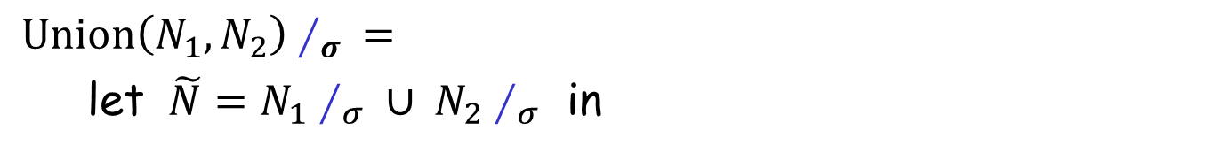

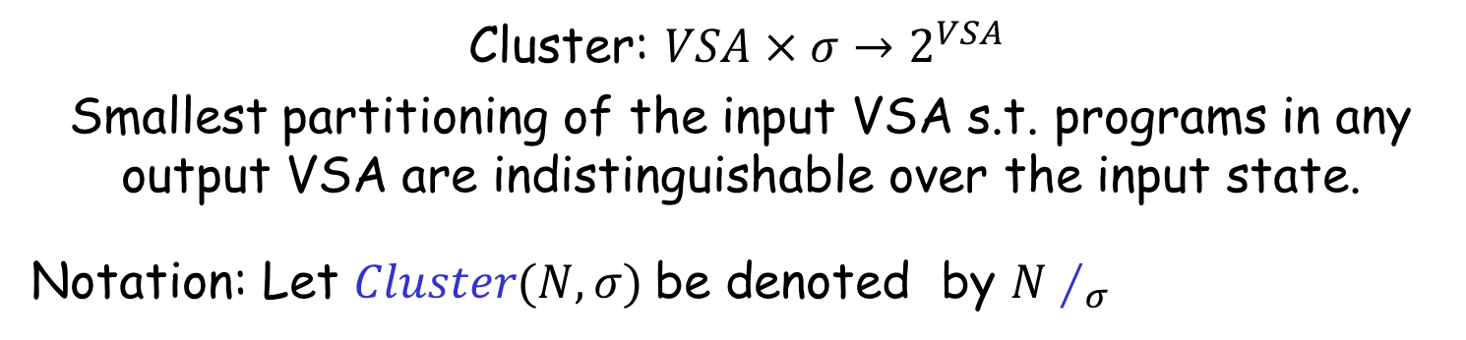
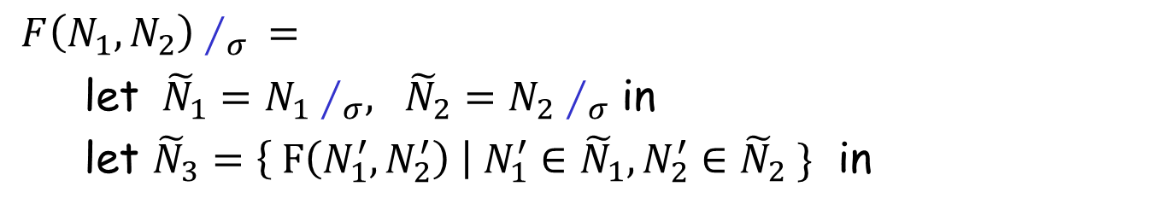

Cluster Operation
Cluster: $VSA×σ→2^{VSA}$
Smallest partitioning of the input VSA s.t. programs in any output VSA are indistinguishable over the input state.
Notation: Let $Cluster(N,σ)$be denoted by $N∕_{σ}$
$Union\left(N_{1},N_{2}\right)∕_{σ} =$
let $\tilde{N}=N_{1}∕_{σ} ∪ N_{2}∕_{σ}$ in
$Merge(\tilde{N},σ)$
$F\left(N_{1},N_{2}\right)∕_{σ} =$
let ${\tilde{N}}_{1}=N_{1}∕_{σ}, {\tilde{N}}_{2}=N_{2}∕_{σ}$ in
let ${\tilde{N}}_{3}=\left\{ F\left(N_{1}^{′},N_{2}^{′}\right) \right| N_{1}^{′}∈{\tilde{N}}_{1}, N_{2}^{′}∈{\tilde{N}}_{2} \}$ in
$Merge({\tilde{N}}_{3},σ)$
$Merge\left(\tilde{N},σ \right)$unites VSAs in $\tilde{N}$that have same behavior on $σ$.

Slide 26

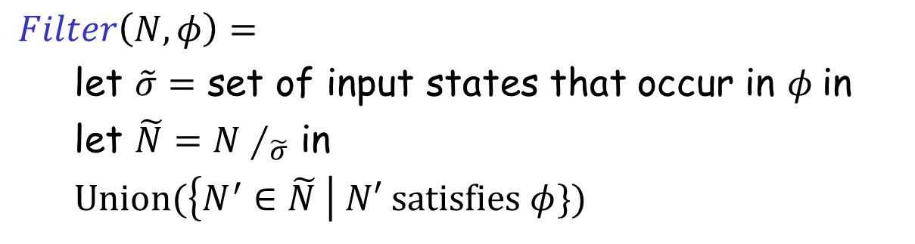
Filter Operation
Filter: $VSA×φ→VSA$
  Filter the input VSA to the subset that satisfies $φ.$
$Filter\left(N,φ\right)=$
let $\tilde{σ}=$ set of input states that occur in $φ$in
let $\tilde{N}=N∕_{\tilde{σ}}$ in
$Union(\left\{N^{′}∈\tilde{N} \right| N′ satisfies φ\})$

Slide 27
Problem Reduction Rules
$$\left[e⊨φ\right]=$$
where $e$ is a non-terminal defined as $e ≔e_{1} | e_{2}$
$$\left[e⊨φ_{1}∧φ_{2}\right] =$$
$\left[e⊨φ_{1}∧φ_{2}\right] =$
$$Union(\left[e_{1}⊨φ\right], \left[e_{2}⊨φ\right])$$
$$Intersect(\left[e⊨φ_{1}\right], \left[e⊨φ_{2}\right])$$
$$Filter(\left[e⊨φ_{1}\right], φ_{2})$$

Slide 28
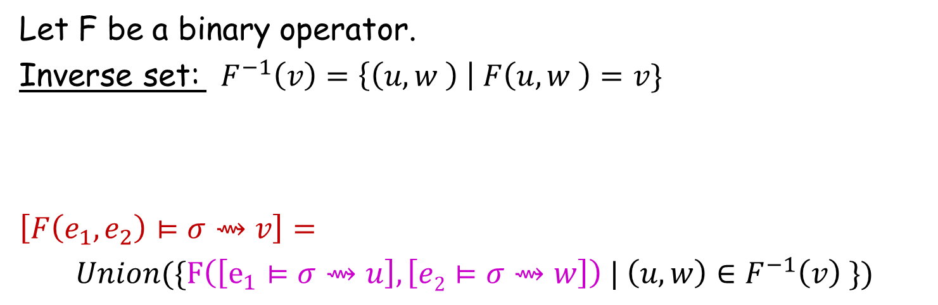
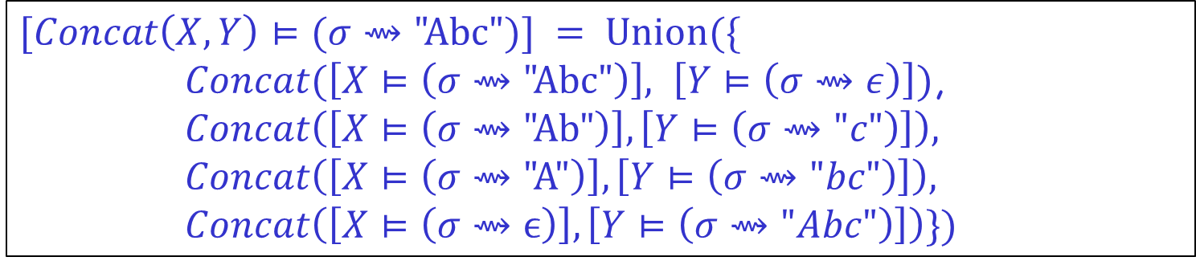
Problem Reduction Rules
Let F be a binary operator.
Inverse set: $F^{−1}\left(v\right)=\left\{\left(u,w \right) \right| F\left(u,w \right)=v\}$
$$\left[F\left(e_{1},e_{2}\right)⊨σ⇝v\right]=$$
$Union(\{F\left(\left[e_{1}⊨σ⇝u\right], \left[e2⊨σ⇝w\right]\right) | \left(u,w\right)∈F^{−1}\left(v\right) \})$
$$\{\left( \text{"}\text{Abc}\text{",}ϵ\right), ("Ab\text{","}\text{c}\text{"), ("}\text{A}\text{","}\text{bc}\text{"), (}ϵ,\text{"}\text{Abc}\text{")\}}$$
$$Concat^{−1}\left(\text{"}\text{Abc}\text{"}\right)=$$
$$[Concat\left(X,Y\right)⊨(σ⇝\text{"}\text{Abc}")] = Union(\{$$
$Concat(\left[X⊨\left(σ⇝\text{"}\text{Abc}\text{"}\right)\right], \left[Y⊨\left(σ⇝ε\right)\right])$,
$$Concat\left(\left[X⊨\left(σ⇝\text{"}\text{Ab}\text{"}\right)\right],\left[Y⊨\left(σ⇝"c"\right)\right]\right),$$
$$Concat\left(\left[X⊨\left(σ⇝\text{"}\text{A}\text{"}\right)\right],\left[Y⊨\left(σ⇝"bc"\right)\right]\right),$$
$$Concat\left(\left[X⊨\left(σ⇝ϵ\right)\right],\left[Y⊨\left(σ⇝"Abc"\right)\right]\right)\})$$

Slide 29
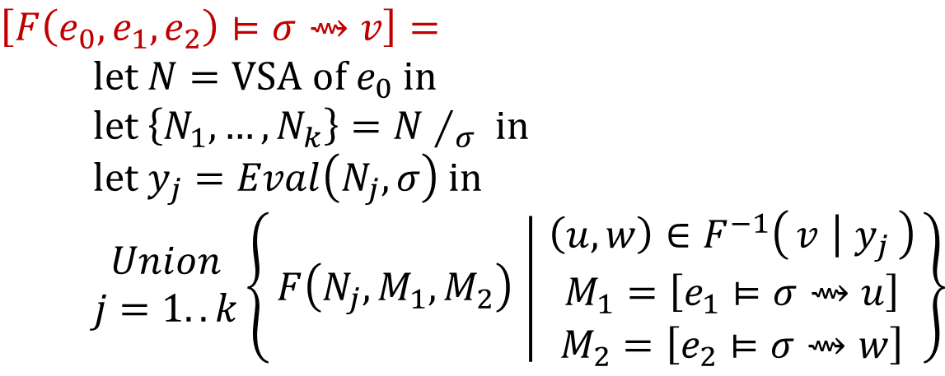
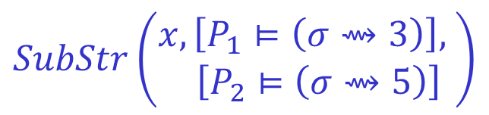

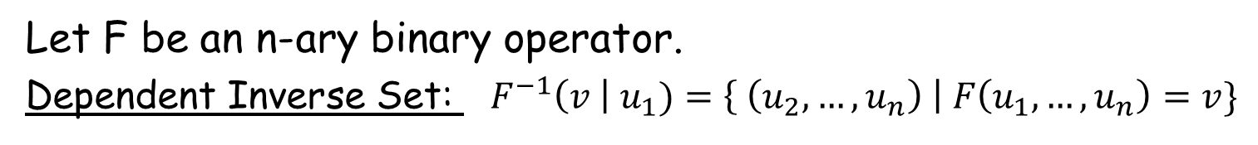
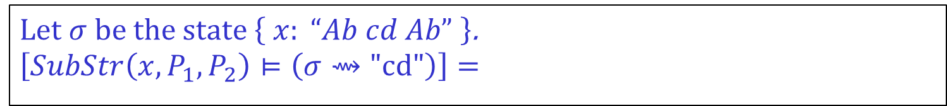
Problem Reduction Rules
Let F be an n-ary binary operator.
Dependent Inverse Set: ${ F}^{−1}\left(v \right| u_{1})=\left\{ \left(u_{2},…, u_{n}\right) \right| F\left(u_{1},…,u_{n}\right)=v\}$
$$\{ \left(0,2\right), (6,8) \}$$
$$SubStr^{−1}\left(\text{"}\text{Ab}\text{"} \right| "Ab cd Ab")=$$
$$\left[F\left(e_{0},e_{1},e_{2}\right)⊨σ⇝v\right]= \\ \text{let} N=\text{VSA} \text{of} e_{0} \text{in} \\ \text{let} \left\{N_{1},…, N_{k}\right\}=N∕_{σ} \text{in} \\ \text{let} y_{j}=Eval\left(N_{j},σ\right) \text{in} \\ \begin{matrix}Union \\ j=1..k\end{matrix}\left\{F\left(N_{j},M_{1},M_{2}\right) ∣ \begin{matrix}\left(u,w\right)∈F^{−1}\left(v ∣ y_{j}\right) \\ M_{1}=\left[e_{1}⊨σ⇝u\right] \\ M_{2}=\left[e_{2}⊨σ⇝w\right]\end{matrix}\right\}$$
Let $σ$be the state $\left\{ x: “Ab cd Ab” \right\}$.
$$\left[SubStr\left(x,P_{1},P_{2}\right)⊨\left(σ⇝\text{"}\text{cd}\text{"}\right)\right]=$$
$$SubStr\left(\begin{aligned}x,\left[P_{1}⊨\left(σ⇝3\right)\right], \\ \left[P_{2}⊨\left(σ⇝5\right)\right]\end{aligned}\right)$$

Slide 30

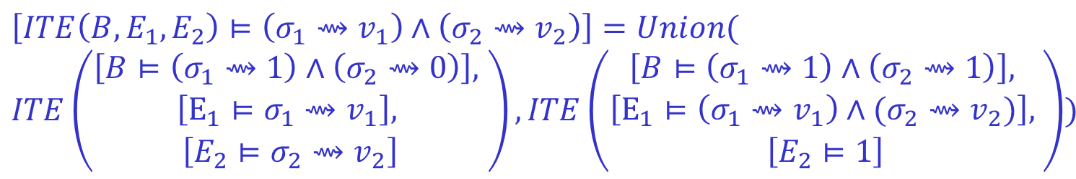
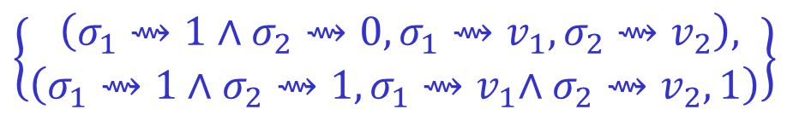
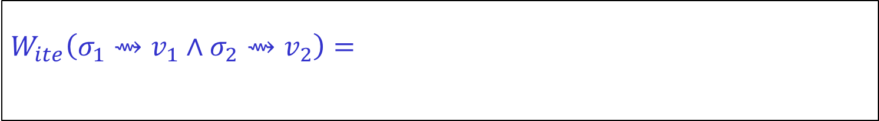
Problem Reduction Rules
Let F be an n-ary operator.
Witness Function: $W_{F}\left(φ\right)=\left\{\left(φ_{1},…,φ_{n}\right) \right| ∀g_{i}⊨φ_{i}: F\left(g_{1},…, g_{n}\right)⊨φ \}$
$$\left[F\left(e_{1},e_{2}\right)⊨φ\right]=$$
$$W_{ite}\left(σ_{1}⇝v_{1}∧σ_{2}⇝v_{2}\right)=$$
$$\left\{\begin{aligned} \left(σ_{1}⇝1∧σ_{2}⇝0,σ_{1}{⇝v}_{1},σ_{2}⇝v_{2}\right), \\ \left(σ_{1}⇝1∧σ_{2}⇝1,σ_{1}{⇝v}_{1}∧σ_{2}⇝v_{2}, 1\right)\end{aligned}\right\}$$
$$Union(\left\{F\left(\left[e_{1}⊨φ_{1}\right], \left[e2⊨φ_{2}\right]\right) \right| \left(φ_{1},φ_{2}\right)∈W_{F}\left(φ\right)\})$$
$$\left[ITE\left(B,E_{1},E_{2}\right)⊨\left(σ_{1}⇝v_{1}\right)∧\left(σ_{2}⇝v_{2}\right)\right]=Union($$
$$ITE\left(\begin{aligned}\left[B⊨\left(σ_{1}⇝1\right)∧\left(σ_{2}⇝0\right)\right], \\ \begin{aligned}\left[E_{1}⊨σ_{1}⇝v_{1}\right], \\ \left[E_{2}⊨σ_{2}⇝v_{2}\right]\end{aligned}\end{aligned}\right), ITE\left(\begin{aligned}\begin{aligned}\left[B⊨\left(σ_{1}⇝1\right)∧\left(σ_{2}⇝1\right)\right], \\ \left[E_{1}⊨\left(σ_{1}⇝v_{1}\right)∧(σ_{2}⇝v_{2})\right], \end{aligned} \\ \left[E_{2}⊨1\right]\end{aligned}\right))$$

Slide 31
FlashMeta Framework
Provides efficient implementations of VSA operations
Provides a library of witness functions
Role of synthesis designer
Can add new operators and witness functions.
Can provide ranking strategies.
Can specify tactics to resolve non-determinism in search
  Which witness function to use?
  How to order search branches?

Slide 32
Comparison of FlashMeta with hand-tuned implementations
Lines of Code (K)
Development time (months)
Project
FlashFill
FlashExtractText
FlashRelate
FlashNormalize
FlashExtractWeb
Original | FlashMeta
12 | 3
7 | 4
5 | 2
17 | 2
N/A | 2.5
Original | FlashMeta
9 | 1
8 | 1
8 | 1
7 | 2
N/A | 1.5
Running time of FlashMeta implementations vary between 0.5-3x of the corresponding original implementation.
Faster because of some free optimizations
Slower because of larger feature sets & a generalized framework

