Slide 1

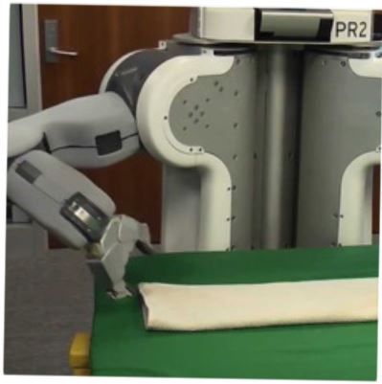

Programming by Examples
Applications, Algorithms & Ambiguity Resolution
Sumit Gulwani
Keynote at IJCAR
June 2016

Slide 2

Motivation
99% of computer users cannot program!
They struggle with simple repetitive tasks.

Slide 3




Spreadsheet help forums
2

Slide 4




Typical help-forum interaction
300_w30_aniSh_c1_b → w30
300_w5_aniSh_c1_b → w5
=MID(B1,5,2)
=MID(B1,5,2)
=MID(B1,FIND(“_”,$B:$B)+1, FIND(“_”,REPLACE($B:$B,1,FIND(“_”,$B:$B), “”))-1)
3

Slide 5
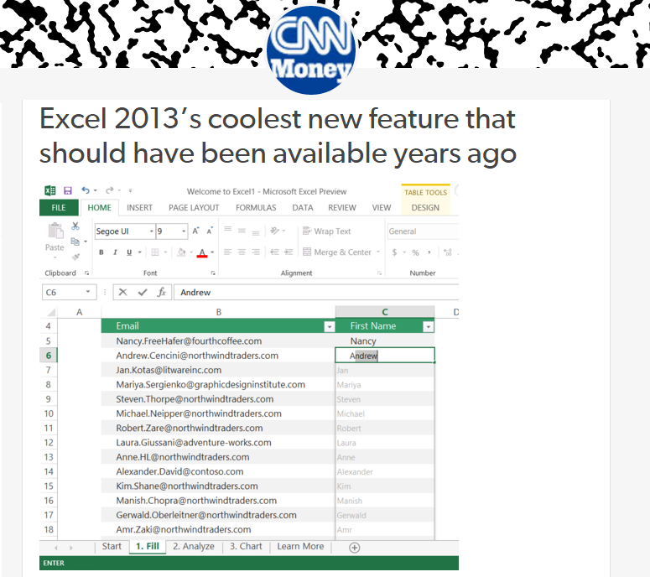
Flash Fill (Excel 2013 feature) demo
“Automating string processing in spreadsheets using input-output examples”; POPL 2011; Sumit Gulwani
4

Slide 6

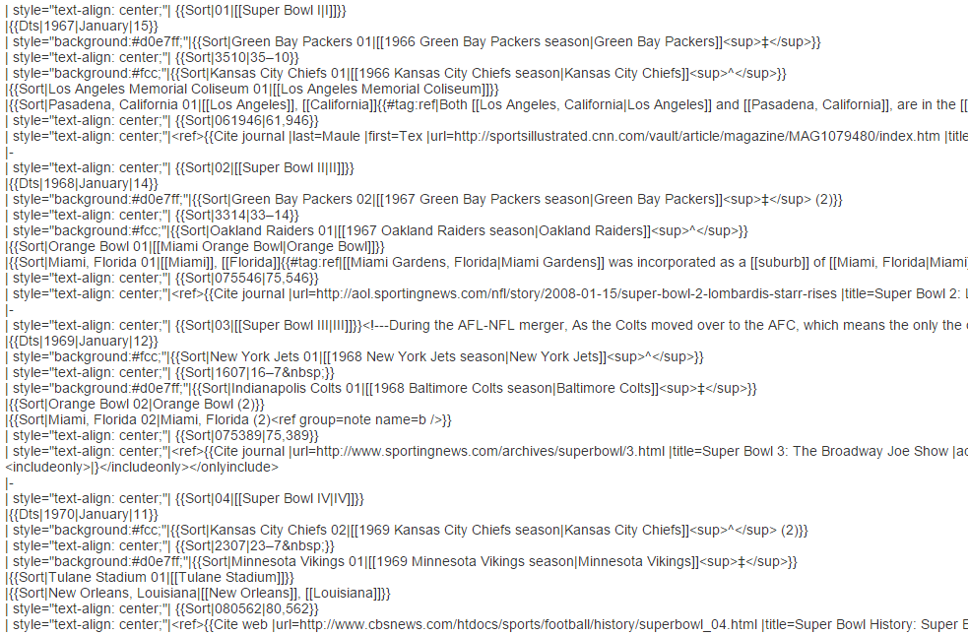
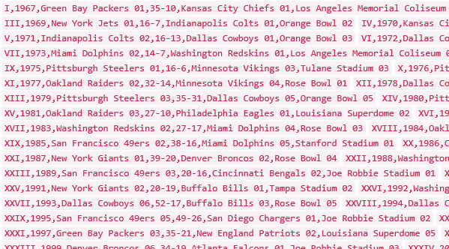
Data Science Class Assignment
To get Started!

Slide 7


FlashExtract Demo
Ships inside two Microsoft products:
Powershell
ConvertFrom-String cmdlet
Custom Log, Custom Field
“FlashExtract: A Framework for data extraction by examples”;
PLDI 2014; Vu Le, Sumit Gulwani

Slide 8

Killer Application: Data Wrangling
Data is the new oil.
Data scientists spend 80% time wrangling data.
Extraction
FlashExtract:Tabular data from log files [PLDI 2014]
Tabular data from spreadsheets [PLDI 2015]
Transformation
FlashFill: Syntactic String Transformations [POPL 2011]
Semantic String Transformations [VLDB 2012]
Number Transformations [CAV 2013]
Date Transformations [POPL 2016]
Normalization Transformations [IJCAI 2015]
Formatting
FlashRelate: Table layout transformations [PLDI 2011]
Repetitive editing in Powerpoint [AAAI 2014]

Slide 9

Programming-by-Examples Architecture
Example-based Intent
Program set
(a sub-DSL of D)
Program
Synthesizer
DSL D
8

Slide 10
Domain-specific Language (DSL)
Balanced Expressiveness
  Expressive enough to cover wide range of tasks
  Restricted enough to enable efficient search
    Restricted set of operators
      those with small inverse sets
    Restricted syntactic composition of those operators
Natural computation patterns
  Increased user understanding/confidence
  Enables selection between programs, editing

Slide 11
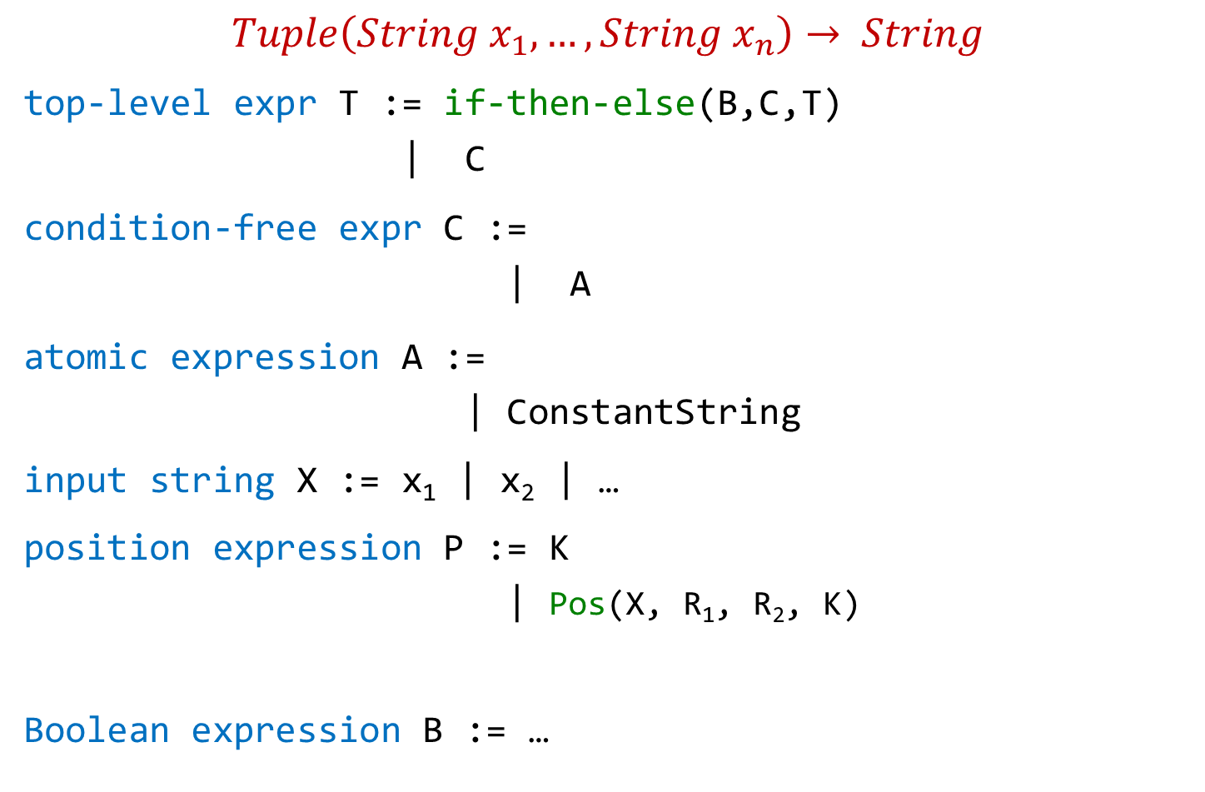
Flash Fill DSL (String Transformations)
$$Tuple\left(String x_{1},…,String x_{n}\right)→ String$$
top-level expr T := if-then-else(B,C,T)
| C
condition-free expr C :=
| A
atomic expression A :=
| ConstantString
input string X := x₁ | x₂ | …
position expression P := K
| Pos(X, R₁, R₂, K)
Boolean expression B := …
Concatenate(A,C)
SubStr(X,P,P)
K^{th} position in X whose left/right side matches with R₁/R₂.

Slide 12


FlashExtract DSL (Sequence Extraction)
$String d→List(String)$
Seq expr E := Map(N, $λ$z: S[z])
| Merge(E_{1,} E₂)
some lines N := FilterByPosition(L, init, iter)
| Filter(L, $λ$z: F)
line filter function F := Contains(z,r,K)
| startsWith(z,r)
all lines L := Split(d,”\n”)
[z])
| Filter(L, $λy$: F[prevLine(y)])
[z]
substr expr S[z] :=
“FlashExtract: A Framework for data extraction by examples”;
PLDI 2014; Vu Le, Sumit Gulwani

Slide 13
Programming-by-Examples Architecture
Example-based Intent
Program set
(a sub-DSL of D)
Program
Synthesizer
DSL D
12

Slide 14
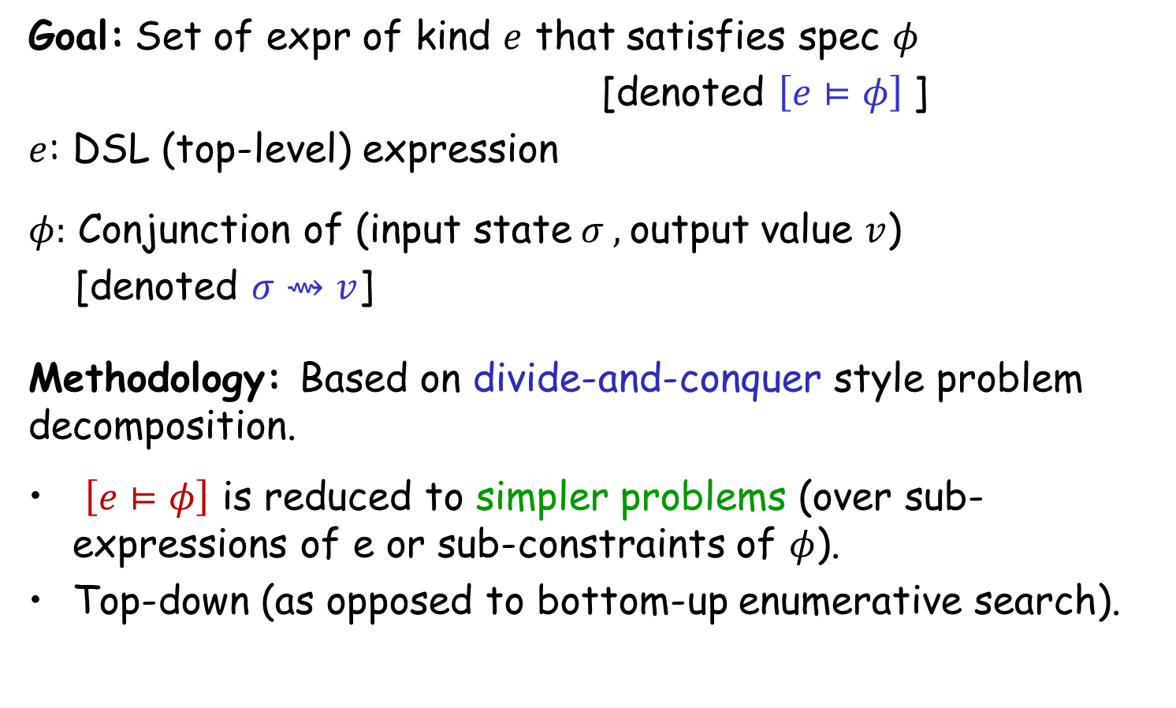
Search Methodology
Goal: Set of expr of kind $e$ that satisfies spec $φ$
[denoted $\left[e⊨φ\right]$]
$e$: DSL (top-level) expression
$φ:$ Conjunction of (input state$σ ,$output value $v$)
[denoted $σ⇝v$]
Methodology: Based on divide-and-conquer style problem decomposition.
$\left[e⊨φ\right]$ is reduced to simpler problems (over sub-expressions of e or sub-constraints of $φ$).
Top-down (as opposed to bottom-up enumerative search).
“FlashMeta: A Framework for Inductive Program Synthesis”;
[OOPSLA 2015] Alex Polozov, Sumit Gulwani

Slide 15

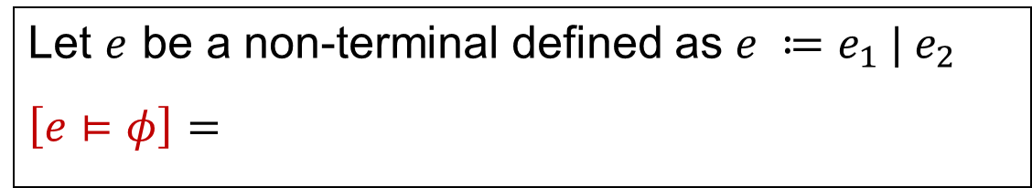



Problem Reduction Rules
$$\left[e⊨φ_{1}∧φ_{2}\right] =$$
$$Intersect(\left[e⊨φ_{1}\right], \left[e⊨φ_{2}\right])$$
An alternative strategy:
$$\left[e⊨φ_{1}∧φ_{2}\right] =$$
$$Filter(\left[e⊨φ_{1}\right], φ_{2})$$
Let $e$ be a non-terminal defined as $e ≔e_{1} | e_{2}$
$$\left[e⊨φ\right]=$$
$$Union(\left[e_{1}⊨φ\right], \left[e_{2}⊨φ\right])$$

Slide 16

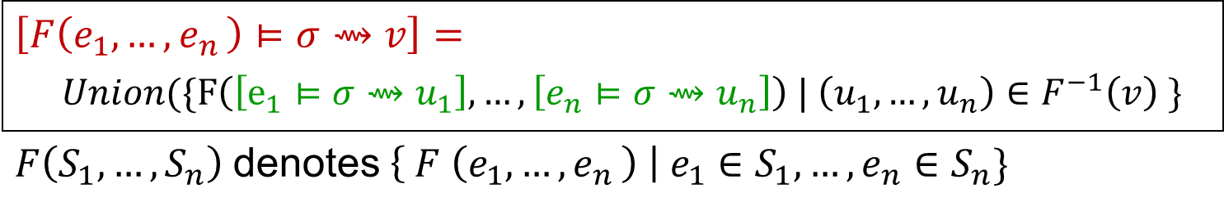
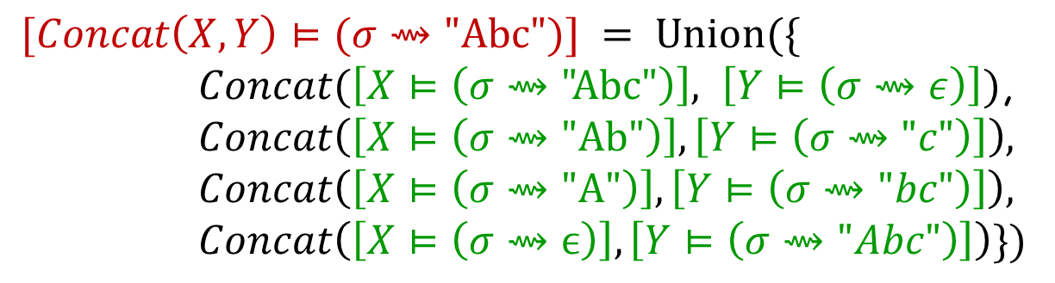
Problem Reduction Rules
Inverse Set: Let F be an n-ary operator.
$$F^{−1}\left(v\right)=\left\{\left(u_{1},…,u_{n} \right) \right| F\left(u_{1},…,u_{n}\right)=v\}$$
$$Concat^{−1}\left(\text{"}\text{Abc}\text{"}\right)=$$
$$\{\left( \text{"}\text{Abc}\text{",}ϵ\right), ("Ab\text{","}\text{c}\text{"), ("}\text{A}\text{","}\text{bc}\text{"), (}ϵ,\text{"}\text{Abc}\text{")\}}$$
$$\left[F\left(e_{1},{…,e}_{n}\right)⊨σ⇝v\right]=$$
$Union(\{F\left(\left[e_{1}⊨σ⇝u_{1}\right], …,\left[e_{n}⊨σ⇝u_{n}\right]\right) | \left(u_{1},…,u_{n}\right)∈F^{−1}\left(v\right) \}$
$F\left(S_{1}, …,S_{n}\right)$denotes$\left\{ F \left(e_{1}, {…,e}_{n}\right) \right| e_{1}∈S_{1},…,e_{n}∈S_{n}\}$
$$[Concat\left(X,Y\right)⊨(σ⇝\text{"}\text{Abc}")] = Union(\{$$
$Concat(\left[X⊨\left(σ⇝\text{"}\text{Abc}\text{"}\right)\right], \left[Y⊨\left(σ⇝ε\right)\right])$,
$$Concat\left(\left[X⊨\left(σ⇝\text{"}\text{Ab}\text{"}\right)\right],\left[Y⊨\left(σ⇝"c"\right)\right]\right),$$
$$Concat\left(\left[X⊨\left(σ⇝\text{"}\text{A}\text{"}\right)\right],\left[Y⊨\left(σ⇝"bc"\right)\right]\right),$$
$$Concat\left(\left[X⊨\left(σ⇝ϵ\right)\right],\left[Y⊨\left(σ⇝"Abc"\right)\right]\right)\})$$

Slide 17


Problem Reduction Rules
Inverse Set: Let F be an n-ary operator.
$$F^{−1}\left(v\right)=\left\{\left(u_{1},…,u_{n} \right) \right| F\left(u_{1},…,u_{n}\right)=v\}$$
$$Concat^{−1}\left(\text{"}\text{Abc}\text{"}\right)=$$
$$\{\left( \text{"}\text{Abc}\text{",}ϵ\right), ("Ab\text{","}\text{c}\text{"), ("}\text{A}\text{","}\text{bc}\text{"), (}ϵ,\text{"}\text{Abc}\text{")\}}$$
$$\{\left(true, v, ⊤\right), (false, ⊤, v)\}$$
$$IfThenElse^{−1}\left(v\right)=$$
$$\{ \left(0,2\right), (6,8) \}$$
$$SubStr^{−1}\left(\text{"}\text{Ab}\text{"} \right| "Ab cd Ab")=$$
$$SubStr^{−1} \left(\text{"}\text{Ab}\text{"}\right)= …$$
The notion of inverse set (and corresponding reduction rule) can be generalized to the conditional setting.

Slide 18
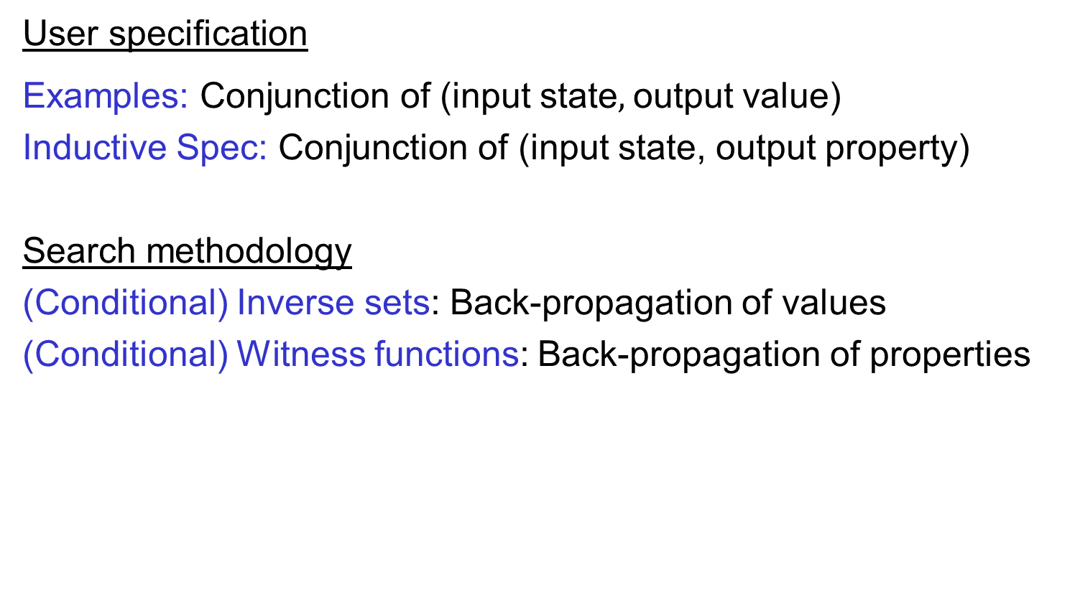
Generalizing output values to output properties
User specification
Examples: Conjunction of (input state$,$output value)
Inductive Spec: Conjunction of (input state, output property)
Search methodology
(Conditional) Inverse sets: Back-propagation of values
(Conditional) Witness functions: Back-propagation of properties

Slide 19
Programming-by-Examples Architecture
Example-based Intent
Ranked Program set
(a sub-DSL of D)
Program set
(a sub-DSL of D)
Program
Synthesizer
Ranking fn
DSL D
18

Slide 20

Basic ranking scheme
Prefer programs with simpler Kolmogorov complexity
Prefer fewer constants.
Prefer smaller constants.
Input | Output
Rishabh Singh | Rishabh
Ben Zorn | Ben
1st Word
If (input = “Rishabh Singh”) then “Rishabh” else “Ben”
“Rishabh”

Slide 21
Challenges with Basic ranking scheme
Prefer programs with simpler Kolmogorov complexity
Prefer fewer constants.
Prefer smaller constants.
Input | Output
Rishabh Singh | Singh, Rishabh
Ben Zorn | Zorn, Ben
2nd Word + “, ‘’ + 1st Word
“Singh, Rishabh”
How to select between
Fewer larger constants vs. More smaller constants?
  Idea: Associate numeric weights with constants.

Slide 22
Challenges with Basic ranking scheme
Prefer programs with simpler Kolmogorov complexity
Prefer fewer constants.
Prefer smaller constants.
Input | Output
Missing page numbers, 1993 | 1993
64-67, 1995 | 1995
1st Number from the beginning
1st Number from the end
How to select between
Same number of same-sized constants?
Idea: Examine data features (in addition to program features)

Slide 23
Machine learning based ranking scheme
Rank score of a program: Weighted combination of various features.
Weights are learned using machine learning.
Program features
Number of constants
Size of constants
Features over user data: Similarity of generated output (or even intermediate values) over various user inputs
IsYear, Numeric Deviation, Number of characters
IsPersonName
“Predicting a correct program in Programming by Example”;
[CAV 2015] Rishabh Singh, Sumit Gulwani

Slide 24
Outline
Core Synthesis Architecture
  Domain-specific Language
  Search methodology
  Ranking function
Next generation Synthesis
  Interactive
  Predictive
  Adaptive

Slide 25

Programming-by-Examples Architecture
Refined Intent
Example based Intent
Ranked Program set
(a sub-DSL of D)
Intended Program in D
Program
Synthesizer
Debugging
Incrementality
Translator
Test inputs
Ranking fn
DSL D
Intended Program in R/Python/C#/C++/…
24

Slide 26

Interactive Debugging
Sampling inputs
Asking questions
Visual explanations of the synthesized program
25

Slide 27

Predictive
Intended programs can sometimes be synthesized from just the input.
  Tabular data extraction, Sort, Join
Can save large amount of user effort.
  User need not provide examples for each of tens of columns.

Slide 28
Programming-by-Examples Architecture
Refined Intent
Example based Intent
Ranked Program set
(a sub-DSL of D)
Intended Program in D
Program
Synthesizer
Debugging
Incrementality
Translator
Test inputs
Ranking fn
DSL D
Intended Program in R/Python/C#/C++/…
27

Slide 29

Adaptive
Learn from past interactions
  of the same user (personalized experience).
  of other users in the enterprise/cloud.
The synthesis sessions now require less interaction.

Slide 30
Programming-by-Examples Architecture
Refined Intent
Example based Intent
Ranked Program set
(a sub-DSL of D)
Intended Program in D
Program
Synthesizer
Debugging
Incrementality
Translator
Test inputs
Ranking fn
DSL D
Intended Program in R/Python/C#/C++/…
Learner
Interaction history
29

Slide 31
PROSE Framework
https://microsoft.github.io/prose
Efficient implementation of the generic search methodology.
Provides a library of reduction rules.
Role of synthesis designer
Implement a DSL and provide reduction rules for new operators.
Provide ranking strategy.
Can specify tactics to resolve non-determinism in search.

Slide 32


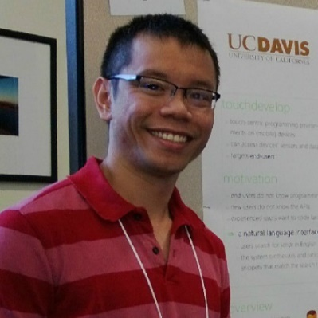


The PROSE Team
Allen Cypher
Sumit Gulwani
Ranvijay Kumar
Vu Le
Daniel Perelman
We are hiring interns/full-time!
Alex Polozov
Mohammad Raza
Danny Simmons
Adam Smith
Abhishek
Udupa

Slide 33
Future Directions
Application to robotics
Learn from usage data
Probabilistic noise handling
Programming using natural language

Slide 34
Conclusion
Killer application: Data wrangling
  99% of end users are non-programmers.
  Data scientists spend 80% time cleaning data.
Algorithmic search
  Domain-specific language
  Deductive methodology based on back-propagation
Ambiguity resolution
  Ranking
  Interactivity
Reference: “Programming by Examples (and its applications in Data Wrangling)”,
In Verification and Synthesis of Correct and Secure Systems; IOS Press; 2016
[based on Marktoberdorf Summer School 2015 Lecture Notes]

