Slide 1

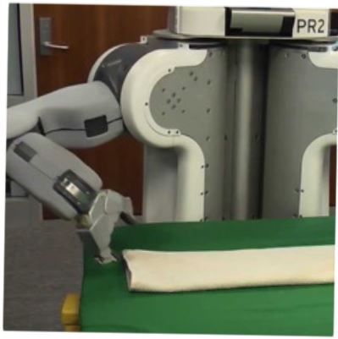

Programming by Examples
Sumit Gulwani
Marktoberdorf Lectures
August 2015

Slide 2
Lecture 2
Domain-specific Languages

Slide 3

PBE Architecture
Example-based specification
Ordered set of Programs
Program
Ranking
Function
Search Algorithm
DSL
Challenge 1: Ambiguous/under-specified intent may result in unintended programs.
Challenge 2: Designing efficient search strategy.

Slide 4
Domain-specific Language (DSL)
Balanced Expressiveness
  Expressive enough to cover wide range of tasks
  Restricted enough to enable efficient search
    Restricted set of operators
      those with small inverse sets
    Restricted syntactic composition of those operators
Natural computation patterns
  Increased user understanding/confidence
  Enables selection between programs, editing
Guiding Principle:
Use composition (parallel or sequential) of simple operators

Slide 5
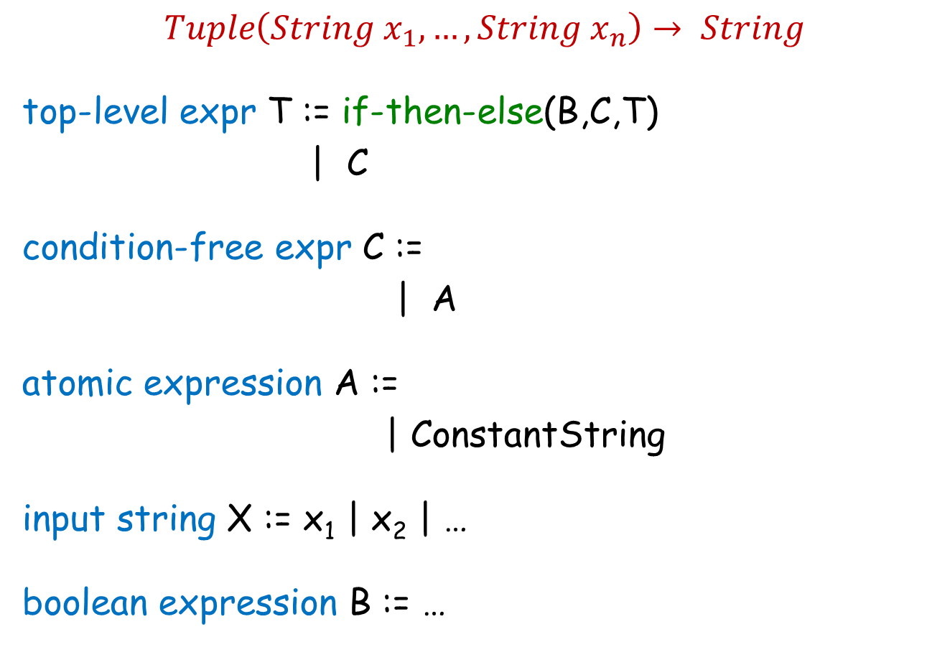
FlashFill DSL
$Tuple\left(String x_{1},…,String x_{n}\right)→ String$
top-level expr T := if-then-else(B,C,T)
| C
condition-free expr C :=
| A
atomic expression A :=
| ConstantString
input string X := x₁ | x₂ | …
boolean expression B := …
Concatenate(A, C)
SubStr(X, …)

Slide 6
Substring Operator
What is a good choice for … in SubStr(X, …) ?
Regular expression
  Not very expressive. Does not take context into account.
  For instance: content within parenthesis, second word
Extended regular expression
  Too sophisticated for learning and readability.
Desired computational pattern:
Should involve simple regexes.
Take context into account.
Notes:
Composition: First do this, then do that (relative position extraction, FlashExtract filter and map)

Slide 7
Substring Operator
position expr P :=
SubStr(X, P, P’)
Pos(X, R₁, R₂, K)
K^{th} position in X whose left/right side matches with R₁/R₂.

Slide 8
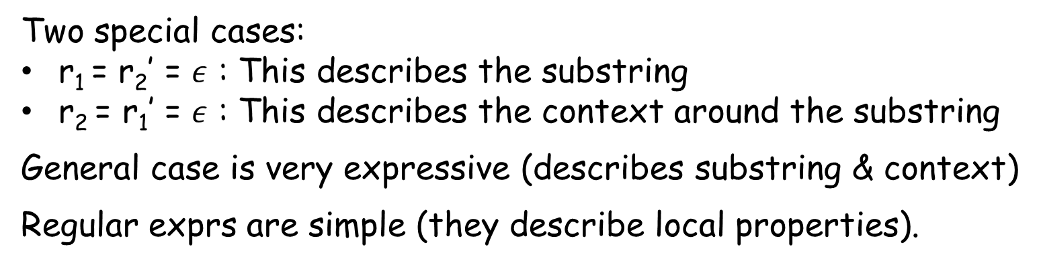
Substring Operator
Evaluation of Expr SubStr(x,p,p’) , where p=Pos(x,r_{1,}r₂,k) &
p’=Pos(x,r₁’,r₂’,k’)
matches r₁
matches r₂
matches r₁’
matches r₂’
p
p’
w
x
Two special cases:
r₁ = r₂’ = $ε$ : This describes the substring
r₂ = r₁’ = $ε$ : This describes the context around the substring
General case is very expressive (describes substring & context)
Regular exprs are simple (they describe local properties).

Slide 9
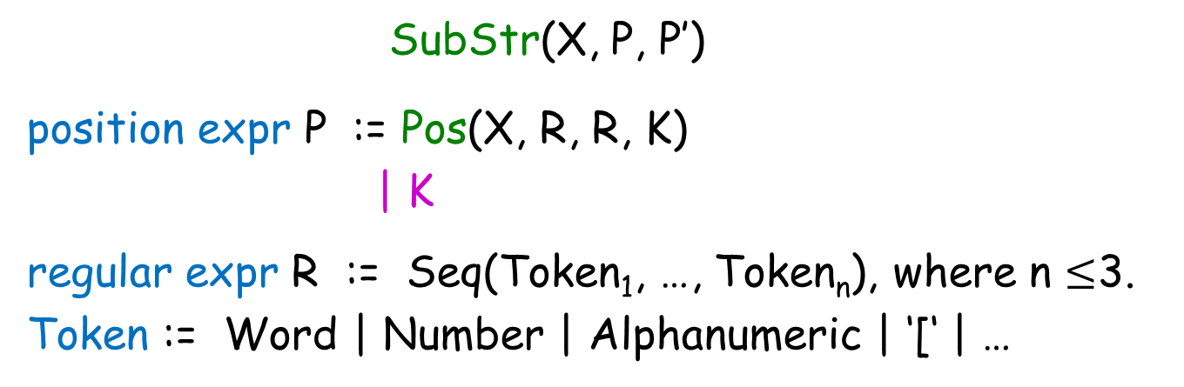
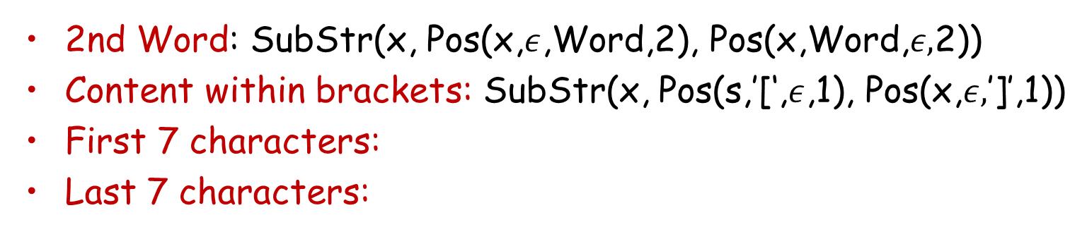
Substring Operator
SubStr(X, P, P’)
position expr P := Pos(X, R, R, K)
| K
regular expr R := Seq(Token₁, …, Token_{n}), where n $≤$3.
Token := Word | Number | Alphanumeric | ‘[‘ | …
2nd Word: SubStr(x, Pos(x,$ε$,Word,2), Pos(x,Word,$ε,$2))
Content within brackets: SubStr(x, Pos(s,’[‘,$ε$,1), Pos(x,$ε,$’]’,1))
First 7 characters:
Last 7 characters:
SubStr(x, 0, 7)
SubStr(x, -8, -1)

Slide 10
Substring Operator
SubStr(X, P, P)
position expr P := Pos(X, R, R, K) | K
Restriction
let x = X in
SubStr(x, P, P)
position expr P := Pos(x, R, R, K) | K
Elegance
let x = X in
let p₁ = P[x] in
let p₂ = P[x] in
SubStr(x, p₁, p₂)
position expr P[y] := Pos(y, R, R, K) | K

Slide 11
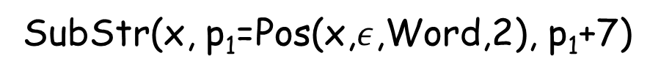

Substring Operator
let x = X in
let p₁ = P[x] in
let p₂ = P[x] in
SubStr(x, p₁, p₂)
position expr P[y] := Pos(y, R, R, K) | K
Increased Expressiveness
let x = X in
let p₁ = P[x] in
let p₂ = P[x] | p₁ + P[Suffix(x,p₁)] in
SubStr(x, p₁, p₂)
position expr P[y] := Pos(y, R, R, K) | K
First 7 chars in 2nd Word:
SubStr(x, p₁=Pos(x,$ε$,Word,2), p₁+7)
Suffix(x,p) $≡$SubStr(x,p,-1)

Slide 12
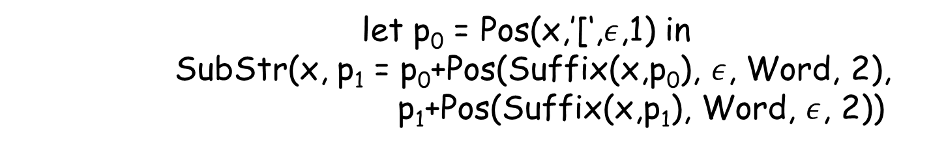
Substring Operator
let x = X in
let p₁ = P[x] in
let p₂ = P[x] | p₁ + P[Suffix(x,p₁)] in
SubStr(x, p₁, p₂)
position expr P[y] := Pos(y, R, R, K) | K
Increased Expressiveness
let x = X in
let p₁ = P[x] | let p₀ = P[x] in (p₀ + P[Suffix(s, p₀)]) in
let p₂ = P[x] | p₁ + P[Suffix(x,p₁)] in
SubStr(x, p₁, p₂)
position expr P[y] := Pos(y, R, R, K) | K
2nd word within brackets:
let p₀ = Pos(x,’[‘,$ε$,1) in
SubStr(x, p₁ = p₀+Pos(Suffix(x,p₀), $ε$, Word, 2),
p₁+Pos(Suffix(x,p₁), Word, $ε$, 2))

Slide 13
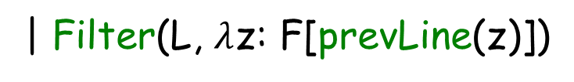

FlashExtract DSL
$String d→List(PosPair)$
all lines L := Split(d,”\n”)
some lines N := Filter(L, $λ$z: F[z])
| FilterByPosition(L, init, iter)
line filter function F[y] := Contains(y,r,K) | startsWith(y,r)
| Filter(L, $λ$z: F[prevLine(z)])
[X]
substr expr S :=
let x = X in
let p₁=P[x] | let p₀=P[x] in (p₀+P[Suffix(s,p₀)]) in
let p₂ = P[x] | p₁ + P[Suffix(x,p₁)] in
SubStr(x, p₁, p₂)
position expr P[y] := Pos(y, R, R, K) | K

Slide 14

FlashExtract DSL
$String d→List(PosPair)$
Seq expr E := Map(N, $λ$z: PP[z])
| Map(Pos(d,R,R), $λ$z: PP[Suffix(d,z)])
| Merge(T_{1,} T₂)
all lines L := Split(d,”\n”)
some lines N := Filter(L, $λ$z: F[z])
| FilterByPosition(L, init, iter)
line filter function F[y] := Contains(y,r,K) | startsWith(y,r)
| Filter(L, $λ$z: F[prevLine(z)])
[X]
substr expr S :=
let x = X in SubStr(x, PP[x])
position pair PP[x] := let p₁=P[x] | let p₀=P[x] in (p₀+P[Suffix(s,p₀)]) in
let p₂ = P[x] | p₁ + P[Suffix(x,p₁)] in
(p₁,p₂)
position expr P[y] := Pos(y, R, R, K) | K

Slide 15
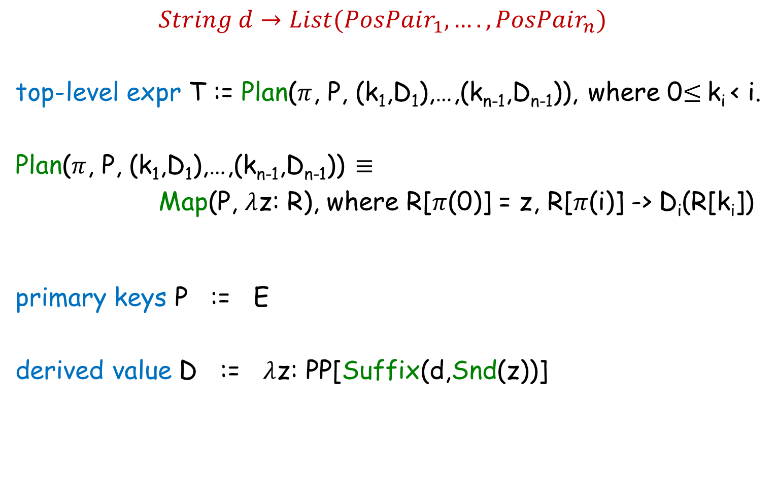
FlashExtract DSL
$String d→List(PosPair_{1},….,PosPair_{n})$
top-level expr T := Plan($π$, P, (k₁,D₁),…,(k_{n-1},D_{n-1})), where 0$≤$k_{i} < i.
Plan($π$, P, (k₁,D₁),…,(k_{n-1},D_{n-1})) $≡$
Map(P, $λ$z: R), where R[$π$(0)] = z, R[$π$(i)] -> D_{i}(R[k_{i}])
primary keys P := E
derived value D := $λ$z: PP[Suffix(d,Snd(z))]

Slide 16
FlashRelate DSL

Slide 17
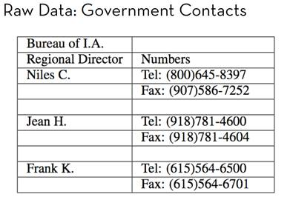
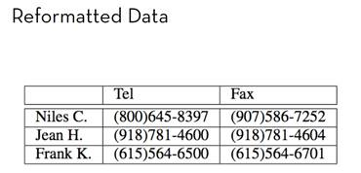
Table Re-formatting
Input: Semi-structured spreadsheet
Output: Relational table

Slide 18
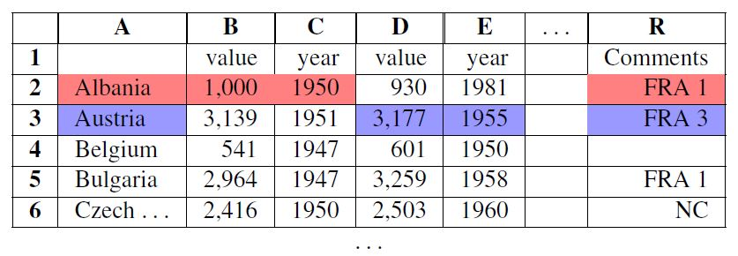
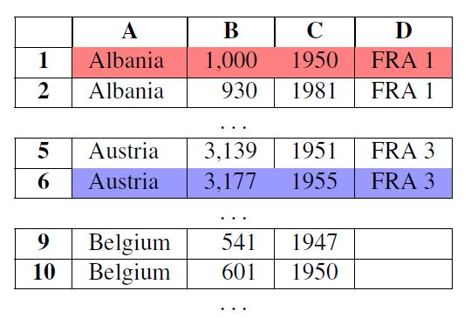
Table Re-formatting
Input: Semi-structured spreadsheet
Output: Relational table

Slide 19
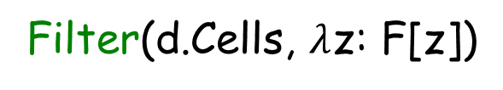
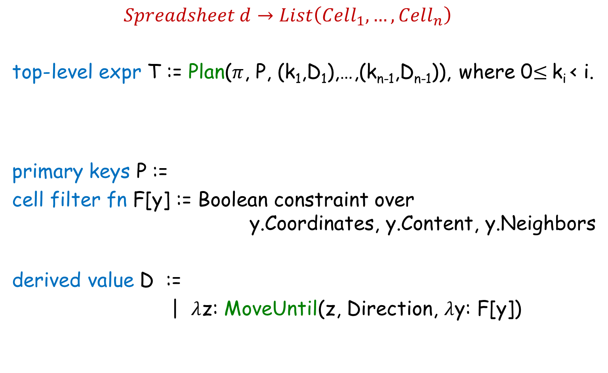
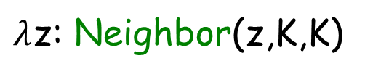
FlashRelate DSL
$Spreadsheet d→List\left(Cell_{1},…, Cell_{n}\right)$
top-level expr T := Plan($π$, P, (k₁,D₁),…,(k_{n-1},D_{n-1})), where 0$≤$k_{i} < i.
primary keys P :=
cell filter fn F[y] := Boolean constraint over
y.Coordinates, y.Content, y.Neighbors
derived value D :=
| $λ$z: MoveUntil(z, Direction, $λ$y: F[y])
Filter(d.Cells, $λ$z: F[z])
$λ$z: Neighbor(z,K,K)

Slide 20
Summary: Design of DSLs for Synthesis
Balanced Expressiveness
  Expressive enough to cover wide range of tasks
    Build out iteratively from a simple core.
  Restricted enough to enable efficient search
    Use “let” construct for syntactic restrictions.
Natural computation patterns
  Use function definitions for reusability.

