Slide 1

Effective Straggler Mitigation: Attack of the Clones
Ganesh Ananthanarayanan, Ali Ghodsi, Srikanth Kandula, Scott Shenker, Ion Stoica

Slide 2
Small jobs increasingly important
Most jobs are small
  82% of jobs contain less than 10 tasks (Facebook’s Hadoop cluster)
Small jobs often are interactive and latency-constrained
  Data analyst testing query on small sample
  New frameworks targeted at interactive analyses

Slide 3
Stragglers in Small Jobs
Small jobs particularly sensitive to stragglers
  Inordinately slow tasks that delay job completion
Straggler Mitigation:
  Blacklisting: Clusters periodically diagnose and eliminate machines with faulty hardware
  Speculation: LATE [OSDI’08], Mantri [OSDI’10]…
    Address the non-deterministic stragglers
    Complete systemic modeling is intrinsically complex

Slide 4
Despite the mitigation techniques…
LATE: The slowest task runs 8 times slower* than the median task
Mantri: The slowest task runs 6 times slower* than the median task
(…but they work well for large jobs)
* progress rate of a task = input-size/duration

Slide 5
State-of-the-art Straggler Mitigation
Speculative Execution:
  Wait: observe relative progress rates of tasks
  Speculate: launch copies of tasks that are predicted to be stragglers

Slide 6
Why doesn’t this work for small jobs?
Consist of just a few tasks
  Statistically hard to predict stragglers
  Need to wait longer to accurately predict stragglers
Run all their tasks simultaneously
  Waiting can constitute considerable fraction of a small job’s duration
Wait & Speculate is ill-suited to address stragglers in small jobs

Slide 7
Cloning Jobs
Proactively launch clones of a job, just as they are submitted
Pick the result from the earliest clone
Probabilistically mitigates stragglers
Eschews waiting, speculation, causal analysis…
Is this really feasible??

Slide 8
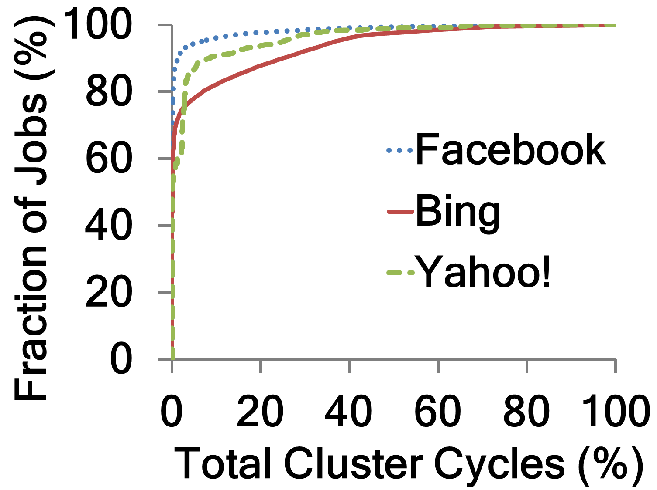
Heavy-tailed Distribution
90% of jobs use 6% of resources
Can clone small jobs with few extra resources

Slide 9
Challenge: Avoid I/O contention
Every clone should get its own copy of data
Input data of jobs
  Replicated three times (typically)
  Storage crunch: Cannot increase replication
Intermediate data of jobs
  Not replicated at all, to avoid overheads

Slide 10
Strawman: Job-level Cloning
M1
R1
M2
Job
Earliest
M1
R1
M2
  Easy to implement
  Directly extends to any framework

Slide 11
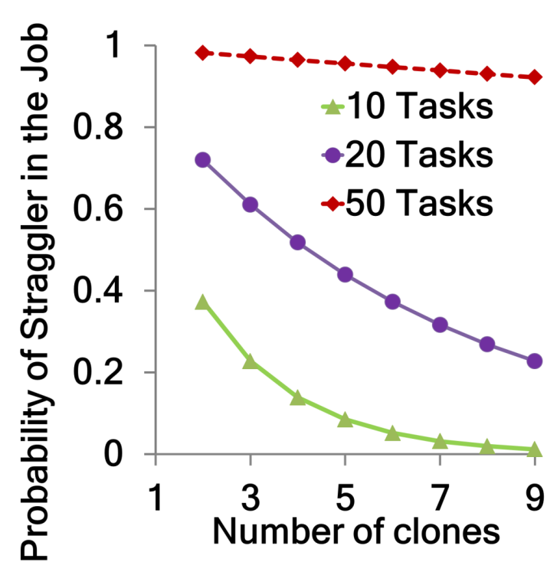
Number of clones
(Map-only job)
>> 3 clones
Contention for input data by map task clones
Storage crunch → Cannot increase replication

Slide 12
Task-level Cloning
M1
M1
Earliest
Earliest
Job
R1
Earliest
R1
M2
M2

Slide 13
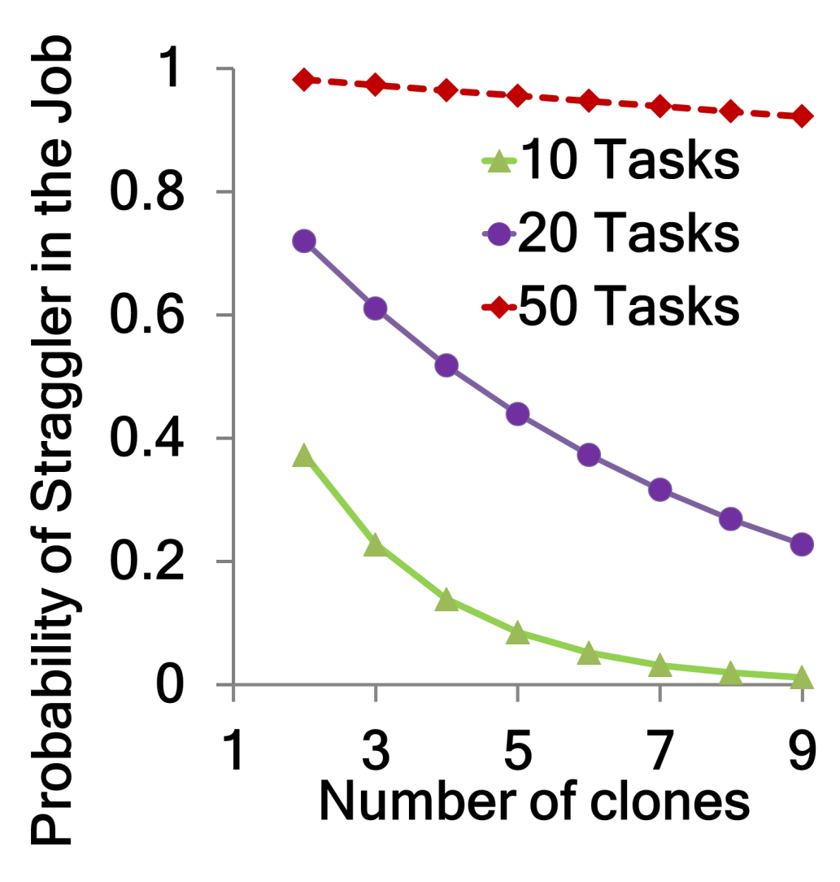
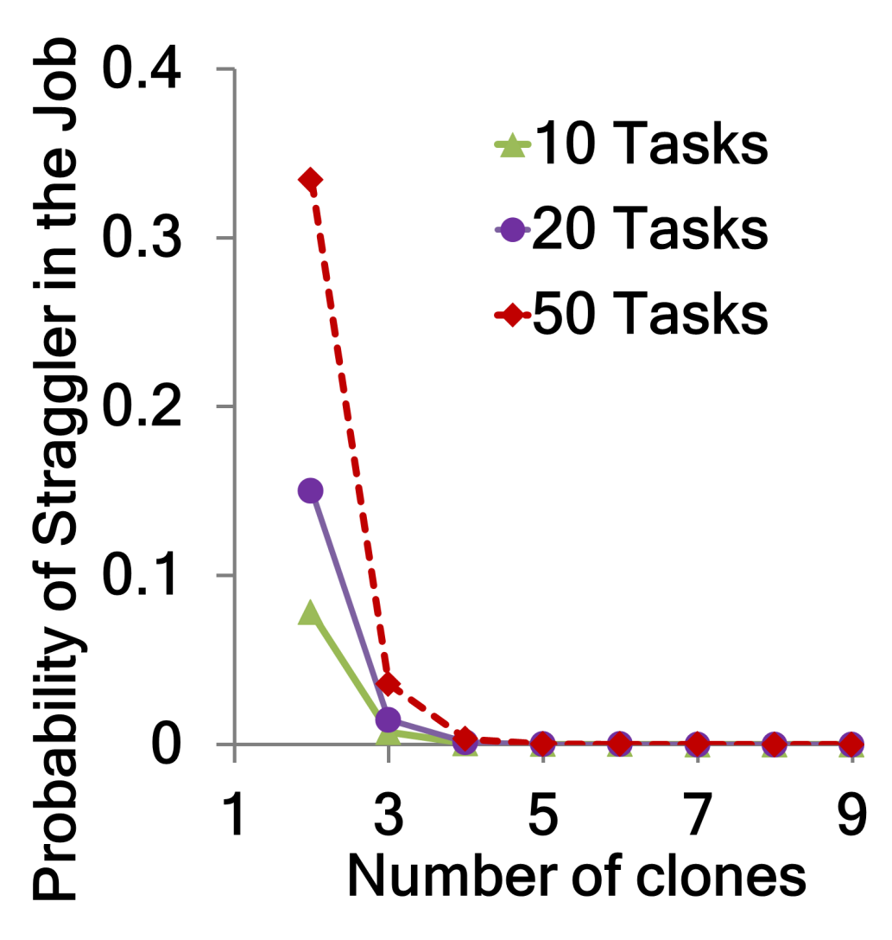
≤3 clones suffices
Strawman
Task-level Cloning

Slide 14
Intermediate Data Contention
We would like every reduce clone to get its own copy of intermediate data (map output)
When a map clones does not straggle, use its output
When they do straggle?

Slide 15

Contention-Avoidance Cloning (CAC)
M1
M1
Exclusive copy
M1
R1
R1
R1
M2
M2
M2
  Jobs are more vulnerable to stragglers

Slide 16
Contention Cloning (CC)
M1
Earliest copy
M1
R1
R1
M2
M2
  Intermediate data transfer takes longer

Slide 17
CAC vs. CC
CAC avoids contentions but makes jobs more vulnerable to stragglers
  Straggler probability in a job increases by >10%
CC mitigates stragglers in jobs but causes contentions
  Shuffle takes ~50% longer
Do not distinguish intrinsic variations in task durations from stragglers

Slide 18
Delay Assignment
Small delay before contending for the available copy of the intermediate data
  (Similar to delay scheduling [EuroSys’10])
Probabilistic modeling of the delay
  Expected task durations
  Read bandwidths w/ and w/o contention
  Happens automatically and periodically

Slide 19

Dolly: Cloning Jobs
Task-level cloning of jobs
Delay Assignment to manage intermediate data
Works within a budget
  Cap on the extra cluster resources for cloning

Slide 20
Evaluation Setup
Workload derived from Facebook traces
  FB: 3500 node Hadoop cluster, 375K jobs, 1 month
Prototype on top of Hadoop 0.20.2
Experiments on 150-node cluster
Baselines: LATE and Mantri, + blacklisting
Cloning budget of 5%

Slide 21
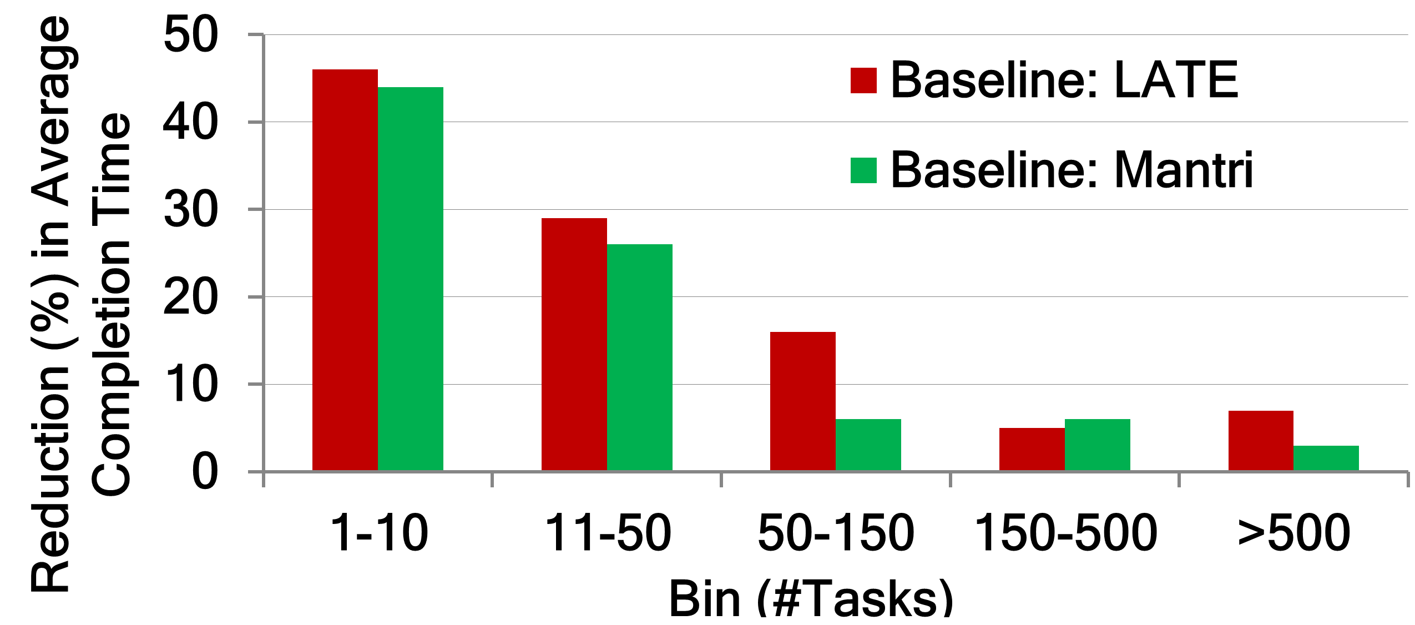
Average job completion time
Jobs are 44% and 42% faster w.r.t. LATE and Mantri
Slowest task in a job now runs 1.06x times slower than median (down from 8x)

Slide 22
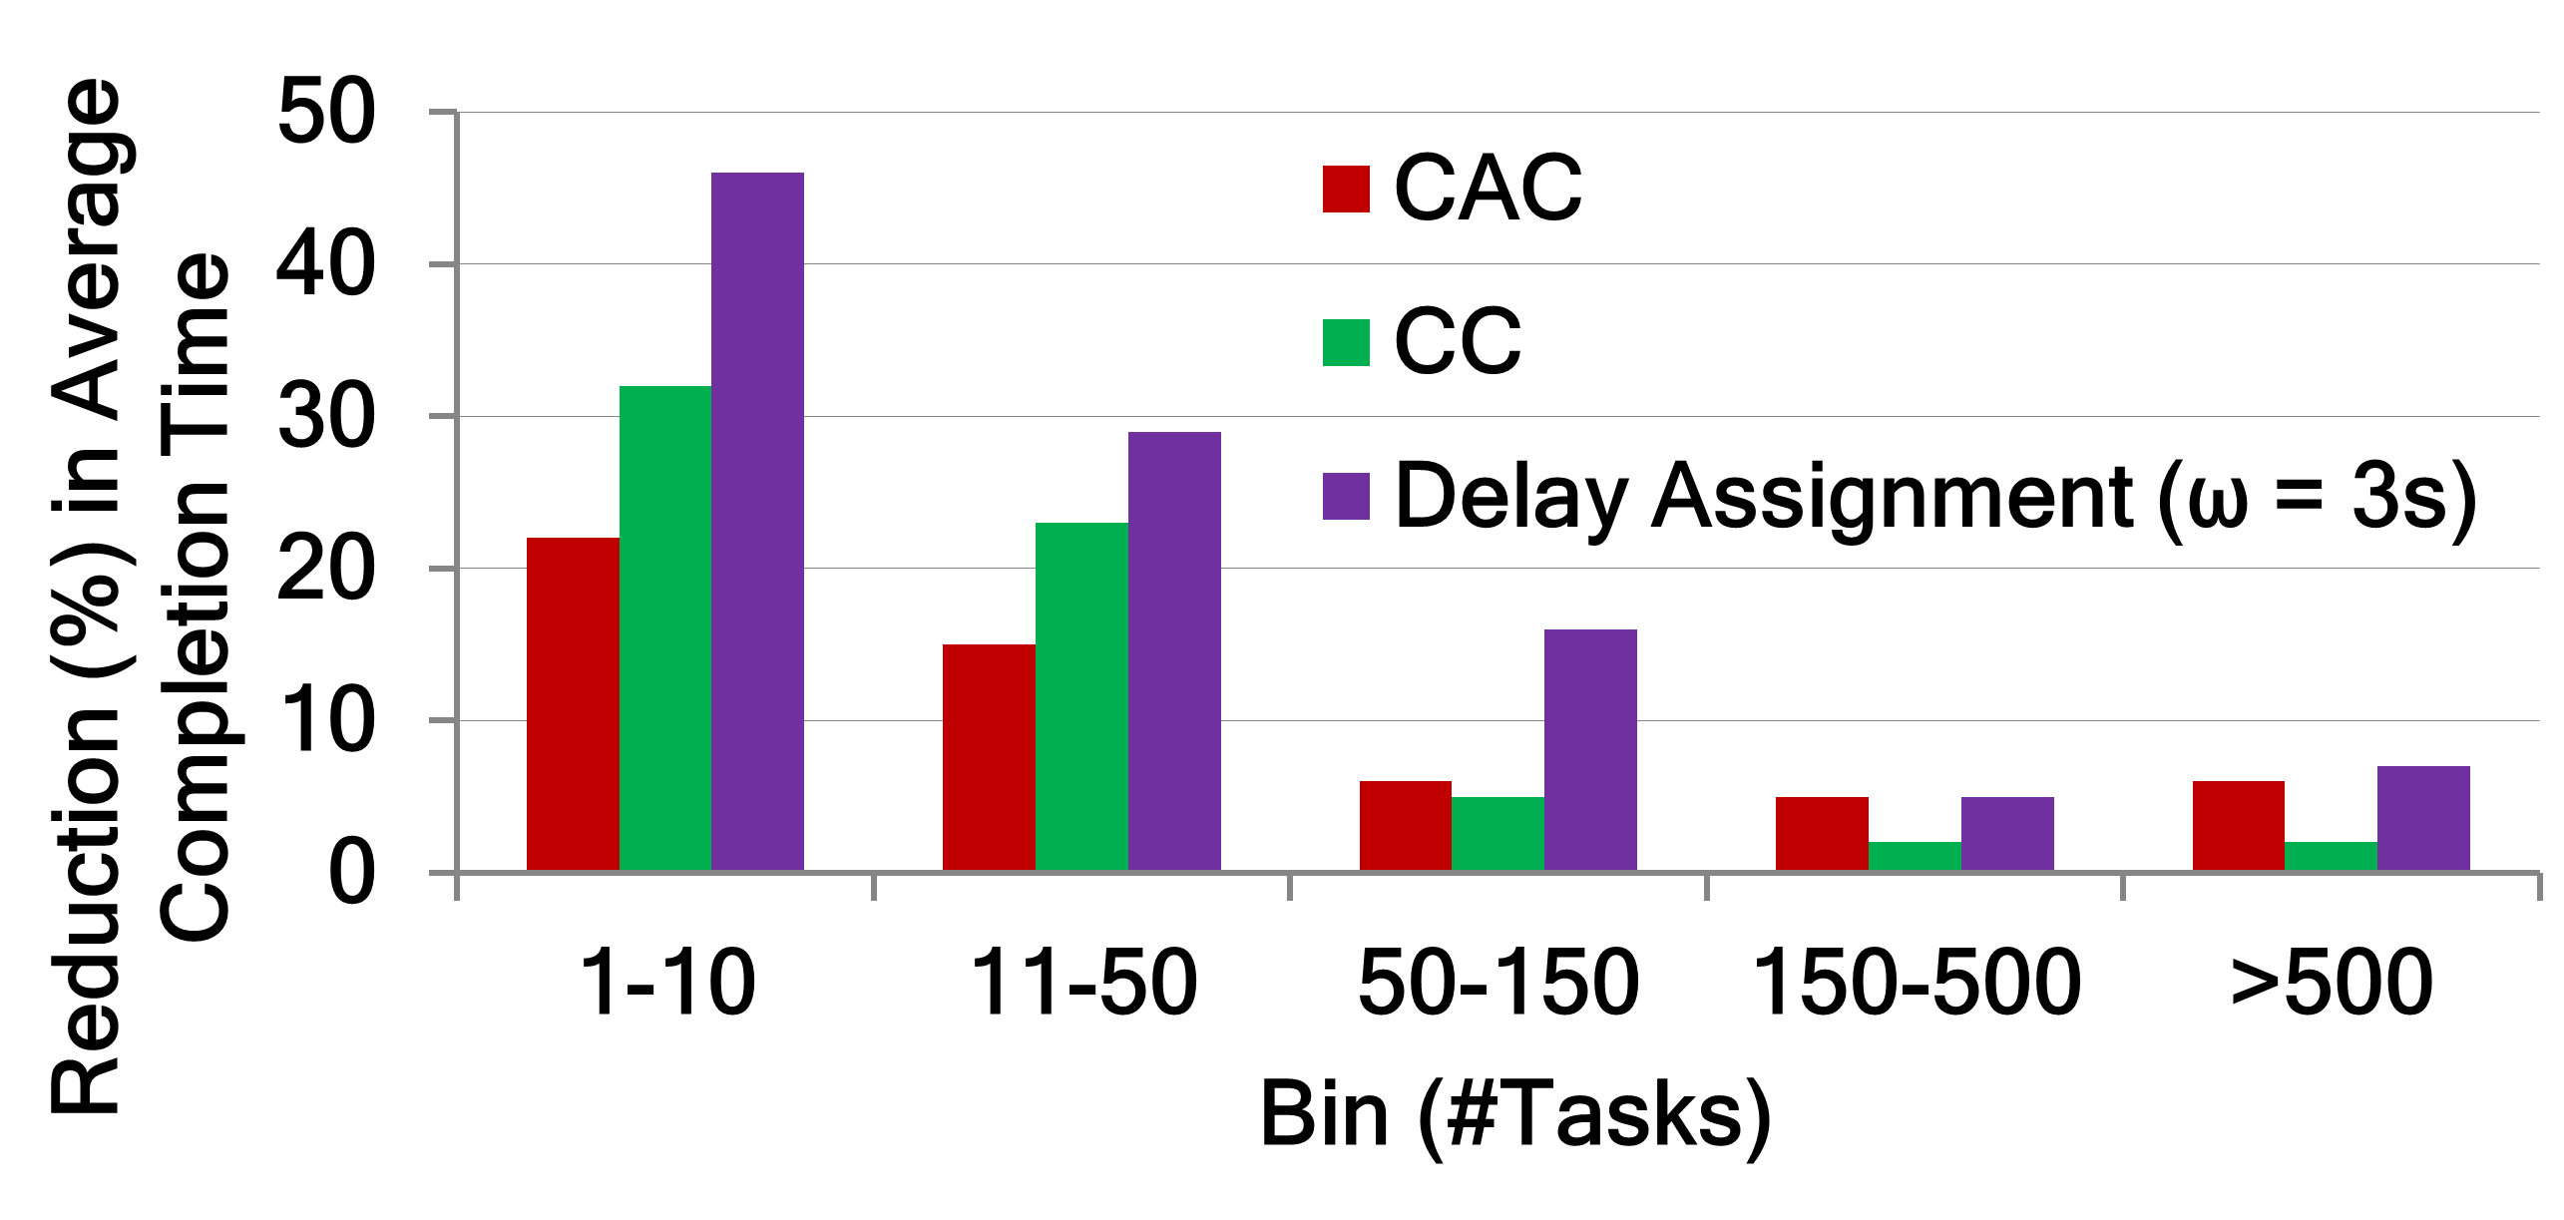
Delay Assignment is crucial…
1.5x – 2x better
(Exclusive Copy)
(Earliest Copy)

Slide 23
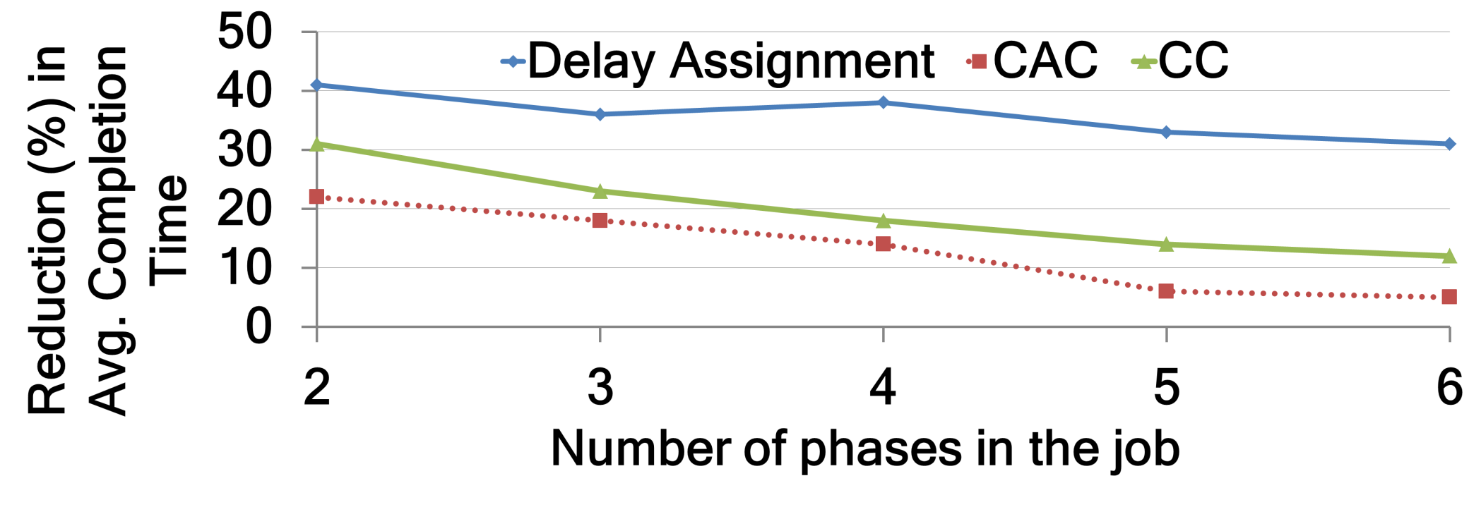
…and gets better with #phases in job
Dryad jobs have multiple phases in a single job
Steady gains, and outperforms CAC and CC

Slide 24
Summary
Stragglers in small jobs are not well-handled by traditional mitigation strategies
Dolly: Proactive Cloning of jobs
  Heavy-tail → Small cloning budget (5%) suffices
Jobs improve by at least 42% w.r.t. state-of-the-art straggler mitigation strategies

