Slide 1

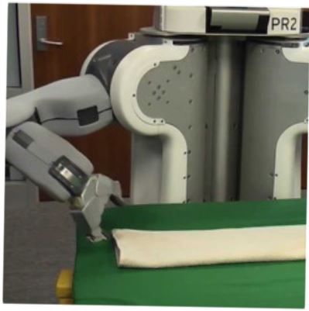

Usability Design Space
in
Programming by Examples
Keynote @ PLATEAU
Oct 2017
Sumit Gulwani
Joint work with many colleagues

Slide 2



Outline
Programming by Examples (PBE) is the task of synthesizing a program in an underlying language from example-based specification using a search algorithm.
Usability Dimensions
Efficiency
Intention
Debuggability

Slide 3

Significance
An old problem but enabled today by
better algorithms & faster machines.
The new programming revolution
Enables 10-100x productivity for programmers.
The new computer-user experience
99% users can’t program and struggle with repetitive tasks.
Non-programmers can now create scripts & achieve more.

Slide 4




Excel Help Forums

Slide 5




Typical help-forum interaction
300_w30_aniSh_c1_b → w30
300_w5_aniSh_c1_b → w5
=MID(B1,5,2)
=MID(B1,5,2)
=MID(B1,FIND(“_”,$B:$B)+1, FIND(“_”,REPLACE($B:$B,1,FIND(“_”,$B:$B),””))-1)

Slide 6
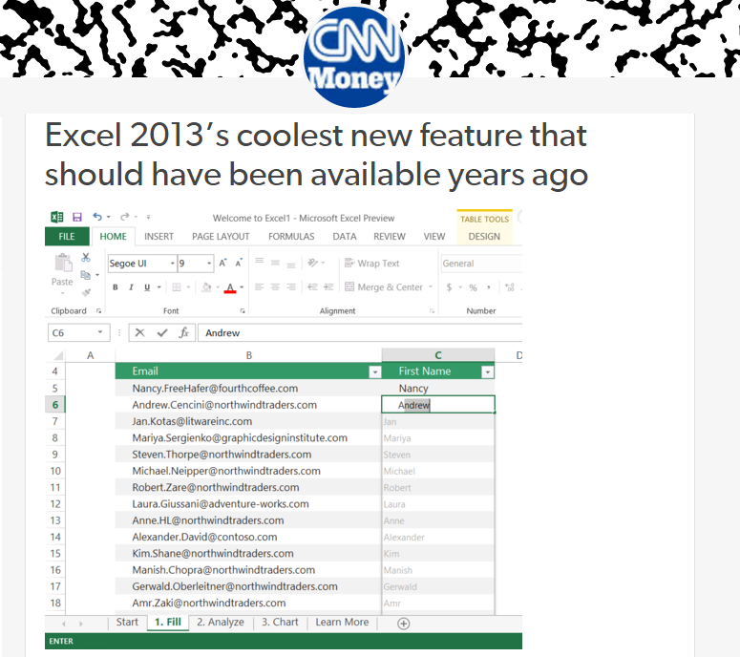
Flash Fill (Excel 2013 feature) demo
“Automating string processing in spreadsheets using input-output examples”;
POPL 2011; Sumit Gulwani

Slide 7
Number and DateTime Transformations
Input | Output (Round to 2 decimal places)
123.4567 | 123.46
123.4 | 123.40
78.234 | 78.23
Excel/C#:
Python/C:
Java:
#.00
.2f
#.##
Input | Output (Half hour bucket)
0d 5h 26m | 5:00-5:30
0d 4h 57m | 4:30-5:00
0d 4h 27m | 4:00-4:30
0d 3h 57m | 3:30-4:00
Synthesizing Number Transformations from Input-Output Examples;
CAV 2012; Singh, Gulwani

Slide 8
Lookup Transformations
Id | Name | Markup
S33 | Stroller | 30%
B56 | Bib | 45%
D32 | Diapers | 35%
W98 | Wipes | 40%
A46 | Aspirator | 30%
... | .... | ...
Id | Date | Price
S33 | 12/2010 | $145.67
S33 | 11/2010 | $142.38
B56 | 12/2010 | $3.56
D32 | 1/2011 | $21.45
W98 | 4/2009 | $5.12
... | ... | ...
MarkupRec
Table
CostRec
Table
Input v1 (Name) | Input v2 (Date) | Output (Price+ Markup*Price)
Stroller | 10/12/2010 | $145.67+0.30*145.67
Bib | 23/12/2010 | $3.56+0.45*3.56
Diapers | 21/1/2011
Wipes | 2/4/2009
Aspirator | 23/2/2010
Learning Semantic String Transformations from Examples; VLDB 2012; Singh, Gulwani

Slide 9

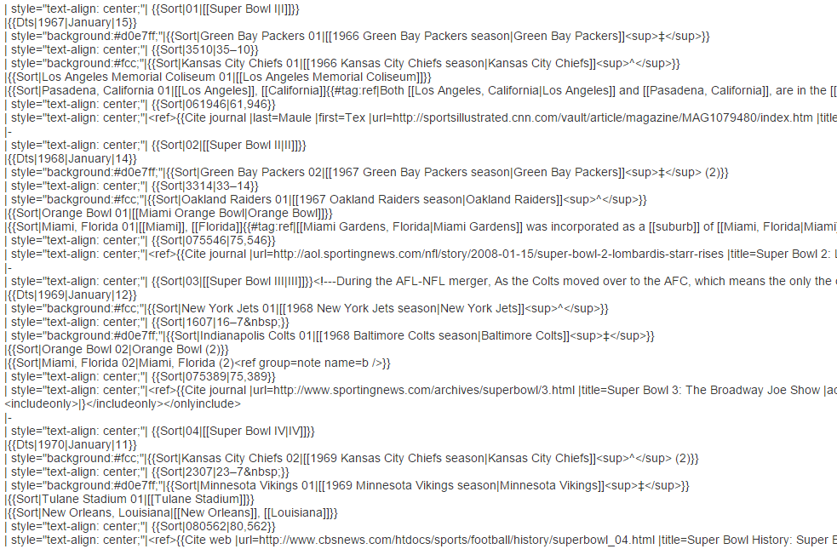
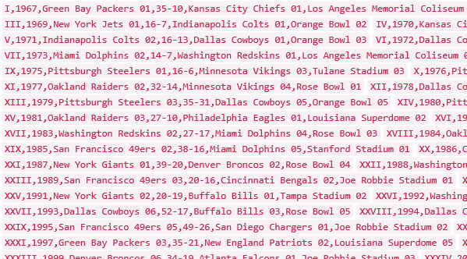
Data Science Class Assignment
To get Started!

Slide 10
FlashExtract Demo
“FlashExtract: A Framework for data extraction by examples”;
PLDI 2014; Vu Le, Sumit Gulwani

Slide 11
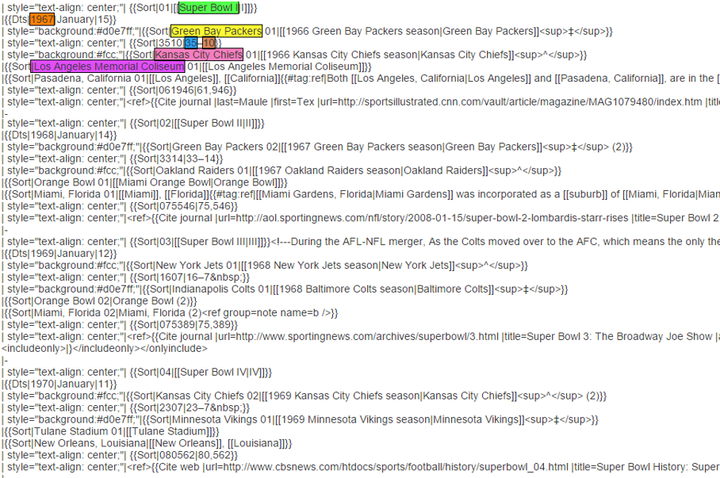
FlashExtract

Slide 12
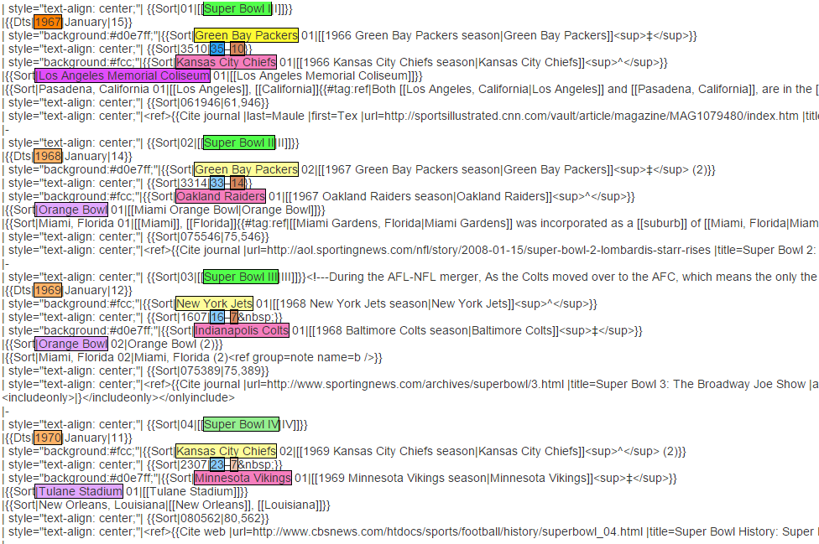
FlashExtract

Slide 13
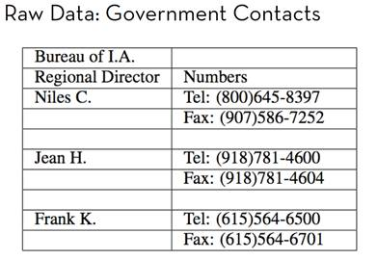
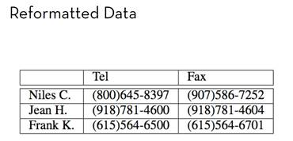
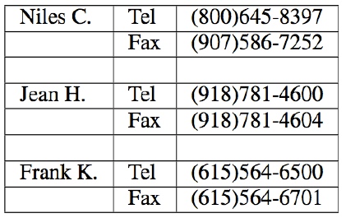
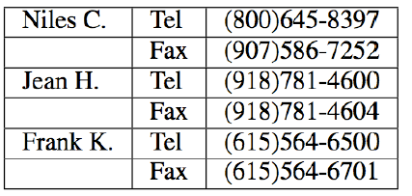
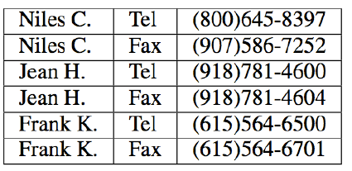
FlashRelate: Table Reshaping by Examples
Start with:
End goal:
FlashRelate
(from few examples of records in output table)
4. Pivot Number on Type
Trifacta facilitates the transformation through a series of recommended steps
1. Split on “:” Delimiter
2. Delete Empty Rows
3. Fill Values Down
50% Excel spreadsheets (e.g., financial reports) are semi-structured.
The need to canonicalize similar information across varying formats is huge.
  Companies like KPMG, Deloitte can budget millions of dollars each to solve this.

Slide 14
FlashRelate Demo
“FlashRelate: Extracting Relational Data from Semi-Structured Spreadsheets Using Examples”;
PLDI 2015; Barowy, Gulwani, Hart, Zorn

Slide 15


Killer Applications
Transformation
Extraction
Formatting
Data scientists spend 80% time wrangling data from raw form to a structured form.
Old
SELECT foo, bar FROM dbo.splunge ORDER BY 1, 2 DESC;
RAISERROR @err @message RAISERROR ('RAISERROR TEST',16,1)
On-prem to cloud
Company 1 to company 2
Old to new
New
SELECT foo, bar FROM dbo.splunge ORDER BY foo, bar DESC;
Throw @err, @message, 1 Throw 99999, 'RAISERROR TEST', 1
Developers spend 40% time in code refactoring in migration

Slide 16
Repetitive Corrections in Student Assignments
def product(n, term):
total, k = 1, 1
while k<=n:
- total = total * k
+ total = total * term(k)
k = k + 1
return total
def product(n, term):
if(n == 1):
return 1
- return product(n-1, term)*n
+ return product(n-1, term)*term(n)
k
term(k)
n
term(n)
<name>
term(<name>)
Learning Syntactic Program Transformations from Examples
ICSE 2017; Rolim, Soares, Antoni, Polozov, Gulwani, Gheyi, Suzuki, Hartmann
Notes:
These edits have the same structure. For instance, if we represent them as tree edit in the abstract syntax tree of the program. On the left-hand side, we replace the node k to term k. On the right-hand side, we replace the node n to term n. So, they share the same structure but have different expressions. In this case, different variable names.

Slide 17


Programming-by-Examples Architecture
Example based Intent
Intended Program in R/Python/C#/Java/…
Refined Intent
Search
Algorithm
Intended Program
Program set
Translator
Disambiguator
Ranked Program set
Test inputs
Program Ranker
“Programming by Examples (and its applications in Data Wrangling)”;
In Verification and Synthesis of Correct and Secure Systems; IOS Press; 2016
[based on Marktoberdorf Summer School 2015 Lecture Notes]
16

Slide 18
Efficiency
Example based Intent
Intended Program in R/Python/C#/Java/…
Refined Intent
DSL D
Search
Algorithm
Intended Program
Program set
in D
Translator
Disambiguator
Ranked Program set
Test inputs
Program Ranker
“Programming by Examples (and its applications in Data Wrangling)”;
In Verification and Synthesis of Correct and Secure Systems; IOS Press; 2016
[based on Marktoberdorf Summer School 2015 Lecture Notes]
17

Slide 19
Domain-specific Language (DSL)
Expressive enough to cover wide range of tasks
Restricted enough to enable efficient search
  Restricted set of operators
    those with small inverse sets
  Restricted syntactic composition of those operators

Slide 20
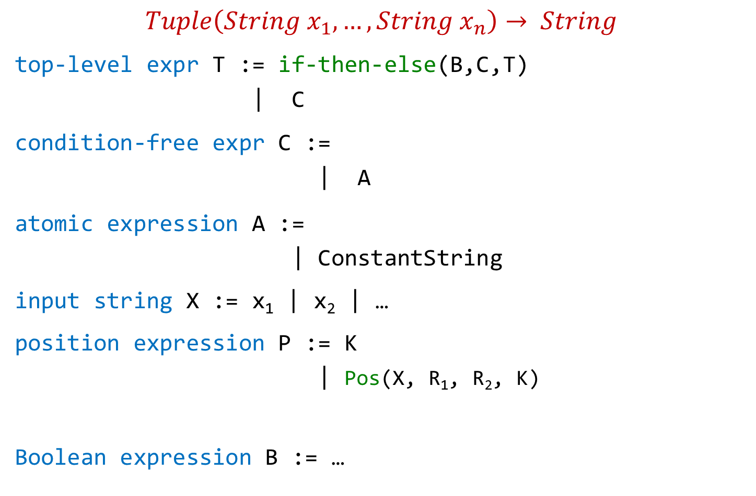
Flash Fill DSL (String Transformations)
$$Tuple\left(String x_{1},…,String x_{n}\right)→ String$$
top-level expr T := if-then-else(B,C,T)
| C
condition-free expr C :=
| A
atomic expression A :=
| ConstantString
input string X := x₁ | x₂ | …
position expression P := K
| Pos(X, R₁, R₂, K)
Boolean expression B := …
Concatenate(A,C)
SubStr(X,P,P)
K^{th} position in X whose left/right side matches with R₁/R₂.

Slide 21
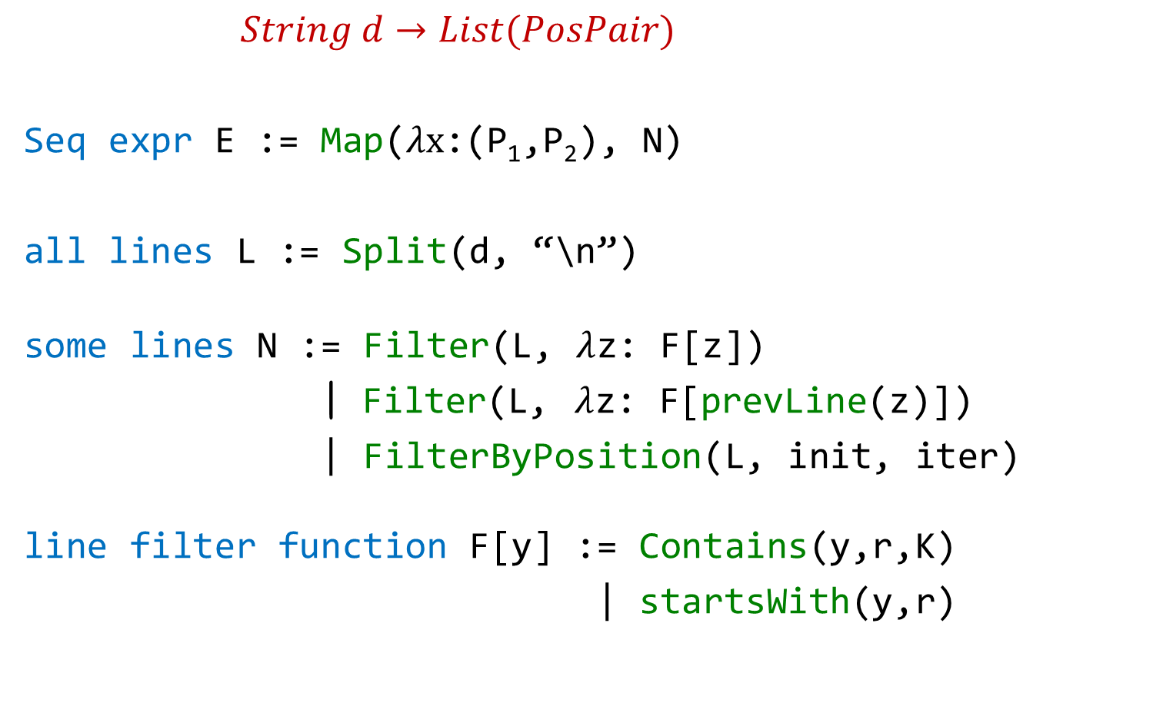
FlashExtract DSL
$String d→List(PosPair)$
Seq expr E := Map($λx$:(P₁,P₂), N)
all lines L := Split(d, “\n”)
some lines N := Filter(L, $λ$z: F[z])
| Filter(L, $λ$z: F[prevLine(z)])
| FilterByPosition(L, init, iter)
line filter function F[y] := Contains(y,r,K)
| startsWith(y,r)
position expression P := K | Pos(x, R₁, R₂, K)

Slide 22
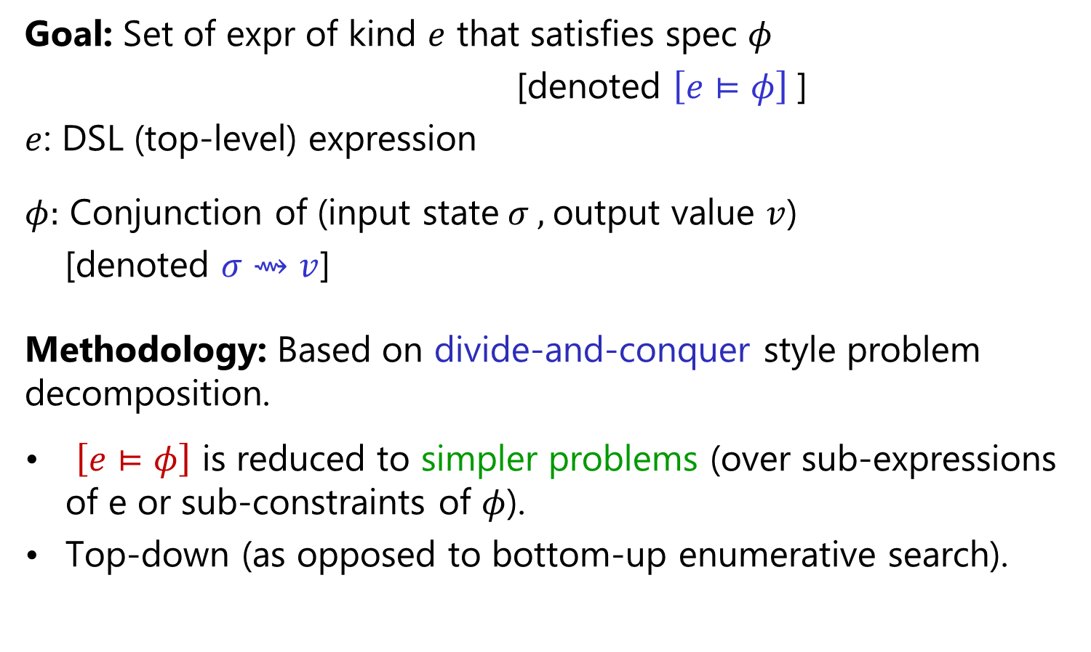
Search Methodology
Goal: Set of expr of kind $e$ that satisfies spec $φ$
[denoted $\left[e⊨φ\right]$]
$e$: DSL (top-level) expression
$φ:$ Conjunction of (input state$σ ,$output value $v$)
[denoted $σ⇝v$]
Methodology: Based on divide-and-conquer style problem decomposition.
$\left[e⊨φ\right]$ is reduced to simpler problems (over sub-expressions of e or sub-constraints of $φ$).
Top-down (as opposed to bottom-up enumerative search).
“FlashMeta: A Framework for Inductive Program Synthesis”;
[OOPSLA 2015] Alex Polozov, Sumit Gulwani

Slide 23
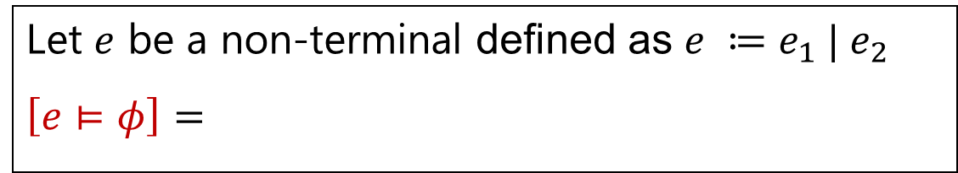
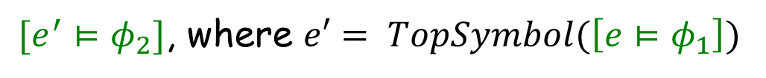



Problem Reduction Rules
$$\left[e⊨φ_{1}∨φ_{2}\right] =$$
$$Union(\left[e⊨φ_{1}\right], \left[e⊨φ_{2}\right])$$
$$\left[e⊨φ_{1}∧φ_{2}\right] =$$
$$Intersect(\left[e⊨φ_{1}\right], \left[e⊨φ_{2}\right])$$
An alternative strategy:
$[e^{′}⊨φ_{2}]$, where $e′= TopSymbol(\left[e⊨φ_{1}\right])$
$$\left[e⊨φ_{1}∧φ_{2}\right] =$$
Let $e$ be a non-terminal defined as $e ≔e_{1} | e_{2}$
$$\left[e⊨φ\right]=$$
$$Union(\left[e_{1}⊨φ\right], \left[e_{2}⊨φ\right])$$

Slide 24

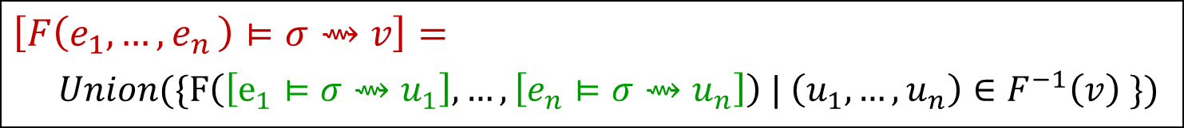
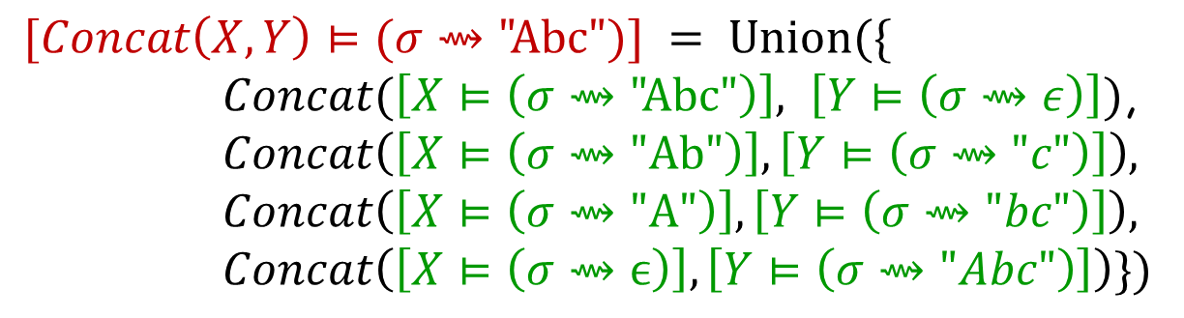
Problem Reduction Rules
Inverse Set: Let F be an n-ary operator.
$$F^{−1}\left(v\right)=\left\{\left(u_{1},…,u_{n} \right) \right| F\left(u_{1},…,u_{n}\right)=v\}$$
$$Concat^{−1}\left(\text{"}\text{Abc}\text{"}\right)=$$
$$\{\left( \text{"}\text{Abc}\text{",}ϵ\right), ("Ab\text{","}\text{c}\text{"), ("}\text{A}\text{","}\text{bc}\text{"), (}ϵ,\text{"}\text{Abc}\text{")\}}$$
$$\left[F\left(e_{1},{…,e}_{n}\right)⊨σ⇝v\right]=$$
$Union(\{F\left(\left[e_{1}⊨σ⇝u_{1}\right], …,\left[e_{n}⊨σ⇝u_{n}\right]\right) | \left(u_{1},…,u_{n}\right)∈F^{−1}\left(v\right) \})$
$$[Concat\left(X,Y\right)⊨(σ⇝\text{"}\text{Abc}")] = Union(\{$$
$Concat(\left[X⊨\left(σ⇝\text{"}\text{Abc}\text{"}\right)\right], \left[Y⊨\left(σ⇝ε\right)\right])$,
$$Concat\left(\left[X⊨\left(σ⇝\text{"}\text{Ab}\text{"}\right)\right],\left[Y⊨\left(σ⇝"c"\right)\right]\right),$$
$$Concat\left(\left[X⊨\left(σ⇝\text{"}\text{A}\text{"}\right)\right],\left[Y⊨\left(σ⇝"bc"\right)\right]\right),$$
$$Concat\left(\left[X⊨\left(σ⇝ϵ\right)\right],\left[Y⊨\left(σ⇝"Abc"\right)\right]\right)\})$$

Slide 25


Problem Reduction Rules
Inverse Set: Let F be an n-ary operator.
$$F^{−1}\left(v\right)=\left\{\left(u_{1},…,u_{n} \right) \right| F\left(u_{1},…,u_{n}\right)=v\}$$
$$Concat^{−1}\left(\text{"}\text{Abc}\text{"}\right)=$$
$$\{\left( \text{"}\text{Abc}\text{",}ϵ\right), ("Ab\text{","}\text{c}\text{"), ("}\text{A}\text{","}\text{bc}\text{"), (}ϵ,\text{"}\text{Abc}\text{")\}}$$
$$\{\left(true, v, ⊤\right), (false, ⊤, v)\}$$
$$IfThenElse^{−1}\left(v\right)=$$
Consider the SubStr(x,i,j) operator
$$\{ \left(0,2\right), (6,8) \}$$
$$SubStr^{−1}\left(\text{"}\text{Ab}\text{"} \right| x="Ab cd Ab")=$$
$$SubStr^{−1} \left(\text{"}\text{Ab}\text{"}\right)= …$$
The notion of inverse sets (and corresponding reduction rules) can be generalized to the conditional setting.

Slide 26



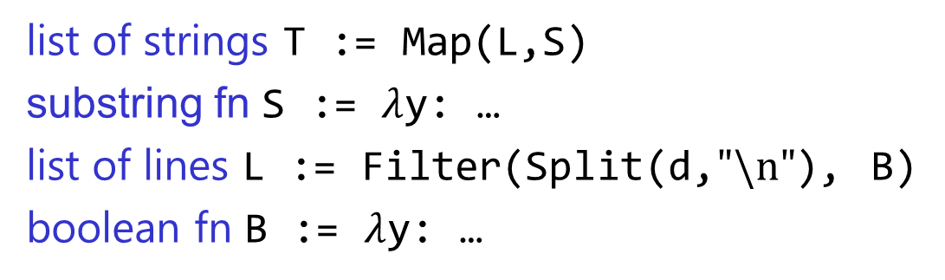


Problem Reduction
list of strings T := Map(L,S)
substring fn S := $λ$y: …
list of lines L := Filter(Split(d,$"\text{\backslash }\text{n}\text{"}$), B)
boolean fn B := $λ$y: …
FlashExtract DSL
$$⋈$$
Spec for S
Spec for T
Spec for L
$$∧$$

Slide 27

Problem Reduction
substring expr E := SubStr(y,P₁,P₂)
position expr P := K | Pos(y,R₁,R₂,K)
SubStr grammar
$$⋈$$
Spec for E
Spec for P₁
Spec for P₂
Redmond, WA
Redmond, WA

Slide 28
Intention
Example based Intent
Intended Program in R/Python/C#/Java/…
Refined Intent
DSL D
Search
Algorithm
Intended Program
Program set
in D
Translator
Disambiguator
Ranked Program set
Test inputs
Program Ranker
“Programming by Examples (and its applications in Data Wrangling)”;
In Verification and Synthesis of Correct and Secure Systems; IOS Press; 2016
[based on Marktoberdorf Summer School 2015 Lecture Notes]
27

Slide 29
Basic ranking scheme
Prefer programs with simpler Kolmogorov complexity
Prefer fewer constants.
Prefer smaller constants.
Input | Output
Gustavo Soares | Gustavo
Titus Barik | Titus
1st Word
If (input = “Gustavo Soares”) then “Gustavo” else “Titus”
“Gustavo”

Slide 30
Challenges with Basic ranking scheme
Prefer programs with simpler Kolmogorov complexity
Prefer fewer constants.
Prefer smaller constants.
Input | Output
Gustavo Soares | Soares, Gustavo
Titus Barik | Barik, Titus
2nd Word + “, ‘’ + 1st Word
“Soares, Gustavo”
How to select between
Fewer larger constants vs. More smaller constants?
  Idea: Associate numeric weights with constants.
Predicting a correct program in Programming by Example; CAV 2015; Singh, Gulwani

Slide 31
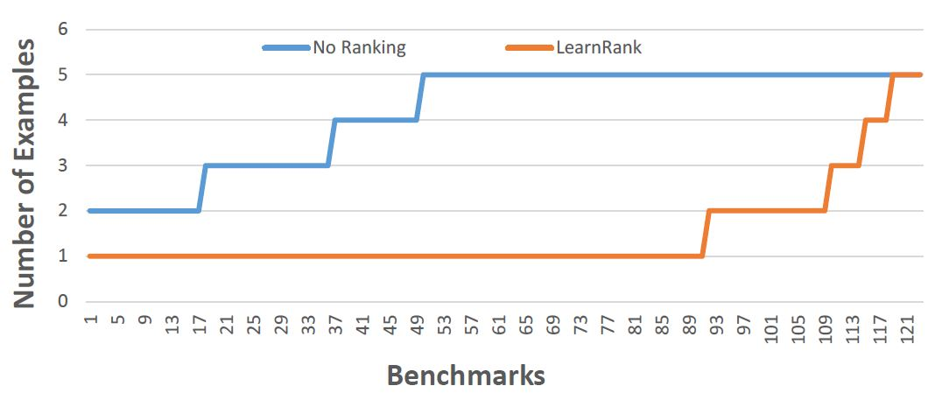
Comparison of Ranking Strategies over FlashFill Benchmarks
Basic
Learning
Strategy | Average # of examples required
Basic | 4.17
Learning | 1.48
Predicting a correct program in Programming by Example; CAV 2015; Singh, Gulwani

Slide 32
FlashFill Ranking Demo

Slide 33
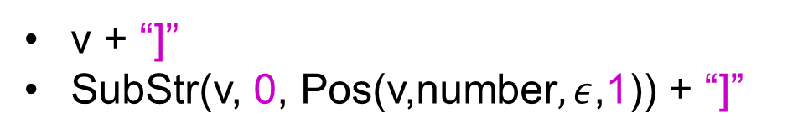
Challenges with Basic ranking scheme
Prefer programs with simpler Kolmogorov complexity
Prefer fewer constants.
Prefer smaller constants.
Input v | Output
[CPT-0123 | [CPT-0123]
[CPT-456] | [CPT-456]
v + “]”
SubStr(v, 0, Pos(v,number$,ε$,1)) + “]”
What if the correct program has larger Kolmogorov complexity?
Idea: Examine data/trace features (in addition to program features)
Learning to Learn Programs from Examples: Going Beyond Program Structure ;
IJCAI 2017; Ellis, Gulwani

Slide 34

Predictive Program Synthesis
Intended programs can sometimes be synthesized from just the input.
  Tabular data extraction, Sort, Join
Can save large amount of user effort.
  User need not provide examples for each of tens of columns.
“Automated Data Extraction using Predictive Program Synthesis”,
[AAAI 2017], Raza, Gulwani

Slide 35
Debuggability
Example based Intent
Intended Program in R/Python/C#/Java/…
Refined Intent
DSL D
Search
Algorithm
Intended Program
Program set
in D
Translator
Disambiguator
Ranked Program set
Test inputs
Program Ranker
“Programming by Examples (and its applications in Data Wrangling)”;
In Verification and Synthesis of Correct and Secure Systems; IOS Press; 2016
[based on Marktoberdorf Summer School 2015 Lecture Notes]
34

Slide 36


Need for a fall-back mechanism
“It's a great concept, but it can also lead to lots of bad data. I think many users will look at a few "flash filled" cells, and just assume that it worked. … Be very careful.”
“most of the extracted data will be fine. But there might be exceptions that you don't notice unless you examine the results very carefully.”

Slide 37
User Interaction Models for Ambiguity Resolution
Make it easy to inspect output correctness
  User can accordingly provide more examples
Show programs
  in any desired programming language; in English
  Enable effective navigation between programs
Computer initiated interactivity (Active learning)
  Cluster inputs/outputs based on syntactic patterns.
  Highlight less confident entries in the output based on distinguishing inputs.
“User Interaction Models for Disambiguation in Programming by Example”,
[UIST 2015] Mayer, Soares, Grechkin, Le, Marron, Polozov, Singh, Zorn, Gulwani
“FlashProfile: Interactive Synthesis of Syntactic Profiles”,
[Under submission] Padhi, Jain, Perelman, Polozov, Gulwani, Millstein

Slide 38
FlashExtract Demo
(User Interaction Models)

Slide 39
Future Directions
Application to robotics
Multi-modal intent involving examples and natural language
Adaptive synthesis
PL meets ML

Slide 40
PBE vs ML
Traditional PBE | Traditional ML
Requires few examples. | Requires too many examples.
Generates human readable and editable models. | Generates black-box models.
Models are deterministic & intended to work correctly. | Models are probabilistic & aimed for high precision.
Deals with simple structured tasks. | Can deal with complicated fuzzy tasks.
Opportunity: Use ML to improve a PBE system (not replace it).

Slide 41







A perspective on “PL meets ML”
PBE/Intelligent software
Logical strategies
Creative heuristics
Features
Model
Can be learned and maintained by ML-backed runtime
Written by developers
Advantages
Better models
Less time to author
Online adaptation, personalization

Slide 42
“PL meets ML” opportunities in PBE
Usability aspect | PL component | Heuristics that can be machine learned
Efficiency | DSL, Inverse functions | Non-deterministic search choices: which production, sub-goal to try first?
Intention | Ranking features | Weights
Debuggability | Program navigation, Distinguishing inputs | Clustering, When/what to ask?

Slide 43
PROSE Framework
https://microsoft.github.io/prose
Efficient implementation of the generic search methodology.
Provides a library of reduction rules.
Role of synthesizer developer
Implement a DSL with executable semantics for new operators.
Implement reduction rules (inverse semantics) for some operators.
Implement ranking strategy.
Can also specify tactics to resolve non-determinism in search.

Slide 44












The PROSE Team
Titus Barik
Sumit Gulwani
Alan Leung
Kunal Pathak
Daniel Perelman
Mark Plesko
Vu Le
Please apply for intern/full-time positions!
Arjun Radhakrishna
Ivan Radicek
Mohammad Raza
Danny Simmons
Gustavo Soares
Ashish Tiwari
Abhishek
Udupa

Slide 45



Conclusion
Killer applications: Data wrangling & Code Refactoring
99% of end users are non-programmers.
Data scientists spend 80% time cleaning data.
Developers spend 40% time refactoring code in migration.
Efficiency
Domain-specific language
Divide-and-conquer using inverse functions
Intention
Ranking
Predictivity
Debuggability
Active learning
Readability
Reference: “Programming by Examples (and its applications in Data Wrangling)”,
In Verification and Synthesis of Correct and Secure Systems; IOS Press; 2016

