Slide 1

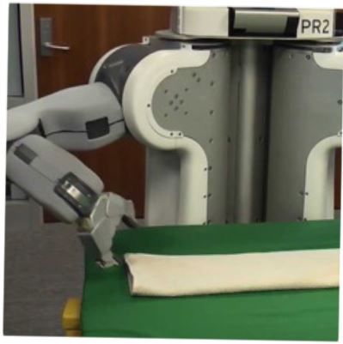

Programming by Examples
Applications, Algorithms & Ambiguity Resolution
Lecture 3: Hands-on Session
Sumit Gulwani
Winter School in Software Engineering
TRDDC, Pune
Dec 2017

Slide 2
Outline
Lecture 1:
Applications
DSLs
Lecture 2:
Search Algorithm
Ambiguity Resolution
  Ranking
  User interaction models
Leveraging ML for improving synthesis
Lecture 3: Hands-on session
Lecture 4: Miscellaneous related topics
Programming using Natural Language
Applications in computer-aided Education
The Four Big Bets
.

Slide 3


Programming-by-Examples Architecture
Refined Intent
Example based Intent
Ranked Program set
(a sub-DSL of D)
Intended Program in D
Program
Synthesizer
Debugging
Translator
Test inputs
Ranking function
DSL D
Witness functions
Intended Program in R/Python/C#/C++/…
2

Slide 4
Hands-on Session
DSL
Expressed as a grammar.
For each operator provide the executable semantics.
Witness Functions
For each operator and for each of its parameters, provide a witness function (possibly conditioned on some other parameters) that describes the constraints on that parameter given a constraint on its output (in a given input state).
Ranking Function
For each operator, define a score (possibly in terms of scores of its parameters).

Slide 5
Instructions (in pdf file embedded below)

Slide 6
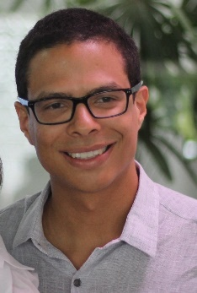
Acknowledgements
Gustavo Soares
(for preparing this tutorial)

