Slide 1

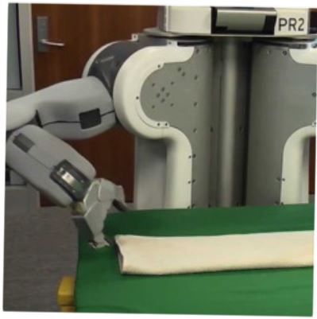

Programming by Examples
Applications, Algorithms & Ambiguity Resolution
Lecture 1: Applications and DSLs for Synthesis
Sumit Gulwani
Winter School in Software Engineering
TRDDC, Pune
Dec 2017

Slide 2

Programming by Examples (PBE)
The task of synthesizing a program in an underlying domain-specific language (DSL) from example-based specification using a search algorithm.
An old problem but enabled today by
better algorithms & faster machines.
The new programming revolution
Enables 10-100x productivity for programmers.
The new computer user experience
99% users can’t program and struggle with repetitive tasks.
Non-programmers can now create scripts & achieve more.

Slide 3
Outline
Lecture 1:
Applications
DSLs
Lecture 2:
Search Algorithm
Ambiguity Resolution
  Ranking
  User interaction models
Leveraging ML for improving synthesis
Lecture 3: Hands-on session
Lecture 4: Miscellaneous related topics
Programming using Natural Language
Applications in computer-aided Education
The Four Big Bets

Slide 4


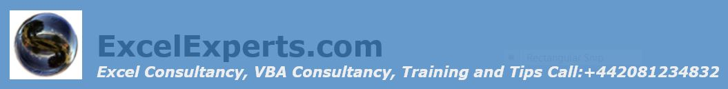

Excel help forums

Slide 5




Typical help-forum interaction
300_w30_aniSh_c1_b → w30
300_w5_aniSh_c1_b → w5
=MID(B1,5,2)
=MID(B1,5,2)
=MID(B1,FIND(“_”,$B:$B)+1, FIND(“_”,REPLACE($B:$B,1,FIND(“_”,$B:$B),””))-1)

Slide 6
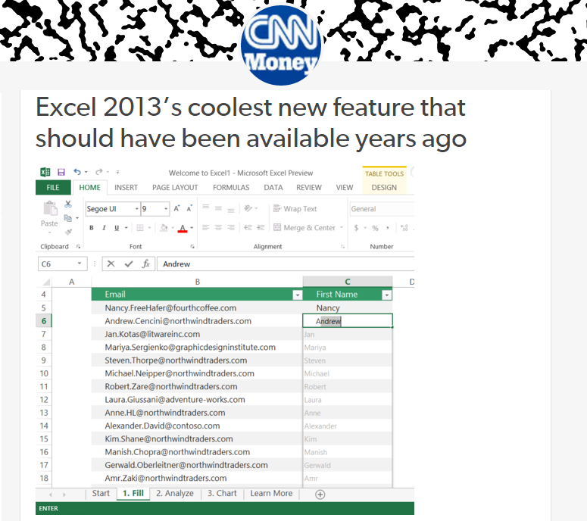
Flash Fill (Excel 2013 feature) demo
“Automating string processing in spreadsheets using input-output examples”;
POPL 2011; Sumit Gulwani

Slide 7
Number and DateTime Transformations
Input | Output (Round to 2 decimal places)
123.4567 | 123.46
123.4 | 123.40
78.234 | 78.23
Excel/C#:
Python/C:
Java:
#.00
.2f
#.##
Input | Output (Half hour bucket)
0d 5h 26m | 5:00-5:30
0d 4h 57m | 4:30-5:00
0d 4h 27m | 4:00-4:30
0d 3h 57m | 3:30-4:00
Synthesizing Number Transformations from Input-Output Examples;
CAV 2012; Singh, Gulwani

Slide 8
Lookup Transformations
Id | Name | Markup
S33 | Stroller | 30%
B56 | Bib | 45%
D32 | Diapers | 35%
W98 | Wipes | 40%
A46 | Aspirator | 30%
... | .... | ...
Id | Date | Price
S33 | 12/2010 | $145.67
S33 | 11/2010 | $142.38
B56 | 12/2010 | $3.56
D32 | 1/2011 | $21.45
W98 | 4/2009 | $5.12
... | ... | ...
MarkupRec
Table
CostRec
Table
Input v1 (Name) | Input v2 (Date) | Output (Price+ Markup*Price)
Stroller | 10/12/2010 | $145.67+0.30*145.67
Bib | 23/12/2010 | $3.56+0.45*3.56
Diapers | 21/1/2011
Wipes | 2/4/2009
Aspirator | 23/2/2010
Learning Semantic String Transformations from Examples; VLDB 2012; Singh, Gulwani

Slide 9

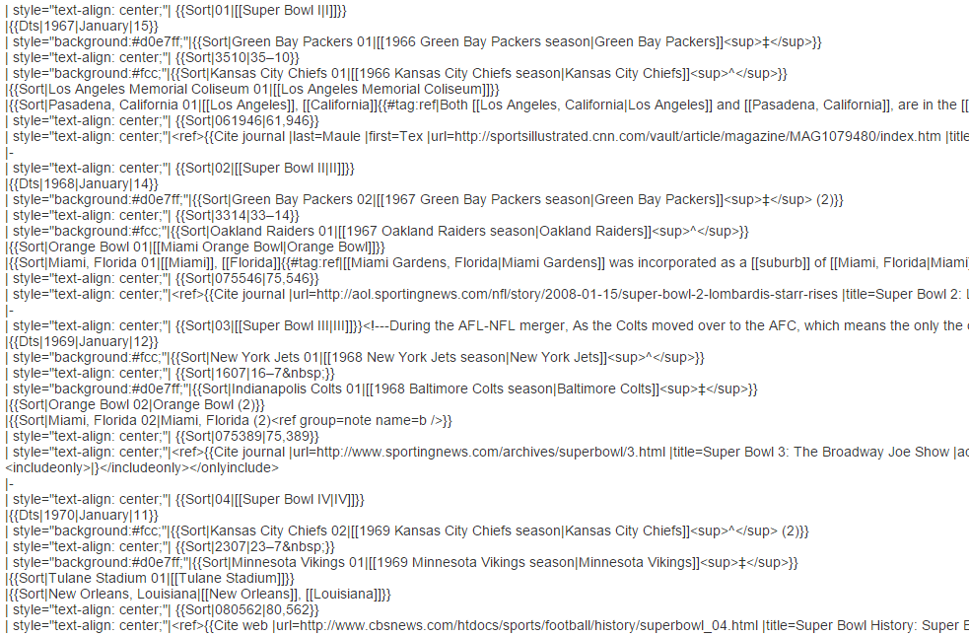
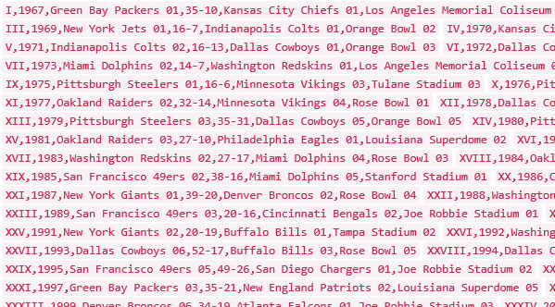
Data Science Class Assignment
To get Started!

Slide 10


FlashExtract Demo
Ships inside two Microsoft products:
Powershell
ConvertFrom-String cmdlet
Custom Log, Custom Field
“FlashExtract: A Framework for data extraction by examples”;
PLDI 2014; Vu Le, Sumit Gulwani

Slide 11
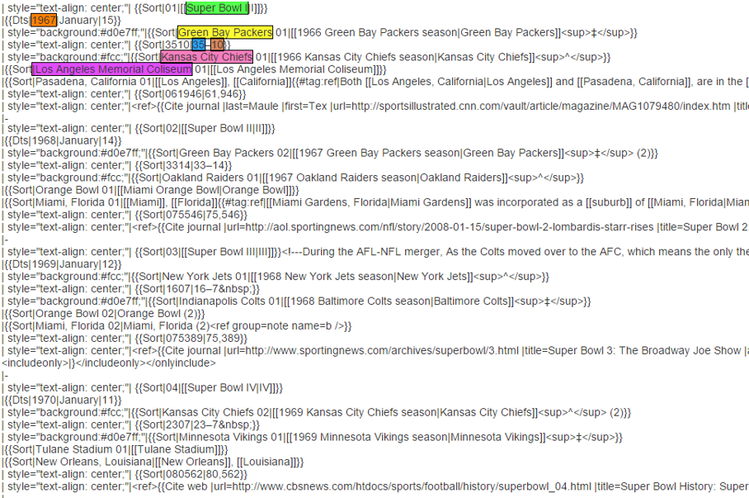
FlashExtract

Slide 12
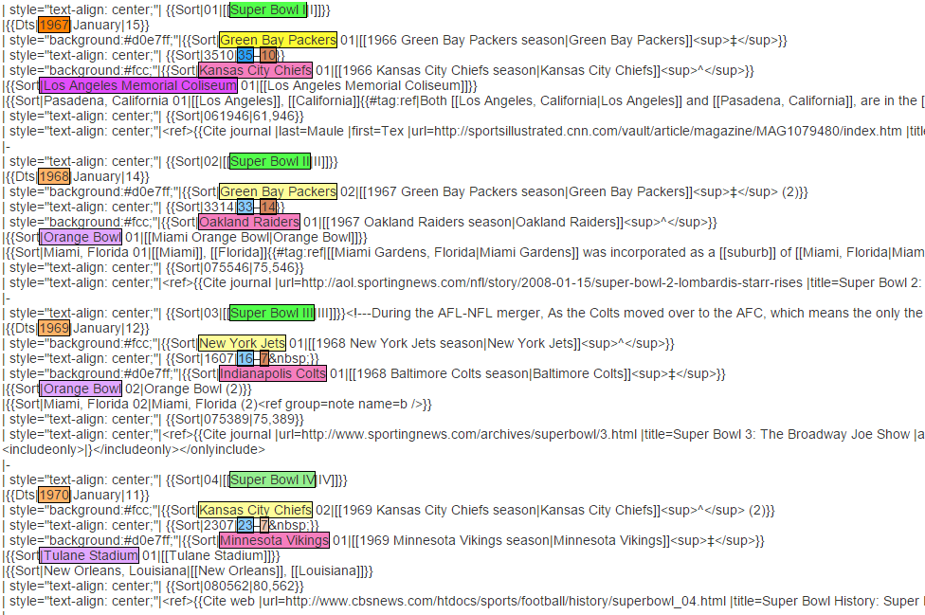
FlashExtract

Slide 13
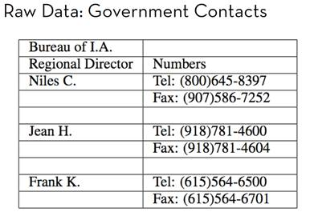
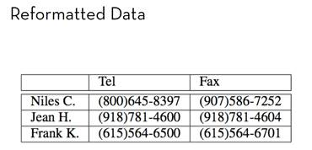
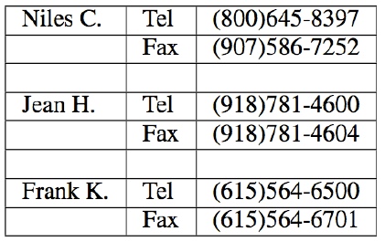
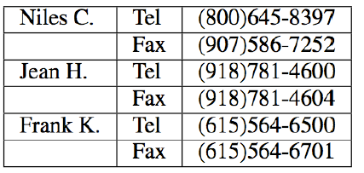
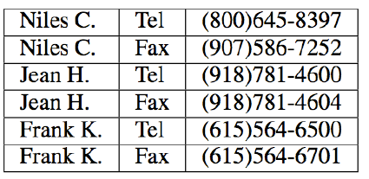
FlashRelate: Table Reshaping by Examples
Start with:
End goal:
FlashRelate
(from few examples of records in output table)
4. Pivot Number on Type
Trifacta facilitates the transformation through a series of recommended steps
1. Split on “:” Delimiter
2. Delete Empty Rows
3. Fill Values Down
50% Excel spreadsheets (e.g., financial reports) are semi-structured.
The need to canonicalize similar information across varying formats is huge.
  Companies like KPMG, Deloitte can budget millions of dollars each to solve this.

Slide 14
FlashRelate Demo
“FlashRelate: Extracting Relational Data from Semi-Structured Spreadsheets Using Examples”;
PLDI 2015; Barowy, Gulwani, Hart, Zorn

Slide 15

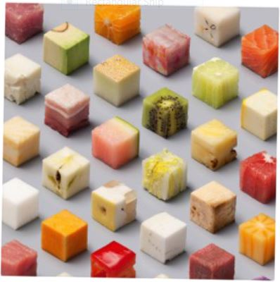
Killer Applications
Transformation
Extraction
Formatting
Data scientists spend 80% time wrangling data from raw form to a structured form.
Old
SELECT foo, bar FROM dbo.splunge ORDER BY 1, 2 DESC;
RAISERROR @err @message RAISERROR ('RAISERROR TEST',16,1)
On-prem to cloud
Company 1 to company 2
Old version to new version
New
SELECT foo, bar FROM dbo.splunge ORDER BY foo, bar DESC;
Throw @err, @message, 1 Throw 99999, 'RAISERROR TEST', 1
Developers spend 40% time in code refactoring in migration

Slide 16
Repetitive API Changes
- while (receiver.CSharpKind() == SyntaxKind.ParenthesizedExpression)
+ while (receiver.IsKind(SyntaxKind.ParenthesizedExpression))
- foreach (var m in modifiers)
{ if (m.CSharpKind() == modifier) return true; };
+ foreach (var m in modifiers)
{ if (m.IsKind(modifier)) return true; };
<name>.CSharpKind() == <exp>
<name>.IsKind(<exp>)
Learning Syntactic Program Transformations from Examples
ICSE 2017; Rolim, Soares, Antoni, Polozov, Gulwani, Gheyi, Suzuki, Hartmann

Slide 17
Repetitive Corrections in Student Assignments
def product(n, term):
total, k = 1, 1
while k<=n:
- total = total * k
+ total = total * term(k)
k = k + 1
return total
def product(n, term):
if(n == 1):
return 1
- return product(n-1, term)*n
+ return product(n-1, term)*term(n)
<name>
term(<name>)
Learning Syntactic Program Transformations from Examples
ICSE 2017; Rolim, Soares, Antoni, Polozov, Gulwani, Gheyi, Suzuki, Hartmann

Slide 18

Programming-by-Examples Architecture
Example-based Intent
Program set
(a sub-DSL of D)
Program
Synthesizer
DSL D
17

Slide 19
Domain-specific Language (DSL)
Balanced Expressiveness
  Expressive enough to cover wide range of tasks
  Restricted enough to enable efficient search
    Restricted set of operators
      those with small inverse sets
    Restricted syntactic composition of those operators
Natural computation patterns
  Increased user understanding/confidence
  Enables selection between programs, editing

Slide 20
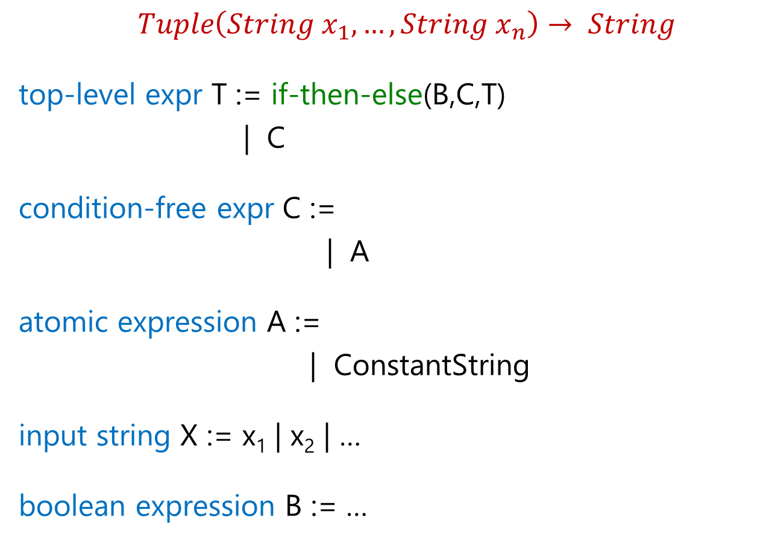
FlashFill DSL
$Tuple\left(String x_{1},…,String x_{n}\right)→ String$
top-level expr T := if-then-else(B,C,T)
| C
condition-free expr C :=
| A
atomic expression A :=
| ConstantString
input string X := x₁ | x₂ | …
boolean expression B := …
Concatenate(A, C)
SubStr(X, …)

Slide 21
Substring Operator
What is a good choice for … in SubStr(X, …) ?
Regular expression
  Not very expressive. Does not take context into account.
  For instance: content within parenthesis, second word
Extended regular expression
  Too sophisticated for learning and readability.
Desired computational pattern:
Should involve simple regexes.
Take context into account.

Slide 22
Substring Operator
position expr P :=
SubStr(X, P, P’)
Pos(X, R₁, R₂, K)
K^{th} position in X whose left/right side matches with R₁/R₂.

Slide 23
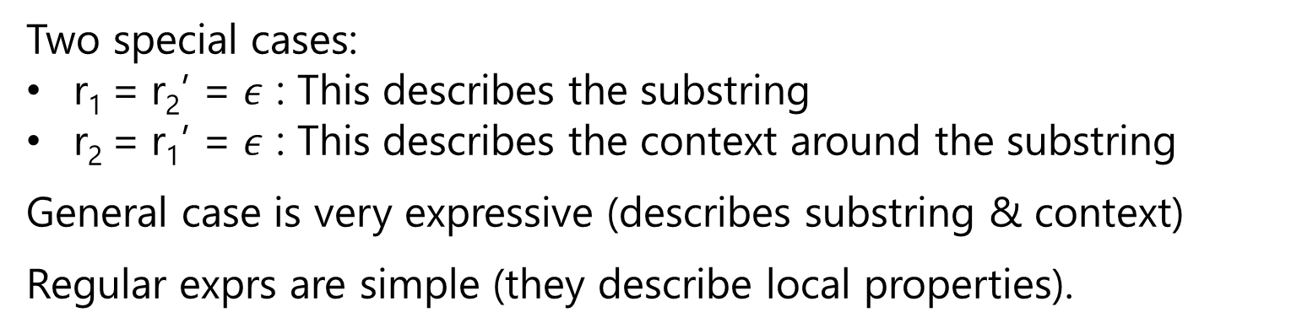
Substring Operator
Evaluation of Expr SubStr(x,p,p’) , where p=Pos(x,r_{1,}r₂,k) &
p’=Pos(x,r₁’,r₂’,k’)
matches r₁
matches r₂
matches r₁’
matches r₂’
p
p’
w
x
Two special cases:
r₁ = r₂’ = $ε$ : This describes the substring
r₂ = r₁’ = $ε$ : This describes the context around the substring
General case is very expressive (describes substring & context)
Regular exprs are simple (they describe local properties).

Slide 24
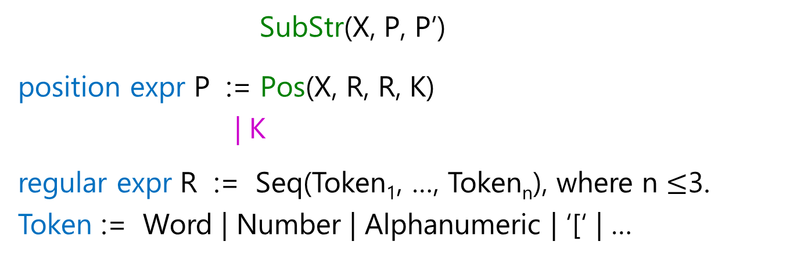
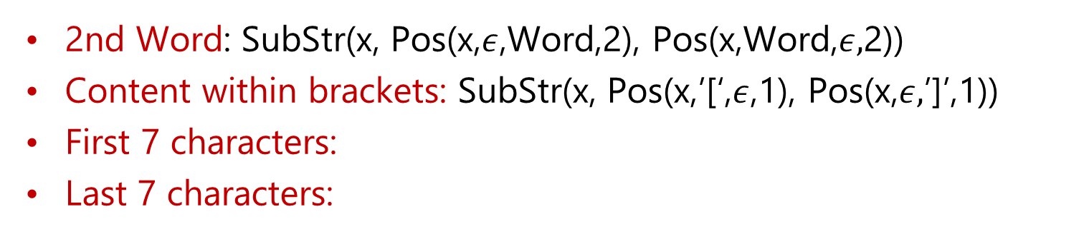
Substring Operator
SubStr(X, P, P’)
position expr P := Pos(X, R, R, K)
| K
regular expr R := Seq(Token₁, …, Token_{n}), where n $≤$3.
Token := Word | Number | Alphanumeric | ‘[‘ | …
2nd Word: SubStr(x, Pos(x,$ε$,Word,2), Pos(x,Word,$ε,$2))
Content within brackets: SubStr(x, Pos(x,’[‘,$ε$,1), Pos(x,$ε,$’]’,1))
First 7 characters:
Last 7 characters:
SubStr(x, 0, 7)
SubStr(x, -8, -1)

Slide 25
Substring Operator
SubStr(X, P, P)
position expr P := Pos(X, R, R, K) | K
Restriction
let x = X in
SubStr(x, P, P)
position expr P := Pos(x, R, R, K) | K
Modularity
let x = X in
let p₁ = P[x] in
let p₂ = P[x] in
SubStr(x, p₁, p₂)
position expr P[y] := Pos(y, R, R, K) | K

Slide 26

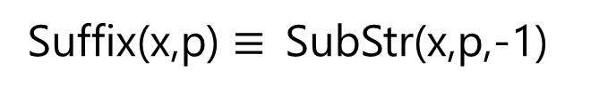
Substring Operator
let x = X in
let p₁ = P[x] in
let p₂ = P[x] in
SubStr(x, p₁, p₂)
position expr P[y] := Pos(y, R, R, K) | K
Increased Expressiveness
let x = X in
let p₁ = P[x] in
let p₂ = P[x] | p₁ + P[Suffix(x,p₁)] in
SubStr(x, p₁, p₂)
position expr P[y] := Pos(y, R, R, K) | K
First 7 chars in 2nd Word:
SubStr(x, p₁=Pos(x,$ε$,Word,2), p₁+7)
Suffix(x,p) $≡$SubStr(x,p,-1)

Slide 27
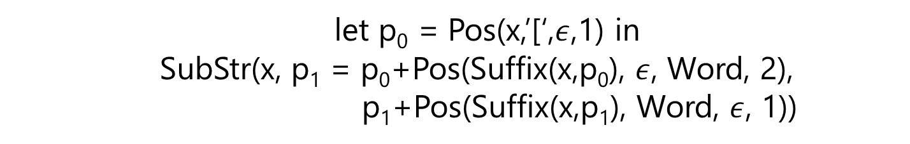
Substring Operator
let x = X in
let p₁ = P[x] in
let p₂ = P[x] | p₁ + P[Suffix(x,p₁)] in
SubStr(x, p₁, p₂)
position expr P[y] := Pos(y, R, R, K) | K
Increased Expressiveness
let x = X in
let p₁ = P[x] | let p₀ = P[x] in (p₀ + P[Suffix(s, p₀)]) in
let p₂ = P[x] | p₁ + P[Suffix(x,p₁)] in
SubStr(x, p₁, p₂)
position expr P[y] := Pos(y, R, R, K) | K
2nd word within brackets:
let p₀ = Pos(x,’[‘,$ε$,1) in
SubStr(x, p₁ = p₀+Pos(Suffix(x,p₀), $ε$, Word, 2),
p₁+Pos(Suffix(x,p₁), Word, $ε$, 1))

Slide 28


FlashExtract DSL
$String d→List(PosPair)$
all lines L := Split(d,”\n”)
some lines N := Filter(L, $λ$z: F[z])
| FilterByPosition(L, init, iter)
line filter function F[y] := Contains(y,r,K) | startsWith(y,r)
| Filter(L, $λ$z: F[prevLine(z)])
[X]
substr expr S :=
let x = X in
let p₁=P[x] | let p₀=P[x] in (p₀+P[Suffix(s,p₀)]) in
let p₂ = P[x] | p₁ + P[Suffix(x,p₁)] in
SubStr(x, p₁, p₂)
position expr P[y] := Pos(y, R, R, K) | K

Slide 29


FlashExtract DSL
$String d→List(PosPair)$
Seq expr PPL := Map($λ$z: PP[z], N)
| Map($λ$z: PP[Suffix(d,z)], Pos(d,R,R))
| Merge(PPL_{1,} PPL₂)
all lines L := Split(d,”\n”)
some lines N := Filter(L, $λ$z: F[z])
| FilterByPosition(L, init, iter)
line filter function F[y] := Contains(y,r,K) | startsWith(y,r)
| Filter(L, $λ$z: F[prevLine(z)])
[X]
substr expr S :=
let x = X in SubStr(x, PP[x])
position pair PP[x] := let p₁=P[x] | let p₀=P[x] in (p₀+P[Suffix(s,p₀)]) in
let p₂ = P[x] | p₁ + P[Suffix(x,p₁)] in
(p₁,p₂)
position expr P[y] := Pos(y, R, R, K) | K

Slide 30

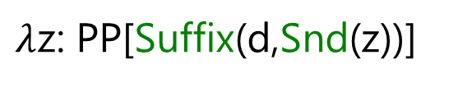
FlashExtract DSL
$$String d→List(PosPair_{1},….,PosPair_{n})$$
top-level expr T := Plan(PK, D₂, …, D_{n})
primary keys PK := PPL
derived value D :=
Plan(PK, D₂, …., D_{n}) $≡$ Map($λ$z: (z, D₂[z], …, D_{n}[z]), PK)
$λ$z: PP[Suffix(d,Snd(z))]

Slide 31
FlashRelate DSL

Slide 32
Table Re-formatting
Input: Semi-structured spreadsheet
Output: Relational table

Slide 33
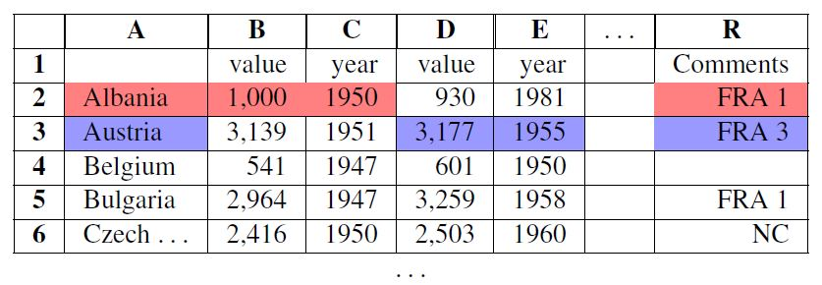
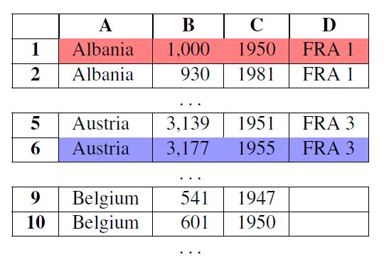
Table Re-formatting
Input: Semi-structured spreadsheet
Output: Relational table

Slide 34
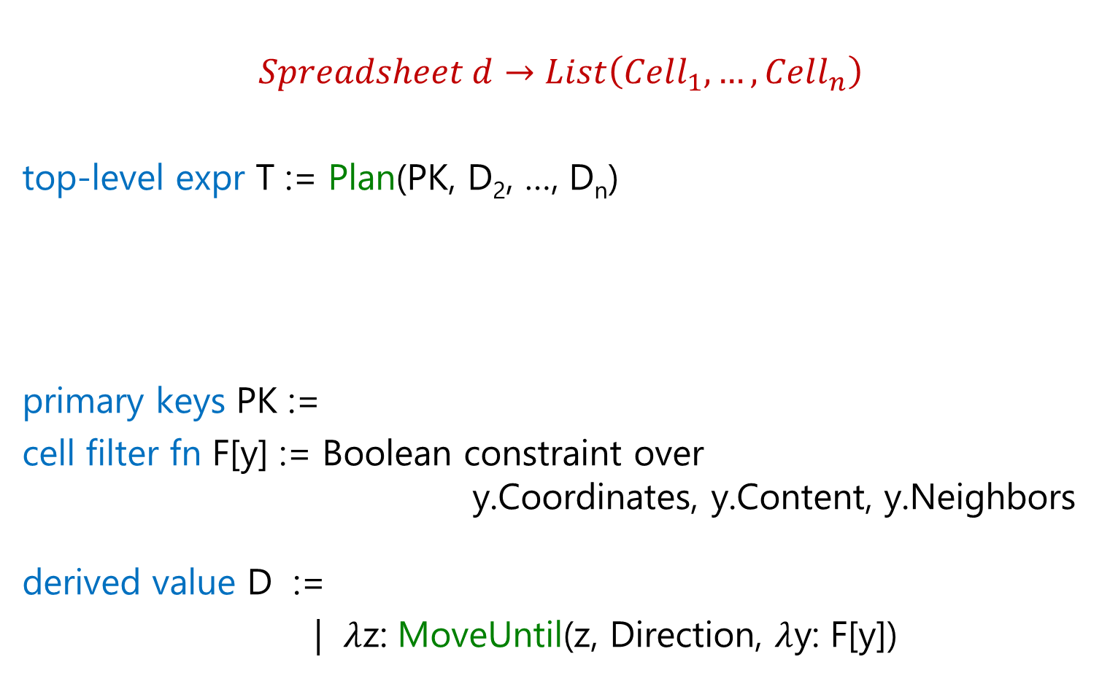
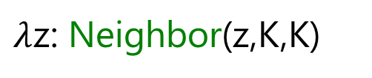
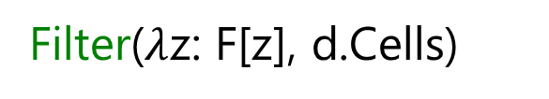
FlashRelate DSL
$$Spreadsheet d→List\left(Cell_{1},…, Cell_{n}\right)$$
top-level expr T := Plan(PK, D₂, …, D_{n})
primary keys PK :=
cell filter fn F[y] := Boolean constraint over
y.Coordinates, y.Content, y.Neighbors
derived value D :=
| $λ$z: MoveUntil(z, Direction, $λ$y: F[y])
Plan(PK, D₂, …., D_{n}) $≡$ Map($λ$z: (z, D₂[z], …, D_{n}[z]), PK)
Filter($λ$z: F[z], d.Cells)
$λ$z: Neighbor(z,K,K)

Slide 35
Summary: Design of DSLs for Synthesis
Balanced Expressiveness
  Expressive enough to cover wide range of tasks
    Build out iteratively from a simple core.
  Restricted enough to enable efficient search
    Use “let” construct for syntactic restrictions.
Natural computation patterns
  Use function definitions for reusability.

Slide 36
Programming-by-Examples Architecture
Example-based Intent
Program set
(a sub-DSL of D)
Program
Synthesizer
DSL D
35

