Slide 1

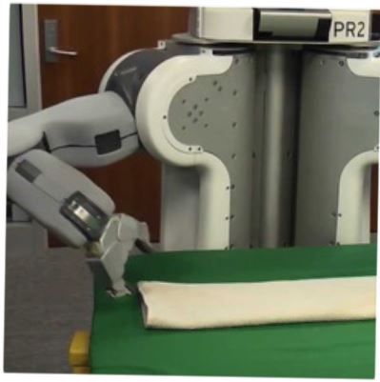

Programming by Examples
Applications, Algorithms & Ambiguity Resolution
Lecture 2: Algorithms and Ambiguity Resolution
Sumit Gulwani
Winter School in Software Engineering
TRDDC, Pune
Dec 2017

Slide 2
Outline
Lecture 1:
Applications
DSLs
Lecture 2:
Search Algorithm
Ambiguity Resolution
  Ranking
  User interaction models
Leveraging ML for improving synthesis
Lecture 3: Hands-on session
Lecture 4: Miscellaneous related topics
Programming using Natural Language
Applications in computer-aided Education
The Four Big Bets

Slide 3

Programming-by-Examples Architecture
Example-based Intent
Program set
(a sub-DSL of D)
Program
Synthesizer
DSL D
2

Slide 4
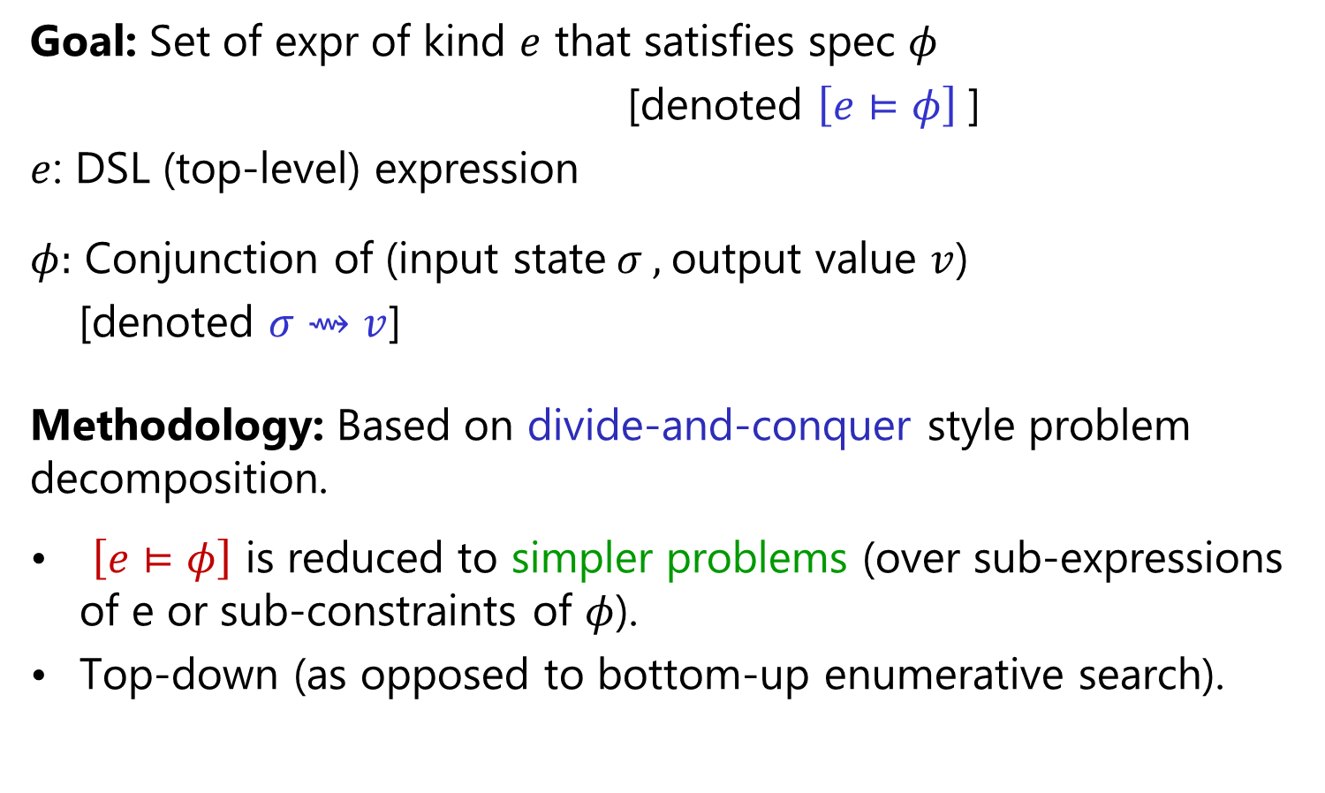
Search Methodology
Goal: Set of expr of kind $e$ that satisfies spec $φ$
[denoted $\left[e⊨φ\right]$]
$e$: DSL (top-level) expression
$φ:$ Conjunction of (input state$σ ,$output value $v$)
[denoted $σ⇝v$]
Methodology: Based on divide-and-conquer style problem decomposition.
$\left[e⊨φ\right]$ is reduced to simpler problems (over sub-expressions of e or sub-constraints of $φ$).
Top-down (as opposed to bottom-up enumerative search).
“FlashMeta: A Framework for Inductive Program Synthesis”;
[OOPSLA 2015] Alex Polozov, Sumit Gulwani

Slide 5
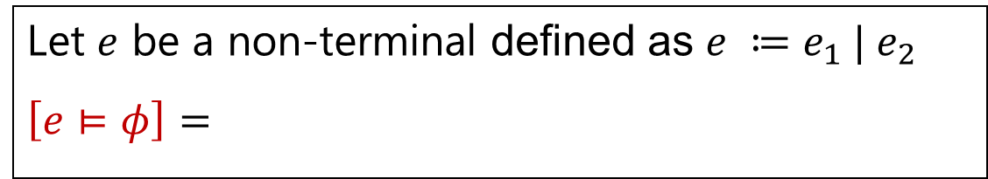
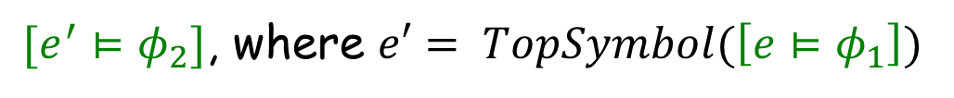



Problem Reduction Rules
$$\left[e⊨φ_{1}∨φ_{2}\right] =$$
$$Union(\left[e⊨φ_{1}\right], \left[e⊨φ_{2}\right])$$
$$\left[e⊨φ_{1}∧φ_{2}\right] =$$
$$Intersect(\left[e⊨φ_{1}\right], \left[e⊨φ_{2}\right])$$
An alternative strategy:
$[e^{′}⊨φ_{2}]$, where $e′= TopSymbol(\left[e⊨φ_{1}\right])$
$$\left[e⊨φ_{1}∧φ_{2}\right] =$$
Let $e$ be a non-terminal defined as $e ≔e_{1} | e_{2}$
$$\left[e⊨φ\right]=$$
$$Union(\left[e_{1}⊨φ\right], \left[e_{2}⊨φ\right])$$

Slide 6

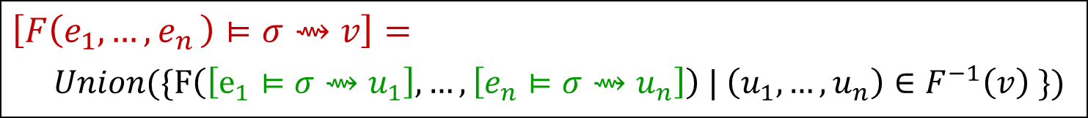
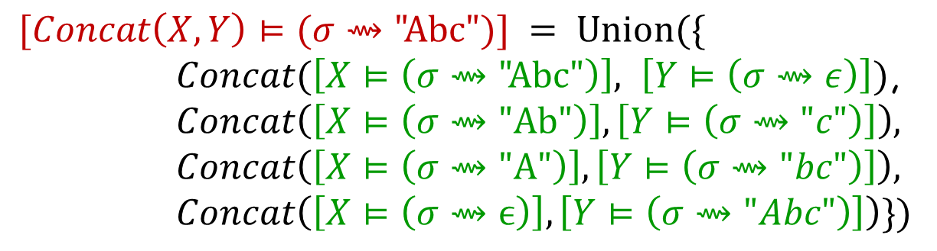
Problem Reduction Rules
Inverse Set: Let F be an n-ary operator.
$$F^{−1}\left(v\right)=\left\{\left(u_{1},…,u_{n} \right) \right| F\left(u_{1},…,u_{n}\right)=v\}$$
$$Concat^{−1}\left(\text{"}\text{Abc}\text{"}\right)=$$
$$\{\left( \text{"}\text{Abc}\text{",}ϵ\right), ("Ab\text{","}\text{c}\text{"), ("}\text{A}\text{","}\text{bc}\text{"), (}ϵ,\text{"}\text{Abc}\text{")\}}$$
$$\left[F\left(e_{1},{…,e}_{n}\right)⊨σ⇝v\right]=$$
$Union(\{F\left(\left[e_{1}⊨σ⇝u_{1}\right], …,\left[e_{n}⊨σ⇝u_{n}\right]\right) | \left(u_{1},…,u_{n}\right)∈F^{−1}\left(v\right) \})$
$$[Concat\left(X,Y\right)⊨(σ⇝\text{"}\text{Abc}")] = Union(\{$$
$Concat(\left[X⊨\left(σ⇝\text{"}\text{Abc}\text{"}\right)\right], \left[Y⊨\left(σ⇝ε\right)\right])$,
$$Concat\left(\left[X⊨\left(σ⇝\text{"}\text{Ab}\text{"}\right)\right],\left[Y⊨\left(σ⇝"c"\right)\right]\right),$$
$$Concat\left(\left[X⊨\left(σ⇝\text{"}\text{A}\text{"}\right)\right],\left[Y⊨\left(σ⇝"bc"\right)\right]\right),$$
$$Concat\left(\left[X⊨\left(σ⇝ϵ\right)\right],\left[Y⊨\left(σ⇝"Abc"\right)\right]\right)\})$$

Slide 7


Problem Reduction Rules
Inverse Set: Let F be an n-ary operator.
$$F^{−1}\left(v\right)=\left\{\left(u_{1},…,u_{n} \right) \right| F\left(u_{1},…,u_{n}\right)=v\}$$
$$Concat^{−1}\left(\text{"}\text{Abc}\text{"}\right)=$$
$$\{\left( \text{"}\text{Abc}\text{",}ϵ\right), ("Ab\text{","}\text{c}\text{"), ("}\text{A}\text{","}\text{bc}\text{"), (}ϵ,\text{"}\text{Abc}\text{")\}}$$
$$\{\left(true, v, ⊤\right), (false, ⊤, v)\}$$
$$IfThenElse^{−1}\left(v\right)=$$
Consider the SubStr(x,i,j) operator
$$\{ \left(0,2\right), (6,8) \}$$
$$SubStr^{−1}\left(\text{"}\text{Ab}\text{"} \right| x="Ab cd Ab")=$$
$$SubStr^{−1} \left(\text{"}\text{Ab}\text{"}\right)= …$$
The notion of inverse sets (and corresponding reduction rules) can be generalized to the conditional setting.

Slide 8

Generalizing output values to output properties
User specification
Examples: Conjunction of (input state$,$output value)
Inductive Spec: Conjunction of (input state, output property)

Slide 9

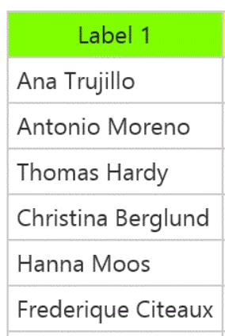

Output properties
Task
Elements belonging to the output list
Elements not belonging to the output list
Contiguous subsequence of the output list
Prefix of the output list

Slide 10

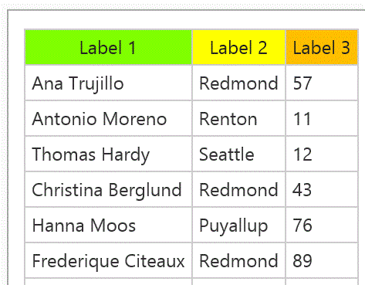
Output properties
Task
Prefix of the output table (seq of records)
Or rather,
Prefixes of projections of the output table

Slide 11
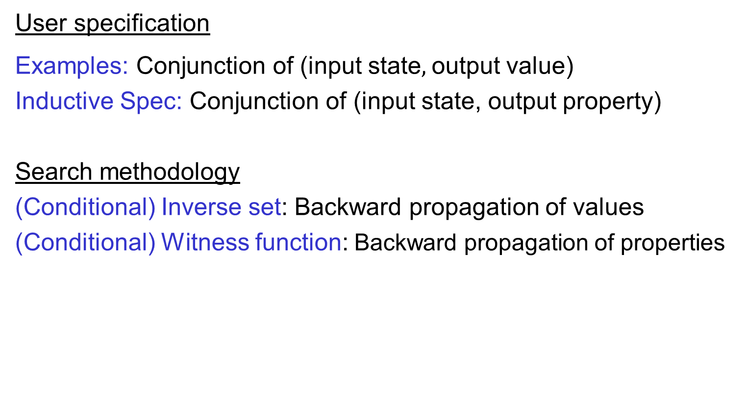
Generalizing output values to output properties
User specification
Examples: Conjunction of (input state$,$output value)
Inductive Spec: Conjunction of (input state, output property)
Search methodology
(Conditional) Inverse set: Backward propagation of values
(Conditional) Witness function: Backward propagation of properties

Slide 12



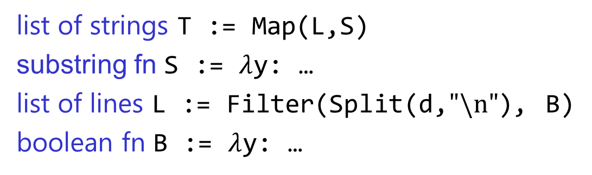


Problem Reduction
list of strings T := Map(L,S)
substring fn S := $λ$y: …
list of lines L := Filter(Split(d,$"\text{\backslash }\text{n}\text{"}$), B)
boolean fn B := $λ$y: …
FlashExtract DSL
$$⋈$$
Spec for S
Spec for T
Spec for L
$$∧$$

Slide 13

Problem Reduction
substring expr E := SubStr(x,P₁,P₂)
position expr P := K | Pos(x,R₁,R₂,K)
SubStr grammar
$$⋈$$
Spec for E
Spec for P₁
Spec for P₂
Redmond, WA
Redmond, WA

Slide 14
Outline
Lecture 1:
Applications
DSLs
Lecture 2:
Search Algorithm
Ambiguity Resolution
  Ranking
  User interaction models
Leveraging ML for improving synthesis
Lecture 3: Hands-on session
Lecture 4: Miscellaneous related topics
Programming using Natural Language
Applications in computer-aided Education
The Four Big Bets

Slide 15
Programming-by-Examples Architecture
Example-based Intent
Ranked Program set
(a sub-DSL of D)
Program set
(a sub-DSL of D)
Program
Synthesizer
Ranking function
DSL D
Witness functions
14

Slide 16

Basic ranking scheme
Prefer programs with simpler Kolmogorov complexity
Prefer fewer constants.
Prefer smaller constants.
Input | Output
Amey Karkare | Amey
Ravindra Naik | Ravindra
1st Word
If (input = “Amey Karkare”) then “Amey” else “Ravindra”
“Amey”

Slide 17
Challenges with Basic ranking scheme
Prefer programs with simpler Kolmogorov complexity
Prefer fewer constants.
Prefer smaller constants.
Input | Output
Amey Karkare | Karkare, Amey
Ravindra Naik | Naik, Ravindra
2nd Word + “, ‘’ + 1st Word
“Karkare, Amey”
How to select between
Fewer larger constants vs. More smaller constants?
  Idea: Associate numeric weights with constants.
Predicting a correct program in Programming by Example; CAV 2015; Singh, Gulwani

Slide 18
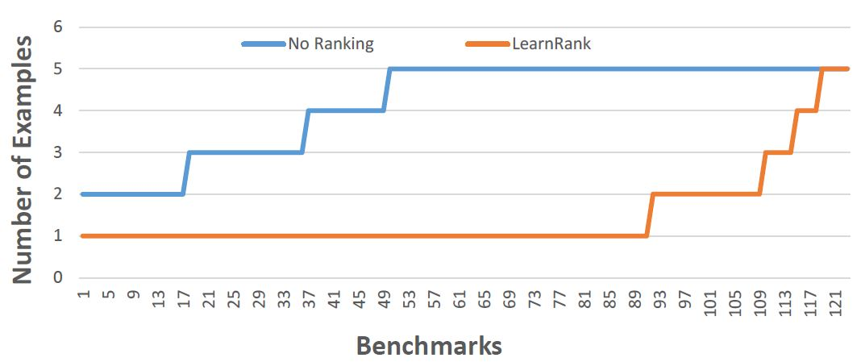
Comparison of Ranking Strategies over FlashFill Benchmarks
Basic
Learning
Strategy | Average # of examples required
Basic | 4.17
Learning | 1.48
Predicting a correct program in Programming by Example; CAV 2015; Singh, Gulwani

Slide 19
FlashFill Ranking Demo

Slide 20
Challenges with Basic ranking scheme
Prefer programs with simpler Kolmogorov complexity
Prefer fewer constants.
Prefer smaller constants.
Input | Output
Missing page numbers, 1993 | 1993
64-67, 1995 | 1995
1st Number from the left
1st Number from the right
How to select between
Same number of same-sized constants?
Learning to Learn Programs from Examples: Going Beyond Program Structure ;
IJCAI 2017; Ellis, Gulwani

Slide 21
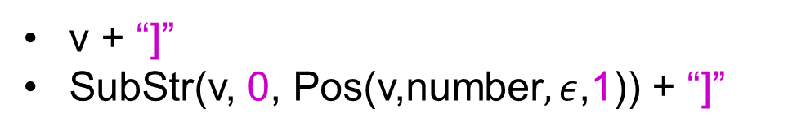
Challenges with Basic ranking scheme
Prefer programs with simpler Kolmogorov complexity
Prefer fewer constants.
Prefer smaller constants.
Input v | Output
[CPT-0123 | [CPT-0123]
[CPT-456] | [CPT-456]
v + “]”
SubStr(v, 0, Pos(v,number$,ε$,1)) + “]”
What if the correct program has larger Kolmogorov complexity?
Idea: Examine data/trace features (in addition to program features)
Learning to Learn Programs from Examples: Going Beyond Program Structure ;
IJCAI 2017; Ellis, Gulwani

Slide 22
Outline
Lecture 1:
Applications
DSLs
Lecture 2:
Search Algorithm
Ambiguity Resolution
  Ranking
  User interaction models
Leveraging ML for improving synthesis
Lecture 3: Hands-on session
Lecture 4: Miscellaneous related topics
Programming using Natural Language
Applications in computer-aided Education
The Four Big Bets

Slide 23


Need for a fall-back mechanism
“It's a great concept, but it can also lead to lots of bad data. I think many users will look at a few "flash filled" cells, and just assume that it worked. … Be very careful.”
“most of the extracted data will be fine. But there might be exceptions that you don't notice unless you examine the results very carefully.”

Slide 24

Programming-by-Examples Architecture
Refined Intent
Example based Intent
Ranked Program set
(a sub-DSL of D)
Intended Program in D
Program
Synthesizer
Debugging
Translator
Test inputs
Ranking function
DSL D
Witness functions
Intended Program in R/Python/C#/C++/…
23

Slide 25

User Interaction Models for Ambiguity Resolution
Make it easy to inspect output correctness
  User can accordingly provide more examples
Show programs
  in any desired programming language; in English
  Enable effective navigation between programs
Computer initiated interactivity (Active learning)
  Cluster inputs/outputs based on syntactic patterns.
  Highlight less confident entries in the output based on distinguishing inputs.
“User Interaction Models for Disambiguation in Programming by Example”,
[UIST 2015] Mayer, Soares, Grechkin, Le, Marron, Polozov, Singh, Zorn, Gulwani
“FlashProfile: Interactive Synthesis of Syntactic Profiles”,
[Under submission] Padhi, Jain, Perelman, Polozov, Gulwani, Millstein

Slide 26
FlashExtract Demo
(User Interaction Models)

Slide 27
Outline
Lecture 1:
Applications
DSLs
Lecture 2:
Search Algorithm
Ambiguity Resolution
  Ranking
  User interaction models
Leveraging ML for improving synthesis
Lecture 3: Hands-on session
Lecture 4: Miscellaneous related topics
Programming using Natural Language
Applications in computer-aided Education
The Four Big Bets

Slide 28





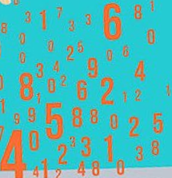

“PL meets ML” in PBE
PBE component
(or, more generally, some intelligent software component)
Logical strategies
Creative heuristics
Features
Model
Can be learned and maintained by ML-backed runtime
Written by developers
Advantages
Better models
Less time to author
Online adaptation, personalization
“Programming by Examples: PL meets ML”; Gulwani, Jain; Invited Talk paper at APLAS 2017

Slide 29
“PL meets ML” opportunity 1: Search Algorithm
PL aspects
Domain-specific language specified as grammar rules.
Top-down/goal-directed search using Inverse semantics.
Heuristics that can be machine learned
Which grammar production to eliminate or try first?
Which sub-goal resulting from application of inverse semantics to try first?

Slide 30
Eliminating Grammar Productions
condition-free expr C := Concat(A, C)
| A
atomic expression A := SubStr(X, P, P)
| ConstantString
Input | Output
amey | amey@wsse.org
raghavan | raghavan@wsse.org
Only Concat(…) branch possible
Input | Output
sridhar, amey | sr
raghavan, sumesh | ra
Need to consider only SubStr(…) branch
Input | Output
sridhar, raghavan | sr
raghavan, amey | ra
Can be Concat(…) or SubStr(…) depending on ranking function

Slide 31
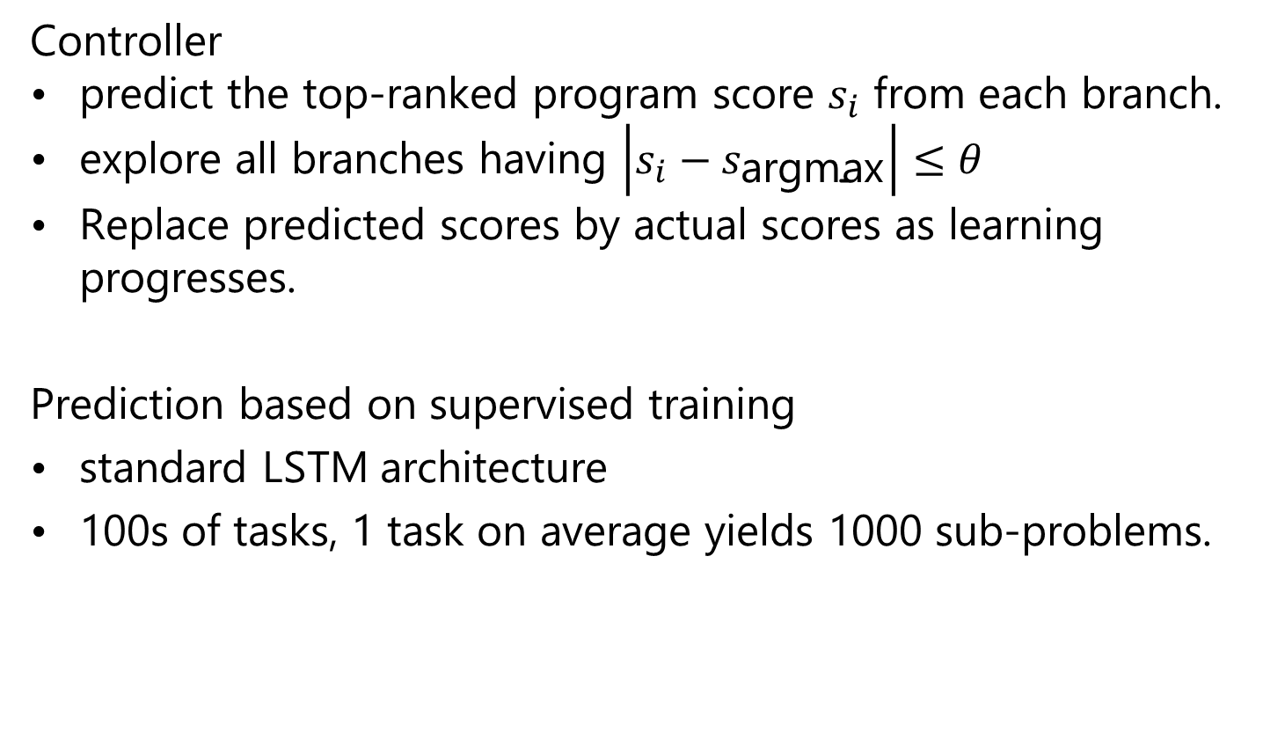
Neural-guided Deductive Search
Controller
predict the top-ranked program score $s_{i}$ from each branch.
explore all branches having $\left|s_{i}−s_{\text{argmax}}\right|≤θ$
Replace predicted scores by actual scores as learning progresses.
Prediction based on supervised training
standard LSTM architecture
100s of tasks, 1 task on average yields 1000 sub-problems.
“Neural-guided Deductive Search for Real-Time Program Synthesis from Examples”;
Mohta, Kalyan, Polozov, Batra, Gulwani, Jain
Under submission to ICLR 2017

Slide 32
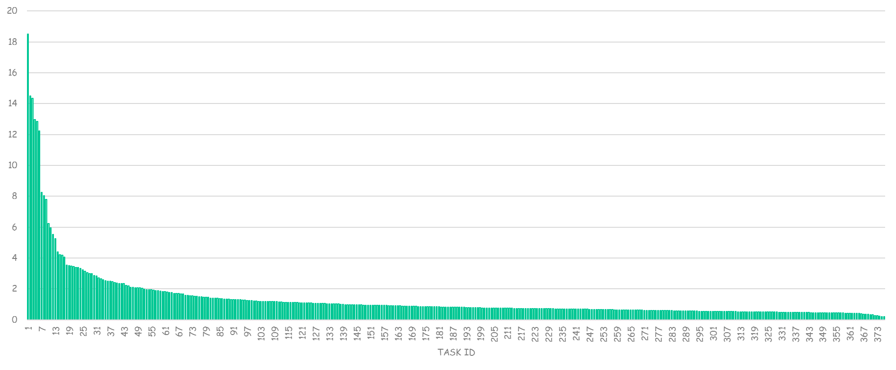
Initial Results
SPEED-UP
Average speed-up: 1.67

Slide 33
“PL-meets-ML” opportunity 2: Program Ranking
PL aspects
Syntactic features of a program
  Number of constants, size of constants
Features of outputs/execution traces of a program on extra inputs.
  IsYear, Numeric Deviation, Number of characters
Heuristics that can be machine learned
Weights over various features
Non-syntactic features
  isPersonName.

Slide 34
“PL meets ML” opportunity 3: Disambiguation
Communicate actionable information back to user.
PL aspects
Generate multiple top-ranked programs
  Enable effective navigation between those programs.
Highlight ambiguity based on distinguishing inputs.
  An input where different programs generate different outputs.
Heuristics that can be machine learned
Highlight ambiguity based on clustering of inputs/outputs
  based on their syntactic and other features.
When to stop highlighting ambiguity?
“User Interaction Models for Disambiguation in Programming by Example”,
[UIST 2015] Mayer, Soares, Grechkin, Le, Marron, Polozov, Singh, Zorn, Gulwani
“FlashProfile: Interactive Synthesis of Syntactic Profiles”,
[ArxiV Report] Padhi, Jain, Perelman, Polozov, Gulwani, Millstein

Slide 35
Programming-by-Examples Architecture
Refined Intent
Example based Intent
Ranked Program set
(a sub-DSL of D)
Intended Program in D
Program
Synthesizer
Debugging
Translator
Test inputs
Ranking function
DSL D
Witness functions
Intended Program in R/Python/C#/C++/…
34

Slide 36
Conclusion
PBE is a revolutionary new frontier in AI.
99% of end users are non-programmers.
Data scientists spend 80% time cleaning data.
Developers spend 40% time refactoring code during migration.
“PL meets ML” in AI software creation
ML can synthesize code heuristics: better, efficient, adaptable
PBE component | PL aspect | Heuristics that can be machine learned
Search Algorithm | DSL, Inverse functions | Non-deterministic choices
Program Ranking | Features | Weights
Disambiguation | Program navigation, Distinguishing inputs | Clustering, When/what to ask?

